Slide 1
I-Share Alma Primo VE Office hours will start shortly
Welcome!
Office Hours will start at 2pm and run until 3pm.
Please mute your microphone.
As time permits, we will respond to questions typed in the chat box, and offline afterwards, as needed.
This session will be recorded and made available on the CARLI website both as PDF slides and as a recording, with live links to all referenced resources.

Slide 2
I-Share Alma/Primo VE Office Hours
EBSCO
January 13, 2022
Notes:
Jen

Slide 3
Agenda Office Hours
Agenda – 1/13/2022
Announcements & Reminders
EBSCOHost Parser Change
Duplicate Records Clean-up: The Basics
Open Q&A

Slide 4
Announcements
Announcements/Reminders
  Upcoming Office Hours
  2022 Office Hours have been scheduled – 2nd Thursday of each month, 2pm-3pm.
  Look for another Lab Reports session later this Spring
  Technical Services Q&A Sessions
  Scheduled for once a month from 10:30am-12:00pm
  Upcoming Dates: January 27, February 24, March 24, April 28, and May 26
  January 27: Duplicate Records Clean-up Forum
  Registration open and available on the CARLI Calendar
Let’s Talk about Fulfillment (I mean Alma, not life’s purpose)
  Sessions are scheduled for every other week, alternating between Tuesday mornings at 10:30am and Friday afternoons at 2pm.
  Registration open and available on the CARLI Calendar

Slide 5
EBSCO Parser Change
EBSCOHost Parser Change
Denise Green (CARLI)
New Documentation
Alma, Primo VE, and the Dec. 2021 EBSCOhost Parser Changes

Slide 6
Duplicate Record Clean-up Basics
Duplicate Record Clean-up Basics
Ted Schwitzner (CARLI)

Slide 7
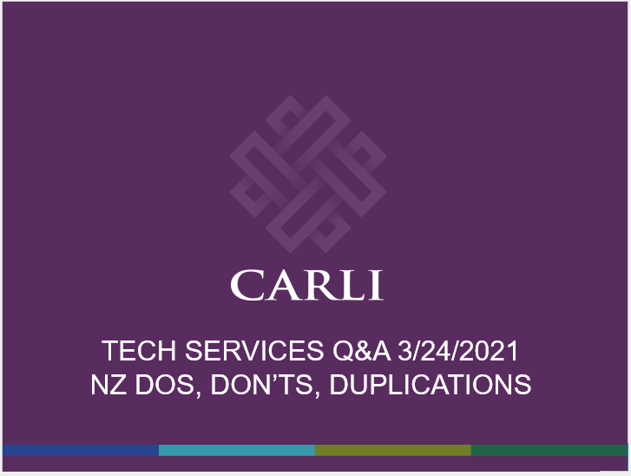
We’ve Discussed Duplicates in the Past
  Tech Services Q&A, 3/24/2021
    Tips for keeping NZ clean
    Practices for merging duplicates
  Duplicate records an ongoing concern
    Patron confusion in discovery
    Interference with importing updated records
    Increase consortial title count
https://www.carli.illinois.edu/tech-services-qa-2021-03-24
https://www.carli.illinois.edu/products-services/i-share/physical-res-man/cat_nz_merge
Notes:
Last March, we started shared tips on how to resolve duplicate records when you find them
https://www.carli.illinois.edu/tech-services-qa-2021-03-24
https://www.carli.illinois.edu/products-services/i-share/physical-res-man/cat_nz_merge

Slide 8
What Do We Mean by Duplicate Records?
  Same record, by OCLC record number, is present two or more times
    Includes cases where the same record may have been added at different times, different methods, without checking duplicates.
    Includes cases where OCLC records have been merged and multiple record numbers are now represented by a single bib.
  By cataloging practices, would we have multiple bibs according to:
    Bibliographic Formats & Standards, When to Input a New Record?
      https://www.oclc.org/bibformats/en/input.html
    ALCTS Differences Between Changes Within
      https://www.ala.org/alcts/sites/ala.org.alcts/files/content/resources/org/cat/differences07.pdf
  At this time, we are not as concerned about duplicates in or from the Community Zone

Slide 9
Finding Duplicates
  Analytics
    See the CARLI Network folder, Resource Management subfolder
    Duplicate Titles by 035a for I-Share Institution
    Duplicate Titles by ISBN for I-Share Institution
  Alma Repository Search
    Records not linked to NZ
      Advanced search: All Titles: Is Linked equals “No”
      Look at 035$$a and 035$$z values and search NZ
      CARLI is working on alternatives to find these in one report

Slide 10
Merging Records, Revisited
  Merge Records and Combine Inventory
    CARLI emphasizes use of metadata editor for merge tasks
  Merge process requires that records have inventory and exist in same zone
    IZ to IZ, or NZ to NZ
    CZ records cannot be merged
    If one of the records has no inventory, DELETE it instead
  MDE merge process works on only two records at a time
  NZ merges affect every library using the bib
  CARLI has IHLS catalogers to assist through June 2022
  Goal of Forum: Discuss desired outcomes and best practices to reduce current amount of duplication.
Notes:
Sometimes the job of duplicate clean-up isn’t done when the records have been merged. Sometimes, the records might still not be up to date, or up to record standards, in which case additional work should be done.

Slide 11

Now, Your Questions
Notes:
Please type any questions in the chat, or feel free to unmute to ask questions.

Slide 12
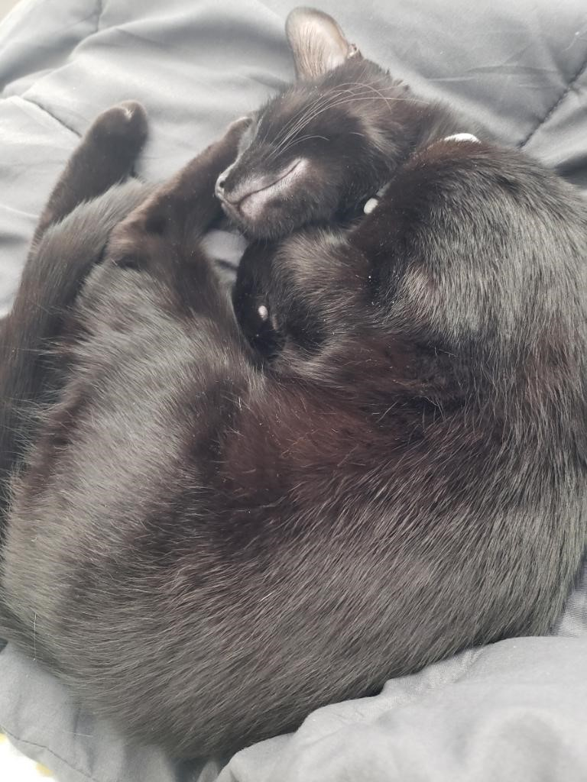
I-Share Alma Primo VE Office hours
Join us February 10, 2022
at 2pm for another
Office Hour.
Contact CARLI at
support@carli.Illinois.edu

