Slide 1
I-Share Alma Primo VE Office hours will start shortly
Welcome!
Office Hours will start at 2pm and run until 3pm.
Please mute your microphone.
As time permits, we will respond to questions typed in the chat box, and offline afterwards, as needed.
This session will be recorded and made available on the CARLI website both as PDF slides and as a recording, with live links to all referenced resources.

Slide 2
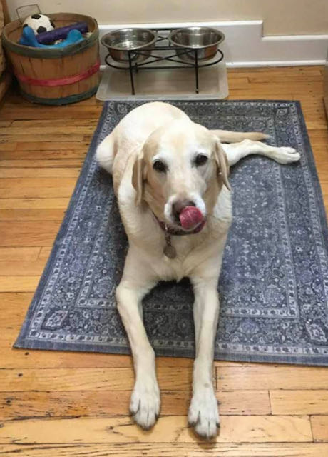
I-Share Alma/Primo VE Office Hours
Lab Reports
December 16, 2021
Notes:
Jen

Slide 3
Agenda Office Hours
Agenda – 12/16/2021
Announcements & Reminders
Lab Reports
Adding a “Report a Problem” Button in Primo – Evan Barber (UIS)
Adding a New Library in Alma – Stacey Knight-Davis & Bill Schulz (EIU)

Slide 4
Announcements
Announcements/Reminders
  Upcoming Office Hours
  2022 Office Hours have been scheduled – 2nd Thursday of each month, 2pm-3pm.
  On CARLI Calendar, starting January 13.
  New Zoom link for 2022.
  Technical Services Q&A Sessions
  Scheduled for once a month from 10:30am-12:00pm
  Upcoming Dates: January 27, February 24, March 24, April 28, and May 26
  Registration open and available on the CARLI Calendar
Let’s Talk about Fulfillment (I mean Alma, not life’s purpose)
  Sessions are scheduled for every other week, alternating between Tuesday mornings at 10:30am and Friday afternoons at 2pm.
  Registration open and available on the CARLI Calendar

Slide 5
Resource sharing off 12/23/2021-1/2/2022
Reminder: Resource Sharing will be off
Thursday, December 23, 2021 and Sunday, January 2, 2022.
The “Request from I-Share” link will be hidden in Primo VE for all I-Share libraries.
Any requests placed before 5 p.m., December 23, but unprocessed by library staff before the winter break, will be held in the queue for later processing.
CARLI Staff will perform the work to set this up.
Optional tasks for your library
Local Requests: Whether to allow local requests (requests placed for your library’s materials by your library’s patrons) to be placed during winter break is at your library’s discretion.
  Please email CARLI Support if you would like to turn off or modify local requesting during winter break.
Options for notifying patrons from within Primo VE:
  Adding an alert banner to the top bar:https://www.carli.illinois.edu/products-services/i-share/discovery-interface/custom_package_topbanner
  Adding a descriptive message to the Primo VE main page HTML cards: https://www.carli.illinois.edu/products-services/i-share/alma/primo-ve/viewconfigs#pvecustcustpackage
  Please email CARLI Support if you need any assistance with customizing the alert banner or HTML cards in your Primo VE.
Notes:
5pm Thursday December 23 to 8am Sunday January 2.

Slide 6
Lab reports
Lab Reports
Adding a “Report a Problem” Button in Primo Evan Barber (UIS)

Slide 7
Lab reports
Lab Reports
Adding a New Library in Alma
Stacey Knight-Davis & Bill Schulz (EIU)

Slide 8
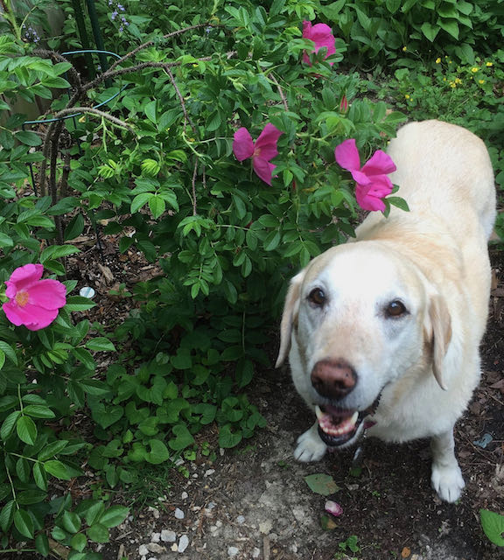
I-Share Alma Primo VE Office hours
Join us January 13, 2022
at 2pm for another
Office Hour.
Contact CARLI at
support@carli.Illinois.edu

