Slide 1
I-Share Alma Primo VE Office hours will start shortly
Welcome!
Office Hours will start at 2pm and run until 3pm.
Please mute your microphone.
As time permits, we will respond to questions typed in the chat box, and offline afterwards, as needed.
This session will be recorded and made available on the CARLI website both as PDF slides and as a recording, with live links to all referenced resources.

Slide 2
I-Share Alma/Primo VE Office Hours
November 18, 2021
Notes:
Jen

Slide 3
Agenda Office Hours
Agenda – 11/18/2021
Announcements
Reminders and upcoming Alma/Primo VE events and learning opportunities
  See https://www.carli.illinois.edu/calendar for CARLI events
Named User Count and Title Reduction Project Updates
Today’s Topic: Related Records in Alma
Open Q&A
Notes:
Jen
Today we’ll have a few announcements and reminders about upcoming events for Alma/Primo VE. You can always check the CARLI calendar for CARLI events.
And after a brief update on the title reduction project we’ll discuss related records in Alma.

Slide 4
Announcements
Announcements/Reminders
  Upcoming Office Hours
  December 16 @ 2:00pm– another round of Lab Reports
  Technical Services Q&A Sessions
  Scheduled for once a month from 10:30am-12:00pm
  Upcoming Dates: January 27, February 24, March 24, April 28, and May 26
  Registration open and available on the CARLI Calendar
Let’s Talk about Fulfillment (I mean Alma, not life’s purpose)
  Sessions are scheduled for every other week, alternating between Tuesday mornings at 10:30am and Friday afternoons at 2pm.
  Registration open and available on the CARLI Calendar
Notes:
Jen
Upcoming CARLI events!

Slide 5
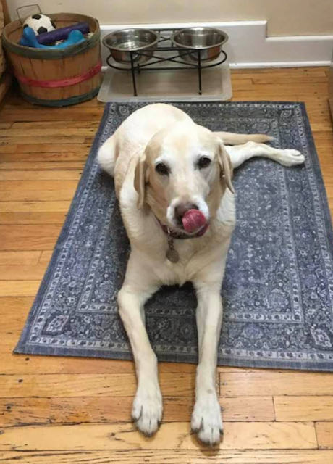
Next month – December 16 office hours
Time for more “Lab Reports”!
Do you have a workflow or process in Alma you think others could benefit from?
Have you set up a process in Alma that has made your co-workers say “WOW!”?
Consider submitting a proposal to present at our December 16 Office Hours and share with your I-Share colleagues. Email your proposal to support@carli.Illinois.edu by Dec. 6.
Notes:
Jen
Next month we are planning another “Lab Reports” session. If you have a workflow or process you would like to share with your I-Share colleagues, please consider submitting it to support@carli to present at the December 16 office hours! Submit proposals no later than December 6 so we can review and let those who have submitted ideas know that we’d like you to present!

Slide 6
Reminders
ELUNA Learns 2021
https://el-una.org/meetings/eluna-learns-2021/
ELUNA is presenting a series of webinars related to Ex Libris products in the summer and fall of 2021.
Sessions will be presented live and recorded.
ELUNA charges $25 per participant, but CARLI has purchased a block of registrations for I-Share library staff to register for free on a first come, first serve basis while our supplies last. You must register through CARLI, not the ELUNA website.
To register, complete this registration form (one form per person) and send it to support@carli.Illinois.edu
Note: ELUNA’s policy is that these registrations are for one individual only and are not for group use.
Notes:
Jen
A reminder about our ELUNA Learns funding: we still do have funding in place so don’t forget to see if there are any upcoming ELUNA learns events that are of interest to you. There are two more sessions remaining in the 2021 ELUNA Learns webinar series, and as a reminder if you’d like to take advantage of CARLI’s purchased block of registrations please register through CARLI rather than the ELUNA website.
As in 2020, CARLI has purchased a block of registrations for the 2021 Ex Libris Users of North America (ELUNA) online webinar series, ELUNA Learns. These sessions will be recorded, and the recordings will be available for a year to those who register. These sessions are normally $25 per person; the CARLI block will be available free to I-Share library staff on a first come first served basis while our supply lasts.
More information about ELUNA Learns is available at https://el-una.org/meetings/eluna-learns-2021/
To take advantage of the CARLI purchase, please register through CARLI and not on the ELUNA website.
CARLI will process your registration with ELUNA. ELUNA will follow up with two emails to you-a registration confirmation (you may ignore the text about how to pay for your registration) and you will receive a second email from ELUNA with the webinar access credentials (these will be sent approximately 1 day before sessions in the future). Please note that ELUNA’s policy is that these registrations are for one individual only and are not for group use.
To register: complete the attached form, attach to email, and send support@carli.illinois.edu, with “ELUNA learns” in the subject line. Please complete a separate form for each person registering.

Slide 7
Reminders
Webinar Recordings
Most past Ex Libris Webinars can be viewed On Demand
  Implementing Acquisitions, Knowledge Days, Primo VE: Become an Expert, and many more standalone topics!
Most CARLI webinars and Discussions after Ex Libris webinars are recorded and available from our website:
  These Office Hours
  Implementing Acquisitions Discussions
  Knowledge Days Discussions
  Primo VE: Become an Expert Discussions
Notes:
Jen
Just a reminder that if you miss any of the Ex Libris or CARLI webinar events, you can usually view a recording to catch up!
I’ll now turn the presentation over to Ted Schwitzner so he can give us an update on the progress of our title reduction project.

Slide 8
Named User Count Update
Named Users Count as of November 18: 3,562
  Includes 644, temporary users for IHLS CMC staff;
    without those: total is 2,918
  Several institutions making changes after Fall Semester
    Expecting another decrease of 75-80 users; maybe more?
  More institutions have created shared users
Names User Count goal in our contract: 2,162
Target test accounts (15), users that login infrequently
Deadline to review your Named Users is December 1
CARLI’s Named User Documentation:
https://www.carli.illinois.edu/products-services/i-share/user-management/nameduserFAQ
Notes:
Ted
Here is an update on the number of named users. That number has been reduced by from NNNN on DATE to NNNN on DATE. As we mentioned at the last office hours, CARLI staff deactivated personal logins to each Alma IZ, but we have also created new but temporary users for the IHLS CMC staff while they assist us with the Alma Title Count Reduction Project. We noticed that several institutions have followed our recommendation to create shared generic accounts for circ desks and other shared service points.
Libraries and CARLI need to focus on identifying and deactivating test accounts, and libraries need to review roles assigned to users who do not login to Alma, or those who have left the library's employment.
Deadline: Dec 1.
All of CARLI’s Named User Documentation can be found on our website.
As we mentioned last month, we did get confirmation from Ex Libris that a user is still considered a Named User even if all staff roles on the user record have been disabled, so that is not a possible workflow for reducing named users. We apologize for any inconvenience and have updated the options in our posted Named Users documentation.

Slide 9
Title Count Reduction Project Update
Alma Title Count Reduction Project
Goals:
  Manage Electronic Resource Collections in the Network Zone when possible
  Delete bib records with no Inventory
  Eliminate duplicate bib records
CARLI Alma Title Count Reduction Project Page: https://www.carli.illinois.edu/products-services/i-share/title-count-reduction/project-overview
  Contains a project overview
  List of the different phases of record cleanup
    Links to sub-project pages with more information on each
  Links to all project announcements and communications
  An FAQ
Notes:
Ted
Now for an update on our Title Count Reduction Project to manage e-collections in the NZ when possible, Delete bibs without inventory, and eliminate duplicate bib records.
CARLI has created a central webpage for the Alma Title Count Reduction Project. It has a project overview, links out to separate webpages that describe each phase of the project in greater detail along with its timeline, contains links to all project announcements and communications, and there’s an FAQ.

Slide 10
Deleting Free/OpeN Access E-Collections UPdate
Open Access/Free Collections should be active only in Network Zone
NZ enables sharing to all consortial members
  Optimizes record, data sharing, and data correction
  Sub-Project page: https://www.carli.illinois.edu/products-services/i-share/title-count-reduction/open-access-e-collections
Work is complete in all IZs!
What about new stuff?
  CARLI Collection Management Committee discusses collections for inclusion at NZ. Guidelines: https://www.carli.illinois.edu/products-services/collections-management/OA_eBooks
Notes:
Ted
The Open Access/Free Collections that were duplicated in IZ’s have been deleted and this round of the project is complete!
Our first priority focused on Open Access and Free E-Collections that could be activated in NZ because, as freely available resources, these do not require patron authentication nor acquisition transactions. Thank you for your cleanup efforts!

Slide 11
Deleting E-Collections Funded by CARLI Update
E-Collections fully or partially funded by CARLI are being handled in separate phases for NZ management:
First round of CARLI fully funded e-colls is complete:
  Harper's Weekly, 1857-1912
  Historical Statistics of the United States (from Cambridge University Press)
  Sage E-Journal 2007 Deep Backfile
Second round—removing E-Collections no longer funded by CARLI that were not continued by libraries—is in progress
  Black Thought and Culture
  Women and Social Movements in the United States, 1600-200
Next round: Alexander Street Press e-collections
Notes:
Ted
E-Collections fully or partially funded by CARLI are being handled in separate phases for NZ management.
The first round of CARLI fully funded e-collections is complete!
Harper's Weekly, 1857-1912
Historical Statistics of the United States (from Cambridge University Press)
Sage E-Journal 2007 Deep Backfile
are being managed in the NZ and have been deleted from all Izs.
The second round—to remove e-collections for “Black Thought and Culture” and “Women and Social Movements in the US” from IZs when libraries did not choose to pay to continue access—is in progress. Affected libraries who opted to remove these themselves should have done so by November 8, and the IHLS Alma Cleanup Team is working through the remainder now.
Finally, watch for more information coming soon on our next round: Alexander Street Press e-collections

Slide 12
Removing bibs with No inventory Update
Removing Bibs with no Inventory from IZs
Announcement to Liaisons/Directors, reports of each IZ’s records, and documentation has been posted.
  These reports exclude Bibs that are part of boundwith relationships
Institutions that elected to complete the work on their own should do so by November 24.
Removing Bibs with no Inventory from the NZ
IHLS Alma Cleanup Team began deleting records on Oct. 14
Notes:
Ted
Here is an update on removing bibliographic records with no inventory in Alma. On October 15, we sent an announcement email to Liaisons and Directors and distributed reports that list these records for each IZ. The reports we shared, and that will be used to delete these bib records, exclude those bibliographic records that have explicit bound with relationships. Additionally, we recommend that the Delete Bibliographic Records job parameters be set to exclude bibs with relationships to other records, which allows records with relationships to be reviewed before deletion.
If your institution opted to do this work yourself, please complete this by November 24.
If your institution opted to have CARLI staff do this work, that work has begun. We may contact you with any questions we have about deleting related records before that part is complete.
On October 14, the IHLS Alma Cleanup Team began deleting records without inventory from the Network Zone. As of November 10, over 1.8 million records have been deleted!

Slide 13
Title Reduction Project Statistics
As of November 16:
E-Resource bibs deleted: 2,161,417
Total bibs deleted: 4,278,348
  Includes bibs with no inventory (IZ & NZ) and e-collections
Consortial title count: 71,725,481
  Target is 46,420,000
Notes:
I’ll turn the presentation over to Jessica Gibson, she will discuss Related Records in Alma.

Slide 14
Related Records in alma
Related Records in Alma
Notes:
Jessica
Today we’ll be reviewing “Related Records” in the context of those records that may not have been deleted by the “Delete Bibliographic records with no Inventory” job because of Related Records to determine if they are needed or if they can be deleted.

Slide 15
Related Records in Alma
What are Related Records in Alma?
Bibliographic records can be related and linked together by MARC 76X, 77X, 78X, and 8XX fields
Some of the most common fields are 773, 774, 776, 780, 785, and 830
When any of these fields in a bib record in Alma refer to another bib record within Alma, a related record relationship is established by the system.
Notes:
First, what are Related Records in Alma?
Related Records are bibliographic records where Alma has identified a relationship between them based on the presence of specific MARC fields in one or more of the records. Catalogers out there will recognize many of these MARC fields used in records to indicate that
a resource is Part Of another with 773 or 774 fields,
Or 776 fields which references other formats of a resource,
With serials or continuing resources, we often use the 780 field for earlier titles, and the 785 field for later titles,
And items in a Series will have that relationship described in an 830 field.
When any of these fields is present and refers to another bib record in Alma, the system establishes a related record relationship. This information can be used by library staff in Alma to find related resources, and by users in Primo VE to gain information about related titles.

Slide 16
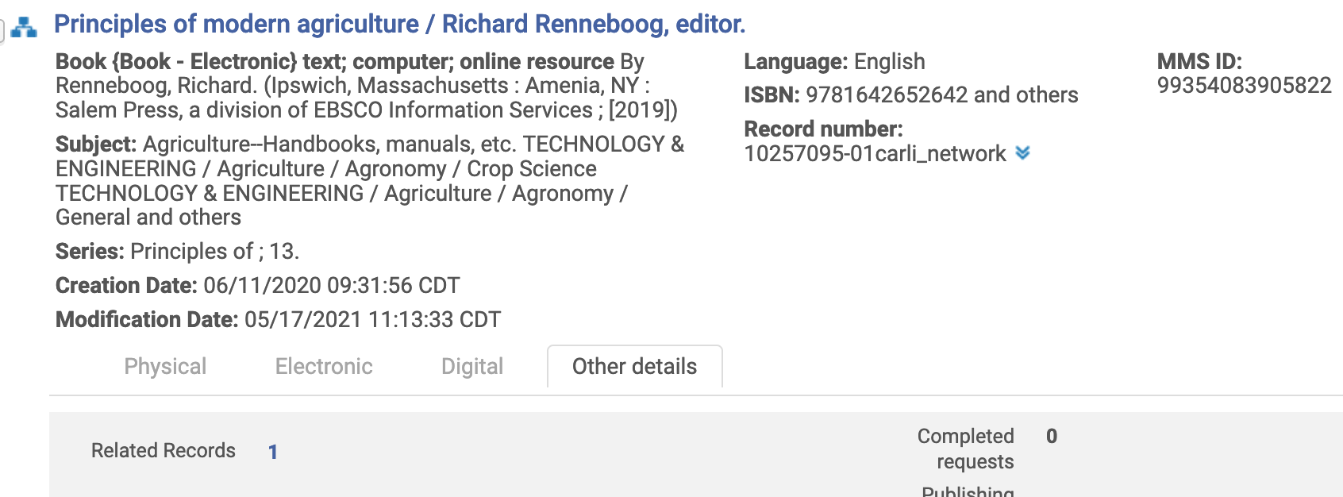
Related Records in Alma
Related Record relationships display in Alma search results in two ways:
Other details tab > Related Records indicator
Notes:
There are two ways that Related Records display in Alma search results. The first is indicated in the Other Details tab if the Related Records field has a blue, hotlinked number. In this example, this Electronic book record for the Principles of Modern Agriculture has one related record in Alma.

Slide 17
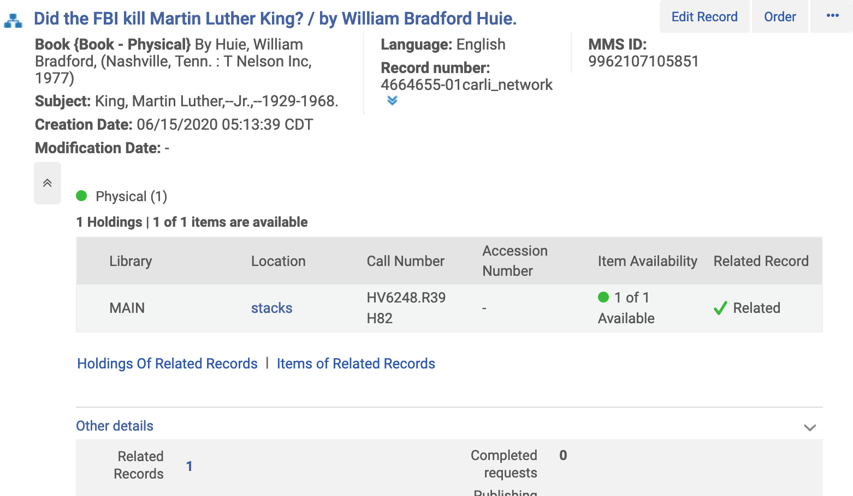
Related Records in Alma
2. Physical inventory tab > Related Records column
AND Other details > Related Records -- only when 774, 786, 800, 810, 811, or 830 fields establish relationship
Notes:
The second way that a related record relationship may be indicated in Alma results is to show physical holdings with a green checkmark in the Related Record column, AS WELL AS the information in the Other Details tab. In this example, it may look like there are physical holdings for this book “Did the FBI kill Martin Luther King?”, but these holdings are displaying here from the Related bib Record, not this bib record.

Slide 18
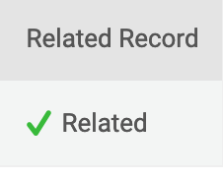
Related Records in Alma
Note: The presence of the Physical inventory tab > Related Records column with
means that the holdings are not attached to bib record that you are viewing; they are attached to another related bibliographic record.
Notes:
So to reiterate, in Search results in Alma, when you see physical holdings with the green checkmark in the Related Record column, those holdings are attached to the related record, not the one that you are viewing.

Slide 19
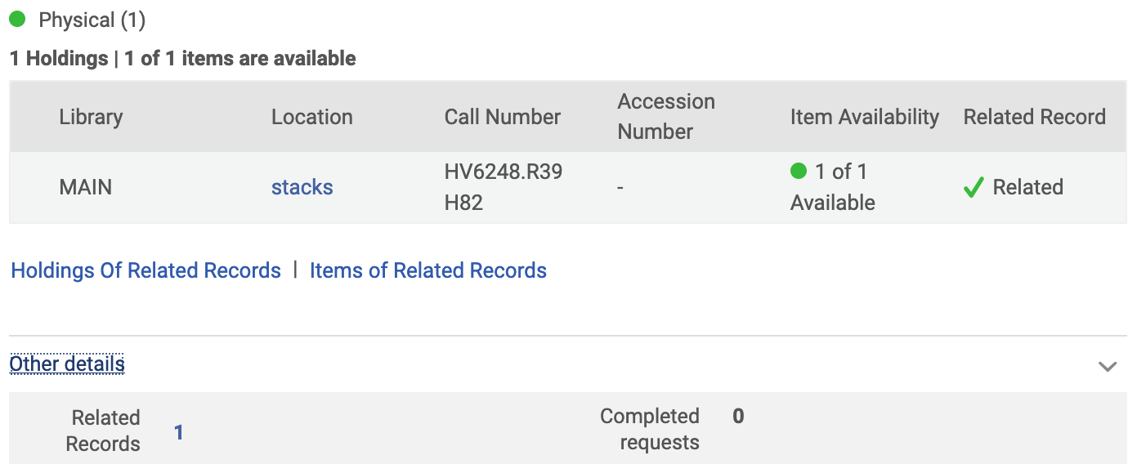
Related Records in Alma
Viewing Related Records
To see which other bib records in Alma are related, click the hotlinked number in the “Other details” tab after “Related Records”
You can also click the “Holdings Of Related Records” or “Items of Related Records” links to see more about those records.
Notes:
To see which other bib records in Alma are related, click the hotlinked number in the “Other details” tab after “Related Records”. Alma with run a search for those related records and present the results.
And, new in the November 2021 release that just came out on November 7th: you can also click the “Holdings Of Related Records” or “Items of Related Records” links to see more about those records.

Slide 20
Related Records in Alma
Why discuss Related Records in Alma?
As part of the Title Reduction Count Project, CARLI has asked I-Share libraries to delete bibliographic records in your IZ with no holdings.
Some of the bibs without holdings may have Related Records.
If using the “Delete Bibliographic Records” job, CARLI recommends using the option to “Do not delete if related to other record”
See also CARLI’s webpage on how to Delete Institution Zone Bibliographic Records With No Inventory from a File
Notes:
Now that we know more about how Related Records relationships are established between bib records in Alma, and how to recognize and view them, let’s talk about Related Records in the context of deleting “Bibs With No Holdings from your IZ”.
As part of the Title Reduction Count Project, CARLI is asking I-Share libraries to delete bibliographic records in your IZ with no holdings.
Some of the bibs without holdings may have Related Records.
CARLI recommends that when running the “Delete Bibliographic Records” job for this project, you check the option to “Do not delete if related to other record”. We recommend this because we want to be cautious when deleting records.
Today’s presentation elaborates on some of the information already documented on Delete Institution Zone Bibliographic Records With No Inventory from a File when a record is not deleted by the job due to a Related Record.

Slide 21
Related Records in Alma
Evaluating Related Records
Example 1 – Microform record in JUD IZ
Example 2 – E-book record in PRC IZ
“Check the shelf” to see if your library has a physical item and if so, add holdings.
The Related Records indicators may not tell the whole story. Search in Alma for “duplicate” records (title or control numbers) that may not display as Related Records.
If you do not have any inventory that should be on this bib, delete the bib from the IZ.
Notes:
Let’s look at two real-life examples of bib records without holdings that would not be deleted by the “Delete Bibliographic Records” job due to Related Records and think about how to evaluate them.
Example 1 – Microform record in JUD IZ
Example 2 – E-book record in PRC IZ
Guiding principles:
You may need to “check the shelf” for physical holdings
Searching in Alma for the title or other control numbers may identify “duplicate” records
If you truly do not have any inventory for this bib, delete it from the IZ.

Slide 22
Related Records in Alma
Reports of Bib Records With No Inventory
CARLI provided I-Share libraries with reports of records in your IZs as of Sept. 29 in Box: XXX_Bibliographic_records_in_Institution_with_no_inventory_#.xlsx
  These reports had Bound Withs REMOVED from them.
Libraries can run the shared “Bibliographic Records with No Inventory” report in Analytics, but it will contain Bound Withs in the results.
See the CARLI Shared Analytics: Title Count Reduction Project page
  This page also contains information on another shared report to identify Bound Withs in your IZ.
Notes:
The reports of Bibliographic records without inventory that CARLI provided in Box for libraries called “XXX_Bibliographic_records_in_Institution_with_no_inventory_#.xlsx” had Bound Withs REMOVED from them. They were run on Sept. 29.
I-Share Libraries can run a similar shared report from Alma Analytics called “Bibliographic Records with No Inventory” at any time as described on the Shared Analytics: Title Count Reduction Project webpage https://www.carli.illinois.edu/products-services/i-share/title-count-reduction/project-analytics HOWEVER, be aware that this report WILL contain Bound Withs in it. CARLI staff performed extra data massaging on the reports that we provided to you in Box that cannot be duplicated in an Analytics report alone.
On our Shared Analytics: Title Count Reduction Project page, there is another shared report described there that can help you identify all of the Bound Withs in your IZ.

Slide 23
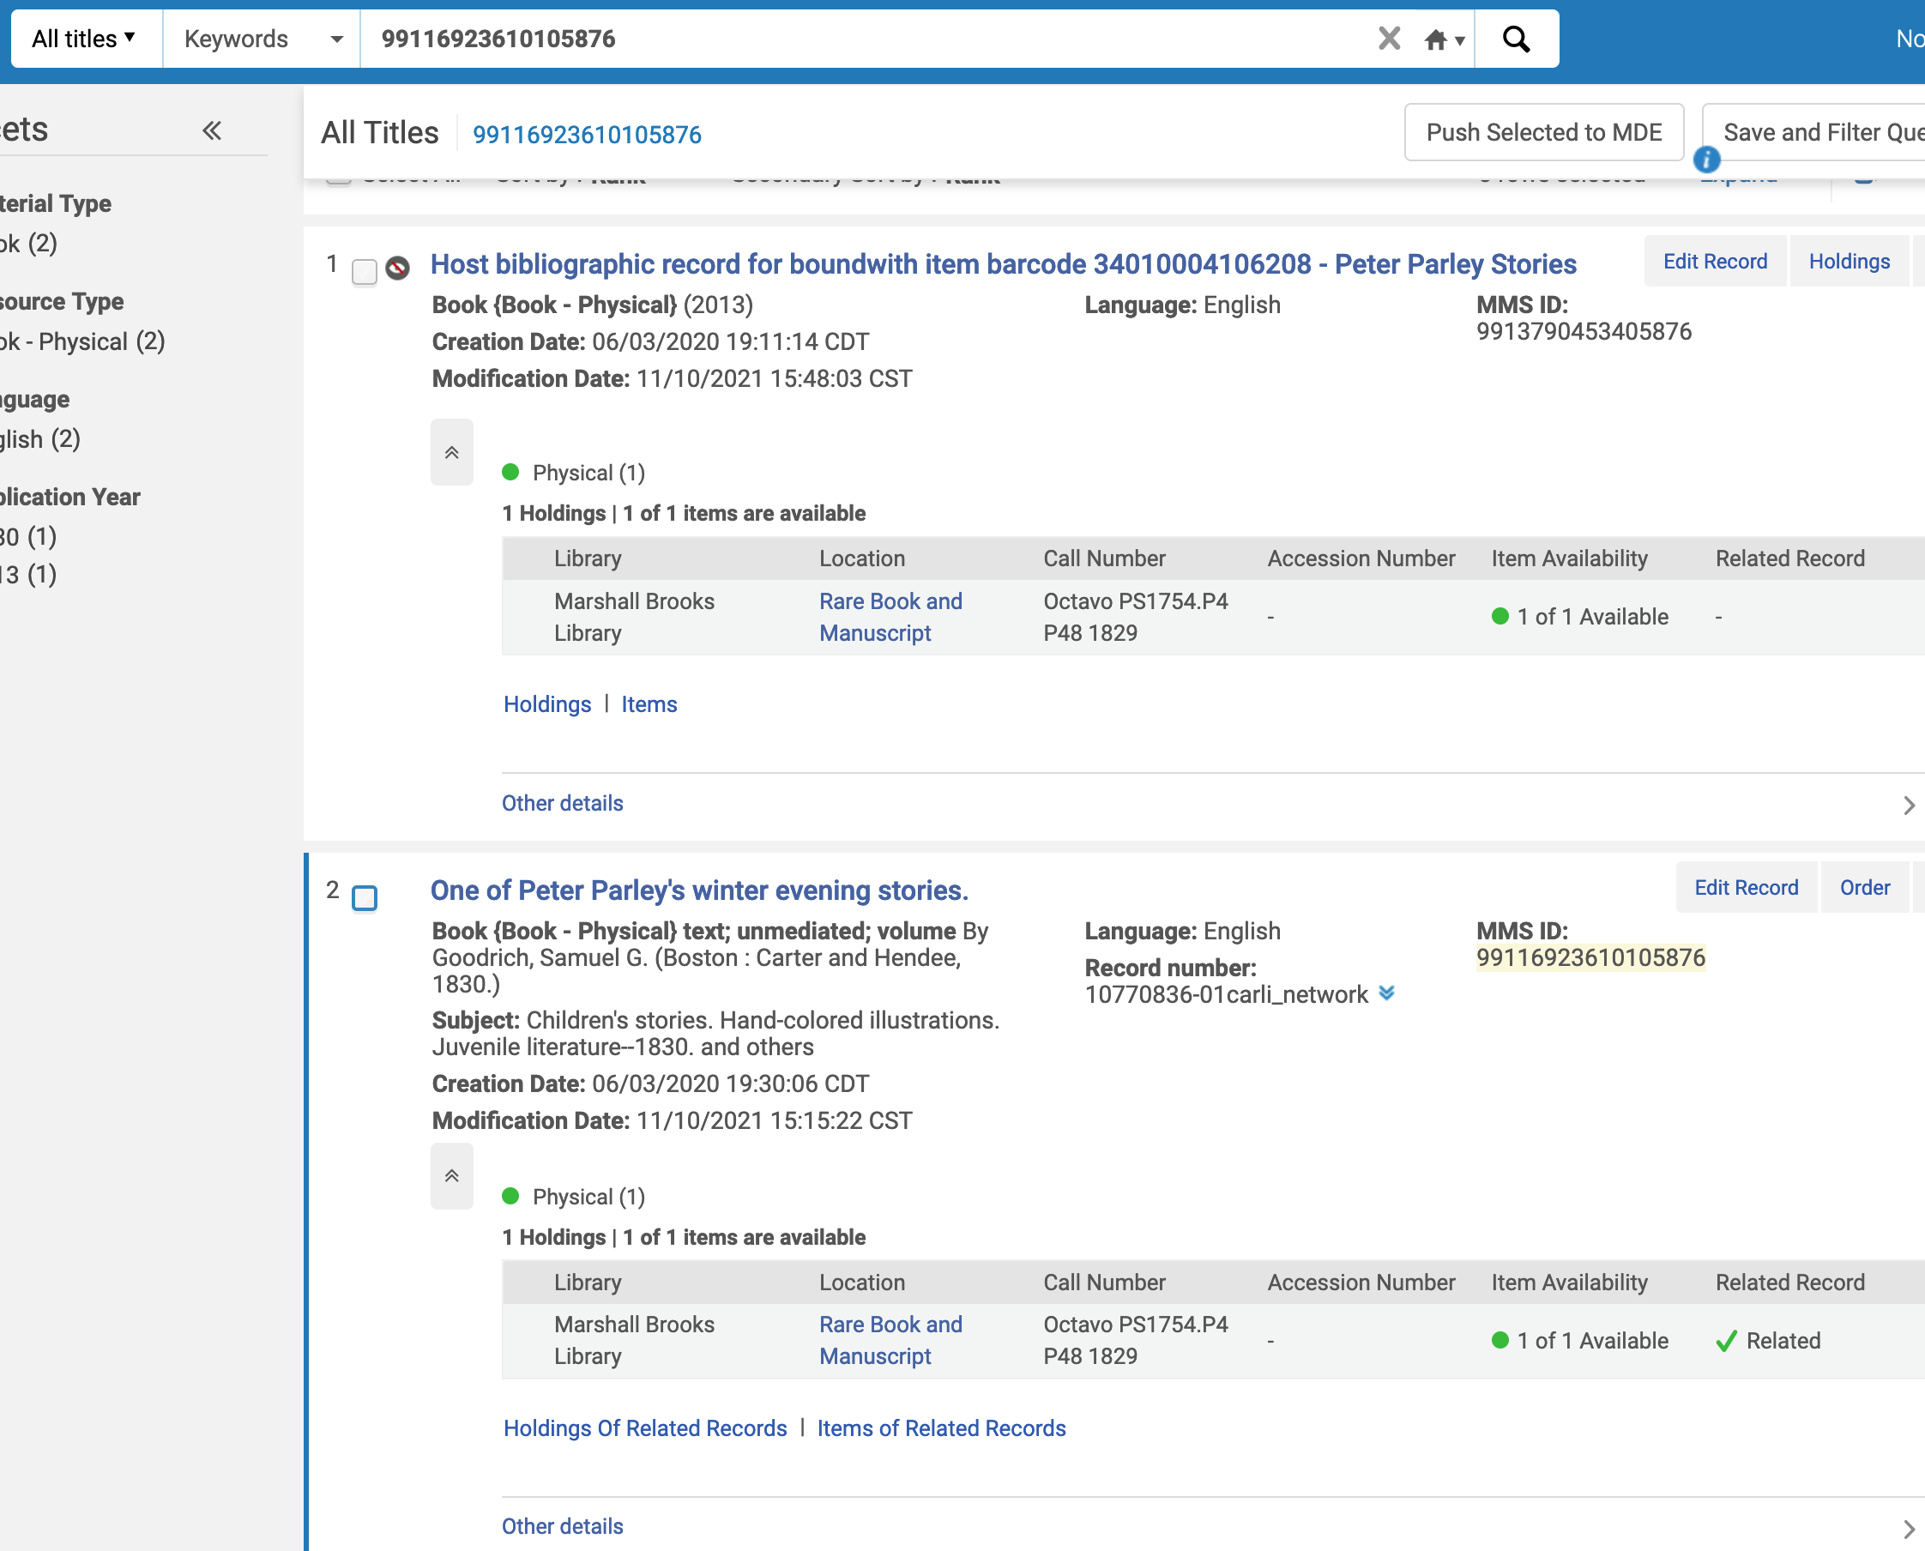
Related RecOrds in Alma
Bound Withs
Tip: search for
MMS IDs as
Keywords in
Alma to reveal
Bound Withs
Notes:
If you are concerned about whether a bib without inventory is part of a Bound With but you’re not sure, in addition to using reports, here’s a quick and easy tip:
Search the MMS ID for the record as a KEYWORD in Alma instead of as MMS ID. This will search the bib data in Alma, not just the MMS ID index, and it will reveal to you if the MMS ID is present in another Alma bib, such as the 774 field of a “Host bibliographic records for boundwith” record.
In this example, the MMD ID for “One of Peter Parley’s winter evening stories” appears on the shared Analytics report of “Bibliographic Records With No Inventory” in Principia College’s IZ. If I search for that MMS ID as a Keyword, Alma retrieves both the record for Peter Parley and the Host Bibliographic Record that it is part of. In this case, I’d know that the bib record for Peter Parley’s winter evening stories is in a Bound With and should not be deleted from the IZ, even though it does not have any holdings of its own.

Slide 24
Related Records in Alma
Bound Withs
Bound Withs are Related Records but do NOT need to be cleaned up as part of the Title Count Reduction Project
  They were removed from the CARLI-provided reports
  Bound With relationships legitimately have full bib records without any holdings attached in Alma and those bibs should not be deleted.
CARLI’s Bound With Practices webpage has recommendations for Bound Withs in Alma, including options for enhancing records that were migrated from Voyager, if you are interested.
Notes:
Finally, though we’ve just talked about Bound Withs, CARLI wants to be clear that Bound Withs in Alma do NOT need to be cleaned up as part of the Title Count Reduction Project.
Migrated Bound Withs have a "Host Bibliographic Record" with MARC 774 fields that link to the full Bib records for the bound with titles. The holdings records are attached to the Host Bib Record only, and the full descriptive Bib records don't have any holdings attached, so that is why it is important to be aware of Bound Withs and not to delete these "full bibs" as part of any cleanup efforts if you use the shared Analytics report “Bibliographic Records with No Inventory”.
For more information, see CARLI’s webpage on “Bound With Practices” https://www.carli.illinois.edu/products-services/i-share/phys-res-man/boundwith that describes our recommendations for Bound Withs in Alma and options for enhancing Bound With records that were migrated from Voyager.

Slide 25
Open Q&A
Questions?
Notes:
Now we’ll open up the floor to your Questions! Feel free to unmute your microphones or type into the Chat.

Slide 26
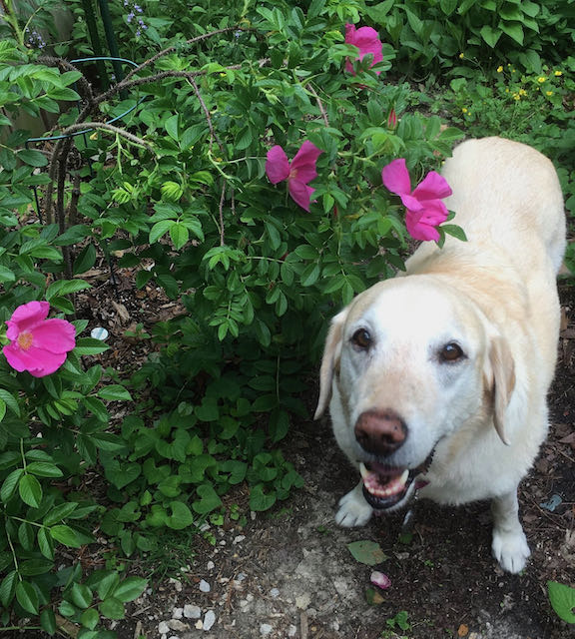
I-Share Alma Primo VE Office hours
Join us December 16, 2021
at 2pm for another
Office Hour.
Contact CARLI at
support@carli.Illinois.edu

