Slide 1
I-Share Alma Primo VE Office hours will start shortly
Welcome!
Office Hours will start at 2pm and run until 3pm.
Please mute your microphone.
As time permits, we will respond to questions typed in the chat box, and offline afterwards, as needed.
This session will be recorded and made available on the CARLI website both as PDF slides and as a recording, with live links to all referenced resources.

Slide 2
I-Share Alma/Primo VE Office Hours
October 14, 2021

Slide 3
Agenda Office Hours
Agenda – 10/14/2021
Announcements
Reminders and upcoming Alma/Primo VE events and learning opportunities
  See https://www.carli.illinois.edu/calendar for CARLI events
Today’s Topic:
  Update on Named User Count
  Comprehensive Update on Title Reduction Count
Notes:
Today we’ll have a few announcements and reminders about upcoming events for Alma/Primo VE. You can always check the CARLI calendar for CARLI events.
And after that, today’s session will cover our progress reducing and managing the number of bibliographic records we have in Alma, and a brief introduction to the next phase of the project.

Slide 4
Announcements
Announcements/Reminders
  Upcoming Office Hours
  Moved to once a month for the remainder of 2021
  Remaining 2021 dates: November 18, December 16
  always at 2:00pm
  Technical Services Q&A Sessions
  Scheduled for once a month from 10:30am-12:00pm
  Upcoming Dates: October 28, November 18, January 27, February 24, March 24, April 28, and May 26
  Registration open and available on the CARLI Calendar
Let’s Talk about Fulfillment (I mean Alma, not life’s purpose)
  Sessions are scheduled for every other week, alternating between Tuesday mornings at 10:30am and Friday afternoons at 2pm.
  Registration open and available on the CARLI Calendar
Notes:
Upcoming CARLI events!

Slide 5
Reminders
ELUNA Learns 2021
https://el-una.org/meetings/eluna-learns-2021/
ELUNA is presenting a series of webinars related to Ex Libris products in the summer and fall of 2021.
Sessions will be presented live and recorded.
ELUNA charges $25 per participant, but CARLI has purchased a block of registrations for I-Share library staff to register for free on a first come, first serve basis while our supplies last. You must register through CARLI, not the ELUNA website.
To register, complete this registration form (one form per person) and send it to support@carli.Illinois.edu
Note: ELUNA’s policy is that these registrations are for one individual only and are not for group use.
Notes:
A reminder about our ELUNA Learns funding, we still do have funding in place so don’t forget to see if there are any upcoming ELUNA learns events that are of interest to you.
As in 2020, CARLI has purchased a block of registrations for the 2021 Ex Libris Users of North America (ELUNA) online webinar series, ELUNA Learns. These sessions will be recorded, and the recordings will be available for a year to those who register. These sessions are normally $25 per person; the CARLI block will be available free to I-Share library staff on a first come first served basis while our supply lasts.
More information about ELUNA Learns is available at https://el-una.org/meetings/eluna-learns-2021/
To take advantage of the CARLI purchase, please register through CARLI and not on the ELUNA website.
CARLI will process your registration with ELUNA. ELUNA will follow up with two emails to you-a registration confirmation (you may ignore the text about how to pay for your registration) and you will receive a second email from ELUNA with the webinar access credentials (these will be sent approximately 1 day before sessions in the future). Please note that ELUNA’s policy is that these registrations are for one individual only and are not for group use.
To register: complete the attached form, attach to email, and send support@carli.illinois.edu, with “ELUNA learns” in the subject line. Please complete a separate form for each person registering.

Slide 6
Reminders
Webinar Recordings
Most past Ex Libris Webinars can be viewed On Demand
  Implementing Acquisitions, Knowledge Days, Primo VE: Become an Expert, and many more standalone topics!
Most CARLI webinars and Discussions after Ex Libris webinars are recorded and available from our website:
  These Office Hours
  Implementing Acquisitions Discussions
  Knowledge Days Discussions
  Primo VE: Become an Expert Discussions
Notes:
Just a reminder that if you miss any of the Ex Libris or CARLI webinar events, you can usually view a recording to catch up!

Slide 7
Named User Update
Named Users Count as of October 12: 3,584
  Includes 534 new, temporary users for IHLS CMC staff; without those: total is 3,050 - down from 3,117 on Sept. 9
  “CARLI_” staff users have been deactivated by CARLI,
    CARLI has started using one generic user in each IZ.
  Several institutions have created shared circ users
Names User Count goal in our contract: 2,162
Libraries/CARLI should target test accounts
Deadline to review your Named Users is December 1
CARLI’s Named User Documentation:
https://www.carli.illinois.edu/products-services/i-share/user-management/nameduserFAQ
Notes:
Here is an update on the number of named users. That number has been reduced by from 3,117 on Sept. 9 to 3,050 on October. As we mentioned at the last office hours, CARLI staff deactivated personal logins to each Alma IZ, but we have also created new but temporary users for the IHLS CMC staff while they assist us with the Alma Title Count Reduction Project. We noticed that several institutions have followed our recommendation to create shared generic accounts for circ desks and other shared service points.
Libraries and CARLI need to focus on identifying and deactivating test accounts, and libraries need to review roles assigned to users who do not login to Alma, or those who have left the library's employment.
Deadline: Dec 1.
All of CARLI’s Named User Documentation can be found on our website.
As an update, we did get confirmation from Ex Libris that a user is still considered a Named User even if all staff roles on the user record have been disabled, so that is not a possible workflow for reducing named users. We apologize for any inconvenience and have updated the options in our posted Named Users documentation.

Slide 8
I-Share Bibliographic Title Counts
I-Share libraries need to reduce our total number of Bibliographic Titles
Ex Libris’ Alma pricing is based on
  Bibliographic title count
  E-journal count
  Alma “Named Users”
“Bibliographic Titles” includes:
  Bibliographic records in an institution zone
  Bibliographic records in the network zone
  Authority records in either IZ or NZ
This count is reduced by the number of records that represent electronic journals
Notes:
As this session was billed as a Comprehensive Update, let’s review why we’re doing all of this from the top. As mentioned at previous office hours, Ex Libris has informed us that we have more active Alma named users than our current license allows, and we have more than our contracted number of bibliographic titles.
Why does this matter? It matters because title counts and named users are some of the metrics Ex Libris uses to set pricing for Alma.
The Bib Titles metric counts records in the IZ’s and the NZ as well as local authority records in either an IZ or NZ. As an aside, remember that the standard authority record sets like LCSH are stored in the Community Zone in Alma and are not counted for pricing metrics.
Also as e-journals is a separate pricing metric from bib titles, those records are not counted as titles.

Slide 9
I-Share bibliographic title counts
CARLI’s consortial Alma contract allows for
  46,420,000 active Bibliographic Titles
  We currently have more (counts changing daily)
  We need to reduce this number and provide room for growth.
There are not specific title limits for each I-Share library
  Our contract is for the consortium as a whole,
  Ex Libris provides neither the price nor the pricing metrics library by library
Notes:
CARLI’s Alma subscription currently allows us to have over 46 million titles across the entire consortium, i.e., 89 institutions plus the Network Zone.
We currently are over that number, but we know we introduced a lot of duplicate records during our migration from Voyager, SFX and the other e-resource systems. And we know we are not yet making the best use of the Network Zone for managing e-resources held by multiple, or all I-Share libraries.
As our contract and Alma pricing is based on aggregate totals for the consortium, we do not have limits per institution.
While Alma does not functionally prevent a customer from adding more users or titles than they have licensed, Ex Libris monitors these counts and can charge CARLI for the overage.
None of us want unexpected cost increases, so it is in our best interest to bring these numbers down.

Slide 10
Benefits of Reducing Title Counts
Reducing duplication engages efficiencies to managing and sharing resources
  Whenever possible, share electronic collection data once for all members.
  Deduplicating bibs improves imports and syncs with OCLC
  Fewer records = cleaner catalogs
This is the work we should be doing at this stage of our Alma implementation.
Notes:
As a reminder, CARLI wants you to know that the contract titles count is not the only goal in this effort. Alma provides a number of efficiencies for managing shared data, particularly electronic resources data, that we haven't yet been using fully. Ex Libris informs us that at this stage of a consortium's implementation, they would be working with institutions to reduce duplication from legacy systems and legacy processes, and take more advantage of Alma's functionality.
Whatever decreased title count we're able to achieve, by engaging in this work, now, we expect to improve our processes for sharing electronic resources metadata, and we believe we can produce cleaner, updated catalogs in the NZ and IZs as well. This work should also help position us better to move forward with other future metadata objectives.

Slide 11
Title Count Reduction Project
Goals:
  Manage Electronic Resource Collections in the Network Zone when possible
  Delete bib records with no Inventory
  Eliminate duplicate bib records
CARLI Alma Title Count Reduction Project Page: https://www.carli.illinois.edu/products-services/i-share/title-count-reduction/project-overview
  Contains a project overview
  List of the different phases of record cleanup
    Links to sub-project pages with more information on each
  Links to all project announcements and communications
  An FAQ
Notes:
Ex Libris and CARLI have identified three areas where we have an excess of records that we can reduce by performing record clean-up:
First, most I-Share libraries have activated electronic resources in their IZs that are identical to collections provided by CARLI via the network zone. This carryover of practices from Voyager isn't unusual, but it is the largest source of duplicate titles across the consortium.
Second, many library institution zones and the network zone contain bibliographic records that have no inventory. While there are several reasons why a bib may be present without inventory, we expect that a fair number of these records are artifacts from Voyager, in particular bibs used on purchase orders where the inventory has been moved or removed since the initial order.
Third, many IZs and the NZ contain duplicate bibliographic records. In some cases, duplicates are identical or nearly identical copies of the same WorldCat bib. In other cases, the duplicates were cataloged initially using different WorldCat bibs that OCLC has since merged. If you have encountered warning messages with duplicate detection when importing records from OCLC, then you've experienced some of this issue.
CARLI has created a webpage for the Alma Title Count Reduction Project. It has been referenced in several of our email communications to Liaisons and Directors thus far, but we want to make sure that everyone is aware of it to keep up to date on the latest project activities. It has a project overview, links out to separate webpages that describe each phase of the project in greater detail along with its timeline, contains links to all project announcements and communications, and there’s an FAQ.

Slide 12
Deleting Free/OpeN Access E-Collections UPdate
Open Access/Free Collections should be active only in Network Zone
NZ is designed to manage these collections centrally to benefit all consortial members. Optimizes record and data sharing.
Sub-Project page: https://www.carli.illinois.edu/products-services/i-share/title-count-reduction/open-access-e-collections
Work is almost complete! Collectively, we have already deleted over 850,000 titles!
Notes:
CARLI identified a priority for how we will reduce the number of duplicate e-collections. Our first priority focused on Open Access and Free E-Collections that are active in NZ. As freely available resources, these resources do not require patron authentication nor acquisition transactions. Thus they will be less complicated to delete from IZs and centrally manage. From there, we expect to move on to electronic resources that CARLI has purchased for all members, and then further into CARLI-brokered collections as much as possible.
The Open Access/Free Collections that were duplicated in IZ’s have been deleted, collectively we have already deleted over 850,000 titles!

Slide 13
Deleting E-Collections Funded by CARLI Update
E-Collections funded by CARLI are being handled in separate phases for NZ management as described in our communications. Future phases coming soon.
  First round Sub-Project page: https://www.carli.illinois.edu/products-services/i-share/title-count-reduction/CARLI-funded-e-collections-nonEBSCO
First phase of CARLI fully funded e-colls includes:
  Harper's Weekly, 1857-1912
  Historical Statistics of the United States (from Cambridge University Press)
  Sage E-Journal 2007 Deep Backfile
I-Share institutions that elected to delete the duplicate e-collections should complete this work by October 15.
CARLI staff work is in progress to delete these e-collections for institutions that requested it.
Notes:
E Collections that are funded by CARLI are being handled in separate phases for NZ management as we have communicated. This first round included Sage 2007, Harper’s Weekly, and Historical Statistics of the United State and is in progress, work that institutions indicated they would do themselves needs to be completed by tomorrow (October 15). Future phases will be announced soon.

Slide 14
Removing bibs with No inventory Update
Next phase: Remove Bibs with no Inventory (IZ and NZ)
Announcement to Liaisons/Directors, reports of each IZ’s records, and documentation will be posted soon.
Numbers of bibs with no inventory in IZs varies from under 10 to over 300,000.
  These reports exclude Bibs that are part of boundwith relationships
Timeline:
  By October 15 - Reports and documentation is shared
  By October 22 - Let CARLI know if you will do the work in your IZ or would you like CARLI to do the work
  By November 24 - Institutions must complete the work in their IZs
Notes:
Our next project phase is working on removing bibliographic records with no inventory in Alma. We have been creating reports that list these records for each IZ. Every IZ has bibs with no inventory. These lists vary in number from under 10 records to over 300,000 records. This is not surprising, and gives a sense of the number of excess titles this category creates.
The reports we share, and that will be used to delete these bib records exclude those bibliographic records that have explicit bound with relationships. Additionally the Delete
Bibliographic Records job parameters will be set to exclude bibs with relationships to other records, which allows the records to be reviewed before deletion. If an institution opts to have CARLI staff do this work, we may contact you with any questions we have about deleting related records before that is done.
Watch for the announcement about this soon!

Slide 15
Scheduling one-on-one meetings
Consultation Meetings are designed to discuss questions or concerns about your institution’s data in relation to the title reduction project.
If you are concerned about being able to accomplish the work, remember we have contracted with IHLS staff to help us with this project.
Work will start as announced, even if your meeting is scheduled after the start date.
More general questions about workflows or issues should be directed to support@carli.Illinois.edu
Notes:
Many of you have already signed up for consultation meetings and we have already had a few! Thank you! These meetings are designed to discuss questions or concerns you may have about specific data you may have in your IZ that you want to bring to our attention or have concerns about. If you have particular workflow or problem reports please send them to support@carli.Illinois.edu as always.

Slide 16
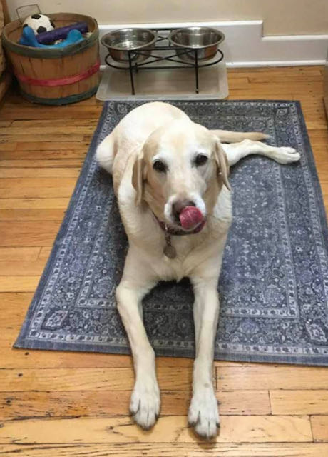
Next month – November 18 office hours
Time for more “Lab Reports”!
Do you have a workflow or process in Alma you think others could benefit from?
Have you set up a process in Alma that has made your co-workers say “WOW!”?
Consider submitting a proposal to present at our November 18 Office Hours and share with your I-Share colleagues. Email your proposal to support@carli.Illinois.edu.
Notes:
Next month we are planning another “Lab Reports” session. If you have a workflow or process you would like to share with your I-Share colleagues please consider submitting it to support@carli to present at the November 18 office hours! Submit proposals no later than November 8 so we can review and let those who have submitted ideas know that we’d like you to present!

Slide 17
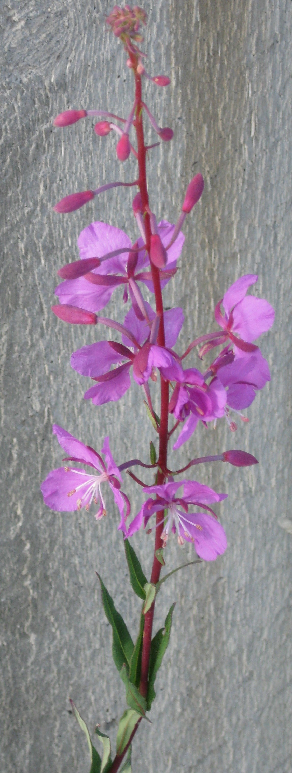
Open Q&A
Questions?
Notes:
That completes our announcements and reminders, so now we’ll open up the floor to your Questions! Feel free to unmute your microphones or type into the Chat.

Slide 18
I-Share Alma Primo VE Office hours
Join us November 18, 2021
at 2pm for another
Office Hour.
Contact CARLI at
support@carli.Illinois.edu
Notes:
The rest of our time together will be focused on your Questions so please feel free to enter them in the chat!
Illustration: Fireweed in bloom.

