Slide 1
I-Share Alma Primo VE Office hours will start shortly
Welcome!
Office Hours will start at 2pm and run until 3pm.
Please mute your microphone.
As time permits, we will respond to questions typed in the chat box, and offline afterwards, as needed.
This session will be recorded and made available on the CARLI website both as PDF slides and as a recording, with live links to all referenced resources.

Slide 2
I-Share Alma/Primo VE Office Hours
September 9, 2021

Slide 3
Agenda Office Hours
Agenda – 9/9/2021
Announcements
Reminders and upcoming Alma/Primo VE events and learning opportunities
  See https://www.carli.illinois.edu/calendar for CARLI events
Today’s Topic:
  Reducing and managing duplicated titles
Notes:
Today we’ll have a few announcements and reminders about upcoming events for Alma/Primo VE. You can always check the CARLI calendar for CARLI events.
And after that, today’s session will cover our need to reduce and manage the number of bibliographic records we have in Alma.

Slide 4
Announcements
Announcements/Reminders
  Upcoming Office Hours
  Moving to once a month for the remainder of 2021
  September 9, October 14, November 18, December 16
  always at 2:00pm
  Technical Services Q&A Sessions
  Scheduled for once a month from 10:30am-12:00pm starting September 23
  Other dates: October 28, November 18, January 27, February 24, March 24, April 28, and May 26
  Registration open and available on the CARLI Calendar
Let’s Talk about Fulfillment (I mean Alma, not life’s purpose)
  Sessions are scheduled for every other week, alternating between Tuesday mornings at 10:30am and Friday afternoons at 2pm.
  Registration open and available on the CARLI Calendar
Notes:
Upcoming CARLI events!

Slide 5
Reminders
ELUNA Learns 2021
https://el-una.org/meetings/eluna-learns-2021/
ELUNA is presenting a series of webinars related to Ex Libris products in the summer and fall of 2021.
Sessions will be presented live and recorded.
ELUNA charges $25 per participant, but CARLI has purchased a block of registrations for I-Share library staff to register for free on a first come, first serve basis while our supplies last. You must register through CARLI, not the ELUNA website.
To register, complete this registration form (one form per person) and send it to support@carli.Illinois.edu
Note: ELUNA’s policy is that these registrations are for one individual only and are not for group use.
Notes:
As in 2020, CARLI has purchased a block of registrations for the 2021 Ex Libris Users of North America (ELUNA) online webinar series, ELUNA Learns. These sessions will be recorded, and the recordings will be available for a year to those who register. These sessions are normally $25 per person; the CARLI block will be available free to I-Share library staff on a first come first served basis while our supply lasts.
More information about ELUNA Learns is available at https://el-una.org/meetings/eluna-learns-2021/
To take advantage of the CARLI purchase, please register through CARLI and not on the ELUNA website.
CARLI will process your registration with ELUNA. ELUNA will follow up with two emails to you-a registration confirmation (you may ignore the text about how to pay for your registration) and you will receive a second email from ELUNA with the webinar access credentials (these will be sent approximately 1 day before sessions in the future). Please note that ELUNA’s policy is that these registrations are for one individual only and are not for group use.
To register: complete the attached form, attach to email, and send support@carli.illinois.edu, with “ELUNA learns” in the subject line. Please complete a separate form for each person registering.

Slide 6
ReminderS
Webinar Recordings
Most past Ex Libris Webinars can be viewed On Demand
  Implementing Acquisitions, Knowledge Days, Primo VE: Become an Expert, and many more standalone topics!
Most CARLI webinars and Discussions after Ex Libris webinars are recorded and available from our website:
  These Office Hours
  Implementing Acquisitions Discussions
  Knowledge Days Discussions
  Primo VE: Become an Expert Discussions
Notes:
Just a reminder that if you miss any of the Ex Libris or CARLI webinar events, you can usually view a recording to catch up!

Slide 7
Reminders
I-Share Union View
I-Share Union View URL:
https://i-share-network.primo.exlibrisgroup.com/discovery/search?vid=01CARLI_NETWORK:IShare_UNION
FAQ : https://www.carli.illinois.edu/products-services/i-share/discovery-interface/i-share_union_view
I-Share Liaisons and Directors received email with information on authentication configuration needed for the Union View for your institution. Contact support@carli.Illinois.edu with questions.
Notes:
Another reminder that the I-Share Union View is now available at this URL. There is an FAQ with more information posted on the CARLI website. I-Share Liaisons and Directors received an email on July 22 with information on authentication configuration needed for the Union View for your institution. If you have any questions about that or the Union View in general, let us know!

Slide 8
Reminders
Premium Sandboxes Refreshed
Refresh occurred on August 8 as part of Alma monthly release update
Six sandboxes are ready for use as of August 19.
Alma Sandbox Information includes URLs and best practices.
Sandbox credentials found in your library’s Box folder.
  Check the “XXX Credentials” subfolder.
  “Alma Primo VE Sandbox Information for CARLI Libraries August 2021.docx”
Notes:
CARLI’s six Premium Sandboxes were refreshed on Sunday, August 8 as part of the Alma monthly release updates. The Sandboxes are refreshed twice a year in February and August. CARLI staff have finished their preparations and the sandboxes were made available on August 19. Be sure to check the Alma Sandbox Information page <https://www.carli.illinois.edu/products-services/i-share/alma/sandbox> on the CARLI website for URLs to access the sandboxes as well as best practices on how to use the sandboxes. Sandboxes have a standard list of generic accounts for access, and these are found in a document that CARLI shares with libraries via Box.Illinois.com. Look for the Alma Primo VE Sandbox Information for CARLI Libraries August 2021.docx file in the XXX credentials subfolder, where XXX is your library’s CARLI code.

Slide 9
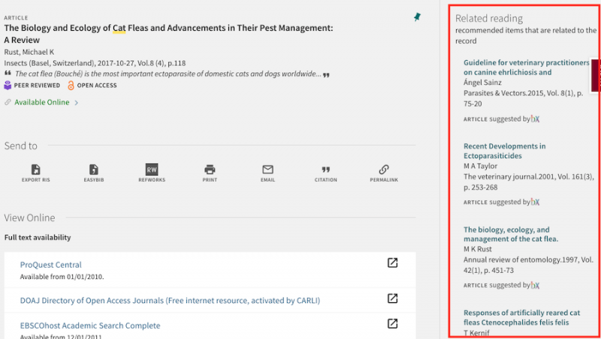
Reminders
bX Article Recommender
The bX Recommender service is now available to I-Share institutions.
See CARLI’s bX Recommender FAQ
I-Share Liaisons and Directors can request a bX Token by emailing support@carli.Illinois.edu
Notes:
CARLI is pleased to announce that the bX Article Recommender service is now available for I-Share institutions. bX uses anonymous link resolver usage information from users around the world to provide relevant recommendations for articles and ebooks in Primo VE, similar to the "More Like This..." or "If You Liked This, You’ll Also Like…" services on consumer websites like Netflix and Amazon. The Ex Libris bX Recommender service is currently included in CARLI's contract for Alma for all I-Share institutions at no additional cost to the institution. To enable bX recommender for your institution, please read CARLI’s bX Article Recommender FAQ and have your institution's I-Share Liaison or Director request a bX Token from CARLI by sending an email to support@carli.illinois.edu .

Slide 10
Alma Bibliographic Title Counts
I-Share libraries need to reduce our total number of Bibliographic Titles
Ex Libris’ Alma pricing is based on
  Bibliographic title count
  E-journal count
  Alma “Named Users”
“Bibliographic Titles” includes:
  Bibliographic records in an institution zone
  Bibliographic records in the network zone
  Authority records in either IZ or NZ
This count is reduced by the number of records that represent electronic journals
Notes:
Kris
At our last Office Hours on August 26, we talked about how Ex Libris has informed us that we have more active Alma named users than our current license allows. We have also currently gone over our contracted number of titles.
Why does this matter? It matters because title counts, are one of the numbers Ex Libris uses to set pricing for Alma.
The Bib Titles metric counts records in the IZ’s and the NZ and authority records in either an IZ or NZ. As an aside, remember that the standard authority record sets like LCSH are stored in the Community Zone in Alma and are not counted for pricing metrics.
Also as e-journals is a separate pricing metric from bib titles, those records are not counted as titles.

Slide 11
I-Share bibliographic title counts
CARLI’s consortial Alma contract allows for
  46,420,000 active Bibliographic Titles
  We currently have more (counts changing daily)
  We need to reduce this number and provide room for growth.
There are not specific title limits for each I-Share library
  Our contract is for the consortium as a whole,
  Ex Libris provides neither the price nor the pricing metrics library by library
Notes:
Kris
CARLI’s Alma subscription currently allows us to have over 46 million titles across the entire consortium, i.e., 89 instutions’ plus the Network Zone.
We currently are over that number, but we know we introduced a lot of duplicate records during our migration from Voyager, SFX and the other e-resource systems. And we know we are not yet making the best use of the Network Zone for managing e-resources held by multiple, or all I-Share libraries.
As with our conversation about named users two weeks ago, I suspect many of you are wondering “How many titles is my library allowed to have according to our Alma subscription?”
As our contract and Alma pricing is based on aggregate totals for the consortium, we do not have limits per institution.
While Alma does not functionally prevent a customer from adding more users or titles than they have licensed, Ex Libris monitors these counts and can charge CARLI for the overage.
None of us want unexpected cost increases, so it is in our best interest to bring these numbers down.

Slide 12
Reducing Title Counts – doing the work
CARLI has contracted with IHLS to hire contract catalogers to help complete this work
  CARLI will be training these catalogers and they will be doing a lot of the work to clean up several categories of duplicate and/or excess records
More information was shared via an email from Anne Craig on 9/1/2021
Notes:
Kris
The good news on this is that CARLI has contracted with the Illinois Heartland Library System’s Catalog Maintenance Center to hire some professional catalogers to work with the CARLI staff and member libraries, on Alma data cleanup. These staff will begin work this month and will be available to us through next June.
Collectively, we will be referring to these staff as the IHLS Alma Cleanup Team. During their first days on the job, the team will spend most of their time on Alma training and sandbox work. The team will be IHLS staff but will be trained by and receive assignments from the CARLI staff. This should not change the way I-Share libraries work with or communicate with CARLI, and the CARLI staff will maintain close oversight on their work.
The IHLS Catalog Maintenance Center is funded in part by the ISL for the purposes of assisting Illinois libraries and consortia with their catalog data. The CMC has been in place for about 20 years but this is the first time CARLI has contracted with them for work. CARLI was able to receive special funding from the UI System Office to cover this effort, your I-Share assessments are not being used for this project.
Hand off to Ted.

Slide 13
Ways to reduce title counts
Reduce Duplication of Records
Remove Bibs with no Holdings (IZ and NZ)
Deduplicate Bibs
Manage Certain Electronic Resource Collections in the Network Zone
  Open Access/Free Collections – Should be active only in Network Zone.
  NZ is designed to manage these collections centrally to benefit all consortial members. Optimizes record and data sharing.
Notes:
Ted
Thanks Kris. Ex Libris and CARLI have identified three areas where we have an excess of records that we can reduce by performing record clean-up. First, many library institution zones and the network zone contain bibliographic records that have no inventory. While there are several reasons why a bib may be present without inventory, we expect that a fair number of these records are artifacts from Voyager, in particular bibs used on purchase orders where the inventory has been moved or removed since the initial order. CMC staff will be involved in reviewing these records and processing deletions where possible.
Second, many IZs and the NZ contain duplicate bibliographic records. In some cases, duplicates are identical or nearly identical copies of the same WorldCat bib. In other cases, the duplicates were cataloged initially using different WorldCat bibs that OCLC has since merged. If you have encountered warning messages with duplicate detection when importing records from OCLC, then you've experienced some of this issue. CMC staff are trained in OCLC's record merging practices, and we will provide the training on how records should be merged in Alma to preserve your data.
Third, most I-Share libraries have activated electronic resources in their IZs that are identical to collections provided by CARLI via the network zone. This carryover of practices from Voyager isn't unusual, but it is the largest source of duplicate titles across the consortium. CARLI will have the CMC team working to reduce duplication by enabling and activating inventory groups in the NZ, which help these collections appear more directly in your Alma and Primo searches. Then they will deactivating collections in IZs.
CARLI has identified a priority for how we will modify collections. Our first priority will focus on Open Access and Free E-Collections that are shared from the NZ. As freely available resources, these resources do not require patron authentication nor acquisition transactions. Thus they will be less complicated to delete from IZs and centrally manage. From there, we expect to move on to electronic resources that CARLI has purchased for all members, and then further into CARLI-brokered collections as much as possible.
Our goal here is very much the same one that you may have heard us mention in past electronic collection efforts. Do the same thing for all libraries by doing it once centrally, rather than doing it 90 times with local variations. That said, we should be able to accommodate requests to localize details for shared collections, and we will be open to discussing any institutional priorities that exist as well. Sometime later this month, we'll release a schedule for libraries with questions to sign up to consult on where our attention may be and what work we plan to do. We also do plan to share our procedures via the CARLI website, so that institutions wanting to manage their data directly may contribute their efforts as well.

Slide 14
Benefits of Reducing Title Counts
Reducing duplication engages efficiencies to managing and sharing resources
  Whenever possible, share electronic collection data once for all members.
  Deduplicating bibs improves imports and syncs with OCLC
  Fewer records = cleaner catalogs
This is the work we should be doing at this stage of our Alma implementation.
Notes:
Ted
CARLI wants you to know that the contract titles count is not the only goal in this effort. Alma provides a number of efficiencies for managing shared data, particularly electronic resources data, that we haven't yet been using fully. Ex Libris informs us that at this stage of a consortium's implementation, they would be working with institutions to reduce duplication from legacy systems and legacy processes, and take more advantage of Alma's functionality.
Whatever decreased title count we're able to achieve, by engaging in this work, now, we expect to improve our processes for sharing electronic resources metadata—which is a dream several CARLI staff have had for several years—and we believe we can produce cleaner, updated catalogs in the NZ and IZs as well. This work should also help position us better to move forward with other future metadata objectives.

Slide 15
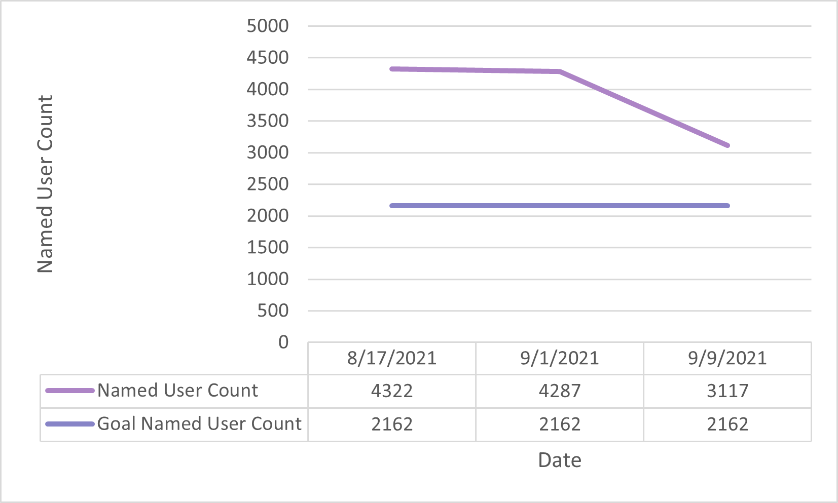
Named User Update
Named Users Count already reduced: 3,117
  “CARLI_” staff users have been deactivated by CARLI, CARLI will use one generic user in each IZ.
  Several institutions have created shared circ users
IHLS CMC staff will have named users active while working in an IZ
Libraries/CARLI should target test accounts
Notes:
Ted
Finally, we're able give you an update on the topic we presented on August 26. Since that presentation, our number of named users has been reduced by 1,205 users to 3,117. As we promised at the last office hours, CARLI staff deactivated personal logins to each Alma IZ. We also noticed that several institutions have followed our recommendation to create shared generic accounts for circ desks and other shared service points.
Meanwhile, we're continuing to improve on our recommendations on creating back-up accounts, and you should hear more information about that shortly. Libraries and CARLI also need to focus on identifying and deactivating test accounts, and libraries need to review roles assigned to users who do not login to Alma, or those who have left the library's employment.
One caveat on these numbers, because we want our work on title reduction to be transparent, the CMC team members will be receiving staff roles in Alma IZs. We will be responsible for keeping these active when necessary and for accounting to the consortial total number of users.

Slide 16
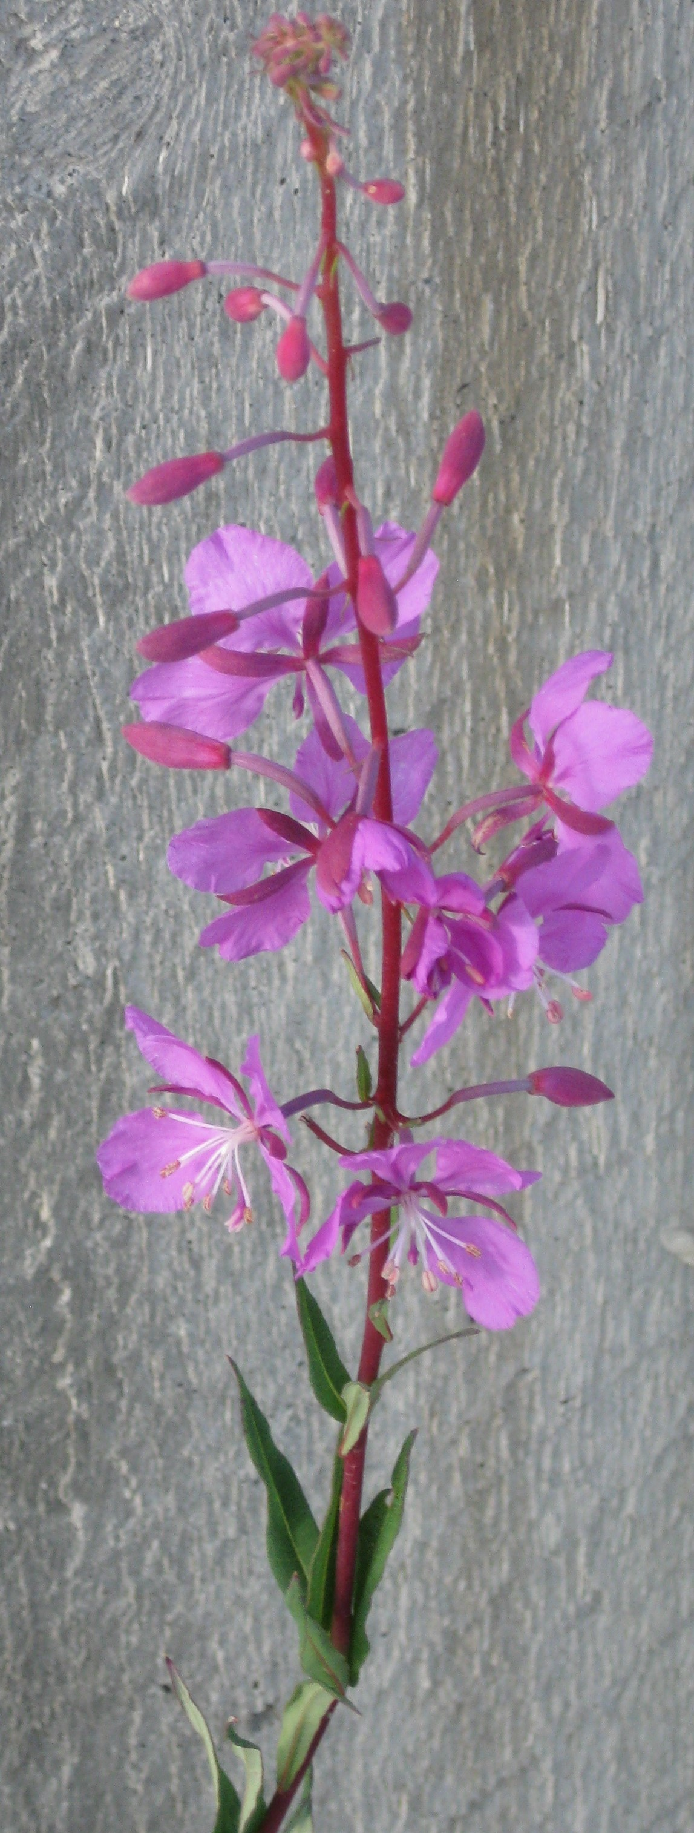
Open Q&A
Questions?
Notes:
That completes our announcements and reminders, so now we’ll open up the floor to your Questions! Feel free to unmute your microphones or type into the Chat.

Slide 17
I-Share Alma Primo VE Office hours
Join us October 14, 2021
at 2pm for another
Office Hour.
Contact CARLI at
support@carli.Illinois.edu
Notes:
The rest of our time together will be focused on your Questions so please feel free to enter them in the chat!
Illustration: Fireweed in bloom.

