Slide 1
I-Share Alma Primo VE Office hours will start shortly
Welcome!
Office Hours will start at 2pm and run until 3pm.
Please mute your microphone.
As time permits, we will respond to questions typed in the chat box, and offline afterwards, as needed.
This session will be recorded and made available on the CARLI website both as PDF slides and as a recording, with live links to all referenced resources.

Slide 2
I-Share Alma/Primo VE Office Hours
August 26, 2021

Slide 3
Agenda Office Hours
Agenda – 8/26/2021
Announcements
Reminders and upcoming Alma/Primo VE events and learning opportunities
  See https://www.carli.illinois.edu/calendar for CARLI events
Today’s Topic:
  Reducing and managing our Alma Named Users
Notes:
Today we’ll have a few announcements and reminders about upcoming events for Alma/Primo VE. You can always check the CARLI calendar for CARLI events.
And after that, today’s session will cover our need to reduce and manage the number of Named Users we have in Alma.

Slide 4
Announcements
Announcements/Reminders
  Upcoming Office Hours
  Moving to once a month for the remainder of 2021
  September 9, October 14, November 18, December 16
  always at 2:00pm
  Technical Services Q&A Sessions
  On hiatus during Ex Libris Implementing Acquisitions series.
  Returning in September!
Let’s Talk about Fulfillment (I mean Alma, not life’s purpose)
  Watch for an announcement about the scheduling of future sessions and registration information!
  Notes are posted on the CARLI calendar event for past sessions.
Notes:
Upcoming CARLI events!

Slide 5
Reminders
ELUNA Learns 2021
https://el-una.org/meetings/eluna-learns-2021/
ELUNA is presenting a series of webinars related to Ex Libris products in the summer and fall of 2021.
Sessions will be presented live and recorded.
ELUNA charges $25 per participant, but CARLI has purchased a block of registrations for I-Share library staff to register for free on a first come, first serve basis while our supplies last. You must register through CARLI, not the ELUNA website.
To register, complete this registration form (one form per person) and send it to support@carli.Illinois.edu
Note: ELUNA’s policy is that these registrations are for one individual only and are not for group use.
Notes:
As in 2020, CARLI has purchased a block of registrations for the 2021 Ex Libris Users of North America (ELUNA) online webinar series, ELUNA Learns. These sessions will be recorded, and the recordings will be available for a year to those who register. These sessions are normally $25 per person; the CARLI block will be available free to I-Share library staff on a first come first served basis while our supply lasts.
More information about ELUNA Learns is available at https://el-una.org/meetings/eluna-learns-2021/
To take advantage of the CARLI purchase, please register through CARLI and not on the ELUNA website.
CARLI will process your registration with ELUNA. ELUNA will follow up with two emails to you-a registration confirmation (you may ignore the text about how to pay for your registration) and you will receive a second email from ELUNA with the webinar access credentials (these will be sent approximately 1 day before sessions in the future). Please note that ELUNA’s policy is that these registrations are for one individual only and are not for group use.
To register: complete the attached form, attach to email, and send support@carli.illinois.edu, with “ELUNA learns” in the subject line. Please complete a separate form for each person registering.

Slide 6
ReminderS
Webinar Recordings
Most past Ex Libris Webinars can be viewed On Demand
  Implementing Acquisitions, Knowledge Days, Primo VE: Become an Expert, and many more standalone topics!
Most CARLI webinars and Discussions after Ex Libris webinars are recorded and available from our website:
  These Office Hours
  Implementing Acquisitions Discussions
  Knowledge Days Discussions
  Primo VE: Become an Expert Discussions
Notes:
Just a reminder that if you miss any of the Ex Libris or CARLI webinar events, you can usually view a recording to catch up!

Slide 7
Reminders
I-Share Annual Statistics Package
Download these data before the end of August!
For a full description of the annual statistical package, see https://www.carli.illinois.edu/products-services/i-share/stats/almastatspck and/or watch the recording of the July 22, 2021 Open Office Hours
Notes:
A friendly reminder about the I-Share Annual Statistics Package data that have been distributed in each institution’s FTP directory on the CARLI Files server. Be sure to download them before the end of August. For more information, see the CARLI website, or better yet, watch the recording of the July 22 Office Hours!

Slide 8
Reminders
I-Share Union View
I-Share Union View URL:
https://i-share-network.primo.exlibrisgroup.com/discovery/search?vid=01CARLI_NETWORK:IShare_UNION
FAQ : https://www.carli.illinois.edu/products-services/i-share/discovery-interface/i-share_union_view
I-Share Liaisons and Directors received email with information on authentication configuration needed for the Union View for your institution. Contact support@carli.Illinois.edu with questions.
Notes:
Another reminder that the I-Share Union View is now available at this URL. There is an FAQ with more information posted on the CARLI website. I-Share Liaisons and Directors received an email on July 22 with information on authentication configuration needed for the Union View for your institution. If you have any questions about that or the Union View in general, let us know!

Slide 9
Reminders
Premium Sandboxes Refreshed
Refresh occurred on August 8 as part of Alma monthly release update
Six sandboxes are ready for use as of August 19.
Alma Sandbox Information includes URLs and best practices.
Sandbox credentials found in your library’s Box folder.
  Check the “XXX Credentials” subfolder.
  “Alma Primo VE Sandbox Information for CARLI Libraries August 2021.docx”
Notes:
CARLI’s six Premium Sandboxes were refreshed on Sunday, August 8 as part of the Alma monthly release updates. The Sandboxes are refreshed twice a year in February and August. CARLI staff have finished their preparations and the sandboxes were made available on August 19. Be sure to check the Alma Sandbox Information page <https://www.carli.illinois.edu/products-services/i-share/alma/sandbox> on the CARLI website for URLs to access the sandboxes as well as best practices on how to use the sandboxes. Sandboxes have a standard list of generic accounts for access, and these are found in a document that CARLI shares with libraries via Box.Illinois.com. Look for the Alma Primo VE Sandbox Information for CARLI Libraries August 2021.docx file in the XXX credentials subfolder, where XXX is your library’s CARLI code.

Slide 10
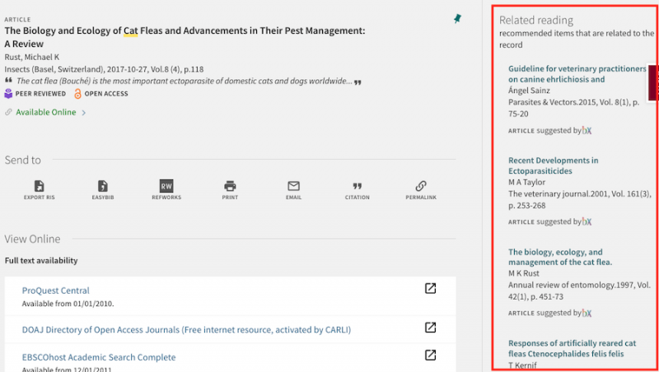
Reminders
bX Article Recommender
The bX Recommender service is now available to I-Share institutions.
See CARLI’s bX Recommender FAQ
I-Share Liaisons and Directors can request a bX Token by emailing support@carli.Illinois.edu
Notes:
CARLI is pleased to announce that the bX Article Recommender service is now available for I-Share institutions. bX uses anonymous link resolver usage information from users around the world to provide relevant recommendations for articles and ebooks in Primo VE, similar to the "More Like This..." or "If You Liked This, You’ll Also Like…" services on consumer websites like Netflix and Amazon. The Ex Libris bX Recommender service is currently included in CARLI's contract for Alma for all I-Share institutions at no additional cost to the institution. To enable bX recommender for your institution, please read CARLI’s bX Article Recommender FAQ and have your institution's I-Share Liaison or Director request a bX Token from CARLI by sending an email to support@carli.illinois.edu .

Slide 11
Alma named users
I-Share libraries need to reduce our total number of active Alma Named Users
Ex Libris’ Alma pricing is based on
  Bibliographic title count
  E-journal count
  Alma “Named Users”
“Named Users” are active user records in Alma that have been assigned any role that can log into Alma.
This includes Alma logins with all roles except Patron, Instructor, and/or Trial Participant
Notes:
Kris
Ex Libris has informed us that we have more active Alma named users than our current license allows.
Why does this matter? It matters because Named users, that is, Alma logins that have a role other than patron, instructor or trial participant, are one of the numbers Ex Libris uses to set pricing for Alma.
The other two pricing metrics are bibliographic titles and e-journals. We are also currently over our licensed number of bibliographic titles, and we will be discussing that issue in our next Office Hours on September 9. Today we are focusing on named users, as Ex Libris has informed us that reducing that count is a higher priority than the title reduction work.
Before we go on, I want to be sure to clarify that we are talking about currently active Alma accounts used by librry staff with staff roles in Alma. This number does not have anything to do with the number of patron records you have, nor does it have anything to do with whether your staff logins are managed internally in Alma or externally via SIS, or what system you are using to manage single signon.

Slide 12
CARLI Named Users
CARLI’s consortial Alma contract allows for
  2162 active Alma Named Users
  We currently have 4322 active Named Users
  We need to reduce this number and stay at or under 2162
There are not specific named user limits for each I-Share library
  Our contract is for the consortium as a whole,
  Ex Libris provides neither the price nor the pricing metrics library by library
Notes:
Kris
CARLI’s Alma subscription currently allows us to have 2162 active named users across the entire consortium, i.e., 89 instutions’ staff plus the CARLI Office staff.
We currently have almost exactly twice that many named users.
I suspect that most of you are about to ask, if you are not already typing into the chat box, “How many named users does my institution currently have, and how many are we allowed to have?”
As our contract and Alma pricing is based on aggregate totals for the consortium, we do not have limits per institution.
While Alma does not functionally prevent a customer from adding more users or titles than they have licensed, Ex Libris monitors these counts and can charge CARLI for the overage.
None of us want unexpected cost increases, so it is in our best interest to bring these numbers down.

Slide 13
How many named users should an institution have?
Collectively, all I-Share libraries and the CARLI staff are allowed 2162 active Alma Named Users
There are not specific limits for each I-Share institution
Each I-Share institution should have as many active Named Users as they require to operate securely, but should have no more active than they need.
CARLI staff believe that 2162 Named Users is more than adequate for our current I-Share members, and that there are many Named Users that are unused and which can be deactivated
Notes:
Kris
So, if there is not an exact limit per institution, how do we set our target numbers.
While it may sound like a Zen riddle, each institution should have as many named users as they need to operate their library securely, but should have no more users activethan they need at any one time.
CARLI staff believe that 2162 active named users should be adequate for our consortium.
In the next part of this presentation, we are going to show you how to monitor the named users you have for your institution and how to identify those that are in use, and how to deactivate those that are not.

Slide 14
How can we find out how many named users we are using?
Staff Login Report
  Located in Alma Configuration > General > General Configuration > Staff Login Report
  Lists all “active” Named Users
  Shows the last login date in the past 90 days
  Shows a dash if the user has not logged on in 90+ days
Analytics Reports written by CARLI
  Found under Shared Folders > Carli NETWORK 01CARLI_NETWORK > User Reports
  Named Users List with Roles
    Lists each user with a staff role, but does not list the roles
  Named Users List with Roles
    Lists each user with a staff role and the roles that are assigned
  Named User Analysis Role Counts
Notes:
Ted
For Ex Libris’ purposes, the Staff Login Report identifies the current count of active named users. CARLI staff have generated copies of this report this week and posted it to Box. You should also be in the habit of checking this report periodically. If you have the General System Administrator role, you will be able to locate this report in Configuration from the General menu. The report is rather spartan, listing only the usernames (or rather primary IDs) and last login dates for these users, so long as the login occurred in the last 90 days.
In order to get more details on these users, you’ll need to go into Alma Analytics. CARLI has prepared some reports within CARLI’s shared User Reports folder. The first of these reports, Named Users List, is the counterpart to the Staff Login Report, showing you the name, expiration, and purge dates of the users that are on that list. If you want to review these users’ roles, then you’ll use the Named Users List with Roles. This report provides the list of all users with a staff role, along with each of those roles.
If you’re looking for an aggregate picture of how different roles are used at your institution, then you could use the Named User Analysis Role Counts report.

Slide 15
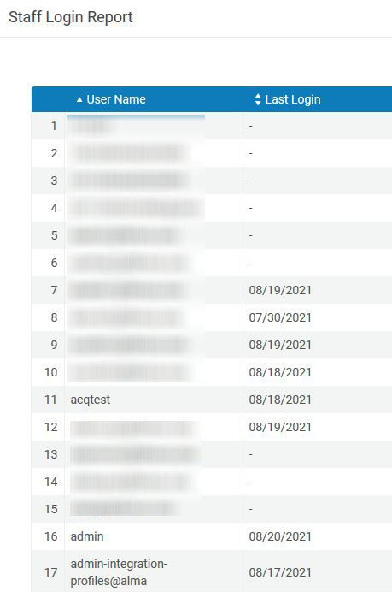
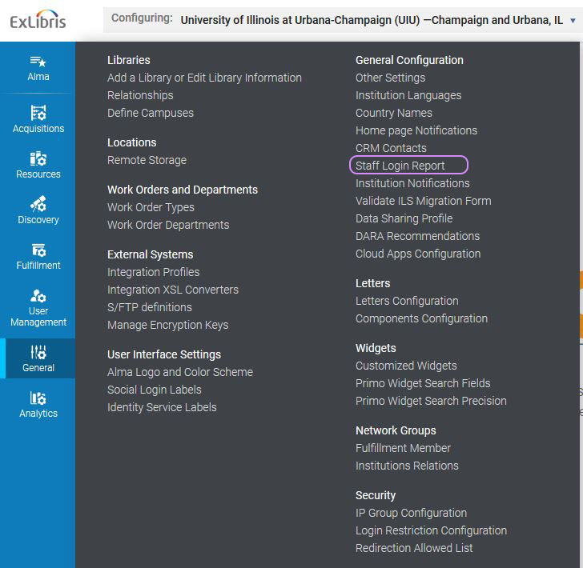
How can we find out how many named users we are using?

Slide 16
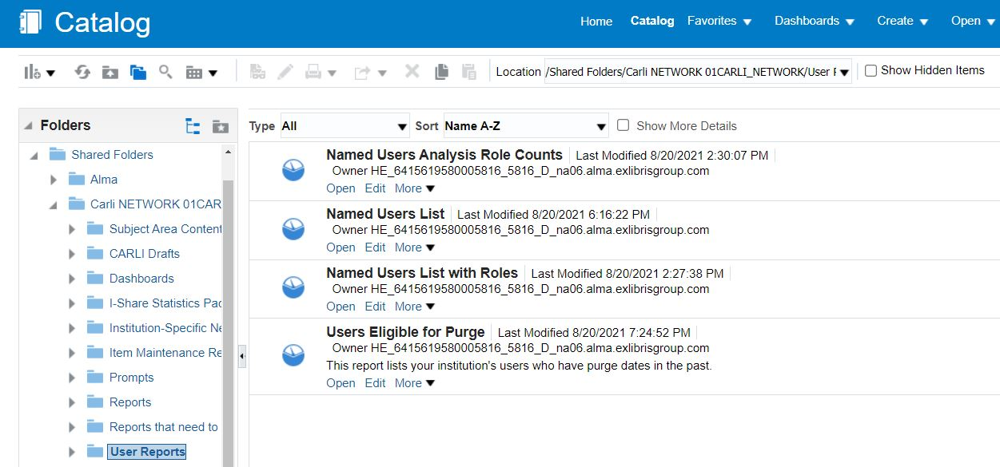
How can we find out how many named users we are using?

Slide 17
Which named users can we deactivate?
User accounts that have never been used, or not used in a long time
“Test” accounts set up to try something infrequently
  Consider using an Alma sandbox instead
  Deactivate test users when not being used
  testAlma_xxx or prodAlma_xxx accounts from migration
Any accounts for staff that are no longer employed by your library
  If they still have borrowing privileges at your institution, their user record can remain active with only the Patron role but no Alma staff roles
Notes:
So, great we have these reports. You’re now wondering how you should use the reports, and which users you should be looking to deactivate. In short, look for accounts that are used infrequently or not at all. A prime target that we identified are test accounts. Each institution appeared to have at least one such account, though many of them were the “testAlma” or “prodAlma” accounts that were created for migration testing. While those accounts were expired, the presence of the roles meant they still appeared on reports. We believe at this point, sandboxes are a better place for creating test users, or modifying the users that are there in order to test Alma functionality under different roles.
Also, when CARLI staff started reviewing the staff login reports, we found many institutions had some users who had not logged in for some time, or not at all in the last 90 days. We recognized some users as former library employees who may have retired or changed jobs in the past year; other accounts appeared to be student workers, whether they left for the summer or moved on wasn’t clear. What is obvious to us is that any users who are not currently employed by your library should have staff roles deactivated.

Slide 18
Do Not deactivate EXL or CARLI accounts
Do not touch user accounts that begin with exl_ . These are Ex Libris staff accounts.
Do not deactivate any accounts that begin with carli_. These are CARLI staff accounts that CARLI staff will manage centrally.
Do not deactivate any accounts with primary ID admin or name of “Alma Administrator.” This is the “super user” account for your institution.
Notes:
On reviewing the list of users that haven’t logged in, you may naturally ask about the CARLI staff accounts and the Ex Libris accounts. You’re right that there are a lot of these. However, we ask that you do not make any changes to these accounts.
Ex Libris accounts, which begin “exl underscore,” are required by Ex Libris staff in case they need to make modifications in your environment. Additionally, Ex Libris accounts are not counted against CARLI’s limit of 2,162 named users.
On the other hand, the CARLI accounts do count against that limit. CARLI staff are currently working on changing how we access your Alma institution zones. We plan to change to a single account for our regular efforts to check issues in Alma, while deactivating our existing accounts. Because CARLI staff sometimes have projects that require more than one user, we will keep these accounts in reserve and reactivate as needed, then deactivating when done. In any case, CARLI staff will take responsibility for these accounts, so please do not change any accounts beginning with “carli underscore.”

Slide 19
New best practice recommendations
When possible, consider using a shared, “generic”, user among some staff such as student workers
  A circ desk computer typically staffed by student workers could use a login such as “circdesk1”
  Multiple service points could use logins in a series such as “circdesk1”, “circdesk2”, etc.
  These should be low privilege accounts
  While Alma will allow it, you should not login from the same account more than once at a time
New best practice for generic accounts
  Note: We recognize this is a change from our recommendation during implementation that each staff member have a unique personal Alma login
Notes:
By the way, please keep in mind that I’m saying “deactivate” rather than “delete.” We have a couple reasons for that, which we’ll get to in a few minutes. First, we should answer the question of what else can libraries do to reduce the count of named users. Based on our discussions with Ex Libris and some examination of other consortial situations, CARLI now recommends that where and when possible, libraries create shared, generic user accounts for any low privilege users, for instance circulation desk students. These accounts should be assigned to specific service points, with one account per workstation at that service point. Only one person should be logged in using a shared account at one time.
By low privilege users, we mean that the account has few roles, basically only the roles needed to perform tasks that are typical at that service point. In terms of roles, we’re thinking about the Circ Desk Operator Limited and Requests Operator roles, perhaps also Course Reserves Viewer or Work Order Operator. We have these roles and a few others listed on our new best practice recommendation for creating generic accounts page: https://www.carli.illinois.edu/products-services/i-share/user-management/GenericUsers

Slide 20
Procedures and Practices
carli.illinois.edu/products-services/i-share/user-management
Identifying Named Users
Deactivating a Named User
Alma “Role Toggler” Cloud App
  See also https://youtu.be/3D_fARn8CUo, “Cloud Apps in Alma”
Setting up a Generic Named User
Notes:
To help you on your way, we have a new set of practices and procedures on the CARLI documentation page under User Management along with other new best practices on named users, identifying named users, and deactivating users.
Earlier, I mentioned that you should focus on deactivating users, rather than deleting. Deleting user records from Alma may have adverse effects on statistical data in Analytics, and possibly on the audit trail data that Alma tracks for most saved records. Deactivating a record prevents a user from logging into Alma with that account and removes the account from the list of named users. If the user record is past its expiration and purge dates, then you could remove it later via a purge job. We’re not planning to cover purges today: look for a future tutorial video or Q&A session.
One tool that libraries may find helpful is the Alma Cloud App named Role Toggler. CARLI staff have enabled each institution’s Alma to allow the use of Cloud Apps, and the Role Toggler is effective at enabling or disabling all of the roles currently associated with an account. If you’ve added or edited roles on user records before, then you may recognize how this might be a help. Here’s a brief video segment to describe more.

Slide 21
Deadlines etc.
CARLI would like to have our Named User count back under 2162 by the end of 2021
Please complete your review and deactivation of unneeded accounts by December 1, 2021
  Sooner is better!
Each institution should do this review at least once a year

Slide 22

Open Q&A
Questions?
Notes:
That completes our announcements and reminders, so now we’ll open up the floor to your Questions! Feel free to unmute your microphones or type into the Chat.

Slide 23
I-Share Alma Primo VE Office hours
Join us September 9, 2021
at 2pm for another
Office Hour.
Contact CARLI at
support@carli.Illinois.edu
Notes:
The rest of our time together will be focused on your Questions so please feel free to enter them in the chat!
Illustration: Fireweed in bloom.

