Slide 1
I-Share Alma Primo VE Office hours will start shortly
Welcome!
Office Hours will start at 2pm and run until 3pm.
Please mute your microphone.
As time permits, we will respond to questions typed in the chat box, and offline afterwards, as needed.
This session will be recorded and made available on the CARLI website both as PDF slides and as a recording, with live links to all referenced resources.

Slide 2
CARLI/I-Share Office Hours
I-Share Union View / Annual Stats Package
July 22, 2021

Slide 3
Agenda Office Hours
Agenda – 7/22/2021
Announcements
Reminders and upcoming Alma/Primo VE events and learning opportunities
  See https://www.carli.illinois.edu/calendar for CARLI events
Today's Agenda:
  Primo VE Union View
  I-Share Annual Statistics Package
Notes:
Upcoming events for Alma/Primo VE, a reminder to always check the CARLI calendar for CARLI events.
A few reminders and then open Q&A

Slide 4
Announcements
Announcements/Reminders
  New page on CARLI website!
  General Alma Troubleshooting and Problem Reporting: https://www.carli.illinois.edu/products-services/i-share/alma-troubleshooting
  Includes general troubleshooting tips for Alma and Primo VE and best practices for reporting problems to CARLI.
  Upcoming Office Hours
  August 12, August 26 (always at 2:00pm)
  Technical Services Q&A Sessions
  On hiatus during Ex Libris Implementing Acquisitions series.
  Returning in September

Slide 5
Announcements
More Announcements/Reminders
I-Share Resource Sharing Code revised
  Eliminates Voyager-specific language
  Removes text specific to no-longer-supported ILLINET direct borrowing
  Specifies that the patron’s library is responsible for covering costs of any direct shipping of materials directly to patrons
  Clarifies that I-Share libraries with collections outside Illinois are not required to make those available via I-Share requests
  Requires I-Share libraries to post their building access policies and hours on their websites
  Reminds I-Share libraries to keep their patron data as current as possible
  See full code at: https://www.carli.illinois.edu/products-services/i-share/circ/I-ShareResourceSharingCode
I-Share lost material processes and billing begin July 1
  Remember: I-Share libraries no longer charge overdue fines or lost material processing fees

Slide 6
Upcoming Alma and Primo VE Events- Ongoing Series
Let's Talk about Fulfillment
(I mean Alma, not life's purpose)
For the opportunity to talk with CARLI staff and your CARLI library colleagues about Alma Fulfillment and Automated Fulfillment Network workflows, known issues, and Q & A.
Friday 7/30 at 2:00pm – https://www.carli.illinois.edu/lets-talk-about-fulfillment20210730
Tuesday 8/10 at 10:30am – https://www.carli.illinois.edu/lets-talk-about-fulfillment20210810
Notes are posted on the CARLI calendar event for past sessions.
Notes:
Talk with CARLI staff and your I-Share library colleagues about Alma Fulfillment and Automated Fulfillment Network workflows, known issues, and Q & A in the “Let’s talk about Fulfillment (I mean Alma, not life’s purpose) sessions
CARLI Office Staff will be online for each session to work with your questions and to facilitate the discussion.
Attendees can unmute their microphones and/or utilize the chat and screensharing for participation.
Sessions will be recorded for CARLI staff use; since Fulfillment involves patron data, the CARLI office will evaluate if it is fitting and valuable to post segments of the session for later review.
Sessions are scheduled every other week into August. Registration for these sessions is available from the event page in the CARLI Calendar, and notes of past sessions are posted on their events pages.

Slide 7
Upcoming Alma and Primo VE Events
Ex Libris Implementing Acquisitions Webinars
https://knowledge.exlibrisgroup.com/Alma/Best_Practices_and_How-Tos/Acquisitions/Implementing_Acquisitions_in_Alma_Webinar_Series
Good for libraries thinking about Acquisitions or those new to Acquisitions (i.e., all of us!)
Fifteen minutes after each of the Ex Libris Knowledge Days Webinars, CARLI will host a Zoom meeting for I-Share institutions to discuss the webinar.
See the CARLI Calendar for Zoom links to the CARLI Discussion sessions https://www.carli.illinois.edu/calendar
  No Registration necessary
Notes:
Fifteen minutes after each Implementing Acquisitions session, CARLI staff host an informal follow-up discussion via Zoom for I-Share library staff to share what they learned and discuss how that information may be applied in the I-Share consortial environment. There is no formal presentation, and attendees participate via voice and chat. The CARLI discussion sessions are recorded and posted later with notes.
See the CARLI Events Calendar for links to these CARLI Discussion sessions.

Slide 8
Primo VE I-SHARE Union View
Primo VE Union View of I-Share

Slide 9
Primo VE I-Share Union View
I-Share Union View released today, July 22, 2021
I-Share Union View URL:
https://i-share-network.primo.exlibrisgroup.com/discovery/search?vid=01CARLI_NETWORK:IShare_UNION
FAQ about the I-Share Union View: https://www.carli.illinois.edu/products-services/i-share/discovery-interface/i-share_union_view
I-Share Liaisons and Directors received email with information on authentication configuration needed for the Union View for your institution.

Slide 10
I-Share Annual Statistics Package
I-Share Annual Statistics Package
FY2021
Notes:
[title slide]
Each July, CARLI generates a package of reports covering data on your libraries’ usage of our library platform over the previous fiscal year.

Slide 11
I-Share Annual Statistics Package
Stats Package Contents
https://www.carli.illinois.edu/products-services/i-share/stats
22 reports generated by CARLI staff, distributed to each institution’s secure FTP account
  CARLI staff attempted to make each report backwards-compatible to Voyager-era reports
Areas covered, July 1, 2020 – June 30, 2021
  AFN
  Circulation
  Collections
    Some stats are snapshots as of date of the report
Notes:
[Stats Package Contents]
The I-Share Annual Statistical Package includes 22 reports that cover circulation activity, I-Share borrowing and requesting activity, and collection growth. These reports are delivered to your libraries’ secure FTP accounts, where they remain available for 60 days. Your library’s director and I-Share liaison should know the credentials for accessing this account.
Given that we’re now on a new platform, basically everything about these reports is new. CARLI staff reviewed all of the previous annual stats package reports and attempted to build them in Alma Analytics, with a particular eye on keeping the reports and data backwards compatible with Voyager-era reports. Though we found that some reports were no longer possible or practical to offer, we believe we mostly succeeded in keeping reports that will compare apples to apples year over year.

Slide 12
I-Share Annual Statistics Package
What’s New?
Report names: “AFN” takes over for “UB”
Report contents:
  Collection stats no longer include electronic resources
  Some Voyager-era reports cannot be directly replicated
    E.g., AFN Stat 2 no longer indicates on-site or off-site borrowing
    E.g., AFN Stat 4 only covers I-Share requests placed/filled (UB stat 4a)
    No reports: Circ Stat 5, Circ Stat 7, Circ Stat 10, Circ Stat 11
New reports: Electronic Stat 1
New sharing: Analytics Shared Folder
  CARLI Network/I-Share Statistics Package
Notes:
[What’s New?]
Still, some changes are unavoidable. First, we have renamed the I-Share borrowing, lending, and requesting reports as “AFN” stats, replacing the “UB” from the Voyager universal borrowing function. We learned also that Analytics doesn’t contain all of the details we need in a way we can use it, so reports AFN Stat 2 and AFN Stat 4 will contain less detail than we provided in the past.
We’re also seeing plenty of changes in the collections reports. Because Alma treats electronic resources separately from physical resources, as it should, the collection stats no longer include details on your electronic holdings. With that in mind, we’ve started working on a new series of Electronic Stat reports that will be available soon.
We were disappointed to learn that we could not recreate every report from before. For example, Circ Stat 5 previously reported on activities at a circ desk, including fine payments and item routing. We learned that fine activities in Analytics aren’t associated with a circulation desk at all, and item routing is related to requesting, not fulfillment. Minus these elements, what remained of Circ Stat 5 was identical to Circ Stat 2. Meanwhile, Circ Stats 10 and 11 aren’t possible because Analytics does not include details from Alma Configuration.
One thing we are excited about is the ability to share the folder where these reports are stored. Analytics users can view and run these reports in their own environment and get their own institution’s data, at least for circ and collection stats. AFN stats, in order to be complete, must still be run by CARLI staff.

Slide 13
I-Share Annual Statistics Package
What Should Libraries Do Now?
Download your data
  Files stored for 60 days only
  https://www.carli.illinois.edu/products-services/i-share/external-system/SSHSecureShell
Review your reports and compare to last year
  Do the stats make sense for your library’s past year?
  Do the stats make sense given migration changes?
  Do you have every report you expect you should receive?
    Default right now: no data, no report.
Ask CARLI if you have questions
  If the report is a snapshot, better to ask closer to July 1
Notes:
[What should libraries do now?]
The reason we’re sharing this information today is that we want you to take some action on these reports. We know that this may not be the season where you actually use the data in these reports. Institutions collect and prepare their own annual snapshots at different times of year. For those of you who only get asked for IPEDS/ACRL data, you won’t do that reporting until Spring 2021. Still, we’d like to encourage you to check this data out now, even if it isn’t immediately relevant.
First, we ask that you download your files now. Make sure you have everything you’re expecting to find. One question that you might have is “If I’m missing a report, did I get skipped or did my institution have no reportable data?” The answer should be the latter—there was no data to report; but it’s safe to ask anyway.
Second, we want you to review the data and compare to last year. Granted, the pandemic will have affected everything about the last year’s activities. We wouldn’t expect circulation to be similar to 2020, but we do want to know whether the data are comparable, perhaps in the same proportions to your past year’s reports. Additionally, many of the collection stat reports are snapshots, your data as of July 1, 2021. If you have questions about certain counts, your questions about those will be more timely now than perhaps next January.
Finally, some differences you should expect, such as not having electronic resources in your counts. Let’s take a quick look at a few examples where the data will have changed.

Slide 14
I-Share Annual Statistics Package
What’s Next?
Monthly Reports?
Dashboards?
Revamping reports based on Alma data hierarchy
Finding reports for IPEDS/ACRL, etc.
Your contributions and discoveries are welcome!
Keep conversation going on rpt-ig@carli.Illinois.edu
Ex Libris Analytics Master Class returning in Fall ‘21
Notes:
[What’s Next?]
Now that we’ve seen a little bit of what’s changed, we can talk about what’s yet to come. We have received questions from libraries about receiving monthly reports again. Getting these reports scripted to run with monthly criteria is definitely on our to-do list, but we want you to know also that you do have access to run them directly.
Down the line, we hope also to build these reports into dashboards that you can use more readily. We also want to explore whether we can make some of these reports more accurate using Alma’s data definitions.
Finally, we are looking down the line to next year’s IPEDS reporting period. We know that there are already some community-defined reports for a number of agencies. We’d like to make sure we identify the correct reports to use and make them easier for members to find as well.
We also hope that you will help contribute your reports and ideas to the community, whether by discussing reports on the Reporting Interest Group list or by sending tickets to CARLI support. Your involvement is necessary and critical to our success.

Slide 15
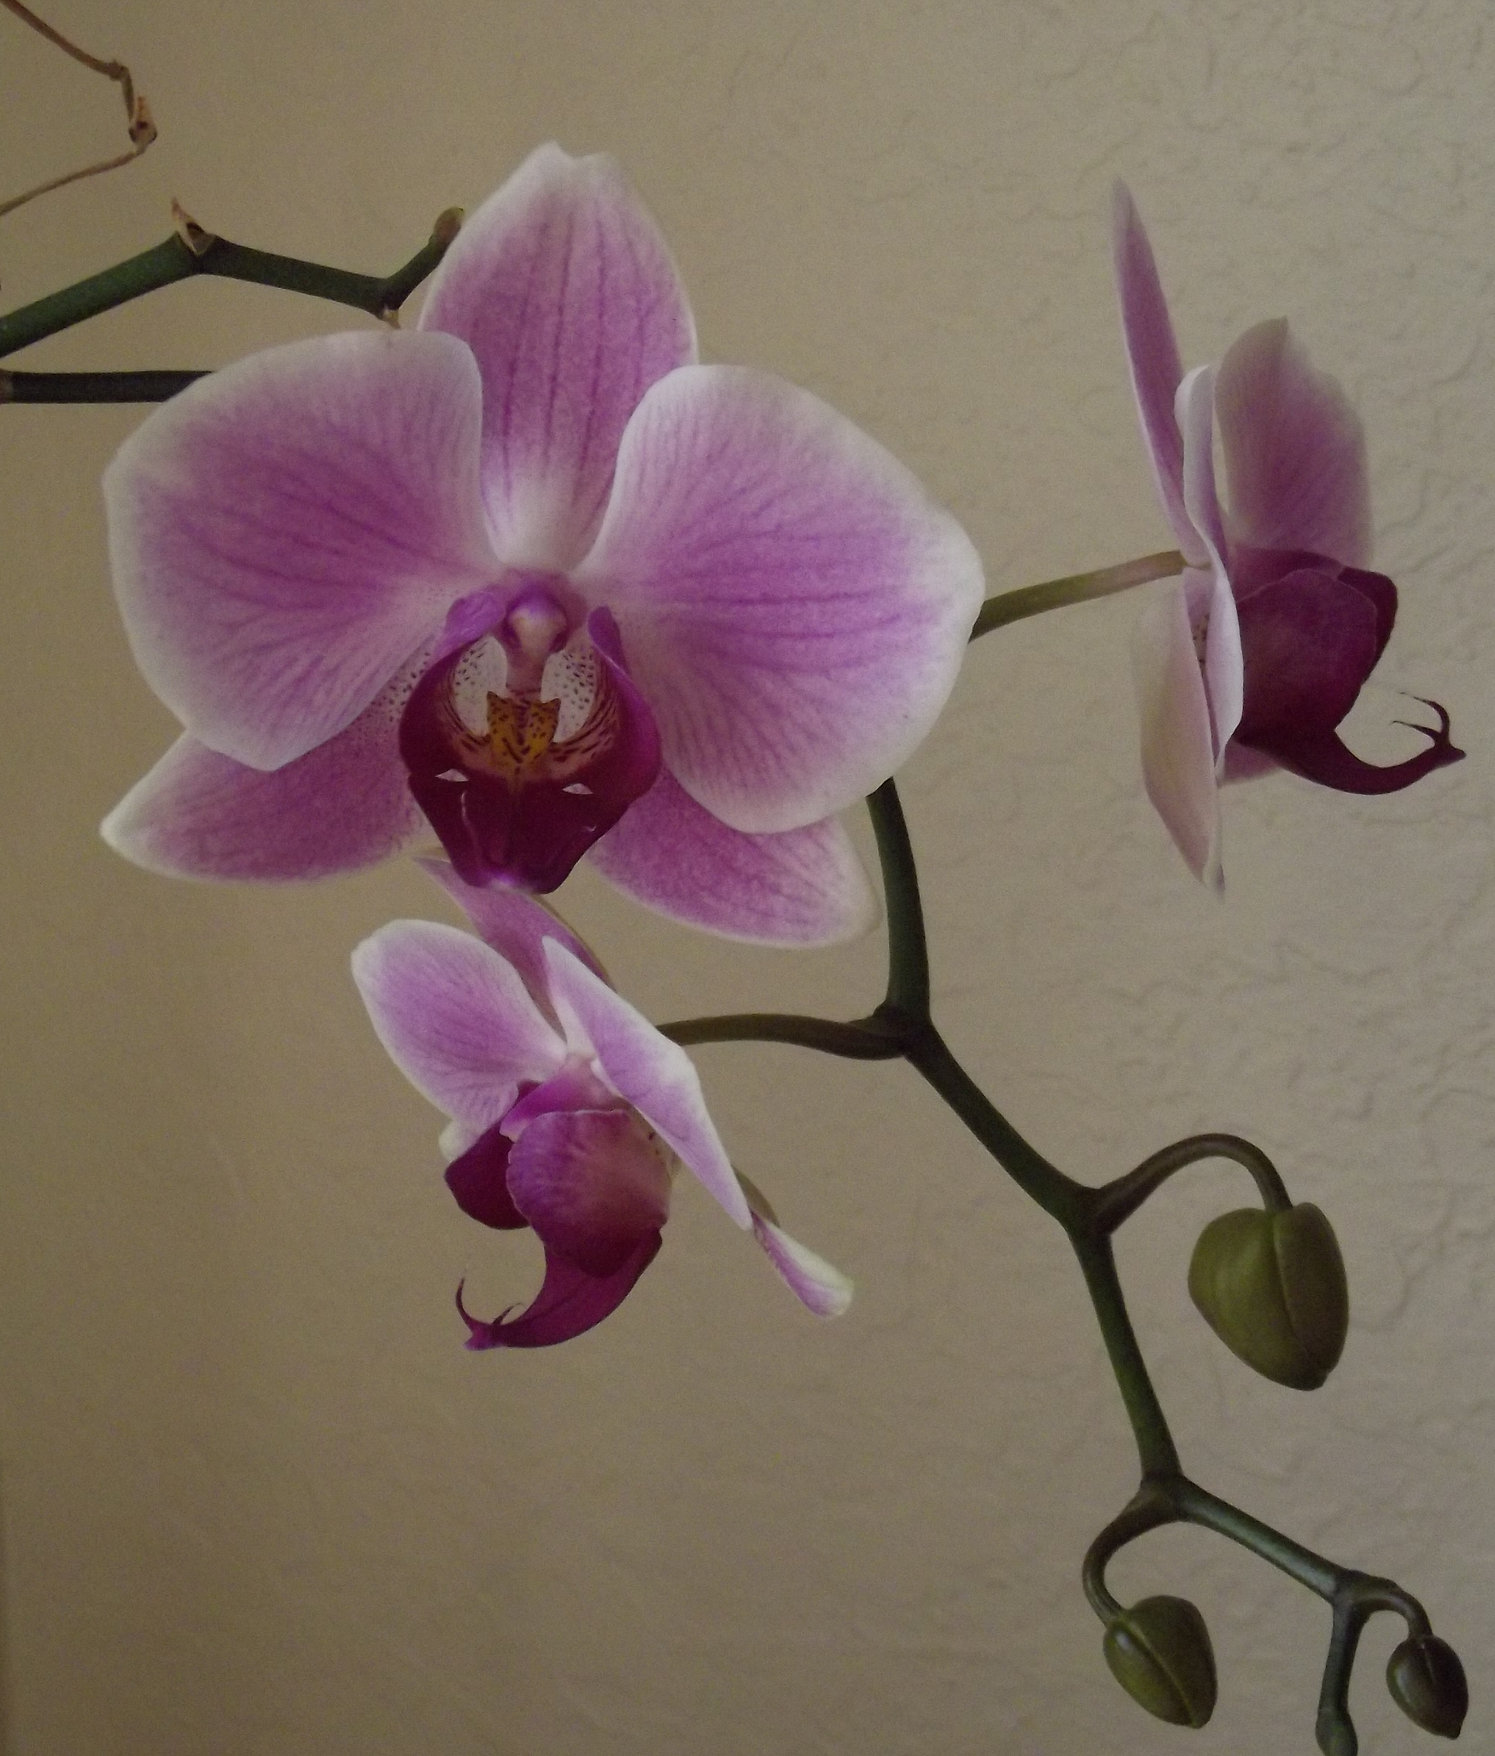
I-Share Alma Primo VE Office hours
Questions?
Join us August 12 and
August 26, 2021
at 2pm for another
Office Hour.
Contact CARLI at
support@carli.Illinois.edu
Notes:
The rest of our time together will be focused on your Questions so please feel free to enter them in the chat!

