Slide 1


CARLI/I-SHARE OFFICE HOURS PRIMO VE AND CDI:
IMPROVE DISCOVERABILITY AND PROMOTE EFFICIENT AND EFFECTIVE SEARCHING JUNE 24, 2021

Slide 2
Agenda – 6/24/2021
AGENDA OFFICE HOURS
Announcements
Reminders and upcoming Alma/Primo VE events and learning opportunities
See https://www.carli.illinois.edu/calendar for CARLI events
Today's Agenda: Improve Discoverability and Searching
Primo VE Configurations for Ranking and Boosting, Blended Search Profiles, Dedup and FRBR
E-Collection settings that affect results from CDI and how you
might edit them
Testing changes in discovery

Slide 3
Announcements/Reminders
ANNOUNCEMENTS
Share Annual Statistics Package
CARLI staff are continuing work on the new I-Share Annual Statistics Package. We are prepared to run many of the stats on July 1 for all I-Share libraries. Watch for an announcement next week on the availability of the stats package and the ability to run data locally.
New page on CARLI website!
General Alma Troubleshooting and Problem Reporting: https://www.carli.illinois.edu/products-services/i-share/alma-troubleshooting
Includes general troubleshooting tips for Alma and Primo VE and best practices for reporting problems to CARLI.
Upcoming Office Hours
July 8, July 22, August 12, August 26 (always at 2:00pm)

Slide 4
More Announcements/Reminders
ANNOUNCEMENTS
Share Resource Sharing Code revised
Eliminates Voyager-specific language
Removes text specific to no-longer-supported ILLINET direct borrowing
Specifies that the patron’s library is responsible for covering costs of any direct shipping of materials directly to patrons
Clarifies that I-Share libraries with collections outside Illinois are not required to make those available via I-Share requests
Requires I-Share libraries to post their building access policies and hours on their websites
Reminds I-Share libraries to keep their patron data as current as possible
See full code at: https://www.carli.illinois.edu/products-services/i-share/circ/I-ShareResourceSharingCode
Share lost material processes and billing begin July 1
Remember: I-Share libraries no longer charge overdue fines or lost material processing fees

Slide 5
Let's Talk about Fulfillment
UPCOMING ALMA AND PRIMO VE EVENTS- ONGOING SERIES
(I mean Alma, not life's purpose)
For the opportunity to talk with CARLI staff and your CARLI library colleagues about Alma Fulfillment and Automated Fulfillment Network workflows, known issues, and Q & A.
Friday 7/2 at 2:00pm – https://www.carli.illinois.edu/lets-talk-about-fulfillment20210702
Tuesday 7/13 at 10:30am – https://www.carli.illinois.edu/lets-talk-about-fulfillment20210713
Notes are posted on the CARLI calendar event for past sessions.

Slide 6
Ex Libris Knowledge Days Online
UPCOMING ALMA AND PRIMO VE EVENTS
Registration is free
Choose the “Register” link in the “EMEA/NA” column. NA stands for North America.
https://knowledge.exlibrisgroup.com/Cross-Product/Conferences_and_Seminars/Knowledge_Days_-
_ELUNA/2021_Knowledge_Days
Final two sessions next week!
Tuesday, June 29 - Managing E-Resources Advanced
Thursday, July 1 - Fundamentals of Sets and Jobs

Slide 7
CARLI Discussion Sessions after the
UPCOMING ALMA AND PRIMO VE EVENTS
Ex Libris Knowledge Days Online Webinars
Fifteen minutes after each of the Ex Libris Knowledge Days Webinars, CARLI will host a Zoom meeting for I-Share institutions to discuss the webinar.
See the CARLI Calendar for Zoom links to the CARLI Discussion sessions https://www.carli.illinois.edu/calendar or the CARLI Knowledge Days webpage https://www.carli.illinois.edu/products-services/i-share/alma/exl-knowledge-days-2021 - No Registration necessary

Slide 8
Primo VE Configuration Options
PRIMO VE CONFIGURATION OPTIONS

Slide 9
Ranking Configuration
PRIMO VE - RANKING CONFIGURATION
Allows you to configure aspects of the results ranking algorithm to affect the order of local records in all search results
Alma Configuration > Discovery > Search Configuration > Ranking Configuration
Options include:
Field Boosting – not recommended to alter unless specific local need
Date Boosting – may choose to boost more recent materials
Resource Type Boosting – may choose to boost some types
Institution Boosting – boost your institution’s records in search results that include the entire network
https://www.carli.illinois.edu/products-services/i-share/discovery-interface/ranking_configuration

Slide 10
Boosting Records in Blended Search Profiles
PRIMO VE - BOOSTING RECORDS IN BLENDED SEARCH PROFILES
Alma Configuration > Discovery > Search Configuration > Search Profiles > Search Profiles tab
If the "Search Type" is listed as Blended, you may boost or deboost results from one source over another.
The most common scenarios for a Blended search are Search Profiles that include:
Local data and Central Index (CDI)
Local data, NZ (network) data, and Central Index (CDI)
The default Search Profile “MyInst_and_CI” used by many libraries already boosts Local data over the Central Index data, but you may wish to boost it further.
https://www.carli.illinois.edu/products-services/i-share/discovery-interface/blended_search_profiles

Slide 11
Dedup and FRBR Options
PRIMO VE – DEDUP AND FRBR
By default, Primo VE performs deduplication and FRBR-ization and groups records together when displaying search results.
Records that have been deduplicated and grouped will not be obvious in search results.
Can use “Dedup and FRBR Test Utility” to reveal them
Records in a FRBR group will appear with the indication “N versions found. See all versions >” as a single entry in the initial search results.
Alma Configuration > Discovery > Display Configuration > Configure Views > Edit the View* > Brief Results tab
*Settings are per View, so you can use a Test View for testing changes.

Slide 12
Dedup and FRBR Recommendations
PRIMO VE – DEDUP AND FRBR
CARLI Recommendations
Sort FRBR Version list by: Date – newest
Define FRBR display for local records: Generic
Enable FRBR checked
Enable Dedup checked
https://www.carli.illinois.edu/products-services/i-share/discovery-interface/dedup_frbr

Slide 13
Best Practices for Testing Configuration Changes
PRIMO VE – BEST PRACTICES FOR TESTING CONFIGURATION CHANGES
Before you start:
Identify several example Primo VE searches to serve as your baseline. Document the behavior of the example searches by copying search URLs, taking screenshots, or recording video.
Reach out at your institution to other stakeholders.
When testing:
Test one small change at a time.
After you make a change, use a new Private browser window to perform the search again in order to avoid caching.
Document what you change as you go, noting the effects on examples.
Consider small group testing with other stakeholders at your institution.
Once you’ve decided to implement a change in production:
Document the change, the date, and the rationale for the change.
Share information on the change(s) with other stakeholders.

Slide 14
PRIMO VE AND CDI: IMPROVE DISCOVERABILITY AND SEARCHING
CDI Settings in Electronic Collections in your Institution Zone

Slide 15
Central Discovery Index: CDI
PRIMO VE AND CDI: IMPROVE DISCOVERABILITY AND SEARCHING
What is CDI?
CDI Settings for e-collections:
What are they?
Why change them?
What search behavior is changed?
New and revised documentation from Ex Libris

Slide 16
What is Primo VE CDI?
PRIMO VE AND CDI: IMPROVE DISCOVERABILITY AND SEARCHING
Central Discovery Index (CDI): a database of citations collected from e-resources including journal articles, e-books, legal documents and more.
Used in Primo VE “Everything” and “Articles” type search slots. Note: A Discovery or indexing feature (not Delivery/Get Full Text per se.)

Slide 17
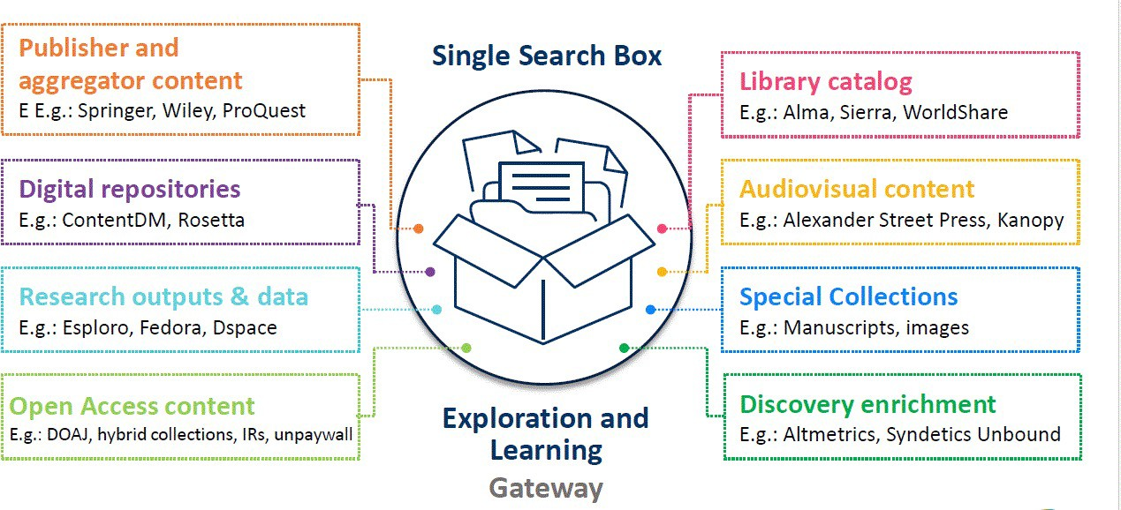



Sources of CDI Citations: From Ex Libris Alma harvesting, From your IZ and the NZ
PRIMO VE AND CDI: IMPROVE DISCOVERABILITY AND SEARCHING
Your Institution Zone & Network Zone

Slide 18
CDI Settings for Institution Zone e-collections: What are they?
PRIMO VE AND CDI: IMPROVE DISCOVERABILITY AND SEARCHING
1. Activation options - Alma e-collection activation
- yes or no
Only Some Titles active? Selective – yes or no
Suppress sending citations to CDI setting
Only send citations to CDI option (no full text)

Slide 19
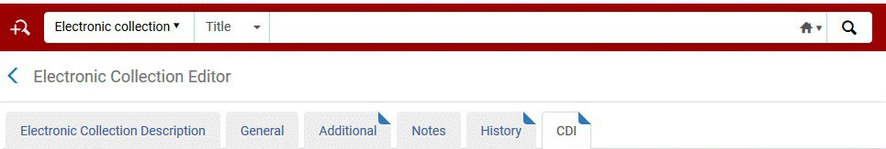


1. I-Share is Alma “Easy Active” activation
PRIMO VE AND CDI: IMPROVE DISCOVERABILITY AND SEARCHING
If active, e-collection sends to CDI with some exceptions: EBSCOhost & a few other vendors.
These settings are in the CDI search activation tab.

Slide 20
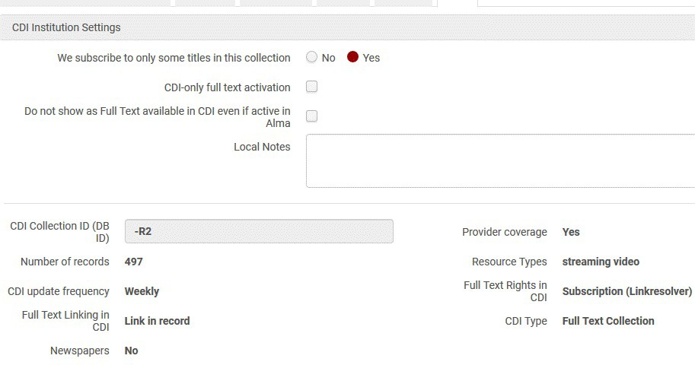






CDI search activation tab – Link in record e-collection
PRIMO VE AND CDI: IMPROVE DISCOVERABILITY AND SEARCHING

Slide 21
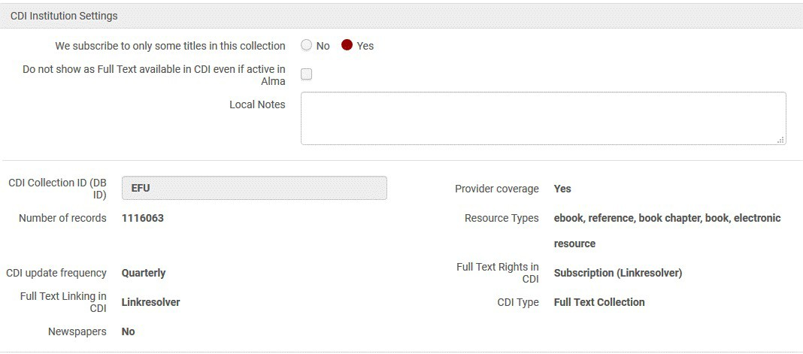






CDI search activation tab – Linkresolver e-collection
PRIMO VE AND CDI: IMPROVE DISCOVERABILITY AND SEARCHING

Slide 22
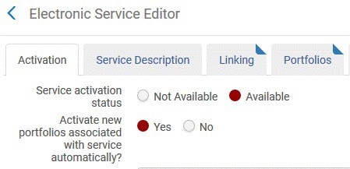


2. CDI Only Some Titles active? (Selective setting)
PRIMO VE AND CDI: IMPROVE DISCOVERABILITY AND SEARCHING
Recommend set to “Yes” = selective for all package e-collections even aggregators/100%ers
Why change? To improve delivery of Full text.
NOT the setting "Activate new portfolios associated with service automatically?":

Slide 23
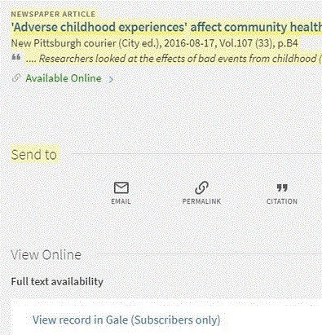




CDI Only Some Titles active: “Yes” = selective even if an aggregator. What search behavior is changed?
Here is an example where it was set to “No”:
PRIMO VE AND CDI: IMPROVE DISCOVERABILITY AND SEARCHING
The “View Online” link on full display to a Gale collection didn’t connect. That title wasn’t in the e-collection yet. If it had been set at selective= yes, less chance of this happening.

Slide 24
3. CDI Suppress sending citations to CDI setting-“Do not show as Full Text Available in CDI even if active in Alma.”
PRIMO VE AND CDI: IMPROVE DISCOVERABILITY AND SEARCHING
Why change?
To declutter search results by reducing very similar citations going into CDI.
Less exact duplicates in search results.
Must rely on CDI citation sources you can’t turn off.

Slide 25
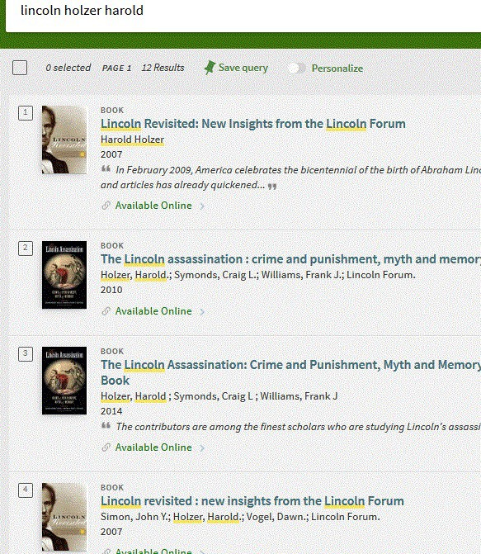
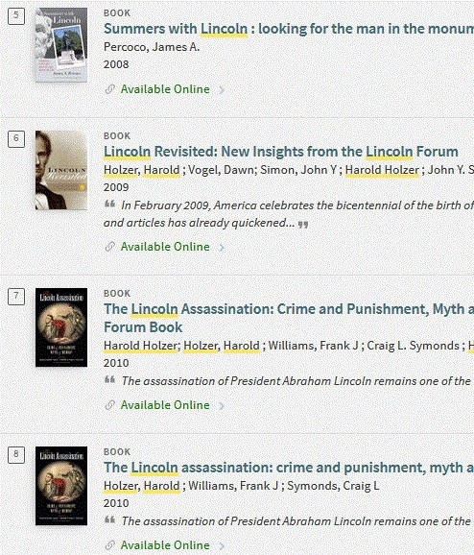
Duplicates in brief results
PRIMO VE AND CDI: IMPROVE DISCOVERABILITY AND SEARCHING

Slide 26
4. “CDI Only Full Text activation”
PRIMO VE AND CDI: IMPROVE DISCOVERABILITY AND SEARCHING
Means send citations to CDI only. Don’t use portfolios in ranking results.
Have to use for database e-collections.
Why change if a full text package or
aggregator? Library doesn’t get the full text but want to use the indexing/citations.
What search behavior is changed? (after the overnight CDI jobs)
Get more citations and better-quality ones (potentially) but more chance of no full text to link to and more ILL requests.

Slide 27
Ex Libris new and revised documentation on CDI
PRIMO VE AND CDI: IMPROVE DISCOVERABILITY AND SEARCHING
Note: All I-Share Libraries are Easy Active for CDI and always have been. Ignore any text only about “Fully Flexible” options.
See “Documentation and Training” (English) section in
https://knowledge.exlibrisgroup.com/Primo/Content_Corner/Central_Discovery_Index
Chart on settings recommendations with examples:
https://knowledge.exlibrisgroup.com/Primo/Content_Corner/Central_Discovery_Index/ Documentation_and_Training/Documentation_and_Training_(English)/CDI_-
_The_Central_Discovery_Index/045CDI_Collections_Types_and_how_to_activate_th
em_for_discovery
Recorded Webinars: especially Feb. 16 on “Settings”:
https://knowledge.exlibrisgroup.com/Primo/Content_Corner/Central_Discovery_Index/Document ation_and_Training/Documentation_and_Training_(English)/Recorded_Webinars_and_Training

Slide 28
Ex Libris new and revised documentation on CDI
PRIMO VE AND CDI: IMPROVE DISCOVERABILITY AND SEARCHING
CDI Tips and Tricks: https://knowledge.exlibrisgroup.com/Primo/Content_Corner/Cen tral_Discovery_Index/Documentation_and_Training/Documentat ion_and_Training_(English)/CDI_-
_The_Central_Discovery_Index/090CDI_Tips_and_Tricks
CDI Collections List: https://knowledge.exlibrisgroup.com/Alma/Product_Documentati on/010Alma_Online_Help_(English)/Electronic_Resource_Mana gement/060_Alma_Single_Activation_Source_for_CDI/050CDI_ Collection_Lists_for_Alma_Customers

Slide 29
CARLI CDI Testing Example Recording sheet
PRIMO VE AND CDI: IMPROVE DISCOVERABILITY AND SEARCHING
To Edit CDI settings, need roles:
CDI Inventory Operator
Electronic Inventory Operator
Be Consistent: Use the same web browser, internet service provider, and also use private or incognito windows to minimize effects of caching data.
Timing: Changes to CDI settings take 48 to 72 hours to be reflected in Primo VE.
Example Tracking Sheet:
https://www.carli.illinois.edu/sites/files/files/CDI%20changes%20checklist.docx

Slide 30
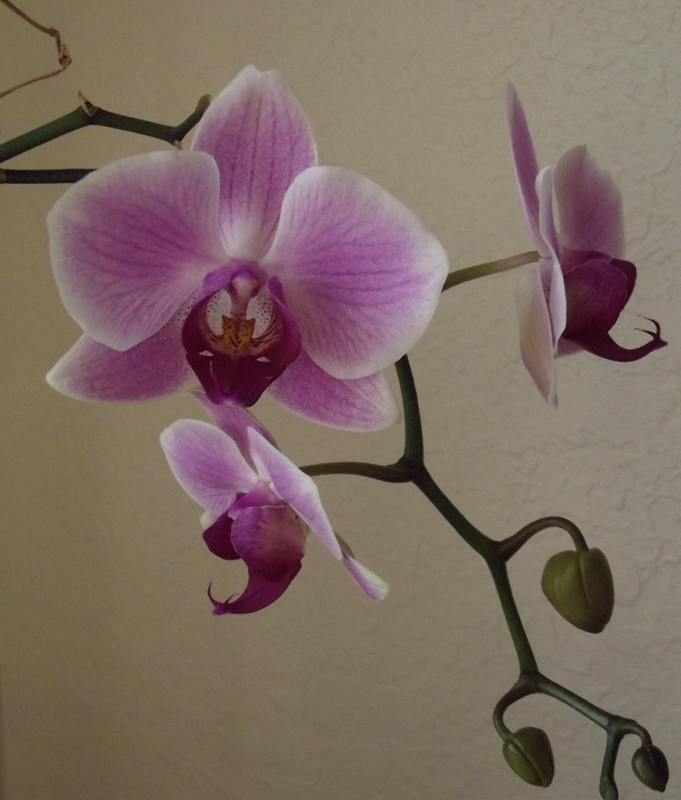
Questions?
I-SHARE ALMA PRIMO VE OFFICE HOURS
Join us July 8 and July 22, 2021
at 2pm for another
Office Hour.
Contact CARLI at support@carli.Illinois.edu

