Slide 1
I-Share Alma Primo VE Office hours will start shortly
Welcome!
Office Hours will start at 2pm and run until 3pm.
Please mute your microphone.
As time permits, we will respond to questions typed in the chat box, and offline afterwards, as needed.
This session will be recorded and made available on the CARLI website both as PDF slides and as a recording, with live links to all referenced resources.

Slide 2
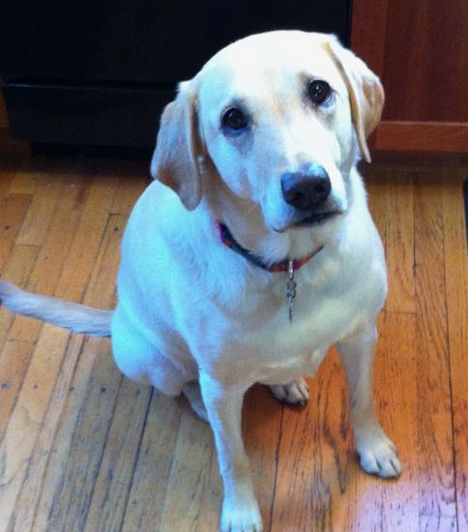
CARLI/I-Share Office Hours
“lab Reports”
May 13, 2021

Slide 3
Office Hours Agenda
Agenda – 5/13/2021
Announcements
Reminders and upcoming Alma/Primo VE events and learning opportunities. See also https://www.carli.illinois.edu/calendar for CARLI events.
“Lab Reports” presentations by I-Share library staff
Notes:
Our agenda today includes going over upcoming events related to Alma and Primo VE, and then our very first “Lab Reports” sessions by your I-Share colleagues!

Slide 4
Announcements
Announcements/Reminders
Alma/Primo VE Downtime while Ex Libris moves the data center: Saturday, May 29 at 8pm Central to Sunday, May 30 at 8pm Central
FAQ: https://knowledge.exlibrisgroup.com/Cross-Product/Knowledge_Articles/Data_Center_Migration_(Moses_Lake_Data_Center%2C_DC_01)_FAQ
  Recording available of the Ex Libris Webinar on April 26 about the Data Center Move and Downtime
  Data Center Migration Recommendations: https://knowledge.exlibrisgroup.com/Cross-Product/Knowledge_Articles/Planning_for_Ex_Libris_Data_Center_migration_or_other_scheduled_downtime
Notes:
As previously announced and shared on the CARLI Calendar, Alma and Primo VE will be down from 8pm on Saturday, May 29 until 8pm on Sunday, May 30 while Ex Libris moves the Moses Lake data center (NA06). More information is shared on this Ex Libris FAQ, and a recording of the April 26th Ex Libris webinar is available if you missed it. Ex Libris has shared some ideas on how to manage the upcoming downtime on their page Data Center Migration Recommendations which we’ve also linked here.
Hopefully the impact on patrons and staff will be minimal as this is Memorial Day weekend.

Slide 5
Upcoming Alma and Primo VE Events
ELUNA – Ex Libris User Group of North America Conference Online
Registration is free and still open for upcoming General Sessions, such as:
  Discovery, CDI, & Summon May 18, 2021, noon – 3:00 pm
  Library Experience, Alma, & Content May 19, 2021, noon – 3:00 pm
  Ex Libris Vision, Primo and ELUNA Closing Session May 27, 2021, noon – 3:00 pm
Recordings available of all sessions at
https://el-una.org/meetings/eluna-2021-annual-meeting-online/
Notes:
The ELUNA Conference is going on Online during May. Registration is free and still open for the upcoming general sessions, such as those listed here, and Recordings of all sessions are also free to view and available on the ELUNA website at the link shown here.
These Annual Meeting sessions contain updates from the ELUNA Steering Committee, ELUNA Working Groups, and Ex Libris Management.

Slide 6
Upcoming Alma and Primo VE Events- Ongoing Series
Let's Talk about Fulfillment
(I mean Alma, not life's purpose)
For the opportunity to talk with CARLI staff and your CARLI library colleagues about Alma Fulfillment and Automated Fulfillment Network workflows, known issues, and Q & A.
Tuesday 5/18 @ 10:30am - https://www.carli.illinois.edu/lets-talk-about-fulfillment20210518
Watch for more sessions to be scheduled in June and July.
Notes are posted on the CARLI calendar event for past sessions.
Notes:
If you'd like to talk with CARLI staff and your I-Share library colleagues about Alma Fulfillment and Automated Fulfillment Network workflows, known issues, and Q & A, join us online for the “Let’s talk about Fulfillment (I mean Alma, not life’s purpose).”
CARLI Office Staff will be online for each session to work with your questions and to facilitate the discussion.
Attendees can unmute their microphones and/or utilize the chat and screensharing for participation.
Sessions will be recorded for CARLI staff use; since Fulfillment involves patron data, the CARLI office will evaluate if it is fitting and valuable to post segments of the session for later review.
The next session is May 18 at 10:30am but watch for more sessions to be scheduled soon for June and July!
Registration for these sessions is available from the event page in the CARLI Calendar, and notes of past sessions are posted on the events pages as well.

Slide 7
Upcoming Alma and Primo VE Events- Ongoing series
Technical Services Q & A
Gather with CARLI staff and your technical services colleagues to discuss Alma technical services topics, from acquisitions and cataloging workflows for physical resources to electronic resources management:
Wednesday 5/26 @ 10:00am https://www.carli.illinois.edu/tech-services-qa-2021-05-26
Watch for more sessions to be scheduled in July.
Recordings of past sessions are posted on the “Physical Resource Management - Cataloging and Acquisitions” page:
https://www.carli.illinois.edu/products-services/i-share/physical-res-man
Notes:
At our Technical Services Q & A sessions, you can gather with CARLI staff and your technical services colleagues to discuss Alma technical services topics, from acquisitions and cataloging workflows for physical resources to electronic resources management.
Each session will include how-to presentations, discussion of consortial practices, and opportunities for questions and answers from CARLI and colleagues alike. Please register for any sessions you’d like to attend using the link from the CARLI event calendar.
Sessions are typically held the second and fourth Wednesdays of each month. Sessions will be recorded for later viewing. The next session is Wednesday, May 26 and more sessions will be scheduled in July because...

Slide 8
Upcoming Alma and Primo VE Events
Ex Libris Knowledge Days Online
Registration is free!
Choose the “Register” link in the “EMEA/NA” column. NA stands for North America.
https://knowledge.exlibrisgroup.com/Cross-Product/Conferences_and_Seminars/Knowledge_Days_-_ELUNA/2021_Knowledge_Days
  June 1 - Handling Related Records
  June 3 - Alma Analytics for Beginners
  June 8 - Managing E-Resources Basics
  June 10 - Central Discovery Index
  June 15 - Managing COUNTER-Compliant Usage Data
  June 17 - Optimize and Streamline Alma Workflows
  June 22 - Overlap Analysis and Deselection Tools with Alma Analytics
  June 24 - Designing and Using Normalization Rules
  June 29 - Managing E-Resources Advanced
  July 1 - Fundamentals of Sets and Jobs
Notes:
The Ex Libris Knowledge Delivery team will be offering a special bi-weekly, FREE webinar series covering the 10 most requested Knowledge Days sessions on a variety of topics, running from June 1st to July 1st. Knowledge Days are the training complement to the ELUNA Annual Conference, and they will be recorded for later viewing.
On the Ex Libris Registration page, click the “Register” link in the “EMEA/NA” column (because NA stands for North America), or click the handy link Register for multiple sessions simultaneously at the Best of Knowledge Days registration dashboard. to sign up for the Ex Libris Knowledge Days sessions.

Slide 9
Upcoming Alma and Primo VE Events
CARLI Discussion Sessions after the
Ex Libris Knowledge Days Online Webinars
Fifteen minutes after each of the Ex Libris Knowledge Days Webinars, CARLI will host a Zoom meeting for I-Share institutions to discuss the webinar.
Conducted like Discussion Sessions we had after the ExL “Primo VE Become an Expert” series, and the ExL “Authorities in Alma” series.
See the CARLI Calendar for Zoom links to the CARLI Discussion sessions https://www.carli.illinois.edu/calendar or the CARLI Knowledge Days webpage https://www.carli.illinois.edu/products-services/i-share/alma/exl-knowledge-days-2021 - NO REGISTRATION NECESSARY
Notes:
Fifteen minutes after each Ex Libris Knowledge Days session, CARLI staff will host an informal follow-up discussion via Zoom for I-Share library staff share what they learned and discuss how that information may be applied in the I-Share consortial environment. There will be no formal presentation, and attendees may participate via voice and chat. The CARLI discussion sessions will be recorded and posted later with notes.
These will be conducted like the Discussions sessions CARLI held after the Ex Libris Primo VE Become an Expert webinars, and the Ex Libris Authorities in Alma webinars. Attendees of those previous Discussions Sessions said they were very helpful; we heard your feedback and are continuing these sessions!
See the CARLI Events Calendar or the new CARLI Knowledge Days 2021 webpage for links to these CARLI Discussion sessions.

Slide 10
Reminder
Reminders about Lost Processes in Alma
I-Share Liaisons and Directors were reminded by email on May 3rd to sign up for a Lost Processes Review meeting with CARLI staff if your institution hasn’t already.
  This meeting is required before Lost Processes can be enabled in Alma.
All I-Share institutions must enable the lost processes in Alma on or before July 1 for local patrons.
All I-Share institutions must enable the lost processes and automatic blocks for overdue items in Alma on July 1 for I-Share patrons.
Contact support@carli.illinois.edu with any questions
Notes:
This is just a brief reminder about upcoming changes to Lost Processes in Alma for I-Share institutions.
All I-Share institutions must enable lost processes on or before July 1 for LOCAL patrons, and lost processes and automatic blocks for overdue items on July 1 for I-SHARE patrons.
Liaisons and Directors were reminded by email on May 3 by Debbie Campbell to sign up for a Lost Processes Review meeting, which is required before Lost Processes can be enabled in Alma. If you have any questions, contact support@carli.Illinois.edu
And this ends our list of Announcements and Reminders!

Slide 11
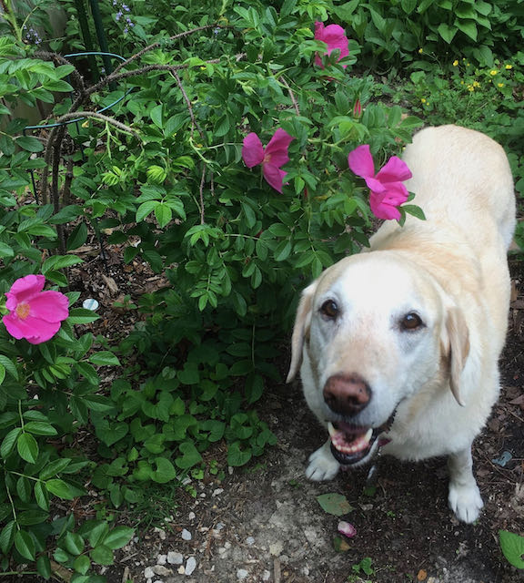
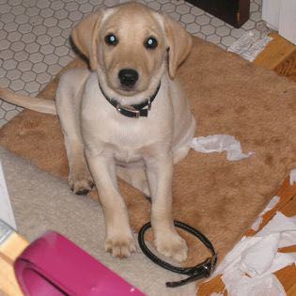
Lab Reports
Lab Reports
  Andrea Imre (SIC)
  Adding a top banner to Primo VE for downtime
  Alice Creason (LEW)
  Creating a General Electronic Services (GES) link to search Google Scholar
  David Stern (SXU)
  Local Extension subject headings provide non-traditional subject facets and virtual collection browsing
Notes:
Next, we have three presentations today for our first ever “Lab Reports” Office Hours by I-Share library staff!
To begin, Andrea Imre from Southern Illinois University Carbondale will show how to add a top banner to Primo VE for the upcoming downtime or other important notifications.
After that, Alice Creason from Lewis University will describe how to create a General Electronic Services link to search Google Scholar.
And finally, David Stern from Saint Xavier University will describe a project they have undertaken to add Local Extension subject headings in order to provide non-traditional subject facets and virtual collection browsing.

Slide 12
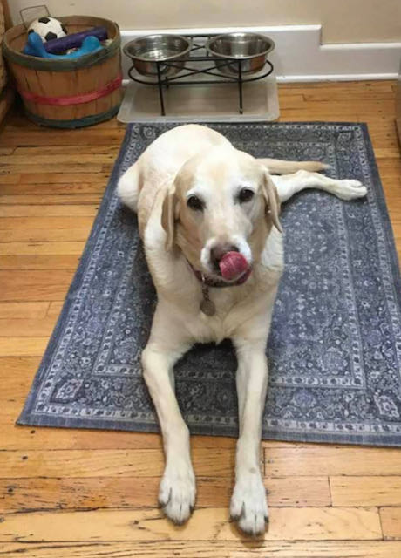
I-Share Alma Primo VE Office hours
Join us June 10, 2021 at
2pm for another Office
Hour.
Contact CARLI at
support@carli.Illinois.edu

