Slide 1
I-Share Alma Primo VE Office hours will start shortly
Welcome!
Office Hours will start at 2pm and run until 3pm.
Please mute your microphone.
As time permits, we will respond to questions typed in the chat box, and offline afterwards, as needed.
This session will be recorded and made available on the CARLI website both as PDF slides and as a recording, with live links to all referenced resources.

Slide 2
CARLI/I-Share Office Hours
Open Q&A
April 22, 2021

Slide 3
Agenda Office Hours
Agenda – 4/22/2021
Announcements
Reminders and upcoming Alma/Primo VE events and learning opportunities
See https://www.carli.illinois.edu/calendar for CARLI events
Participant Q & A
Notes:
Upcoming events for Alma/Primo VE, a reminder to always check the CARLI calendar for CARLI events.
A few reminders and then open Q&A

Slide 4
Announcements
Announcements/Reminders
Alma/Primo Downtime May 29-30
  Ex Libris moving the data center
    More information FAQ: https://knowledge.exlibrisgroup.com/Cross-Product/Knowledge_Articles/Data_Center_Migration_(Moses_Lake_Data_Center%2C_DC_01)_FAQ
  Ex Libris Hosting Webinar April 26 about the Data Center Move and Downtime. Register Link
  Data Center Migration Recommendations: https://knowledge.exlibrisgroup.com/Cross-Product/Knowledge_Articles/Planning_for_Ex_Libris_Data_Center_migration_or_other_scheduled_downtime
Notes:
As previously announced and shared on the CARLI Calendar Alma and Primo VE will be down May 29-30 while Ex Libris moves the Moses Lake data center (NA06). More information is shared on this FAQ, and Ex Libris will be hosting a webinar on May 26. The link to register for this webinar is also shared here and in chat. Kris Hammerstrand shared information about this downtime on April 13, to the I-Share announce list as well as I-Share directors and I-share Liaisons. Ex Libris has shared some ideas on how to manage the upcoming downtime on their page Data Center Migration Recommendations which We’ve also linked here.
Hopefully the impact on patrons and staff will be minimal as this is Memorial day weekend.

Slide 5
Announcements
Announcements/Reminders
User Loan Counts at Other I-Share Libraries report
  New report shared in your xxxftp directory on files.carli.Illinois.edu
  Report lists which of your users have loans at other I-Share libraries.
    Report contains the user’s name, primary ID, Institution they have loans at, number of loans at that Institution, and user’s expiration and purge date.
  New copy each day at Noon, containing data from 6pm the previous day.
  Useful for tracking soon to graduate patrons, as well as patrons that have expired for other reasons.
Notes:
'User loan counts at other i-share libraries XXX.xlsx'
There is a new report available in your ftp directory on the files server (files.carli.illinois.edu) called 'User loan counts at other i-share libraries XXX.xlsx' where XXX is your three letter code. The report lists which of your users have loans at other I-Share libraries. The report lists the users name, primary ID, Institution they have loans at, the number of loans at that institution, and the users Expiration and Purge dates.
The report is run daily. At the moment the new copy will be there by noon each day. I hope to soon have the report automated so it will be there by 7am. The report is based on Analytics data so it is as of 6pm the previous day. The first line in the report lists the date of the data.

Slide 6
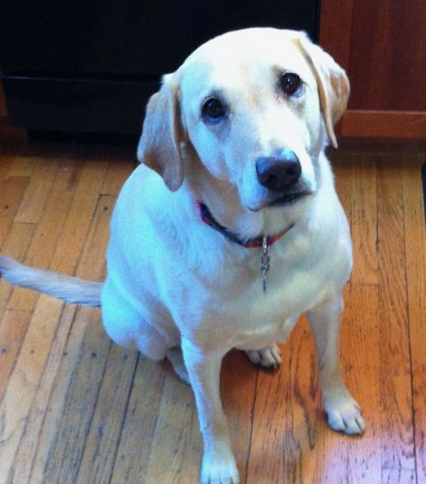
Upcoming Office Hours
Upcoming Office Hours
May 13, 2021 “Lab Reports”
We want to hear from you!
Short 3-5 minute reports on a problem & solution in Alma or Primo VE.
Submit your topic ideas by May 12 to support@carli.illinois.edu
Notes:
On May 13 we are planning to mix things up a bit with our Open Office hours and we’ll be having “Lab Reports” – an opportunity for libraries to present in an informal lightening round fashion a tip you’ve found helpful at your institution in Alma and / or Primo VE.
Please submit your topic ideas by May 12 to support@carli so we have an idea of who would like to present.

Slide 7
Upcoming Alma and Primo VE Events- Ongoing series
Technical Services Q & A
Gather with CARLI staff and your technical services colleagues to discuss Alma technical services topics, from acquisitions and cataloging workflows for physical resources to electronic resources management:
Wednesday 4/28 @ 10- https://www.carli.illinois.edu/tech-services-qa-2021-04-28
Wednesday 5/12 @ 10- https://www.carli.illinois.edu/tech-services-qa-2021-05-12
Wednesday 5/26 @ 10- https://www.carli.illinois.edu/tech-services-qa-2021-05-26
Recordings are posted on the “Physical Resource Management - Cataloging and Acquisitions” page:
https://www.carli.illinois.edu/products-services/i-share/physical-res-man
Notes:
Looking at ongoing events-- with the Technical Services Q & A sessions, you can gather with CARLI staff and your technical services colleagues to discuss Alma technical services topics, from acquisitions and cataloging workflows for physical resources to electronic resources management.
Each session will include how-to presentations, discussion of consortial practices, and opportunities for questions and answers from CARLI and colleagues alike.
Sessions will be held the second and fourth Wednesdays of each month. Sessions will be recorded for later viewing.
Please register for any sessions you’d like to attend using the link from the CARLI event calendar.

Slide 8
Upcoming Alma and Primo VE Events- Ongoing Series
Let's Talk about Fulfillment (I mean Alma, not life's purpose)
For the opportunity to talk with CARLI staff and your CARLI library colleagues about Alma Fulfillment and Automated Fulfillment Network workflows, known issues, and Q & A:
Friday 5/07 @ 2- https://www.carli.illinois.edu/lets-talk-about-fulfillment20210507
Tuesday 5/18 @ 10:30- https://www.carli.illinois.edu/lets-talk-about-fulfillment20210518
Notes are posted in the calendar event for past sessions.
Notes:
If you'd like to talk with CARLI staff and your CARLI library colleagues about Alma Fulfillment and Automated Fulfillment Network workflows, known issues, and Q & A, join us online for the spring sessions of “Let’s talk about Fulfillment (I mean Alma, not life’s purpose).”
These sessions are scheduled for every other week, alternating between Tuesdays at 10:30am and Fridays at 2:00pm.
CARLI Office Staff will be online for each session to work with your questions and to facilitate the discussion.
Attendees will be able to unmute their microphones and/or utilize the chat for participation. We'll take turns sharing screens as appropriate.
This session will be recorded for CARLI staff use; since Fulfillment involves patron data, the CARLI office will evaluate if it is fitting and valuable to post segments of the session for later review.
Registration for these sessions is also available from the event page in the CARLI Calendar.

Slide 9
Upcoming Alma and Primo VE Events
ELUNA – Ex Libris User Group of North America Conference Online
Registration is Open for General Sessions
  https://el-una.org/meetings/eluna-2021-annual-meeting-online/
Notes:
The ELUNA Steering Committee and Ex Libris have made the decision to proactively move the 2021 in-person annual events scheduled for May in Atlanta, Georgia to virtual meetings due to continued COVID-19 safety concerns and ongoing travel restrictions.
The Ex Libris Knowledge Delivery team will offer a special bi-weekly webinar series covering the most requested Knowledge Days sessions. The Knowledge Days trainings will be available to all customers via live webinars scheduled in Spring 2021 at no cost.
Register for the no fee online series of Annual Meeting sessions with updates from the ELUNA Steering Committee, ELUNA Working Groups, and Ex Libris Management.

Slide 10
CARLI Known Issues Page
CARLI’s Alma and Primo VE Known Issues Page
Located under Products & Services> I-Share Documentation> Alma and Primo VE Known Issues
https://www.carli.illinois.edu/products-services/i-share/alma-primo-ve-known-issues

Slide 11
Ex Libris Idea Exchange
  Ex Libris Idea Exchange
  https://ideas.exlibrisgroup.com/
The Ex Libris Idea Exchange allows library staff at institutions using Ex Libris products to:
  Share ideas for enhancement/development.
  Vote to support your favorite user-submitted ideas.
  Add comments to provide weight and additional use cases to your favorite user-submitted ideas.
  Any and all library staff members at your institution can have their own individual account.
  Please read the FAQ and Guidelines before you begin.
  The CARLI Office, and your CARLI Library Colleagues, may periodically send announcements for ideas they’d like you to consider supporting.
Notes:
A reminder we keep mentioning about the Ex Libris Idea Exchange.
The Idea Exchange allows library staff at institutions using Ex libris products to share ideas for enhancement and development, vote to support your favorite user submitted ideas, and add comments to provide weight and additional use cases to your favorite user submitted ideas.
Any and all library staff members at your institution can have their own individual account. Please read the linked FAQ and Guidelines before you begin.
CARLI office and your CARLI library colleagues may periodically send announcements for ideas they’d like you to consider supporting.

Slide 12
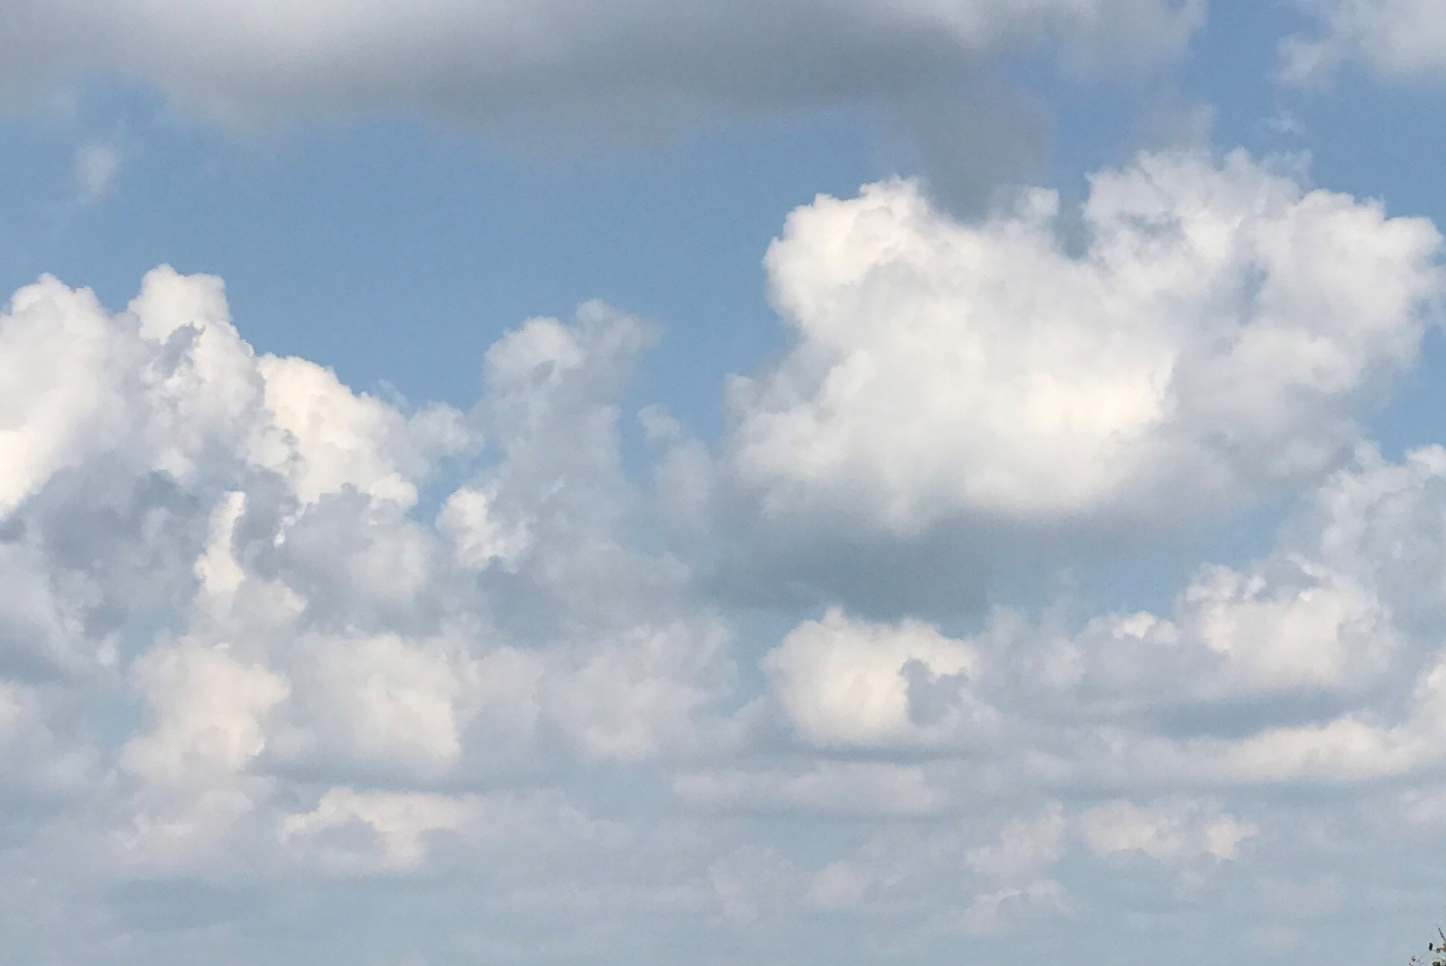
I-Share Alma Primo VE Office hours
Questions?
Join us May 13, 2021
at 2pm for another Office Hour.
Contact CARLI at support@carli.Illinois.edu
Notes:
The rest of our time together will be focused on your Questions so please feel free to enter them in the chat!

