Slide 1
I-Share Alma Primo VE Office hours will start shortly
Welcome!
Office Hours will start at 2pm and run until 3pm.
Please mute your microphone.
As time permits, we will respond to questions typed in the chat box, and offline afterwards, as needed.
This session will be recorded and made available on the CARLI website both as PDF slides and as a recording, with live links to all referenced resources.

Slide 2
Alma Course Reserves:
Semester Transition
Office Hours
April 8, 2021

Slide 3
Agenda Office Hours 4/8/2021
Agenda – 4/8/2021
Reminders and upcoming Alma/Primo VE events and learning opportunities
See https://www.carli.illinois.edu/calendar for CARLI events
Alma Course Reserve workflows for semester transitions
Participant Q & A
Notes:
Upcoming events for Alma/Primo VE, a reminder to always check the CARLI calendar for CARLI events.
As always we do expect time for general Q&A at the end of the hour.

Slide 4
Alma- Consortial Term Loans
Today- April 8, 2021- CARLI Office staff are removing the term loan configuration for I-Share Resource Sharing Loans.
I-Share patrons:
Materials checked out through I-Share resource sharing on or after April 8 will calculate the loan period based on the “regular” I-Share policies.
  Print loans will receive a 28 day loan with 3 renewals (max 112 days loan);
  Non-print loans will receive a 14 day loan with 1 renewal (max 28 days loan).
If the I-Share patron’s original loan date of a print item was more than 112 days ago (loan date more than 28 days ago for a non-print item), the patron will NOT be able to renew the item. The I-Share patron will need to return the item or contact the item’s owning library for a due date extension.

Slide 5
Alma- Consortial Term Loans-
Local patrons:
If your institution is currently using a CARLI-enabled term loan period for your local patron transactions, and we did NOT receive an email to CARLI Support before April 8th, CARLI Office staff will remove the term loan configuration for your local patrons.
On/after April 8, loans will calculate based on your “regular” local policies (if they were not already).
  FYI: If the local patron’s original loan date occurred before the maximum renewal period allowed by your regular local policies, the patron will NOT be able to renew the item. The patron will need to return the item or contact your library for a due date extension.
If your institution is NOT currently using CARLI-enabled term loans for local patron transactions; no changes will be made to your configuration for local patrons.

Slide 6
Upcoming Alma and Primo VE Events- Ongoing series
Technical Services Q & A
Gather with CARLI staff and your technical services colleagues to discuss Alma technical services topics, from acquisitions and cataloging workflows for physical resources to electronic resources management:
Wednesday 4/14 @ 10- https://www.carli.illinois.edu/tech-services-qa-2021-04-14
Wednesday 4/28 @ 10- https://www.carli.illinois.edu/tech-services-qa-2021-04-28
Wednesday 5/12 @ 10- https://www.carli.illinois.edu/tech-services-qa-2021-05-12 Wednesday 5/26 @ 10- https://www.carli.illinois.edu/tech-services-qa-2021-05-26
Recordings are posted on the “Physical Resource Management - Cataloging and Acquisitions” page:
https://www.carli.illinois.edu/products-services/i-share/physical-res-man
Notes:
Looking at ongoing events-- with the Technical Services Q & A sessions, you can gather with CARLI staff and your technical services colleagues to discuss Alma technical services topics, from acquisitions and cataloging workflows for physical resources to electronic resources management.
Each session will include how-to presentations, discussion of consortial practices, and opportunities for questions and answers from CARLI and colleagues alike.
Sessions will be held the second and fourth Wednesdays of each month. Sessions will be recorded for later viewing.
Please register for any sessions you’d like to attend using the link from the CARLI event calendar.

Slide 7
Upcoming Alma and Primo VE Events- Ongoing Series
Let's Talk about Fulfillment (I mean Alma, not life's purpose)
For the opportunity to talk with CARLI staff and your CARLI library colleagues about Alma Fulfillment and Automated Fulfillment Network workflows, known issues, and Q & A:
Friday 4/09 @ 2- https://www.carli.illinois.edu/lets-talk-about-fulfillment20210409
Tuesday 4/20 @ 10:30- https://www.carli.illinois.edu/lets-talk-about-fulfillment20210420
Friday 5/07 @ 2- https://www.carli.illinois.edu/lets-talk-about-fulfillment20210507
Tuesday 5/18 @ 10:30- https://www.carli.illinois.edu/lets-talk-about-fulfillment20210518
Notes are posted in the calendar event for past sessions.
Notes:
If you'd like to talk with CARLI staff and your CARLI library colleagues about Alma Fulfillment and Automated Fulfillment Network workflows, known issues, and Q & A, join us online for the spring sessions of “Let’s talk about Fulfillment (I mean Alma, not life’s purpose).”
These sessions are scheduled for every other week, alternating between Tuesdays at 10:30am and Fridays at 2:00pm.
CARLI Office Staff will be online for each session to work with your questions and to facilitate the discussion.
Attendees will be able to unmute their microphones and/or utilize the chat for participation. We'll take turns sharing screens as appropriate.
This session will be recorded for CARLI staff use; since Fulfillment involves patron data, the CARLI office will evaluate if it is fitting and valuable to post segments of the session for later review.
Registration for these sessions is also available from the event page in the CARLI Calendar.

Slide 8
Upcoming Alma and Primo VE Events- Ongoing Series
Ex Libris’ “Primo VE- Become an Expert”
From Ex Libris, “This course will delve into advanced topics including building effective searches, configuration, branding, normalization rules, loading external data sources, CDI, and more.”
https://knowledge.exlibrisgroup.com/Primo/Product_Materials/Primo_Webinars/Primo_VE_-_Become_an_Expert
Thursday 4/15 @ 10am – Primo Analytics
Recordings from past sessions are available at the link above.
Notes:
Ex Libris has announced a live webinar series called “Primo VE – Become an Expert” to start at the end of January 2021! Each of the 12 sessions in the series will cover a different topic related to Primo VE, including “building effective searches, configuration, branding, normalization rules, loading external data sources, CDI, and more.” Complete descriptions of each session are available on the Ex Libris website.
Registration for these Ex Libris Primo VE webinars is free, and the sessions will be recorded for later viewing.
CARLI recommends that you share this timely Ex Libris webinar opportunity with anyone at your institution who performs customization or configuration of Primo VE, makes decisions about Primo VE, or provides instruction on the use of Primo VE.
Registration is available at the link on this slide.

Slide 9
CARLI Known Issues Page
CARLI’s Alma and Primo VE Known Issues Page
Located under Products & Services> I-Share Documentation> Alma and Primo VE Known Issues
https://www.carli.illinois.edu/products-services/i-share/alma-primo-ve-known-issues

Slide 10
Ex Libris Idea Exchange
  Ex Libris Idea Exchange
  https://ideas.exlibrisgroup.com/
The Ex Libris Idea Exchange allows library staff at institutions using Ex Libris products to:
  Share ideas for enhancement/development.
  Vote to support your favorite user-submitted ideas.
  Add comments to provide weight and additional use cases to your favorite user-submitted ideas.
  Any and all library staff members at your institution can have their own individual account.
  Please read the FAQ and Guidelines before you begin.
  The CARLI Office, and your CARLI Library Colleagues, may periodically send announcements for ideas they’d like you to consider supporting.
Notes:
A reminder we keep mentioning about the Ex Libris Idea Exchange.
The Idea Exchange allows library staff at institutions using Ex libris products to share ideas for enhancement and development, vote to support your favorite user submitted ideas, and add comments to provide weight and additional use cases to your favorite user submitted ideas.
Any and all library staff members at your institution can have their own individual account. Please read the linked FAQ and Guidelines before you begin.
CARLI office and your CARLI library colleagues may periodically send announcements for ideas they’d like you to consider supporting.

Slide 11
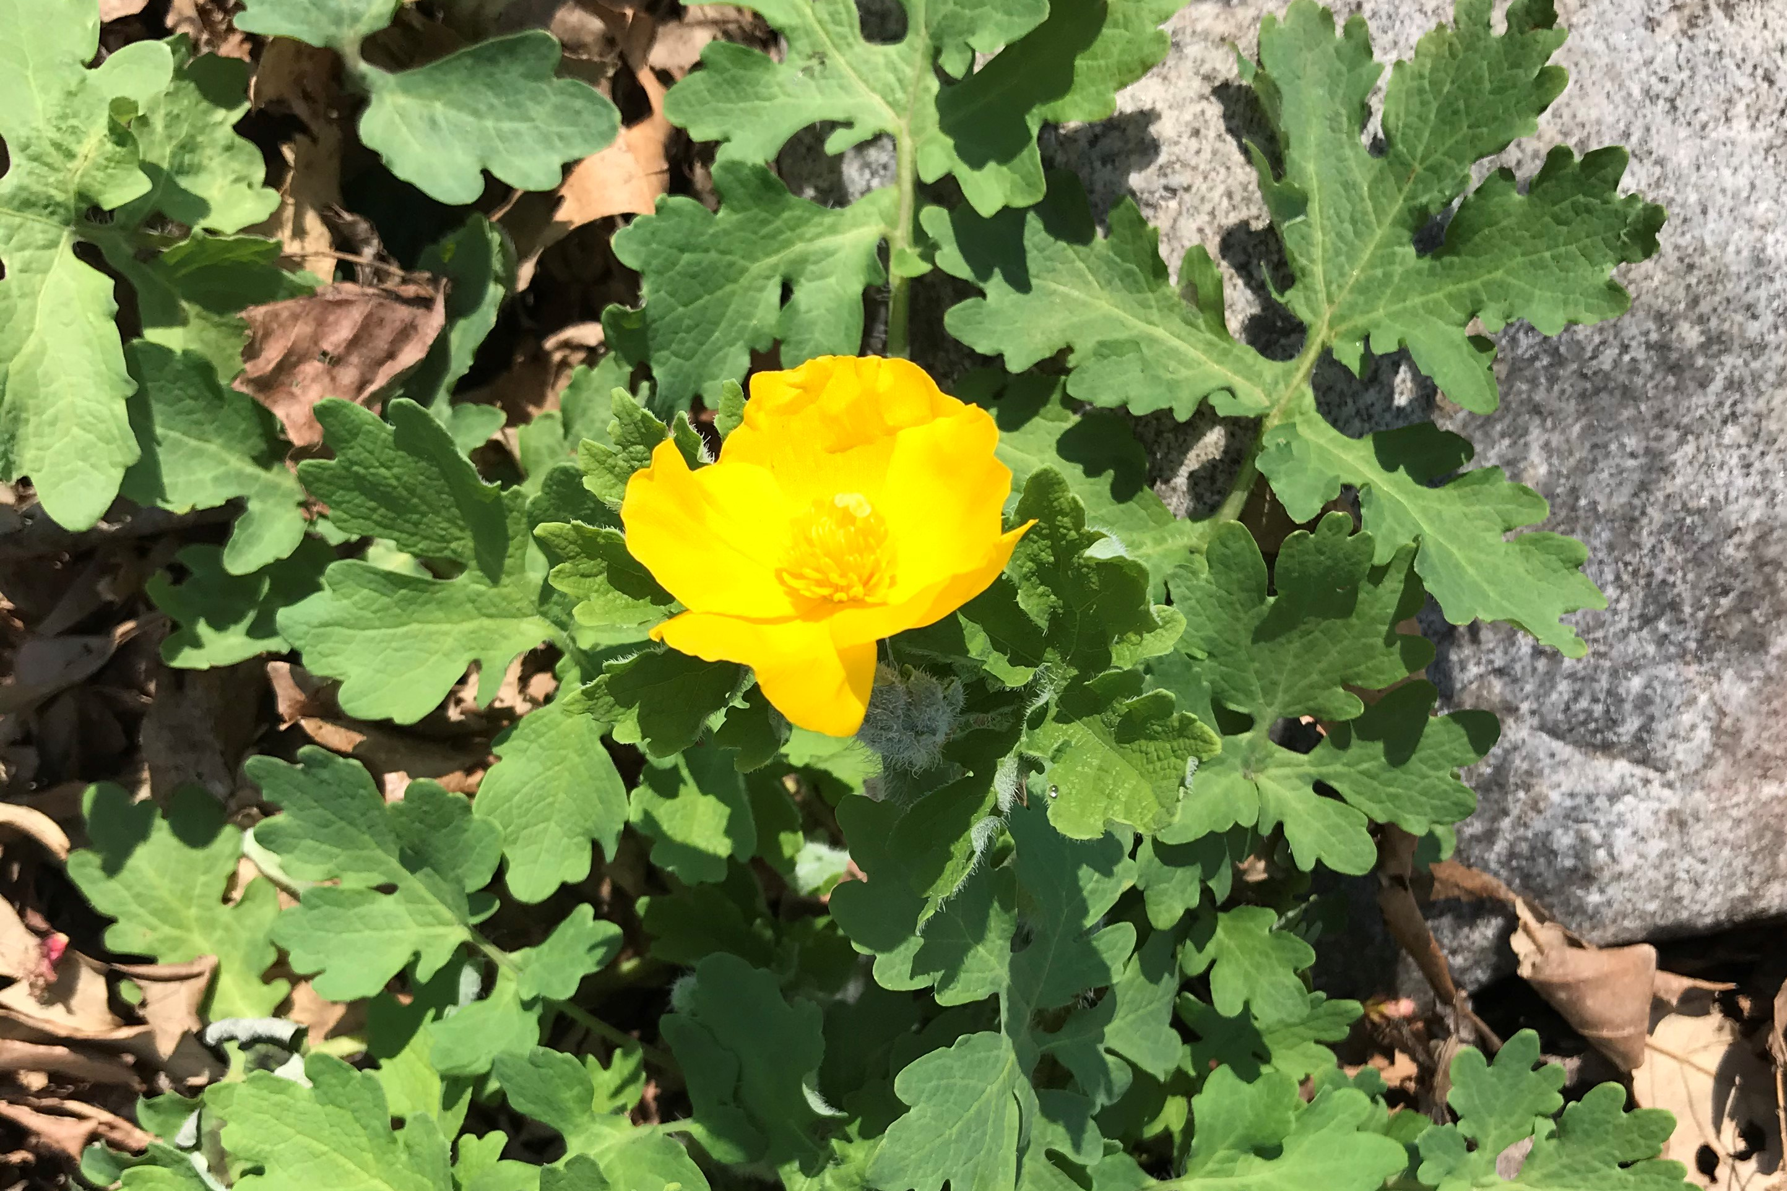
Alma Course Reserves Semester Transition
Notes:
Alright, let’s switch over to talking about the semester transition for Alma Course Reserves; we’re going to be discussing this topic using the UIS Alma Sandbox.

Slide 12
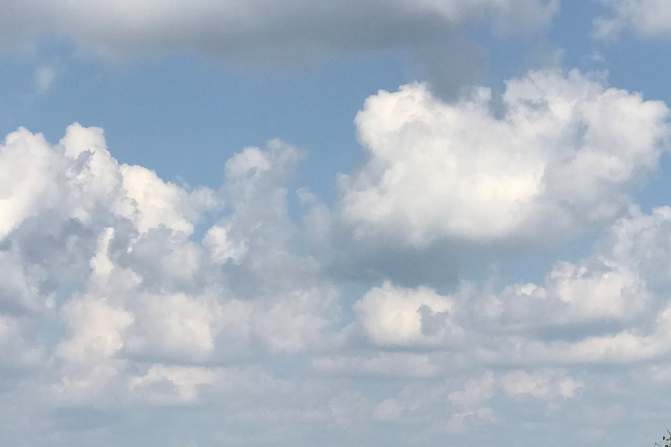
I-Share Alma Primo VE Office hours
Questions?
Join us April 22, 2021
at 2pm for another Office Hour.
Contact CARLI at support@carli.Illinois.edu

