Slide 1
I-Share Alma Primo VE Office hours will start shortly
Welcome!
Office Hours will start at 2pm and run until 3pm.
Please mute your microphone.
As time permits, we will respond to questions typed in the chat box, and offline afterwards, as needed.
This session will be recorded and made available on the CARLI website both as PDF slides and as a recording, with live links to all referenced resources.

Slide 2
End of Term User Management
Office Hours
March 25, 2021

Slide 3
Agenda Office Hours 2/25/2021
Agenda – 3/25/2021
Reminders and upcoming Alma/Primo VE events and learning opportunities
See https://www.carli.illinois.edu/calendar for CARLI events
End of Term User Management Activities
  Identifying graduating students
  Setting expiry dates
  Patron purge techniques
Notes:
Upcoming events for Alma/Primo VE, a reminder to always check the CARLI calendar for CARLI events.
As always we do expect time for general Q&A at the end of the hour.

Slide 4
April 2021 Alma Primo VE MONTHLY Release
The April Release is scheduled for Sunday, April 4.
The April release is a “maintenance release”—no new functionality, no release update on April 11.
Alma Release Notes:
https://knowledge.exlibrisgroup.com/Alma/Release_Notes/2021/Alma_2021_Release_Notes
Primo VE Release Notes:
https://knowledge.exlibrisgroup.com/Primo/Release_Notes/002Primo_VE/2021/010Primo_VE_2021_Release_Notes
Dates and links to documentation in CARLI Event Calendar.
Notes:
The April 2021 release of Alma is scheduled for Sunday April $. Release notes are available on these webpages.

Slide 5
Upcoming Alma and Primo VE Events- Ongoing series
Technical Services Q & A
Gather with CARLI staff and your technical services colleagues to discuss Alma technical services topics, from acquisitions and cataloging workflows for physical resources to electronic resources management:
Wednesday 4/14 @ 10- https://www.carli.illinois.edu/tech-services-qa-2021-04-14
  Fiscal Period Close
Wednesday 4/28 @ 10- https://www.carli.illinois.edu/tech-services-qa-2021-04-28
Wednesday 5/12 @ 10- https://www.carli.illinois.edu/tech-services-qa-2021-05-12 Wednesday 5/26 @ 10- https://www.carli.illinois.edu/tech-services-qa-2021-05-26
Recordings are posted on the “Physical Resource Management - Cataloging and Acquisitions” page:
https://www.carli.illinois.edu/products-services/i-share/physical-res-man
Notes:
Looking at ongoing events-- with the Technical Services Q & A sessions, you can gather with CARLI staff and your technical services colleagues to discuss Alma technical services topics, from acquisitions and cataloging workflows for physical resources to electronic resources management.
Each session will include how-to presentations, discussion of consortial practices, and opportunities for questions and answers from CARLI and colleagues alike.
Sessions will be held the second and fourth Wednesdays of each month. Sessions will be recorded for later viewing.
Please register for any sessions you’d like to attend using the link from the CARLI event calendar.

Slide 6
Upcoming Alma and Primo VE Events- Ongoing Series
Let's Talk about Fulfillment (I mean Alma, not life's purpose)
For the opportunity to talk with CARLI staff and your CARLI library colleagues about Alma Fulfillment and Automated Fulfillment Network workflows, known issues, and Q & A:
Friday 4/09 @ 2- https://www.carli.illinois.edu/lets-talk-about-fulfillment20210409
Tuesday 4/20 @ 10:30- https://www.carli.illinois.edu/lets-talk-about-fulfillment20210420
Friday 5/07 @ 2- https://www.carli.illinois.edu/lets-talk-about-fulfillment20210507
Tuesday 5/18 @ 10:30- https://www.carli.illinois.edu/lets-talk-about-fulfillment20210518
Notes are posted in the calendar event for past sessions.
Notes:
If you'd like to talk with CARLI staff and your CARLI library colleagues about Alma Fulfillment and Automated Fulfillment Network workflows, known issues, and Q & A, join us online for the spring sessions of “Let’s talk about Fulfillment (I mean Alma, not life’s purpose).”
These sessions are scheduled for every other week, alternating between Tuesdays at 10:30am and Fridays at 2:00pm.
CARLI Office Staff will be online for each session to work with your questions and to facilitate the discussion.
Attendees will be able to unmute their microphones and/or utilize the chat for participation. We'll take turns sharing screens as appropriate.
This session will be recorded for CARLI staff use; since Fulfillment involves patron data, the CARLI office will evaluate if it is fitting and valuable to post segments of the session for later review.
Registration for these sessions is also available from the event page in the CARLI Calendar.

Slide 7
Upcoming Alma and Primo VE Events- Ongoing Series
Ex Libris’ “Primo VE- Become an Expert”
From Ex Libris, “This course will delve into advanced topics including building effective searches, configuration, branding, normalization rules, loading external data sources, CDI, and more.”
https://knowledge.exlibrisgroup.com/Primo/Product_Materials/Primo_Webinars/Primo_VE_-_Become_an_Expert
Thursday 4/1 @ 10am – External Data Sources
Thursday 4/8 @ 10am – Deduplication and FRBR
Thursday 4/15 @ 10am – Primo Analytics
Recordings from past sessions are available at the link above.
Notes:
Ex Libris has announced a live webinar series called “Primo VE – Become an Expert” to start at the end of January 2021! Each of the 12 sessions in the series will cover a different topic related to Primo VE, including “building effective searches, configuration, branding, normalization rules, loading external data sources, CDI, and more.” Complete descriptions of each session are available on the Ex Libris website.
Registration for these Ex Libris Primo VE webinars is free, and the sessions will be recorded for later viewing.
CARLI recommends that you share this timely Ex Libris webinar opportunity with anyone at your institution who performs customization or configuration of Primo VE, makes decisions about Primo VE, or provides instruction on the use of Primo VE.
Registration is available at the link on this slide.

Slide 8
Ex Libris Idea Exchange
  Ex Libris Idea Exchange
  https://ideas.exlibrisgroup.com/
The Ex Libris Idea Exchange allows library staff at institutions using Ex Libris products to:
  Share ideas for enhancement/development.
  Vote to support your favorite user-submitted ideas.
  Add comments to provide weight and additional use cases to your favorite user-submitted ideas.
  Any and all library staff members at your institution can have their own individual account.
  Please read the FAQ and Guidelines before you begin.
  The CARLI Office, and your CARLI Library Colleagues, may periodically send announcements for ideas they’d like you to consider supporting.
Notes:
Areminder we keep mentioning about the Ex Libris Idea Exchange.
The Idea Exchange allows library staff at institutions using Ex libris products to share ideas for enhancement and development, vote to support your favorite user submitted ideas, and add comments to provide weight and additional use cases to your favorite user submitted ideas.
Any and all library staff members at your institution can have their own individual account. Please read the linked FAQ and Guidelines before you begin.
CARLI office and your CARLI library colleagues may periodically send announcements for ideas they’d like you to consider supporting.

Slide 9
Email lists reminder
Join CARLI Email lists at https://www.carli.illinois.edu/email-lists
I-Share Announcements from CARLI: I-Share@carli.Illinois.edu
CARLI open discussion lists on Alma and Primo VE
Primo VE Interest Group
Public Services Interest Group
  Reports Interest Group
  Resource Sharing Interest Group
  Serials & Acquisitions Interest Group
  Technical Services Interest Group
Ex Libris User Group (ELUNA) Email Lists for all customers
https://el-una.org/about/mailing-lists
  Alma-L
  Primo

Slide 10
End Of Term User Management activities
What do we mean by “activities?”
  Patron maintenance tasks that libraries expect to perform
    Patron loads to reset expiry/purge dates or change user groups
    Identifying graduating students and their loans/fines/fees.
  Tasks that CARLI expects libraries to perform
    Purge expired user records
    Purge I-Share linked users with no loans

Slide 11
End Of Term User Management activities
Reporting on graduating students
  User statistical categories
    Configuration > User Management > User Details > Statistical Categories
    C > UM > User Details > Category Types
    C > UM > User Details > Statistical Categories/Types
    C > Analytics > General Configuration > Analytics User Statistics
  Create user set, run Update/Notify Users job to add category
  Use analytics to find current loans and fines
    Start with a report that pulls Primary Identifier by stat category
    Use the above analysis to find loans and fines/fees
    CARLI staff can also use the above analysis to match with other IZs.
      Contact support to request your users’ activity at other institutions.
Notes:
Draftiness follows:
Statistical categories are primarily a tool for enhancing analytics data. Defining and assigning statistical categories allows one to report on users’ activities in more than one dimension, but prep work should happen in advance to take full advantage.
For instance, when a user has statistical categories assigned to their account, loans that they make will include the stat category in the analytics data for the transaction. This data point is not removed by anonymization, so it can be used later to create broader analyses.
Stat category may be added to users at any point and still can be used to identify users by some criteria other than user group, and which can then be used to identify other related information, such as loans for those users.
[Do we want to show how to create and apply categories? Or refer to documentation and maybe a separate video? For analytics, we’ll obviously want to have examples in advance.]
Custom user groups… [room here to describe the ONU option and what works and doesn’t]

Slide 12
End Of Term User Management activities
Adjusting functionality for these students
  Idea might be to limit loan lengths, block renewals or new loans
  Custom user groups, e.g., Graduating Student
    Configuration > User Management > User Groups
    Configuration > User Management > User Record Type/User Group
    Configuration > Fulfillment > Fulfillment Units: Add rules and TOUs
  Update expire dates for graduating students to end of semester
  Apply a network block on user records
We have not tested some of these options extensively yet.
Notes:
Draftiness follows:
Statistical categories are primarily a tool for enhancing analytics data. Defining and assigning statistical categories allows one to report on users’ activities in more than one dimension, but prep work should happen in advance to take full advantage.
For instance, when a user has statistical categories assigned to their account, loans that they make will include the stat category in the analytics data for the transaction. This data point is not removed by anonymization, so it can be used later to create broader analyses.
Stat category may be added to users at any point and still can be used to identify users by some criteria other than user group, and which can then be used to identify other related information, such as loans for those users.
[Do we want to show how to create and apply categories? Or refer to documentation and maybe a separate video? For analytics, we’ll obviously want to have examples in advance.]
Custom user groups…
The network block could be set up to prevent the patrons from new local and AFN loans, renewals, or requests (it will allow the patron to place AFN requests in Primo VE, but, Alma then cancels the request; it seems to prevent placing local requests).
Another option that would take some pre-planning (as Alma doesn't appear to shorten a due date if the user's expiration date is later shortened), would be to set the graduating student's record expiration dates to be no later than the day of graduation. This would allow them to do transactions, but, Alma wouldn't permit due dates to be calculated beyond the patron's record expiration dates.

Slide 13
Patron Purge
CARLI expects that libraries will periodical purge old user data
  Protects PII, anonymizing analytics
  Keeps institution data up to date
  Cleans up after AFN processes
  Purge is preferred over manual deletion of users
Purge job does not:
  Delete users with active transactions in your IZ*
    Purge job is not AFN-aware; it may purge users with I-Share transactions.
  Delete users that have no purge date
To run a purge, staff must have the User Administrator role; or contact CARLI Support for assistance.
Notes:
Draftiness follows:
Preferred over manual deletion of users, as purging completes the task of anonymizing user data and user-related fields in analytics. Deleting a user deletes all traces of the user’s existence, which could mean removing still-reportable aspects of the user (e.g., the number of UG patrons with loans as of 6/30/2021).
Roles: Library staff must have the User Administrator role to run purges. Libraries may contact CARLI support to have purges run for them.
Purge jobs cannot be scheduled.
https://knowledge.exlibrisgroup.com/Alma/Product_Documentation/010Alma_Online_Help_(English)/050Administration/030User_Management/030Purging_Users

Slide 14
Generic Purge Walkthrough
Admin > User Management > Purge User Records
  Number of days after purge date
    Pick a date and identify the difference, e.g., from 12/31/20 to 3/25/21 = ?
    How powerful is “0” days?
  User record type: Usually keep All—need to check this again, have seen this be weird.
  User Group: leave blank for all, or select a single group
    Selecting a group means running multiple purge jobs, but this may be B.P.
  Waive threshold: How much in fines/fees to forgive in order to clean-up data.
    Above threshold, user retained
    Default is 0
  Add vs. Close vs. Add and Close
    Add queues the job while letting you stay on the screen to run more groups, which you probably will do

Slide 15
Preparation Work for User Purges
Analytics:
  Users that have purge dates in the past
  Users with outstanding fines-fees with purge dates in the past
  Library Staff Users Have Purge Dates in the Past
  Users that have no purge dates assigned
IZ Users Advanced Search
  User Group
  Expiration Date
  Purge Date
  Last Activity Date

Slide 16
Possible Safe Purge Practice
Create a list of “OK to Purge” users.
  In Config, create a user group, “OK to Purge.”
    Configuration > User Management > User Groups
    Configuration > User Management > User Record Type/User Group
  Use an advanced search or analytics report to create a set
    Be sure to create an itemized set
  Run the Update/Notify Users job to set the new user group
  Run the purge job, limited to the OK to Purge group.
Notes:
User purge can be powerful, and even with reports, you may not spot all of the users that should and shouldn’t be purged, particularly if you know that your data isn’t as clean as it could be. Therefore, it’s often advisable to identify groups of user records that you know are safe for purging, then run the purge jobs on those sets.
Start by creating a user group specifically for purges, e.g., “OK to purge.” (process of user group setup in config, obligatory mention that one shouldn’t add a group lightly, impacts on fulfillment rules, etc.)
Using one or more of the report or search methods identified, create a user record set of users eligible to be purged. (Search -> Logical set; analytics -> itemized set). If creating a set from a search, be sure to itemize the set next, review the contents (actions menu > members), and remove any records that shouldn’t be purged.
Use the update/notify users job to change the user group of these users to your “OK to purge” group. Check the job results.
Run the user purge only on the “OK to purge” group. Repeat as needed.

Slide 17
Other Good/Best Practices
Additional good/best practices for purges
  Set purge dates predictably
    Always set a purge date
    Always keep purge date the same or after expiry date
    Consider having purge dates at fixed points during the year
  Use SIS user loads/syncs to update expiry and purge dates
    After students graduate
    After faculty/staff retire or leave the institution
  Scan for expiry and purge dates for users with staff roles
    Recommend running this kind of report once a month

Slide 18
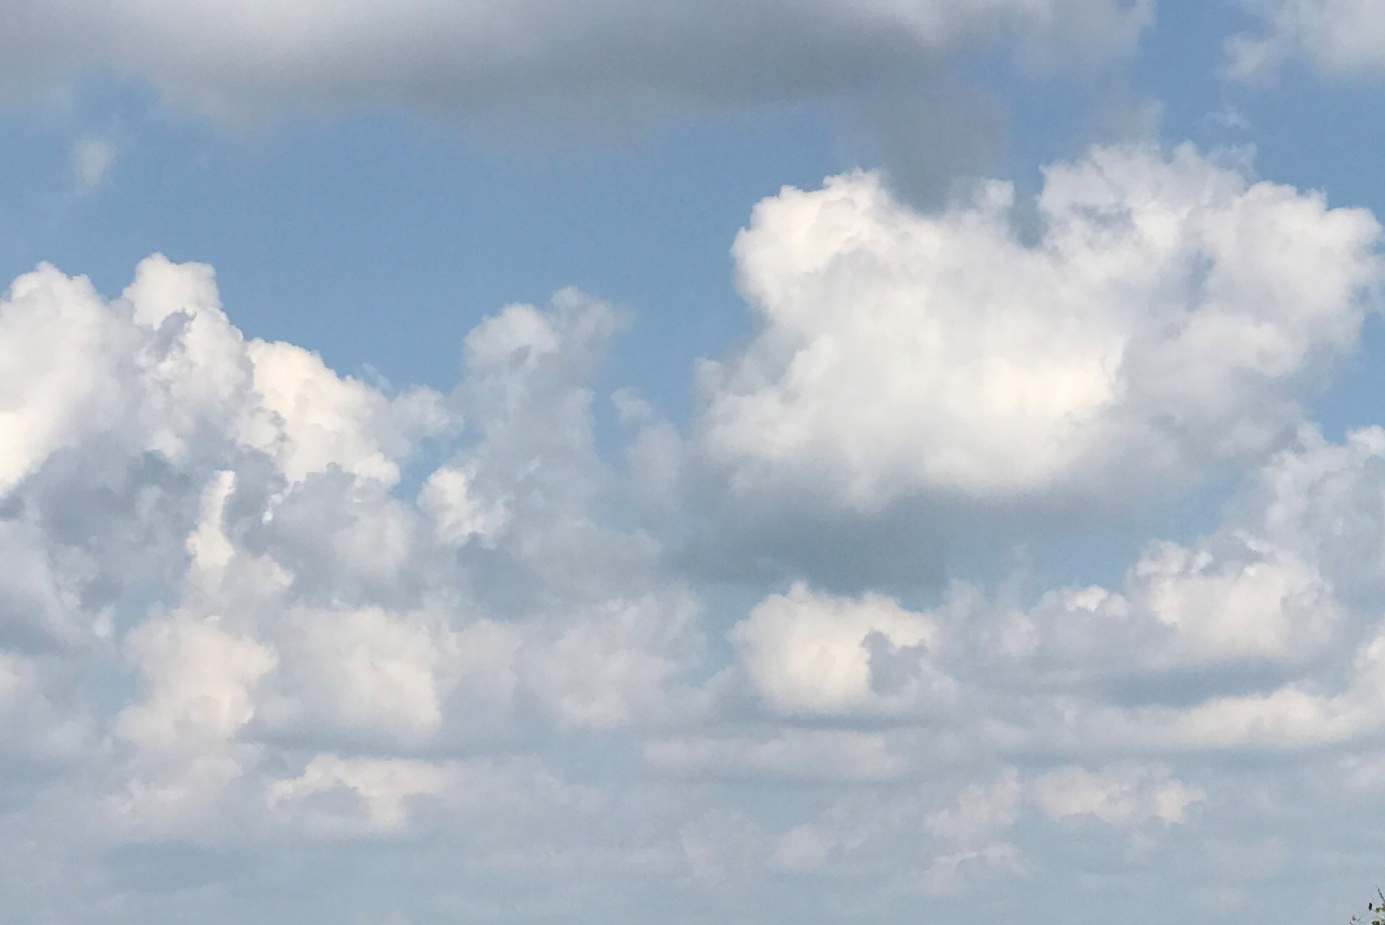
I-Share Alma Primo VE Office hours
Questions?
Join us April 8, 2021
at 2pm for another Office Hour.
Contact CARLI at support@carli.Illinois.edu

