Slide 1
I-Share Alma Primo VE Office hours will start shortly
Welcome!
Office Hours will start at 2pm and run until 3pm.
Please mute your microphone.
As time permits, we will respond to questions typed in the chat box, and offline afterwards, as needed.
This session will be recorded and made available on the CARLI website both as PDF slides and as a recording, with live links to all referenced resources.

Slide 2
alma and Primo VE Office Hours
February 11, 2021
Notes:
[Jen]

Slide 3
Office Hours Agenda
Agenda – 2/11/2021
CARLI Updates
Issue Reporting in Alma
Q & A

Slide 4
Upcoming Events
Feb. 12: Let’s Talk About Fulfillment
Feb. 19: CARLI Resource Sharing in our New Age: Material Handling During COVID
Feb. 23: Let’s Talk About Fulfillment
Feb. 24: CANCELED Tech Services Q&A
Sign up for the new Technical Services Meetings with CARLI Staff
Thursdays through April 15 from 11:15-noon: CARLI Discussion sessions after the Ex Libris Primo VE-Become an Expert webinars
Notes:
Upcoming Alma and Primo VE-related Events:
On Feb. 12 and 23 there will be two more sessions of ”Let’s Talk About Fulfillment (I mean Alma, not life’s purpose)”. Please register via the links on the CARLI calendar.
On Feb. 19th the CARLI Resource Sharing committee will present "CARLI Resource Sharing in our New Age: Tips and Tricks in the Time of Alma and COVID" as part of their monthly discussion series. Please register via the link on the CARLI calendar.
The Feb. 24th Technical Services Q&A session has been canceled in lieu of the new offering of “Technical Services Meetings with CARLI Staff”. We’ve set up a Google spreadsheet for I-Share libraries to sign-up for a meeting time with CARLI Staff to discuss topics in the technical services area of their choice. Please read and follow the instructions at the top of the sheet before signing up!
On Thursdays through April 15, CARLI is hosting “Discussion sessions” after the Ex Libris “Primo VE – Become an Expert” webinars. You can sign up for future Ex Libris sessions on the Ex Libris website and see powerpoints and recordings from past sessions. There is no registration for the CARLI Discussions sessions, and we are posting notes and the recordings on the CARLI website.

Slide 5
Changes to CARLI Email lists
CARLI established the Alma Primo Contacts email list to have a designated Alma migration project contact at each I-Share library; now that the migration is done, we are going to retire the Alma Primo Contacts email list.
We are going to return to using the I-Share email list for CARLI staff announcements about I-Share related news and events.
Please make sure you are subscribed to the I-Share list, go to: https://carli.illinois.edu/mailman/listinfo/i-share
Anyone can subscribe to the I-Share list; only CARLI office staff will post to it.
Please continue to use the CARLI interest group (IG) lists for email discussions with other I-Share library staff

Slide 6
Reporting Problems With Alma and Primo VE
In most situations, please contact CARLI first at support@carli.illinois.edu for problems and questions about Alma and Primo VE
  We know our unique I-Share consortial environment and configurations better than general Ex Libris Support.
  It helps CARLI staff identify problems across I-Share institutions.
  If needed, CARLI staff will open a Case with Ex Libris and copy you so that you can participate in correspondence on the Case.
  Email to our support@carli.illinois.edu address is always better than a direct email to one staff member.
Notes:
[Jen]
So, when it comes to general error reporting – when you are experiencing problems with or have questions about Alma and Primo VE, as you know, we want you to contact support@carli.Illinois.edu first.

Slide 7
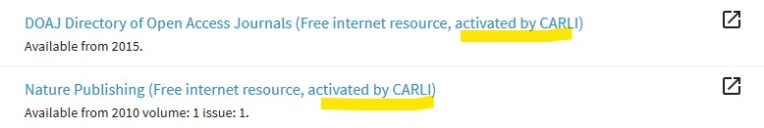
Reporting issues with collections and portfolios
Reporting Issues with Collections and Portfolios
If the Collection / Portfolio is active in your Institution Zone (IZ) via the Network Zone (NZ):
  Report to CARLI via support@carli.illinois.edu. CARLI will follow up with any adjustments needed for access, and report the problem on behalf of I-Share to Ex Libris.
  Example:
Notes:
You may receive reports from a patron that they cannot access the full text as indicated in a specific portfolio – perhaps the dates available have changed, or the full text isn’t available any longer. These issues should be reported so they can be corrected in the Community Zone records (more about this shortly).
If the portfolio or collection is active from the Network zone (activated by CARLI) – you can still send a note to support… we’ll take care of things on our end, including reporting the problem to Ex Libris.
If the portfolio or collection is active from the community zone you can use the “report to ex Libris” function. This needs to be set up in Alma. Once you report the problem to Ex Libris, you’ll probably also want to change the information in your local portfolio so other patrons won’t have the same issue. Denise will talk about this more in a few minutes.

Slide 8

Reporting issues with collections and portfolios
Reporting Issues with Collections and Portfolios
If the Collection / Portfolio is active in your IZ via the Community Zone (CZ):
  Report directly to Ex Libris using the “Report to Ex Libris” functionality we’ll be describing today.
  Example:
Notes:
You may receive reports from a patron that they cannot access the full text as indicated in a specific portfolio – perhaps the dates available have changed, or the full text isn’t available any longer. These issues should be reported so they can be corrected in the Community Zone records (more about this shortly).
If the portfolio or collection is active from the community zone you can use the “report to ex Libris” function. This needs to be set up in Alma. Once you report the problem to Ex Libris, you’ll probably also want to change the information in your local portfolio so other patrons won’t have the same issue. Denise will talk about this more in a few minutes.

Slide 9
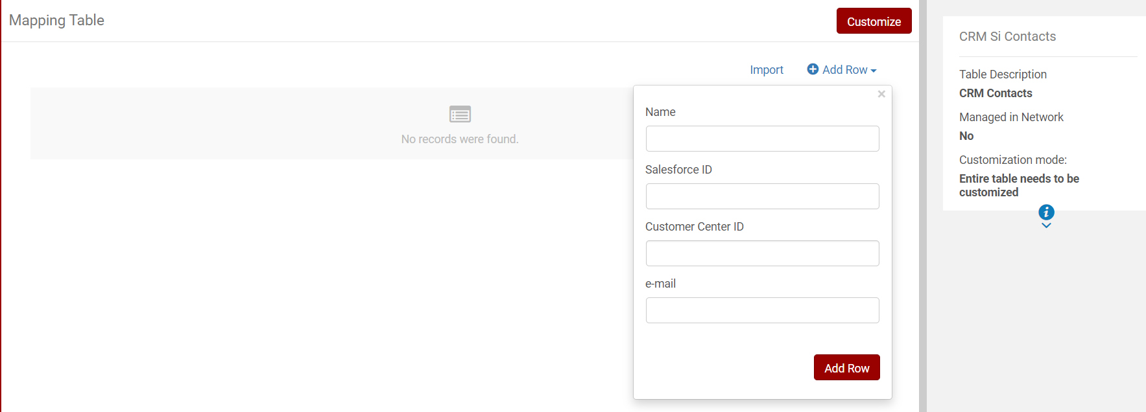
Report to Ex Libris
“Report to Ex Libris” Functionality
Requires a Salesforce Account with Ex Libris
Requires CRM Contacts list to be set up in Configuration
  Configuration Menu > General > General Configuration > CRM Contacts
Notes:
The Report to Ex Libris Functionality requires a Salesforce Account with Ex Libris, which is an account to their problem reporting system.
The Salesforce account credentials are added to the “CRM Contacts list” in Alma Configuration.
If you aren’t sure you have a salesforce account we can help you get one set up for this report to ex libris purpose.

Slide 10
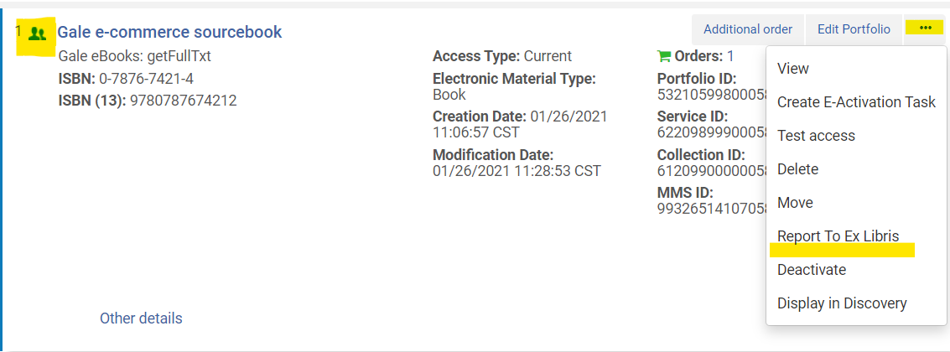
Using the Report to Ex Libris Function
Find the collection or portfolio with a problem
Click “More Actions” (...)
Select “Report to Ex Libris”
Notes:
Once you have identified the collection or portfolio with an issue you can click the “More Actions” ellipsis and then select Report to Ex Libris.
If the CRM contacts list is not set up in configuration the message “No Contacts in CRM Contact List” will pop up, even as Alma prepares the “Report”.

Slide 11
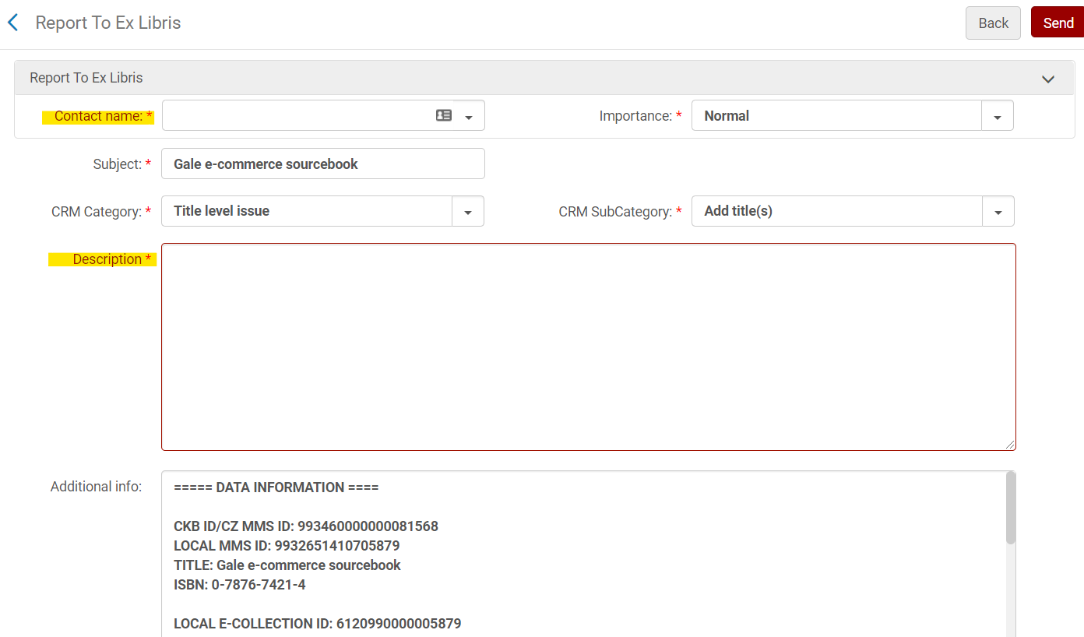
Using the report to ex libris function
Notes:
The Report to ex Libris form allows you to add a description of the problem, which is required, as well as selecting the Contact name, which comes from the CRM Contact List.
We’ll talk more about the types of information you can supply here during the demonstration.

Slide 12
Live Demo
Live Demo

Slide 13
More INformation
More Information
Alma CRM https://knowledge.exlibrisgroup.com/Alma/Product_Documentation/010Alma_Online_Help_(English)/050Administration/050Configuring_General_Alma_Functions/100Configuring_CRM_Contacts
See section “Editing a Portfolio Using the Electronic Portfolio Editor” subsection “Coverage”:
https://knowledge.exlibrisgroup.com/Alma/Product_Documentation/010Alma_Online_Help_(English)/Electronic_Resource_Management/030_Working_with_Local_Electronic_Resources/010Managing_Electronic_Resources#Coverage_tab

Slide 14

Questions
Notes:
[Jen]
Please type any questions in the chat, or feel free to unmute to ask questions.

Slide 15
See you next time!
Thank you!
The next Open Office Hours will be on February 25th

