Slide 1
I-Share Alma Primo VE Office hours will start shortly
Welcome!
Office Hours will start at 2pm and run until 3pm. Please mute your microphone. As time permits, we will respond to questions typed in the chat box, and offline afterwards, as needed.
This session will be recorded and made available on the CARLI website both as PDF slides and as a recording, with live links to all referenced resources.

Slide 2
Put your Thinking Cat On: Choosing Discussion Topics for 2021 Office Hours January 14, 2020
Notes:
[Jen]
Welcome to the first office hours of 2021! We’ll be putting our thinking cat… CAP’s on today to talk about discussion topics for 2021 office hours.

Slide 3
Agenda Office Hours 1/14/2021
Agenda – 1/14/2021
Office Hours: Where we’ve been and where we’re going
Upcoming Alma/Primo VE events and learning opportunities See https://www.carli.illinois.edu/calendar for CARLI events
Reminders:
Re-enabling overdue notices
Fines and fees update
Reporting problems
Choosing Office Hours discussion topics for 2021
Participant Q & A
Notes:
[Jen]
Here’s today’s agenda.
We want to talk about our Alma Primo VE office hours, where we have been and where we are going.
Upcoming events for Alma/Primo VE, a reminder to always check the CARLI calendar for CARLI events.
Reminders about re-enabiling overdue notices, a fines and fees update, and some information about reporting problems.
We’ll then have our discussion of topics for 2021 office hours
As always we do expect time for general Q&A at the end of the hour.

Slide 4
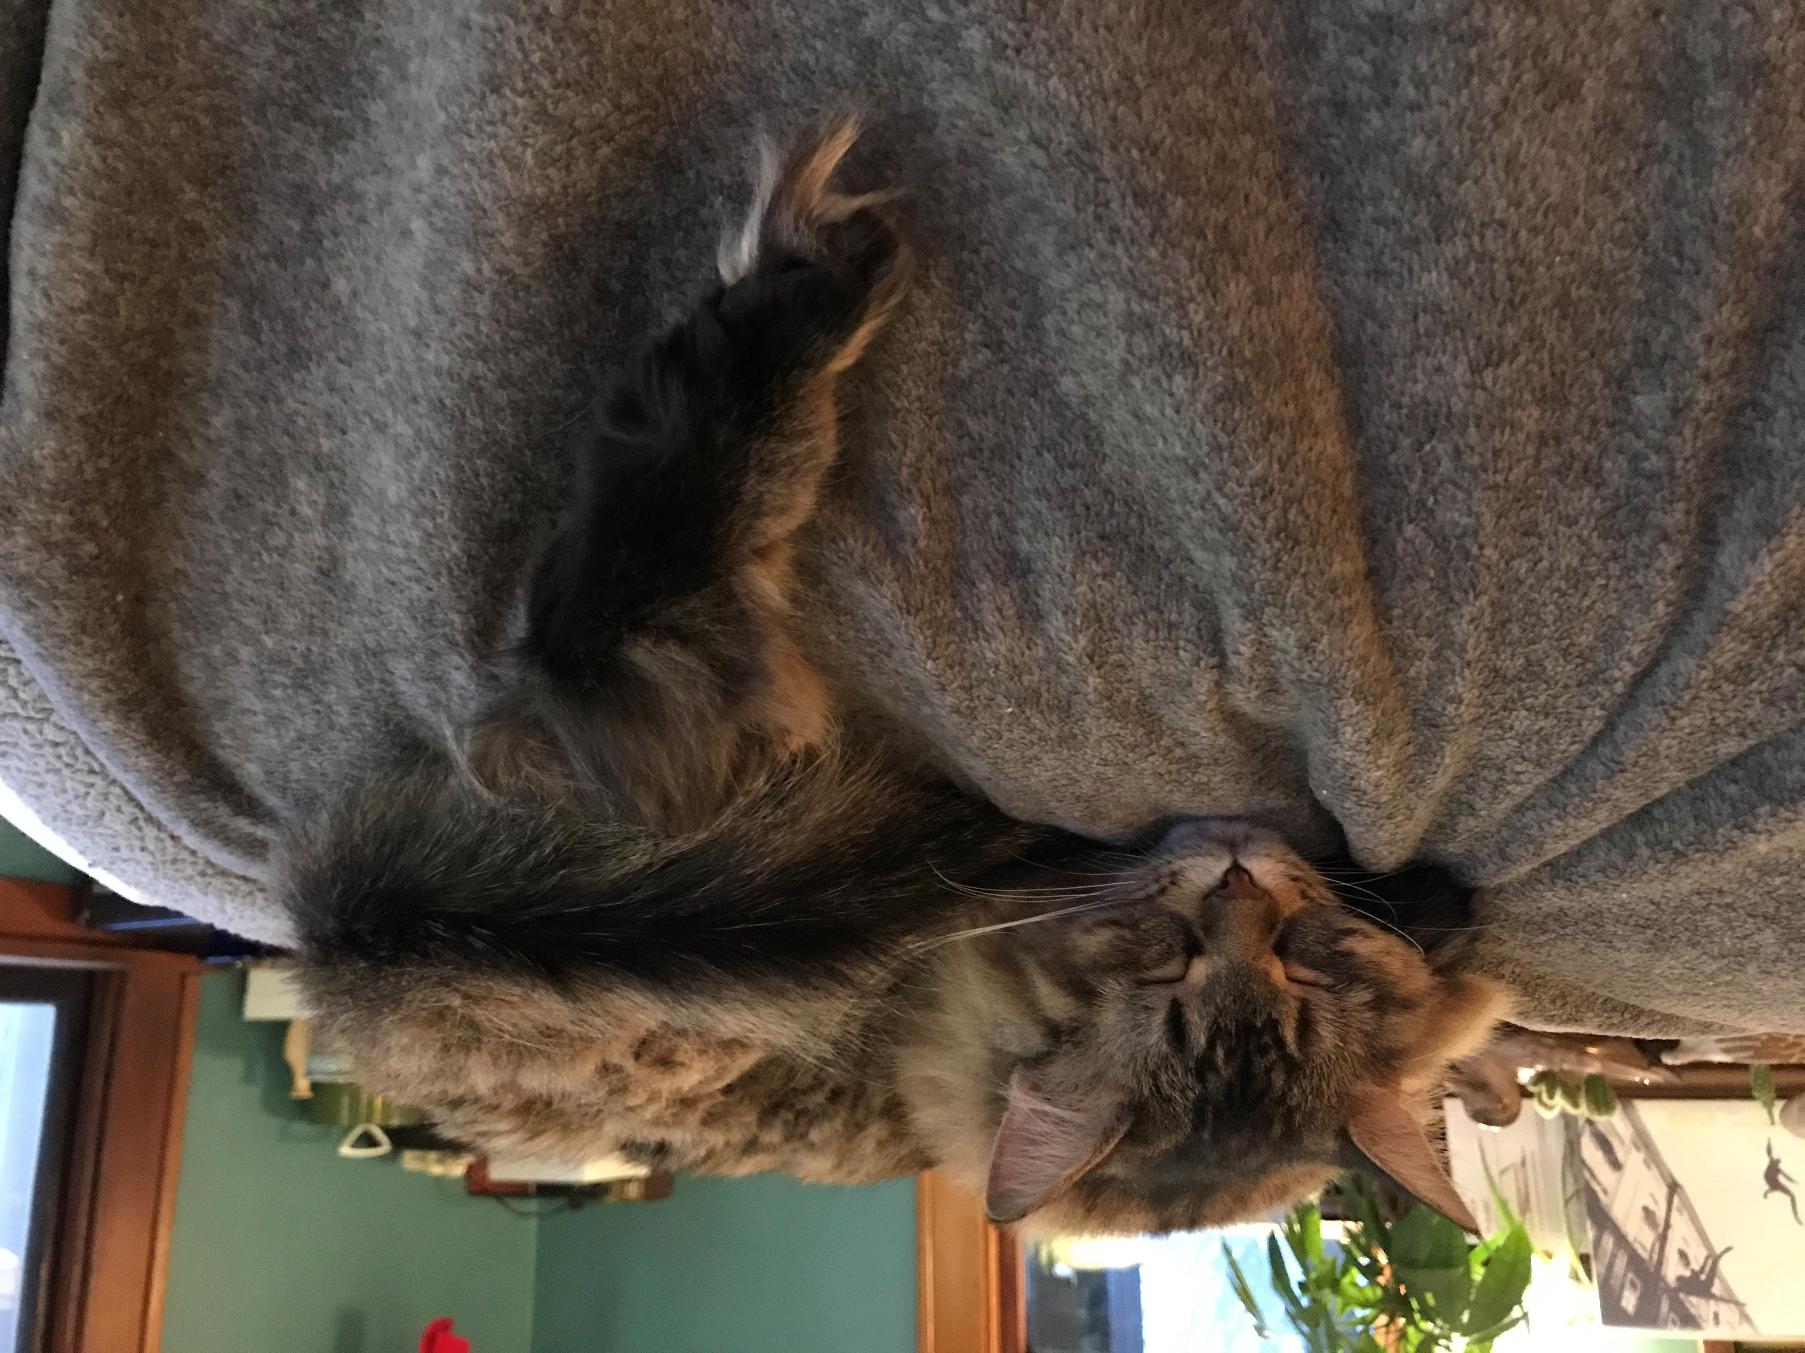
Upcoming Alma and Primo VE Events- Office Hours Schedule
January 14
January 28
February 11
February 25
March 11
March 25
April 8
April 22
May 13
May 27
Office Hours Schedule (through May)
Notes:
[Jen]
As everyone prepares for another busy semester, the CARLI Office staff wanted to take a moment to remind you of our Alma Primo VE Open Office Hours schedule on the 2nd and 4th Thursday of each month; future dates listed on this slide and on the CARLI Event calendar.

Slide 5
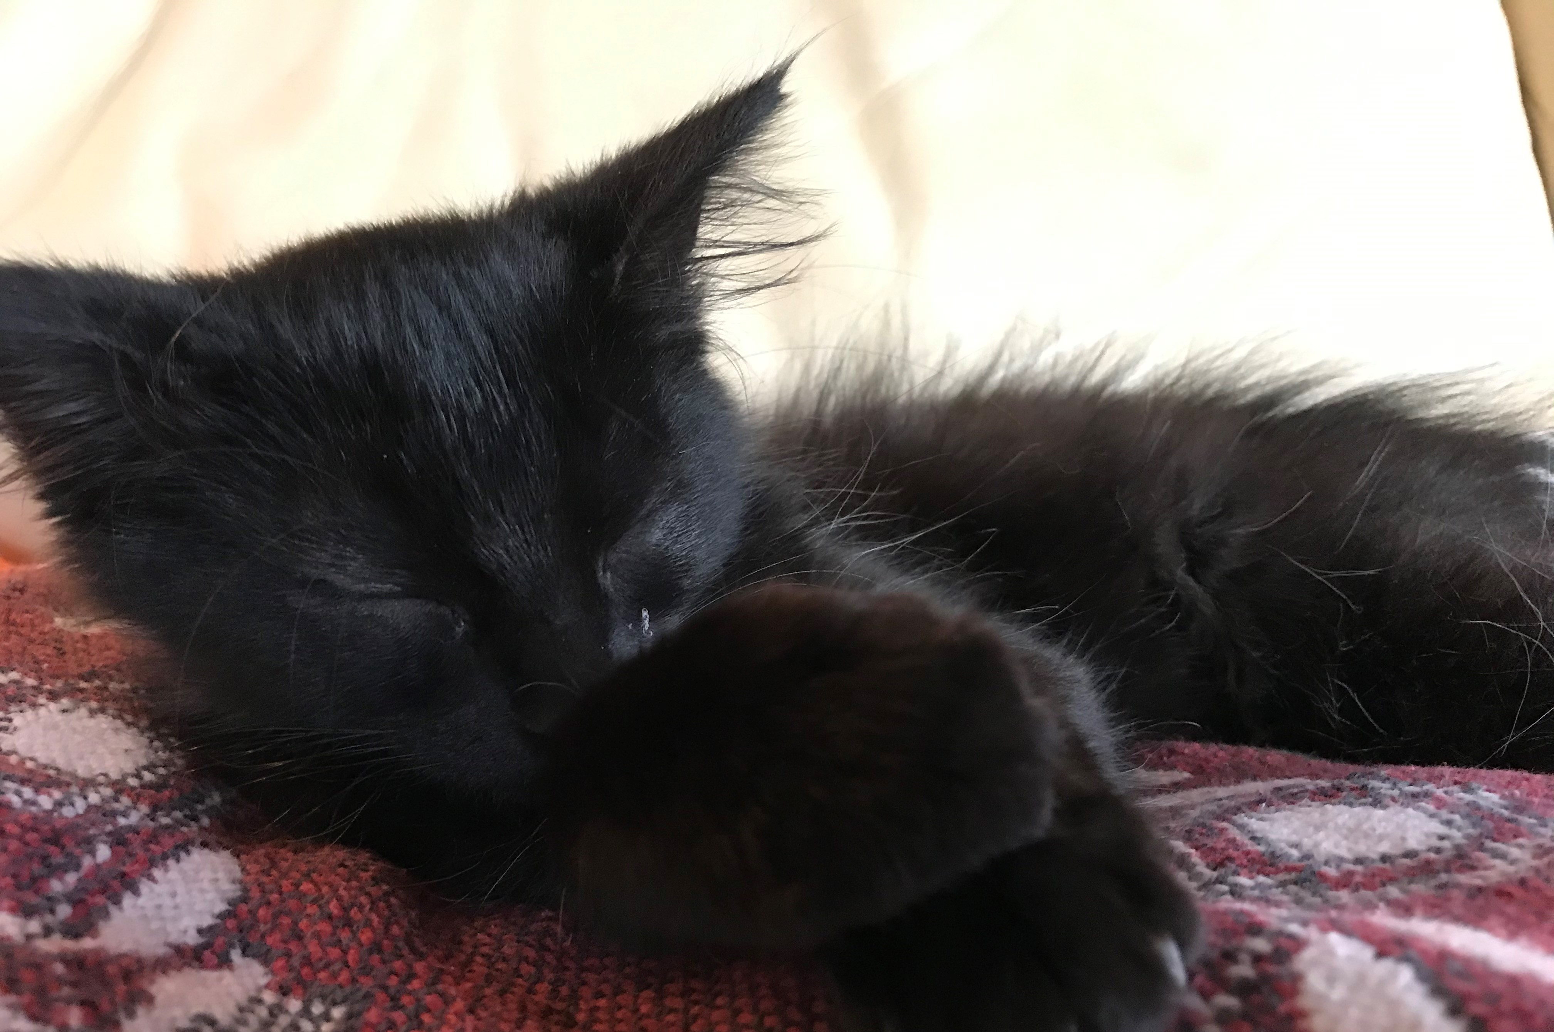
Future Office Hours ToPics
Topics for Office Hours Discussions
https://go.illinois.edu/officehourstopicsuggestions
Notes:
[Jen]
These CARLI Alma and Primo VE Office Hours sessions launched as weekly sessions back on May 24th of 2019, a lifetime ago.
These sessions were initially used to help keep I-Share library staff apprised of tasks that needed to completed as part of our Voyager to Alma migration process.
Early topics included such smash hits as “Migration Form, due July 23” and “CARLI’s Annotated Configuration Form Directions, and Printers.”
Those early 2019 sessions often also covered topics to help build foundational understanding of specific Alma functionality and structure, such as the “Fulfillment Configuration Utility” and “Student Information System Integration” as we began having access to our test environments.
In 2020, early sessions also focused on migration-related tasks, including clean-up and end-of-Voyager tasks. As we were working in our test environments, sessions began to focus on some workflows unique to our consortial environment, with many more sessions devoted to participant Q&A. Then, we went live with Alma on June 24 of 2020, a year after weekly office hours began.
Since go-live in 2020, the content of weekly office hours have morphed as our task-based needs have changed.
As of late, we usually include some updates, reminders, and participant Q & A, with a brief topical-based presentation.
We’ve begun holding additional “topical area” based sessions, the technical services and fulfillment sessions we’ll review soon.
Even with those, attendance at these office hours has remained strong, and the audiences are often different too.
We shouldn’t keep doing something the same way because we’ve been doing it that way; evaluation for relevancy is important!
So we want to hear from you; we have some questions prepared to guide the conversation, but please feel free to unmute your microphones to chime in with your audio as well when we reach this portion of today’s time. Here are those questions for your consideration; we’ll come back to them for discussion following the reminders and announcements:
What about office hours have you found helpful?
What could add value to office hours?
These Office Hours serve as a point of connection between our member libraries; what are some topics you would like to discuss with your colleagues? They don’t necessarily need to be how-to based (although those are welcome); they can be philosophical/theoretical in nature as well.
What continuing educational needs do you have at your library? Which would be helpful to have addressed/presented during these office hours sessions?
I’ll read those a second time so they can be in your thoughts:
What about office hours have you found helpful?
What could add value to office hours?
These Office Hours serve as a point of connection between our member libraries; what are some topics you would like to discuss with your colleagues? They don’t necessarily need to be how-to based (although those are welcome); they can be philosophical/theoretical in nature as well.
What continuing educational needs do you have at your library? Which would be helpful to have addressed/presented during these office hours sessions?
Next, announcements and reminders.

Slide 6
Upcoming Alma and Primo VE Events- Ongoing series
Technical Services Q & A
Gather with CARLI staff and your technical services colleagues to discuss Alma technical services topics, from acquisitions and cataloging workflows for physical resources to electronic resources management:
Wednesday 1/13 @ 10- https://www.carli.illinois.edu/tech-services-qa-2021-01-13
Wednesday 1/27 @ 10- https://www.carli.illinois.edu/tech-services-qa-2021-01-27
Wednesday 2/10 @ 10- https://www.carli.illinois.edu/tech-services-qa-2021-02-10
Wednesday 2/24 @ 10- https://www.carli.illinois.edu/tech-services-qa-2021-02-24
Wednesday 3/10 @ 10- https://www.carli.illinois.edu/tech-services-qa-2021-03-10
Wednesday 3/24 @ 10- https://www.carli.illinois.edu/tech-services-qa-2021-03-24
Wednesday 4/14 @ 10- https://www.carli.illinois.edu/tech-services-qa-2021-04-14
Wednesday 4/28 @ 10- https://www.carli.illinois.edu/tech-services-qa-2021-04-28
Wednesday 5/12 @ 10- https://www.carli.illinois.edu/tech-services-qa-2021-05-12 Wednesday 5/26 @ 10- https://www.carli.illinois.edu/tech-services-qa-2021-05-26
Notes:
[Debbie]
Looking at other ongoing series besides the Office Hours, with the Technical Services Q & A sessions, you can gather with CARLI staff and your technical services colleagues to discuss Alma technical services topics, from acquisitions and cataloging workflows for physical resources to electronic resources management.
Each session will include how-to presentations, discussion of consortial practices, and opportunities for questions and answers from CARLI and colleagues alike.
Sessions will be held the second and fourth Wednesdays of each month. Sessions will be recorded for later viewing.
Please register for any sessions you’d like to attend using the link from the CARLI event calendar.

Slide 7
Upcoming Alma and Primo VE Events- Ongoing Series
Let's Talk about Fulfillment (I mean Alma, not life's purpose)
For the opportunity to talk with CARLI staff and your CARLI library colleagues about Alma Fulfillment and Automated Fulfillment Network workflows, known issues, and Q & A:
Friday 1/15 @ 2- https://www.carli.illinois.edu/lets-talk-about-fulfillment20210115
Tuesday 1/26 @ 10:30- https://www.carli.illinois.edu/lets-talk-about-fulfillment20210126
Friday 2/12 @ 2- https://www.carli.illinois.edu/lets-talk-about-fulfillment20210212
Tuesday 2/23 @ 10:30- https://www.carli.illinois.edu/lets-talk-about-fulfillment20210223
Friday 3/12 @ 2- https://www.carli.illinois.edu/lets-talk-about-fulfillment20210312
Tuesday 3/23 @ 10:30- https://www.carli.illinois.edu/lets-talk-about-fulfillment20210323
Friday 4/09 @ 2- https://www.carli.illinois.edu/lets-talk-about-fulfillment20210409
Tuesday 4/20 @ 10:30- https://www.carli.illinois.edu/lets-talk-about-fulfillment20210420
Friday 5/07 @ 2- https://www.carli.illinois.edu/lets-talk-about-fulfillment20210507
Tuesday 5/18 @ 10:30- https://www.carli.illinois.edu/lets-talk-about-fulfillment20210518
Notes:
[Debbie]
If you'd like to talk with CARLI staff and your CARLI library colleagues about Alma Fulfillment and Automated Fulfillment Network workflows, known issues, and Q & A, join us online for the spring sessions of “Let’s talk about Fulfillment (I mean Alma, not life’s purpose).”
These sessions are scheduled for every other week, alternating between Tuesdays at 10:30am and Fridays at 2:00pm.
CARLI Office Staff will be online for each session to work with your questions and to facilitate the discussion.
Attendees will be able to unmute their microphones and/or utilize the chat for participation. We'll take turns sharing screens as appropriate.
This session will be recorded for CARLI staff use; since Fulfillment involves patron data, the CARLI office will evaluate if it is fitting and valuable to post segments of the session for later review.
Registation for these sessions is also available from the event page in the CARLI Calendar.

Slide 8
Upcoming Alma and Primo VE Events- Ongoing Series
Ex Libris’ “Primo VE- Become an Expert”
From Ex Libris, “This course will delve into advanced topics including building effective searches, configuration, branding, normalization rules, loading external data sources, CDI, and more.”
https://knowledge.exlibrisgroup.com/Primo/Product_Materials/Primo_Webinars/Primo_VE_-_Become_an_Expert
Thursday 1/28 @ 10am – Introduction to Discovery
Thursday 2/4 @ 10am – How Primo Works
Thursday 2/11 @ 10am – Search Configuration
Thursday 2/18 @ 10am – Search Interfaces
Thursday 2/25 @ 10am – Branding, CSS, HTML
Thursday 3/4 @ 10am - Display
Thursday 3/11 @ 10am – Delivery
Thursday 3/18 @ 10am – Local Data
Thursday 3/25 @ 10am – Central Discovery Index
Thursday 4/1 @ 10am – External Data Sources
Thursday 4/8 @ 10am – Deduplication and FRBR
Thursday 4/15 @ 10am – Primo Analytics
Notes:
[Debbie]
Ex Libris has announced a live webinar series called “Primo VE – Become an Expert” to start at the end of January 2021! Each of the 12 sessions in the series will cover a different topic related to Primo VE, including “building effective searches, configuration, branding, normalization rules, loading external data sources, CDI, and more.” Complete descriptions of each session are available on the Ex Libris website.
Registration for these Ex Libris Primo VE webinars is free, and the sessions will be recorded for later viewing.
CARLI recommends that you share this timely Ex Libris webinar opportunity with anyone at your institution who performs customization or configuration of Primo VE, makes decisions about Primo VE, or provides instruction on the use of Primo VE.
Registration is available at the link on this slide.

Slide 9
Upcoming Alma and Primo VE Events
CARLI Resource Sharing in our New Age: Primo VE Configuration & Customizations https://www.carli.illinois.edu/carli-resource-sharing-our-new-age-primo-ve-configuration-customizations Friday 1/22 @ 11am
Notes:
[Debbie]
For upcoming one-time events, we have the
CARLI Resource Sharing in our New Age: Primo VE Configuration & Customizations
The CARLI Resource Sharing committee presents "CARLI Resource Sharing in our New Age: Tips and Tricks in the Time of Alma and COVID," a monthly discussion series.
The third discussion will be on Friday, January 22, 2020 at 11am central.
This discussion will focus on configuring and customizing labels in Primo VE with a focus on Resource Sharing needs. Belinda Cheek of North Central College will discuss the considerations for configurations made to Primo VE labels by NCC library staff, and Jessica Gibson of the CARLI Office will explain the how-to steps and workflows for making similar changes for your institution.

Slide 10
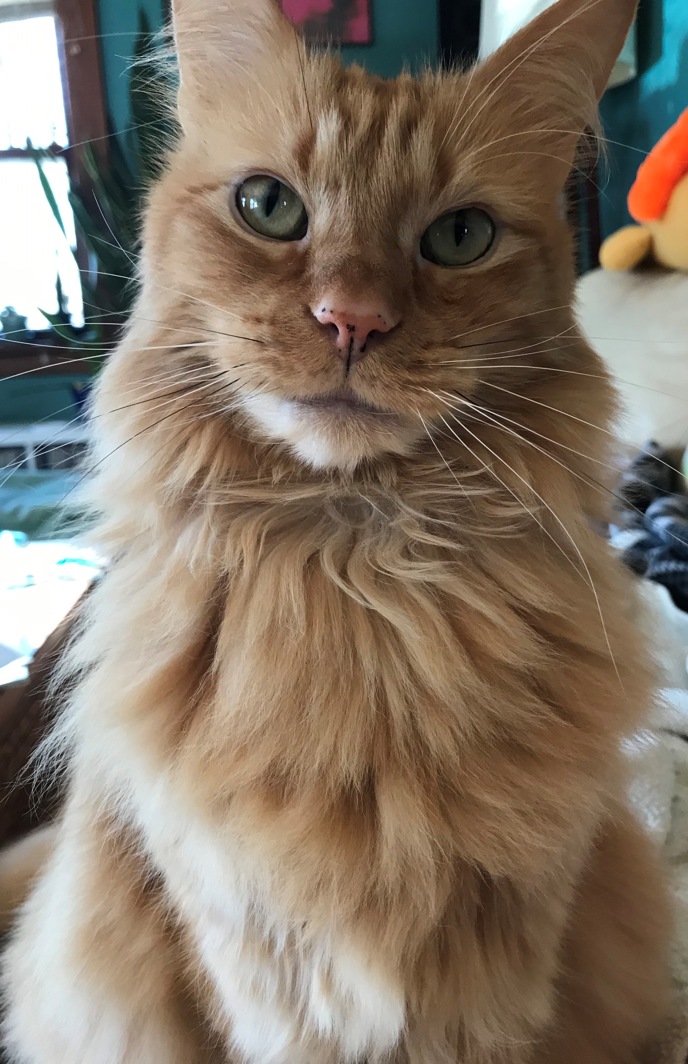
Enabling Overdue Notices in Alma
Enabling Overdue Notices
in Alma
Overdue Notices can now be enabled in Alma.
Sign up for meeting with CARLI staff to review settings.
As of today:
25 institutions have enabled
14 have met with CARLI staff/ have a future date in mind
Notes:
[Debbie]
Switching to our next agenda item of some ongoing project reminders.
We’ve been meeting with I-Share libraries who are ready to enable the sending of Overdue Notices to be sent to local and I-Share patrons.
If your institution is ready to turn on overdue notices in Alma, please have your Alma/Primo VE contact or your I-Share Liaison select one of the Overdue Notice Review meeting timeslot for your institution, from the link in the email I’ve sent to them.
At the meeting, we will review your library’s settings related to the overdue notices and discuss the next steps for your library staff and CARLI staff to complete.
The meeting should be scheduled after your library has completed the review and updates for the "Patron Review in Alma" reports that CARLI uploaded to Box in November.
The steps for working with these files were emailed to two staff at each I-Share Institution. Depending on your staff distribution of duties, this may have been the I-Share Liaison, Circulation Contact, and or Alma/Primo contact.
This meeting must also be scheduled before CARLI staff enable your overdue notices, but, the date of your meeting does not need to be the date your notices are turned on, I.E. you can schedule a review meeting in advance of your desired notice turn-on date.
A reminder that at this time we are NOT enabling the Alma fulfillment jobs, rules, and settings that cause either local or I-Share patrons to be further fined, billed, or blocked until we begin more “normal” circulation operations again.

Slide 11
endING overdue fines and processing fees by Jan. 1, 2021
Ending Overdue Fines and Processing Fees
Reminder: CARLI Board of Directors approved two proposals that will end the practice of I-Share libraries charging overdue fines for their main circulating collections and “processing fees” for any lost materials.
I-Share Libraries filled out a survey letting CARLI know whether they planned to implement the changes on their own before January 1, 2021, or would prefer CARLI staff make these policy configuration changes on their behalf.
CARLI Office Staff: Work completed.
Library Staff: Work should have been finished by January 1, 2021.
Notes:
[Debbie]
Next reminder-
In September, the CARLI Board of Directors approved two proposals that will end the practice of I-Share libraries charging overdue fines for their main circulating collections and “processing fees” for any lost materials. We asked each I-Share library to fill out a survey letting us know whether the library’s staff would make the changes in Alma Configuration, or whether CARLI Staff should make the changes on the library’s behalf. Thanks to you all for filling out the survey!
If you elected to have CARLI Offices staff make the edits, we have completed that work.
If your library noted in the survey that you would make the changes yourselves, that work should have been completed by January 1, 2021, but it’s not too late to double-check.
On the next two slides, I’ve listed which libraries selected those options.

Slide 12
endING overdue fines and processing fees by Jan. 1, 2021
Ending Overdue Fines and Processing Fees:
Library noted staff would make the edits
Aurora University
Bradley University
Catholic Theological Union
DePaul University
Elmhurst University
Eureka College
Illinois Central College
Joliet Junior College
Kishwaukee College
Lewis and Clark Community College
Lewis University
Lincoln Christian University
McHenry County College
Meadville Lombard Theological School
North Park University
Northern Illinois University
Oakton Community College
School of the Art Institute of Chicago
Southern Illinois University Carbondale
Spertus Institute of Jewish Studies
Trinity Christian College
Trinity International University
University of Illinois at Chicago
University of Saint Mary of the Lake Mundelein Seminary
Notes:
[Debbie]
This slide shows the libraries who filled out the survey to note that library staff would make the edits.
I’ll pause here a moment so that you can see if your institution is in the list.

Slide 13
endING overdue fines and processing fees by Jan. 1, 2021
Ending Overdue Fines and Processing Fees: Library noted in survey no changes would be needed
Abraham Lincoln Presidential Library
Concordia University Chicago
Illinois Institute of Technology
Illinois Wesleyan University
JKM Library Trust
Knox College
Lincoln Land Community College
McHenry County College
Millikin University
Monmouth College
Moody Bible Institute
National-Louis University
Newberry Library
North Central College
Northeastern Illinois University
Oakton Community College
Sauk Valley Community College
Southeastern Illinois College
Notes:
[Debbie]
And this slide shows the libraries who filled out the survey to note that they did not think that edits would need to be made, and those who did not fill out the survey.
These libraries should do a double-check as well.
I’ll pause here a moment so that you can see if your institution is in the list.
If you didn’t see your institution in either list, you’d noted in the survey that CARLI staff should make the edits on your behalf.
I’ll now pass this presentation to Jen for our next reminders

Slide 14
Reporting Problems With Alma and Primo VE
In most situations, please contact CARLI first at support@carli.illinois.edu for problems and questions about Alma and Primo VE
We know our unique I-Share consortial environment and configurations better than general Ex Libris Support.
It helps CARLI staff identify problems across I-Share institutions.
If needed, CARLI staff will open a Case with Ex Libris and copy you so that you can participate in correspondence on the Case.
Email to our support@carli.illinois.edu address is always better than a direct email to one staff member.
Notes:
[Jen]
And finally, a few reminders about problem reporting as we enter the new year:
Please contact CARLI first at support@carli.illinois.edu when you experience problems or have questions about Alma and Primo VE. Although none of us would claim to be experts, CARLI staff are collectively aware of what is going on in our unique I-Share consortial environment and its configurations, so chances are we can provide context in addition to help and direction. Filing a ticket with CARLI first also helps us to identify broader issues that may be occurring across more than one I-Share institution so that we can recognize larger issues and contact Ex Libris Support for help, when needed. And please remember to email our CARLI support address at support@carli rather than a direct email to one CARLI staff member; that will ensure that no correspondence is missed if someone is out of the office, and it allows staff to work together on issues in our ticketing system.

Slide 15
Reporting Problems
When you contact CARLI Support, help us to help you better and faster by including these elements in your support tickets:
Who: User or patron, or user group(s) that have the issue
What: MMS ID or barcode of one or more titles/items; Primo VE permalinks or search URLs
When: Time the event occurred
Where: What zone (IZ, NZ), library, menu, search
Why: Describe the context; what you were trying to do
How: Length for slow response time reports
Screenshots (in Word files or PDFs) or short videos (with or without sound) can also be very helpful!
Notes:
[Jen]
When you contact CARLI Support, remember to include as many details as possible so that we can effectively and efficiently replicate your problem.
Who: User or patron, or user group(s) that have the issue
What: MMS ID or barcode of one or more titles/items; Primo VE permalinks or search URLs
When: Time the event occurred
Where: What zone (IZ, NZ), library, menu, search
Why: Describe the context; what you were trying to do
How: Length for slow response time reports
Screenshots or Short videos (with or without sound) can also be very helpful!
Thank you for your help!

Slide 16
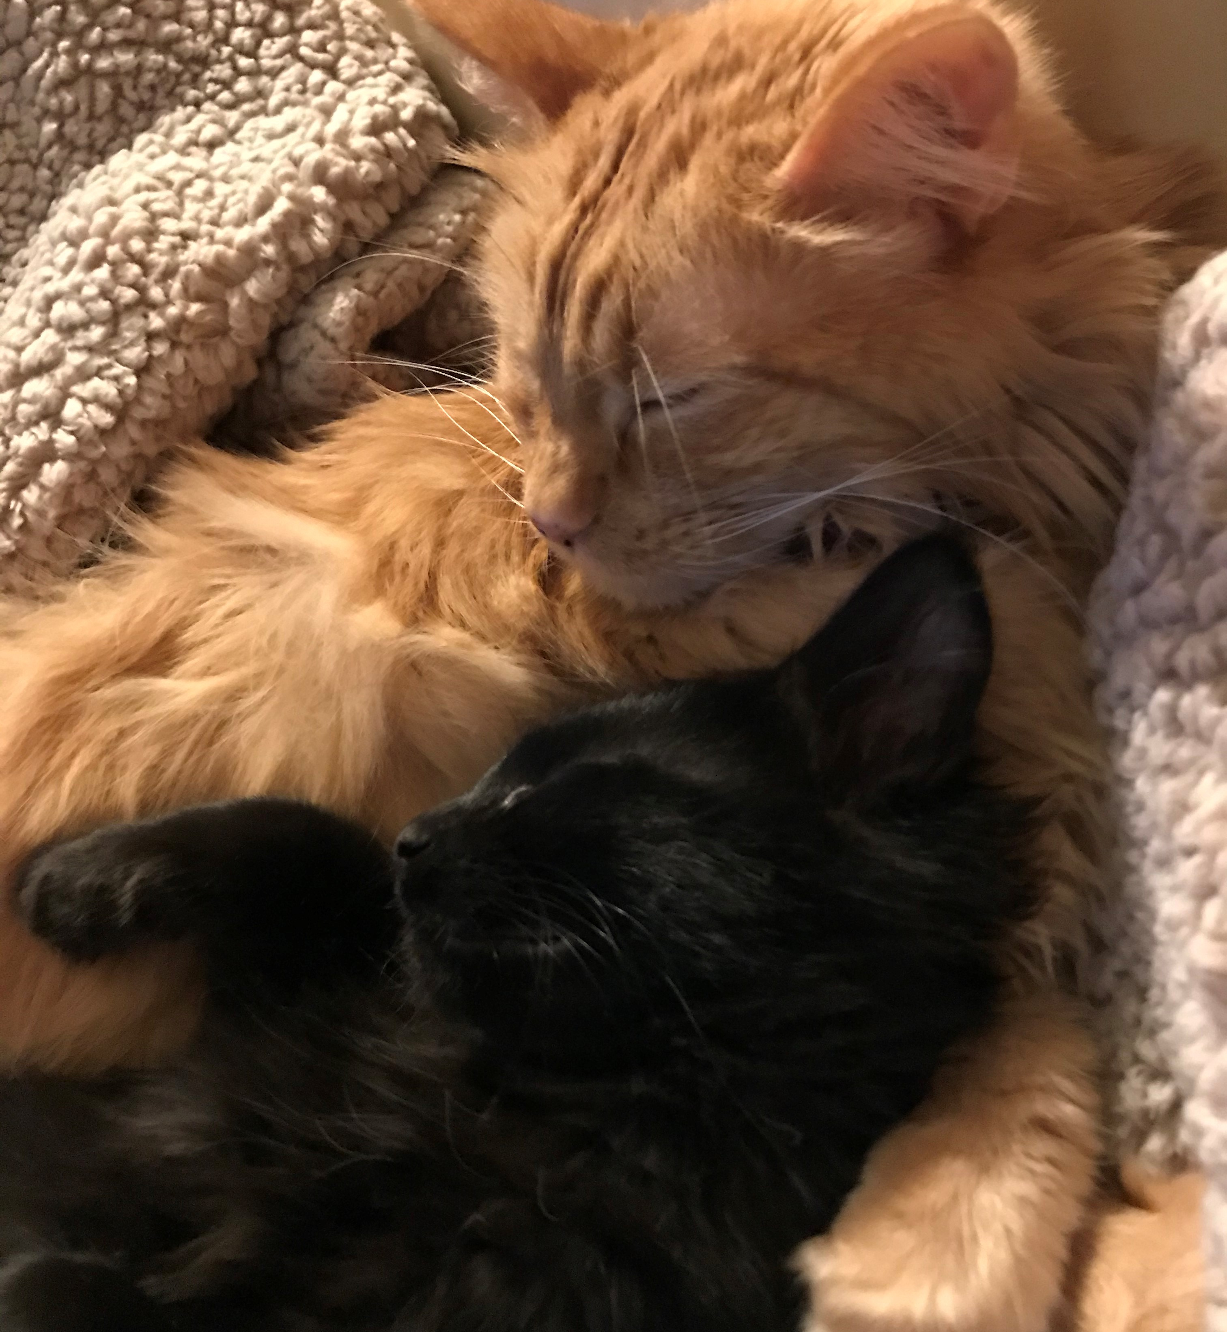
Future Office Hours ToPics
Topics for Office Hours Discussions
https://go.illinois.edu/officehourstopicsuggestions
Anything about office
hours you have found helpful that we should keep doing?
2) What could add value to office hours?
Notes:
[Jen]
Alright, bringing this back for discussion. Denise will be taking notes for us, thank you Denise!
We want to hear from you; we have some questions prepared to guide the conversation, but please feel free to unmute your microphones to chime in with your audio as well.
Anything about office hours have you found helpful that we should keep doing?
What could add value to office hours?

Slide 17
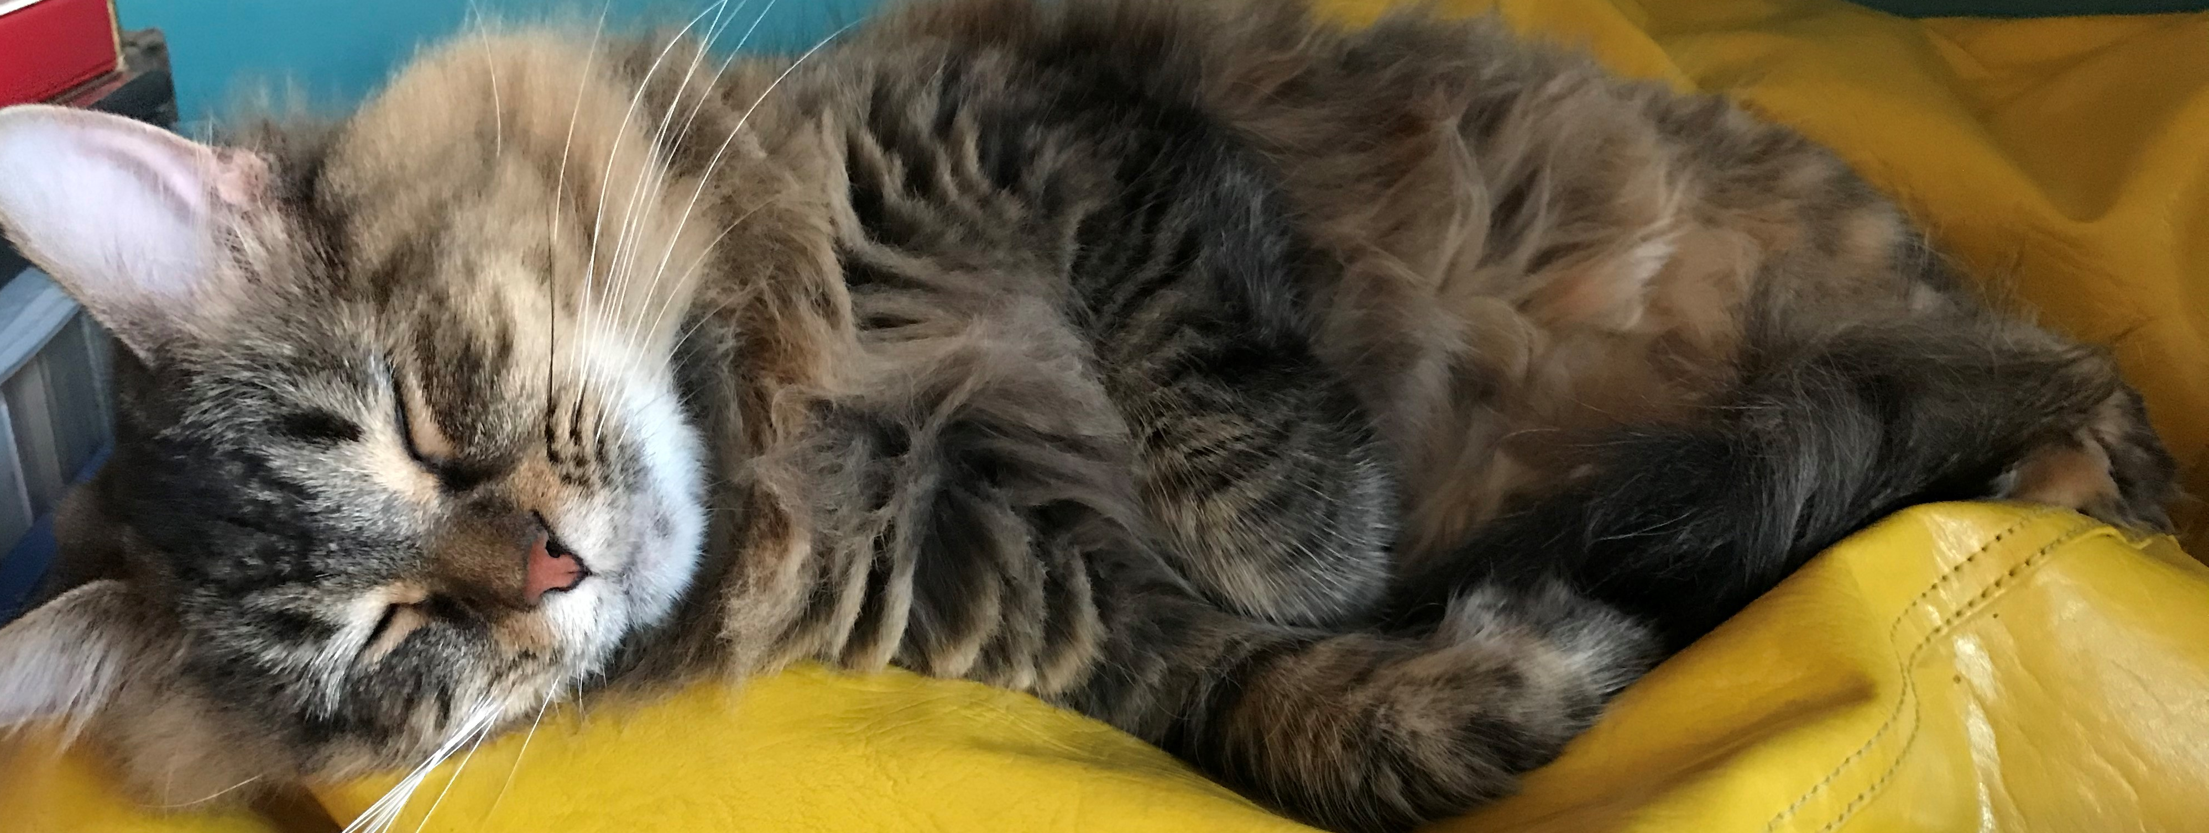
Future Office Hours ToPics
Topics for Office Hours Discussions
https://go.illinois.edu/officehourstopicsuggestions
What topics would you like to have active discussions about with your CARLI Library colleagues?
What continued educational needs do you have at your library?
Notes:
[Jen]
These Office Hours serve as a point of connection between our member libraries; what are some topics you would like to discuss with your colleagues? They don’t necessarily need to be how-to based (although those are welcome); they can be philosophical/theoretical in nature as well.

Slide 18
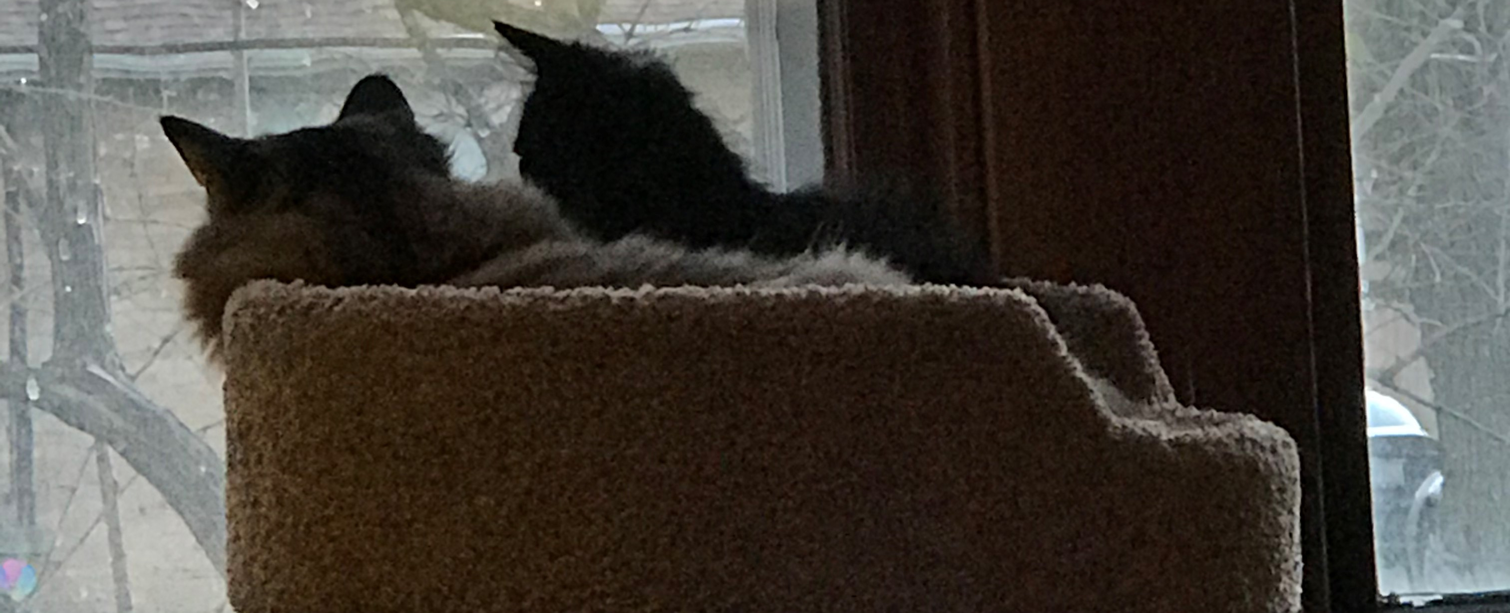
Future Office Hours ToPics
Topics for Office Hours Discussions
https://go.illinois.edu/officehourstopicsuggestions
What continued educational needs do you have at your library?
Notes:
[Jen]
What continued educational needs do you have at your library? Which would be helpful to have addressed/presented during these office hours sessions?

Slide 19
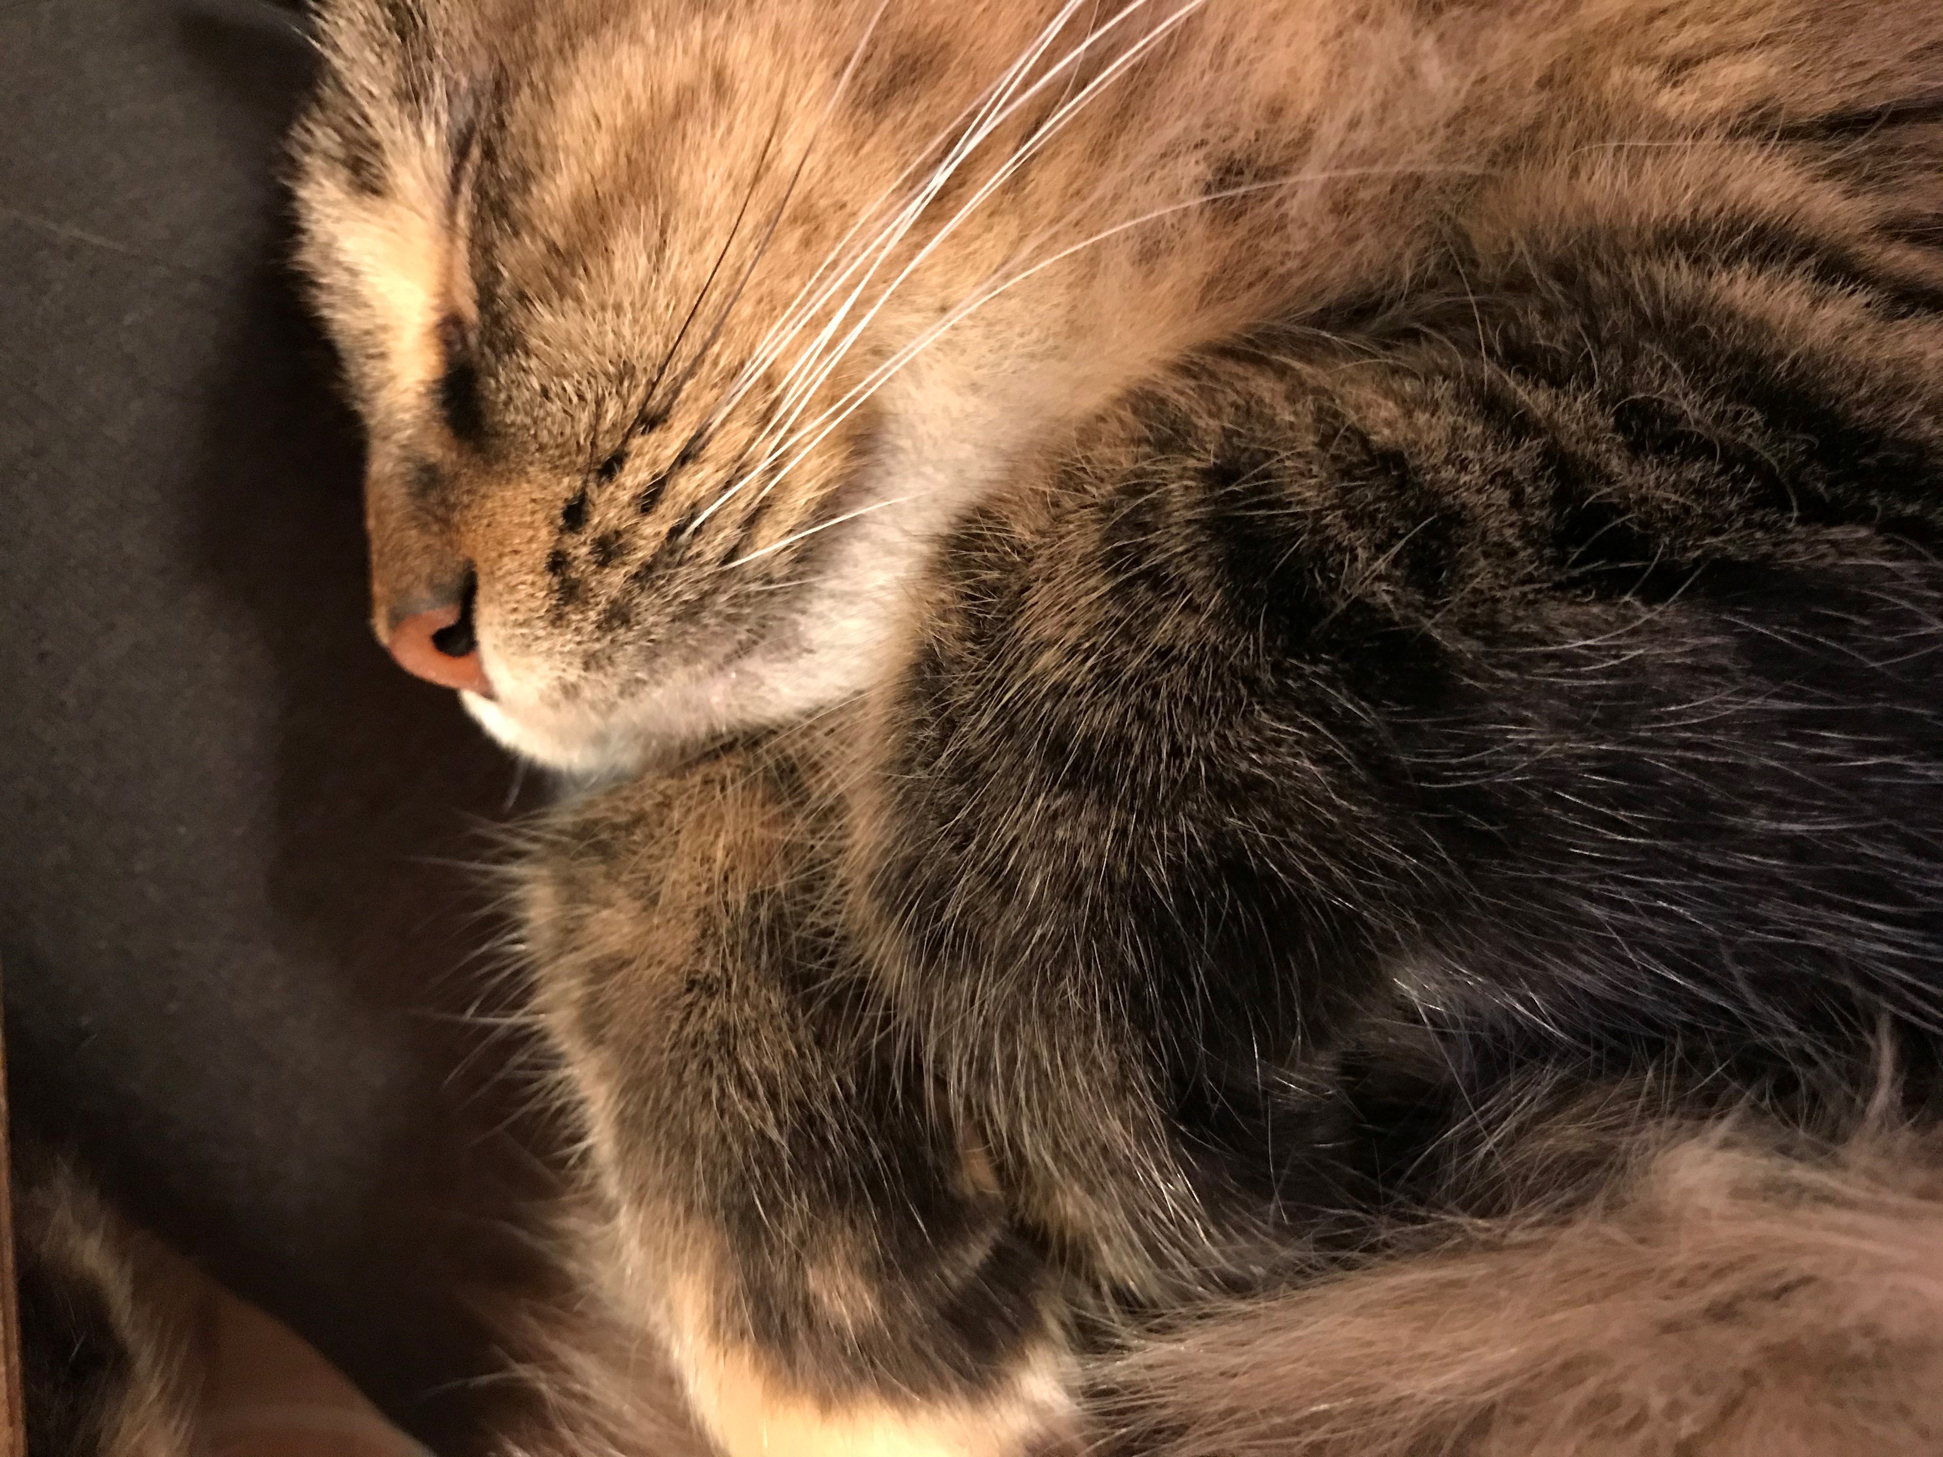
I-Share Alma Primo VE Office hours
Questions?
Join us January 28, 2021 at 2pm for another Office Hour.
Contact CARLI at support@carli.Illinois.edu

