Slide 1
I-Share Alma Primo VE Office hours will start shortly
Welcome!
Office Hours will start at 2pm and run until 3pm Please mute your microphone As time permits, we will respond to questions typed in the chat box, and offline afterwards, as needed
This session will be recorded and made available on the CARLI website both as PDF slides and as a recording, with live links to all referenced resources

Slide 2
Office Hours December 10, 2020

Slide 3
Agenda Office Hours 12/10/2020
Agenda – 12/10/2020
Upcoming Alma/Primo VE learning opportunities See https://www.carli.illinois.edu/calendar
Reminders:
AFN during the winter break
Fines and Fees Update
Re-enabling Overdue Notices
Review of Improving Linking/Augmentation and deactivating e-collections
Participant Q & A

Slide 4
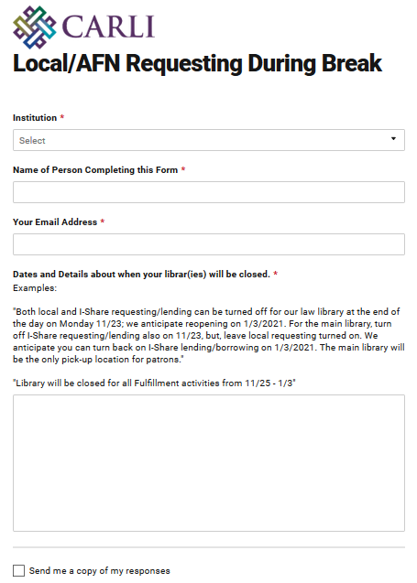
Local and I-Share/AFN requesting during Break
Local and I-Share/AFN Requesting During Break
Form to collect dates https://go.uillinois.edu/IShareRequesting
I-Share lending and borrowing enabled
Notes:
[Debbie] Hi everyone! As a reminder about I-Share/AFN requesting during the holidays this year, we will be temporarily turning off both lending and requesting while each library is closed, rather than continuing to allow patrons to place new requests during the closure.
To simplify collecting this information from all I-Share institutions, we’ve created an online form where your can submit your anticipated dates when your libraries will be closed during this upcoming winter break, and how requesting and lending should be modified. We’ve already heard from the majority of I-Share libraries- thanks! But if we haven’t heard from you yet, I’ll send out a reminder email to the I-Share Liaisons with the link after office hours.
Last night I updated our webpage with the information of which institutions have I-Share lending/borrowing enabled, and with a new column for when we anticipate I-Share turning on, or off, whichever is the next activity for the institution. We’ll keep the webpage updated as we flip institutions between On and Off, and vice versa. https://www.carli.illinois.edu/products-services/i-share/alma/fulfillment/how-to_AFNEnabled
This form is only to gather information for the Alma configuration changes needed; you will want to be in contact for ILDS delivery separately, if you haven’t been already.
And if anything changes about your open/close dates after you’ve filled out the form, you can email CARLI Support.

Slide 5
endING overdue fines and processing fees by Jan. 1, 2021
Ending Overdue Fines and Processing Fees
Reminder: CARLI Board of Directors approved two proposals that will end the practice of I-Share libraries charging overdue fines for their main circulating collections and “processing fees” for any lost materials.
I-Share Libraries filled out a survey letting CARLI know whether they planned to implement the changes on their own before January 1, 2021, or would prefer CARLI staff make these policy configuration changes on their behalf.
CARLI Office Staff: Plans to make the changes December 21-23.
Library Staff: Work should be complete before January 1, 2021.
Notes:
[Debbie]
In September, the CARLI Board of Directors approved two proposals that will end the practice of I-Share libraries charging overdue fines for their main circulating collections and “processing fees” for any lost materials. We asked each I-Share library to fill out a survey letting us know whether the library’s staff would make the changes in Alma Configuration, or whether CARLI Staff should make the changes on the library’s behalf. Thanks to you all for filling out the survey!
If you elected to have CARLI Offices staff make the edits, we plan to do that work the week of December 21st.
If your library plans to make the changes yourselves, that work should be completed before January 1, 2021.

Slide 6
endING overdue fines and processing fees by Jan. 1, 2021
Ending Overdue Fines and Processing Fees
Upcoming work
Workflow to implement changes
Alma Configuration at the Institutional Level > Fulfillment > Terms of Use (TOU) > Loan TOU
Lost Item Fine (aka processing fee)
Maximum Fine
Overdue Fine
Recalled Overdue Fine
Grace Period
Notes:
[Debbie]
This slides lists where in Alma changes will be made to the configuration, depending on the setup at the library.
If your library opted to make the adjustments yourself, and you have any questions while you are making those adjustments, please email CARLI Support.

Slide 7
Enabling Overdue Notices in Alma
Enabling Overdue Notices in Alma
If your institution is ready to turn on overdue notices in Alma starting in December 2020:
https://docs.google.com/spreadsheets/d/1Qyn4fH2UCHmnCPawYnd1rEbPqL9Nl5Uc6LnzsGtrLdg/edit?usp=sharing
If your institution prefers to wait and have your overdue notices turned on sometime in 2021, a second set of meetings will be available in 2021.
Notes:
[Debbie] This past Monday, I sent an email to the Alma Primo Contacts and I-Share liaisons that we’re now ready to begin enabling (in Alma) the sending of overdue notices to local and I-Share patrons. Overdue Notices for the first institution to be enabled went out last night, with several more institutions planned for this evening.
If your institution is ready to turn on overdue notices in Alma staring in December 2020, please have your Alma/Primo VE contact or your I-Share Liaison select one Overdue Notice Review meeting timeslot for your institution in the linked Google Document.
At the meeting, we will review your library’s settings related to the overdue notices and discuss the next steps for your library staff and CARLI staff to complete.
The meeting should be scheduled after your library has completed the review and updates for the "Patron Review in Alma" reports that CARLI uploaded to Box in November.
The steps for working with these files were emailed to two staff at each I-Share Institution. Depending on your staff distribution of duties, this may have been the I-Share Liaison, Circulation Contact, and or Alma/Primo contact.
This meeting must also be scheduled before CARLI staff enable your overdue notices, but, the date of your meeting does not need to be the date your notices are turned on, I.E. you can schedule a review meeting in advance of your desired notice turn-on date.
A reminder that at this time we are NOT enabling the Alma fulfillment jobs, rules, and settings that cause either local or I-Share patrons to be further fined, billed, or blocked until we begin more “normal” circulation operations again.
I’ll now pass this presentation over to my colleague Denise.

Slide 8
Improving Linking in Alma/Primo VE
How to improve accuracy of linking to
articles and ebooks?
Alma & Primo VE build OpenURL links based on citation information.
Example: Alvanoudi, Angeliki. “Gender, Language and a Lipstick: Creating Cultural Change in a World of Paradoxes.” Humanities (Basel) 7.3 (2018): 87–. https://doi.org/10.3390/h7030087 This library has full text in DOAJ Directory of Open Access Journals (Free internet resource, activated by CARLI) Available from 2012.
.
Notes:
Alma & Primo VE build OpenURL links, here’s an example

Slide 9
Improving Linking in Alma/Primo VE
Creates an open URL like this:
https://i-share-xxx.primo.exlibrisgroup.com/discovery/openurl?institution=01CARLI_XXX&vid=01CARLI_XXX:CARLI_XXX&rft_val_fmt=info:ofi%2Ffmt:kev:mtx:journal&rft.aulast=Alvanoudi&rft.aufirst=Angeliki%20L.&%3Fctx_ver=Z39.88-2004&rft.volume=7&rft.date=2018&rfr_id=info:sid%2F/cdi_doaj_primary_oai_doa&rft.spage=87&rft.jtitle=Humanities&rft.genre=article&rft.atitle=Gender%20language%20lipstick
Takes the patron to:
https://www.mdpi.com/2076-0787/7/3/87
Notes:
Yes, OpenURLs are messy, but you can see some of the citation or metadata elements in the Open URL,; date = 2018, author name last; first, periodical title “Humanities”, starting page 87, etc.

Slide 10
Improving Linking in Alma/Primo VE
What’s missing?
Example From:
Alvanoudi, Angeliki. “Gender, Language and a Lipstick: Creating Cultural Change in a World of Paradoxes.” Humanities (Basel) 7.3 (2018): 87–. https://doi.org/10.3390/h7030087
To:
https://i-share-mmc.primo.exlibrisgroup.com/discovery/openurl?institution=01CARLI_MMC&vid=01CARLI_MMC:CARLI_MMC&rft_val_fmt=info:ofi%2Ffmt:kev:mtx:journal&rft.aulast=Alvanoudi&%3Fctx_ver=Z39.88-2004&rft.volume=7&rft.date=2018&rfr_id=info:sid%2F/cdi_doaj_primary_oai_doa&rft.spage=87&rft.jtitle=Humanities&rft.genre=article&rft.aufirst=Angeliki%20L.&rft.atitle=Gender%20language%20lipstick
The DOI
https://doi.org/10.3390/h7030087
Notes:
But what’s missing from this OpenURL?
Importantly, the DOI is missing: the
Digital Object identifier is much more precise and quick to process. Same true for Pub Med id numbers,.

Slide 11
Improving Linking in Alma/Primo VE
How to improve Alma linking? Use “Augmentation”
By default, the Digital Object Identifier (DOI) linking and PubMed ID linking are NOT turned on in Alma.
Setting up CrossRef within your Alma IZ turns DOI & PMID querying on.
Setting up PubMed API linking turns on deeper PMID linking.
Unpaywall service to match more OpenAccess/Free resources. NEW web page: https://www.carli.illinois.edu/products-services/i-share/electronic-res-man/unpaywall
See https://www.carli.illinois.edu/products-services/i-share/electronic-res-man
Notes:
After reading slide go to
https://www.carli.illinois.edu/products-services/i-share/electronic-res-man and https://www.carli.illinois.edu/products-services/i-share/electronic-res-man/unpaywall
Then https://www.carli.illinois.edu/sites/files/files/Augmentation_addProfile.pdf

Slide 12
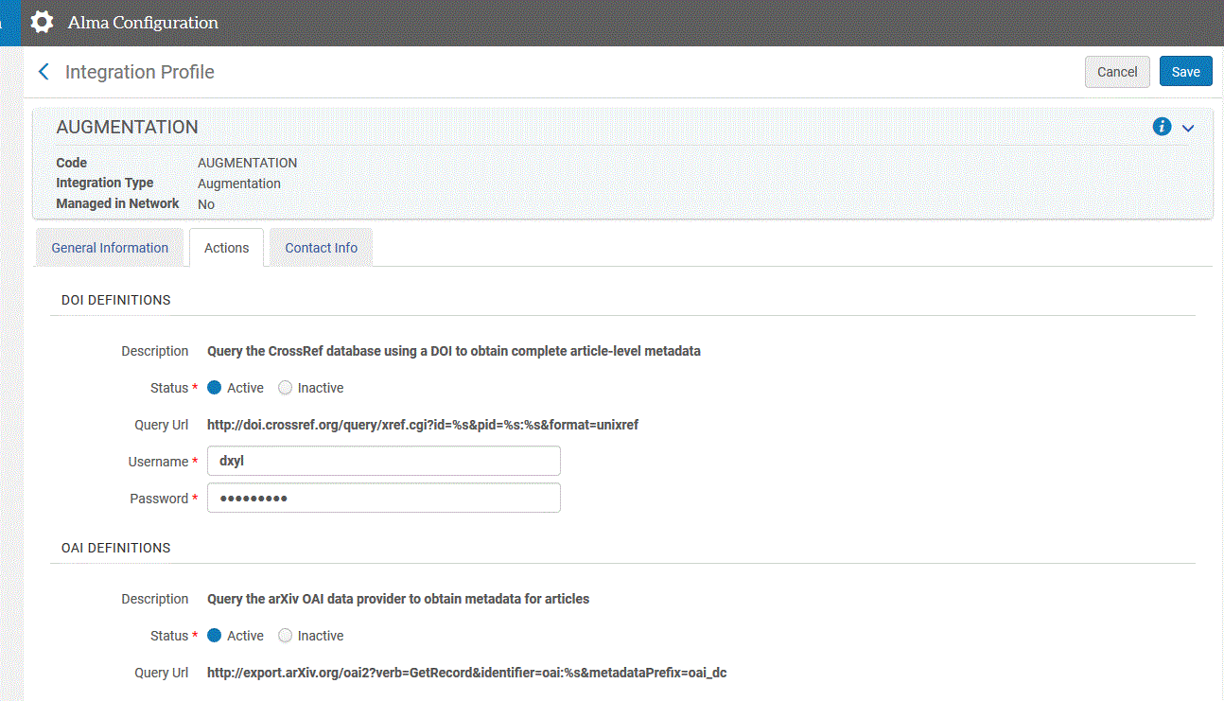
Improving Linking in Alma/Primo VE
Config- General- Integration Profiles: “Augmentation”
Notes:
After showing CARLI web site and “blank” profiles, here’s filled out examples for library. To summarize make a profile, get the relevant CrossRef and PubMed info. Fill out so look similar to these anonymized examples.

Slide 13
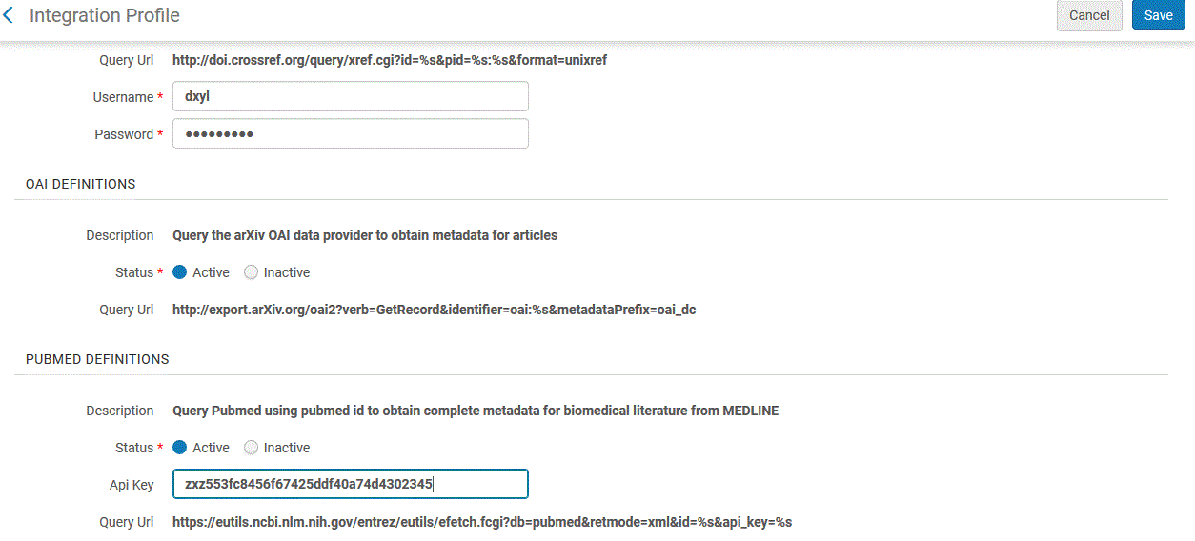
Improving Linking in Alma/Primo VE
Config- General- Integration Profiles: “Augmentation”
Notes:
After showing CARLI web site and “blank” profiles, here’s filled out examples for library. To summarize make a profile, get the relevant CrossRef and PubMed info. Fill out so look similar to these anonymized examples.

Slide 14
Improving Linking in Alma/Primo VE
What about Google Scholar and
Alma/ Primo VE?
Bring more students and faculty to library resources.
Alma has built in export profile to send holdings to Google scholar.
Get started at https://www.carli.illinois.edu/products-services/i-share/external-system/GoogleScholar
Note: takes up to 7 days for process to start. And additional weeks to see Primo VE links in Google Scholar. Between terms great time to work on and test out.
Notes:
Many of your students, staff and faculty are using Google Scholar. You can set up an export of e-holdings to Google Scholar. CARLI has documentation to help you get started. The sooner your start the better, the export is only done once a week. And Google scans for such files once a week on Monday nights. It takes 2 to 4 weeks for results to fully show in Google Scholar.

Slide 15
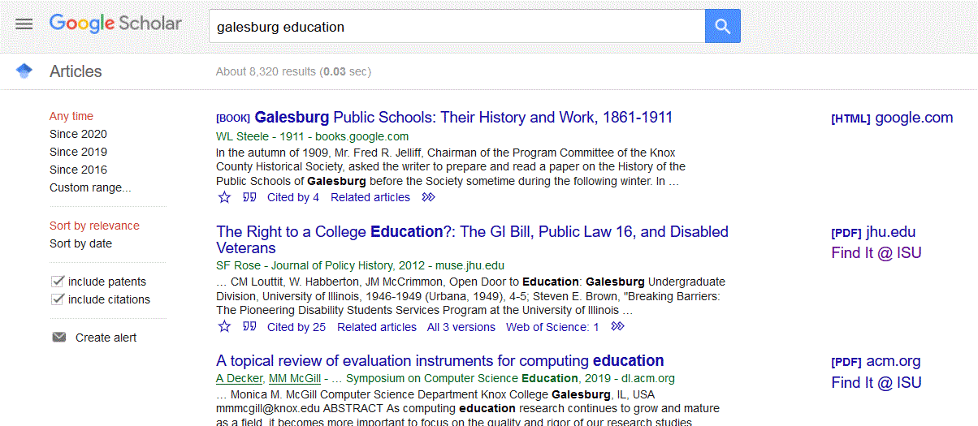
Improving Linking in Alma/Primo VE
Google Scholar and Alma/ Primo VE Example
Notes:
Final result, would you like to see how to get here?

Slide 16
Improving Linking in Alma/Primo VE
Deleting E-Collections
New web page at https://www.carli.illinois.edu/products-services/i-share/electronic-res-man/deleting-alma-electronic-collection-your-institution-zone
Notes:
End of calendar year, so may have e-collections and title coming or going.

Slide 17
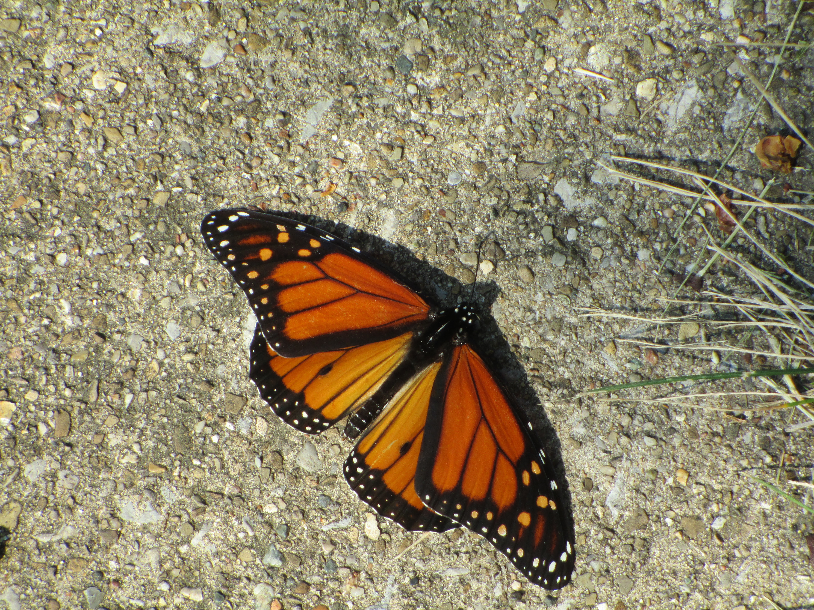
I-Share Alma Primo VE Office hours
Questions?
Join us January 14, 2021 at 2pm for another Office Hour.
Contact CARLI at support@carli.Illinois.edu

