Slide 1
I-Share Alma Primo VE Office hours will start shortly
Welcome!
Office Hours will start at 2pm and run until 3pm Please mute your microphone As time permits, we will respond to questions typed in the chat box, and offline afterwards, as needed
This session will be recorded and made available on the CARLI website both as PDF slides and as a recording, with live links to all referenced resources

Slide 2
Office Hours November 12, 2020
Notes:
[Debbie] Welcome everyone to today’s CARLI Alma and Primo VE Office Hours!

Slide 3
Agenda Office Hours 11/12/2020
Agenda – 11/12/2020
Upcoming Alma/Primo VE events
Local and I-Share/AFN requesting during holidays/break
General Reminders
Participant Q & A
Notes:
[Debbie] During today’s session, we’ll go over some upcoming events related to Alma and Primo VE, discuss plans for handling local and I-Share/AFN requesting during the holiday break, cover some general reminders, followed by open participant Q & A.

Slide 4
Upcoming events
Upcoming Alma and Primo VE Events
Next Office Hours
December 10 at 2pm
CARLI Resource Sharing Committee: Alma Digitization Dos and Don’ts
November 20 at 11am
CARLI Instruction Committee Webinar: Primo VE in Practice- Life After Going Live
December 2 at 1pm
Notes:
[Debbie]
First, beginning with a reminder that with the holidays in November and December, we have one more of these Thursday Office Hours during 2020, on December 10th at 2pm.
However, there are some additional topically-focused meetings over the next several weeks.
On November 20th at 11am, the CARLI Resource Sharing Committee is holding a session entitled “CARLI Resource Sharing in our New Age: Alma Digitization Dos and Don’ts.” They’ll have a presentation on configuring digitization requests in and things to think about regarding workflow, with Ashtin Trimble of Black Hawk College and Sarah McHone-Chase of Northern Illinois University.
On December 2nd, the CARLI Instruction Committee is holding a webinar focused on instruction and the Primo VE user experience. Six presenters are confirmed, and we’ll be updating the event page with their information soon!

Slide 5
Upcoming events
Upcoming Alma and Primo VE Events
Informal Chat with the CARLI Collection Management Committee: Looking Back to Move Forward: Reflecting on a Challenging Year in Collection Management:
December 11 at 11am
Let's talk about Fulfillment (I mean Alma, not life's purpose):
November 23 at 2pm
December 4 at 2pm
December 8 at 9am
December 17 at 3pm
December 22 at 10am
Notes:
[Debbie]
On December 11th at 11am, you can join members of the CARLI Collection Management Committee (CMC) and your CARLI colleagues in Collection Management via Zoom to take stock of the past year in the world of Collection Management. This is an opportunity for an informal discussion of your challenges and successes over the past 12 months.
There are also five more Fulfillment discussion sessions scheduled through the end of 2020. Please join us if you’d like to talk with CARLI staff and your CARLI library colleagues about Alma Fulfillment and Automated Fulfillment Network workflows, known issues, and Q & A, and please make sure your colleagues who work in circulation and resource sharing are aware of these informal sessions.

Slide 6
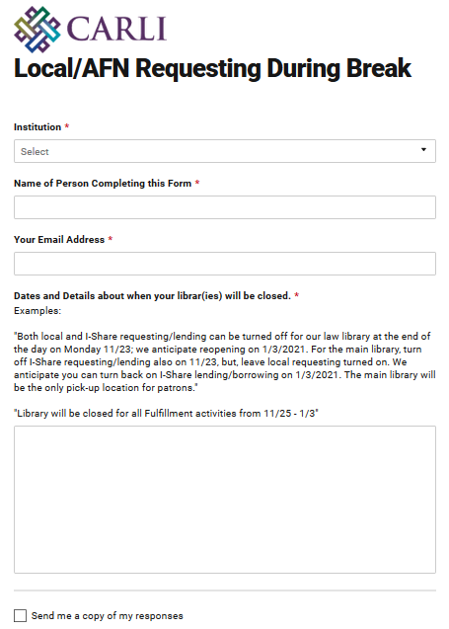
Local and I-Share/AFN requesting during Break
Local and I-Share/AFN Requesting During Break
Form to collect dates https://go.uillinois.edu/IShareRequesting
I-Share lending and borrowing enabled
Notes:
[Debbie] We have a long history in Voyager of pausing I-Share lending and borrowing during the winter holiday break season. Towards the end of our time with Voyager, CARLI Office staff would send out reminders of the steps for library staff to take, to pause requesting in Voyager.
With where we currently are at with Alma’s relative newness, and with the added complexity from the pandemic, this season the CARLI Office staff will handle the steps for turning off requesting and lending for each I-Share institution’s libraries, if and when those libraries close.
As a change for this year, we will be temporarily turning off both lending and requesting while the library is closed, rather than continuing to allow patrons to place new requests during the closure.
We will plan to keep our website updated with which I-Share institutions are lending and borrowing. https://www.carli.illinois.edu/products-services/i-share/alma/fulfillment/how-to_AFNEnabled
To simplify collecting this information from all I-Share institutions, we’ve created an online form where your can submit your anticipated dates when your libraries will be closed during this upcoming winter break, and how requesting and lending should be modified. I’ll send out an email with the link as well.
If I’ve already heard from your library through support@carli.Illinois.edu, you do not also need to fill out the form.
Also, I’m using this form to gather information for the Alma configuration changes needed; you will want to be in contact for ILDS delivery separately, if you haven’t been already.

Slide 7
Ex Libris Idea Exchange
Ex Libris Idea Exchange
https://ideas.exlibrisgroup.com/
The Ex Libris Idea Exchange allows library staff at institutions using Ex Libris products to:
Share ideas for enhancement/development.
Vote to support your favorite user-submitted ideas.
Add comments to provide weight and additional use cases to your favorite user-submitted ideas.
Any and all library staff members at your institution can have their own individual account.
Please read the FAQ and Guidelines before you begin.
The CARLI Office, and your CARLI Library Colleagues, may periodically send announcements for ideas they’d like you to consider supporting.
Notes:
[Debbie]
Lastly, a reminder we keep mentioning about the Ex Libris Idea Exchange.
The Idea Exchange allows library staff at instiutitons using Ex libris products to share ideas for enhancement and development, vote to support your favorite user submitted ideas, and add comments to provide weight and additional use cases to your favorite user submitted ideas.
Any and all library staff members at your institution can have their own individual account. Please read the linked FAQ and Guidelines before you begin.
CARLI office and your CARLI library colleauges may periodically send announcements for ideas they’d like you to consider supporting.

Slide 8
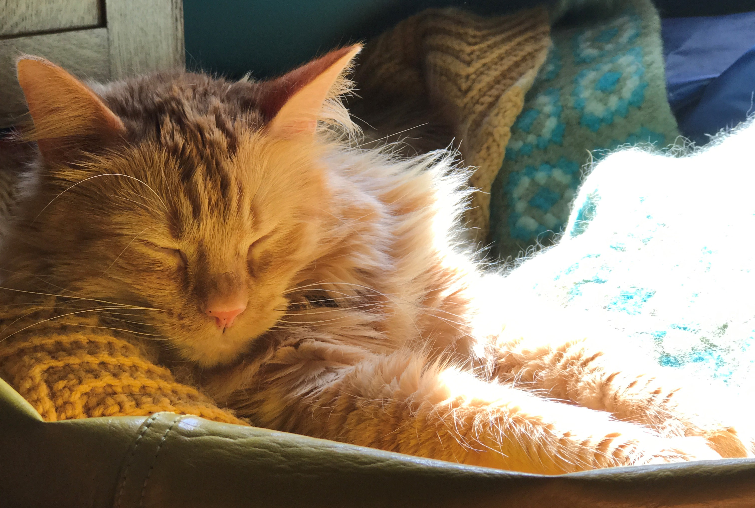
Questions
Notes:
[Debbie]
Please type any questions in the chat, or feel free to unmute to ask questions.

Slide 9
I-Share Alma Primo VE Office hours
Thank you!
Join us December 10 at 2pm for another Office Hour
You can always contact CARLI at support@carli.Illinois.edu

