Slide 1
I-Share Alma Primo VE Office hours will start shortly
Welcome!
Office Hours will start at 2pm and run until 3pm
Please mute your microphone
As time permits, we will respond to questions typed in the chat box, and offline afterwards, as needed
This session will be recorded and made available on the CARLI website both as PDF slides and as a recording, with live links to all referenced resources

Slide 2
Office Hours
October 8, 2020

Slide 3
Agenda Office Hours 10/8/2020
Agenda – 10/08/2020
Upcoming Alma/Primo VE learning opportunities
See https://www.carli.illinois.edu/calendar
Call for presenters for “Primo VE in Practice—Life After Going Live webinar”
Improving accuracy of linking to articles and ebooks.
Participant Q & A

Slide 4
Improving Linking in Alma/Primo VE
  How to improve accuracy of linking to
  articles and ebooks?
Alma & Primo VE build OpenURL links based on citation information.
Example:
Alvanoudi, Angeliki. “Gender, Language and a Lipstick: Creating Cultural Change in a World of Paradoxes.” Humanities (Basel) 7.3 (2018): 87–. https://doi.org/10.3390/h7030087
This library has full text in
DOAJ Directory of Open Access Journals (Free internet resource, activated by CARLI)
Available from 2012.
.
Notes:
Alma & Primo VE build OpenURL links, here’s an example

Slide 5
Improving Linking in Alma/Primo VE
  Creates an open URL like this:
  https://i-share-xxx.primo.exlibrisgroup.com/discovery/openurl?institution=01CARLI_XXX&vid=01CARLI_XXX:CARLI_XXX&rft_val_fmt=info:ofi%2Ffmt:kev:mtx:journal&rft.aulast=Alvanoudi&rft.aufirst=Angeliki%20L.&%3Fctx_ver=Z39.88-2004&rft.volume=7&rft.date=2018&rfr_id=info:sid%2F/cdi_doaj_primary_oai_doa&rft.spage=87&rft.jtitle=Humanities&rft.genre=article&rft.atitle=Gender%20language%20lipstick
  Takes the patron to:
https://www.mdpi.com/2076-0787/7/3/87
Notes:
Yes, OpenURLs are messy, but you can see some of the citation or metadata elements in the Open URL,; date = 2018, author name last; first, periodical title “Humanities”, starting page 87, etc.

Slide 6
Improving Linking in Alma/Primo VE
  What’s missing?
From: Example:
Alvanoudi, Angeliki. “Gender, Language and a Lipstick: Creating Cultural Change in a World of Paradoxes.” Humanities (Basel) 7.3 (2018): 87–. https://doi.org/10.3390/h7030087
  To:
  https://i-share-mmc.primo.exlibrisgroup.com/discovery/openurl?institution=01CARLI_MMC&vid=01CARLI_MMC:CARLI_MMC&rft_val_fmt=info:ofi%2Ffmt:kev:mtx:journal&rft.aulast=Alvanoudi&%3Fctx_ver=Z39.88-2004&rft.volume=7&rft.date=2018&rfr_id=info:sid%2F/cdi_doaj_primary_oai_doa&rft.spage=87&rft.jtitle=Humanities&rft.genre=article&rft.aufirst=Angeliki%20L.&rft.atitle=Gender%20language%20lipstick
The DOI
https://doi.org/10.3390/h7030087
Notes:
But what’s missing from this OpenURL?
Importantly, the DOI is missing: the
Digital Object identifier is much more precise and quick to process. Same true for Pub Med id numbers,.

Slide 7
Improving Linking in Alma/Primo VE
  How to improve Alma linking? Use “Augmentation”
  By default, the Digital Object Identifier (DOI) linking and PubMed ID linking are NOT turned on in Alma.
  Setting up CrossRef within your Alma IZ turns DOI & PMID querying on.
  Setting up PubMed API linking turns on deeper PMID linking.
  Creating Unpaywall general electronic service may also match more OpenAccess/Free resources.
  See https://www.carli.illinois.edu/products-services/i-share/electronic-res-man
Notes:
After reading slide go to
https://www.carli.illinois.edu/products-services/i-share/electronic-res-man
Then https://www.carli.illinois.edu/sites/files/files/Augmentation_addProfile.pdf

Slide 8
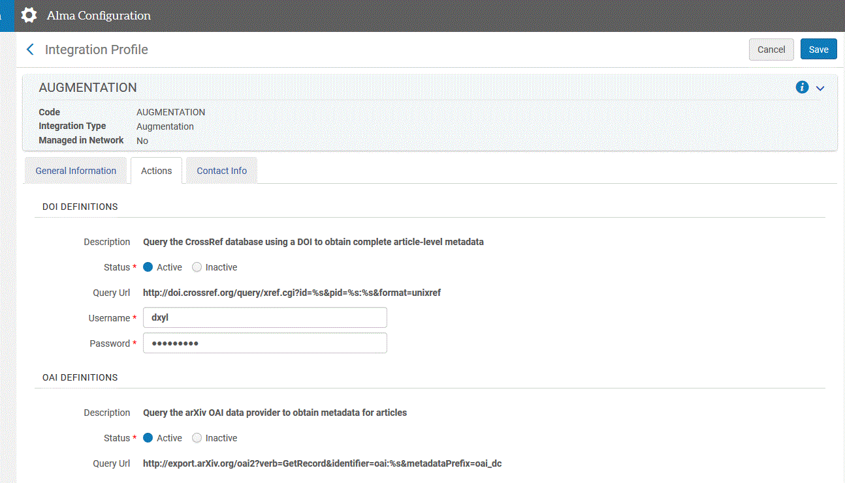
Improving Linking in Alma/Primo VE
  Config- General- Integration Profiles: “Augmentation”
Notes:
After showing CARLI web site and “blank” profiles, here’s filled out examples for library. To summarize make a profile, get the relevant CrossRef and PubMed info. Fill out so look similar to these anonymized examples.

Slide 9
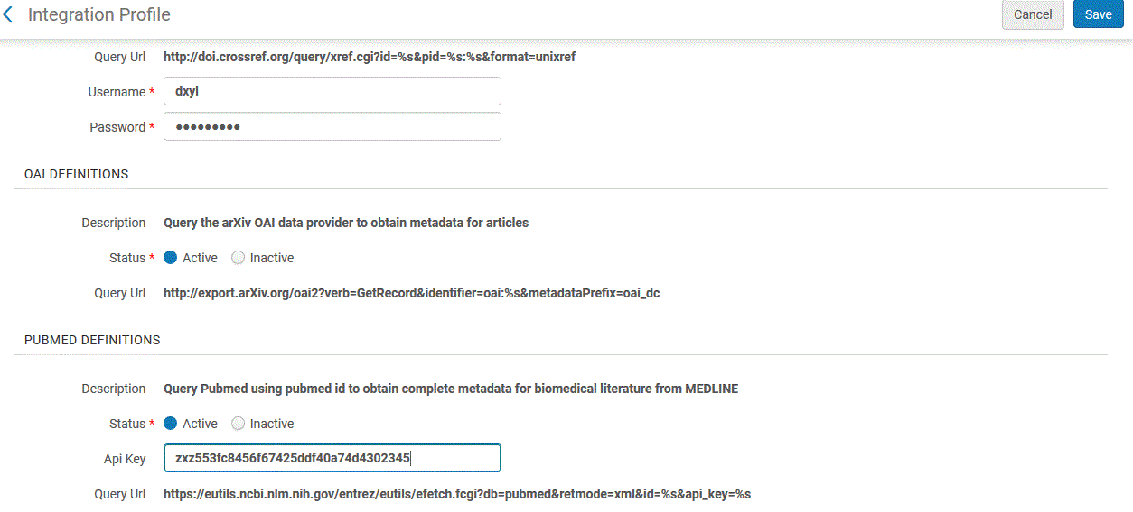
Improving Linking in Alma/Primo VE
  Config- General- Integration Profiles: “Augmentation”
Notes:
After showing CARLI web site and “blank” profiles, here’s filled out examples for library. To summarize make a profile, get the relevant CrossRef and PubMed info. Fill out so look similar to these anonymized examples.

Slide 10
Improving Linking in Alma/Primo VE
  What about Google Scholar and
  Alma/ Primo VE?
  Bring more students and faculty to library resources.
  Alma has built in export profile to send holdings to Google scholar.
  Get started at https://www.carli.illinois.edu/products-services/i-share/external-system/GoogleScholar
  Note: takes up to 7 days for process to start. And additional weeks to see Primo VE links in Google Scholar.
Notes:
Many of your students, staff and faculty are using Google Scholar. You can set up an export of e-holdings to Google Scholar. CARLI has documentation to help you get started. The sooner your start the better, the export is only done once a week. And Google scans for such files once a week on Monday nights. It takes 2 to 4 weeks for results to fully show in Google Scholar.

Slide 11
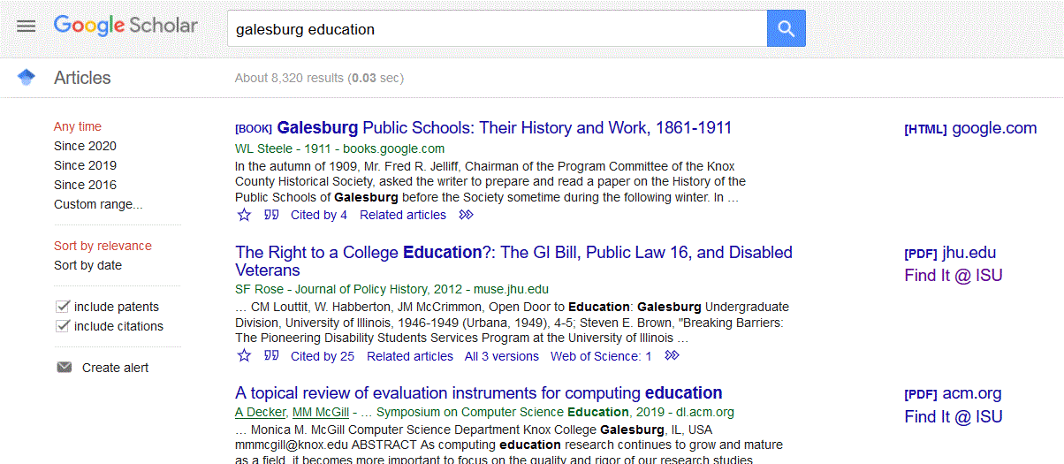
Improving Linking in Alma/Primo VE
  Google Scholar and Alma/ Primo VE Example
Notes:
Final result, would you like to see how to get here?

Slide 12
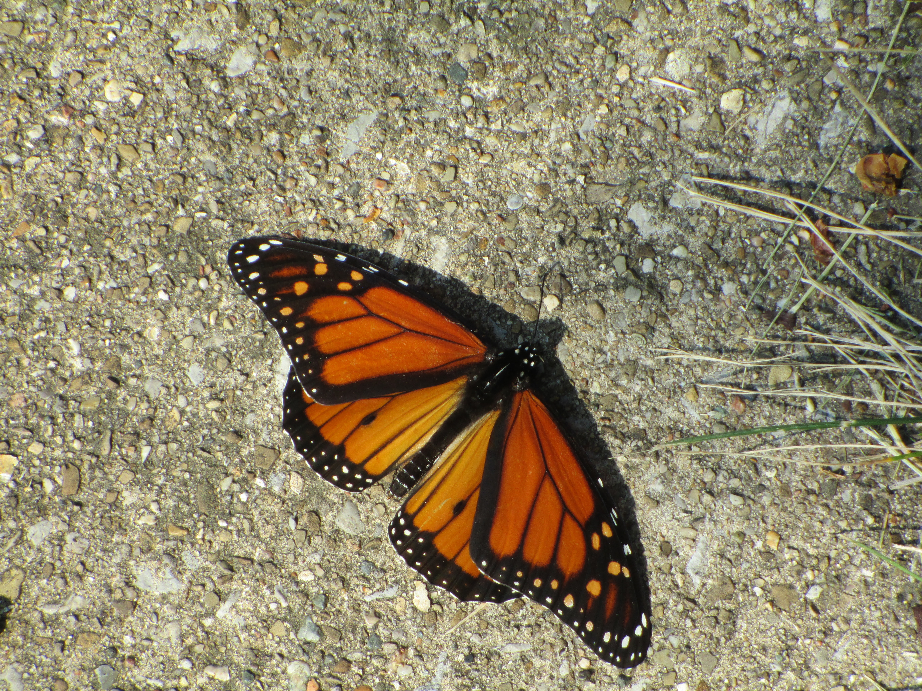
Questions?
Questions?
Notes:
Please type any questions in the chat, or feel free to unmute to ask questions.

Slide 13
I-Share Alma Primo VE Office hours
Thank you!
Join us October 22
at 2pm for another
Office Hour
You can always contact CARLI at support@carli.Illinois.edu

