Slide 1
I-Share Alma Primo VE Office hours will start shortly
Welcome!
Office Hours will start at 2pm and run until 3pm Please mute your microphone As time permits, we will respond to questions typed in the chat box, and offline afterwards, as needed
This session will be recorded and made available on the CARLI website both as PDF slides and as a recording, with live links to all referenced resources

Slide 2
Office Hours September 24, 2020

Slide 3
Agenda Office Hours 9/24/2020
Agenda – 9/24/2020
Upcoming Alma/Primo VE learning opportunities
Update on OCLC Data Sync
CARLI Board of Directors’ actions:
Due date extensions to 2/1/2021
Ending overdue fines and processing fees
Fulfillment workflows/workarounds for current known issues
Participant Q & A
Notes:
[Kris]

Slide 4
Upcoming Alma and Primo VE Learning Opportunities
Alma and Primo VE Learning Opportunities
ELUNA Learns CARLI Pre-paid Registration Block
https://www.carli.illinois.edu/products-services/i-share/alma/eluna-training-opportunity-i-share-library-staff
Ex Libris Alma Analytics Master Class (Free)
https://www.exlibrisgroup.com/customer-education-webinars/?product=alma
Ex Libris Alma 2020 What’s New Videos
https://knowledge.exlibrisgroup.com/Alma/Training/What%27s_New_Videos/80_Alma_2020_Whats_New_Videos
Notes:
[Kris]

Slide 5
Update on OCLC Data Sync
Update on OCLC Data Sync
CARLI is changing your OCLC Data Sync publishing ftp connections to point at OCLC’s new file exchange server by September 30.
Processing and matching should work the same as what we are currently seeing.
What is coming in early 2021:
More detailed reports
Reports generated sooner
CARLI is adding a secondary fix for LDR 00-04 containing hyphens.
Notes:
[Nicole]

Slide 6
CARLI Board of Directors: Due Date Extensions 2/1/2021
Due Date Extensions 2/1/2021
CARLI Board of Directors voted to extend I-Share resource sharing due dates, and optionally local circ, to 2/1/2021
Proposal came from many of the participants at an open discussion session for CARLI library directors held on 9/3/2020.
The proposal that went to the Board was drafted by CARLI Office staff.
Details were emailed to I-Share Directors, I-Share Liaisons, and Alma Primo Contacts on 9/16/2020.
Notes:
[Kris]

Slide 7
CARLI Board of Directors: Due Date Extensions 2/1/2021
Due Date Extensions 2/1/2021, upcoming work
CARLI staff:
Will change the due date of everything* that is currently checked out in Alma and due before 2/1/2021, to be due 2/1/2021.
Will adjust Alma Configuration to set a fixed due date of 2/1/2021 for all I-Share and local* loans for materials that are checked out in Alma.
Will NOT enable the Alma fulfillment jobs, rules, and settings that cause either local or I-Share patrons to be further fined, billed, or blocked.
WILL enable the jobs, rules, and settings that create overdue notices on the schedules set by the libraries.
Notes:
[Kris]

Slide 8
CARLI Board of Directors: Due Date Extenstions 2/1/2021
*To opt out of the bulk due date extension for local circulation, send email CARLI support.
This exemption can include:
Opting out of the one-time bulk due date extension for your patrons’ loans of your items.
This can be for all local patrons/materials, or for a subset of local patrons/materials.
Opting out of the term loan due date of 2/1/2021 for ongoing loans of your materials to your patrons.
This can also be for all local patrons/materials, or for a subset of local patrons/materials.
Notes:
[Kris]

Slide 9
CARLI Board of Directors: Due Date Extensions 2/1/2021
Institutions we have heard from for requesting some exemptions for local patrons, as of noon, 9/24/2020:
ARU
COD
CSU
CTU
DAC
DOM
DPU
JUD
JWC
ISU
IWU
KIS
KNX
MBI
MIL
MLS
MRT
NEI
ONU
SAI
SWI
TRN
TRT
UIU
Notes:
[Kris]

Slide 10
CARLI Board of Directors: Overdue Fines and Processing FEes
Ending Overdue Fines and Processing Fees
CARLI Board of Directors approved two proposals that will end the practice of I-Share libraries charging overdue fines for their main circulating collections and “processing fees” for any lost materials.
This covers both I-Share resource sharing transactions (already overdue fine exempt) and also “local” circulation to patrons affiliated with the institution.
At the discretion of the institution, overdue fines may still be assessed to local patrons late in returning limited access collections such as reserves, equipment, and other special materials.
Libraries may still bill any patron for the replacement of lost materials, but may not charge an additional processing fee.
Notes:
[Kris]

Slide 11
CARLI Board of Directors: Overdue Fines and Processing FEes
Ending Overdue Fines and Processing Fees
These proposals were discussed by the Board at their June 2020 meeting and subsequently put out for public comment.
The comments received were overwhelmingly in support of suspending both overdue fines and processing fees.
The comment period is now closed but those received are available for review along with background material about this policy change: https://www.carli.illinois.edu/call-public-comment-i-share-fines-and-fees.
Notes:
[Kris]

Slide 12
CARLI Board of Directors: Overdue Fines and Processing FEes
Ending Overdue Fines and Processing Fees
These policy changes are mandatory for I-Share libraries, but all CARLI Governing Member institutions (i.e., non-I-Share) are encouraged to adopt them.
I-Share libraries may implement these changes on their own or ask CARLI to make these policy configuration changes on their behalf.
This work may be done at any time and must be completed by January 1, 2021.
Each I-Share library should complete this form (https://go.uillinois.edu/ishare_fines_fees_end) by November 10, 2020
Notes:
[Kris]

Slide 13
CARLI Board of Directors: Overdue Fines and Processing FEes
Ending Overdue Fines and Processing Fees
Upcoming work
Workflow to implement changes
Alma Configuration at the Institutional Level > Fulfillment > Terms of Use (TOU) > Loan TOU
Lost Item Fine (aka processing fee)
Maximum Fine
Overdue Fine
Recalled Overdue Fine
Grace Period
Live Demonstration of Configuration
Notes:
[Debbie]
Use MMC
Show how to delete from Advanced Policy Configuration once tidied.

Slide 14
CARLI Known Issues Webpage
Alma and Primo VE: Known Issues
New collated webpage! https://www.carli.illinois.edu/products-services/i-share/alma-primo-ve-known-issues
Notes:
[Debbie] Page is a work in progress, combining together known issues from all areas of Alma and Primo VE. Some of the known issues have been reported to Ex Libris for investigation and possible fixes, but some are simply differences between how Voyager worked (hence our expectations) and how Alma or Primo VE works.
Let’s take a look at the page real quick so you an see the types of things posted. This page will be updated frequently as we know more about the topics listed, or as we have knew known issues. Some will list possible work-arounds, while others are just statements about how it works.

Slide 15
Ex Libris Idea Exchange
Ex Libris Idea Exchange
https://ideas.exlibrisgroup.com/
The Ex Libris Idea Exchange allows library staff at institutions using Ex Libris products to:
Share ideas for enhancement/development.
Vote to support your favorite user-submitted ideas.
Add comments to provide weight and additional use cases to your favorite user-submitted ideas.
Any and all library staff members at your institution can have their own individual account.
Please read the FAQ and Guidelines before you begin.
The CARLI Office, and your library colleagues, may periodically send announcements for ideas they’d like you to consider supporting.
Notes:
[Debbie] Several of the issues listed on the page will

Slide 16
Alma Fulfillment- Known Issues workflows/Workarounds
Alma Fulfillment- Known Issues Demonstration of Workflows/Workarounds
Alma using incorrect "On Hold" letter for incoming AFN items.
Staff receive an error message after checking out AFN materials to a patron and clicking "Done.“
Alma does not display institutional affiliation or contact information for another I-Share library's patron with material on the hold shelf.
Requests placed by patrons in Primo VE are canceled, even though copies should be requestable.
Local requests converted to Resource Sharing requests stuck in "waiting to be sent" status.
Notes:
[Debbie] First two- show known issues page with fix anticipated dates.
Bottom 3, live demo.

Slide 17
CARLi Job Opening
The CARLI Office currently has an open position for a Library Services Coordinator
Required: M.S. in LS/IS and at least 1 year one year of experience working in a position with responsibilities that include using and/or supporting online library systems and services
Full position description, requirements and application instructions as https://www.carli.illinois.edu/library-services-coordinator-carli-0
Apply by October 7, 2020

Slide 18
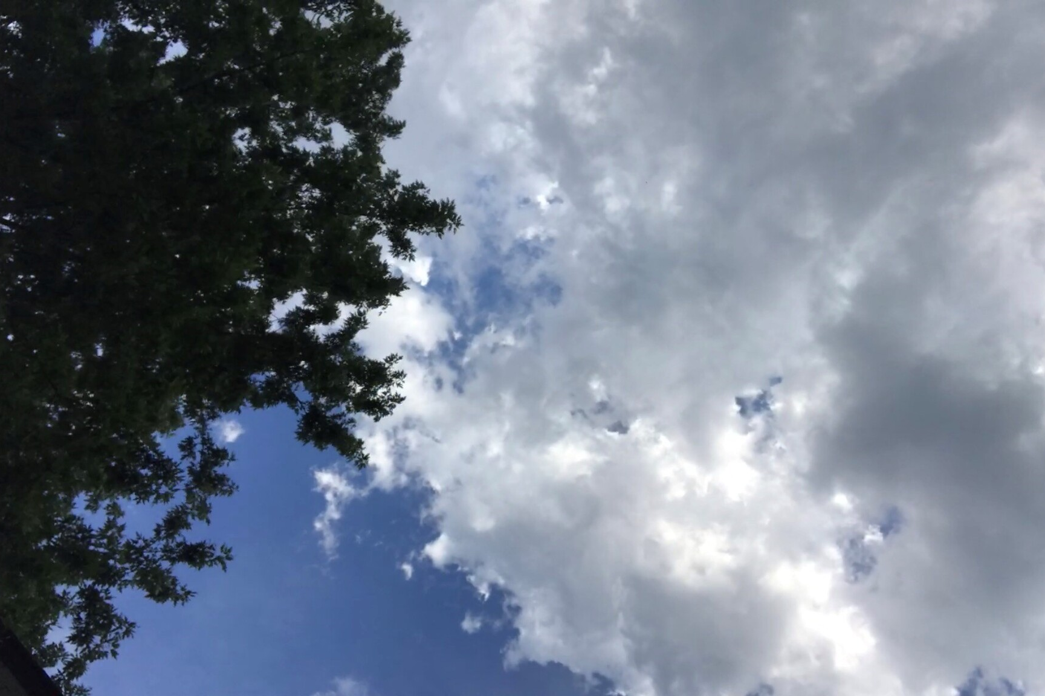
Questions?
Notes:
Please type any questions in the chat, or feel free to unmute to ask questions.

Slide 19
I-Share Alma Primo VE Office hours
Thank you!
Join us October 8 at 2pm for another Office Hour
You can always contact CARLI at support@carli.Illinois.edu

