Slide 1


Welcome!
I-SHARE ALMA PRIMO VE OFFICE HOURS WILL START SHORTLY
Office Hours will start at 2pm and run until 3pm
Please mute your microphone
As time permits, we will respond to questions typed in the chat box, and offline afterwards, as needed
This session will be recorded and made available on the CARLI website both as PDF slides and as a recording, with live links to all referenced resources

Slide 2
OPEN OFFICE HOURS AUGUST 27, 2020

Slide 3
Agenda – 8/27/2020
AGENDA OFFICE HOURS 8/27/2020
September Release Updates
Reminder: Courtesy Notices/Jobs re-enabled
Required Alma Configuration Setting
Printing Options in Alma
Ex Libris Idea Exchange
Purchase Order Line Types
On Hold Shelf Letter local customization
Participant Q & A

Slide 4
The September release is scheduled for Sunday, September 6. The regular follow-up release is on Sunday, September 13.
SEPTEMBER 2020 ALMA PRIMO RELEASE
Alma Release Notes: https://knowledge.exlibrisgroup.com/Alma/Release_Notes/20 20/Alma_2020_Release_Notes
Primo VE Release Notes: https://knowledge.exlibrisgroup.com/Primo/Release_Notes/00 2Primo_VE/2020/010Primo_VE_2020_Release_Notes
Dates and links to documentation in CARLI Event Calendar.

Slide 5
SEPTEMBER 2020 ALMA PRIMO RELEASE: NEW ALMA LAYOUT
The layout of the Alma UI is going into production
Config > General > User Interface: New Alma Layout and Menu Settings
The new layout will be enabled in each IZ
Users may opt-out and in from their User menu
New layout becomes default in November

Slide 6
SEPTEMBER 2020 ALMA PRIMO RELEASE: NEW ALMA METADATA EDITOR
New Metadata Editor (MDE) available as beta
Icon to show the MDE on the menu bar
In the MDE, click New MDE to use new editor
Catalogers may switch between UIs
Core functionality for editing and saving records
Some features not yet ready
Templates, Rules, Set Management Tags
New MDE formally goes live in January 2021

Slide 7
My Library Card – New Activity Filter and Indicator for Consortia
SEPTEMBER 2020 ALMA PRIMO RELEASE: PRIMO VE USAGE INDICATOR
Ex Libris added a filter above the list of member institutions. Users have the ability to select one of the following options:
Has Activity – When selected, it will display only the institutions for which the user has active fulfillment status.
All Institutions – When selected, it will display all institutions supported by the consortium.
Ex Libris also added a Has Activity indicator to the left of the institutional name in the list, if they have active fulfillment statuses or messages.

Slide 8
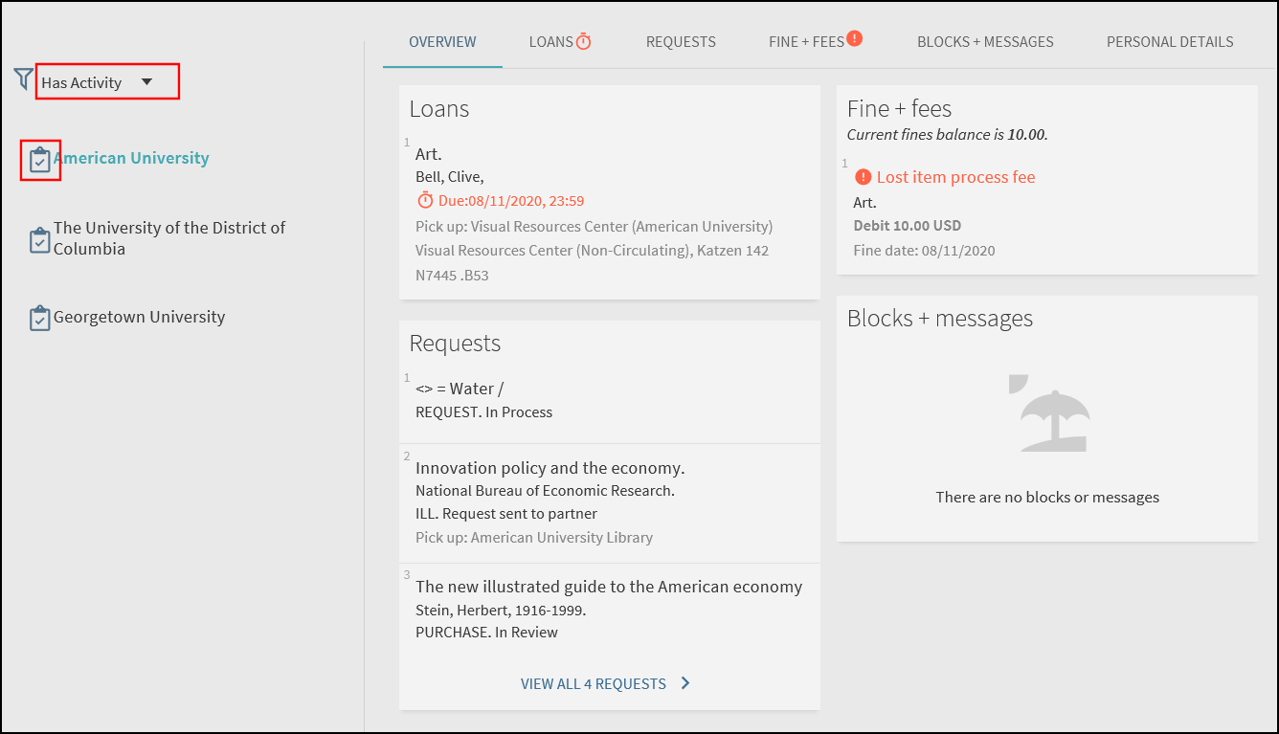
SEPTEMBER 2020 ALMA PRIMO RELEASE: PRIMO VE USAGE INDICATOR
My Library Card – New Activity Filter and Indicator for Consortia
Screenshot from Release Notes: https://knowledge.exlibrisgroup.com/Primo/Release_Notes/002Primo_VE/2020/010Primo_VE_2020_Release_Notes

Slide 9
CARLI re-enabling Courtesy Notices and Job this Friday, 8/28
REMINDER: COURTESY NOTICES/JOB RE-ENABLED THIS FRIDAY, 8/28
CARLI Office staff will re-enable:
FulUserLoansCourtesyLetter aka Courtesy Letter
"Send Courtesy Notices and Handle Loan Renewals" job
What this means:
For loans with day/week/month/term loan periods:
The Courtesy letter is sent to patrons overnight when the "Days before due date field" value set in the companion Fulfillment job is met.
CARLI staff will consortially set the letter to send 3 days before the item is due for consistency for both local and I-Share patrons.

Slide 10
CARLI re-enabling Courtesy Notices and Job this Friday, 8/28
REMINDER: COURTESY NOTICES/JOB RE-ENABLED THIS FRIDAY, 8/28
What this means:
For loans with minute/hourly loan periods (short loans):
The Courtesy letter is sent to patrons before the loan is due based on a separate parameter set in Alma Configuration.
CARLI staff will initially set this parameter for all I-Share libraries to be 15 minutes before due.
If you library would like a different value, or no courtesy notice for short loans, your Alma-Primo contact should email CARLI support (ASAP!).

Slide 11
CARLI re-enabling Courtesy Notices and Job this Friday, 8/28
REMINDER: COURTESY NOTICES/JOB RE-ENABLED THIS FRIDAY, 8/28
What this means:
For loans with minute/hourly loan periods (short loans):
It is possible to have Alma send patrons a second letter at the time of charge with the due date, in addition to the courtesy notice before the item's due date/time is reached.
CARLI staff will initially set this second letter as OFF, so the patron will only receive one notice (the courtesy letter) for short loans.
If you library would like the second letter to be sent, your Alma-Primo contact should email CARLI support (ASAP!).

Slide 12
CARLI re-enabling Courtesy Notices and Job this Friday, 8/28
REMINDER: COURTESY NOTICES/JOB RE-ENABLED THIS FRIDAY, 8/28
Automatic Renewals:
If/when your institution is interested in testing and using Alma's Automatic Renewal functionality for local patrons, or a subset of local patrons, email CARLI Support.
Automatic Renewals should not yet be enabled for I-Share patrons; we need consistency across the consortium.

Slide 13
CARLI re-enabling Letters/Jobs for Overdue, Lost, Fine Fee Assessment on Monday, October 5.
REMINDER: OVERDUE AND LOST RELATED JOBS AND LETTERS, OCTOBER 5
In September, the CARLI Office will provide more information on:
Which letters and jobs will be consortially re-enabled on Monday, October 5,
Review and clean-up to do before October 5,
Review of each I-Share library's Overdue and Lost Loan Profiles.

Slide 14
Consortially Required Default Rule Value
Located in Alma Configuration at the Institutional Level, under Fulfillment> Library Management> “Reshelve without Transit Rules.”
CONSORTIALLY REQUIRED CONFIGURATION SETTING
The Default Rule must be Reshelve Without Transit = False
If it is set to True, when another I-Share library discharges/returns your institution’s item, the item will not go into “Transit” status.
It will immediately show as “On Shelf” at your institution.
If your institution has internal libraries/departments that you do not want them to “Transit” between, enter explicit rules for those libraries/departments rather than editing the default rule.
https://knowledge.exlibrisgroup.com/Alma/Product_Documentation/010Alma_Online_ Help_(English)/030Fulfillment/080Configuring_Fulfillment/020Library#Configuring_Re shelve_Without_Transit_Rules
NOTE: Do not make any specific rules for the “Resource Sharing Library” so that it will be covered by the Default Rule=False.

Slide 15
New CARLI webpage- Overview: Printing Options in Alma
https://www.carli.illinois.edu/products-services/i-share/letters/PrintingOptions
OVERVIEW: PRINTING OPTIONS IN ALMA
There are 6 primary "printing" options:
An email-enabled physical-paper-printer, so "printed" letters print directly to paper.
An email address as a "printer" so "printed" letters are emailed to the account.
Alma's Quick printing so staff can print to a computer-connected "printer" via a browser immediately; also a copy can be sent to an email account.
Alma's Quick printing so staff can print to computer-connected "printer" via a browser immediately; also a copy can be sent to an Alma print queue for staff to review as needed/desired.
A print queue for staff to review and print from as needed/desired.
A print queue paired with the Alma Print Daemon

Slide 16
Ex Libris Idea Exchange https://ideas.exlibrisgroup.com/
EX LIBRIS IDEA EXCHANGE
The Ex Libris Idea Exchange allows library staff at institutions using Ex Libris products to:
Share ideas for enhancement/development.
Vote to support your favorite user-submitted ideas.
Add comments to provide weight and additional use cases to your favorite user-submitted ideas.
Any and all library staff members at your institution can have their own individual account.
Please read the FAQ and Guidelines before you begin.
The CARLI Office, and your CARLI Library Colleagues, may periodically send announcements for ideas they’d like you to consider supporting.

Slide 17
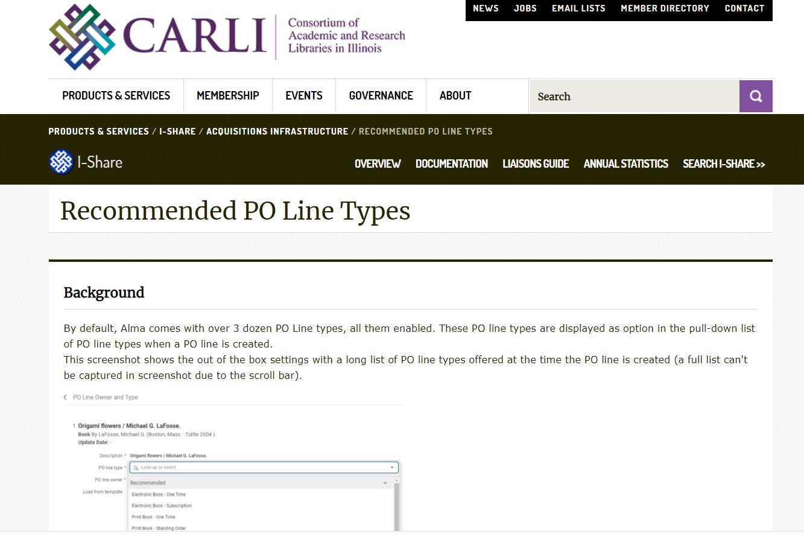
PURCHASE ORDER LINE ITEM TYPES

Slide 18
On Hold Shelf Letter
EDITING ON HOLD SHELF LETTER – LOCAL VS. I-SHARE
Sent to patron when item is available for pickup
Same letter for I-Share notices and Local notices
Sent from institution that owns the item
Letter will now differentiate between I-Share and Local notifications
Some libraries have used this for specific instructions (curbside, scheduling appts)
Currently Letter #84

Slide 19
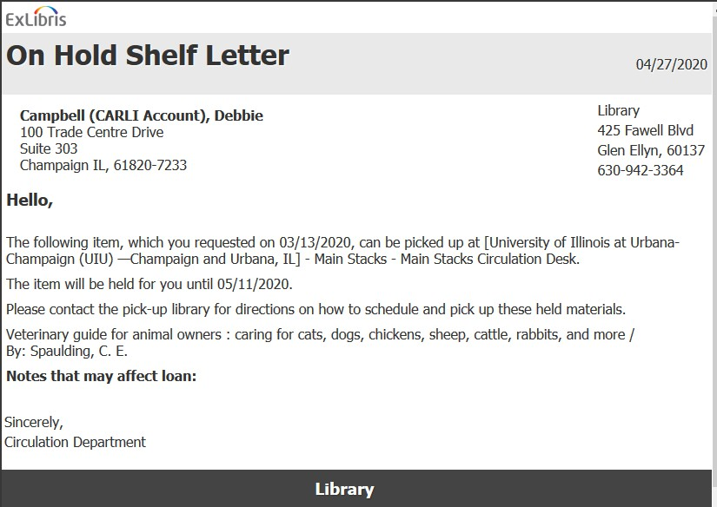
I-SHARE ON HOLD SHELF LETTER

Slide 20
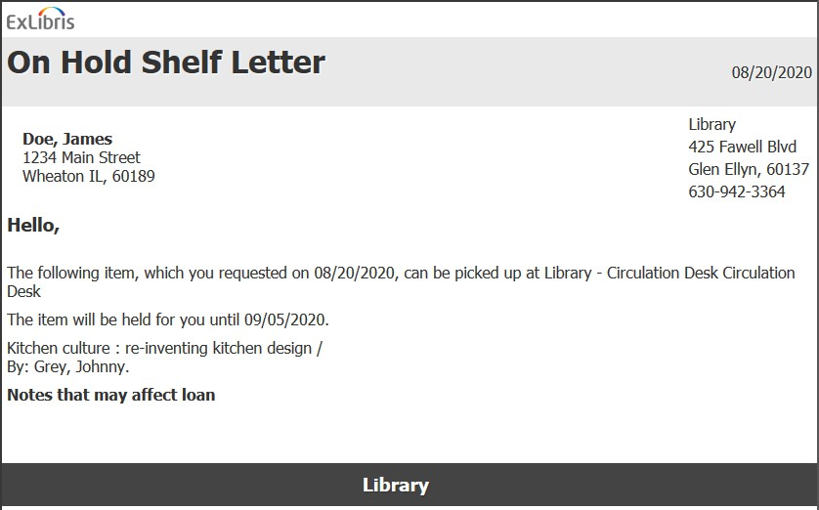
LOCAL ON HOLD SHELF LETTER

Slide 21
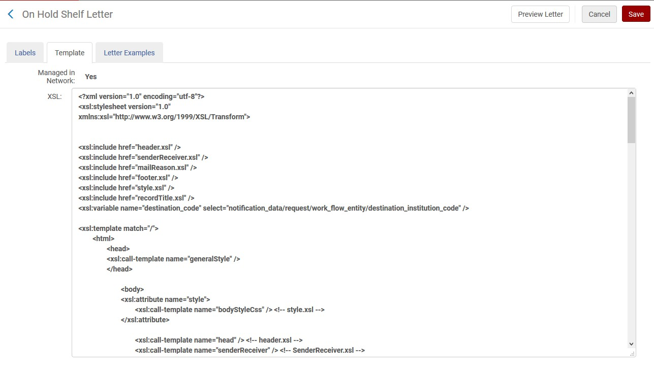
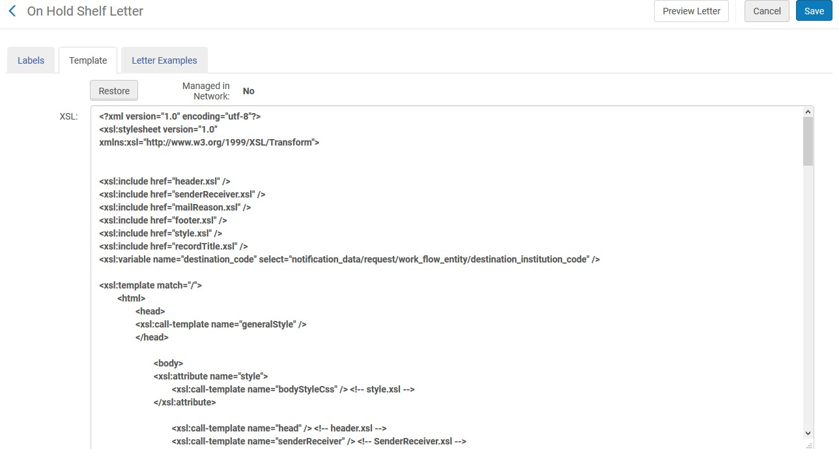

“MANAGED IN NETWORK”

Slide 22
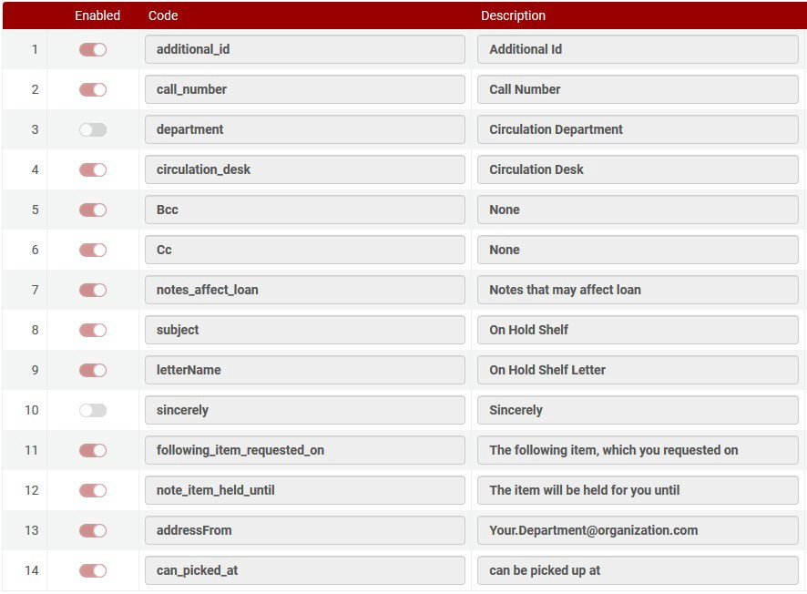
LOCAL ON HOLD SHELF LETTER

Slide 23
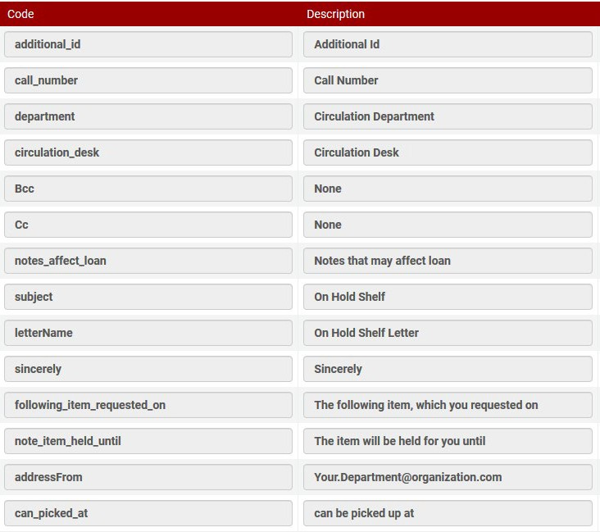
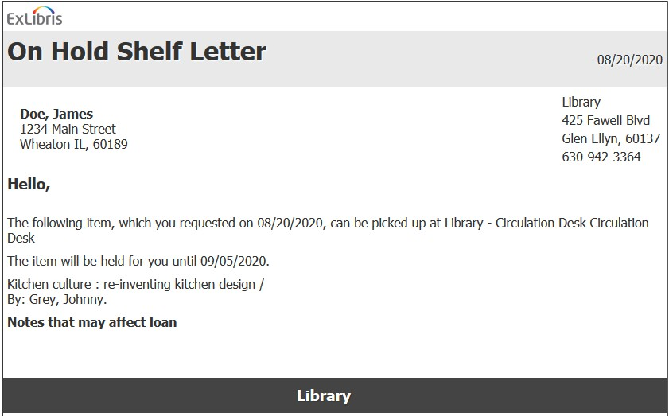
LOCAL ON HOLD SHELF LETTER

Slide 24
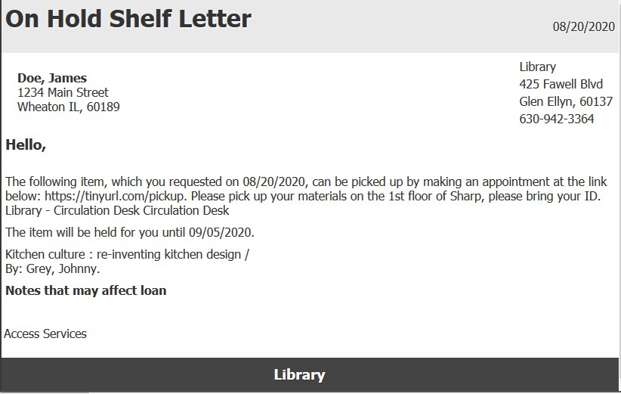
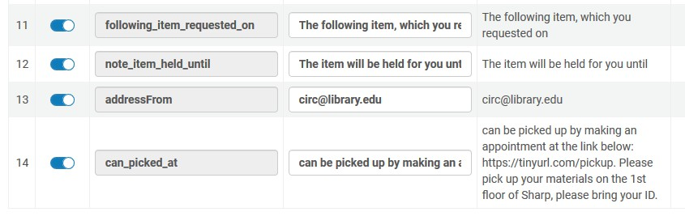
LOCAL ON HOLD SHELF LETTER

Slide 25
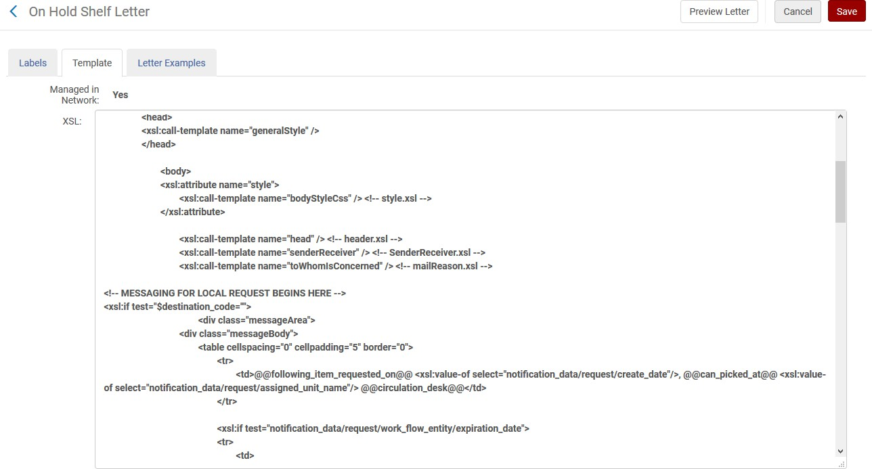

EDITING LETTER XSL

Slide 26
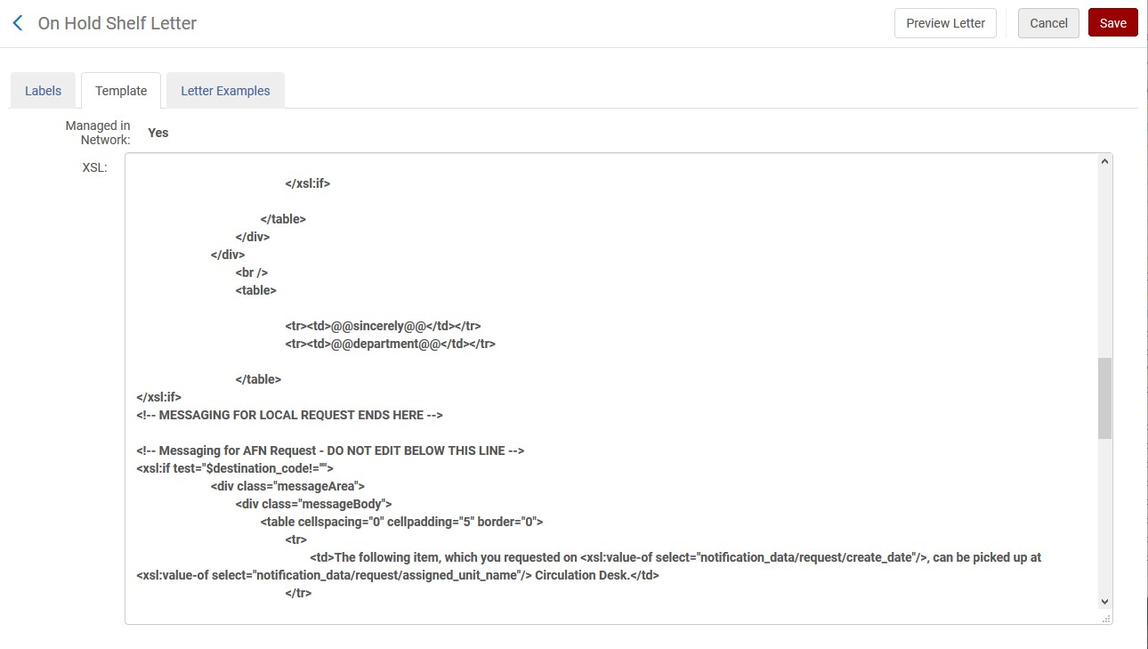

EDITING LETTER XSL

Slide 27
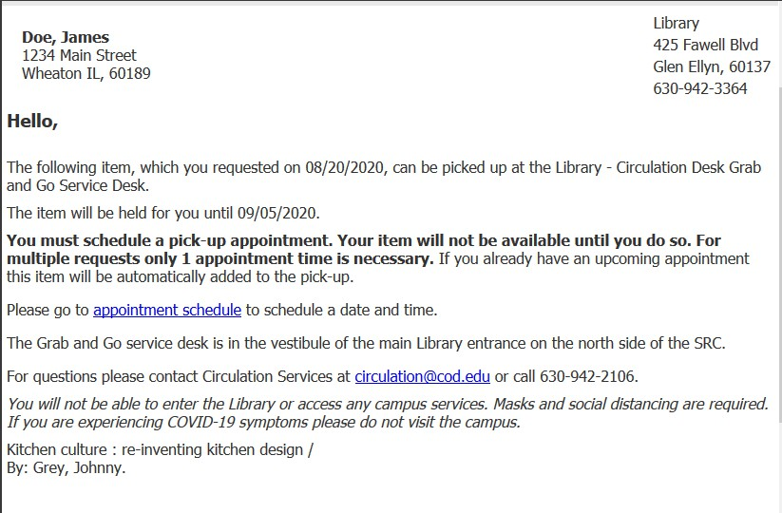

Slide 28

QUESTIONS

Slide 29
Thank you!
I-SHARE ALMA PRIMO VE OFFICE HOURS
Join us September 10 at 2pm for another Office Hour
You can always contact CARLI at support@carli.Illinois.edu

