Slide 1
I-Share Alma Primo VE Office hours will start shortly
Welcome!
Office Hours will start at 2pm and run until 3pm Please mute your microphone As time permits, we will respond to questions typed in the chat box, and offline afterwards, as needed
This session will be recorded and made available on the CARLI website both as PDF slides and as a recording, with live links to all referenced resources

Slide 2
Open Office Hours August 13, 2020

Slide 3
Fall 2020 Sandbox Release
https://go.illinois.edu/CARLISandboxes
Five sandboxes with data from Alma as of 8/5/20
General use by all members
Personal data are anonymized
Library staff must use the assigned generic accounts
Check Box, “XXX Credentials” folder for CARLI Sandbox August 2020.docx
Sandboxes may be used with APIs
Contact CARLI support for Developer Network access

Slide 4
Fall 2020 Sandbox Release
Why use a sandbox?
Training with real-ish data in a network
Testing of functionality without affecting production
E.g., SIS user update, user purge, AFN requesting, work orders, acq processes.
Developing new workflows and services
Primo VE views
API testing

Slide 5
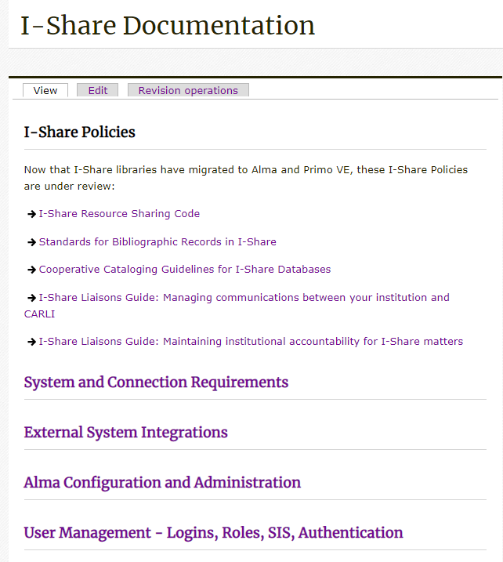
CARLI Website Update: Alma Documentation
https://go.illinois.edu/I-ShareDocs

Slide 6
Please review the Go-Live Readiness Checklist
Ex Libris wants each I-Share library to complete a “Go Live Readiness Checklist”
This is not a test or certification; it is an opportunity to tell Ex Libris how things are going for your institution
Please complete one per institution and send it to support@carli.Illinois.edu or place it in your Box folder, asap
https://www.carli.illinois.edu/sites/files/files/CARLI_Alma%20PrimoVE_GoLive_Readiness_Checklist_200428.docx

Slide 7

Questions
Notes:
Please type any questions in the chat, or feel free to unmute to ask questions.

Slide 8
I-Share Alma Primo VE Office hours
Thank you!
Join us August 27 at 2pm for another Office Hour
You can always contact CARLI at support@carli.Illinois.edu

