Slide 1


Welcome!
I-SHARE ALMA PRIMO VE OFFICE HOURS WILL START SHORTLY
Office Hours will start at 2pm and run until 3pm
Please mute your microphone
As time permits, we will respond to questions typed in the chat box, and offline afterwards, as needed
This session will be recorded and made available on the CARLI website both as PDF slides and as a recording, with live links to all referenced resources

Slide 2


REVIEWING AS WE PREPARE: AUTOMATED FULFILLMENT NETWORK (AFN)
7/16/2020

Slide 3
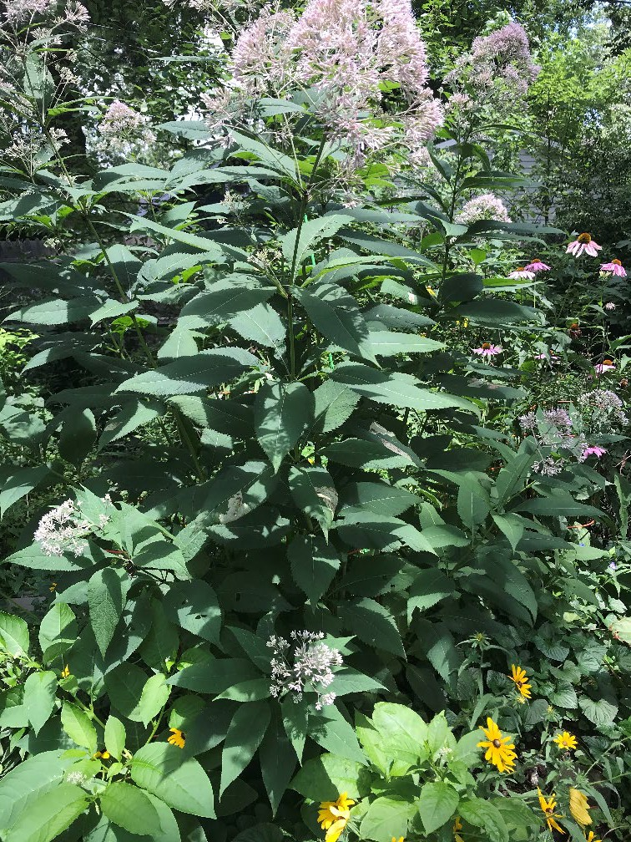
AGENDA
AFN to be available beginning July 20 for institutions that are ready
AFN Review Demonstration
Open Q&A

Slide 4
AFN TO START JULY 20
CARLI staff will turn on AFN on July 20 only for institutions that say they are ready
If your institution is ready to start lending and borrowing via AFN:
– Send email to support@carli.Illinois.edu indicating your start date (July 20 or later)
If you don’t know when you will be ready for resource sharing, that’s fine, let us know when you can

Slide 5
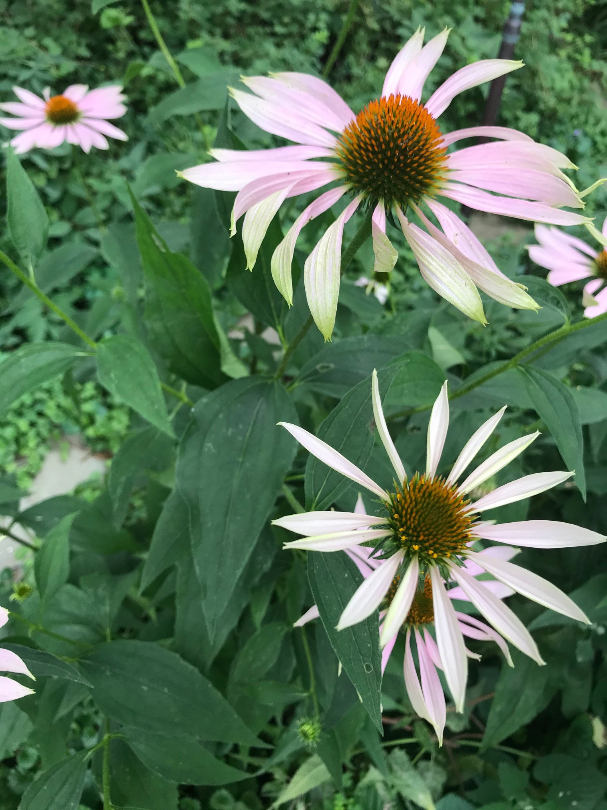
AFN TO START JULY 20
You must notify your library system (RAILS or IHLS) when you are ready for delivery to resume.
If your institution is a RAILS member, email: railsdelivery@railslibraries.info
If your institution is an IHLS member, email: ihlsdelivery@illinoisheartland.org

Slide 6

AFN TO START JULY 20
We’ve heard/recorded AFN start dates from:
ARU | Aurora University | 20-Jul
AUG | Augustana College | 3-Aug
BRA | Bradley University | 20-Jul
CON | Concordia University Chicago | 20-Jul
CTU | Catholic Theological Union | 27-Jul
DAC | Danville Area Community College | 20-Jul
EIU | Eastern Illinois University | 20-Jul
ERK | Eureka College | 20-Jul
IEC | Illinois Eastern Community Colleges | 20-Jul
ISL | Illinois State Library | 20-Jul
ISU | Illinois State University | 20-Jul
IWU | Illinois Wesleyan University | 20-Jul
JUD | Judson University | 20-Jul
LCC | Lincoln Christian University | 20-Jul
MIL | Millikin University | 20-Jul
MLS | Meadville Lombard Theological School | 24-Jul
NBT | Northern Seminary | 20-Jul
NBY | Newberry Library | 20-Jul
NEI | Northeastern Illinois University | 20-Jul
NIU | Northern Illinois University | 20-Jul
ONU | Olivet Nazarene University | 20-Jul
QCY | Quincy University | 27-Jul
SIE | Southern Illinois University Edwardsville | 20-Jul
SSC | South Suburban College | 20-Jul
SVC | Sauk Valley Community College | 20-Jul
SXU | Saint Xavier University | 20-Jul
TIU | Trinity International University | 20-Jul
TRN | Trinity Christian College | 20-Jul
UIS | University of Illinois at Springfield | 20-Jul
USF | University of St. Francis | 3-Aug
WIU | Western Illinois University | 20-Jul

Slide 7
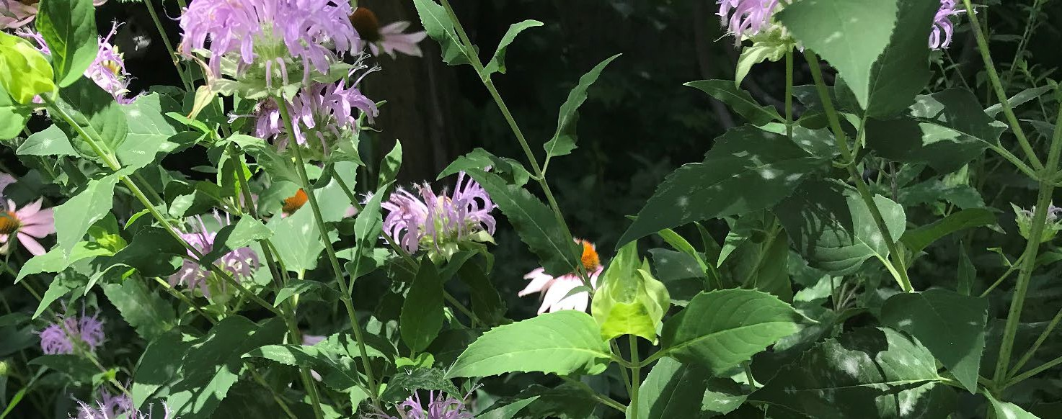
How To: Staff workflows for Alma Requests-Local and AFN
https://www.carli.illinois.edu/products-services/i-share/alma/fulfillment/how-to_AFN
AFN TO START JULY 20

Slide 8
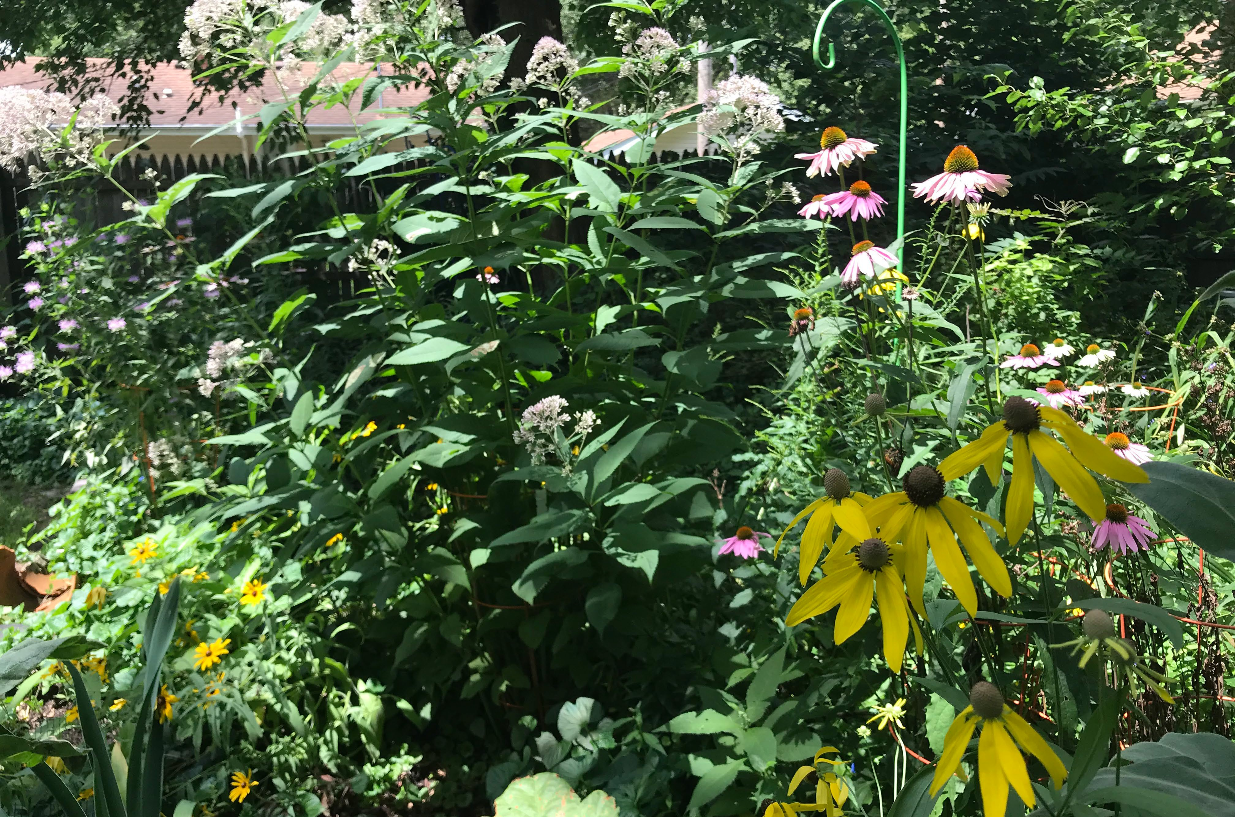
QUESTIONS?

Slide 9
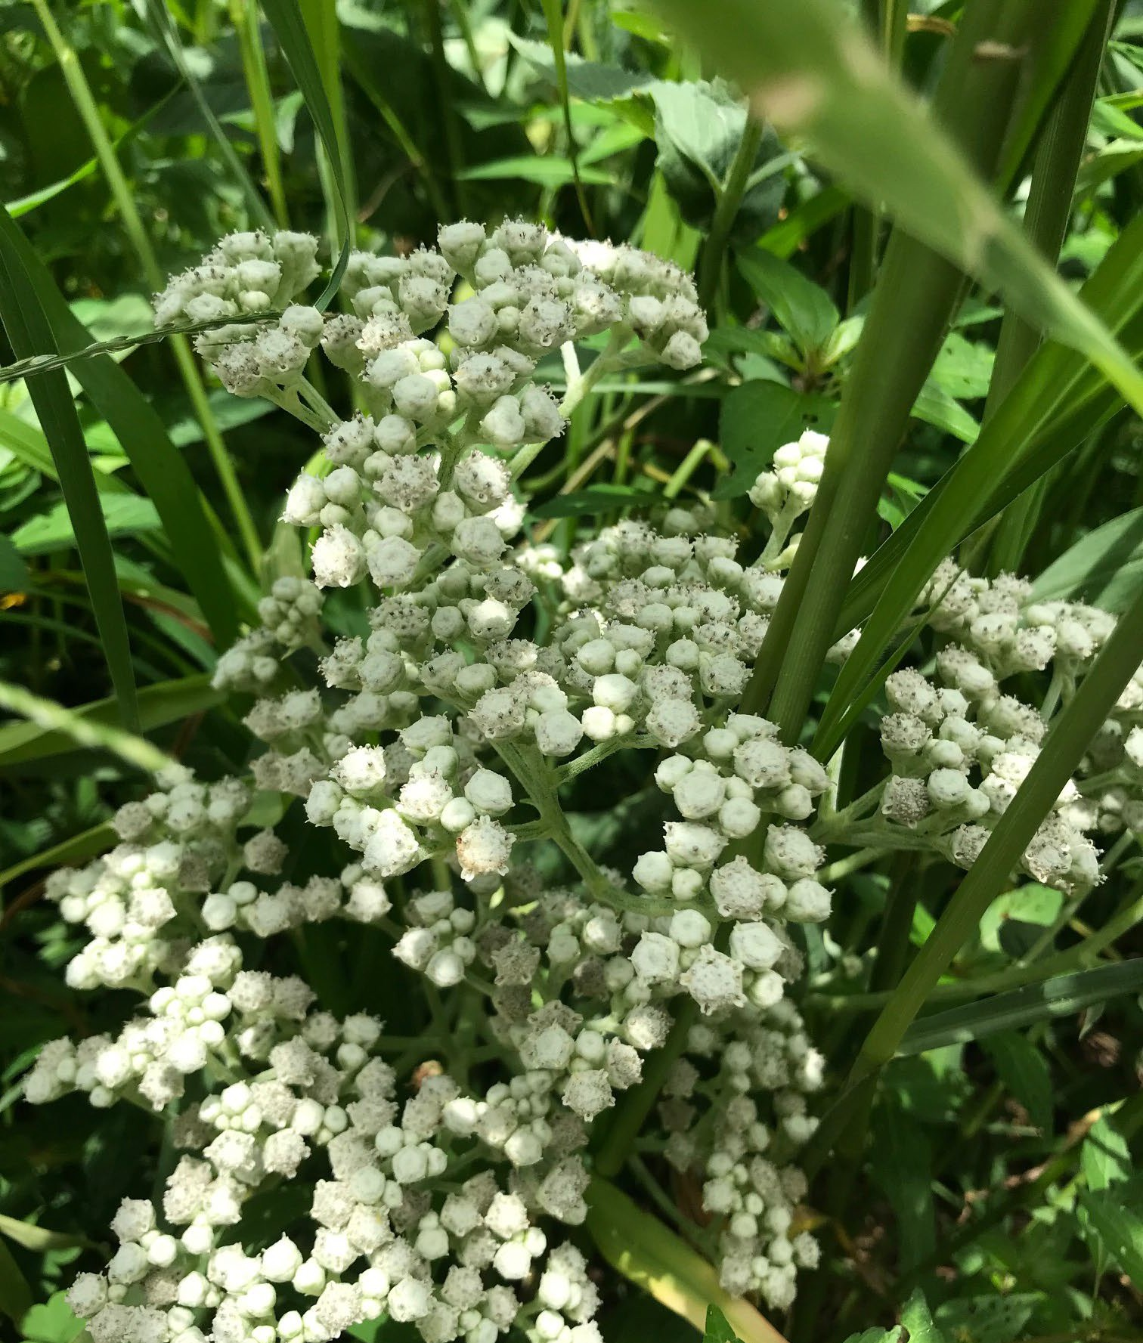
Thank you!
I-SHARE ALMA PRIMO VE OFFICE HOURS
Join us next Thursday at 2pm for another Office Hour —
The CARLI calendar has the Zoom connection instructions!
You can always contact CARLI at
support@carli.illinois.edu

