Slide 1
I-Share Alma Primo VE Office hours will start shortly
Welcome!
Office Hours will start at 2pm and run until 3pm Please mute your microphone As time permits, we will respond to questions typed in the chat box, and offline afterwards, as needed
This session will be recorded and made available on the CARLI website both as PDF slides and as a recording, with live links to all referenced resources

Slide 2
Open Office Hours 7/9/2020
Notes:
[Jessica]

Slide 3
Agenda
Alma/Primo VE Monthly Releases followup
AFN available July 20 for ready institutions
Checking Electronic Collections, esp. Alexander Street Press
OCLC Collection Manager July Release Affects Data Sync Publishing
Open Q&A
Notes:
[Jessica] Today we will follow up on the Monthly release, an update on plans to turn on the Automated Fulfillment Network, checking Electronic collections and the OCLC data sync, and then, of course, we’ll again leave lots of time for your questions.

Slide 4
System status resources
When you aren’t sure if a problem is unique to you, or one someone has already reported, remember to check the System Status icon and details on the CARLI website, https://www.carli.illinois.edu/

Slide 5
System status resources
Status updates will be provided and updated as they become available.

Slide 6
AFN to start July 20
CARLI staff will turn on AFN on July 20 only for institutions that say they are ready
If your institution is ready to start lending and borrowing via AFN:
Send email to support@carli.Illinois.edu indicating your start date (July 20 or later)
If you don’t know when you will be ready for resource sharing, that’s fine, let us know when you can
Notes:
[Kris]

Slide 7
AFN to start July 20
Four options as of July 20
Neither AFN nor local requesting
Local requesting ONLY
AFN ONLY
AFN and local requesting
You do not need to start on July 20, you may enable these services on a schedule that works best for your institution
Notes:
[Kris]

Slide 8
AFN to start July 20
You must notify your library system (RAILS or IHLS) when you are ready for delivery to resume.
If your institution is a RAILS member, email: railsdelivery@railslibraries.info
If your institution is an IHLS member, email: ihlsdelivery@illinoisheartland.org
Notes:
[Kris]

Slide 9
AFN to start July 20
Office Hours on Thursday, July 16 will review AFN processing workflows.
Link to Office Hours connection info: https://www.carli.illinois.edu/carli-alma-primo-ve-open-office-hours-1
Notes:
[Kris]

Slide 10
Electronic Collections
Good time for checking your link resolver input against what was activated in Alma at go live:
360 and EBSCO See library’s box.com for your input files (see folder “Production Load” or “360 files” )
SFX libraries can check their admin modules
Notes:
[Denise] Time to check electronic collections, each link resolver different in puts

Slide 11
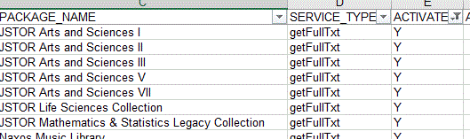
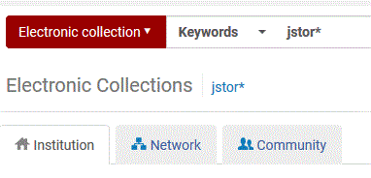
Electronic Collections
Do “Electronic Collections” search to compare what’s in your link resolver input with what’s actually active:
Notes:
[Denise] Here’s example from the spreadsheet “LR to Alma”,

Slide 12
Electronic Collections
Check your Box for file 01CARLI_XXX_PQ_Activations
Compare this file with your Alma activations.
Several error possible in electronic collection type, geographic focus or matching.
Notes:
[Denise] All libraries need to check this input:

Slide 13
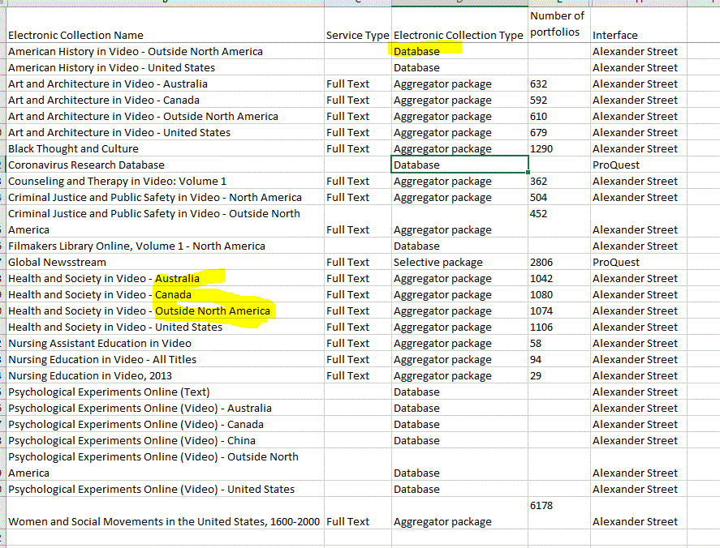
Electronic Collections
Notes:
[Denise & Jen] Here’s a typical example with all three. Some wrong type, some “international” focus and some possible mis-match, ex. Nursing 2013? Review what’s active in your library’s Alma. Delete or deactivate as needed and activate if appropriate collections.

Slide 14
OCLC Collection Manager Update For Data Syncs
July 7 Collection Manager Updates Affect Data Sync Publishing:
https://help.oclc.org/Metadata_Services/WorldShare_Collection_Manager/Release_notes/2020_Release_notes/085WorldShare_Collection_Manager_release_notes_July_2020
Changes to Matching
*requires initial evaluation by testing partners
More Detailed Reporting
New Formats
Faster Processing
During the evaluation of these updates, your Data Sync Collections will process with the old Collection Manager settings.
Notes:
[Nicole]
On Tuesday, July 7 at 2pm OCLC applied a Collection Manager update with enhancements for the Data Sync Collections we use for publishing holdings from Alma to WorldCat.
OCLC notified us the day prior that our current matching by OCLC number only and excluding records from matching when no OCLC number exists are features not yet available with the new system.
Because a new matching algorithm is in place, we know this is an important change to test and evaluate before your records are processed with the new system.
The good news is only records sent to OCLC’s new file exchange servers are processed by the new system. Those being sent to OCLC’s old server are still being processed without the updates.
Earlier this week, we changed your Alma OCLC ftp definitions to point to the old OCLC server to ensure your records continue to processes and match just as they have been since going live on Alma while we evaluate this change.
Over the next few weeks, CARLI will be working with Andrea Imre and Susan Howell at Southern Illinois University - Carbondale who both kindly agreed to be the first of us to test the new matching algorithm through a variety of carefully planned scenarios. SIC has a strong history of identifying problems with Collection Manager matching, having found two past issues with fingerprint matching and title matching which helped guide our current consortial settings for Data Sync projects. I very much appreciate their willingness to test. If any other institutions wish to volunteer to test as well, please email us at CARLI support. We will share the findings from testing and next steps once this initial review concludes.
For those interested in some more details about matching, the changes identified in the release notes in the URL provided here indicate:
1. The first OCLC # identified in the bib record is used to target that specific record within WorldCat
2. Then, validation by material type and comparison of title occur
3. When no OCLC # is provided, or if a provided OCLC # does not pass the verification steps, matching is attempted based on the combined metadata within the record.
*Obviously, both components of that last statement are ones to test carefully.
I was excited to hear about some of the other new features coming with this update:
We have heard that reports found in WorldShare > My Files > Downloads will be more informative. Supposedly, in addition to MMS ID, the original OCLC number in the record you send will be included, as well as the matching WorldCat OCLC number. Holdings status will also be indicated, whether set as new, set again, or deleted.
New record formats can be submitted, including MARCXML.
Although not indicated in the release notes, we have heard that processing of files is also much faster.
Again, we look forward to sharing the findings about these new features with you all when testing concludes.

Slide 15
Please review the Go-Live Readiness Checklist
Ex Libris wants each I-Share library to complete a “Go Live Readiness Checklist”
This is not a test or certification; it is an opportunity to tell Ex Libris how things are going for your institution
Please complete one per institution and place it in your Box folder by July 31, if possible
https://www.carli.illinois.edu/sites/files/files/CARLI_Alma%20PrimoVE_GoLive_Readiness_Checklist_200428.docx

Slide 16

Questions
Notes:
Please type any questions in the chat, or feel free to unmute to ask questions.
If you’ve already submitted a ticket for your question we’re working on getting back to you! We’ll prioritize new questions during the Q&A.

Slide 17
I-Share Alma Primo VE Office hours
Thank you!
Join us next Thursday at 2pm for another Office Hours —
Focusing on AFN processing workflows.
We will continue to be using Zoom going forward and the CARLI calendar has connection instructions!
You can always contact CARLI at support@carli.illinois.edu

Slide 18
Alma Monthly Updates
Updates to Alma and Primo VE are applied monthly by Ex Libris the first Sunday of the month:
July 5, 2020
August 2, 2020
September 6, 2020
October 4, 2020
November 1, 2020
December 6, 2020
Work typically occurs between 2:00am-3:00am Central time.
Access to your environment may be unavailable during the time of installation.
Notes:
[Jessica] Now that we are live on Alma and Primo VE, we’ll need to pay close attention to the software update cycle, which typically occurs on Production the first Sunday of every month. This is in stark contrast to our past experience on Voyager, where we’d often go for years without significant changes to the software. It will be a bit of an adjustment for us, but in good news, it does mean that new features and bug fixes will be introduced much more quickly than we are used to.
The next monthly update is this Sunday, July 5, between 2-3am Central time! Please note that during the maintenance, your environment may be unavailable, so you may want to share and post these known services times for your staff and late-night users.

Slide 19


Links Related to Monthly Releases
Release Schedule: https://knowledge.exlibrisgroup.com/Alma/Release_Notes/Release_and_Maintenance_Schedule
Sandboxes are updated two weeks before Production for testing.
Alma Release Notes: https://knowledge.exlibrisgroup.com/Alma/Release_Notes/2020/Alma_2020_Release_Notes
Primo VE Release Notes: https://knowledge.exlibrisgroup.com/Primo/Release_Notes/002Primo_VE/2020/010Primo_VE_2020_Release_Notes
Ex Libris System Status Page: https://status.exlibrisgroup.com/
Sign up for email updates on this page by clicking the envelope icon
CARLI I-Share environments are ALMA NA06 and PRIMO VE NA06
Notes:
[Jessica] Ex Libris has posted the Release Schedule for the whole year at this link. CARLI has also added the Production release dates to the CARLI Calendar.
Another new concept for us is that the Releases are applied to our Sandbox environments about two weeks BEFORE the Release is applied to the Production environment. This enables library staff to learn about and test the new features and fixes, and become aware of any changes that might affect their workflows or procedures. You can see in advance what changes the release will contain by reviewing the Release Notes for Alma and Primo VE at the URLs shows here.
Finally, Ex Libris also has a System Status Page for all of their many services where you can see the current status and date of next scheduled maintenance. Even better than this page is that you can sign up for email updates to receive an email about scheduled or unscheduled downtime that will affect our environments. CARLI I-Share environments are on ALMA NA06, and PRIMO VE NA06--that’s NA for North America, Zero Six. Simply click the envelope icon next to the name to sign up.
Next, Kris will provide some updates on turning on the Automated Fulfillment Network in July.

