Slide 1

I-Share Alma Primo VE Office hours will start shortly
Welcome!
Office Hours will start at 2pm and run until 3pm.
Please mute your microphone.
As time permits, we will respond to questions typed in the chat box and offline afterwards if needed.
This session will be recorded and made available on the CARLI website: https://www.carli.illinois.edu/products-services/i-share/alma/CARLIOfficeHours

Slide 2
Alma Primo VE Open Office Hours:
Lab Reports
December 14, 2023

Slide 3
Agenda
Today’s Agenda
Announcements and upcoming events
Lab Reports
  Eric Neagle (IIT)
  Gretchen Schneider (OAK)
  Charity Ringel (UIS)
  Leslie Starasta (LCC) (pre-recorded)

Slide 4
Announcements & Reminders
​Named User Reduction
  Certification due December 8, 2023 via webform.
  Information shared with Deans/Directors and I-Share Liaisons via email as well as three webinars.
  Please contact support with any questions or concerns.

Slide 5
CARLI EVENTS
Upcoming CARLI Events
https://www.carli.illinois.edu/calendar
Weekly Professional Development Alliance (PDA) sessions
Weekly Support for the Creation of Open Educational Resources (SCOERs) office hours and sessions
"Let’s Talk About Fulfillment" is back and occurs every other Tuesday.
“Technical Services Q&A” returning 4th Thursday of each month*
Notes:
All upcoming CARLI events are listed on the CARLI calendar. Here is a small list of ongoing events that might be of interest.

Slide 6
E-Resources Updates
Time to review your Alma Electronic Resources to keep aligned with current purchases.
End of Calendar Year 2023 coming soon-
  If your library has added or cancelled/not renewed subscriptions to e-resources, plan to update your Alma Institution Zone.
  More “how to” documentation at https://www.carli.illinois.edu/products-services/i-share/electronic-res-man
Notes:
The end of calendar year 2023 approaching soon. Please adjust active e-collections and e-titles in your Izs. Otherwise your patrons will try to access “not renewed” e-resources and hit dead ends. And similarly, miss out on newly added e-resources in searching and link resolving via Primo VE.
CARLI staff will email I-Share libraries reminders about changes via CARLI brokering for the Calendar Year cycle.

Slide 7
online Exams Collection
Eric Neagle, Kent College of Law, Illinois Institute of Technology

Slide 8
Reserve usage stats
Gretchen Schneider, Oakton College

Slide 9
ShelF Reading Strategies
Charity Ringel, University of Illinois Springfield

Slide 10
Generic Account Strategy
Leslie Starasta, Lincoln Christian University

Slide 11
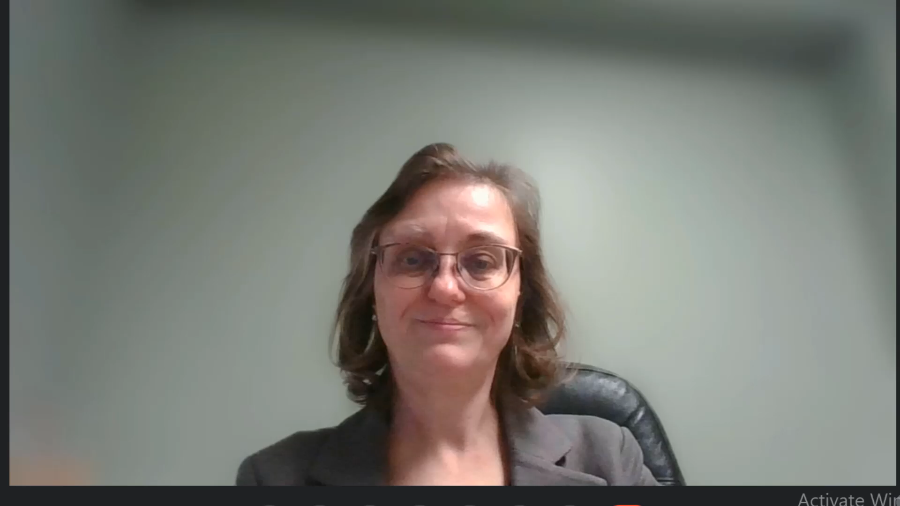
Generic Account Strategy

Slide 12

QUESTIONS?
Contact CARLI at:
support@carli.illinois.edu
January 11, 2024 Office Hours are canceled, watch for a special session in January on I-Share Annual Statistics!
The next Alma Primo VE Office Hours are Thursday, February 8, 2024.
Multicolored wildflowers.

