Slide 1
E-Resources in alma and carli selection system September 14, 2023

Slide 2
Agenda
Today’s Agenda or Topics
Introductions and Announcements
Alma CZ E-Collection IDs
Licensing Information and Terms
Eresources Selection System
Alma options
Automatic Upload of Electronic Holdings

Slide 3
CARLI EVENTS
Upcoming CARLI Events
https://www.carli.illinois.edu/calendar
Weekly Professional Development Alliance (PDA) sessions
Weekly Support for the Creation of Open Educational Resources (SCOERs) office hours and sessions
"Let’s Talk About Fulfillment" is back and occurs every other week
Informational sessions on Leganto (Sept. 21) and Alma Digital (Sept. 22)
FOR MORE INFORMATION VISIT THE CARLI CALENDAR

Slide 4
Introduction
Why this topic?
New data and web pages about Alma CZ E-Collection IDs and choosing right CZ E-Collection for your IZ.
Recent changes to E-Resources Selection System facilitate putting license information into Alma and showing in Primo VE.
Review of autoholdings options for major eJournal and eBook publishers.

Slide 5
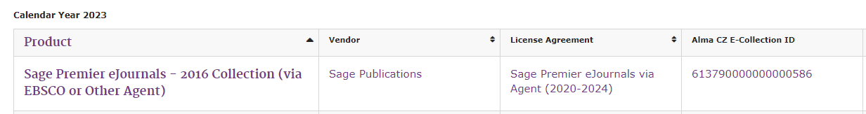
NEW FEATURE UPDATE
Alma CZ E-Collection IDs
Are now viewable in the Selection System
ID is featured with your selected products for the CY23 and FY24 cycles and all subsequent cycles moving forward.
A listing of the IDs for selected products is now available on the CARLI website
https://www.carli.illinois.edu/products-services/i-share/electronic-res-man/cz-ecollection-ids
NEW!

Slide 6
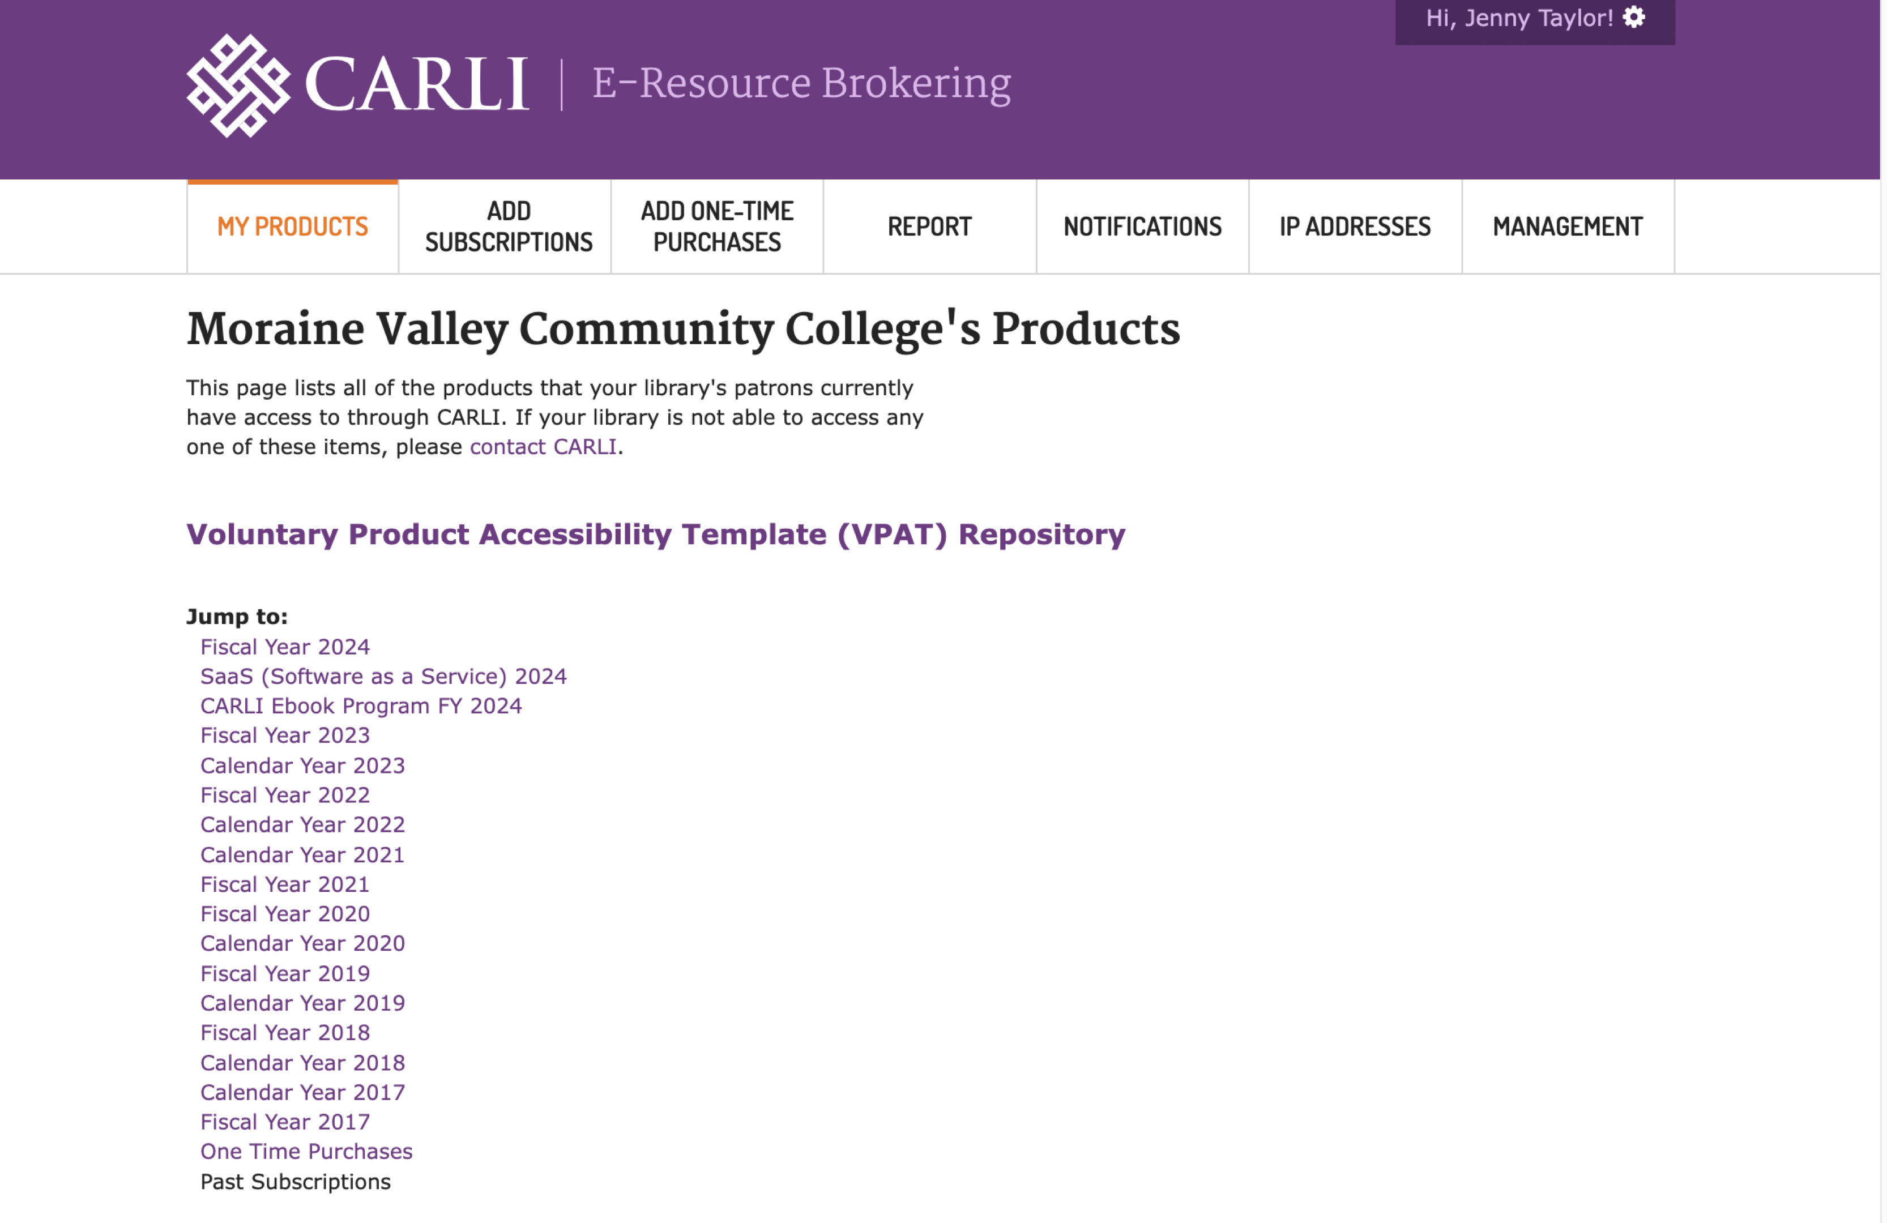
Licensing Information
E-Resources Selection System Changes to Licensing Information and Terms

Slide 7
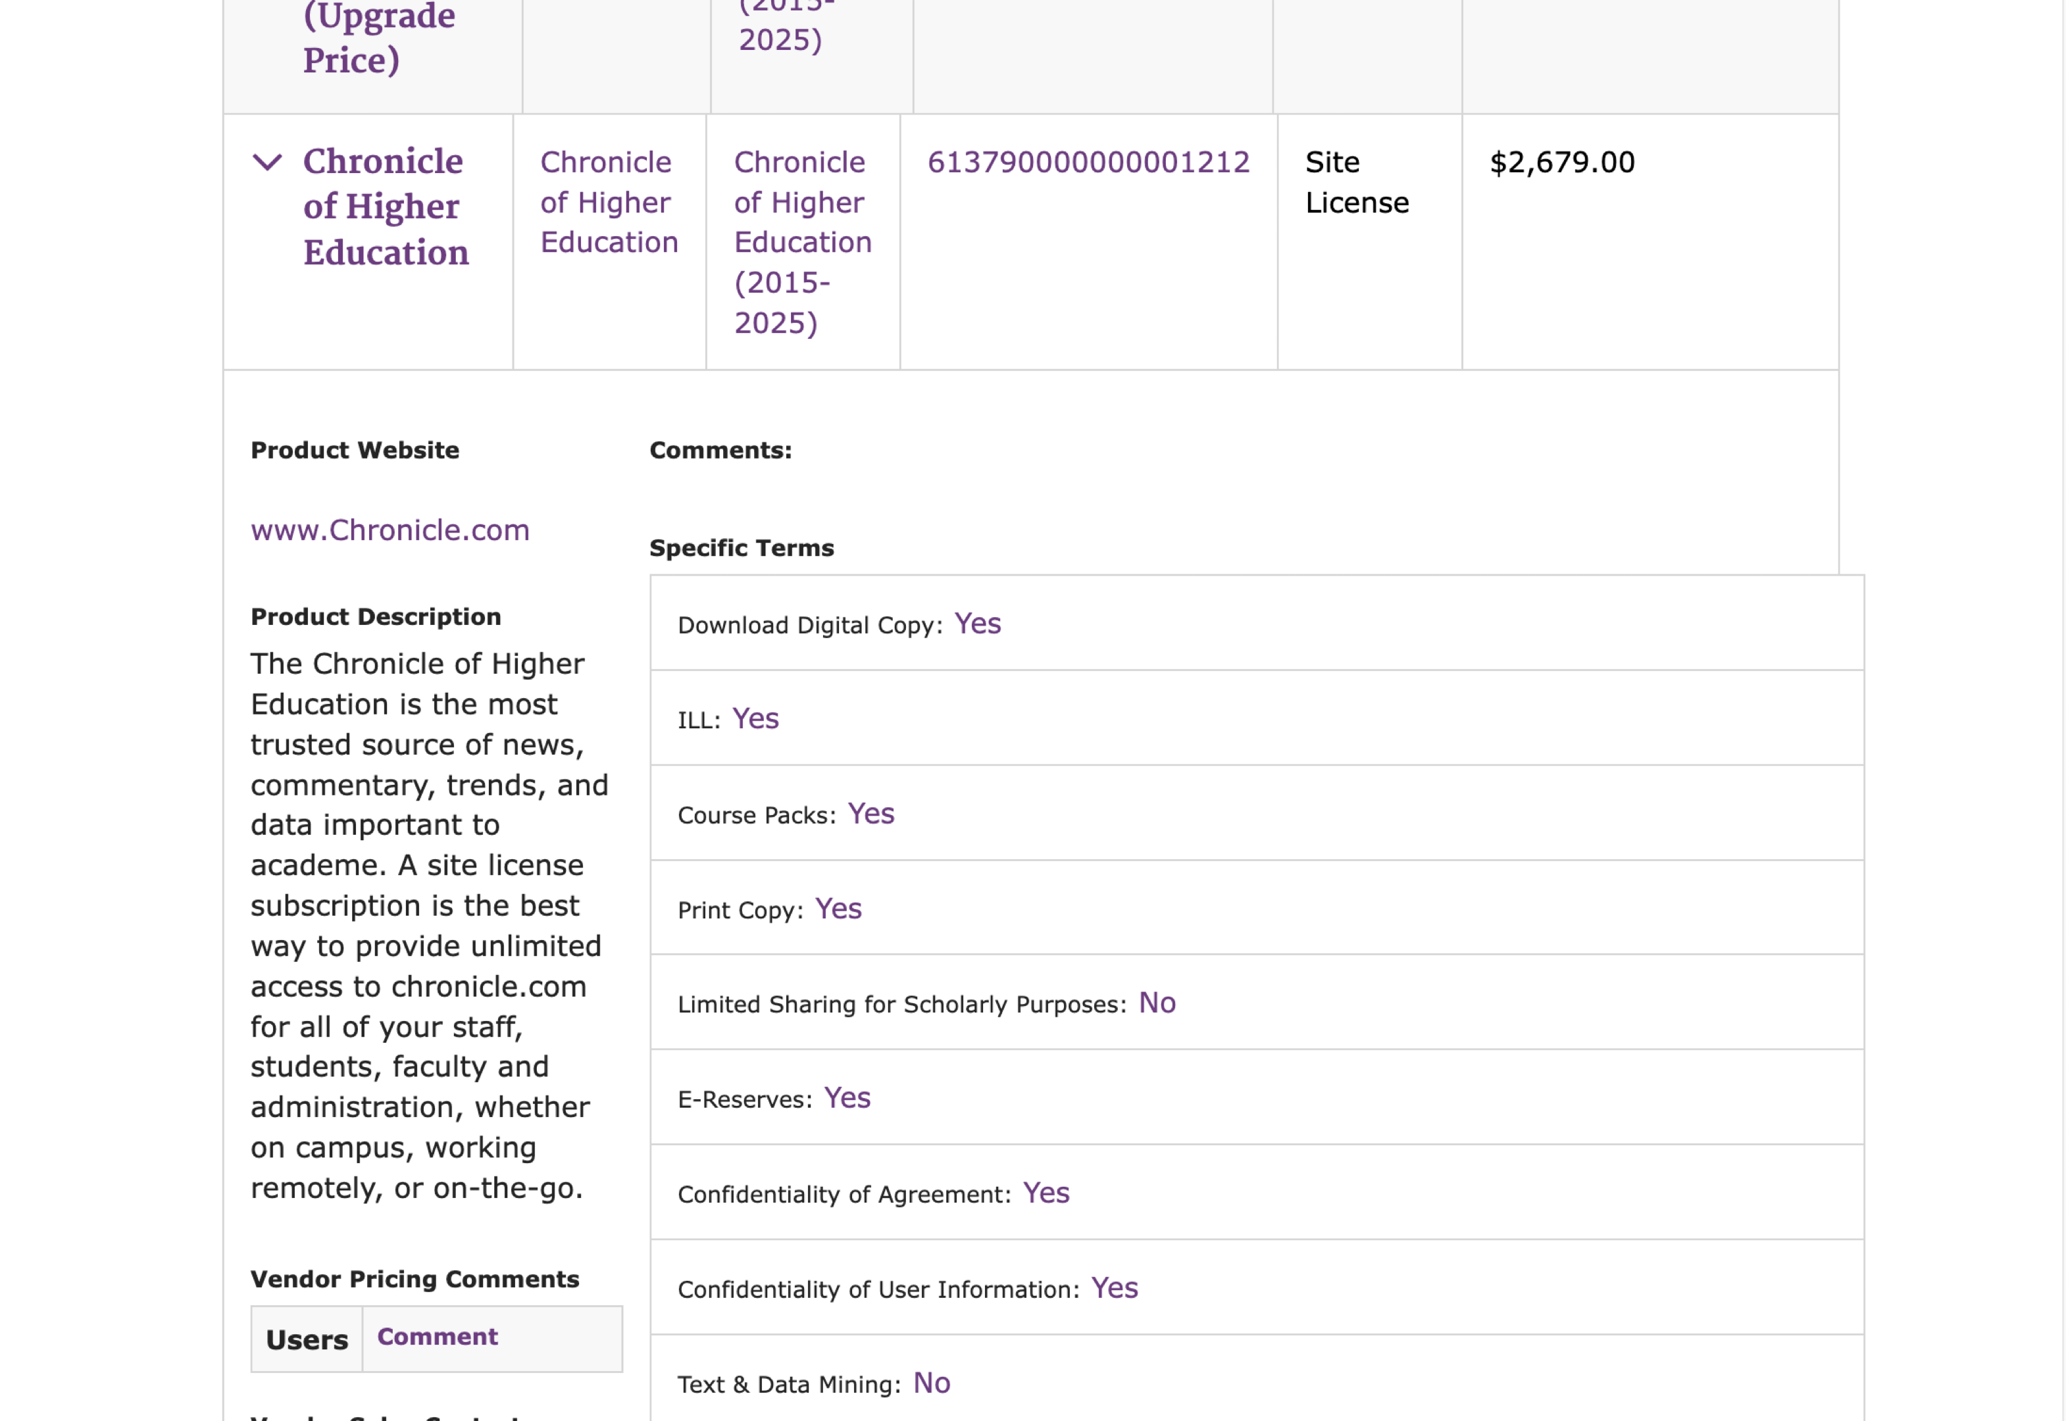
Licensing Information
Notes:
Specific terms roughly match up to what is in Alma.
If a field is blank, it isn’t covered in the license. This is common in earlier licenses that may not have a clause for, say, text and data mining
But all new licenses should have all of this information

Slide 8
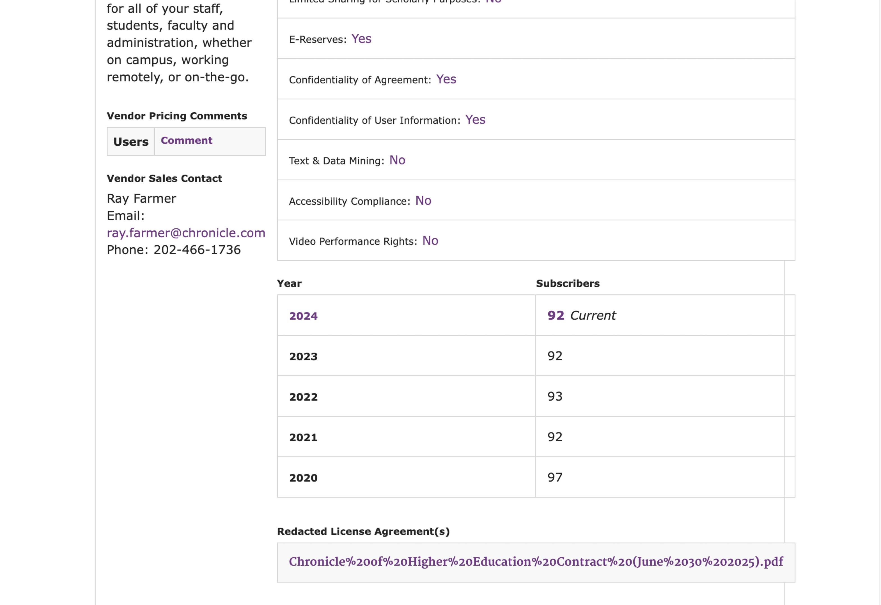
Licensing Information
Notes:
Keep scrolling, and there is a link to the redacted agreement. You can open this in a browser.

Slide 9
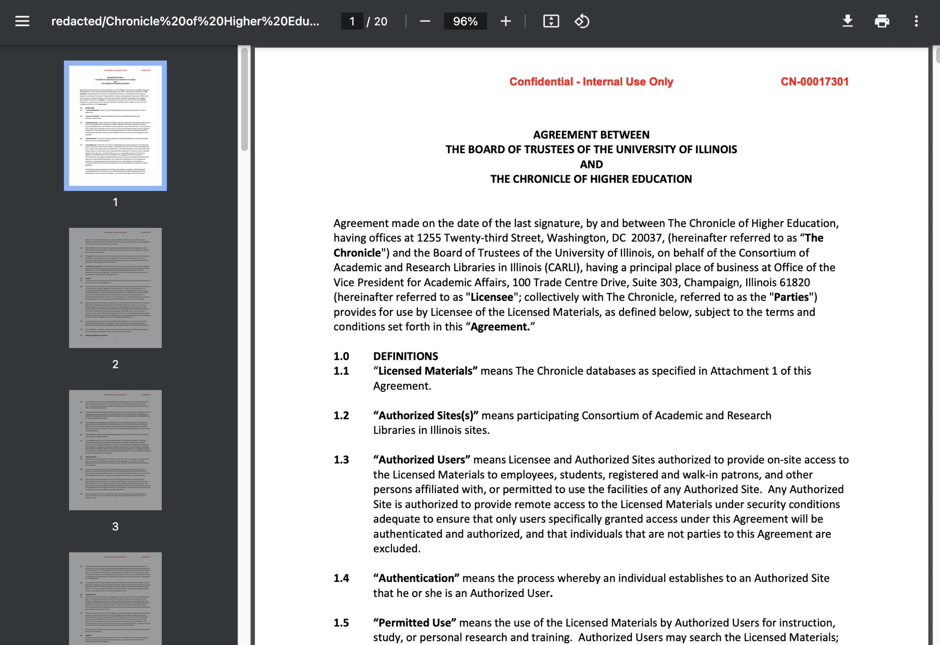
Licensing Information
Notes:
Note that it is labeled confidential. These agreements are meant to be used internally by your library. You can download them and load them into your local Alma instance, but should not make them publicly viewable.

Slide 10
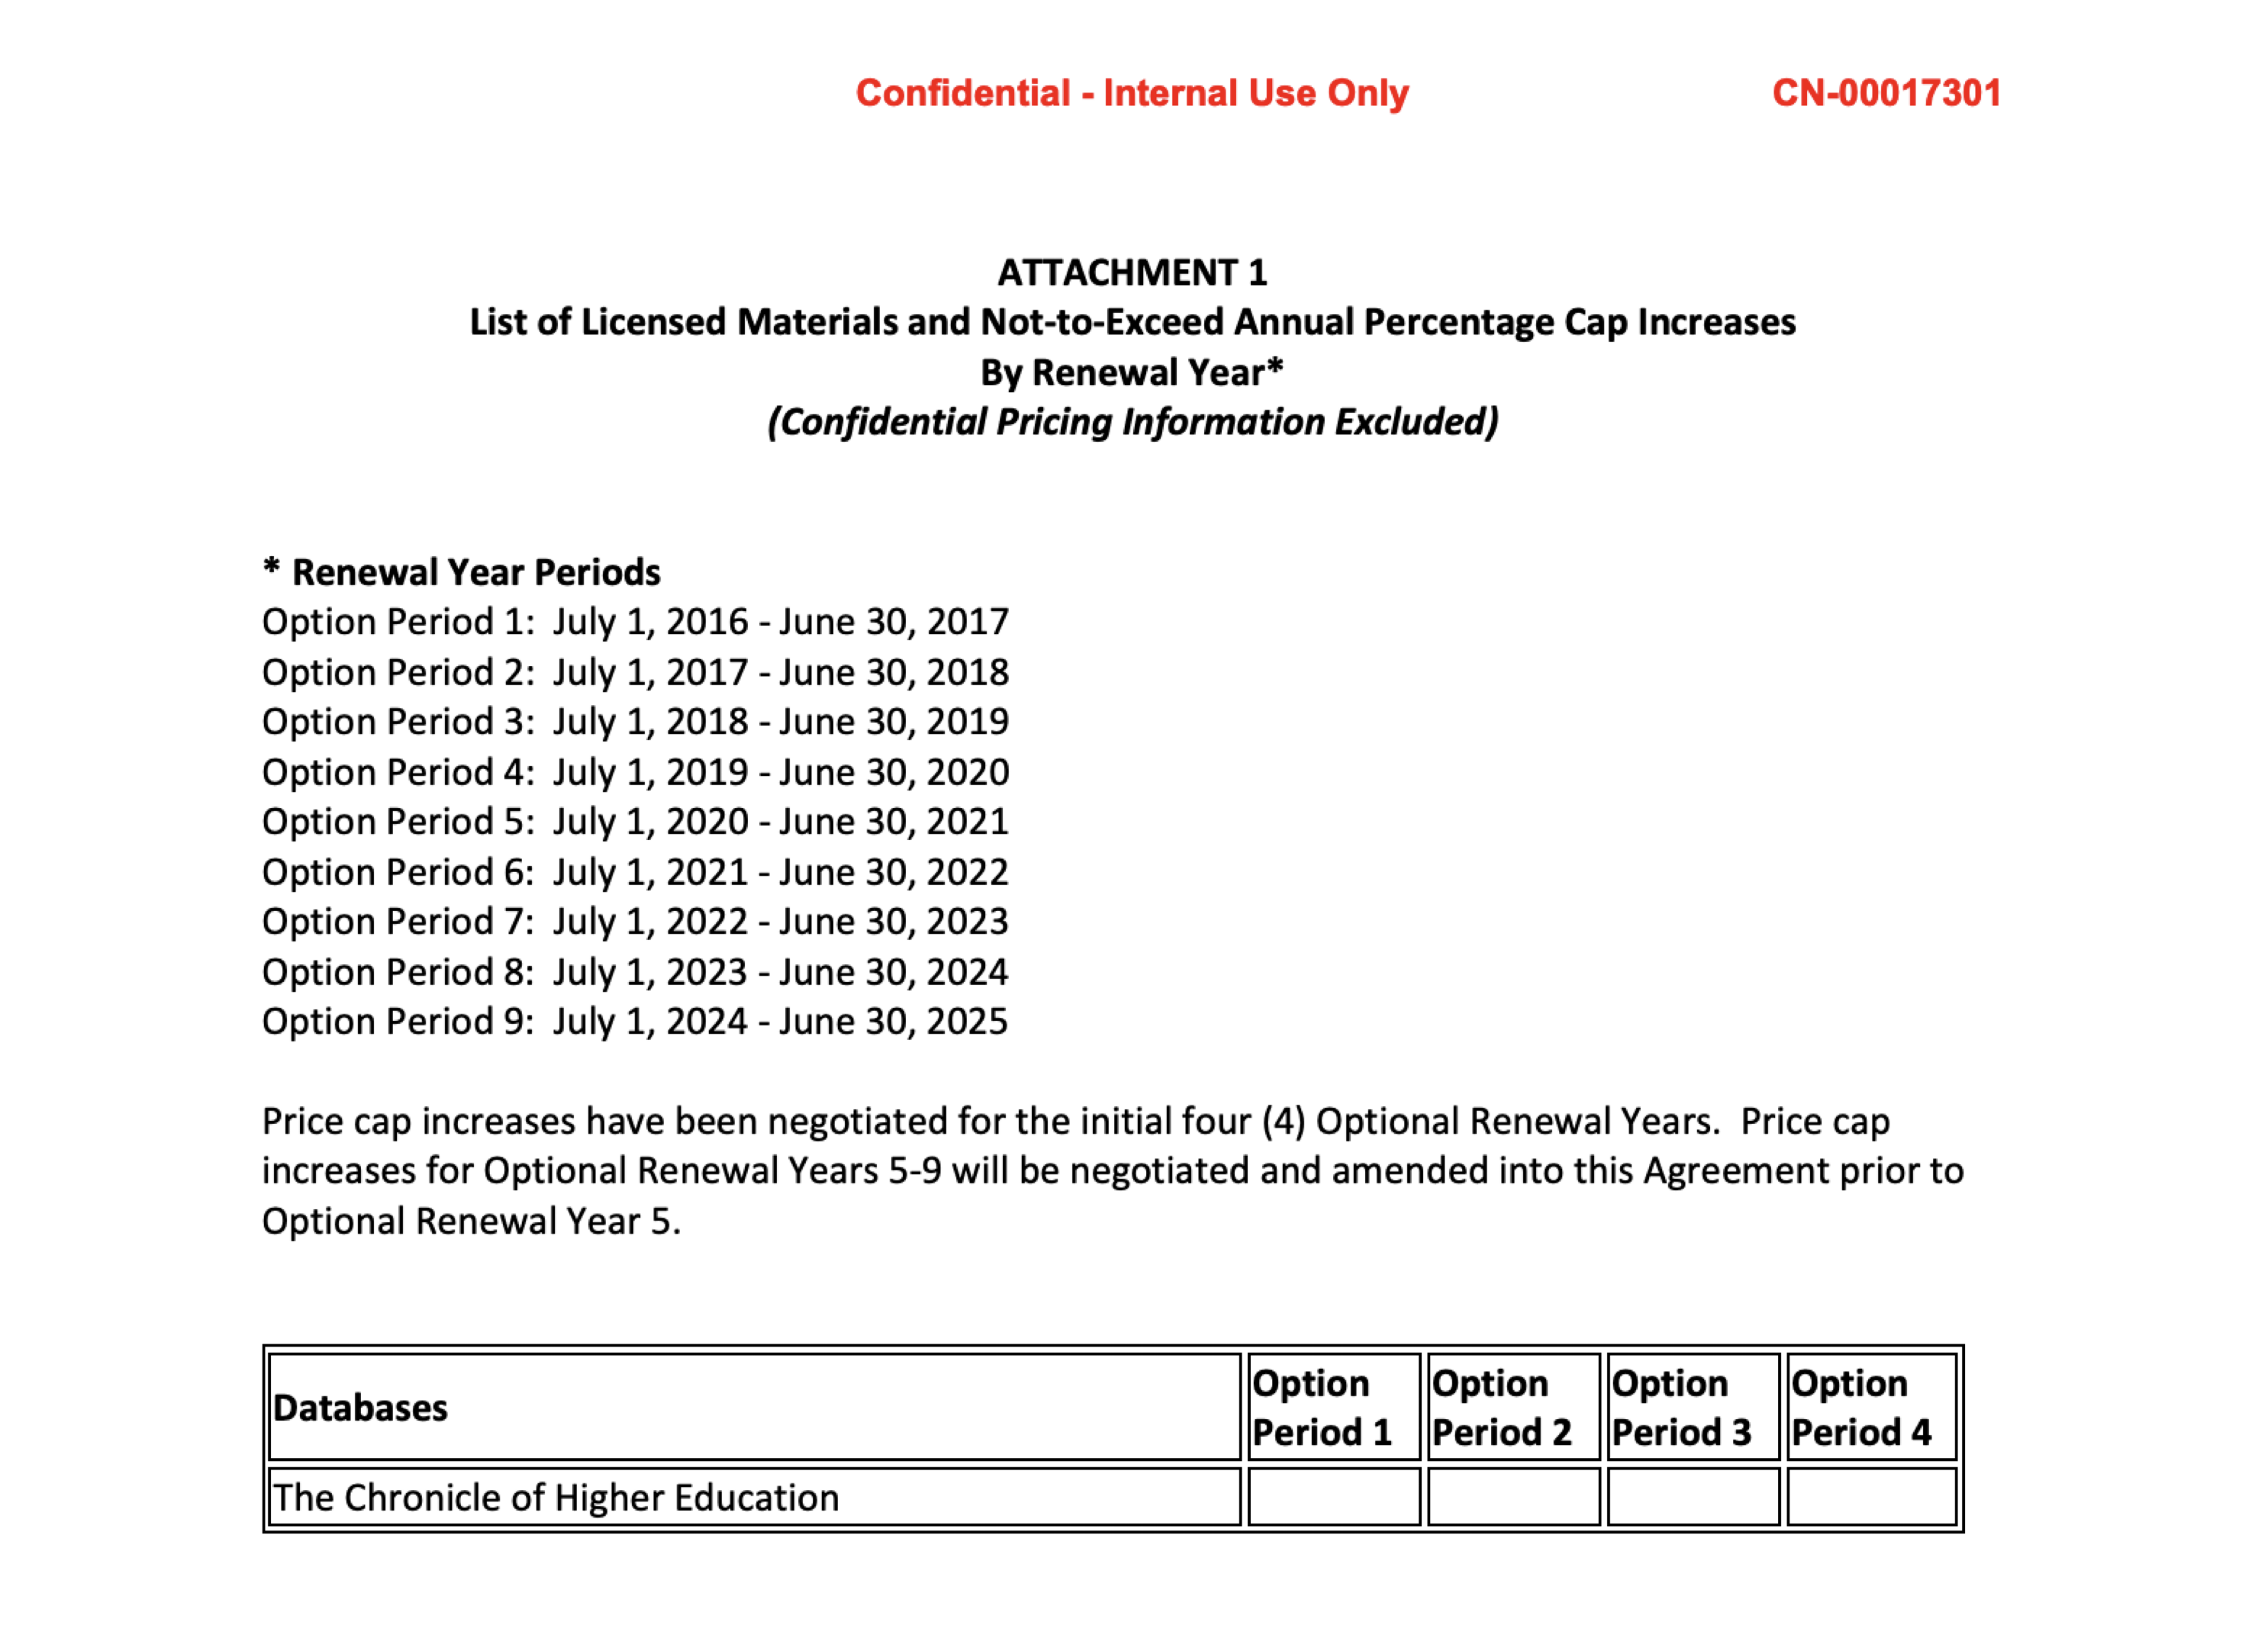
Licensing Information
Notes:
We redact signature information and anything pertaining to pricing. Most licenses have this as a black redaction; this one was just left blank prior to getting a signature, so we used it as the redacted version.
Price caps are considered pricing information for now, and thus are confidential.

Slide 11
Licensing Information
Vendor Licenses:
AAAS
ACM
ACS
AMS
Bloomsbury
Chronicle
Duke
EBSCO**
eHRAF
Gale
Infobase/Credo
ITHAKA*
JHU/Muse
Kanopy
Lexis Nexis
MLA
Ovid**
Oxford
ProQuest
Sage
Swank
Wiley*
Notes:
Per our purchasing office, we checked in with vendors, making sure they were comfortable having librarians (with logins) access redacted copies. There was a little reluctance with who would have access to these, so please make sure they stay internal. But, all of these agreed that putting them in the selection system and libraries downloading them to put into Alma was ok.
Starred licenses are pending; we will be writing language in future agreements that states a redacted license will be posted in the selection system.
Vendors with 2 stars didn’t want their licenses posted, citing that they were old, had different terms, people who signed them had left. None of these arguments make sense, as they’re still in place, and we believe libraries need access to them. But for now, they are not available. We’ll work on that.

Slide 12
Licensing information
Alma and Licensing Information and Terms
Must have role License Manager
If need to create a vendor first, need role Vendor Manager
Collect the Licensing Terms you wish to enter.
Great way to use Alma as electronic resources manager
Can share license terms with coworkers via Alma and (potentially) Primo VE

Slide 13
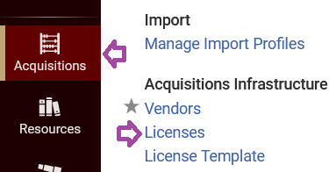
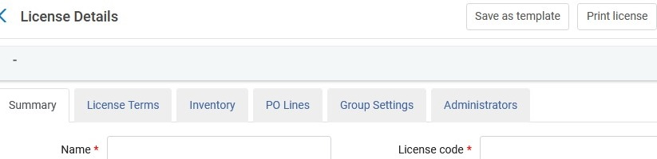
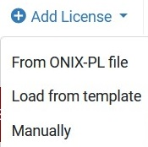
Licensing information
Major steps after logging into Alma IZ and going to Acquisitions.
Look up Vendor to make sure has Licensor trait.
Go to Acquisitions- License
Add a License
Go to either Template, From ONIX file or Manually.
If pick “Manually”, fill in relevant fields and save.
Notes:
ONIX-PL, = Online INformation eXchange for Publication Licenses (standard format some vendors/publishers use)

Slide 14
Licensing information
Brief Demo
Major steps after logging into Alma IZ and going to Acquisitions.
Look up Vendor to make sure have Licensor trait.
Go to Acquisitions- License
Add a License
Go to either Template, From ONIX file or Manually.
Fill in relevant fields and save.
** Training video at http://exl-edu.com/01_Alma/Alma_Essentials/en/Acquisitions/Licenses/ with steps/transcript as well. (see https://knowledge.exlibrisgroup.com/Alma/Training/AlmaEssentials/Alma_Essentials_-_English/I_Acquisitions_Infrastructure/D_Licenses )
Notes:
Training video and its’ transcript very helpful

Slide 15
Licensing information
Primo VE steps
To configure the display of license-related information, the following roles are necessary:
Acquisitions Administrator
Fulfillment Administrator
General System Administrator
Open the Other Settings page (Configuration Menu > Fulfillment > Discovery Interface Display Logic > Other Settings).
Select the Enable Display of License Information check box.
Select Save.
Note: for instructions on modify the license-related labels, which are defined by the codes that contain a c.uresolver.viewit.license prefix, see instructions on Primo VE label editing: https://www.carli.illinois.edu/products-services/i-share/discovery-interface/custom_labels

Slide 16
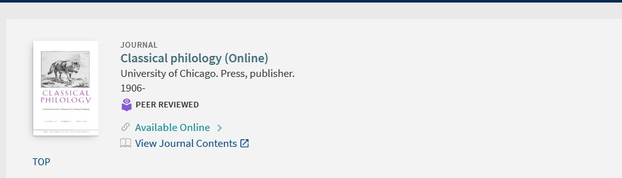
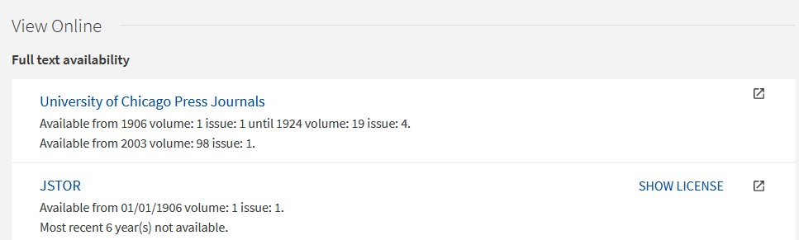
Licensing information
Example from Wheaton College Library
https://i-share-whe.primo.exlibrisgroup.com/permalink/01CARLI_WHE/9s5va0/alma99100792725005903
Notes:
Why show in Primo VE? Can assist your colleagues in finding relevant info for ILL or course reserves and other tasks.

Slide 17
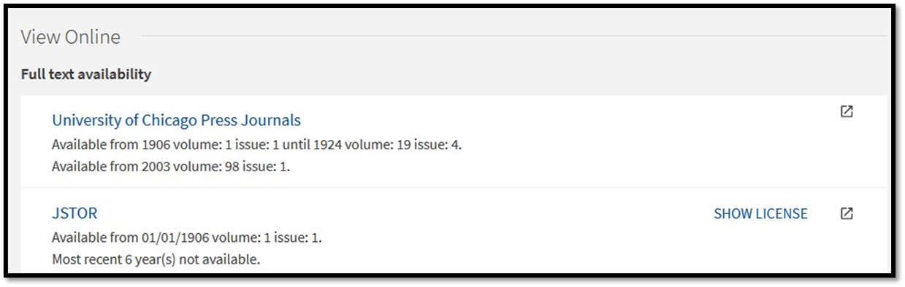

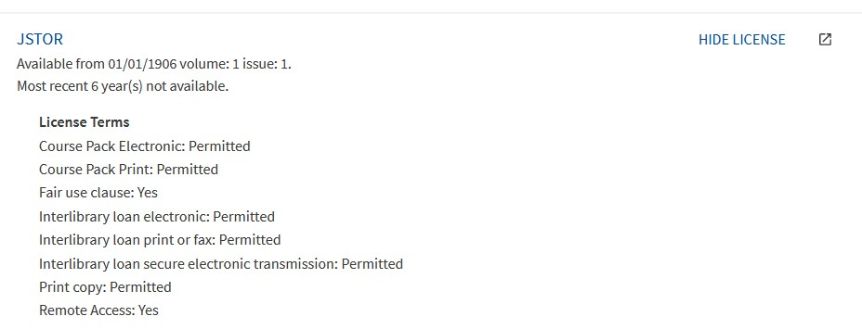
Licensing information
Example from Wheaton College Library
https://i-share-whe.primo.exlibrisgroup.com/permalink/01CARLI_WHE/9s5va0/alma99100792725005903
Notes:
Besides this periodical title level, the “Show license links” also appear on article citations in Primo VE.

Slide 18
Resources
Links for further learning…
License Terms in Alma https://knowledge.exlibrisgroup.com/Alma/Product_Documentation/010Alma_Online_Help_(English)/020Acquisitions/110Configuring_Acquisitions/170Managing_License_Terms
License Training https://knowledge.exlibrisgroup.com/Alma/Training/AlmaEssentials/Alma_Essentials_-_English/I_Acquisitions_Infrastructure/D_Licenses

Slide 19
AutoHoldings
Automatic Upload of Electronic Holdings
Way to automate the ongoing updates to selected vendors’ electronic collections. Set up and KBART files enable scheduled additions, deletions or updated bibliographic records and portfolios activated.
Helpful if many changes over time and/or demand driven acq. type e-collections
Alma has integrations set up for:
Elsevier
Ovid
Project Muse
ProQuest Ebook Central
Springer
Taylor & Francis
Wiley
Coming in 2024: SAGE

Slide 20
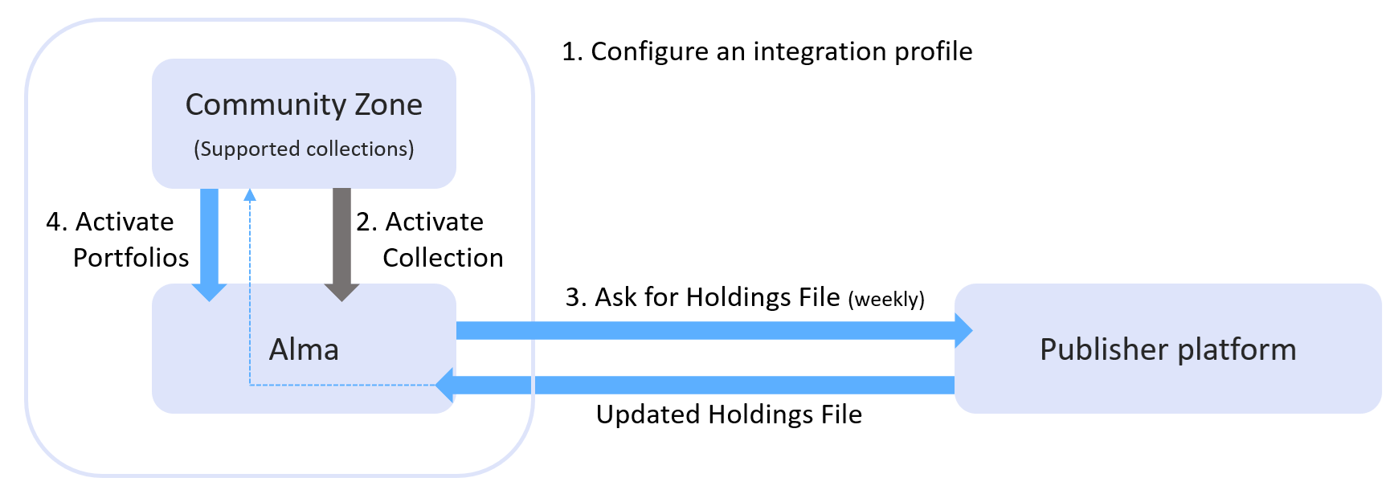
AutoHoldings
Overview of Process
Step “Zero”. Get token/site id/customer id from vendor.
Taken from: https://knowledge.exlibrisgroup.com/Alma/Product_Documentation/010Alma_Online_Help_(English)/Electronic_Resource_Management/020_Working_with_Community_Zone_Electronic_Resources/040Automatic_Upload_of_Electronic_Holdings includes links to each vendor/publisher Alma documentation.

Slide 21
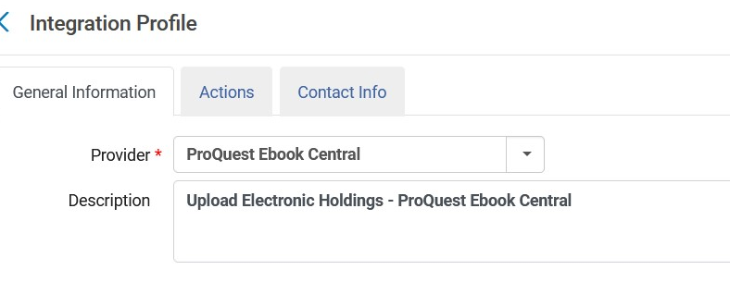
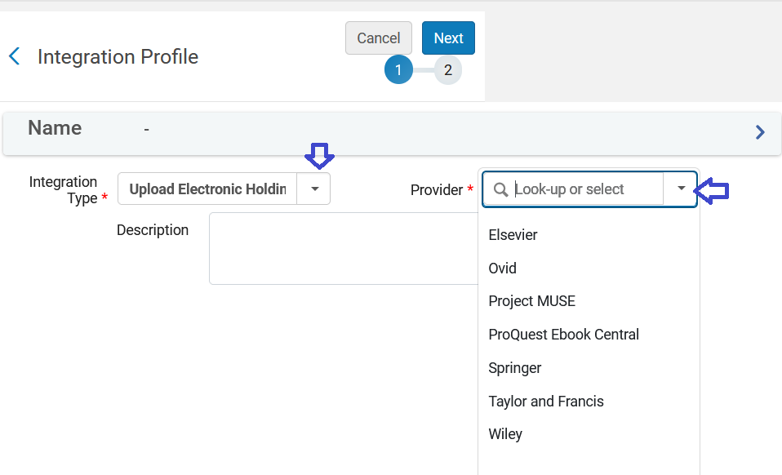
AutoHoldings: Examples from SIC Library
Notes:
Alma already has communication info/mapping set up between vendor and Alma.

Slide 22
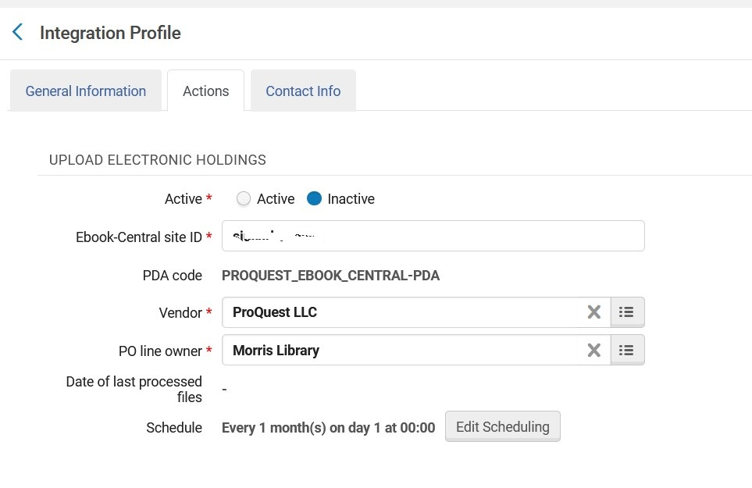
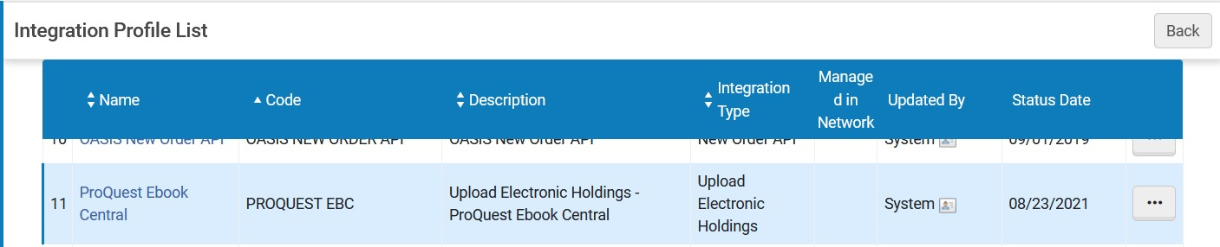
AutoHoldings: Examples from SIC Library
Notes:
Frequency options vary depending on vendor. Definitely need to test and monitor esp. first few cycles of such an upload of electronic holdings.

Slide 23


QUESTIONS?
Contact CARLI at
support@carli.illinois.edu
The next Alma Primo VE Office Hours are Thursday, October 12, 2023.
Multicolored wildflowers.

