Slide 1
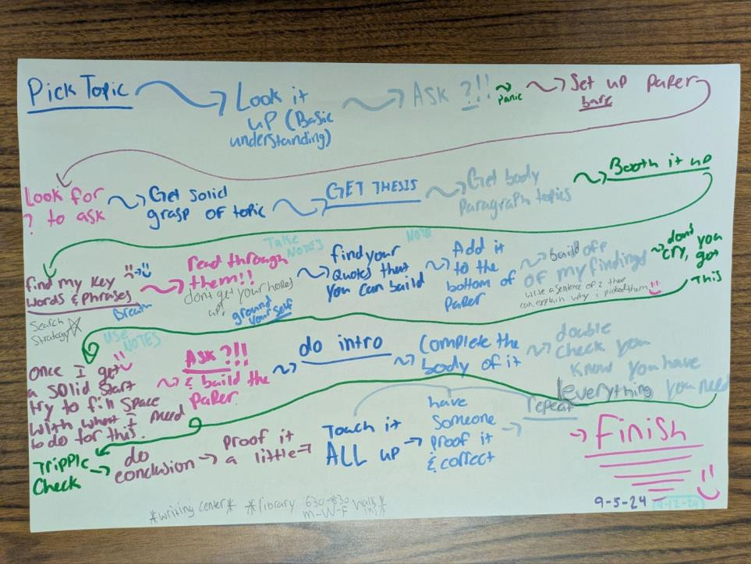
CARLI Instruction Showcase, 2026
Authentic Researcher
Encouraging student agency in the research life cycle
Amy Odwarka
Booth Library, Eastern Illinois University

Slide 2
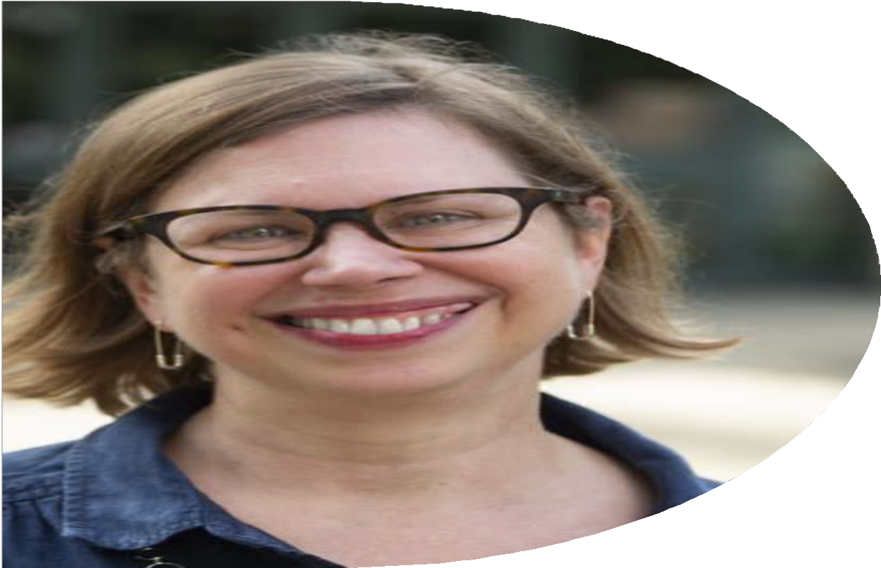
Amy Odwarka
Mary J. Booth Library, Eastern Illinois University
Assistant Professor
First Year Experience/ Student Success Librarian aodwarka@eiu.edu
LinkedIn

Slide 3
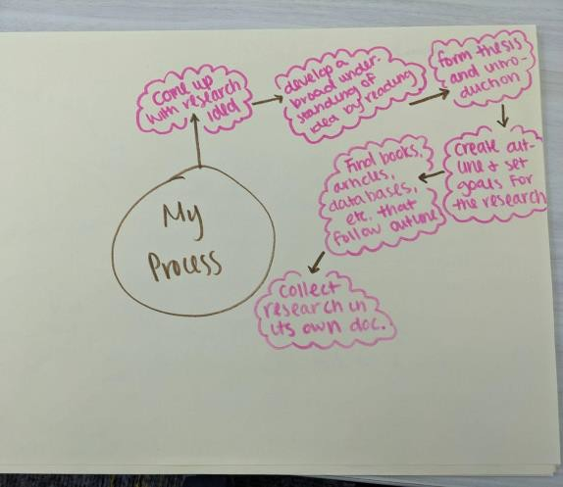
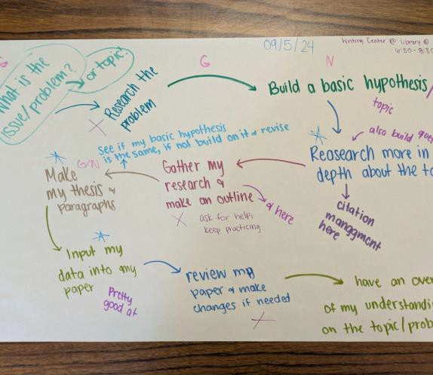
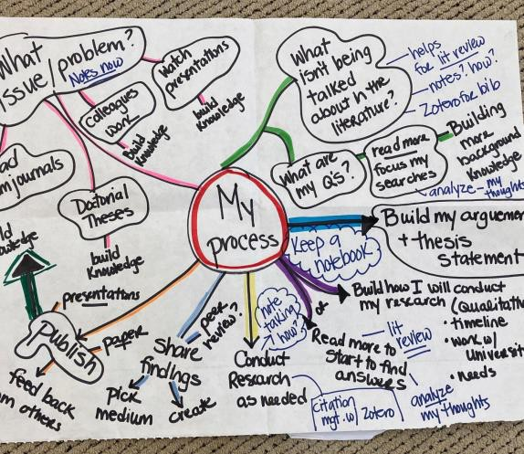
Today’s Workshop
Overview of using personalized research life cycles in information literacy instruction
Develop your own research life cycle
What did you learn today and how would you apply it to your own teaching?

Slide 4
Personalized Research Life Cycle

Slide 5
Why use visual representations?
“Creating pictures, visuals or nonlinguistic representations is one of
the most powerful ways to process information.” (Marzano, 2004)
“Neuroscience has confirmed that the use of nonlinguistic representations increases brain activity and aids information processing. Drawing pictures, flowcharts, or any type of visual is consistent with culturally responsive ways to process information.” (Hammond, 2015)

Slide 6
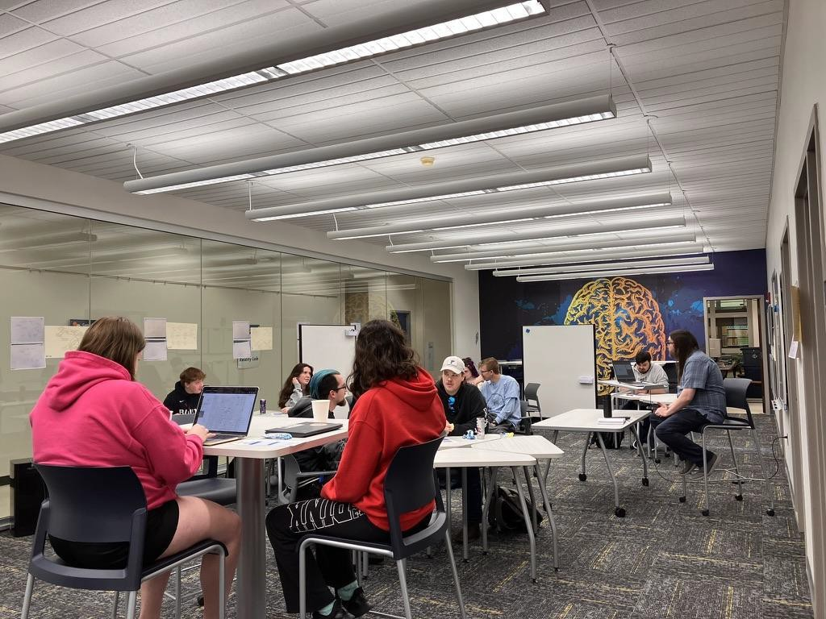
Intro Session

Slide 7
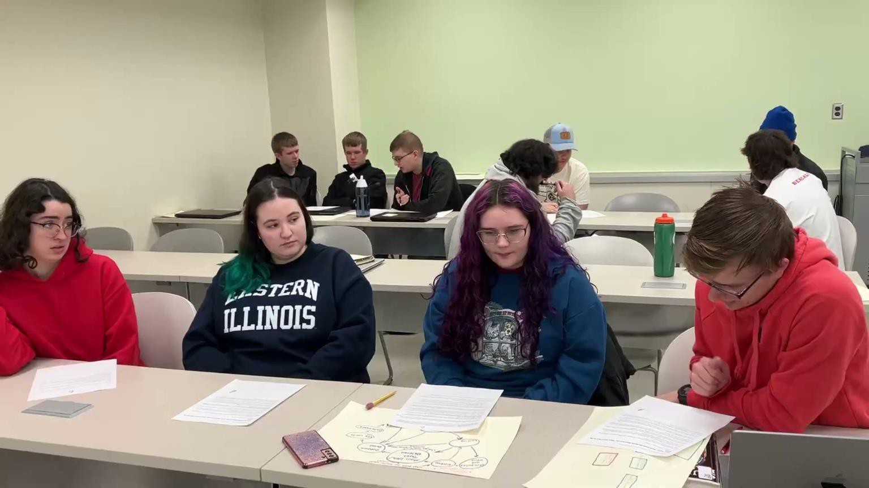
Strategy Classes

Slide 8
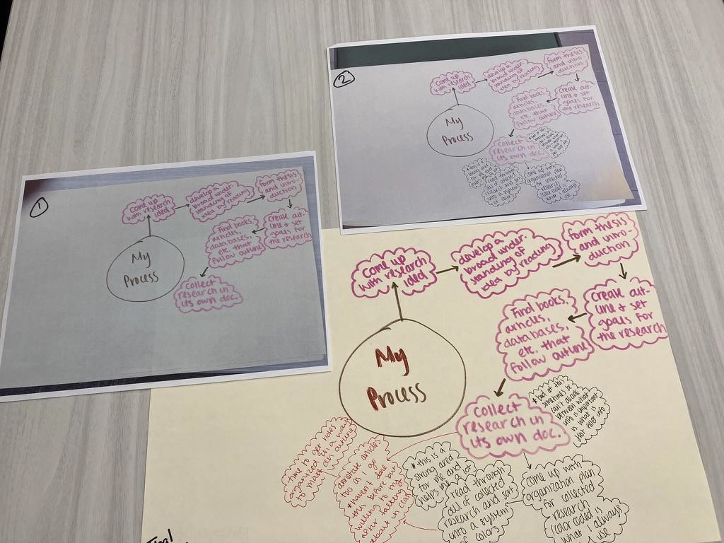
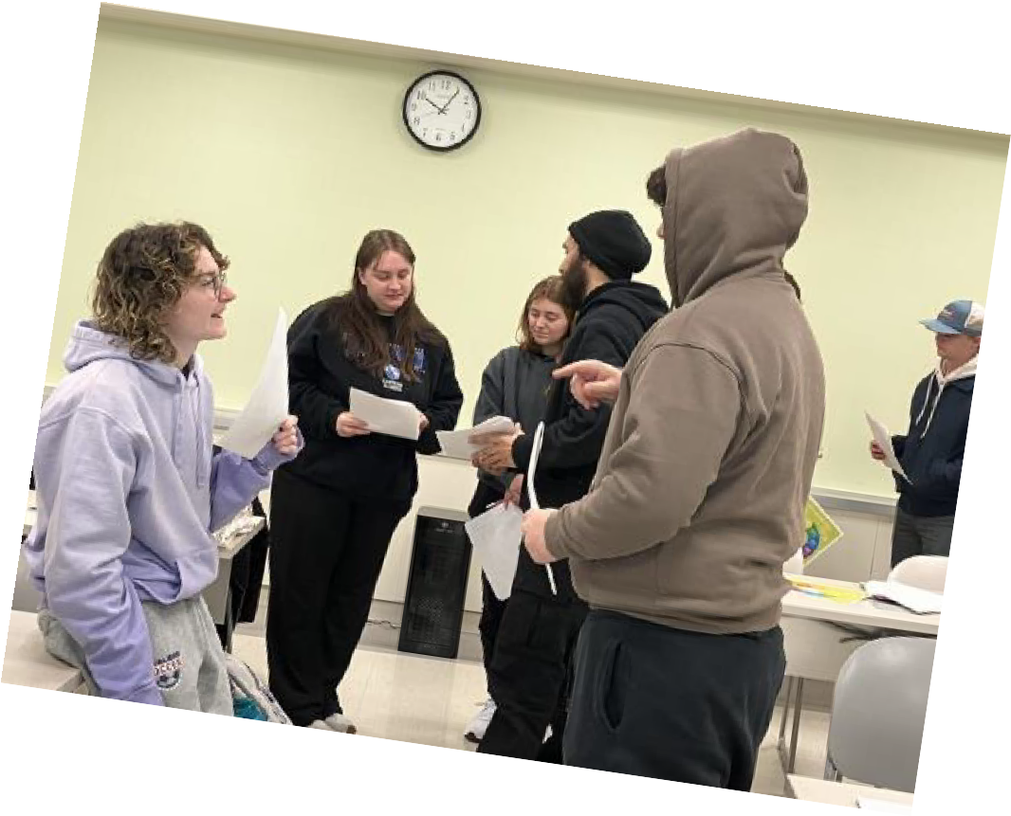
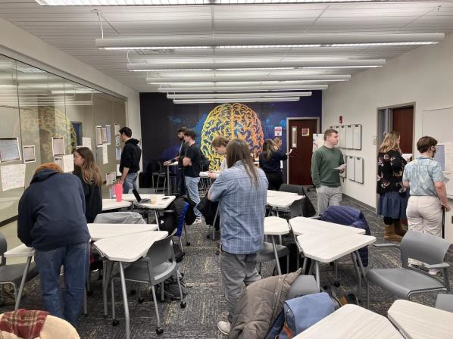
Gallery Walk Critiques

Slide 9
Building student agency
Metacognition for personal research process
Identify strengths and needed areas of growth
Identify support systems before issues arise
Builds trust in personal abilities to complete research process

Slide 10
Mini-Break

Slide 11
Create
Time to make your own personalized research cycle
12 minutes to create and load on Padlet
Answer one of the questions posed about your personalized research cycle (on Padlet)

Slide 12
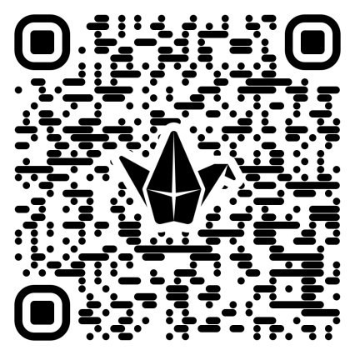
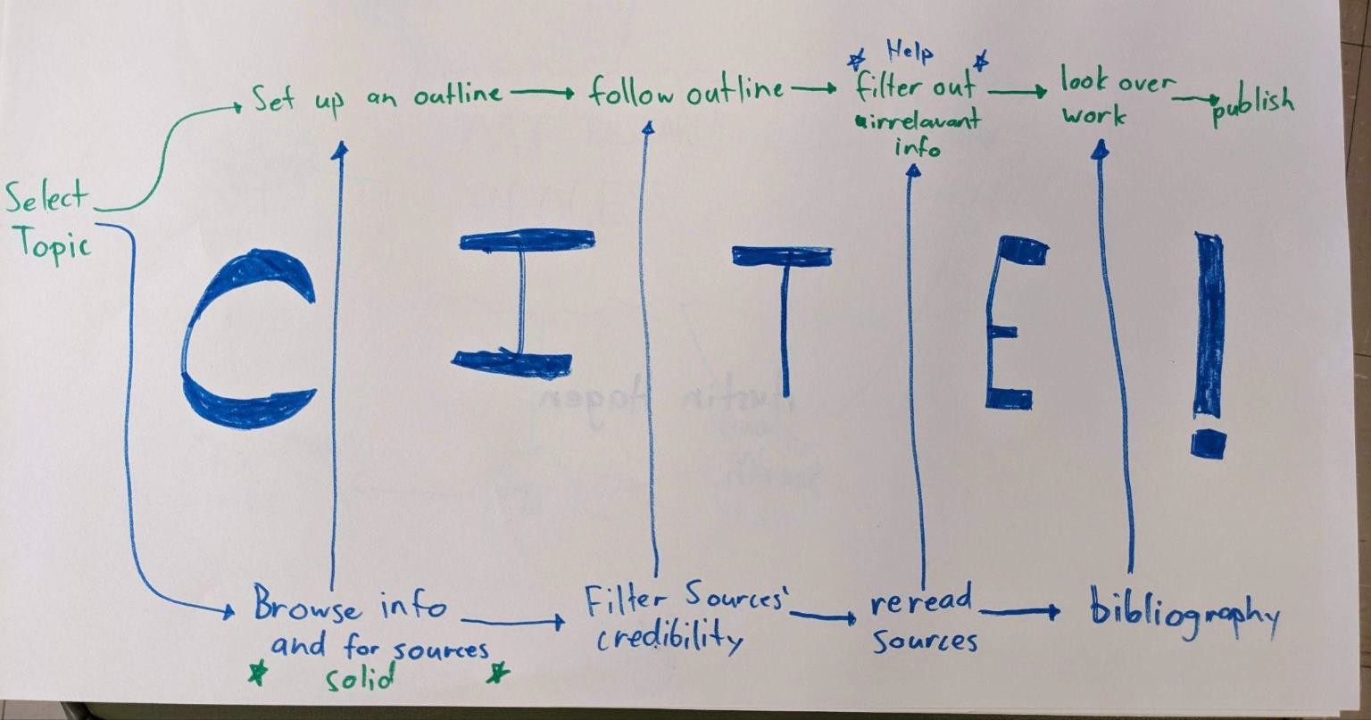
Connect to our Padlet here
12 minutes to create and load on Padlet
Answer one of the questions posed about your personalized research cycle (on Padlet)

Slide 13
Share & Chat

Slide 14
Works Referenced
Hammond, Z. (2015). Culturally responsive teaching and the brain : promoting authentic engagement and rigor among culturally and linguistically diverse students. Corwin, a SAGE Company.
Kuhlthau, C. (2025). Information Search Process Theory. https://wp.comminfo.rutgers.edu/ckuhlthau/information-search-process-theory/
Marzano, R. (2004). Building background knowledge for academic achievement. Alexandria, VA. ASCD.

Slide 15
Thank you!

