Slide 1
Display Preparation with Circulation Work Orders
Gretchen Schneider
Coordinator of Access Services
Oakton Community College Library

Slide 2
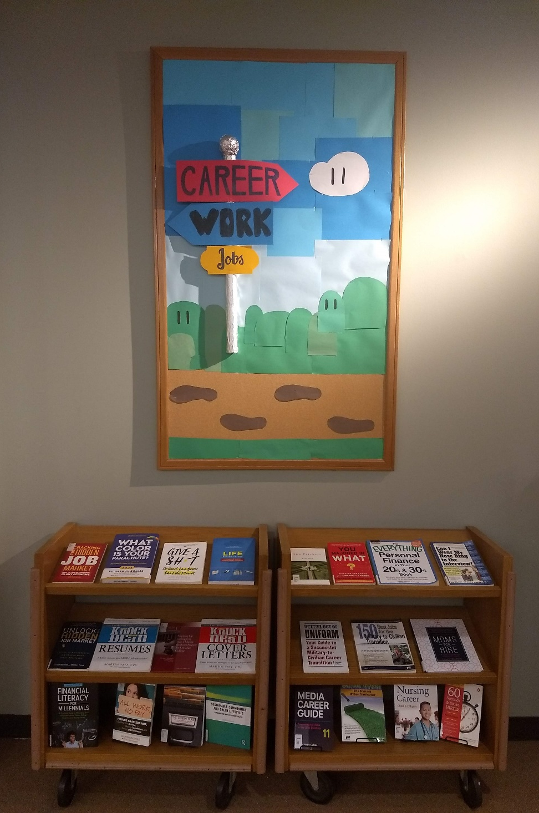
Today I will show you:
How to create a circulation work order area to store items as you prepare a display
How to create sets of items used for common displays to reuse annually
How to run a job to send a set to the pick from shelf for display preparation

Slide 3
Setting Up the Display Preparation Work Order Area

Slide 4
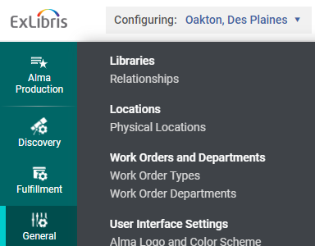
Create a Display Preparation Area
Role: General System Administrator
Configuring: Pick library location (if necessary)
Location: Configuration > General > Work Orders and Departments > Work Order Types

Slide 5
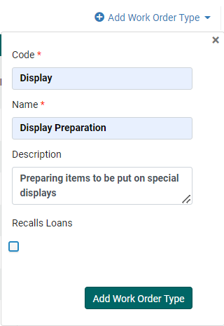
Add Work Order Type
Click Add Work Order Type
Fill in the following:
Code
Name
Description
Deselect Recall Loans (optional)
Click Add Work Order Type Button

Slide 6
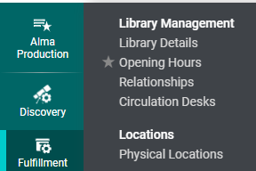
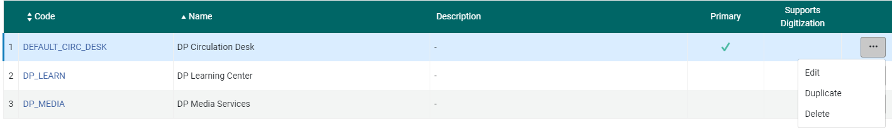
Adding the Circulation Desk
Roles: General System Administrator or Fulfillment Administrator
Location: Configuration > Fulfillment > Library Management > Circulation Desks
On the Circulation Desks List, click … next to your circulation desk
Click Edit

Slide 7

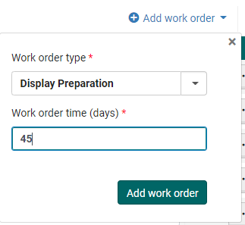

Add Circulation Work Order Type
Click the Work Order Types Tab
Click Add work order
Select the created Work order type from the dropdown menu
Enter the Work order time (days)
Click Add work order
Click Save on the top right

Slide 8
Display Preparation Work Order Area: Adding & Removing Items

Slide 9

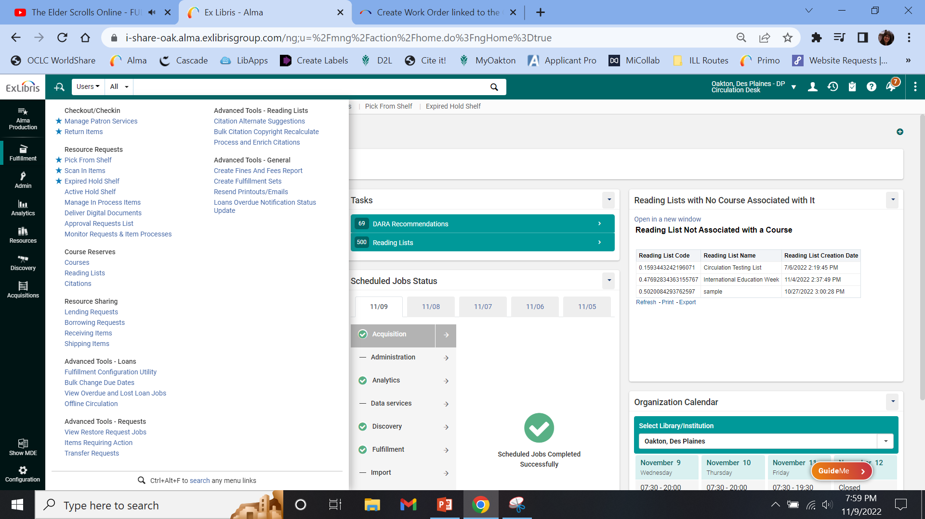
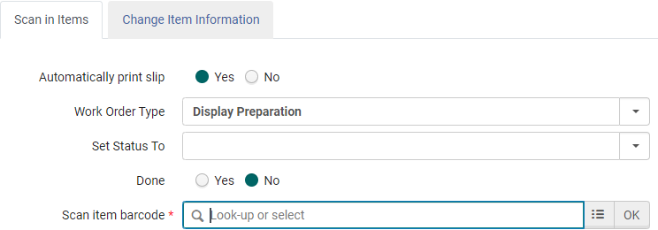
Manually Adding Items to the Work Order Department
Role: Physical Inventory Operator or Physical Inventory Operator – Extended
Desk Location: Circulation Desk
Location: Fulfillment > Resource Requests > Scan In Items
Select Work Order Type
Scan item barcode

Slide 10
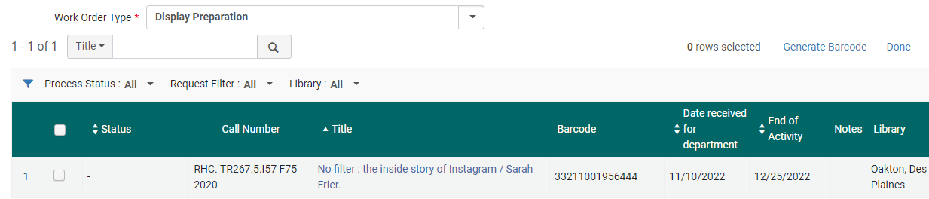
Remove Items from the Work Order Department
Role: Physical Inventory Operator or Physical Inventory Operator – Extended
Location: Fulfillment > Resource Requests > Manage In Process Items
Select Work Order Type
Toggle & click Done

Slide 11
Creating a Display Itemized Set

Slide 12
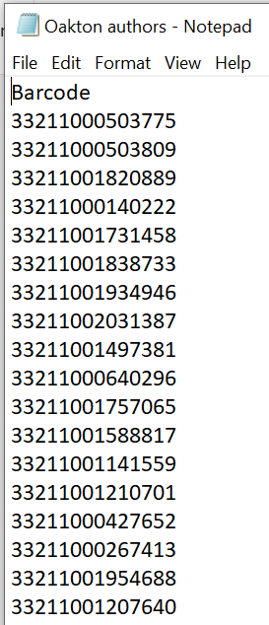
Creating a Set List
Create a list of books you want to keep as an itemized set:
Create a Notepad document
Type “Barcode” on the first line (first letter alphabetized)
Starting with the second line, scan in the item barcodes of the items you wish to add to the set
Save the notepad document File > Save

Slide 13
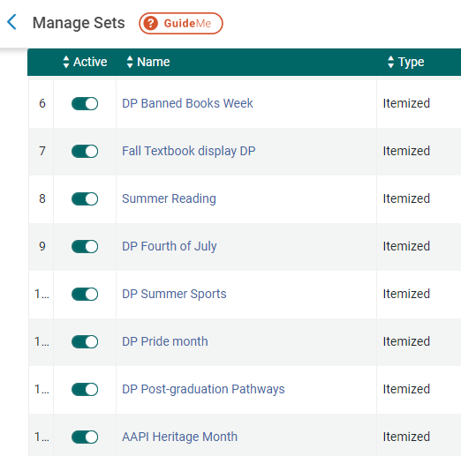
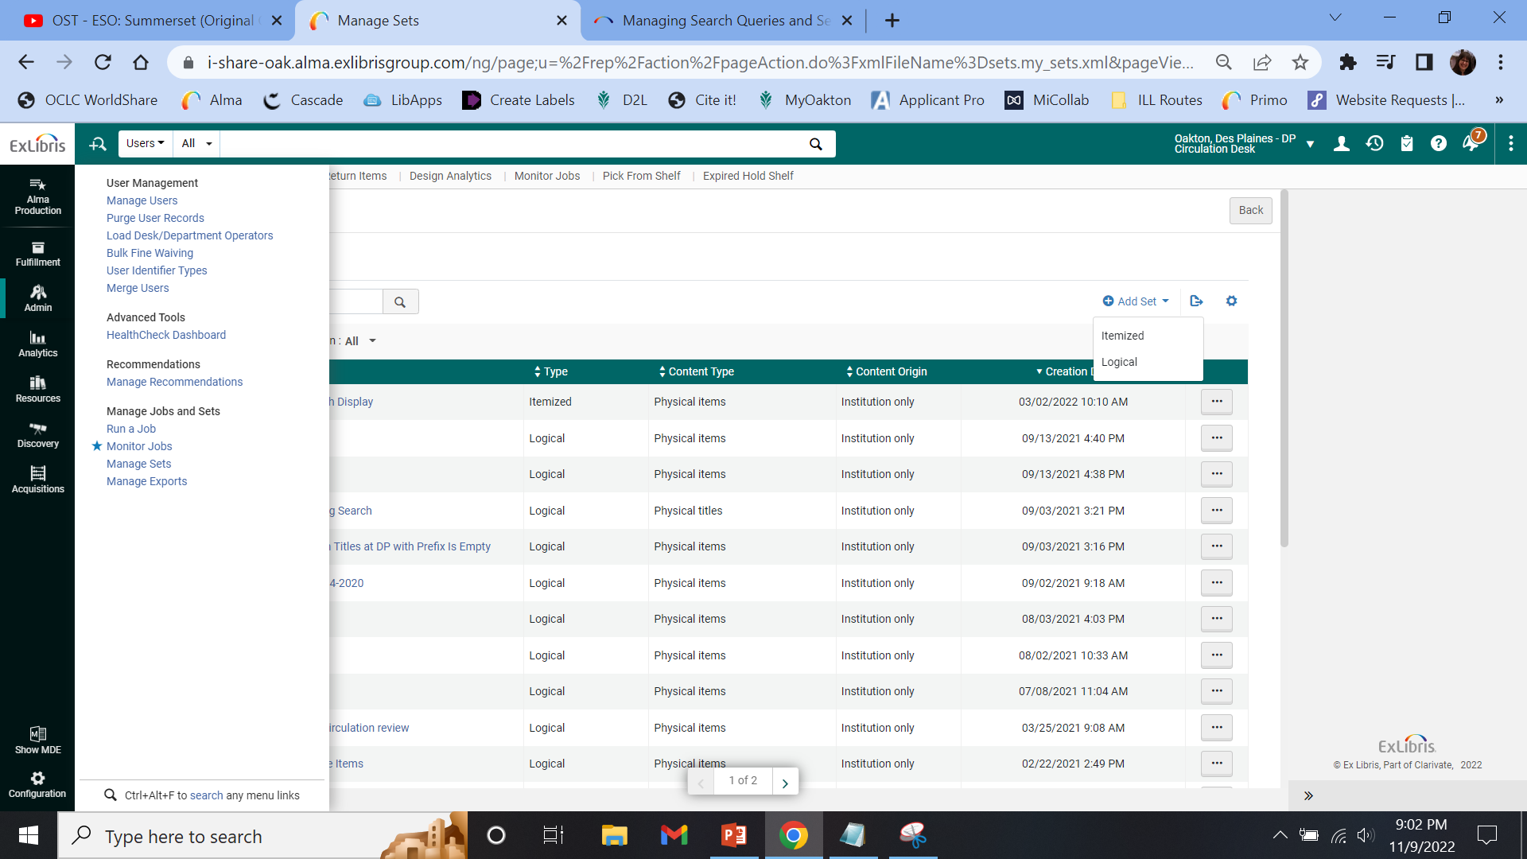
Creating a Display Itemized Set
Role: Fulfillment Services Operator or Fulfillment Services Manager
Location: Admin > Manage Jobs and Sets > Manage Sets

Slide 14
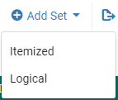
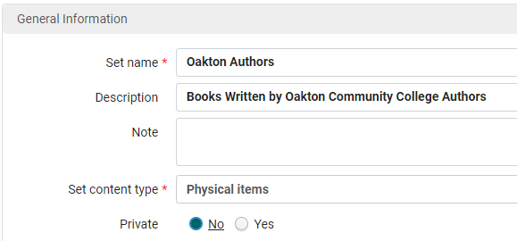
Adding an Itemized Set
On the Manage Sets page, click Add Set and choose Itemized
Enter General Information:
Set name
Description
Set content type: Select Physical Items
Private: Yes/No

Slide 15
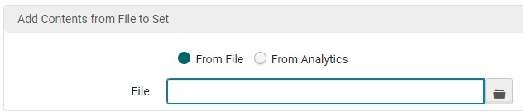
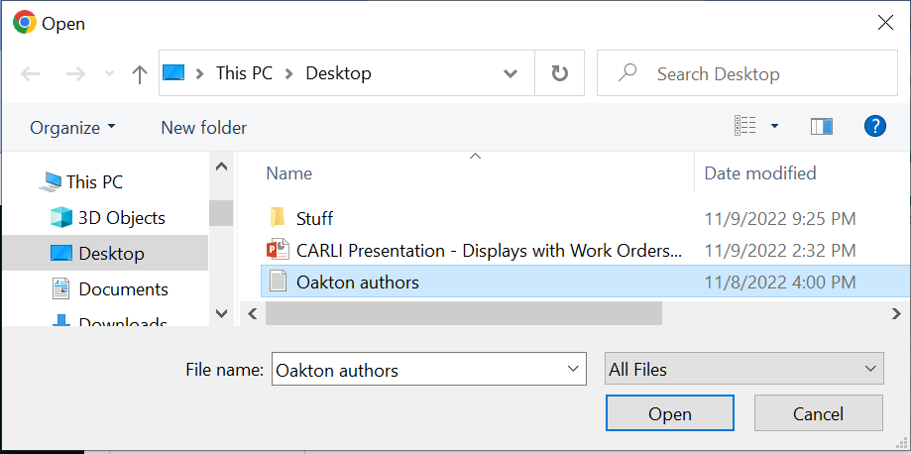

Adding an Itemized Set (continued)
Add Contents from File to Set:
Click the File icon
Select Set File
Click Open
Click Save

Slide 16
Sending Sets to Pick from Shelf

Slide 17
Send to Pick From Shelf
Role: Fulfillment Administrator
Location: Admin > Manage Jobs and Sets > Run a Job
Job Name: Create physical item work orders

Slide 18
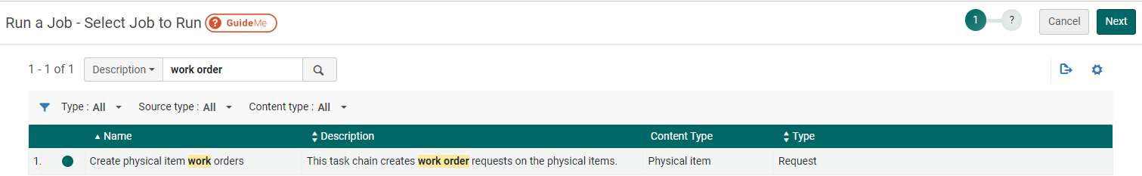
Run a Job, page 1
Search for Description: work order
Select Job
Click Next

Slide 19
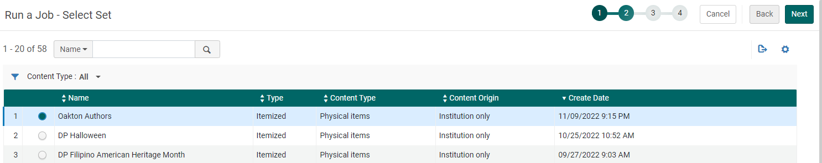
Run a Job, page 2
Select the Itemized List
Click Next

Slide 20
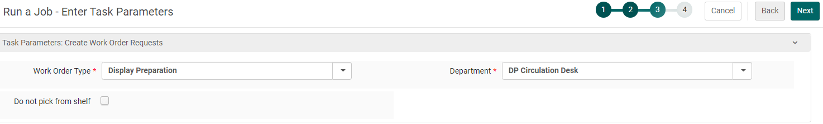
Run a Job, page 3
Select the Work Order Type: Display Preparation (this will auto select the department to match)
Leave “Do not pick from shelf” unchecked
Click Next

Slide 21
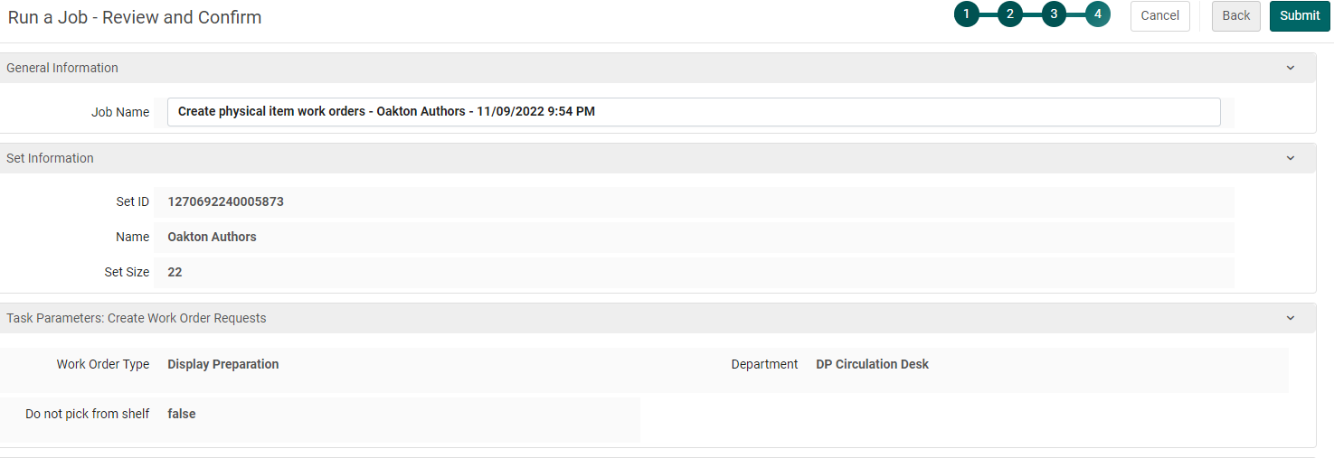
Run a Job, page 4
Review
Click Submit

Slide 22
Display Preparation Work Order Area: Adding Requested Items

Slide 23
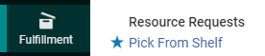
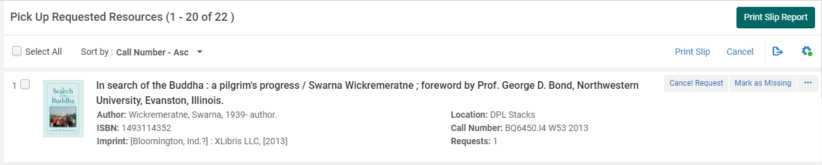
Find Books
Role: Requests Operator
Location: Fulfillment > Resource Requests > Pick From Shelf
Find Books

Slide 24
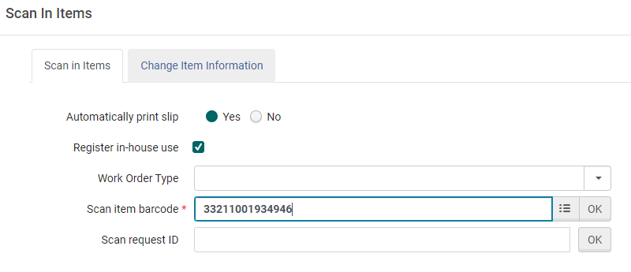
Scan Books
Role: Requests Operator
Location: Fulfillment > Resource Requests > Scan In Items
Scan item barcode

Slide 25
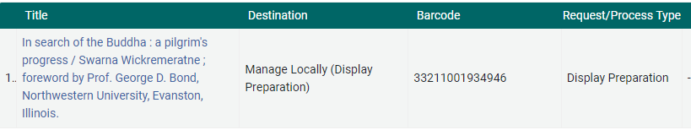
Final Result
Items scanned will be added to the Display Preparation area

Slide 26

Questions? Contact me at gschneid@oakton.edu

