Slide 1
Managing an Exam Database Using Alma / Primo VE
Eric Neagle
Associate Director, Chicago-Kent Law Library

Slide 2
Why move exams to Alma / Primo VE?
Our homegrown database was programmed in a language that no one currently on staff knew.
Migration would eliminate the need for a local server.
Alma is designed to manage electronic resources.
Course Reserves functionality is designed to tag resources with professors and courses.
Makes the most of the tools available.

Slide 3
Where do the resources live and why?
Alma Digital
Cloud storage (Google Drive, Box, etc.)
Alma Digital would provide access university wide.
Google Drive would allow us to limit access to users affiliated with the law school.
Some universities mandate storage locations for digital assets.

Slide 4
Which Alma tools did we use?
Local electronic collection
Import profile
Import process - using Excel spreadsheet
Alma course reserves

Slide 5
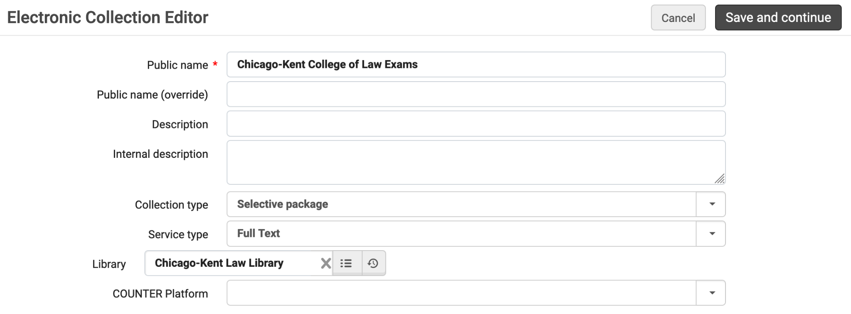
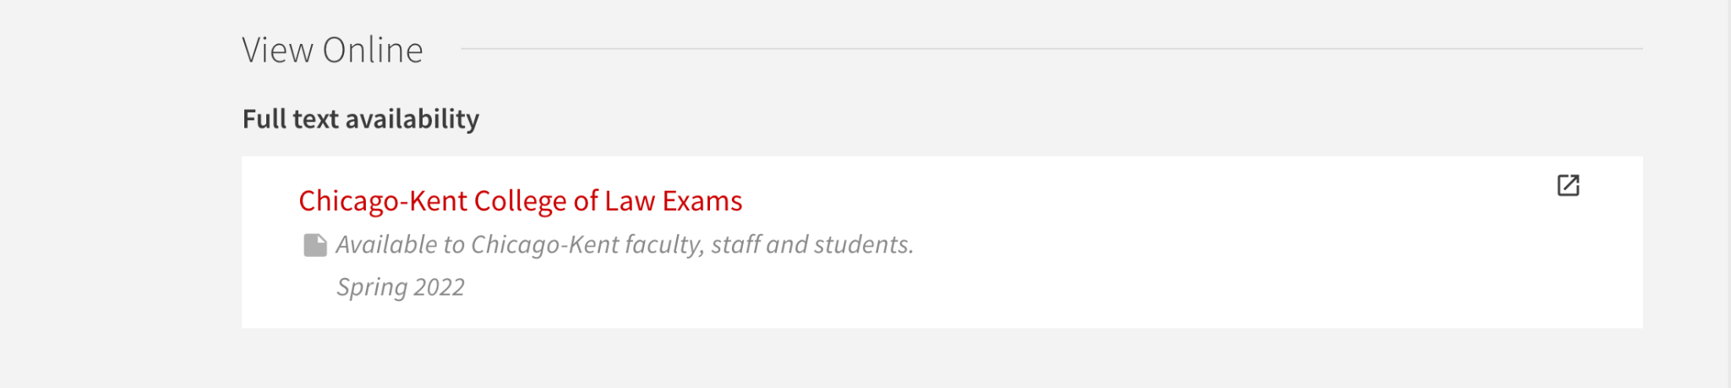
Local Electronic Collection
Groups Exams together
Bulk updates easier to process
Provides a collective title in the Primo VE display
Allows public notes to be managed at collection level

Slide 6
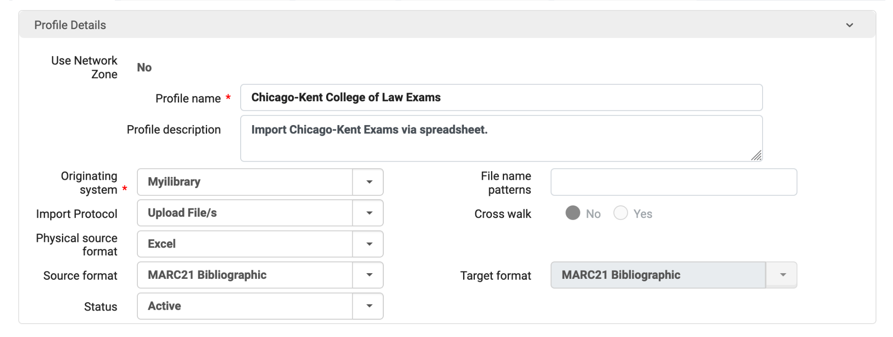
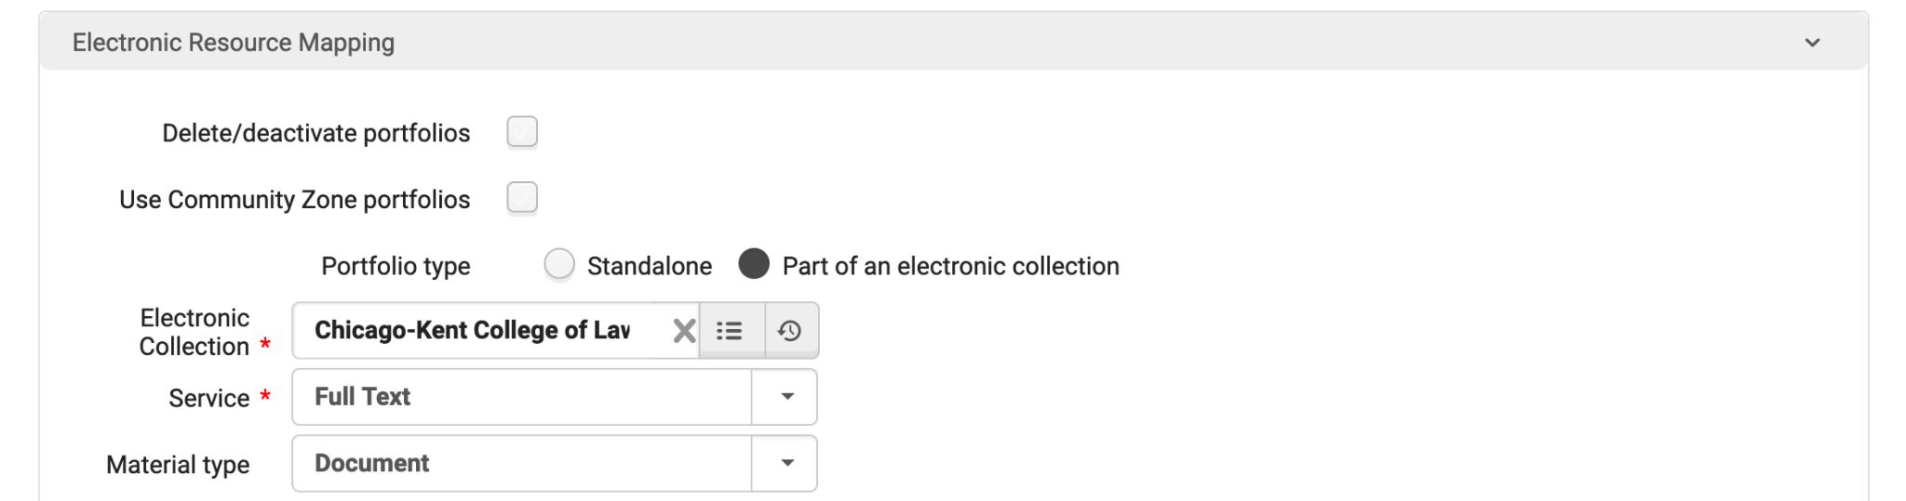
Import Profile
Import to IZ
Import from Excel spreadsheet
Set new portfolios to automatically be added to existing local electronic collection.

Slide 7
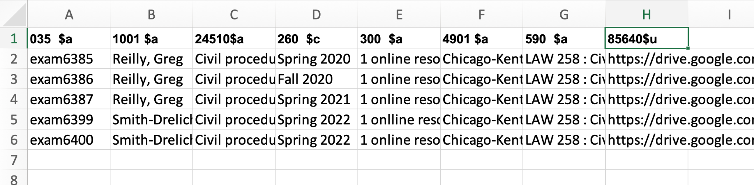
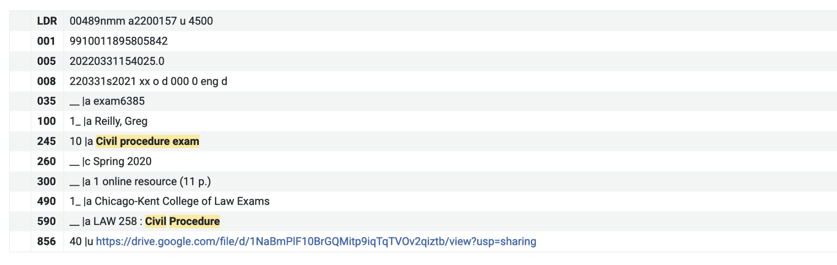
Import Spreadsheet
Column headers correspond to MARC tags
Even if cataloging rules for the tag allows repeating, Excel spreadsheet upload only allows for one instance of a tag.

Slide 8
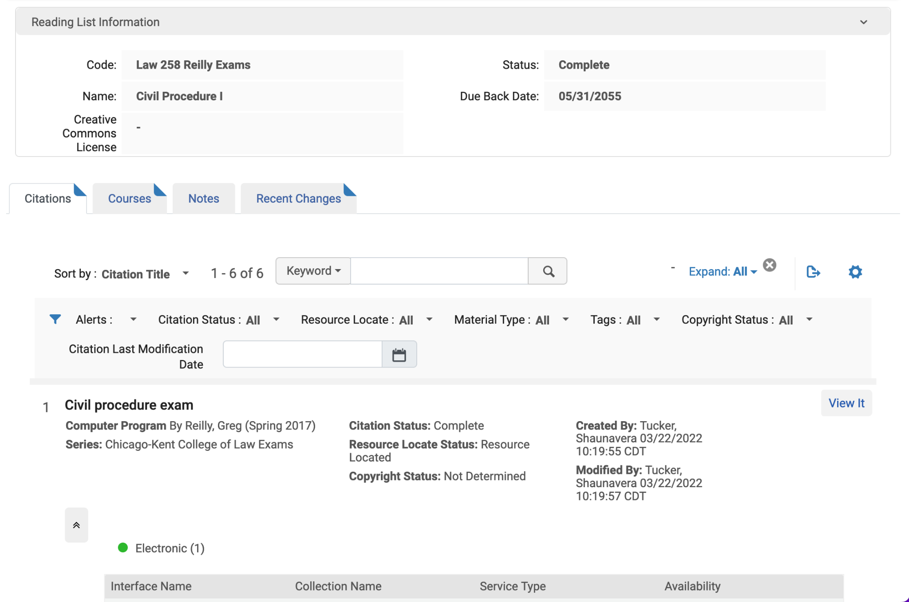
Course Reserves
Create separate courses and reading lists for exams since they will be on reserve forever
Make use of a Due Back Date far into the future

Slide 9
What do students see in Primo VE?
https://kentlaw.iit.edu/law/library/sample-exams

Slide 10
ExLibris Knowledge Center Resources
Managing Electronic Collections
https://knowledge.exlibrisgroup.com/Alma/Product_Documentation/010Alma_Online_Help_(English)/Electronic_Resource_Management/030_Working_with_Local_Electronic_Resources/015Managing_Electronic_Resources
Managing Import Profiles
https://knowledge.exlibrisgroup.com/Alma/Product_Documentation/010Alma_Online_Help_(English)/040Resource_Management/060Record_Import/020Managing_Import_Profiles

Slide 11
ExLibris Knowledge Center Resources
Importing Records Using an Import Profile
https://knowledge.exlibrisgroup.com/Alma/Product_Documentation/010Alma_Online_Help_(English)/040Resource_Management/060Record_Import/050Importing_Records_Using_an_Import_Profile
Courses & Reading Lists
https://knowledge.exlibrisgroup.com/Alma/Product_Documentation/010Alma_Online_Help_(English)/030Fulfillment/060Courses_and_Reading_Lists

Slide 12
Questions?
Eric Neagle
eneagle@kentlaw.iit.edu

