Slide 1
Using Purchase Requests to Increase Book Ordering
Or, using purchase requests to increase Faculty ordering.
Gail Heideman, Collection Strategies Librarian
Laurie Sauer, Associate Librarian for Digital Initiatives and Collections
Seymour Library, Knox College

Slide 2
Let Alma do the work for you….
Keep track of order requests coming at you from faculty members, perhaps other librarians, and whoever else you allow to make book purchasing selections.
Users can specify the format they want: print or electronic
Liaison librarians can approve orders

Slide 3
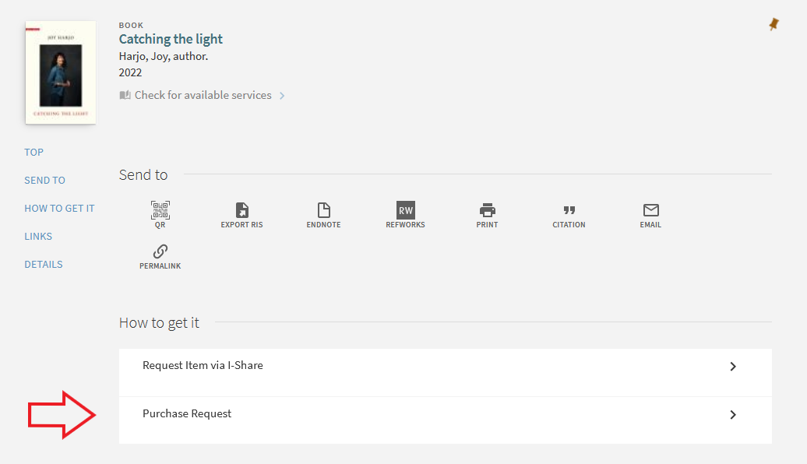
How to Request: From I-Share

Slide 4
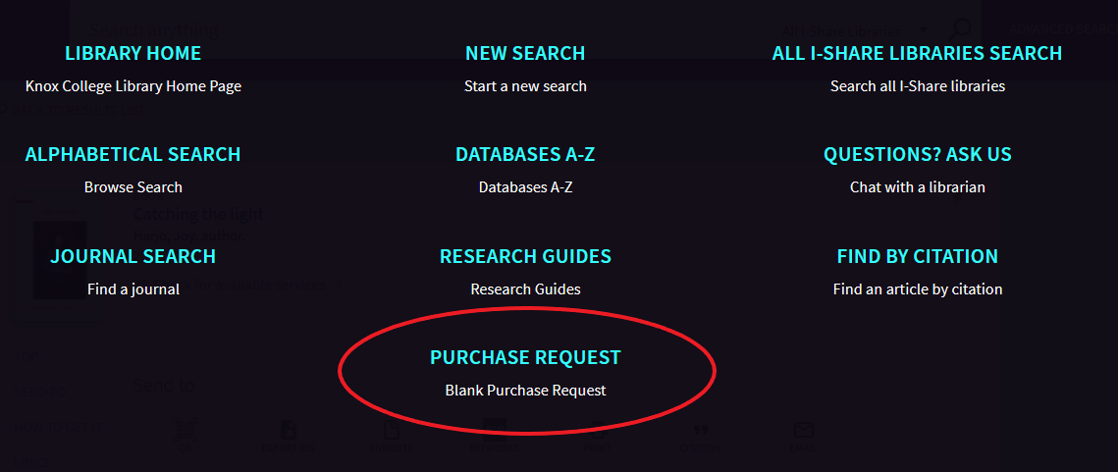
How to Request: Manual Form

Slide 5
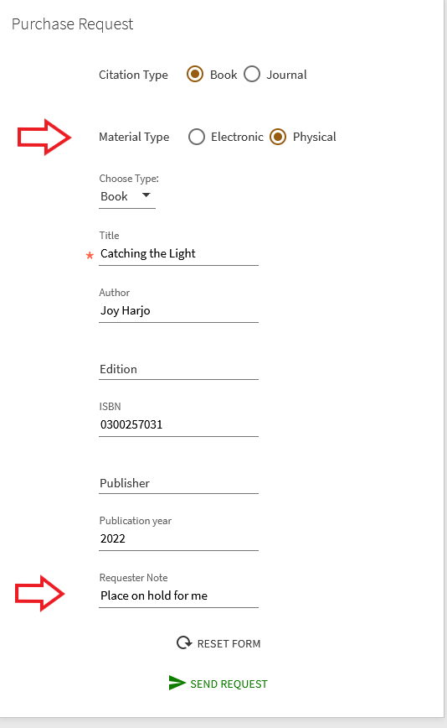
Request form
On the manual form, users can fill in as much or as little as they want.
I ask them to leave a Requester note if they’d like to pick up the item when it arrives or if it needs to go on Reserve.

Slide 6
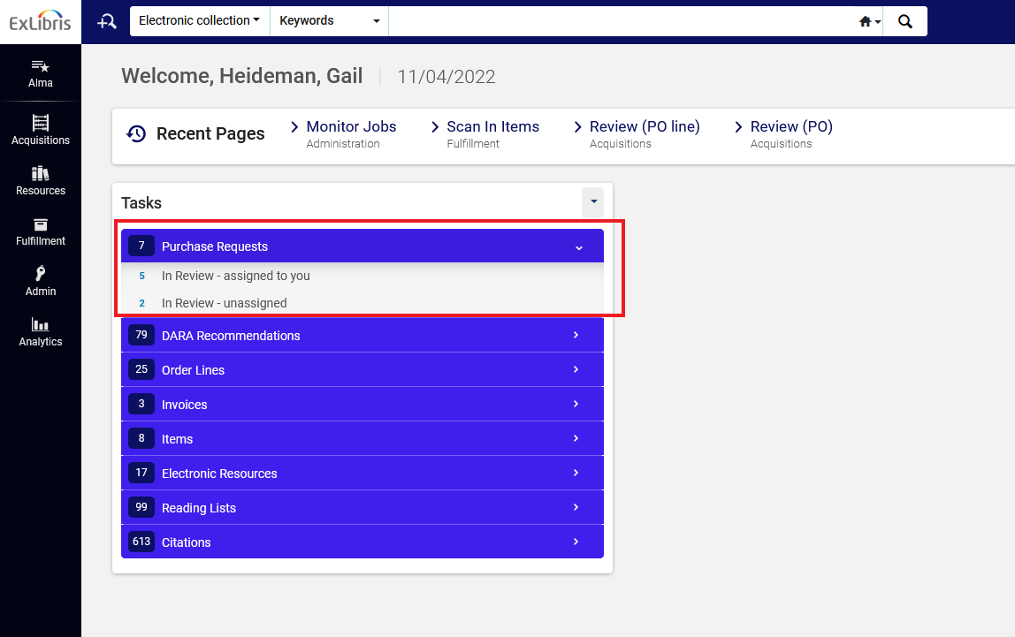
Acquisitions -> Purchase Requests -> Manage Purchase Requests

Slide 7
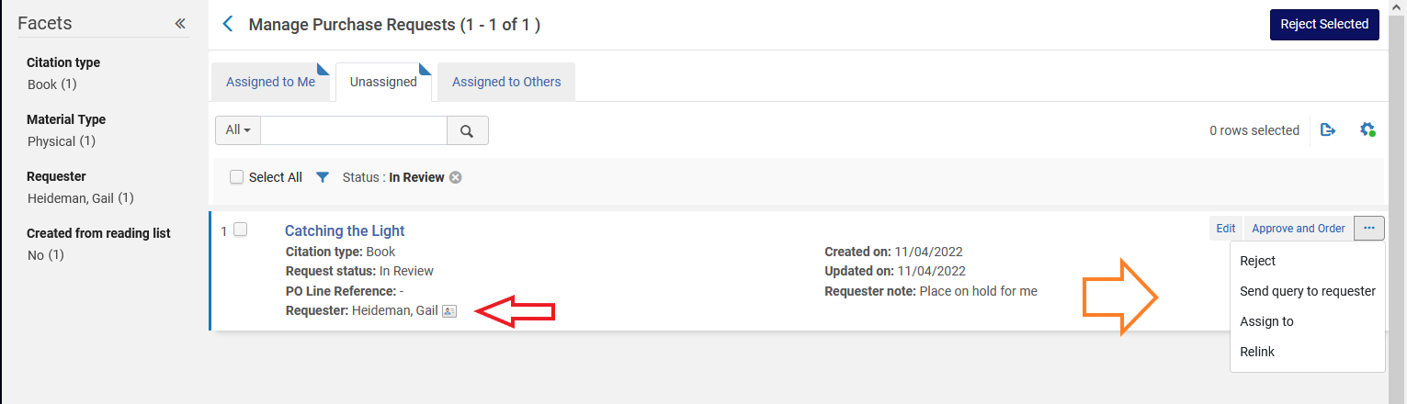
Manage Purchase Requests
My Work Flow:
Check to see who requested
Faculty requests are assigned to Liaison Librarian
Librarian requests move forward to Checking Bib record.

Slide 8
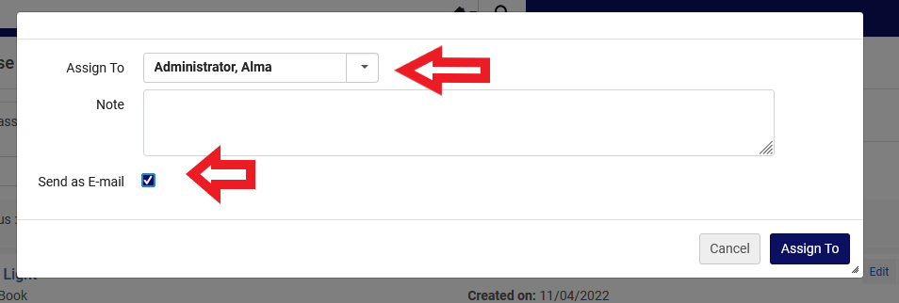
Liaison approval -> Assign to another librarian

Slide 9
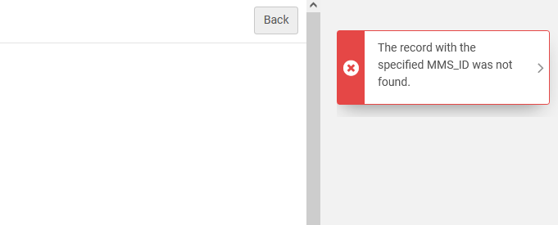

Common Error: Bib not found
When I or another librarian would click on the Title of the book to see the record, it will give us this error screen:
Simple solution: Click the EDIT button and use the Relink option
(If you have the PR Manager role)

Slide 10
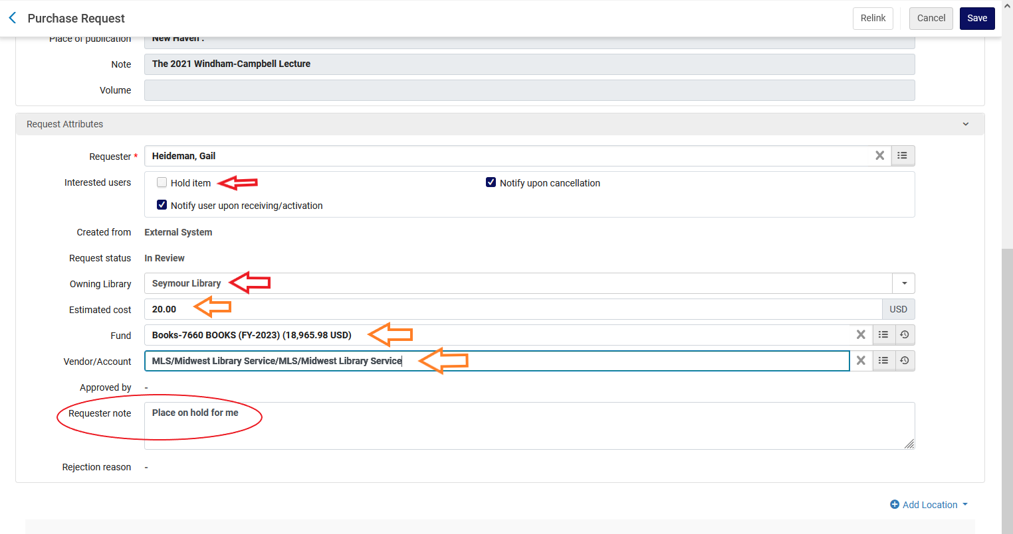
Required Edit: Owning Library

Slide 11
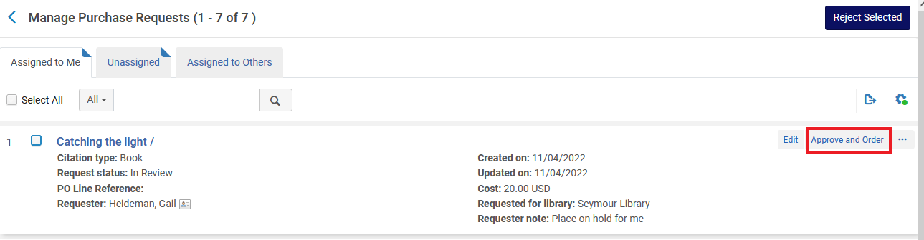
Now you can Approve and Order (PR becomes POL)

Slide 12
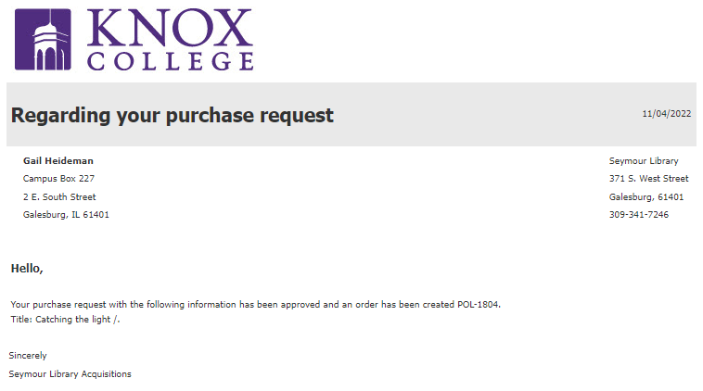
Approved email

Slide 13
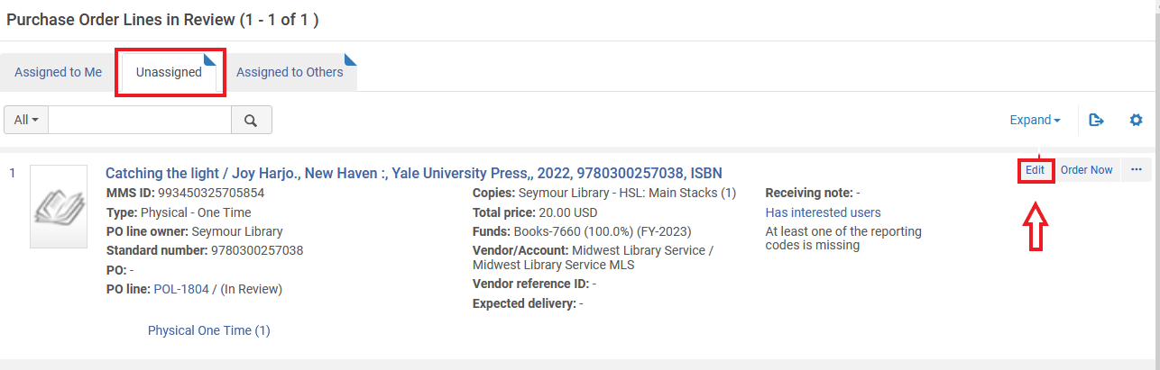
POL is now ready for me to edit to so that I can start the purchase process.

Slide 14
How do I set up Purchase Requests?

Slide 15
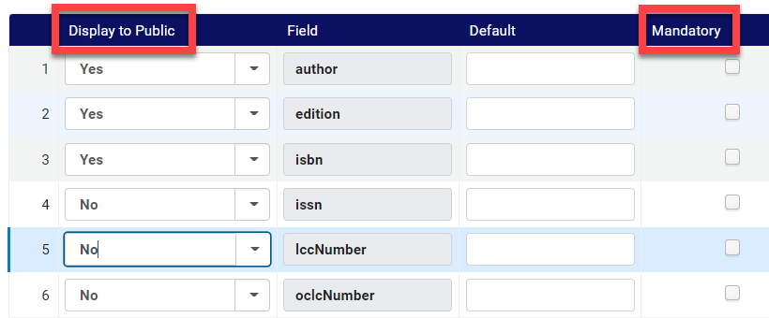
Purchase Requests: Alma config
Alma config > Discovery > Get It configuration > Purchase request

Slide 16
Alma documentation:
Purchase requests is a service exposed from Alma to Primo. Like any other service, it can be hidden from groups of users using Alma’s Display Logic Rules. This service is initially hidden from users by default with the rule Hide Service Purchase Request.
To enable the service for all Primo users, remove this rule.

Slide 17
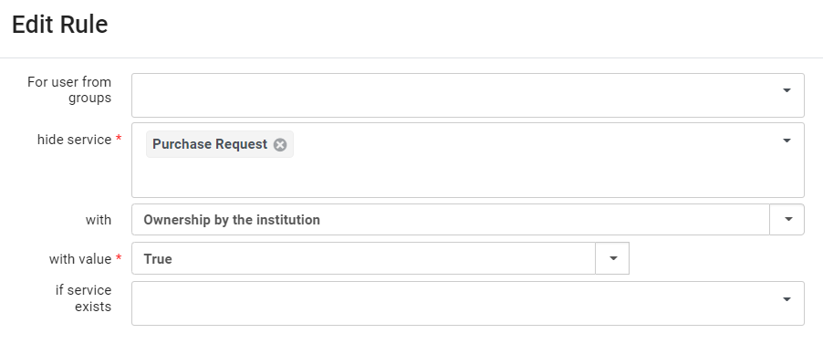
Purchase Requests: Alma config
Alma config > Discovery > Fulfillment> Discovery Interface Display Logic > Display Logic Rules

Slide 18
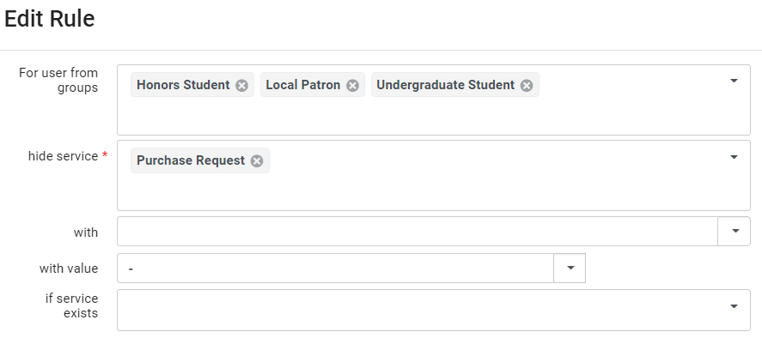
Purchase Requests: Alma config
Alma config > Discovery > Fulfillment> Discovery Interface Display Logic > Display Logic Rules

Slide 19
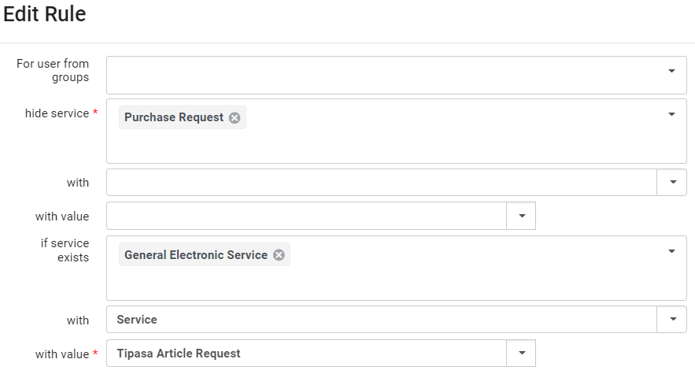
Purchase Requests: Alma config
Alma config > Discovery > Fulfillment> Discovery Interface Display Logic > Display Logic Rules

Slide 20
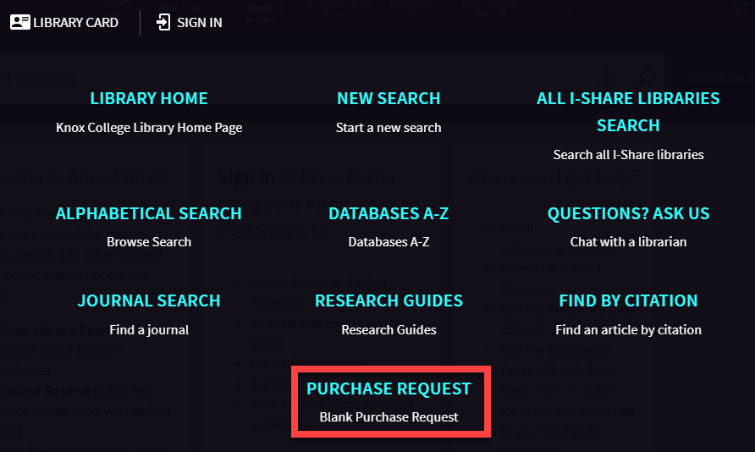
Purchase Requests: Get a link
https://i-share-knx.primo.exlibrisgroup.com/discovery/purchaseRequest?vid=01CARLI_KNX:CARLI_KNX

Slide 21
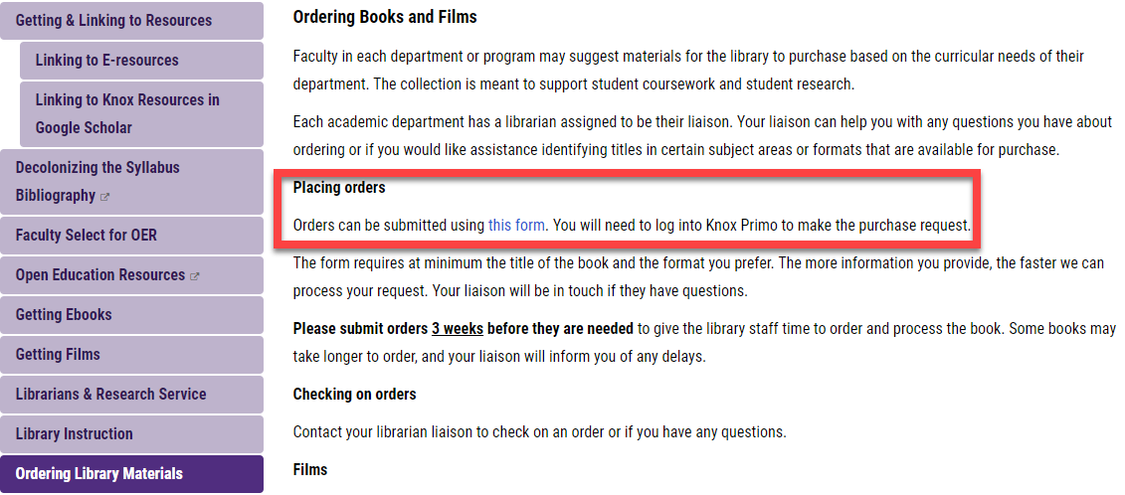
Purchase Requests: Link form to website

