Slide 1
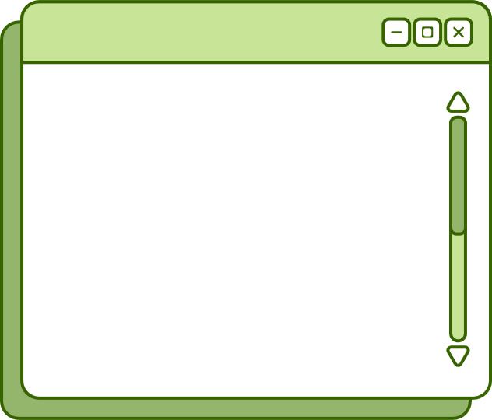
Welcome to
E-resources
Presented by
Jacob Del Rio, Southern Illinois University Edwardsville
&
Sara Margaret Rizzo, National Louis University

Slide 2
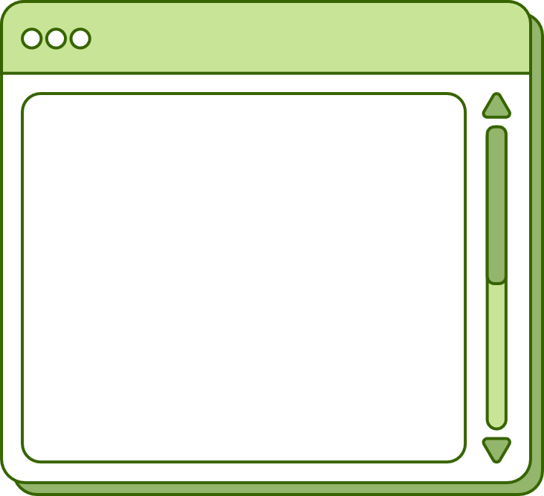


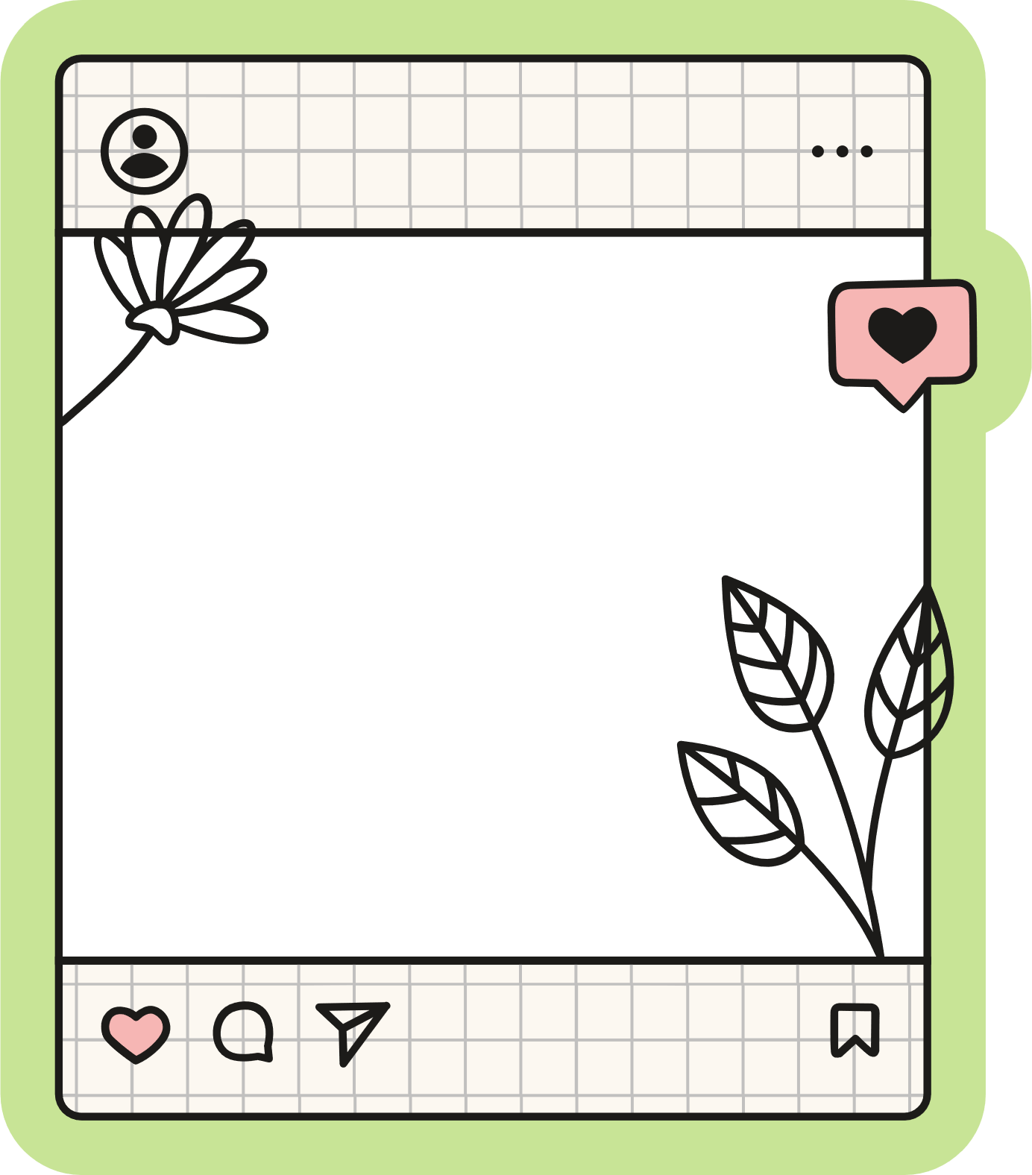
Basic troubleshooting
Recreate the search
Have the user try another browser
Are they going through the library or a personal account?
  Ex- going directly to JSTOR or Kanopy
Are they at work/using a work issued laptop?
  Local firewall may be blocking resources, very common with users who are K-12 teachers!
CARLI created a page with a wealth of information:
  https://www.carli.illinois.edu/products-services/i-share/electronic-res-man/primove-broken-links#
Notes:
Jacob

Slide 3

Authentication
EZProxy
openathens
Check stanza in config file. Is it up to date?
Check IP Ranges with vendor
Check permission set for user
Allocate resource to permission set
Notes:
Jacob

Slide 4
Institutional quirks
  You will tend to see the same problems over and over- take good notes!
  Know what little problems tend to come up and share with your colleagues
    Ex- Delay in turnover from Summer to Fall term
    Ex- myEBSCO account is different than university account
Notes:
Sara

Slide 5
choosing the right collection in the cz
  Many collections have very similar titles.
    Verify the exact name of the activated collection in IZ.
  No customer ID or Local Library Identifier in IZ.
    Check Customer ID or Location ID in Linking Parser Parameter
  Full text found in CZ but not IZ
    IZ collection is out of sync with CZ
    Use Add all Portfolios from Community in Electronic Service Editor
  Users hit paywalls for Free or Open Access material
    Deactivate the portfolio in IZ
    Report CARLI provided portfolios in NZ by emailing CARLI support
    Report portfolios in IZ to Ex Libris Alma Support
Notes:
Jacob

Slide 6
Open url
  https://<Primo_domain>/openurl/<Alma_institution_code>/<view_code>?
    https://i-share-xxx.primo.exlibrisgroup.com/openurl/01CARLI_XXX/01CARLI_XXX:CARLI_XXX?
    https://i-share-nlu.primo.exlibrisgroup.com/openurl/01CARLI_NLU/01CARLI_NLU:CARLI_NLU?
  https://www.carli.illinois.edu/products-services/i-share/discovery-interface/embed_links
Notes:
Sara

Slide 7
CZUTL
  Community zone updates task list
  Additions, deletes, and coverage changes
  Best practice is to check about once a week or every other week
  https://www.carli.illinois.edu/products-services/i-share/electronic-res-man/czutl-review
Notes:
Sara

Slide 8
Use google!
Can usually find documentation from CARLI, another consortium, or ExLibris by googling
  Ex: alma delete ebook record -ai
Notes:
Sara

Slide 9
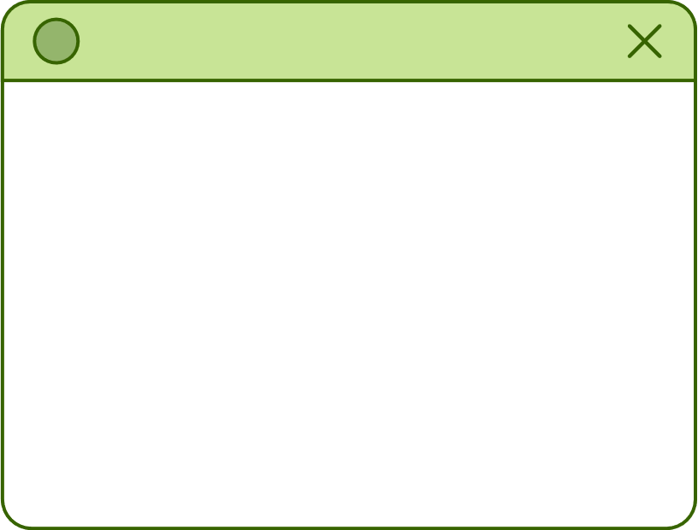
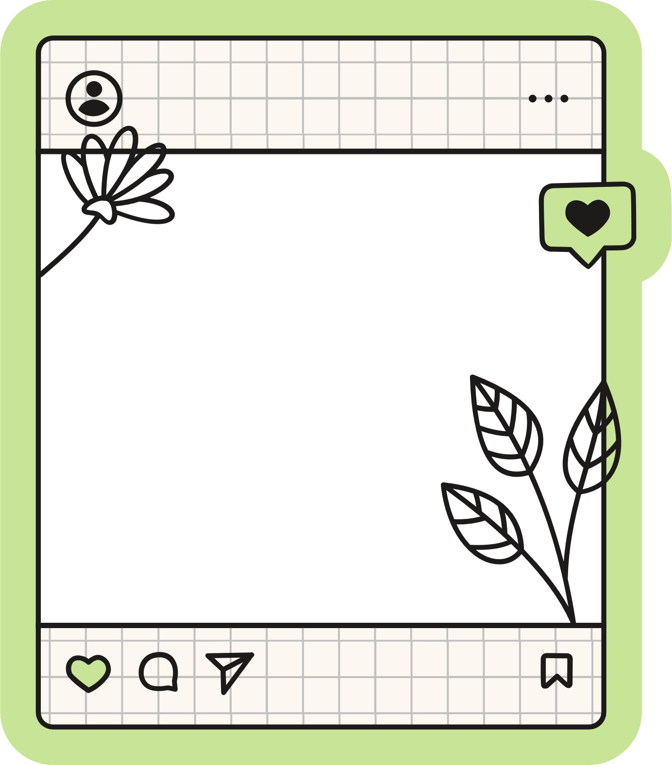

Questions?

