Slide 1
Combining Shelf Reporter Tools
What we do at Brookens library
By Charity Ringel, Patron Services Coordinator At UIS
Notes:
Introduce self and institution and credit Sarah and Erich and Student Assistants

Slide 2
TABLE OF CONTENTS
WHY?
WHAT?
Why use multiple tools? Why these tools?
What tools and how do they work?
HOW?
NOW WHAT?
What does this process look like in practice?
Problems, changes, and future concerns.

Slide 3
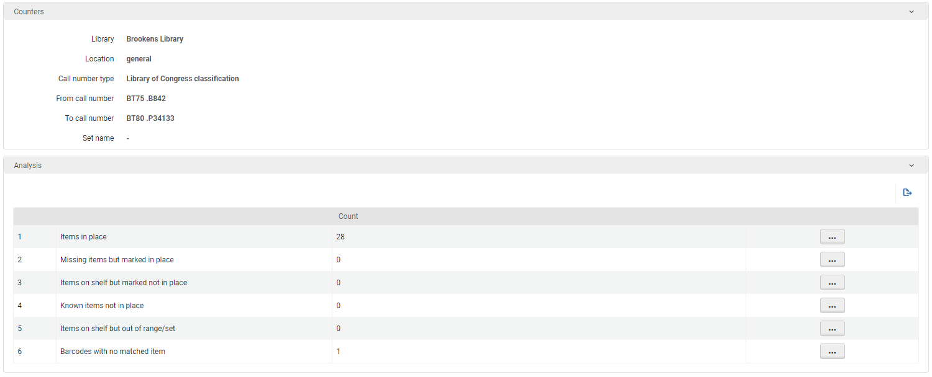

WHY CHANGE?
Shelf Reporter in Alma
Confusing interface
Confusing language
No clear action from results
Results often not useful
Notes:
Our shelf reporter situation:
Students do the work
Been doing shelf reporter intermittently for years
However still finding numerous issues on the regular
We are in the midst of a big weeding project
Issues in stacks=issues in weeding the right books
Leaned into shelf reporter, but needed to catch more errors
Then discuss listed issues with Shelf Reporter

Slide 4
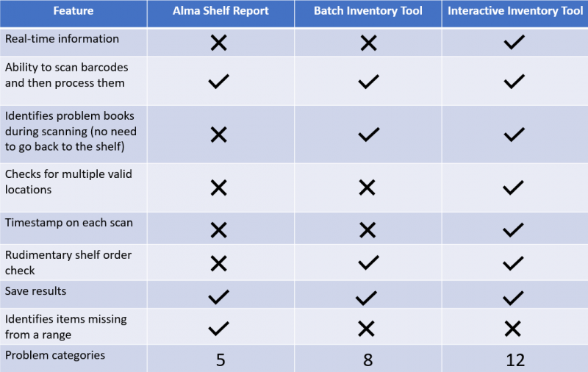
WHAT? The best of both
Notes:
Not sure which tool to use at first
Tried out both the Batch and Alma interactive inventory tools
Found the latter to be very user friendly
Was only lacking the ability to identify items missing from the shelf
Hence also running reports through Shelf Reporter
Shelf Reporter also helps us track the progress and notice errors
Monitor Jobs

Slide 5
HOW? Our use of these tools
#1
#2
#3
#4
Scan Shelf
Examine Errors
Book Flags for Triage
Shelf Report in Alma
Identify any missing books
Done in Alma Interactive Inventory Tool
Color-coding allows students to easily scan issues
Used for issues that need supervisor’s attention
Notes:
Here’s our basic procedure
Scan Shelf
Students grab barcode scanners, laptops, cart, and book flags
Scan items into interactive inventory tool one by one
Errors
While scanning errors appear in colors so they’re easy to spot
Students can troubleshoot some on their own
For the rest they,
Book Flags for Triage
They insert a book flag that tells us what’s wrong
Also includes other issues like damage or no barcode
These will be brought down to a triage cart at the end of the shift
Shelf Reporter
They run the csv file through Shelf Reporter to identify missing items
Then toggle missing
Rinse and repeat

Slide 6
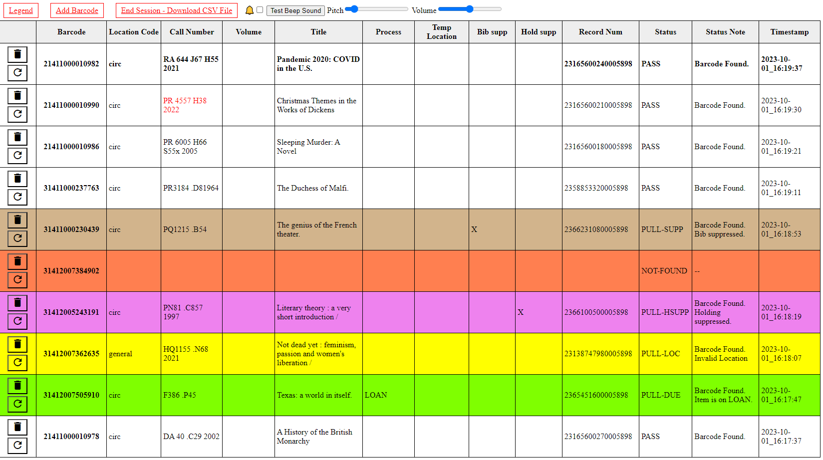
Using the Interactive Inventory Tool
Notes:
Legend gives more detail about colors
Book Flags are designed to mirror
Different statuses are color coded and written out to avoid confusion

Slide 7
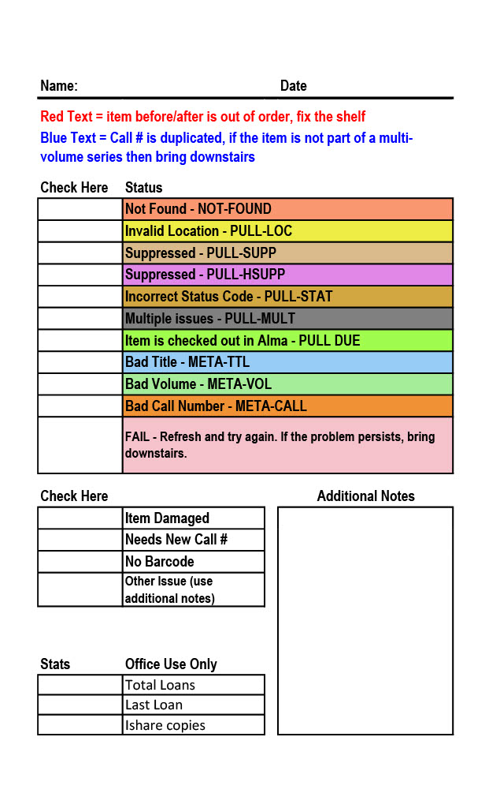
Address Errors
Triaging with book flags
Fill out Flag
Put on Triage Cart
Triage Team Fixes*
Reshelve
Notes:
Point out purposes of different areas
Name and Date in case we need to talk to the person
Table mirroring inventory tool
Table for other issues
Notes section
Area for triage team

Slide 8
Run in Alma Shelf Report
Only check Missing Items but marked in place

Slide 9
NOW WHAT?
Problems and Adaptations
Training-Heavy
Triage Methods
Staged Training
Color Confusion
Circ Review WO
Notes:
Training + Staged Training Method
Triage +WO
Color Confusion and written word

Slide 10
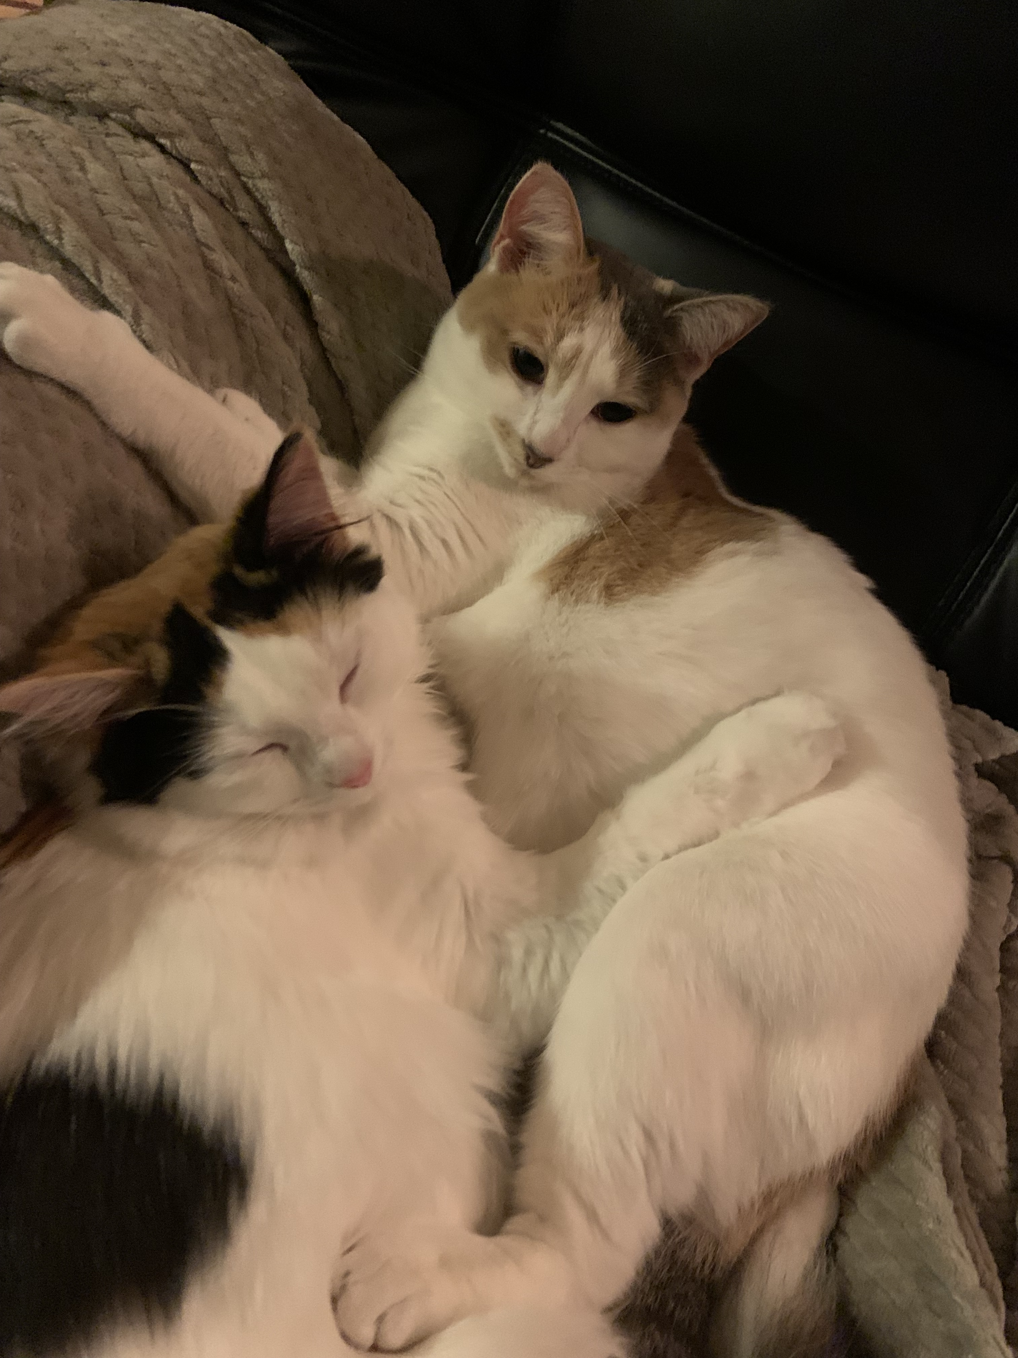
Resources
CARLI Documentation on the Alma Interactive Inventory Tool
ExLibris Documentation on Shelf Reporter
CARLI Documentation on Work Orders
ExLibris Documentation on Work Orders

Slide 11
THANKS!
Do you have any questions?
Would you like copies of any materials?
cring4@uis.edu
(217)206-8116

Slide 12
Triage Guide
 | Error | Stats | Put in Circ Review | Action
Red | Not in Alma | I-share only | Yes | Pink Cart
Orange | Bad Call Number | No | Yes | Black Cart
Blue | Bad Title | No | Yes | Black Cart
Mint Green | Bad Volume | No | Yes | Black Cart
Goldenrod | Incorrect Status Code | No | No | Likely the status is “missing”. Confirm and remove missing status. Check call number on book matches Alma. Then scan into inventory tool to see if it’s now clear. If so, put on reshelve shelf.
Yellow | Incorrect Location | No | No | Use Scan In to change the permanent location to match what is on the book. Put on reshelve shelf.
Tan | Item is marked as suppressed | No | No | Check call number on book matches Alma. Put on Charity’s desk.
Purple | Item is marked as suppressed | No | No | Check call number on book matches Alma. Put on Charity’s desk.
Bright Green | Item is checked out in Alma | No | No | Put on Charity’s desk.
Grey | Multiple Issues |  |  | Put on Charity’s desk.
 | Damage | Yes | Yes | Pink Cart
 | Needs new Call # | Maybe | Maybe | FEA/Video/ESL put on black cart. All other locations complete all stats.
 | No Barcode in Book | No | Yes | Black Cart

