Slide 1
Partners in Practice: Asserting Library Expertise Through Campus Collaboration
Kylie Riordan, Information Literacy & Instruction Librarian, Illinois Institute of Technology
Nichole Novak, Head of Reference and Instruction Services, Illinois Institute of Technology

Slide 2
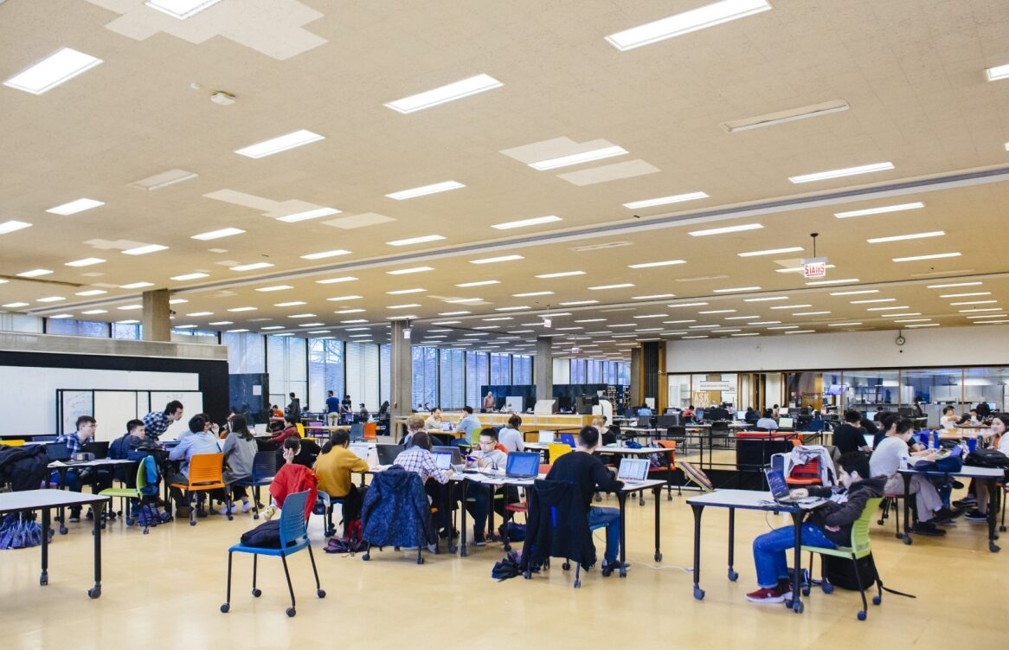
Illinois Institute of Technology and Galvin Library
Private, non-profit, STEM-focused
Located in Bronzeville neighborhood, Chicago, IL
Bachelor's- PHD program
Fall 2025 enrollment: 7,502, representing 117 countries
Paul V. Galvin Library
Main Library at Illinois Tech
Illinois Institute of Technology. (n.d.). Quick facts. https://www.iit.edu/about/rankings-and-recognition/quick-facts

Slide 3
Building Trust Through
Collaboration
Strategies for collaborating with faculty and staff
Collaboration initiatives are the first step in the trust-building process with campus stakeholders
Notes:
Library instruction goes beyond teaching research skills. It includes connecting students to resources, campus services, and communities that support their academic and personal growth.
POEM

Slide 4
Collaboration with Career Services
Since Fall 2023, Galvin Library has hosted a "Doing Company Research" workshop in collaboration with Career Services every semester to help students prepare for Career Fairs.
Designed to help students:
Learn about important library resources for doing research on companies
Learn research strategies for doing research on companies
Gain contextual information for doing research on private & public companies
Notes:
Add an open house poster
Starting college can feel overwhelming, and the library plays a vital role in helping students feel connected from the start. In addition to orientation activities, Galvin Library hosts an annual Open House during Welcome Week as a drop-in event for both new and returning students. The Open House highlights the library as a welcoming, inclusive space where students can explore, connect, and feel at home on campus.

Slide 5
How it started
A librarian met a member of the career services team at an event, and they discussed the importance of library resources.
Attended a Career Services department meeting and decided a workshop to promote library resources would be beneficial.
A LibGuide already existed, but it was updated with input from Career Services.
Workshop was planned around the guide.
Workshop has been given every semester since, both in person and online.

Slide 6
Planning & Promotion
Internal:
  Library social media (Facebook and Instagram)
  Signage posted in the library
  Library News Story posted on the library website
  Local library monitors
External:
  Illinois Tech’s twice-weekly newsletter
  Office of campus life newsletter
  Posted event on Illinois Tech's new student engagement platform
  Cross promoted with Career Services

Slide 7
Execution
Walks through library databases
  Business Source Ultimate, Mergent Intellect, Privco
Search Strategies
Background info on public vs private companies
Time for searching and questions

Slide 8
Turnout
Semester | # of Sessions | Attendance
Fall 2023 | 2 | 65
Spring 2024 | 3 | 108
Fall 2024 | 3 | 46
Spring 2025 | 1 | 17
Fall 2025 | 2 | 25
Spring 2026 | 1 | 10

Slide 9
Assessment & Feedback
What was the most important takeaway from this session?How confident do you feel about using the library's resources to do research on companies?
How confident do you feel about using the library's resources to do research on companies? (1-5)
All 4s & 5s
What was the most important takeaway from this session?
"Now I can prepare better for the interview"
"This has really been an eye opener"
Notes:
Takeaway: Crafts are effective low-barrier engagement activities that help students feel comfortable and welcomed
Takeaway: Feedback will inform future tours to enhance engagement and student experience
Overall Impact
Positive student experience
Increased comfort and familiarity with library spaces
Strengthened sense of belonging and connection

Slide 10
Overall
Impact
Great partnership with Career Services
Interview booth advertisement
Resume workshop for student workers
Collaborating on a resources page for the career fairs, full of specific company and industry research on companies attending the career fairs

Slide 11
Wellness Initiative
Challenges of studying in Galvin Library
16' high ceilings
Open floor plan
No individual study rooms
Sensory overload and other challenges for neurodivergent students
Applied for Reaching Across Illinois Library System (RAILS) My Library Is.. Grant in January 2025
Creating Inclusive Spaces: Enhancing Library Resources for Neurodivergent Students

Slide 12
Wellness Initiative
Received $1500 Grant
Books
Happy Lights for Seasonal Affective Disorder (SAD)
  SAD is a type of depression
Items for Tranquility Kits
  Disposable foam earplugs
  Sanitizing hand wipes
  Affirmation/wellness cards
  Fidget spinners
  Magnetic fidget spheres
  Marble maze mats
  Stress balls
  Spiky sensory rings
  Worry stones
  Fidget sticks

Slide 13
Planning
Brainstormed ways to raise awareness about these new resources in POEM meetings
Reached out to psychology faculty for input and they offered to help promote the new resources
Decided to hold an event so students could see and touch the books, lights and kits
National Stress Awareness Day seemed like a good fit for the event.

Slide 14
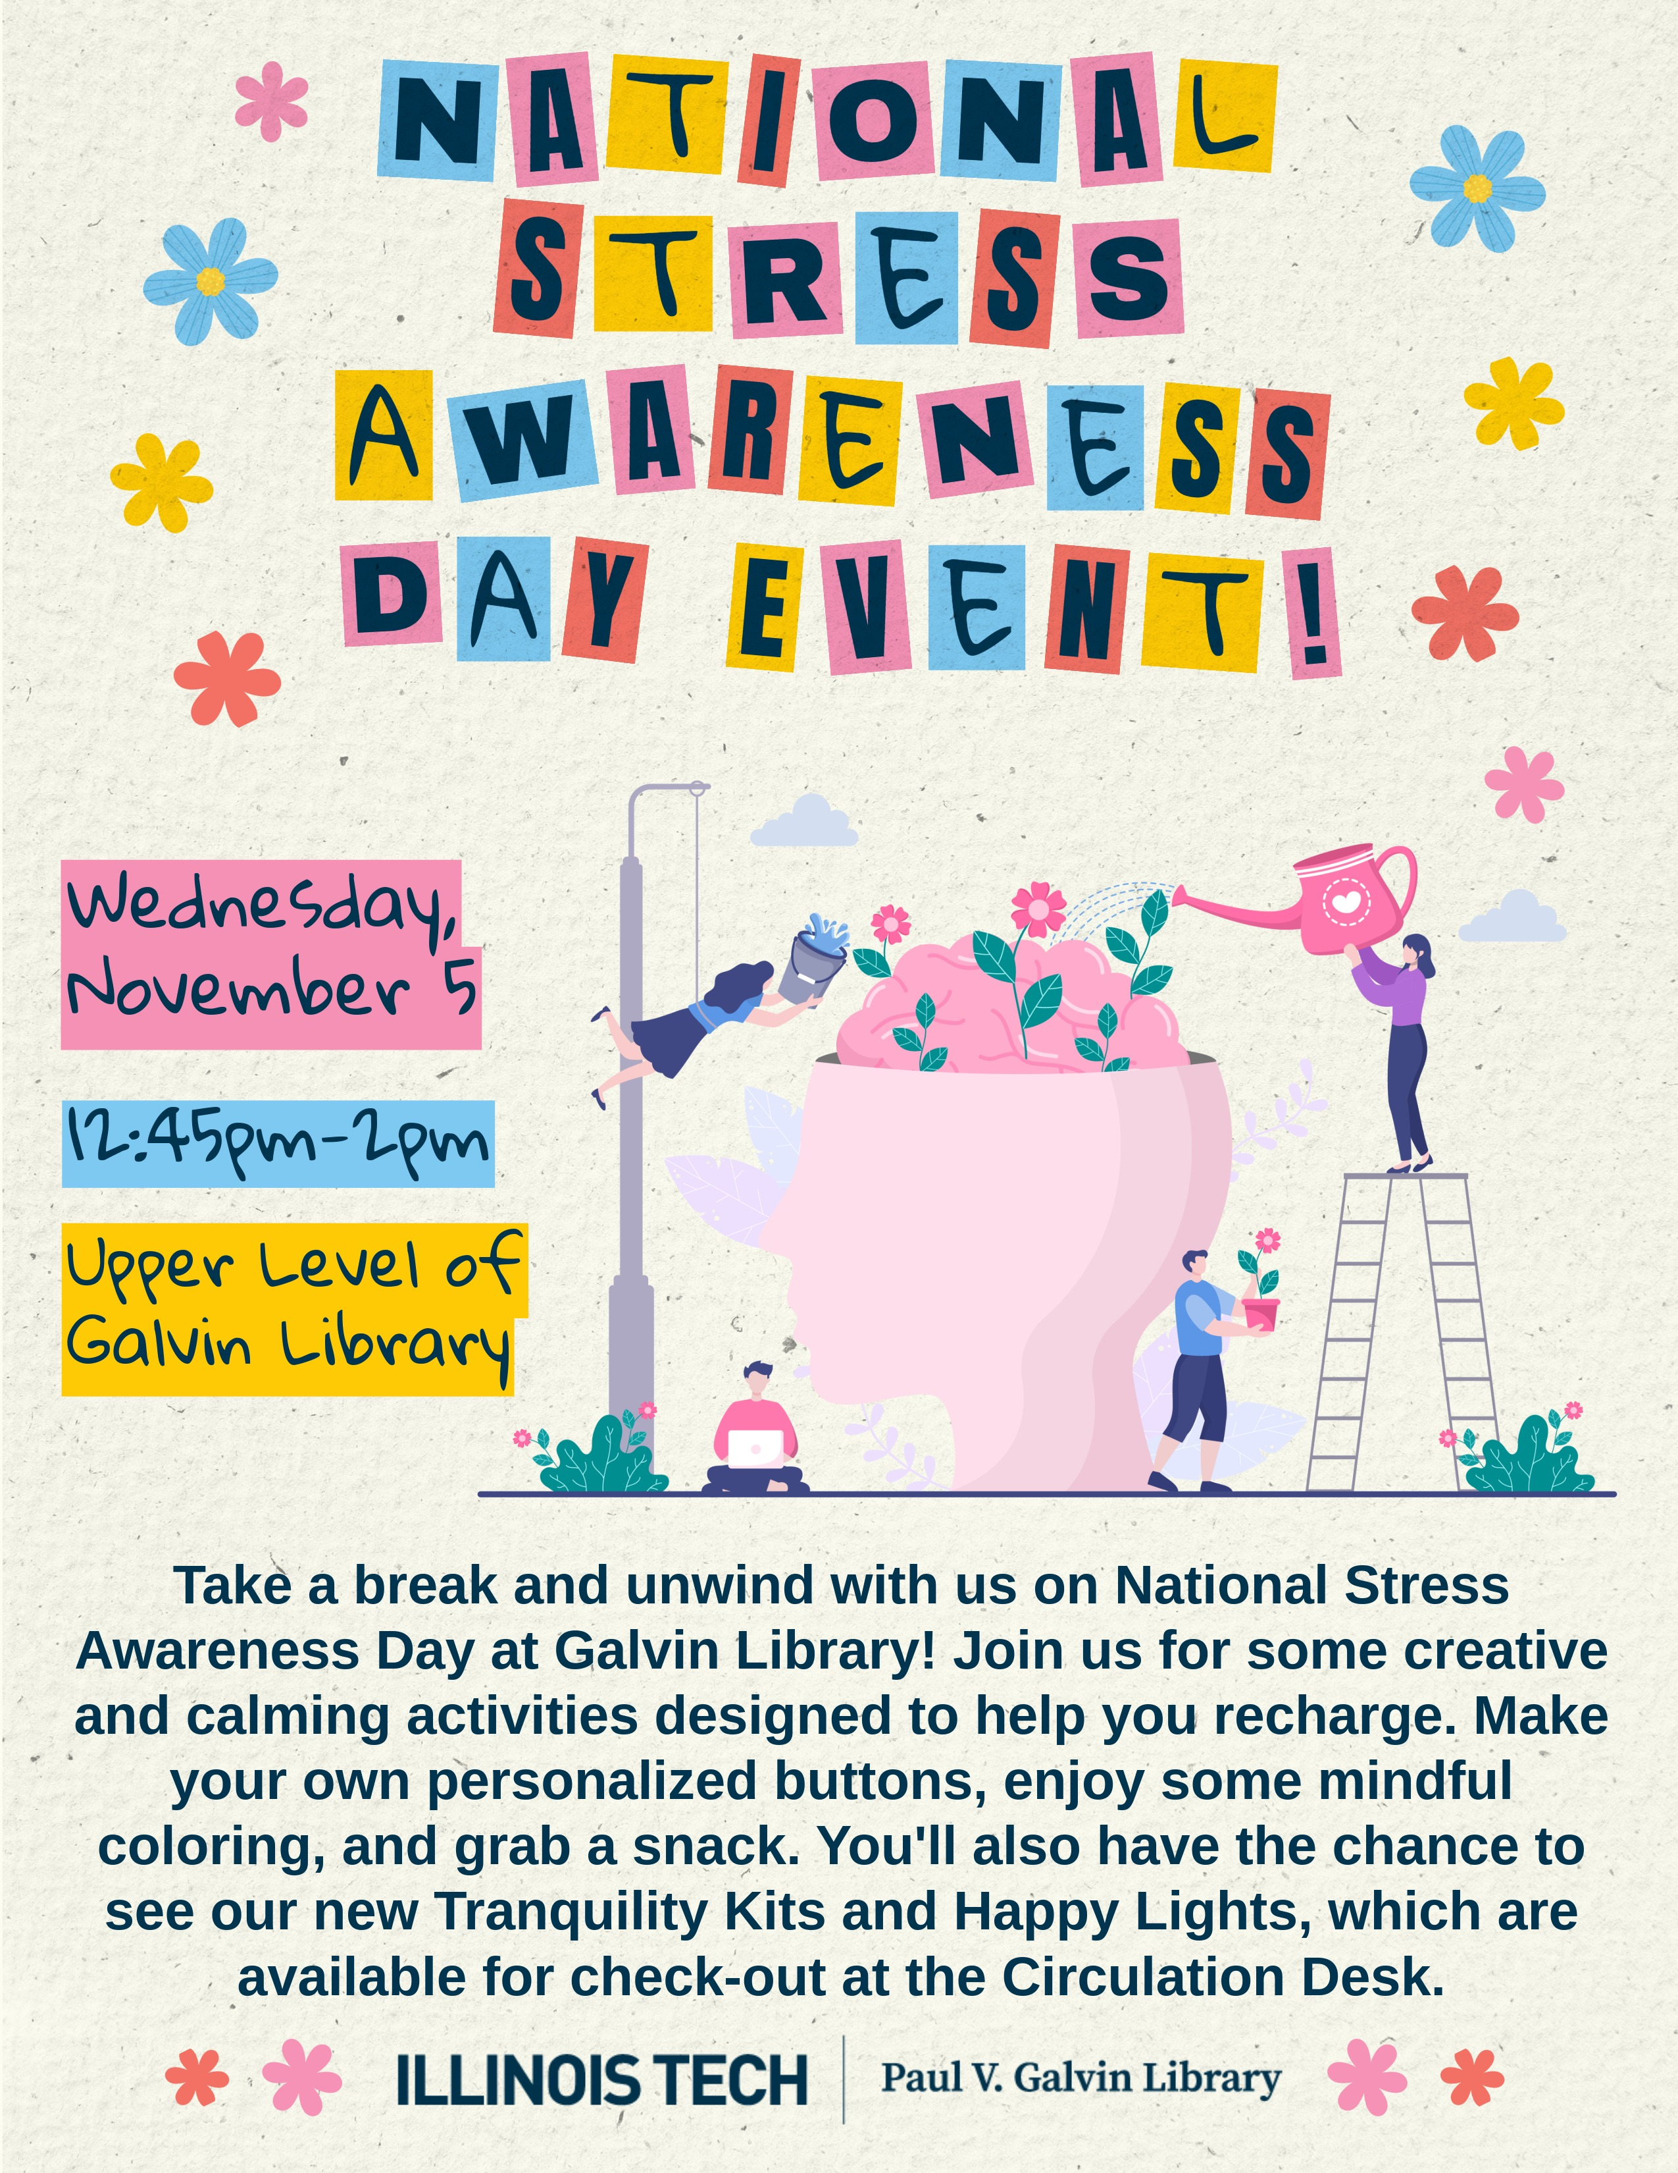
Marketing
Social media posts
Flyers posted around campus
  Faculty posted them in Psychology Department
Illinois Tech's twice-weekly online newsletter
Posted event on Illinois Tech's new student engagement platform

Slide 15
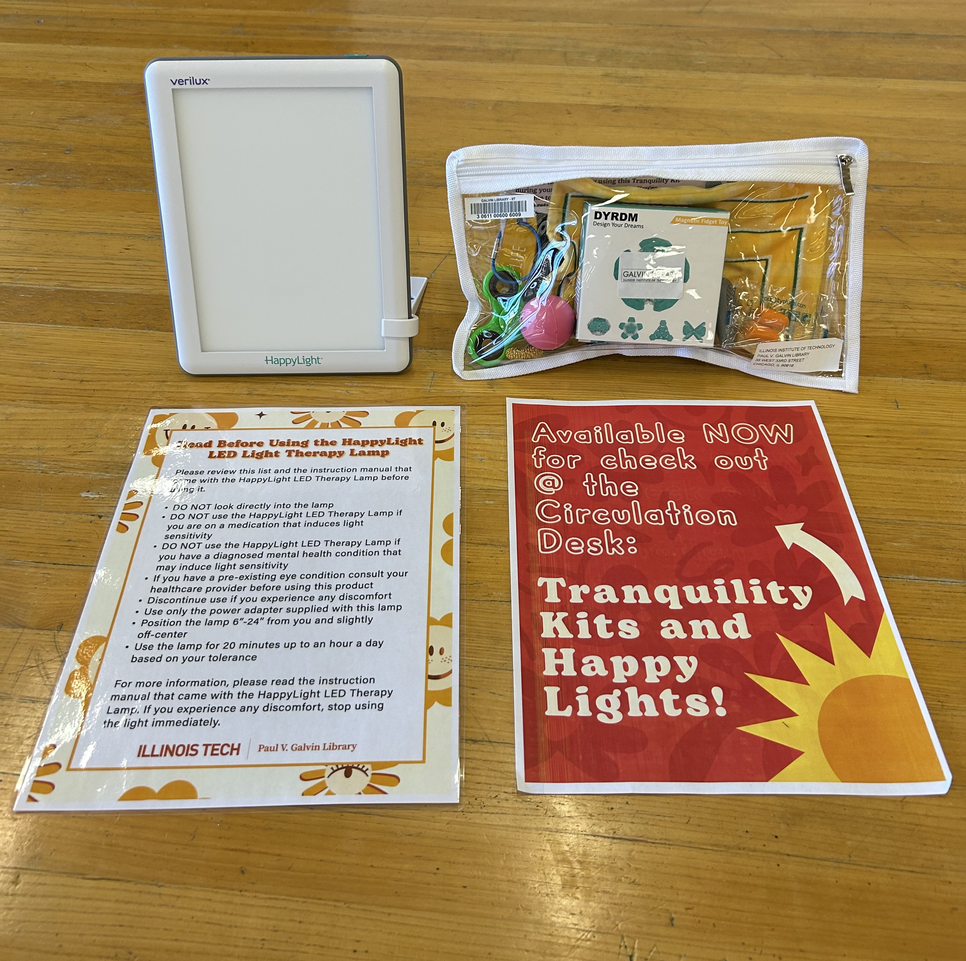
National Stress Awareness Day Event
Held event on November 5, 2025
    Kits, lights and books available for students to see and checkout​
    Activities included coloring and button making​
    Snacks provided​
    Event ran for 2 hours

Slide 16
Assessment
Attendance
25 students and staff attended
Approximately 1/4 of attendees stayed for the entire event
Event was scheduled to run for about one hour but ran closer to 2 hours
Feedback
Students expressed appreciation for event
Books and kits were checked out during the event
While the resources are for everyone, they make our neurodivergent population feel seen and heard

Slide 17
Impact
Strengthened partnerships with psychology faculty and paved the way for future collaborations
Psychology professor offered to partner with a student org and the library to hold a fundraiser for new health and wellness materials for the library
Psychology professor connected the library with a graduate student developing a campus radio program about campus health and wellness resources for Finals Week. This helped us promote our resources and programming

Slide 18
Questions?
Contact Info:
Kylie Riordan – kriordan@illinoistech.edu
Nichole Novak - nnovak2@illinoistech.edu

