Slide 1
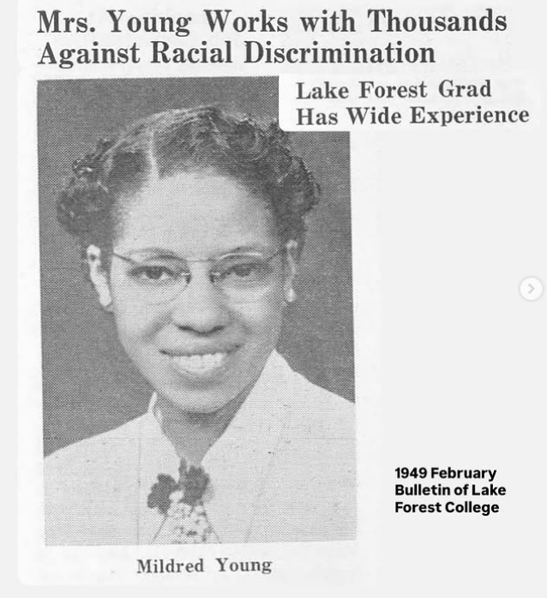
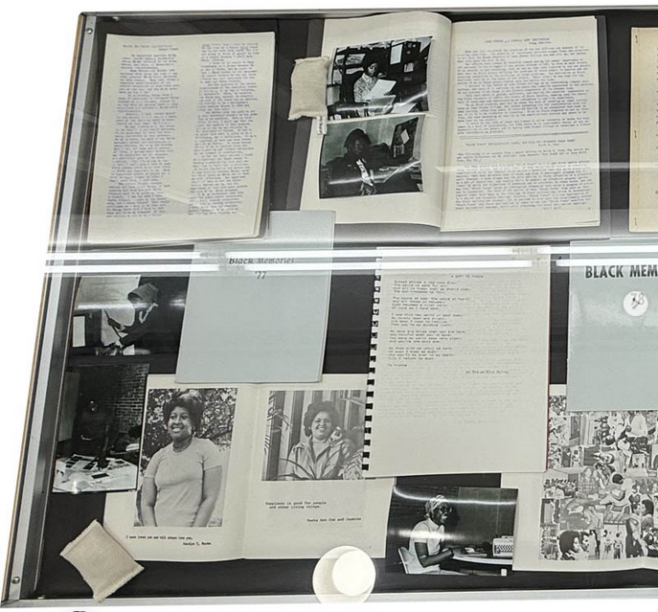
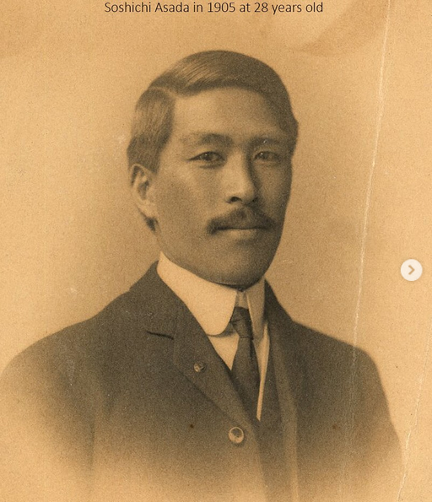
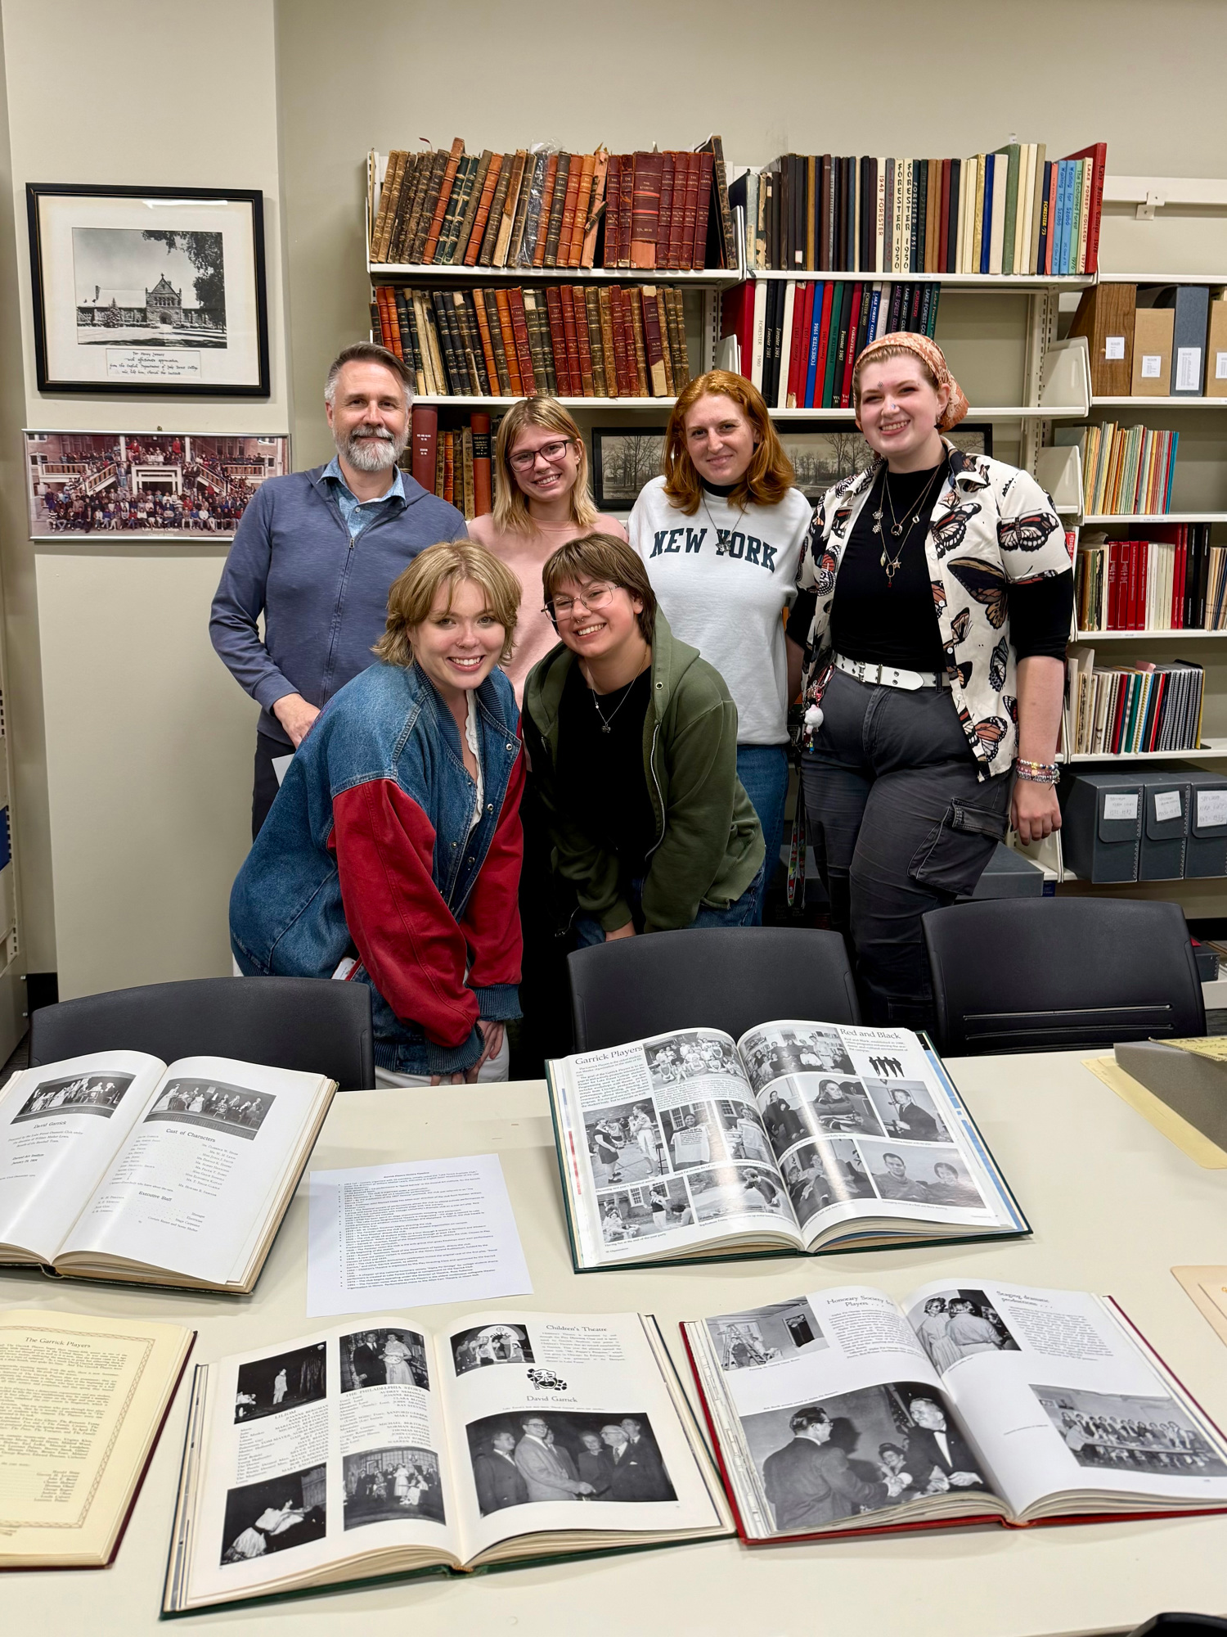
Building Community Trust
from an Institutional Archive
Transforming Campus Collaborations Panel
CARLI Instruction Showcase
Natalia Gutiérrez-Jones
Thursday, June 4th, 2026

Slide 2
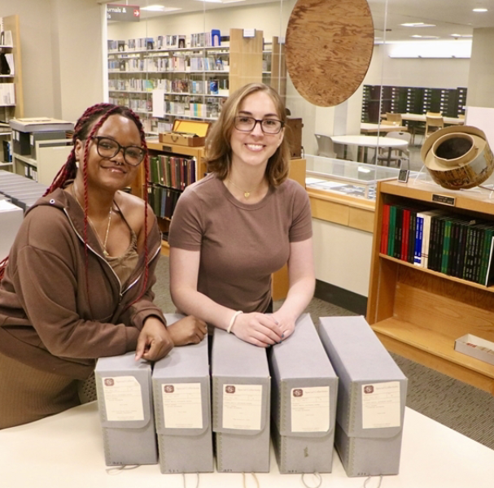
My background
Full-time academic archivist since 2019 (Wellesley College, Northwestern University, Loyola University Chicago, now at Lake Forest College) - always working with students and student orgs to some degree.
MLIS concentrating in Archives Management, MA in History, BA in Spanish and Comparative Literature
I grew up in Santa Barbara, CA, was in Philadelphia area for undergrad (Haverford College) and Boston for grad school (Simmons University) - in Chicago area since 2021.
Two English professor parents and an older sister teaching English as a Second Language.
My current job is my first doing instruction solo!

Slide 3
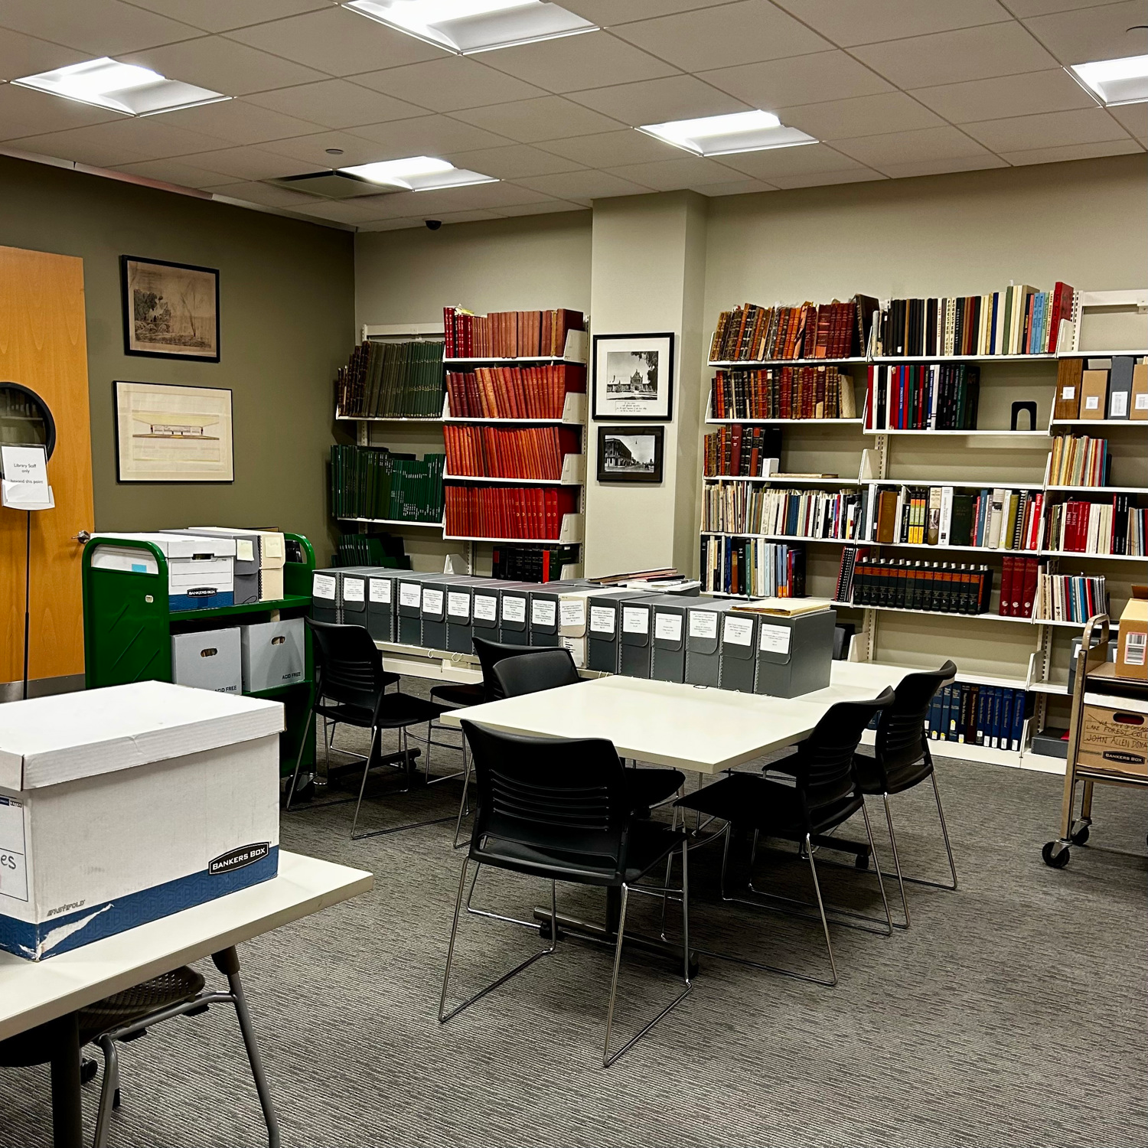
My background
In my current role as Archivist and Librarian for Special
Collections, my typical instruction experience is hosting students for 1-2 visits to the Archives Reading room in the Library during their participation in a course (these have included Religion, Environmental Science, African American Studies, Sociology and Anthropology, History…)
These have been for either 50 minutes or 2 hours. Typically I give a ~10-20 minute lecture, get into a Q&A discussion, and then facilitate students interacting with archival materials selected for the class. The structure is dependent on the faculty member’s preference.

Slide 4
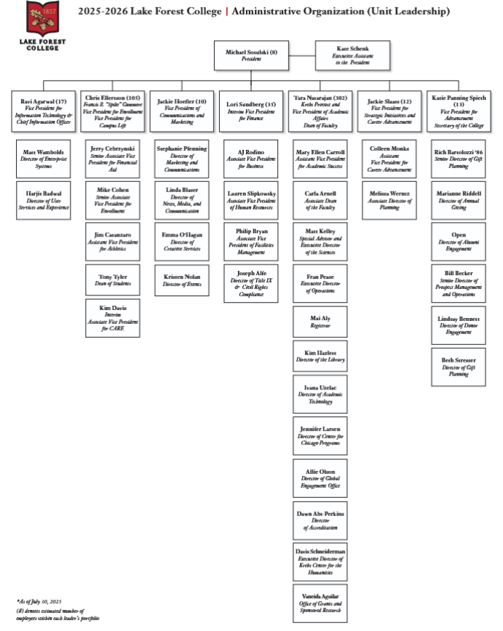
Institutional Archivist Role
Key goal: Identify and fill gaps in the collection (reflective of past bias)
Key goal: Build community partnerships and engage students
Key goal: Make reparative outreach to historically neglected, marginalized groups and rebuild trust, solicit donations
Key goal: Serve your institution’s needs, align with institutional mission/goals, achieve tasks as assigned by supervisors
There needs to be mutual understanding with institutional leadership/ stakeholders about what the goals and responsibilities of archivists are!

Slide 5
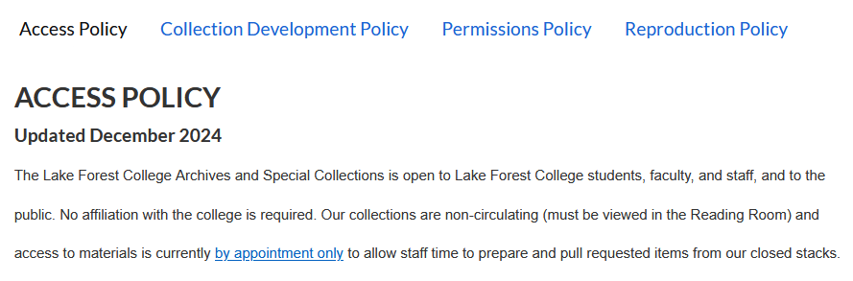
Institutional Archivist Role
Complexity: Frequent Archivists are either fully staff or both faculty and staff - tenure-track positions are rare! Seen more as administrators without full faculty’s Academic Freedom protections
Complexity: Expectation to serve promotion, marketing, and development purposes, while being a reliable source of accountability and transparency about institutional history, while protecting individuals’ privacy and complying with policy and law re: restricting or destroying some records
It’s a delicate balance! DOCUMENTATION of policy and action is your friend.

Slide 6
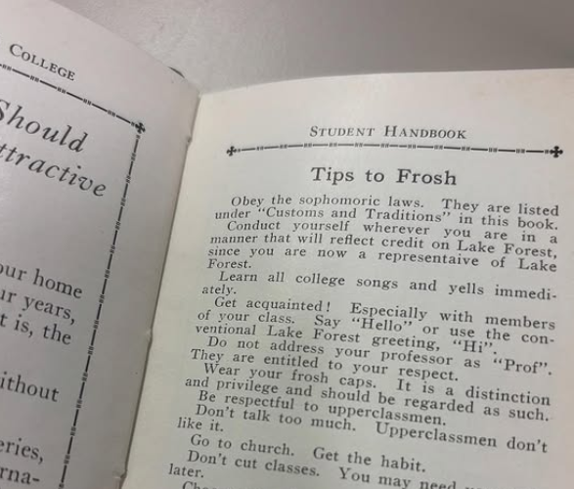
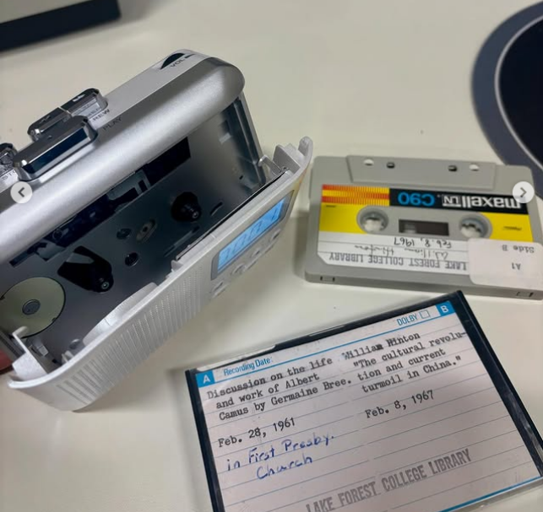
INSTRUCTION in the Archives
Students are smart and aware of these tensions - address them openly!
Acknowledge gaps in representation, be prepared to talk collection development, how to donate, donors’ rights and choices
Deconstruct the idea of Archives as being final, authoritative representations of history, instead being incomplete and influenced by culture and individuals’ bias
Emphasize that the Archives are in constant evolution based not only on the Archivist’s collections-work, but on its donors’ and researchers’ contributions - empower students as desired donors and researchers

Slide 7
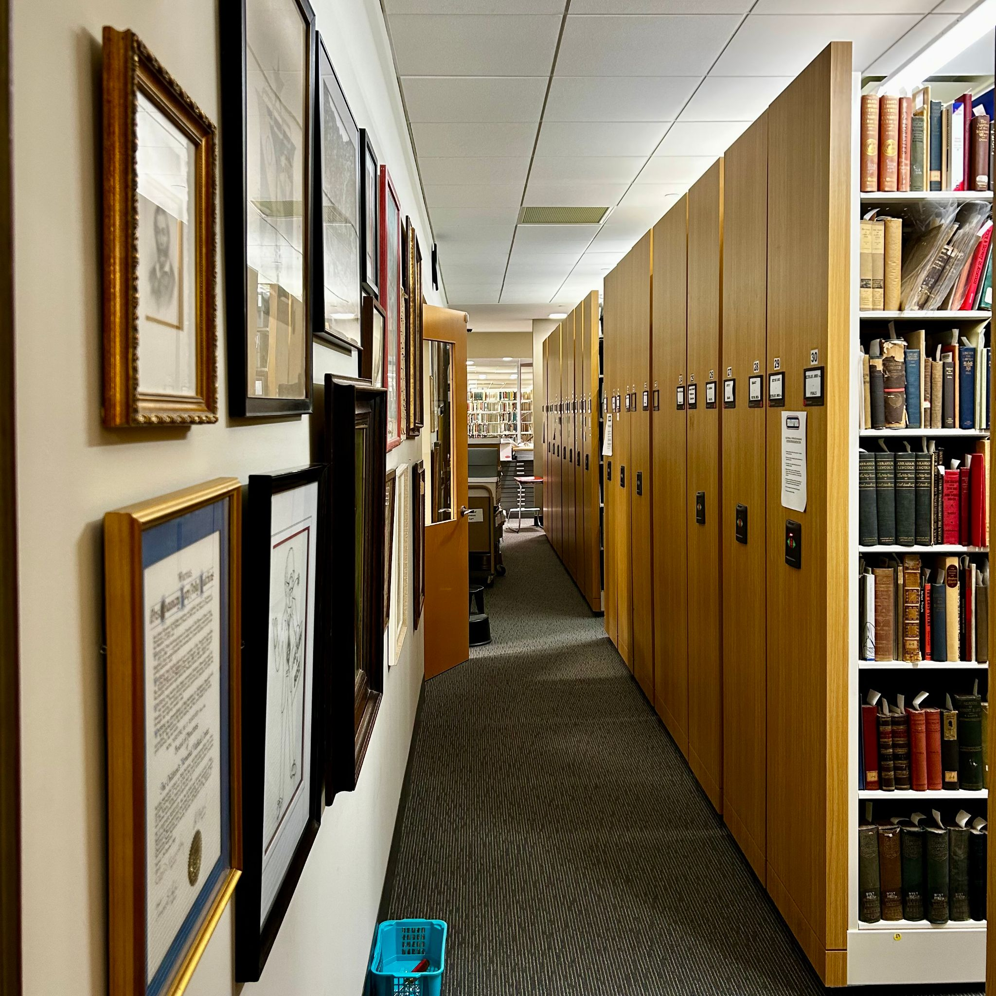
INSTRUCTION in the Archives
Express expectation of care and respect for material’s preservation and arrangement, but don’t let that detract from encouraging active use and perusal, safe handling, photographs, commentary, a sense of student ownership of their educational resources
Demystify the process by which records come into researcher’s hands - summarize the lifecycle of a record from creation, custodial history/provenance, acquisition and accession, description and arrangement, potential restrictions or separations...
If field-specific jargon is used, always define (and provide definitions in handout/online)

Slide 8
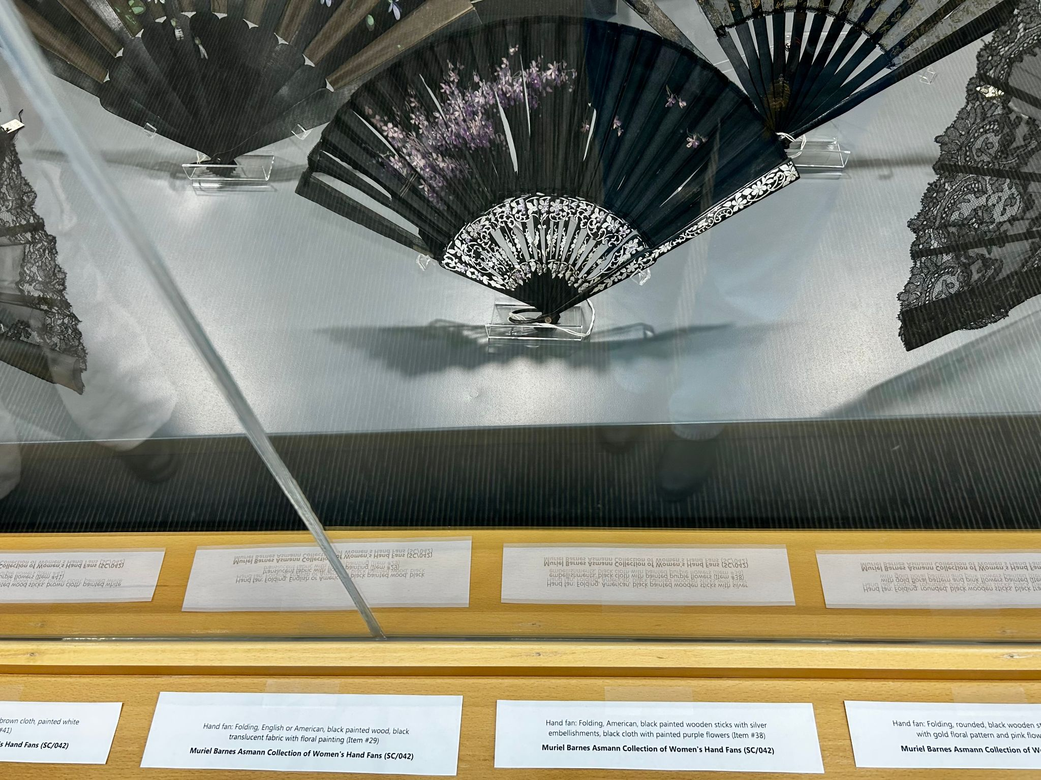
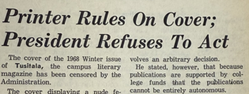
INSTRUCTION in the Archives
Collection processing skills are in a way transferable to instruction - in both, you must balance using your experience and expertise with assuming the perspective of a researcher approaching the material without context or background knowledge, maybe using an Archive for the first time. Do not assume prior understanding and encourage questions.
Make the abstract concrete! Visual aids, examples, narrative anecdotes - specificity, visuals, and hands-on engagement will stick with them longer.
Rather than framing archival materials as providing final answers, encourage their use as jumping off points for further questions, and nodes of connection to further records, to be interrogated!

Slide 9
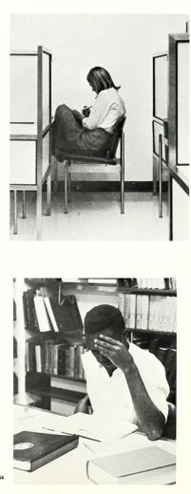
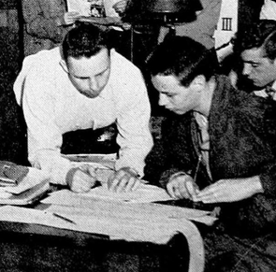
INSTRUCTION in the Archives
Archival instruction can tie beautifully into the broader goal of teaching students to critically evaluate sources - something emphasized in our library instruction for First Year Studies classes.
Acknowledging Archives as incomplete and as fallible as their human creators should not discourage their use, but rather encourage students to question, cross-examine, compare with other sources, consider authorship, audience, intent, and bias - and consider their own role as creators of records.

Slide 10
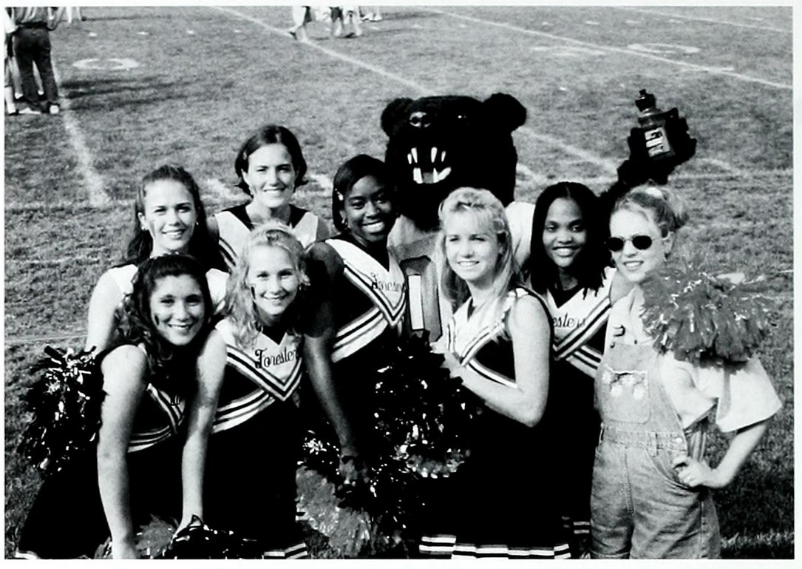
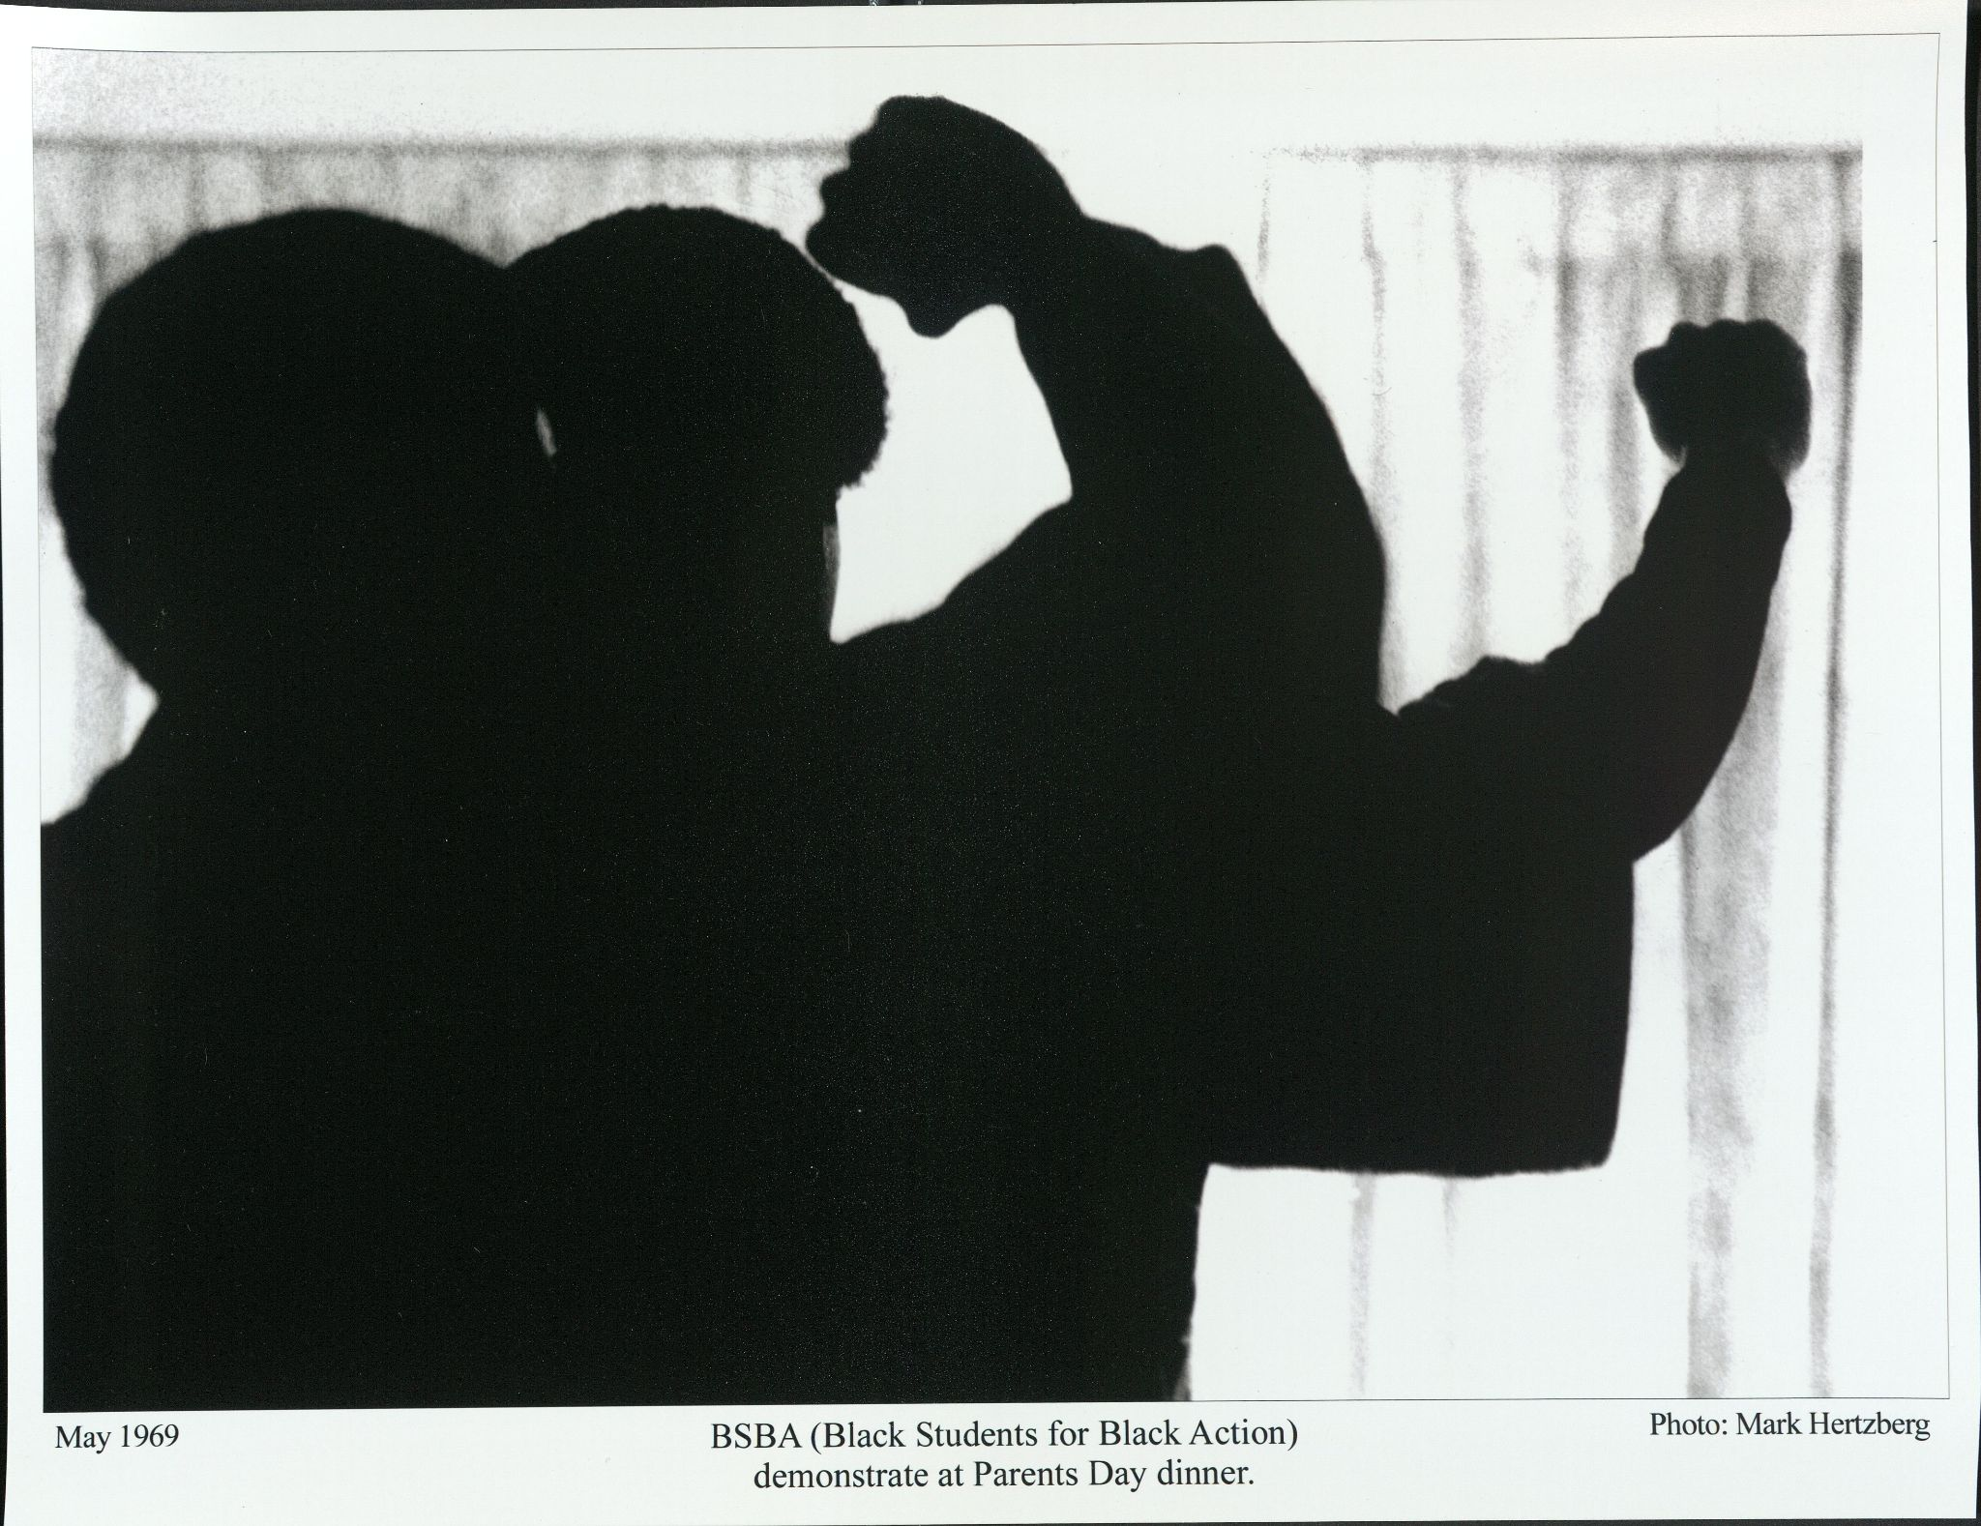
INSTRUCTION in the Archives
Institutional growth and achievement can be celebrated without erasing historical wrongs, their impact, and the activists who challenged them
If necessary, advocate to admin that the institution serves itself best by supporting open reflection and critique, in the pursuit of continued progress
Using a strictly positive lens delegitimizes the historical work and erodes community trust that could be built up by acknowledging harm and engaging in self-critique

Slide 11
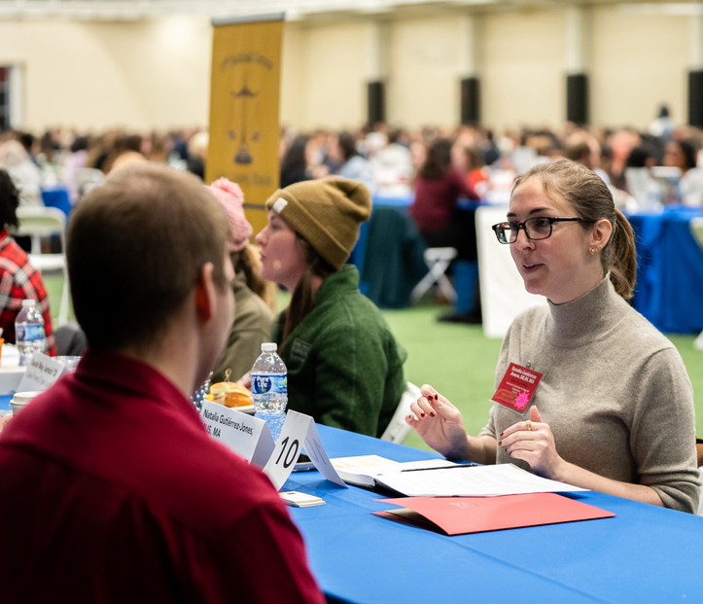
Thanks for your time and attention!
Feel free to get in touch at:
gutierrezjones@lakeforest.edu
archives@lakeforest.edu
847-735-5064

