Slide 1
Rethinking the Worksheet
Collaborating to Create Adaptable Activities
June 4, 2026
CARLI Instruction Showcase
School of the Art Institute of Chicago Librarians
Notes:
Building blocks / back to basics / building something new / CMYK updated primary color palette

Slide 2
Context

Slide 3
Research Studio 1
Required Course For First-Year Students
Research methods to facilitate artistic practice
Required one-shot orientation to library collections
Fall semester: 60 RS1 sections

Slide 4
Developing

Slide 5
Chicago Modules
Students create work responding to…
You Are Here
  “How your geographical past relates to your geographical present.”
Six Degrees
  “How your own creative practices are connected to those of artists from or in Chicago.”
Unmonumental
  “How non-monumental histories can be recognized in decidedly non-monumental ways.”

Slide 6
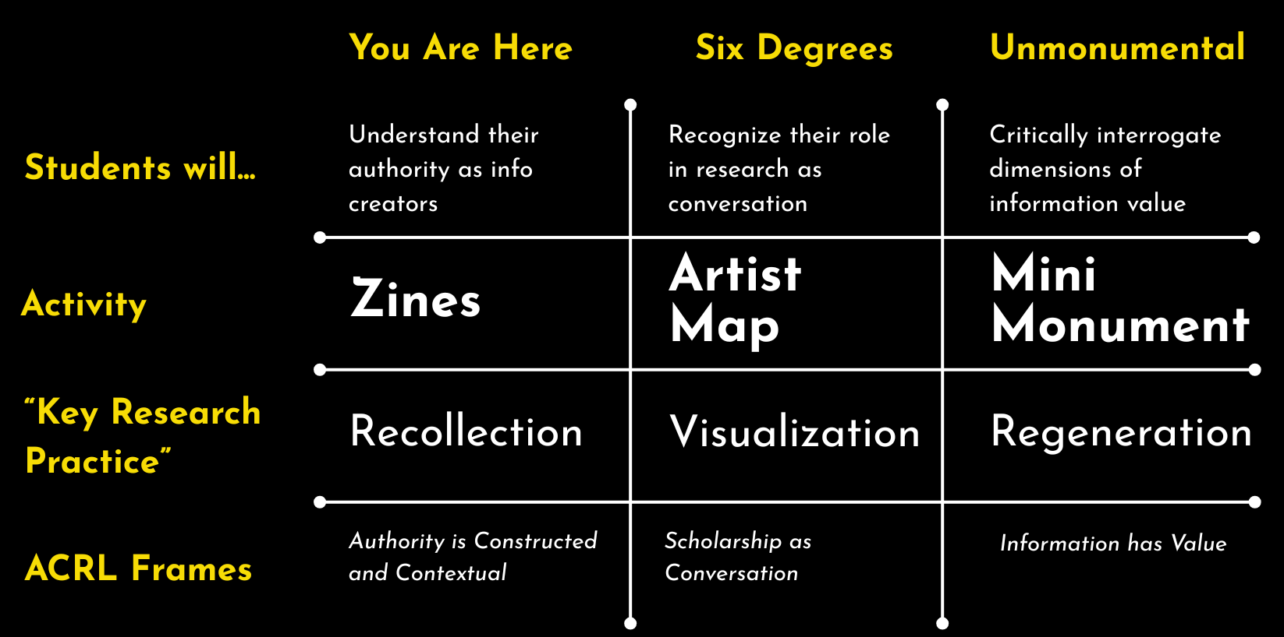
An Eye Towards Outcomes

Slide 7
Designing

Slide 8
Design Constraints
Our Considerations
Why not Canvas Modules?
  Not a faculty preference
  Engage with both collections materials and physical spaces
We aimed for each activity to…
  Succeed as a solo assignment or in in-class activity
  Take 1-2 hours to complete

Slide 9
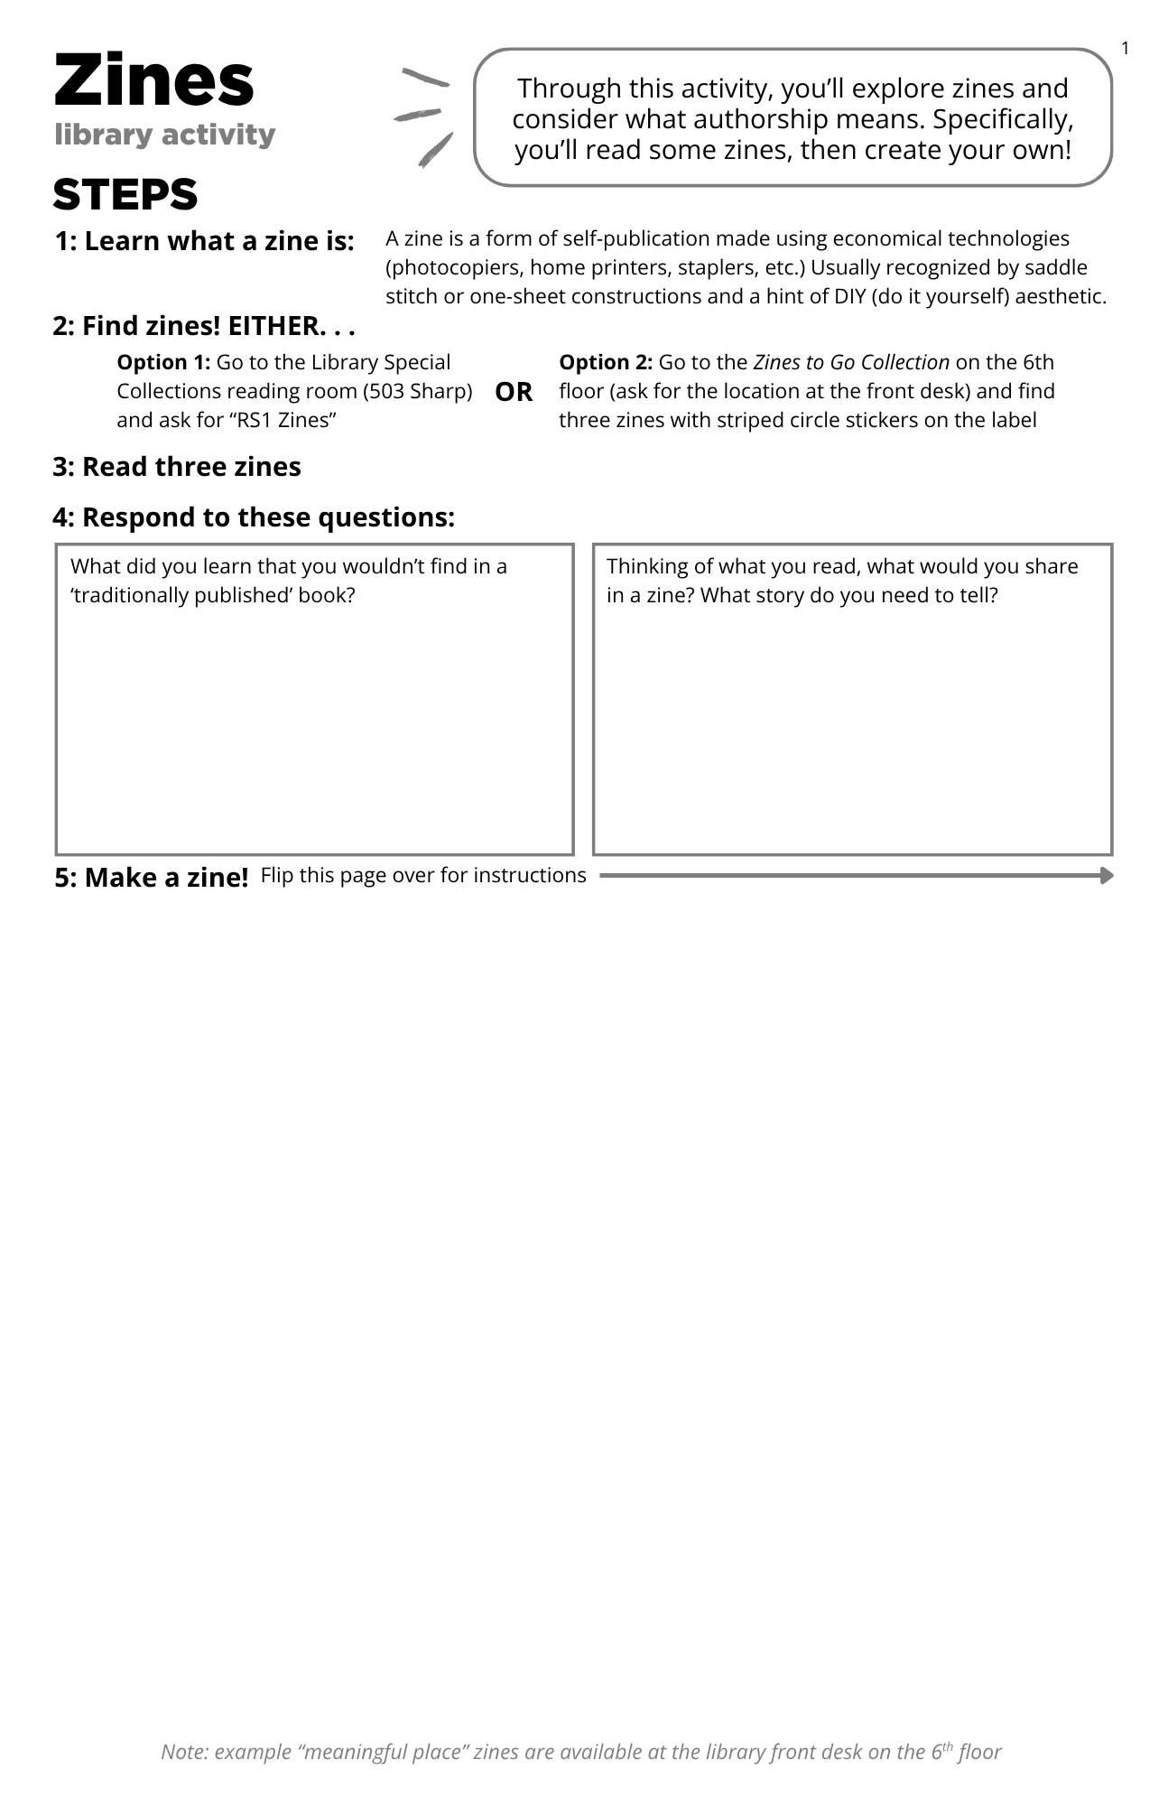
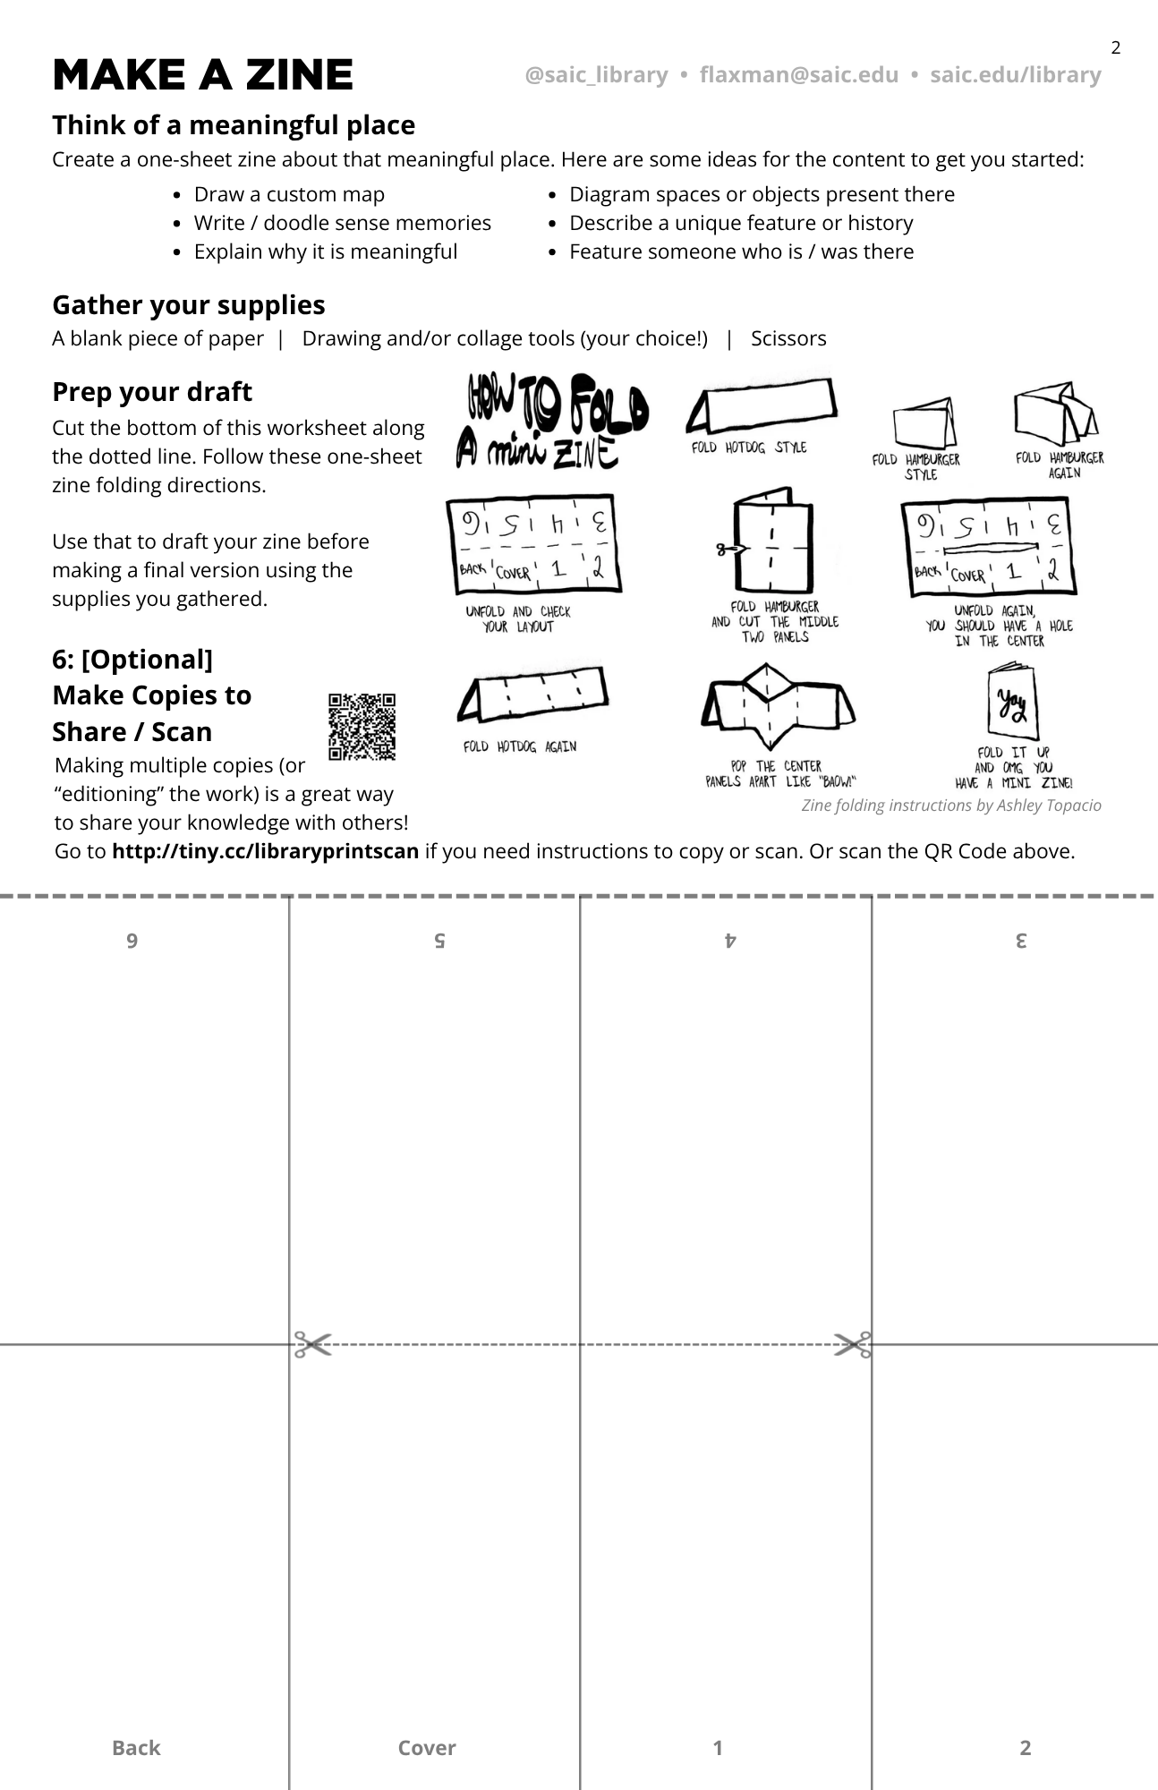
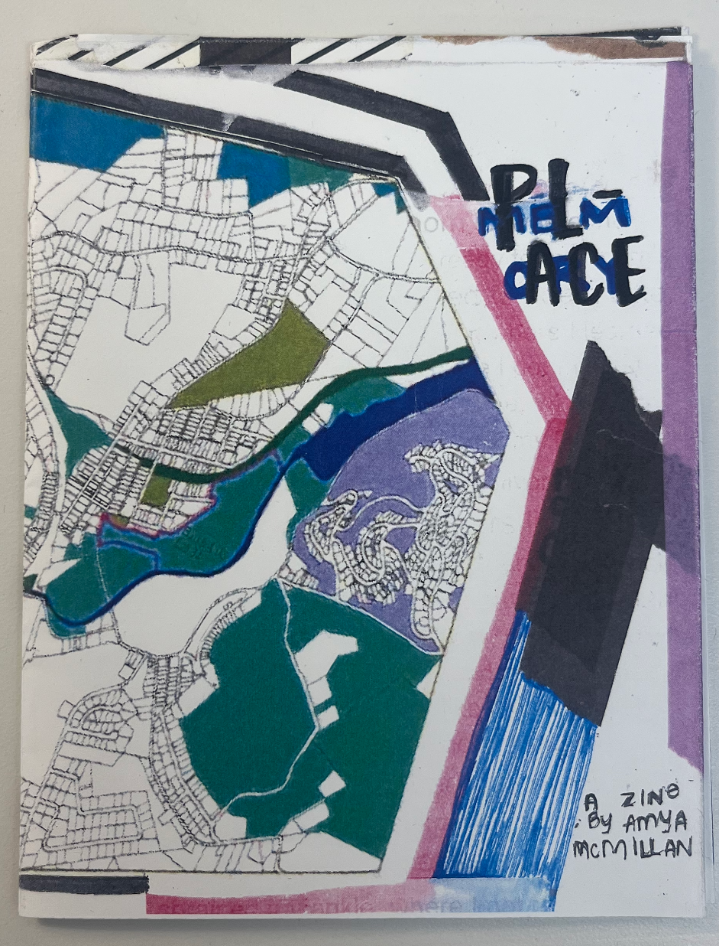
Example created by student worker Amya McMillan.

Slide 10
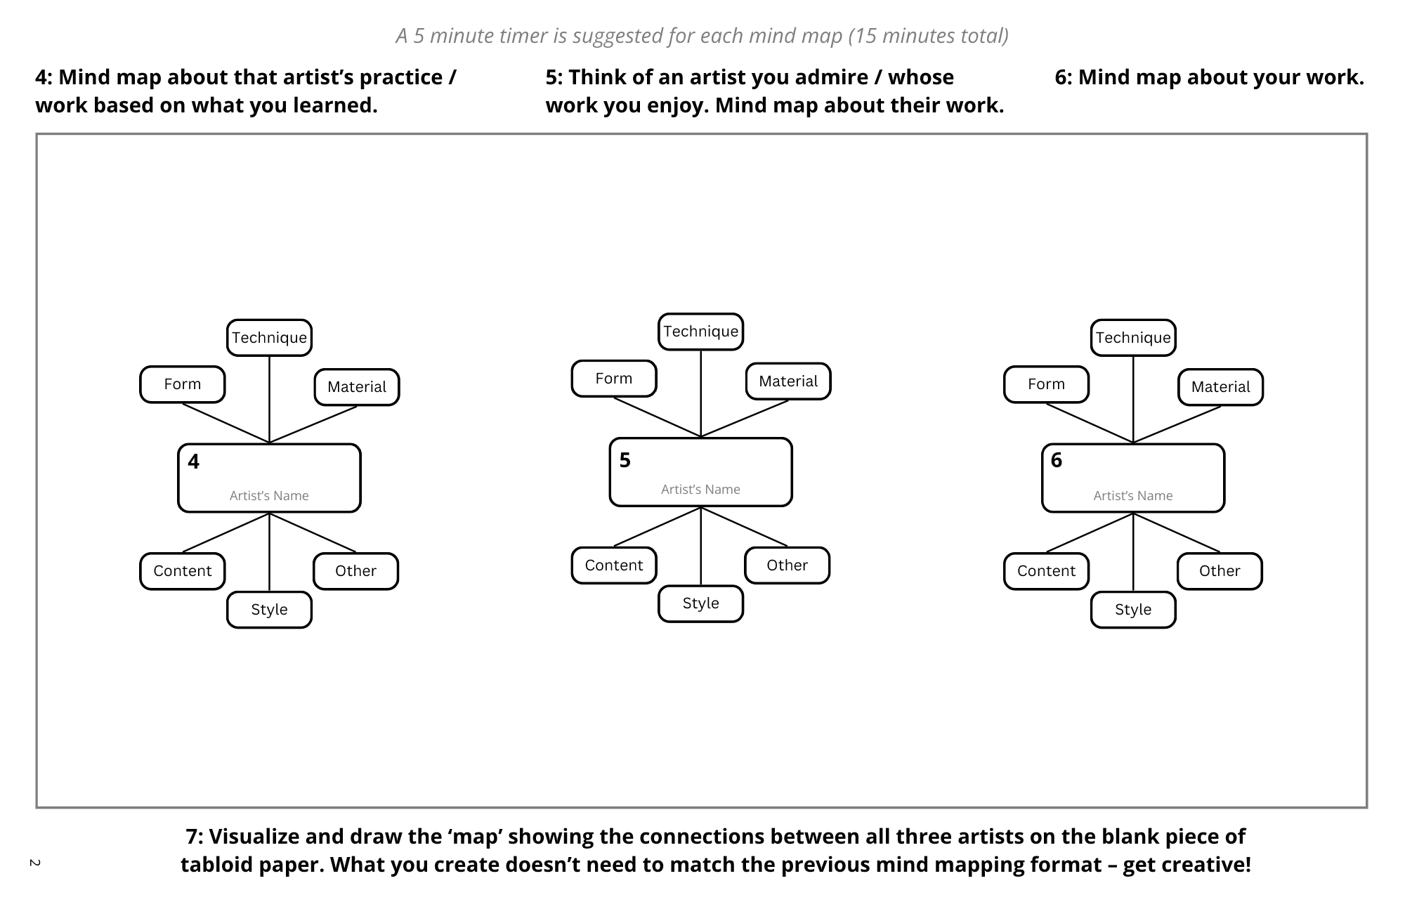
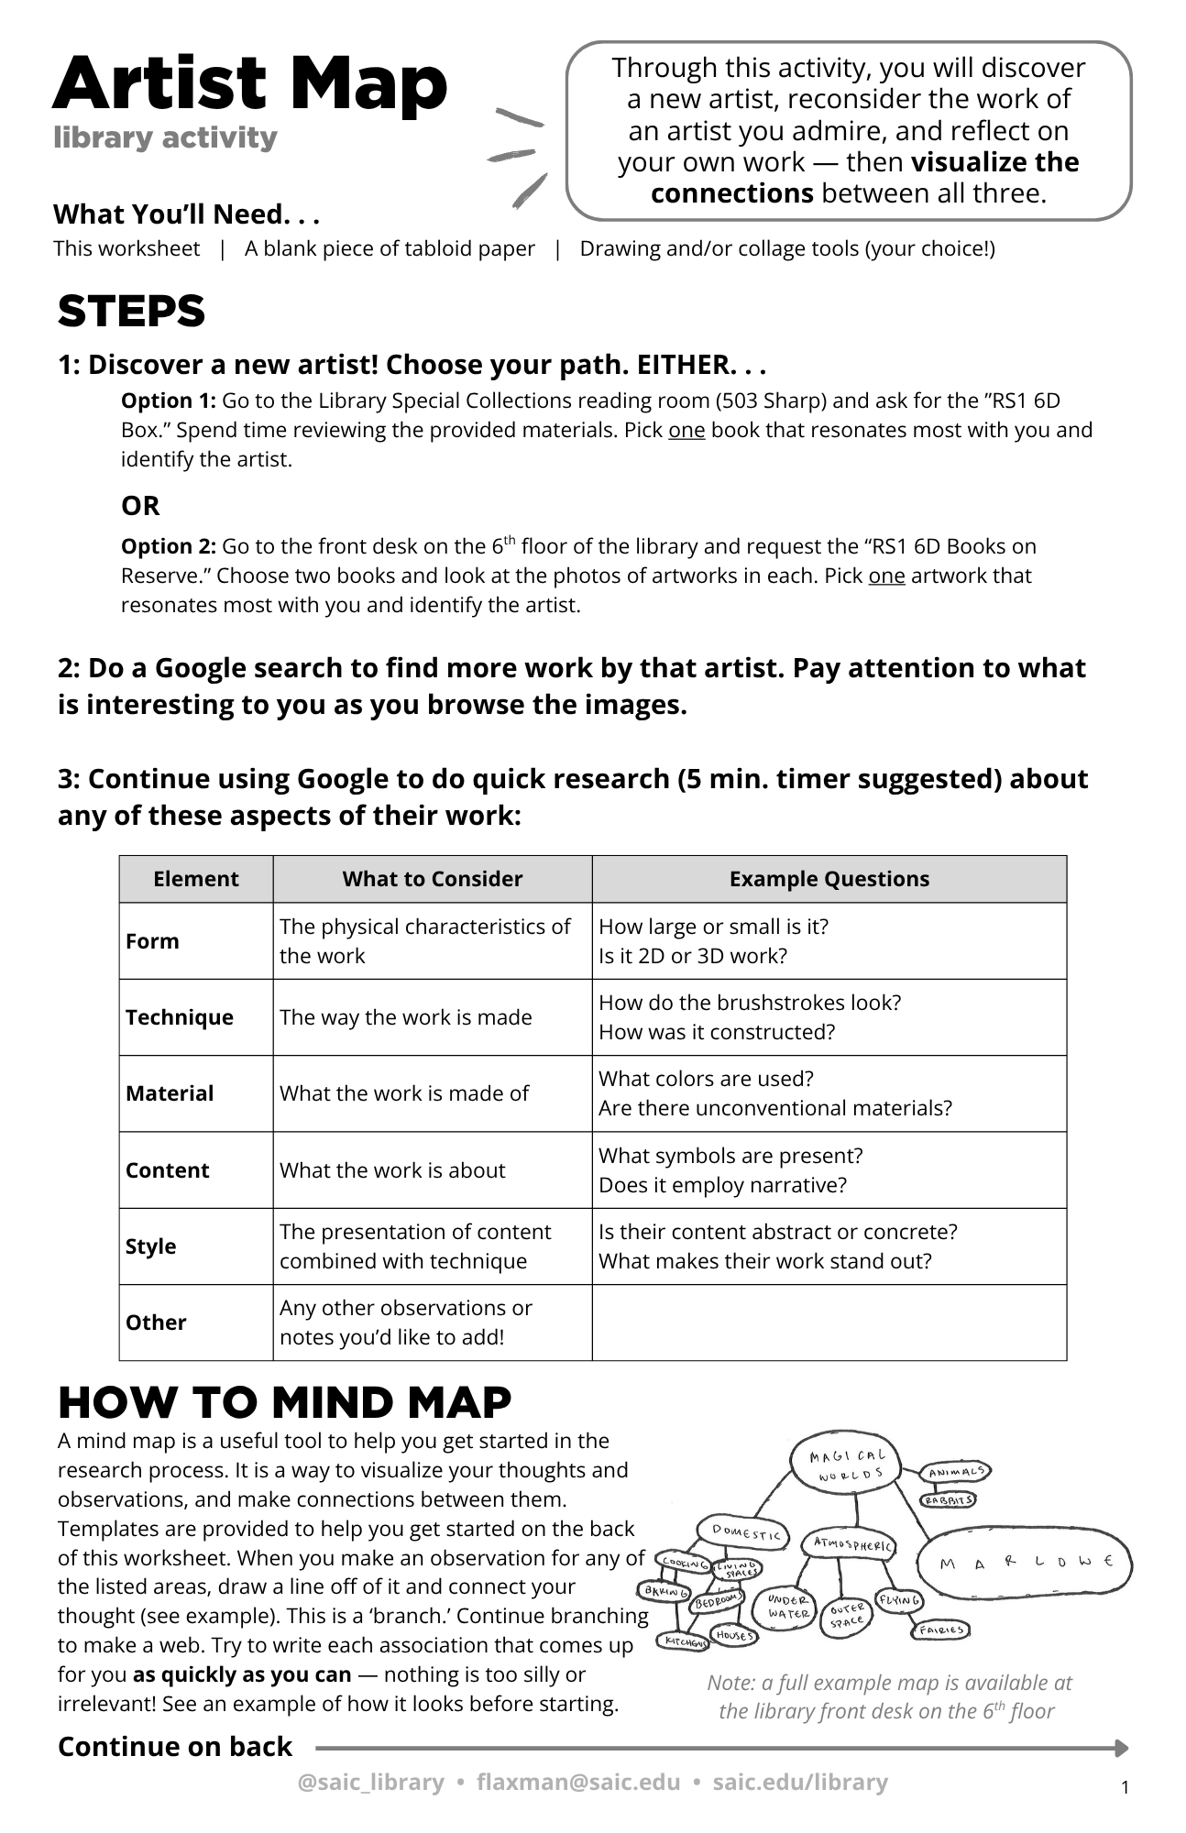

Slide 11
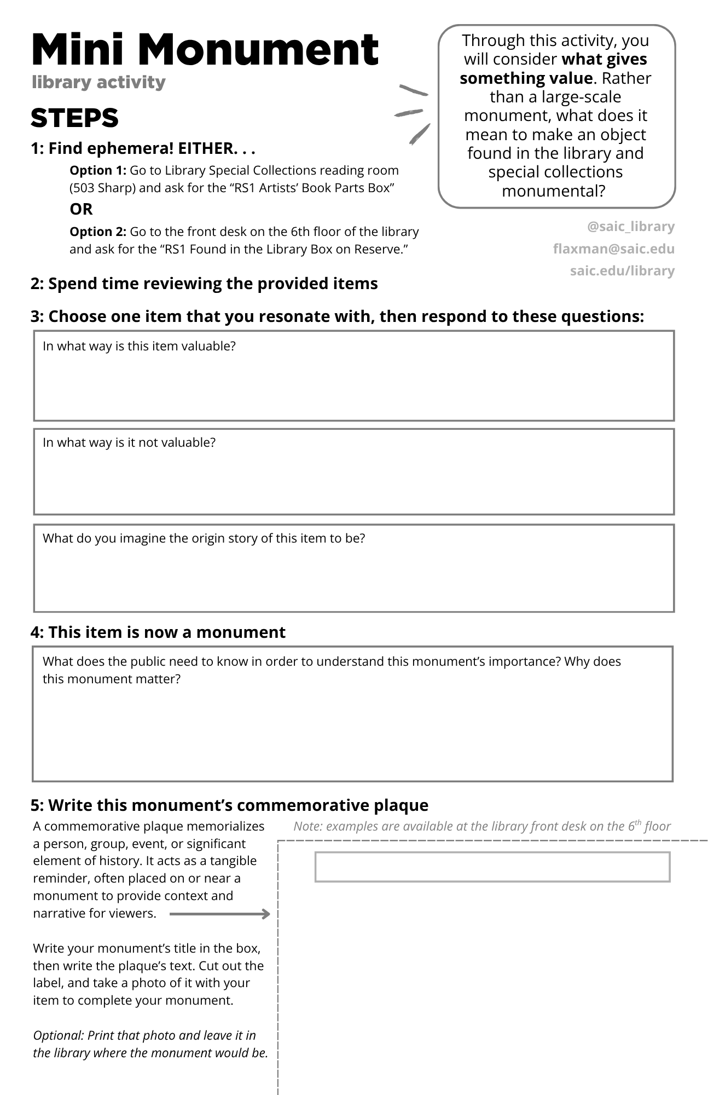
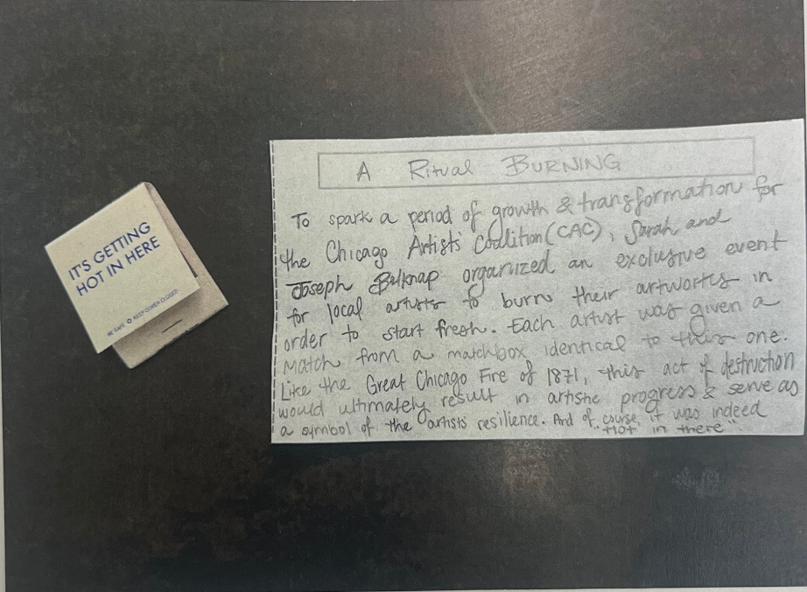
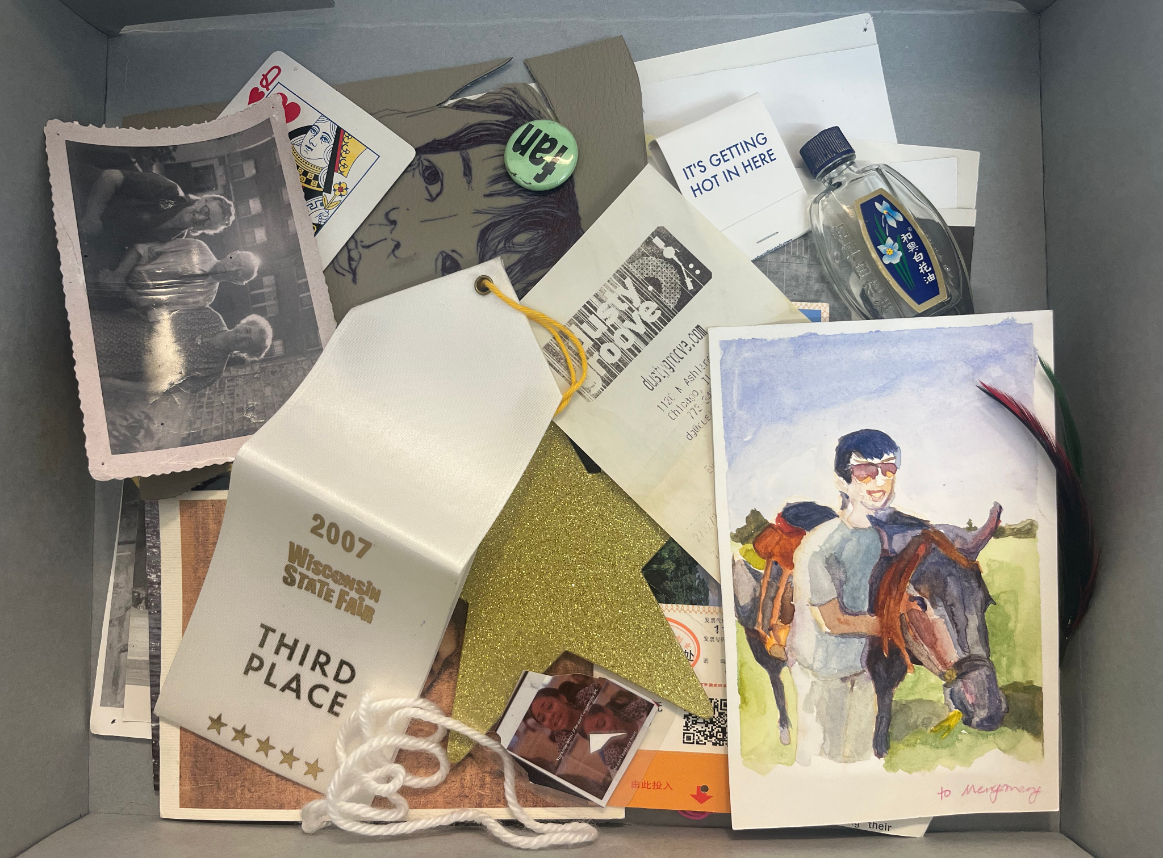
Example created by student worker Amya McMillan.
The Main Collection’s Found in the Library Box.

Slide 12
Focus Groups
Utilizing Student Worker Feedback
Impactful feedback on their experiences led to redrafting:
  Zines: Changed from “perzine” to “meaningful place” lens
  Artist Map: Added a definitions table of “artistic elements”
  Monument: Pedagogical shift from “collection” to “regeneration”
Reduced / clarified reflection questions
Adjusted language (e.g. "material / object" to "item")

Slide 13
Communicating

Slide 14
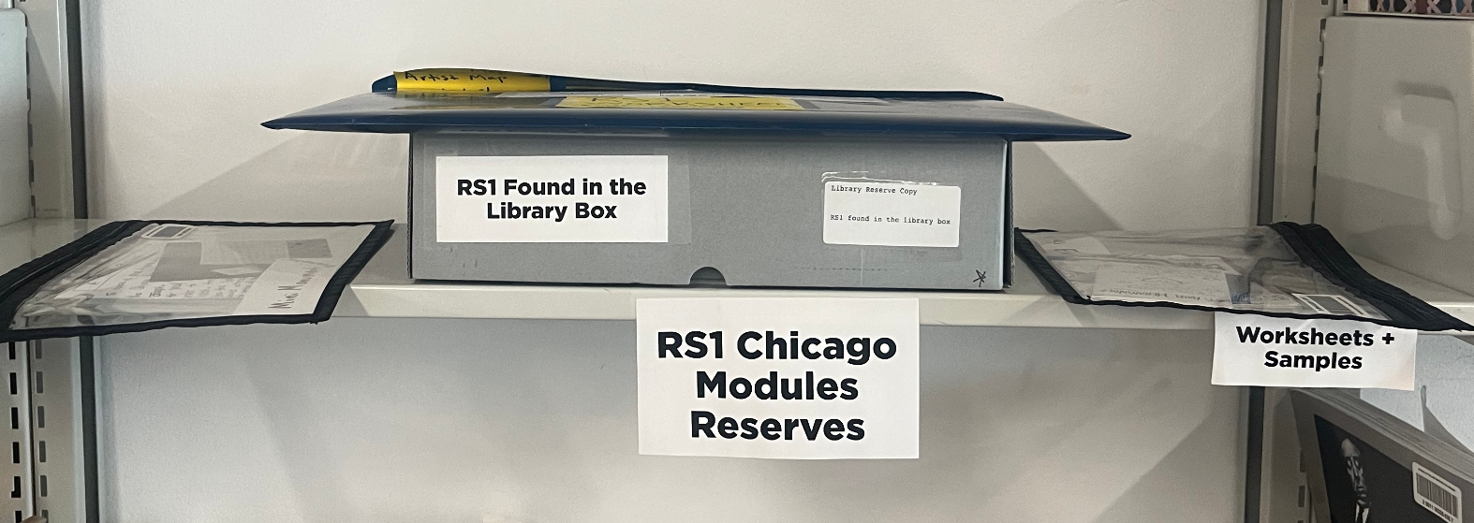
Internal Communications
Front-Line Staff
Pro-staff collaboration
Student Worker instruction
Stat tracking strategy
Worksheets, sample packs, and required activity materials behind the Main Collections front desk.

Slide 15
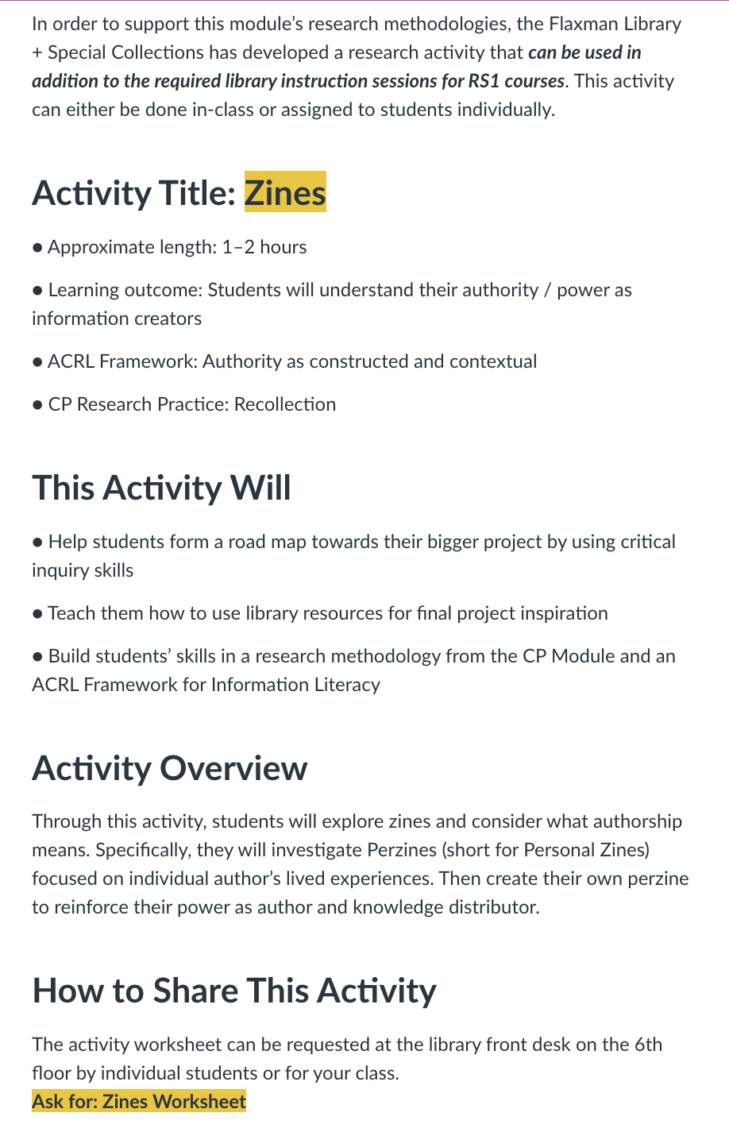
Internal Communications
All Staff
Project execution + goals debrief
Request for advocacy

Slide 16
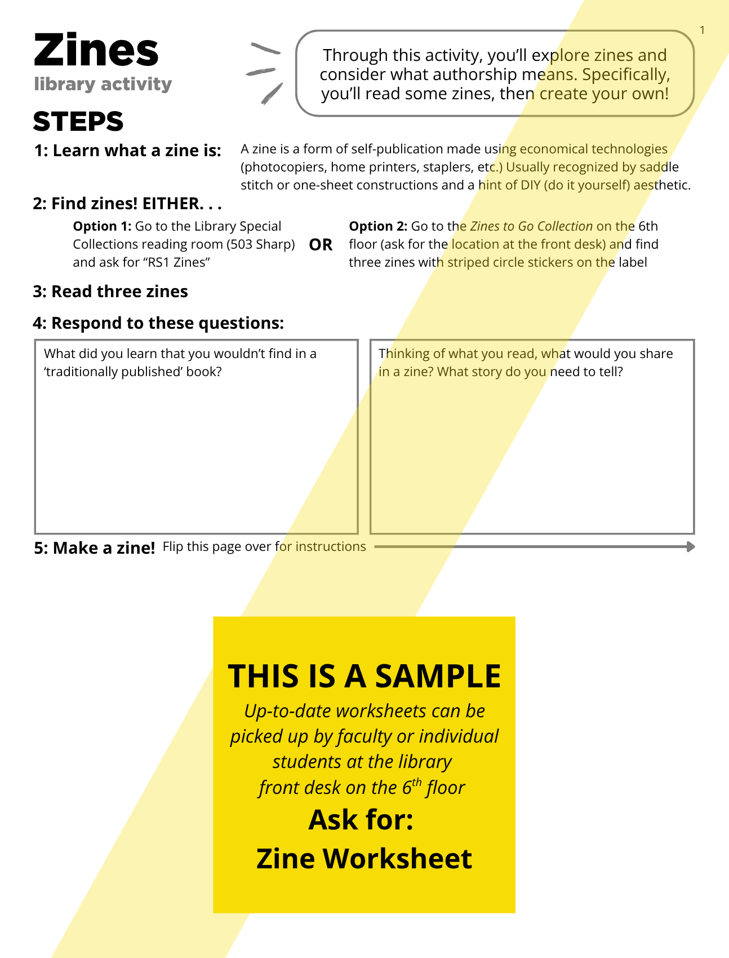
External Communications
Pitching to Faculty
Crafting clear informational pages
Outlining perks
  Can be done as a class OR an assignment
  Builds on required library orientation
  Mapped to Chicago module learning outcomes + information literacy skills
Canvas demos at faculty meetings

Slide 17
Reflecting

Slide 18
Next Steps + Recommendations
Assessment
Takeaways
Stats: 129 worksheets used
Faculty Feedback: Worksheets + Collaboration
Successful response to bandwidth constraints
Adapt to different teaching modalities
Viable learning outcomes

Slide 19
Resources
Framework for Information Literacy [ACRL]
Worksheets
Artist Map
Mini Monument
Zines

Slide 20
Thank You
Presented by SAIC Librarians
Ana Hernandez
Information Literacy Librarian
ahernandez46@saic.edu
Brittan Nannenga
Head of Library Special Collections + Digital Services
bnannenga@saic.edu
Alex O’Keefe
Research + Instruction Librarian
aokeefe@saic.edu
April Sheridan
Special Collections Librarian
asheridan@saic.edu
Special thanks to Holly Stec Dankert, Nick Favela, Ned Marto, Mackenzie Salisbury, Jordan Wright, and our amazing student assistants.
saic.edu/library
@saic_library

