Slide 1





Breaking the “Rules” to Break the Ice:
Short Research Activities to Encourage Student Engagement
Kaitlyn Goss-Peirce
Tredway Library, Augustana College
Notes:
Welcome to Breaking the Rules to Break the Ice; I am Kaitlyn Goss-Peirce, a Research & Instruction Librarian at Augustana College. Augustana is home to 2500 students, over a quarter of whom are first generation students and a quarter of whom are international students, two communities who often are less comfortable in academic library spaces. In this session, I will introduce you to 2 different short activities I regularly use to help break tension and boost student engagement while simultaneously reinforcing key research skills during library one-shot sessions.

Slide 2


Library Session Opening
  Introductions
  Session Overview
  IL Game
  Debrief
Notes:
I start nearly all my library sessions with the same opening sequence:
Introduction to myself & Tredway (silly fact to make approachable)
Overview of session, which helps reduce anxiety and give a sense of structure to the session
Transition to the main activity with a short game that practices important search skills; "If it's okay with all of you, I like to start all my classes with a quick game to help us get into the research mindset"
Quick debrief of the game before we move to the main activity

Slide 3
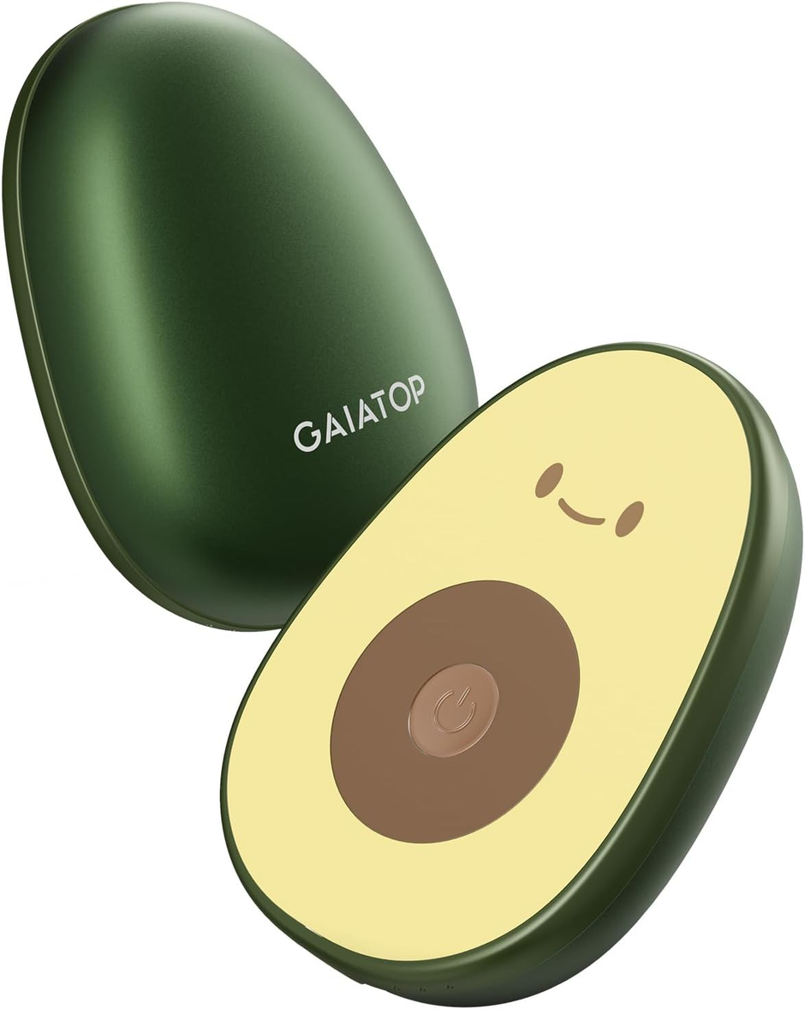
Amazon Game
  30 seconds thinking to themselves
  1-2 minutes discussing as group
  3-4 minutes looking on Amazon as a group
Notes:
Clever name: Amazon Game (this is sarcastic)
Give each set of students an image of an unusual object. Feel free to add in the chat what you think this is!
We start with 30 seconds for individual thoughts, 1-2 minutes for group brainstorming, and 3-4 minutes group searching: what is this object & finding it on Amazon
Try to choose objects that are fun but not impossible to decipher -- using visual cues (avocado, power button, & brand name, so we have the start for a search (Gaiatop avocado)

Slide 4
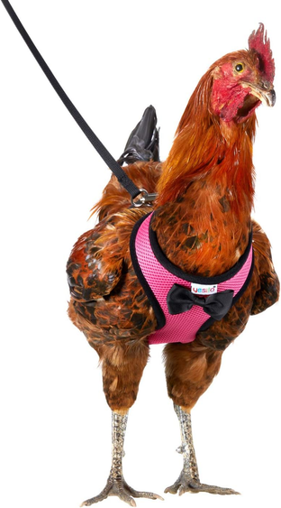
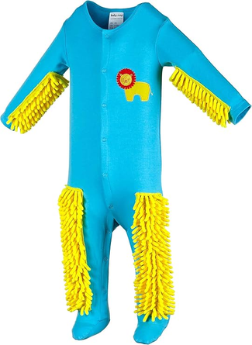
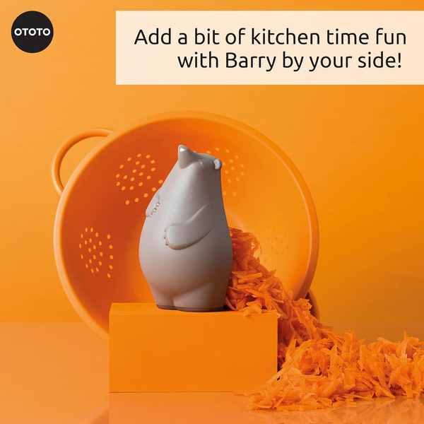
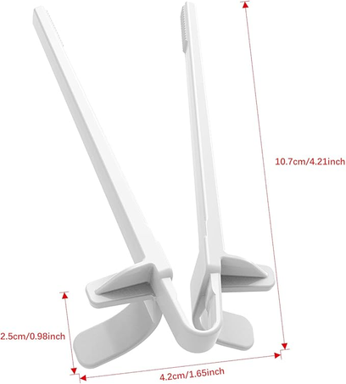

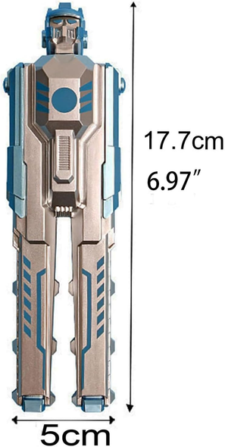
Notes:
I keep a folder of two levels of items that I refresh every semester: easier objects like the ones on the top, where the items are usually definable -- like chicken leash or baby mop. These are ideal for lower level classes.
Other objects are more of a challenge -- they may be harder to determine purpose or may require more thinking outside of the box, with fewer contextual clues -- like these gaming chopsticks or transformer pen

Slide 5

Why did we do this?
Mirrors Research:
  Keyword practice
  Patience & persistence
  Creativity & perspective
  Database selection
  Expert advice when needed
Breaks Tension:
  Subverts students’ expectations: telling students to go shopping in class!
  Gives them permission to be silly and “off-topic”
  Shows real-world application beyond academic research
Notes:
Once we find the objects (and share out the answers), I always ask: Why did I have us start with this activity? Occasionally, students give a sarcastic answer ("to amuse yourself/for fun"), but we usually hit on the main objectives:
It mirrors the research process by allowing us to practice keywords in a contained setting, putting our patience and persistence to use like in a traditional research process. Creativity and perspective are baked into the activity -- the silly objects require creative thinking and the group aspect encourages multiple perspectives. It also touches upon the importance of database selection -- these are all from Amazon, so you may have difficulty finding them at Target or other stores, mirroring how different databases are helpful for different research needs -- and turning to experts when needed -- it is ALWAYS okay to ask for help from a librarian, professor, or peer tutor (etc).
What we usually DON'T talk about is how this helps break the tension in the classroom -- this activity subverts expectations because I explicitly tell them to go shopping in class! It gives them opportunities to be silly and "off topic" within a limited scope and demonstrates the real-world application of these skills beyond traditional research. This all allows students to feel more comfortable with me, ease into the library session overall, and start seeing the library as a comfortable place beyond just academia as well.

Slide 6

Stump the Database
Class refresher on 5 Boolean Operators:
  AND
  OR
  NOT
  “quotation marks”
  asterix*
Using ANY keywords and ANY booleans, use OneSearch to get 0 search results!
2 minute timer on screen
Notes:
2nd game is a little more to-the-point; Stump the Database is a game to practice boolean operator use. I start with a short refresher on operators -- lower level classes often take a library tutorial on the topic as an "entry ticket" to the session, so this refresher can take just 2-3 minutes. We review key booleans and remind ourselves AND, OR, and NOT must be in all-caps.
Then, I have students pull up the library website to put any keywords & booleans into OneSearch catalog to turn up 0 results. 2 minute timer on the screen to help monitor time and add structure.

Slide 7



Stump the Database: Debrief
Show of hands: who managed <10; <5; 0
What worked? // What DIDN’T work?
Acknowledgement of opposite intentions
Do we feel comfortable using Booleans on our own to enhance our searches?
Notes:
Once the 2 minutes are up, I ask for a show of hands: who managed to get single-digit results? Less than 5? 0 total?
We talk about what techniques worked and what didn't for a few minutes
I always acknowledge that this feels backwards, because usually we use Booleans to narrow our results to what we need, but in this case, we wanted 0, so in outsmarting the database, we are using Booleans effectively
I end with a nonverbal check in: Thumbs up if we are comfortable using Booleans on our own; thumbs middle if we want more practice during the work time; thumbs down if we are still totally confused. Usually thumbs up with the occasional middle; never had a thumbs down.

Slide 8

Other Icebreakers to Try
  6-word story of their topic (Megan Lotts)
  Red Flag / Green Flag ⟶ Credibility Refresher
  Alt-text game / variation of Amazon game
  Organization game
Notes:
Other games that can be used, depending on overall session goals:
6 word story (credit to Megan Lotts)
Red / Green flags in refresher on source and author credibility (can implement references to "Flag Guy" Dustin Poynter https://linktr.ee/dustinpoynter)
Variation of Amazon game to practice alt-text use
Organization game where students are given a set of random objects and are asked to categorize them into themes

Slide 9

Conclusion
In creating icebreakers that break research or classroom “rules,” librarians invert presumptions of research and/or the library as boring, stern, and serious, allowing students to feel more comfortable within the session and the library as a whole. These activities often lead to higher energy and engagement in the session to follow.

