Slide 1
Autoholdings for ProQuest Ebooks into Alma for CARLI
Kristin Johnson, Training and Consulting Partner
August 2022

Slide 2
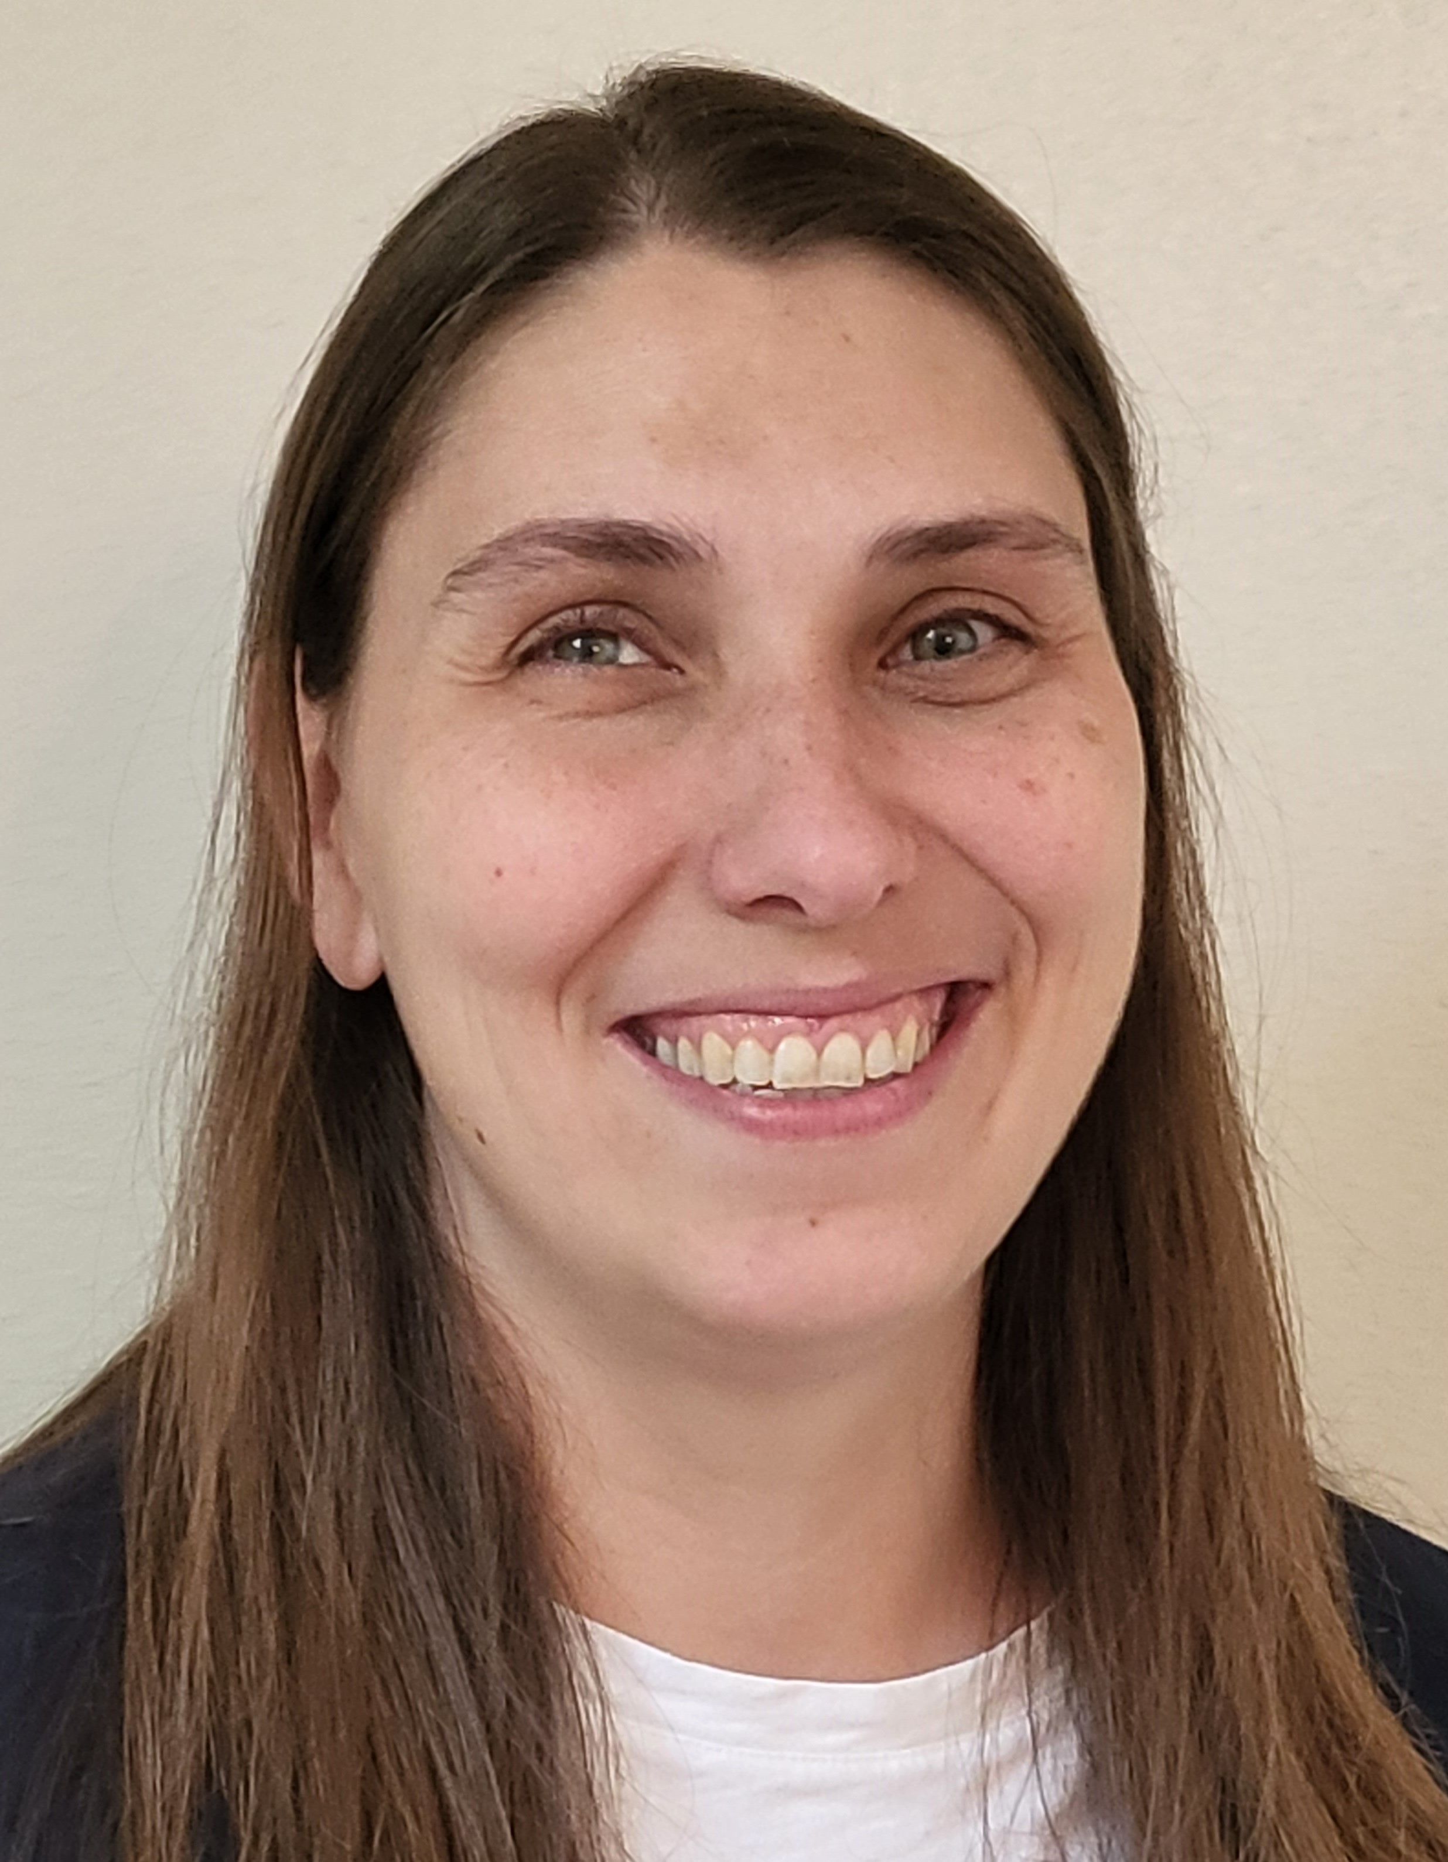
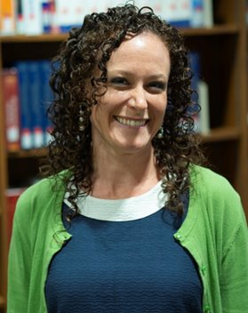
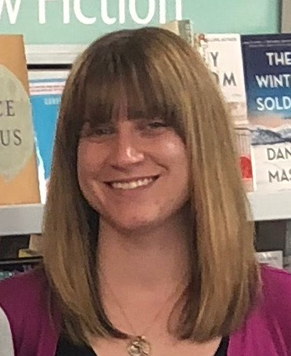
Training & Consulting Partners (TCP)
Kristin Johnson
  Masters of Library and Information Science
  kristin.johnson@clarivate.com
Heather Mitchell-Botts
  Masters of Library and Information Science
  heather.mitchell-botts@clarivate.com
Amanda Richio
  MLIS & MA Linguistics
  amanda.richio@clarivate.com
Notes:
KJ Started with ProQuest in January 2022 Worked mostly in academic libraries ranging from community colleges to graduate degree granting universities. From Chicago, now in Texas

Slide 3
Session Objectives
By the end of the session, you will be able to
Recall the benefits of autoholdings
List some of the considerations of autoholdings
Prepare for initial outreach from ProQuest about autoholdings

Slide 4
What is autoholdings?
Automated process where all ProQuest Ebook Central titles are activated in Alma
Ex Libris documentation calls it “Upload Electronic Holdings”

Slide 5
Is this new?
Autoholdings existed previously
  Only for owned and DDA titles
  Updated weekly or less frequent
Autoholdings with new “enhanced integration profile”
  Owned, DDA, and Subscription
  Updated daily
  Updates appear in 24 to 48 hours
  Purchase model indication for each portfolio

Slide 6
How does it work?
Community Zone
Ebook Central Perpetual Subscription & DDA Titles collection
1. Call ProQuest Ebook Central with customer specific ID at ProQuest Ebook Central (SiteID)
Alma
ProQuest Ebook Central
3. Activate & Manage customer specific electronic holdings in Alma
2. Daily retrieve customer specific electronic holdings:
DDA titles
Owned Titles
Subscription
Notes:
HMB – start here

Slide 7
What are the benefits?
Daily incremental loads of all Ebook Central content: owned, DDA, and subscribed titles.
No manual activations for individual titles in Ebook Central.
Once a DDA title is triggered for purchase, the purchase model will be updated via autoholdings in the next daily load.
Territorial restrictions are not an issue because autoholdings only delivers the titles an institution has access to.
Set up reports to show any changes or deletions.

Slide 8
What are the considerations?
Must use the Ebook Central Perpetual, DDA, and Subscription titles Community Zone collection.
Enhanced or customized records can be difficult to retain and maintain.
To participate in the Training and Consulting Partner-led project, you must activate all Ebook Central content.
  Owned, DDA, and subscription
  Can proceed on your own if you do not want all Ebook Central content.
Each institution is different → individual consultations are needed.

Slide 9
Example consultation questions
Do you use Alma to maintain your purchasing data (PO Lines) for Ebook Central ebooks?
If so, how does that order information get into Alma?
How do you manage Ebook Central records in Alma?
  Community Zone, Institution Zone, Free-Floating Portfolios
If you use Community Zone records, are you making any adjustments to those records once you activate titles?

Slide 10
What are the steps in this process?
Outreach
ProQuest TCPs will reach out to all CARLI members.
TCPs will schedule consultations with individual members who are interested in the project.
Decision
You decide if you would like to proceed.
If so, TCP sends case to Ex Libris.
Completion
Ex Libris will let TCP know when autoholdings has been set up.
TCP will let institution and CARLI know it is complete.

Slide 11
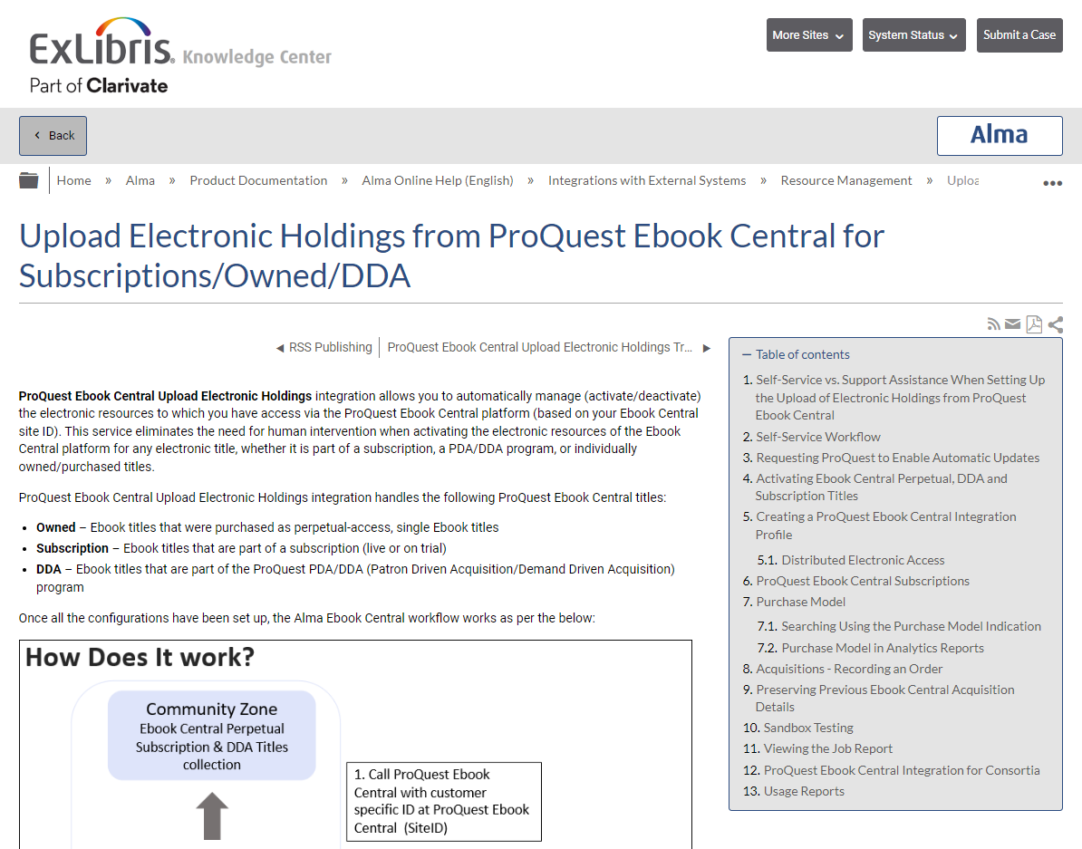
Where can you find more details?
Upload Electronic Holdings from ProQuest Ebook Central for Subscriptions/Owned/DDA (Ex Libris Knowledge Center Article)
  If you participate in the TCP-led project, TCPs and Ex Libris will take care of the steps in the “Self-Service Workflow”
Notes:
Back to KJ

Slide 12
What are your next steps?
Review
Review Upload Electronic Holdings from ProQuest Ebook Central for Subscriptions/Owned/DDA.
Watch
Watch for an email in the next few weeks from Heather Mitchell-Botts, Amanda Richio, or Kristin Johnson.
Reply
Reply to email.
Not interested, questions, and/or consultation times
If you’re ready to get started NOW, email kristin.johnson@clarivate.com.
Notes:
KJ again

Slide 13
Recap of Today’s Objectives
Know the benefits of autoholdings
List some of the considerations of autoholdings
Prepare for initial outreach from ProQuest about autoholdings
Notes:
You'll receive emails from one of us. You can also email me directly when you're ready.

