Slide 1
Alma How-to: Alma Anonymization, Reporting, and PII
June 10, 2024
Notes:
(Jessica)
Welcome to this I-Share webinar about Alma Anonymization, Reporting, and Personally-Identifiable Information (PII). My name is Jessica Gibson, and I’ll be joined today by Dennis Krieb from Lewis & Clark Community College, and my CARLI colleagues, including Ted Schwitzner.

Slide 2
Agenda
Overview of Alma Anonymization
Resources and Best Practices for Handling Patron Information/Personally Identifiable Information (PII)
Case Study—Lewis & Clark Community College
  Student Library Usage without Analytics
Analytics with PII before anonymization
  Sample reports
  Minimizing exposure
Notes:
(Jessica)
Today’s agenda will include:
a quick overview of I-Share’s implementation of Alma Anonymization
A brief discussion of resources and best practices for handling personally identifiable information
A Case Study from I-Share member library Lewis & Clark Community College
And finally, some discussion and examples of how your library might use PII in analytics responsibly.

Slide 3
Alma Anonymization Implementation
CARLI staff and the CARLI Resource Sharing Committee have tested and decided upon several consortial policies for I-Share that optimize the privacy of patron data while balancing the needs of library staff to access these data.
  These configurations have been approved by the CARLI Governance Board.
CARLI will enable Alma’s anonymization of user data feature for all I-Share libraries on July 29, 2024.
Notes:
(Jessica)
CARLI staff and the CARLI Resource Sharing Committee have tested and decided upon several consortial policies for I-Share that optimize the privacy of patron data while balancing the needs of library staff to access these data for different purposes. These configurations have been approved by the CARLI Governance Board.
CARLI will enable Alma’s anonymization of user data feature for all I-Share libraries on July 29, 2024. CARLI staff will set and maintain these configurations in all I-Share Institution Zones. There is no action required on the part of I-Share libraries to configure Anonymization.
There will be no changes to the day-to-day tasks within Alma such as loaning materials or returning materials, either from a local or I-Share perspective. However, as we'll discuss today, anonymization will affect the storage of personally-identifiable information in Alma Analytics.

Slide 4
Overview of Alma Anonymization
Anonymization in Alma removes personal user information from fulfillment transactions (loans, fines/fees, requests) after that information is no longer required for a current transaction and is considered “complete” in the system.
Anonymization in Alma leaves non-patron-identifiable information such as user group and affiliated I-Share institution reportable through Alma Analytics.
Notes:
(Jessica)
Anonymization in Alma removes data about a patron's identity from fulfillment transactions--specifically loans, fines/fees, and requests--after that information is no longer required for a current transaction and is considered “complete” in the system.
Once anonymization is enabled on July 29, completed user loan and request data in Alma will be anonymized after a retention period of seven days; and fine and fee data will be retained for seven years.
Data that do not identify a patron, such as user group and affiliated I-Share institution, remain available in Alma Analytics for generating statistics.

Slide 5
What is Personally Identifiable Information (PII)?
According to National Institute of Standards and Technology (NIST):
Any representation of information that permits the identity of an individual to whom the information applies to be reasonably inferred by either direct or indirect means.
Any information about an individual maintained by an agency, including (1) any information that can be used to distinguish or trace an individual’s identity, such as name, social security number, date and place of birth, mother’s maiden name, or biometric records; and (2) any other information that is linked or linkable to an individual, such as medical, educational, financial, and employment information.
Information that can be used to distinguish or trace an individual’s identity, either alone or when combined with other information that is linked or linkable to a specific individual.
Notes:
(Jessica)
So, before we get started, an Important Disclaimer: I’m not a lawyer or a security expert or privacy professional! But in my work at CARLI, I have access to PII, and I’m also a patron of libraries and and customer of business who have my PII, so I embarked on an adventure to learn more about this issue to increase my understanding.
Let’s take a moment to think about: What IS Personally Identifiable Information, or, PII?
If you google “What is personally Identifiable Information?” you will get more results than you know what to do with! I chose this definition from the National Institute of Standards and Technology’s Computer Security Resource Center, part of the US Department of Commerce.
Any representation of information that permits the identity of an individual to whom the information applies to be reasonably inferred by either direct or indirect means.
Any information about an individual maintained by an agency, including (1) any information that can be used to distinguish or trace an individual’s identity, such as name, social security number, date and place of birth, mother’s maiden name, or biometric records; and (2) any other information that is linked or linkable to an individual, such as medical, educational, financial, and employment information.
Information that can be used to distinguish or trace an individual’s identity, either alone or when combined with other information that is linked or linkable to a specific individual.
This is both broad and specific!

Slide 6
PII Considerations
PII is not any single category of information or part of a specific technology.
Information that may be considered PII in some contexts may also be available in public sources like directories.
Non-PII data may become PII when combined with other data.
Some PII data are more sensitive than others.
Handling PII requires a context-specific assessment of risk.
Consider carefully if you really need to collect PII.
  If you do, minimize access to it and regularly dispose of it when no longer needed.
There are international, national, state, and local privacy regulations that govern the collection, retention, and use of PII.
Notes:
(Jessica)
During my reading of several sources that wanted to answer the question “What is PII?” for me, I picked up on several considerations. These are my own personal simplifications.
PII is not any single category of information or part of a specific technology.
Information that may be considered PII in some contexts is also available in public sources like directories.
Non-PII data may become PII when combined with other data.
Some PII data are more sensitive than others.
Handling (which includes receiving, storing and using) PII requires a context-specific assessment of risk.
Consider carefully if you really need to collect PII.
If you do, minimize access to it and regularly dispose of it when no longer needed.
There are international, national, state, and local privacy regulations that govern the collection, retention, and use of PII.

Slide 7
CARLI Privacy Policy
CARLI takes the collection of personally identifiable information required to provide library services very seriously. It is our policy to store personal information in our systems for the shortest amount of time necessary to complete transactions or provide service. Access to personal information is restricted to the library and consortium staff needing such access to conduct library business. Personal information is never made available for commercial purposes and will not be revealed to any third party except by such process, order, or subpoena as authorized by law.
Approved by the CARLI Board of Directors, March 10, 2017
Notes:
(Jessica)
Again, keeping in mind that I am NOT an expert on this topic, what I can do is share with you the CARLI Privacy Policy and other resources, and ask your library to carefully consider its handling of PII in general.
CARLI takes the collection of personally identifiable information required to provide library services very seriously. It is our policy to store personal information in our systems for the shortest amount of time necessary to complete transactions or provide service. Access to personal information is restricted to the library and consortium staff needing such access to conduct library business. Personal information is never made available for commercial purposes and will not be revealed to any third party except by such process, order, or subpoena as authorized by law.
This policy was approved by the CARLI Board of Directors on March 10, 2017.
CARLI Policies and Practices are informed by statute, specifically the Illinois Library Records Confidentiality Act (Illinois Compiled Statutes 75 ILCS 70/1) and the U.S. Dept. of Education Family Educational Rights and Privacy Act (FERPA); as well as by the University of Illinois System Web Privacy Statement.
By extension, CARLI expects that its member institutions will handle personally identifiably information with the same care. Your institutions likely have their own privacy policies, some of which may be more stringent than CARLI’s. If so, you should follow the stronger requirements, and consult your institution’s local experts with any questions about how you collect, retain, and use PII from Alma.

Slide 8
Professional Best Practices
From Data Lifecycles, part of the Privacy Field Guides for Libraries:
Only collect data that has a specific operational need.
Keep user data secure and limit staff access to only the data they need to perform specific tasks.
Retain records in compliance with legal and operational considerations, and dispose of data in a timely manner when data are no longer required.
Library consortia "should have retention policies and procedures for its member libraries to ensure the same level of user privacy throughout the consortium."
ALA Code of Ethics:
"3. We protect each library user's right to privacy and confidentiality with respect to information sought or received and resources consulted, borrowed, acquired or transmitted."
Notes:
(Jessica)
There are also some best practices for the library profession that you might want to consult. For example, the Data Lifecycles section of the Privacy Field Guides for Libraries enumerates several actions that individuals and organizations should take regarding personally identifiable information, such as:
Only collect data that has a specific operational need.
Keep user data secure and limit staff access to only the data they need to perform specific tasks.
Retain records in compliance with legal and operational considerations, and dispose of data in a timely manner when data are no longer required.
Library consortia "should have retention policies and procedures for its member libraries to ensure the same level of user privacy throughout the consortium.”
In addition, the ALA Code of Ethics states:
"3. We protect each library user's right to privacy and confidentiality with respect to information sought or received and resources consulted, borrowed, acquired or transmitted.”
None of this information is meant to discourage you from utilizing data from Alma to provide necessary statistics or to tie patron activities to assessment goals and outcomes for your institutions; we simply want to encourage you to think about how maintain and protect patron privacy as you do so!
I will now turn things over to Dennis Krieb, Director of Library Services at Lewis and Clark Community College in Godfrey, Illinois, and current member of the CARLI Governance Board, to discuss his library as a Case Study for using student library usage data.

Slide 9
  Dennis Krieb
  Director – Reid Memorial Library
  Lewis & Clark Community College

Slide 10
Data Sources for Reid Library
DATA SOURCES FOR REID LIBRARY
Digital Collections
Physical Collections
Library Services
Homegrown
SARS/Blackboard Analytics
ALMA Analytics
ALMA Analytics
Homegrown
OpenAthens
SARS/Blackboard Analytics

Slide 11
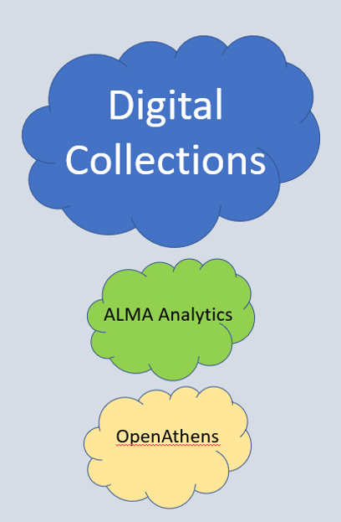
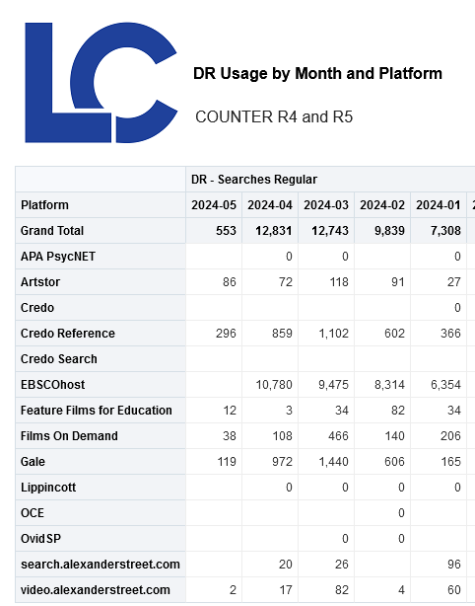
User attributes are not available with SUSHI harvesting of electronic resources in ALMA Analytics .
OpenAthens

Slide 12
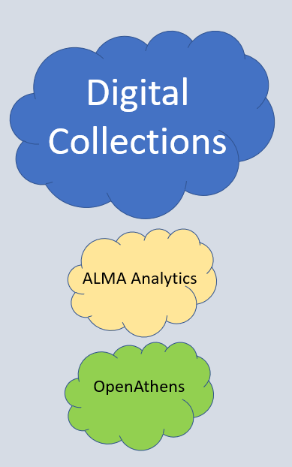
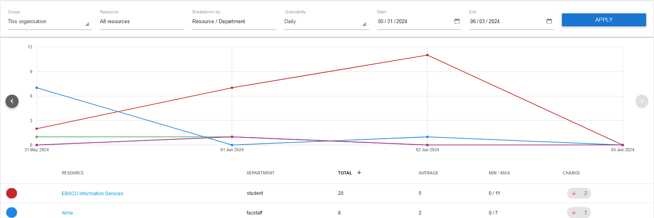
User attributes can be included with OpenAthens. We have added two attributes:
Student
Fac/Staff

Slide 13
Data Sources for Reid Library
Data Sources for Reid Library
Digital Collections
Physical Collections
Library Services
Homegrown
SARS/Blackboard Analytics
ALMA Analytics
ALMA Analytics
Homegrown
OpenAthens
SARS/Blackboard Analytics

Slide 14
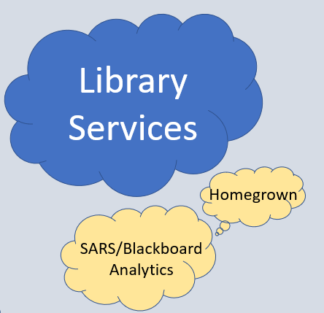
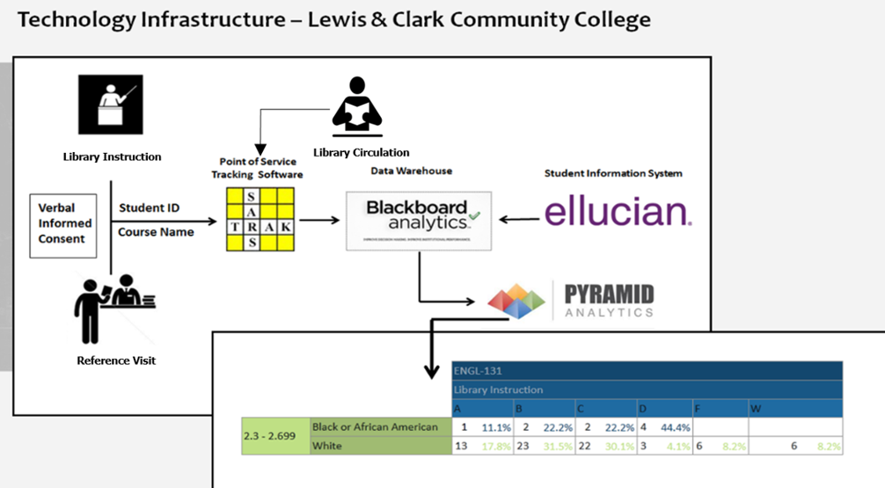
Many attributes can be added – age, gender, degree major, Pell status,…
SARS/Blackboard Analytics

Slide 15
Data Sources for Reid Library
Data Sources for Reid Library
Digital Collections
Physical Collections
Library Services
Homegrown
SARS/Blackboard Analytics
ALMA Analytics
ALMA Analytics
Homegrown
OpenAthens
SARS/Blackboard Analytics

Slide 16
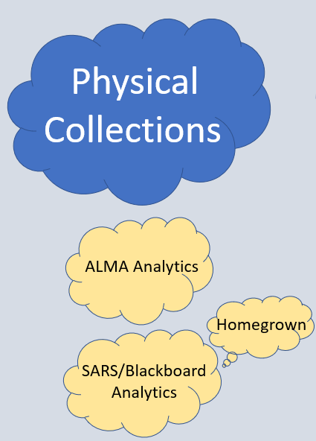
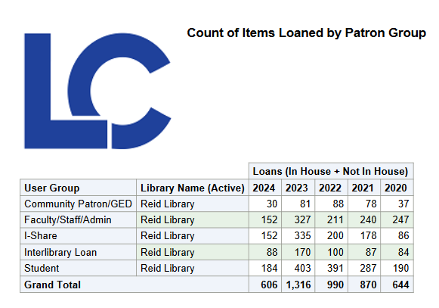
Useful circulation reports that we use in Alma Analytics
ALMA Analytics

Slide 17
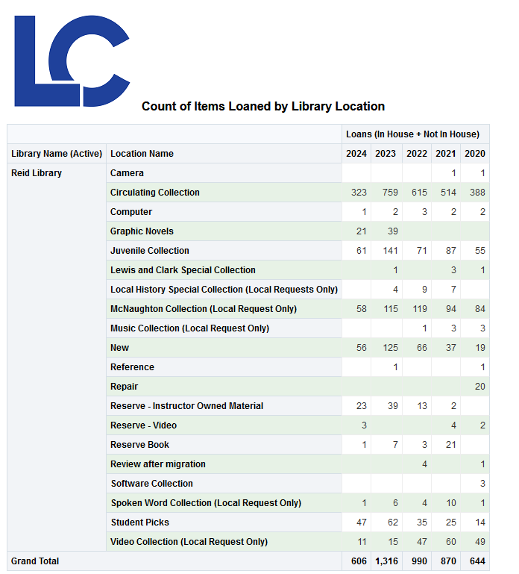
Other useful circulation reports that we use.
ALMA Analytics

Slide 18
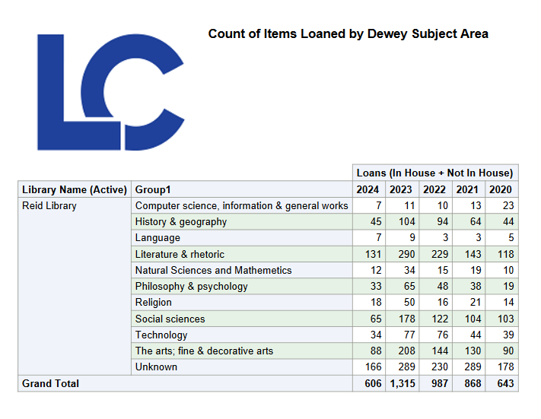
Other useful circulation reports that we use.
ALMA Analytics

Slide 19
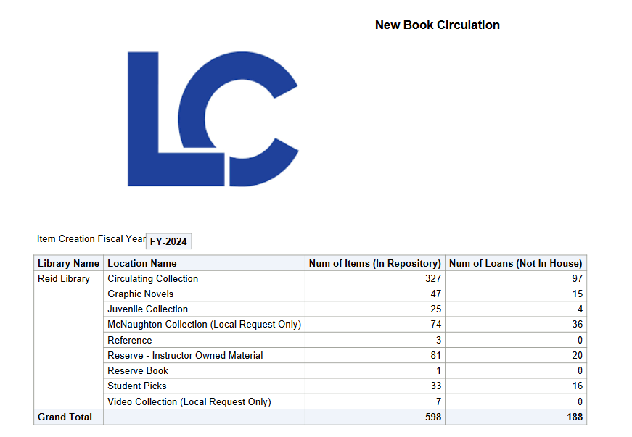
Other useful circulation reports that we use.
ALMA Analytics

Slide 20

No bibliographic data is captured when tracking circulation data in SARS/Blackboard – only that a patron checked-out an item(s). It is completely “firewalled” from Alma to protect patron privacy. Frequencies are not collected either.
SARS/Blackboard Analytics

Slide 21
Thanks!
Dennis Krieb
Lewis & Clark Community College

Slide 22
Analytics, Anonymization, PII Exposure
Anonymization schedule
Minimize PII data used when collecting and reporting
  Sample Report: Patron with Loans 3 Days Previous
  Sample Report: Patron Last Activity Date
  Reports may be found at:
  Shared Folders > Community > Reports > Consortia > CARLI > Shared Reports
Notes:
(Ted)
Thanks Dennis. That’s an excellent example of a partnership with administrative computing staff and using the data sources already available to capture student interactions with library resources.
We wanted to follow that up with some tips and examples of how you might use PII in analytics responsibly with minimum exposure. As a reminder, CARLI’s anonymization schedule will apply to transactions that have been complete for 7 days. We believe this provides sufficient opportunity to review data on transactions that contain personal information, and that if you are collecting data, you should do so promptly rather than saving it all for later.
With the thought of collecting data actively, we wanted to provide a couple example reports that demonstrate ways to minimize exposure of PII data and take anonymization into account in the process. These reports may be found in the CARLI Community Shared folder: The path to these reports is Shared Folders > Community > Reports > Consortia > CARLI > Shared Reports.
By the way, remember to always save local copies of community reports, either to your private folder or your institution's shared reports before beginning to work with the analysis design. This keeps the shared report sharable for others.

Slide 23
Patron with Loans 3 Days Previous
Lists patrons who borrowed items three days previous
  Requires the Fulfillment subject area
  Use data from the Patron Details at Time of Loan dimension
May be useful for:
  Adding context to circ activity
  Measuring interactions and effects on student performance
Notes:
(Ted)
The first example report I have pulls from loan transactions that were started the three day ago. This is inspired by Dennis’ approach to collecting activity by user, as well as by Martin Kong's report demonstrated at our June 6 webinar. Some differences from both include that it captures counts rather than just a yes or no and rather than actual titles and items loaned.
This takes advantage of the existing Loans counters to aggregate transaction counts rather than look at each specific loan, and also uses the Patron Details at Time of Loan dimension to capture what was true of a patron at the time, rather than the current information on a user, which may change as patrons move from undergraduate to alumni or to employee.

Slide 24
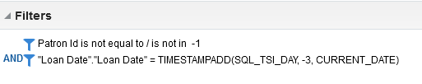
Patron with Loans 3 Days Previous
Filters for Patron with Loans 3 Days Previous
Patron Id (internal Alma user ID) is “-1” if anonymized
TIMESTAMPADD function calculates dates by a given value an a reference date
Could use Return Date instead of Loan Date
Notes:
(Ted)
A look at the filters for this report shows that we’re using some of what we know about how Alma anonymizes transactions. Specifically, the Patron Id field, which is Alma’s internal user identifier and is part of the Patron Details at time of loan dimension, is minus one whenever the transaction has been anonymized. If I select something other than minus one, the results include an identifier related to an active user.
Also, we have selected to run this report by selecting transactions that happened the day before. The TIMESTAMPADD function calculates a new date relative to another date by a certain value. In this case, the current date minus one day. It’s fair to note that we don’t have to use Loan Date. We could choose any other transaction date here. For instance, selecting Return Date as the filter would let us find patron loans completed yesterday.

Slide 25
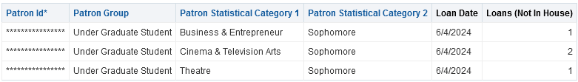
Patron Loans 3 Days Previous
Sample results for Patron Loans 3 Days Previous
Actual results will show Patron Id
Could use User Primary Identifier
Notes:
(Ted)
Here is a sample set of results for this analysis. I mentioned that I used the Patron Id field from Patron Details at Time of Loan. An advantage of using Patron Id is that it is only an internal ID number to Alma. The patron ID field requires reference back to the Users subject area to get personal information; I could also have chosen the User Primary Identifier field if I need to match this data to patrons actual ID in the student information system.
I have used some analytics functional sleight of hand to mask the patron ID for this display. In practice, you would see the actual identifier values rather than asterisks.
An additional thought worth considering is included here, which is the use of statistical categories for patrons. If these are present on a user record at the time of a transaction, Alma records them with the Patron Details at Time of Loan. When present, they offer a way to aggregate and slice data on values other than user group. Some planning is required to use these, as is cooperation from your administrative computing folks to provide those details.

Slide 26
Patron Last Activity Date
List patrons by primary identifier and include Last Activity Date
  Requires only the Users subject area
  Last Activity Date – last occurrence of a loan, return, or request
May be useful for:
  Adding context to circ activity
  Measuring interactions and effects on student performance
Notes:
(Ted)
My next report is based on a sample I found shared by Cal State Fullerton. It identifies the Patron’s Last Activity Date. This is a field in the Users subject area that gets updated any time a patron makes a request, a loan, or a return. In some ways, that makes this a bit of an improvement over my previous analysis, because this doesn’t require me to view any of the patron’s transactions. By showing just an activity date, I’m not touching any records of what resources a patron actually used.
This report could be used to add more context to circulation activity reports, in that you could see unique users who have requested or borrowed at least one item. This also could be used to do something like Dennis’ program, in that a last activity date in a specific time frame could provide the count.
Finally, since this is the Users subject area, it’s not affected by anonymization of transaction details. The Users area is anonymized when user records are purged.

Slide 27
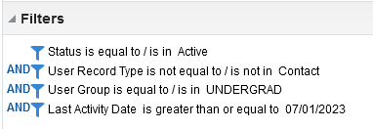
Patron Latest Activity Date
Filters for Patron Last Activity Date
Limiting by user group exposes less of the overall set of data
Notes:
(Ted)
Because this report relies on the users area, showing all active users reveals more information than may be necessary. So, we would likely want to filter the set down by user group, here I’ve chosen undergraduates, and by the last activity date being last July 1st or later. You’ll see I also exclude User Record Types of Contact, as any user created as a Contact will not have any activity, and would just produce noise in report output.

Slide 28
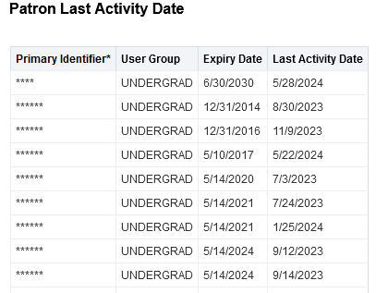
Patron Last Activity Date
Sample results for Patron Last Activity Date
Actual results will show Primary Identifier
Notes:
(Ted)
Here, we see a sample report listing that shows the Primary Identifier, the user group, expiry date, and the last activity date. The primary identifier has been masked for privacy in this demonstration, but in actual use, you would see the primary identifier in the clear.

Slide 29
Daily FTP Reports
Standard reports scripted for delivery to files.carli.illinois.edu
  Lost Items Found Yesterday
  PIDs for users with loans or fines at other I-Share libraries
  User loan counts at other I-Share libraries
  Users with fines at other I-Share libraries
See What's in My Library's FTP directory?

Slide 30
Further Risk Reduction
Minimize exposure to user-specific data
  Consider which roles staff members need
  New user roles for analytics
    Designs Analytics – Fulfillment
  Consider analytics objects instead of providing design roles
Notes:
(Ted)
Finally, we want to remind you that there are other ways to reduce risks related to access to PII. As Jessica mentioned, one of the best ways of managing exposure is by limiting which staff members have access to that data in the first place. Alma staff user roles may be, and should be, assigned only according to a user’s day-to-day operational needs. If a staff member isn’t responsible for lending materials or updating patron records, then a staff member should probably not have any circulation desk roles.
In May, Ex Libris added new roles that extend the same concepts to data in Analytics. There are now three distinct Design Analytics roles to cover separate access to acquisitions, fulfillment, and resource management data. This allows more granular access to the data in these areas, and staff who are qualified and capable to create reports may work with fulfillment data or not based on their authorized responsibilities. You could assign the Designs Analytics – Fulfillment role to only authorized staff. These roles are documented on Ex Libris’ page on Managing User Roles, and there is some configuration work required to enable the granular roles.
<https://knowledge.exlibrisgroup.com/Alma/Product_Documentation/010Alma_Online_Help_(English)/050Administration/030User_Management/060Managing_User_Roles#User_Roles_.E2.80.93_Descriptions_and_Accessible_Components>
Finally, some staff members may not need design roles if they only run reports periodically. For users who are only report consumers, consider creating analytics objects that can be accessed by specific staff or staff roles. These objects may be accessed from the Alma Analytics menu, and they may also be delivered to staff. Martin Kong demonstrated some of this functionality in our Anonymization and Analytics webinar on June 6. You may refer to the recording of that for more information.
With all that said, we’re ready to take your questions and comments.

Slide 31
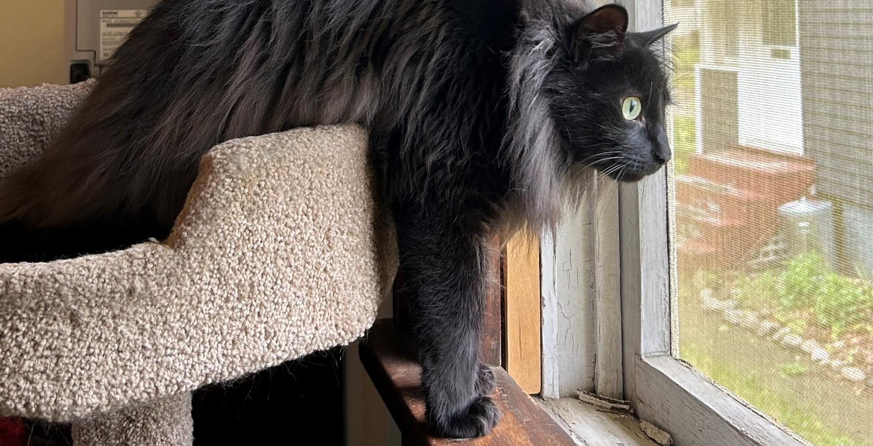
Q & A
Notes:
(Jessica)

