Slide 1
Alma How-to: Alma Anonymization and Analytics
June 6, 2024
Notes:
(Ted)
Welcome to this I-Share webinar about Alma Anonymization and the changes coming to our consortial environment.

Slide 2
Agenda
Overview
Alma fields that will be changed
Alma fields where data moves
How to determine if you run a report that relies on data that will be anonymized
How to schedule a report to run and export automatically
How to download a report and verify that an exported report is working
Notes:
(Ted)
Our agenda for today’s session includes

Slide 3
Alma Anonymization Implementation
CARLI staff and the CARLI Resource Sharing Committee have tested and decided upon several consortial policies for I-Share that optimize the privacy of patron data while balancing the needs of library staff to access these data.
These configurations have been approved by the CARLI Governance Board.
CARLI will enable Alma’s anonymization of user data feature for all I-Share libraries on July 29, 2024.
Notes:
(Ted)
CARLI staff and the CARLI Resource Sharing Committee have tested and decided upon several consortial policies for I-Share that optimize the privacy of patron data while balancing the needs of library staff to access these data for different purposes. These configurations have been approved by the CARLI Governance Board. CARLI staff will implement these policies for all I-Share libraries on July 29, 2024.CARLI will enable Alma’s anonymization of user data feature for all I-Share libraries on July 29, 2024. CARLI staff will set and maintain these configurations in all I-Share IZs. There is no action required on the part of I-Share libraries to configure Anonymization.
There will be no changes to the day-to-day tasks within Alma such as loaning materials or returning materials, either from a local or I-Share perspective. However, as we'll discuss today, anonymization will affect the storage of personally-identifiable information in Alma Analytics.

Slide 4
Overview of Alma Anonymization
Anonymization in Alma removes personal user information from fulfillment transactions (loans, fines/fees, requests) after that information is no longer required for a current transaction and is considered “complete” in the system.
Anonymization in Alma leaves non-patron-identifiable information such as user group and affiliated I-Share institution reportable through Alma Analytics.
Notes:
(Ted)
Anonymization in Alma removes data about a patron's identity from fulfillment transactions--specifically loans, fines/fees, and requests--after that information is no longer required for a current transaction and is considered “complete” in the system. Data that do not identify a patron, such as user group and affiliated I-Share institution, remain available in Alma Analytics for generating statistics.
Once we turn it on, user loan and request data in Alma will be anonymized after a retention period of seven days; while fine and fee data will be retained for seven years.

Slide 5
Evaluation Process
CARLI Staff Investigation
Review of Ex Libris documentation and specifications
Testing transactions in a mini-AFN
Reports before and after anonymization
Alma anonymization removes patron data from transactions
Rows that contained user data still exist with empty fields
Details about what, where, and when remain
Notes:
(Ted)
[Share link on Analytics anonymization <https://knowledge.exlibrisgroup.com/Alma/Product_Documentation/010Alma_Online_Help_(English)/080Analytics/010Introduction/The_Basics_of_Working_with_Analytics/Anonymizing_Alma_Analytics_Report_Details>]
Over the last several months, CARLI staff have been reviewing documentation and testing transactions against analytics to confirm what changes in analytics reports. We have been able to create and follow a series of transactions in the Alma IZs for closed institutions. These transactions allowed us to and test requesting and lending, using both local and automated fulfillment network workflows, to generate analytics reports corresponding to those transactions. We then applied the anonymization policies to those environments, and compared the data in Analytics from after anonymization to the data from before anonymization. In addition to watching for the removal of personally-identifiable information, we wanted to verify that data needed for accurate resource sharing statistics would be retained.
When anonymization rules are applied to completed transactions, Alma modifies existing analytics data by removing only personally-identifiable information from the row of data. Details used for identifying specific users may be made null or changed to a value of –1. Data that may aggregate users, such as user group and statistical categories, are retained.
In practical terms, when you create or view an analysis that combines loan details or request details with user data, you will continue to see the information about the transaction, such as when it was created, which staff created it, what title was involved. However, user details basically appear as empty fields.

Slide 6
Fields That Are Anonymized: Fulfillment
Borrowing Details
PII fields changed to null values
User Linked From Institution fields nullified
User Linked from Other Institution changed to “No”
User Primary Identifier changed to None
Patron Details at Time of Loan
Patron ID changed to “-1”
Patron Job Title changed to internal job category code
Preferred Contact Information
All fields nullified, per transaction
Notes:
Now for a summary of fields that are anonymized. These will also be documented on the CARLI website at < >, so don’t worry about trying to write all these down. For the Fulfillment subject area we have the following.
The borrowing details dimension normally contains information similar to what you find in the Users subject area. In Fulfillment, it is related by the item loan id. When anonymized, all the personally identifiable information will be removed on a per transaction basis. That is to say, if I have three loans that are completed and one loan still active, my information will still appear in the borrowing details information when related to that active loan. However, the three completed loans will no longer be linked to my information after anonymization.
There are three fields in the Borrowing Details area that we didn’t want to see changed, but they do. The User Linked from Institution Code, User Linked from Institution Name and User Linked from Other Institution also change, even though we don’t consider these to be personally identifiable data. If you have reports for resource sharing that count interlibrary lending based on these fields, we recommend updating your report designs.
Similarly, the Patron Details at Time of Loan information is modified such that the Patron ID is changed to a value of “-1”. Interestingly, this is the same effect as if the patron had been purged. Interestingly, the Patron Job Title is also updated, replaced by the corresponding code of the Job Category table in configuration.
Finally, the Preferred Contact Information fields are all changed to null values.

Slide 7
Fields That Are Anonymized: Fines and Fees
User Details (per transaction)
PII fields changed to null values
User Linked From Institution fields nullified
User Linked from Other Institution changed to “No”
User ID changed to “-1”
User Primary Identifier changed to "None"
Preferred Contact Information
All fields nullified, per transaction
Notes:
The Fines and Fees subject area has a similar set of fields that are anonymized.
In this area, the User Details section usually is related to a fine or fee by the fine transaction id. After anonymization, all the personally identifiable information will be removed on a per transaction basis. As before, if I have three fines that are completed and one fine still active, my information will still appear in the user details information when related to that active fine. The three completed fines will no longer be linked to my information after anonymization.
As with fulfillment, the User Linked From Institution fields are modified by the anonymization routine, and identifiers are changed to minus one or None accordingly.
Also, the Preferred Contact Information fields are all changed to null values. As well.

Slide 8
Fields That Are Anonymized: Borrowing Requests
Requester
PII fields changed to null values
User Linked from Other Institution changed to “No”
User Primary Identifier changed to None
Borrowing Request Details
Borrowing Request Status updated to "Deleted"
Is Filled value is changed to “No” if previously “Yes”
Notes:
The Borrowing Requests subject area in Alma Analytics records the requests that my institution’s patrons place for another I-Share library’s materials.
Within the Borrowing Requests subject area, the Requester dimension/field group has the most changes following anonymization; this dimension normally contains information similar to what you find in the Users subject area.
When anonymized, all the personally identifiable information will be removed on a per transaction basis. That is to say, if I have three requests that are completed and one request still active, my information will still appear in Requester information when related to that active borrowing request. However, the three completed borrowing requests will no longer be linked to my information after anonymization.
There are two fields in the Borrowing Request Details area that we didn’t want to see changed, but they do. The Borrowing Request Status field is updated to “Deleted” and the “Is Filled” value is changed to “No” if it was previously set to “Yes.”

Slide 9
Fields That Are Anonymized: Requests
Requester
PII fields changed to null values
User ID is changed to -1
User Primary Identifier changed to None
More to come…

Slide 10
Alma fields that need to be updated in reports
What are the fields that need to be changed?
Fulfillment > Borrower Details >
User - Linked From Institution Code
User - Linked From Institution Name
User - Linked From Other Institution (Yes/No)
These fields:
Contain borrowing institution data
Will be anonymized
Need to be updated to different fields in your Alma Analytics reports

Slide 11
Alma fields that need to be updated in reports
What are the fields that I should use instead?
Fulfillment > Loan Details >
Loans - Linked From Institution Code
Loans - Linked From Institution Name
Loans - Linked From Other Institution (Yes/No)
These fields:
Contain borrowing institution data
Will not be anonymized
Use these fields in your Alma Analytics reports to ensure accurate data

Slide 12
Alma fields that need to be updated in reports
What do I need to do?
Before anonymization is turned on:
Check for these fields in any reports that use the Fulfillment subject area
Update the fields if needed

Slide 13
Alma fields that need to be updated in reports
Important notes about these fields
For the “User – Linked from” fields:
After anonymization, fulfillment reports with these fields requesting data between June 24, 2020 - March 6, 2021 will appear to be local transactions when they are not
For the “Loans – Linked from” fields:
Due to analytics limitations, transactions between June 24, 2020 - March 6, 2021 will have no data reported
You can contact CARLI support if you need this data in the future.

Slide 14
How to determine if you run a report that relies on data that will be anonymized?
CARLI Office staff are responsible for updating the reports that we provide to member libraries as part of the Annual Statistics Package.
Consortial statistics posted to the CARLI website each fiscal year. https://www.carli.illinois.edu/products-services/i-share/stats
Individual statistics provided to each Institution. https://www.carli.illinois.edu/products-services/i-share/stats/almastatspck
Notes:
(Debbie)
Firstly, CARLI Office staff are responsible for updating the reports that we provide to member libraries as part of the Annual Statistics Package. This includes the Consortial statistics posted to the CARLI website each fiscal year as well as the individual statistical reports Individual statistics provided to each Institution. These are not reports that your library needs to worry about when determining if you run a report that relies on data that will be anonymized.
For the majority of these reports, the statistics are reported in aggregate. They do not include the personally identifiable information of individual patrons.
We will update a few of the reports where we were calculating those aggregate values on a field that will now be null or modified after anonymization, but the data that is output by the reports should remain the same.
So, if these reports are on your list of reports in use by your institution, you do not need to worry about these.

Slide 15
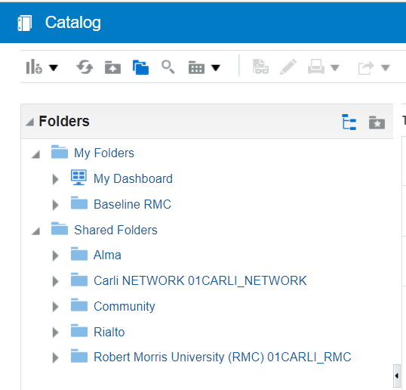
How to determine if you run a report that relies on data that will be anonymized?
Compile a list of the Analytics reports in use:
Depending on your responsibility, this may be those reports that are:
Used as part of your workflows and data reporting.
Used by colleagues as part of their workflows and data reporting.
Alma Analytics folder navigation menu
Notes:
(Debbie)
You will want to compile a list of the Analytics reports in use- this will be the hardest part, finding out which reports you or others use. Whether you are only responsible for the reports that you use yourself, or for assisting your colleagues, will depend on your role at your institution.
You may have reports that are automatically generated for you through the use of Alma’s Scheduled Reports (my colleague Martin will talk about this in detail later in this presentation).
You may have reports saved to your personal folder in Alma Analytics.
You may have reports save to your institutional folder in the Analytics Shared Folders directory.
Also from the Shared Folders, you may be using reports shared more broadly by CARLI, or from the Analytics Community Folder, or by Ex Libris in the Alma folder.

Slide 16
How to determine if you run a report that relies on data that will be anonymized?
Remember that Anonymization will affect only “complete” transactions:
Those where the loaned item is returned.
The fine/fee is waived or paid.
The request has finished its process.
Anonymization will not affect transactions that are NOT YET complete.
Examples:
Overdue and lost items (these are still on loan, so not yet “complete”).
Fines/fees that are still owed by the patron.
Notes:
(Debbie)
Remember that Anonymization will affect only “complete” transactions:
Those where the loaned item is returned.
The fine/fee is waived or paid.
The request has finished its process.
Anonymization will not affect transactions that are NOT YET complete.
Examples:
Overdue and lost items (these are still on loan, so not yet “complete”).
Fines/fees that are still owed by the patron.

Slide 17
How to determine if you run a report that relies on data that will be anonymized?
Remember that Anonymization removes patron identifiable information related to loan transactions, fines and fees, and both internal/local requests and I-Share requests.
This data is located in these Alma Analytics Subject Areas:
Fulfillment
Fines and Fees
Requests (includes all types of requests placed on your library’s items where a user record is recorded)
Borrowing Requests
If your report does not include these data, it should be unaffected by Anonymization.
Notes:
(Debbie)
Remember that Anonymization removes patron identifiable information related to loan transactions, fines and fees, and both internal/local requests and I-Share requests.
This data is located in the Alma Analytics Subject Areas:
Fulfillment
Fines and Fees
Requests (includes all types of requests placed on your library’s items where a user record is recorded)
Borrowing Requests
If your report does not include these data, it should be unaffected by Anonymization.
Remembering that Anonymization will affect only the subject areas involving patron data will narrow down the number of reports that you will need to review for affected fields.

Slide 18
How to determine if you run a report that relies on data that will be anonymized?
Of the reports that you compile, narrow your list to those that include “complete” transactions in the analytics report results.
Examples:
Count of physical library materials each individually-identifiable patron checked out during the fiscal year. (count includes returned items; count is for an identifiable individual and not in aggregate)
List of patron names who have checked out materials from the Special Collections for in-house use. (results include returned items; results tie patron to borrowed titles)
List of purchase requests placed by an individual patron, after the request is complete; the material is received and cataloged.
Notes:
(Debbie)
Of the reports that you compile, narrow your list to those that include “complete” transactions in the analytics report results.
These are the reports that you will want to review.

Slide 19
How to determine if you run a report that relies on data that will be anonymized?
Of the reports that include “complete” transactions in the analytics report results, do you need to collect and maintain this data?
Notes:
(Debbie)
Of the reports that include “complete” transactions in the analytics report results- ask yourself- do you need to collect and maintain this data?
If yes, that is okay, and my colleague Martin will have more information on exporting data pre-anonymization this later in the presentation.
If not, prepare additional workflows for post-anonymization processes.

Slide 20
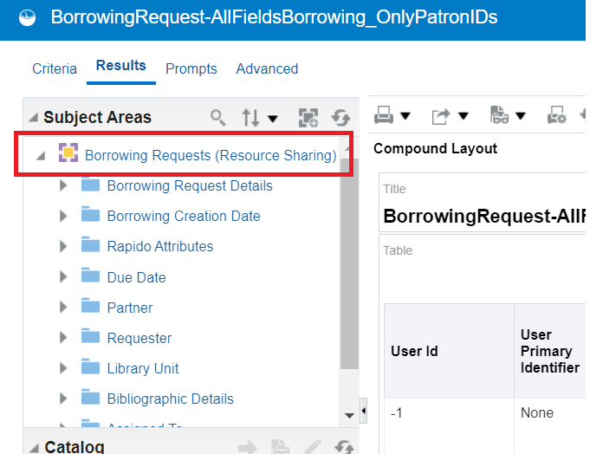
How to determine if you run a report that relies on data that will be anonymized?
The majority of Analytics reports use only one Analytics Subject Area.
(It is possible someone at your institution wrote a complex Analysis that uses a subquery to provide additional details pulled from within a second subject area; in this case, you would want to review both the main query and the subquery.)
Selecting to Edit the report in Analytics will display which Subject Area the report uses for its data.
Alma Analytics Subject Area navigation menu
Notes:
(Debbie)
The majority of Analytics reports use only one Analytics Subject Area. (It is possible someone at your institution wrote a complex Analysis that uses a subquery to provide additional details pulled from within a second subject area; in this case, you would want to review both the main query and the subquery.)
You can then double-check whether the subject area used is one of the four affected by Alma’s Anonymization.

Slide 21
How to determine if you run a report that relies on data that will be anonymized?
To determine if the fields used in the report will be affected by anonymization, compare the “Alma Anonymization: List of Fields Modified by Anonymization” https://www.carli.illinois.edu/products-services/i-share/alma-fulfillment/anonymization/Anonymization_Analytics_Fields
Notes:
(Debbie)
To determine if the fields used in the report will be affected by anonymization, compare the “Alma Anonymization: List of Fields Modified by Anonymization”

Slide 22
How to determine if you run a report that relies on data that will be anonymized?
You can do the comparison visually from the “Criteria” tab:
Alma Analytics Criteria tab and Selected Columns
Notes:
(Debbie)
You can do this comparison visually from the “Criteria tab” to review the selected fields.
However, if someone at your institution is fancy with their Analytics, it is possible that they have renamed the way that the field names display on the screen, and it can be tedious to double-check the column properties for each selected field.
As such, I like to do some additional review from the Advanced tab.

Slide 23
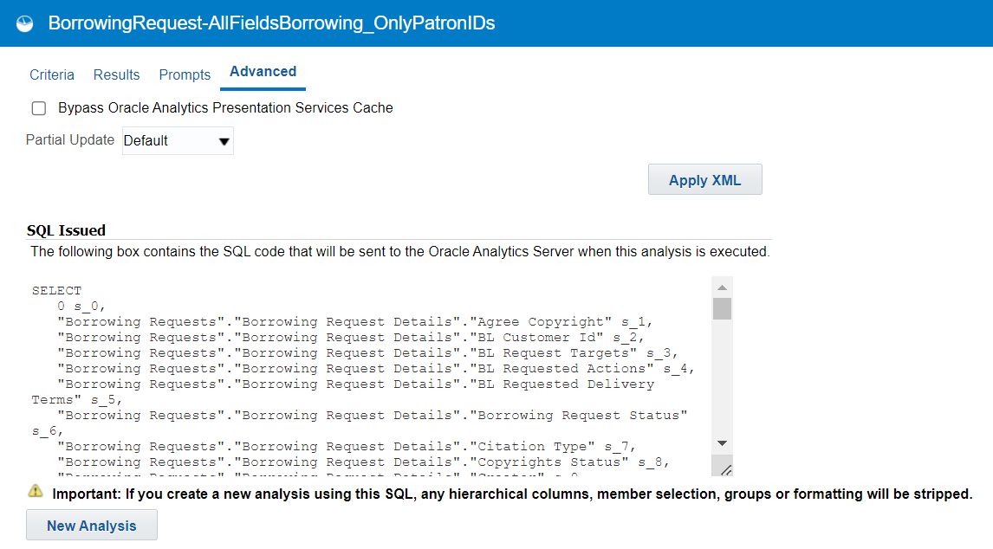
How to determine if you run a report that relies on data that will be anonymized?
You can also do the comparison using the SQL on the Advanced tab:
Alma Analytics Advanced tab and SQL
Notes:
(Debbie)
I carefully copy the SQL out into a notepad document (or other such software). If the field has been renamed, the SQL will still include reference to the true field name from within Analytics.
Over the next week, CARLI staff will add the field list as they are displayed in the SQL to the “Alma Anonymization: List of Fields Modified by Anonymization”, website, so that you can more easily use the “find” functionality within your favorite office productivity software, if desired.

Slide 24
How to determine if you run a report that relies on data that will be anonymized?
You can contact CARLI support and set up a meeting where we’ll review any Analytics reports you have questions about together via Zoom/Teams.
Send and email to support@carli.illinois.edu to schedule a meeting.
Notes:
(Debbie)
You can contact CARLI support and set up a meeting where we’ll review any Analytics reports you have questions about together via Zoom/Teams.
Send and email to support@carli.illinois.edu to schedule.

Slide 25
Scheduling a report to run and export automatically
Background:
Capture the number of items that local students have checked out from your collection before the data is anonymized in 7 days;
This may be useful to determine if there is a correlation between library material use and academic performance.
Forthcoming demonstration:
Create an Analytics object to schedule a daily report that captures the total number of loans for local patrons who checked out a local item 3 days ago
Three-day time period is necessary due to the delay in transferring of data from Alma to Analytics.
Notes:
(Martin)
Here is a scenario for why one might want to schedule an automated report:
Capture the number of items that local students have checked out from your collection before the data is anonymized in 7 days;
This may be useful to determine if there is a correlation between library material use and academic performance.
Forthcoming demonstration:
Create an Analytics object to schedule a daily report that captures the total number of loans for local patrons who checked out a local item 3 days ago
The three-day time period is necessary due to the delay in transferring of data from Alma to Analytics.

Slide 26
Scheduling a report to run and export automatically (continued)
Some things to note:
The properly configured query/analysis should already be created in Alma Analytics and available for use. The demonstration will focus on how to schedule a report in the Alma Analytics Object list and will not include how to create the underlying Alma query/analysis.
The report scheduled from the Alma Analytics Object list will be sent via FTP to the CARLI Files server for your institution.
Note: The CARLI Files server only keeps files for 60 days before they are automatically deleted – so regular downloading of the exported report files is necessary.
Recommendation: download the files once a month (~30 days).
Notes:
(Martin)
Here are some things to note:
The properly configured query/analysis should already be created in Alma Analytics and available for use. The demonstration will focus on how to schedule a report in the Alma Analytics Object list and will not include how to create the underlying Alma query/analysis.
The report scheduled from the Alma Analytics Object list will be sent via FTP to the CARLI Files server for your institution.
Note: The CARLI Files server only keeps files for 60 days before they are automatically deleted – so regular downloading of the exported report files is necessary.
Recommendation: download the files once a month (~30 days).

Slide 27
Downloading and verifying the exported reports are working
Forthcoming demonstration:
How to download the exported Analytics Object reports from the CARLI files / FTP server
How to verify that a delivered report contains data.
Link to the CARLI documentation page that explains how to schedule a report as an automated export, how to download the exported report from the FTP server, and how to verify that an exported report is working:
https://www.carli.illinois.edu/products-services/i-share/alma-fulfillment/anonymization-schedule-report-autorun-autoexported-download-verify
Notes:
(Martin)
The forthcoming demonstration will also include:
How to download the exported Analytics Object reports from the CARLI files / FTP server
How to verify that a delivered report contains data.
Here is a link to the documentation page that explains the process that I will be demonstrating today.
I will now switch to the live demonstration of these processes.

Slide 28
Upcoming Webinars and Training
Alma How-To: Reporting and Anonymization – Monday, June 10, 2024, 11:00 AM – 12:00 PM
CARLI staff and Dennis Krieb from Lewis and Clark Community College will discuss using reporting data for institutional purposes (and in light of Anonymization)
Notes:
(Ted)
One more webinar is scheduled to help I-Share libraries prepare. Registration is required, and the sessions will be recorded and posted to the CARLI website.
On June 10th, CARLI staff and Dennis Krieb, Director of Library Services at Lewis and Clark Community College, will discuss using reported data from Alma for institutional purposes, and how this can be accomplished with Alma Anonymization in place.

Slide 29
Q & A
Notes:
(Martin)

