Slide 1

Adding a Report a Problem Button to Primo
Evan Barber (He/Him)
IT Technical Associate

Slide 2
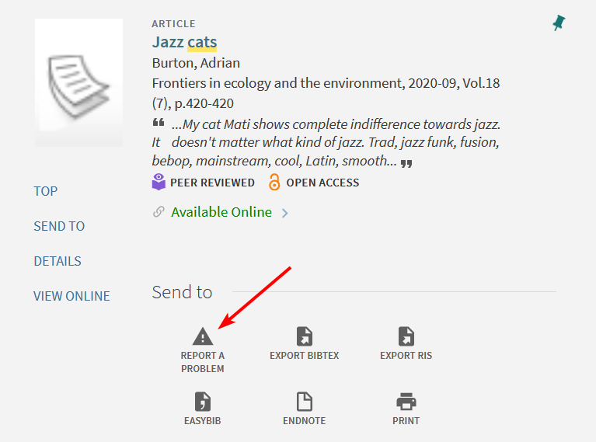
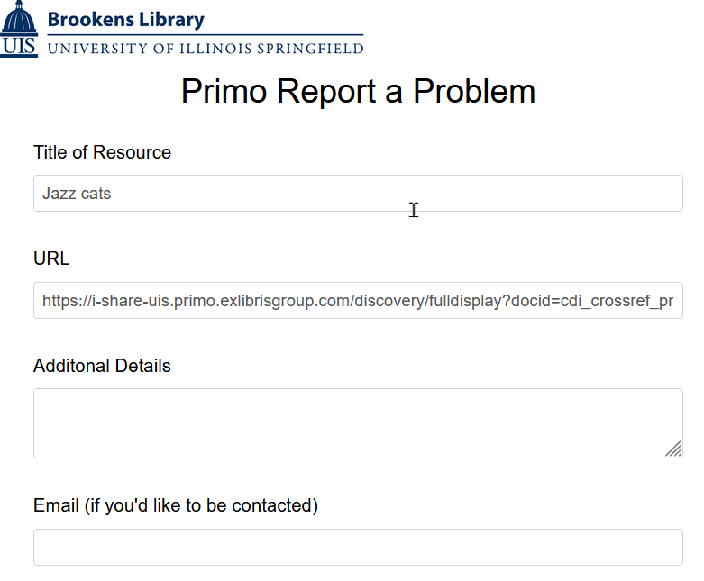
Report button with Automatic Info capture

Slide 3
Acknowledgements
Orbis Cascade Alliance
  https://github.com/alliance-pcsg/primo-explore-custom-actions
Paxton Luangnikone
  UIS Library Systems Student
Notes:
Credit to Orbis Cascade Alliance for doing this work and Paxton for tweaking the code and getting it to work with our system.

Slide 4
What You’ll Need
Ability to edit your Primo view
  Role: Discovery – Administrator
LibWizard
  You can do this with other services too
Basic coding experience
  Copy, paste, edit

Slide 5
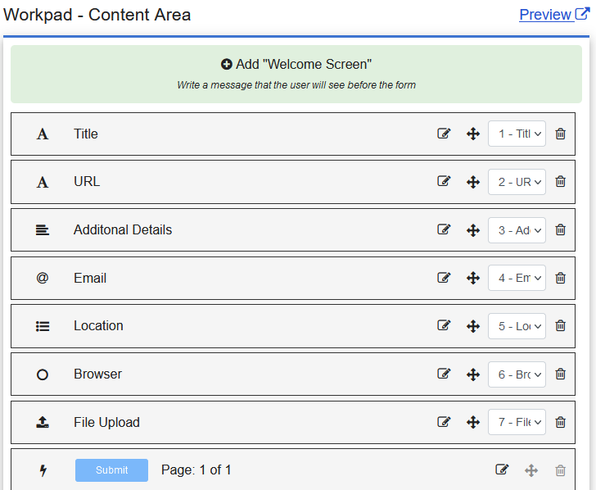
Making your LibWizard Survey:
Add fields
Add the fields you’d like to display for the user

Slide 6
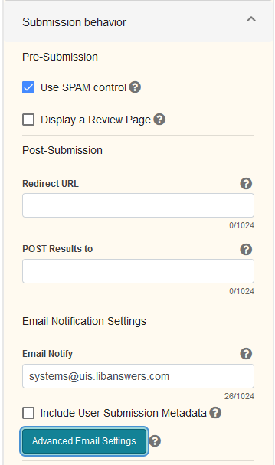
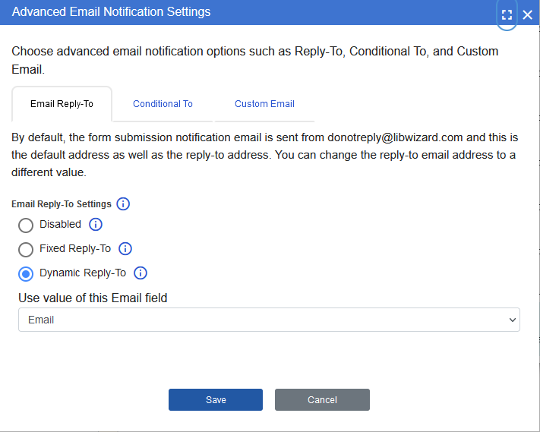
Making your LibWizard Survey:
Set Submission Behavior
I have submissions going to our LibAnswers queue but you can have yours go to a regular email.
Under Advanced Email Settings I’ve set the reply-to to be the email the user entered into the form so it’s easier to respond.

Slide 7
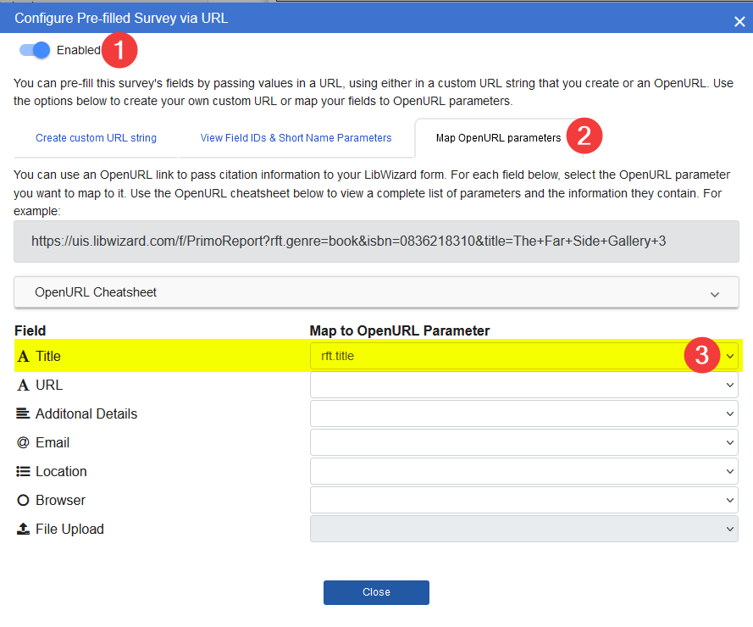
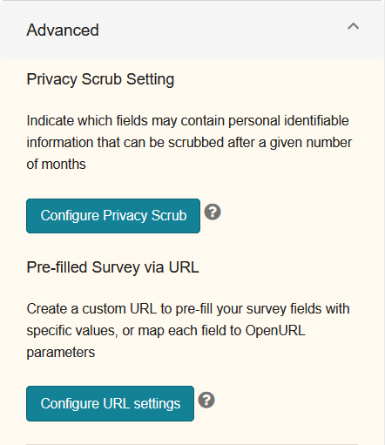
Making your LibWizard Survey:
Configure URL Settings
Under the Advanced section click Configure URL Settings and toggle it to enabled
On the Map OPENURL Parameters tab
Map title (or whatever your appropriate field is called) to rft.title

Slide 8
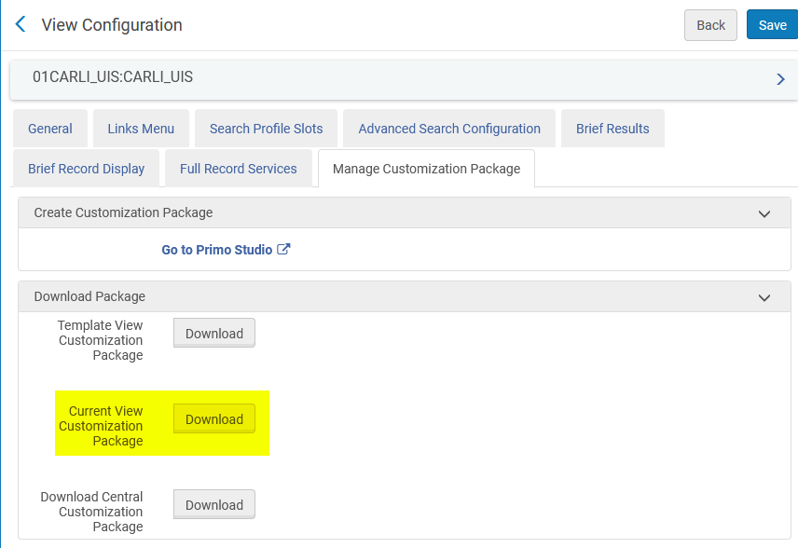
Download your Customization Package
Login to Alma.
Navigate to Discovery > Display Configuration > Configure Views.
Click the three dots to edit your view.
Navigate to Manage Customization Package > Download Package.
Download the Current View Customization Package .zip file.

Slide 9

Editing Custom.js
Unzip the file and navigate to 01CARLI_ZZZ-CARLI_ZZZ > js > custom.js
Add the custom action code to the top of the custom.js file
Locate the var app = line and add 'customActions' after 'angularLoad'
  var app = angular.module('viewCustom', ['angularLoad', 'customActions']);
Add button code and edit it to add your URL

Slide 10
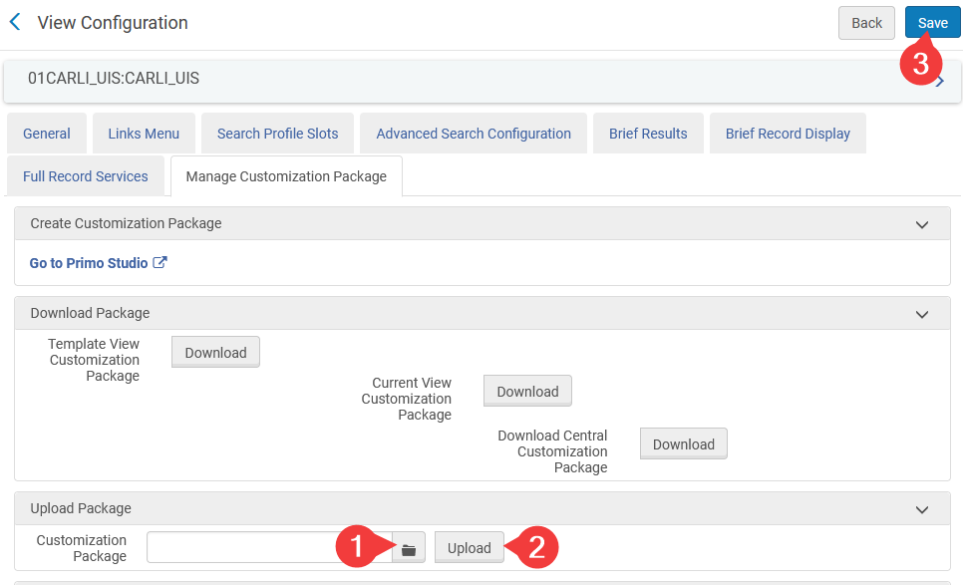
Adding the Button to Primo:
Right-click on the root folder (01CARLI_ZZZ-CARLI_ZZZ) of the package and navigate to Send to > Compressed (zipped) folder to compress the customization package.
In Alma go to Configuration > Discovery > Display Configuration > Configure Views > [3 dot Button of the current default view] > Edit > Manage Customization Package
Under Upload Package > Customization Package, click the folder icon to select to zipped package.
Click Upload, then click Save (Alt + S) to deploy the new customization package.

Slide 11
Test
Your new report a problem button should now appear in Primo.
Verify everything is working as it should be.

Slide 12
Troubleshooting
If have problems uploading the .zip file make sure your structure is correct:
  ZipNameMMDDYY.zip
    01CARLI_ZZZ-CARLI_ZZZ
      css
      html
      img
      js
For other problems view the UIS sandbox to see how it’s implemented and check your code against it.
  UIS Alma Sandbox
  UIS Primo Sandbox

Slide 13
Thanks!
Evan Barber
  ebarb2@uis.edu
Materials
  Code available on CARLI site
  Presentation available on office hours page

