Slide 1

Adding a New Library in Alma
CARLI Lab Reports
Stacey Knight-Davis and Bill Schultz
Eastern Illinois University
December 16, 2021

Slide 2
The Original CSI in Alma
Location in Booth Library
Shared an Alma Circ Desk
Shared Hours
Has fines
Has non-standard overdue days until item lost

Slide 3
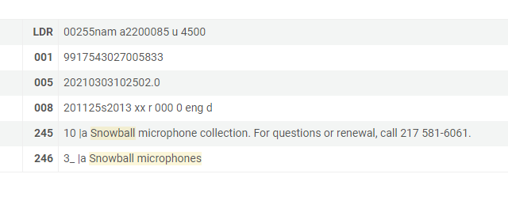
Initial Challenges…
Created bib records and added inventory for various collections of technology equipment
Some items have many “pieces”
Records based on models created pre-Alma
Example:

Slide 4
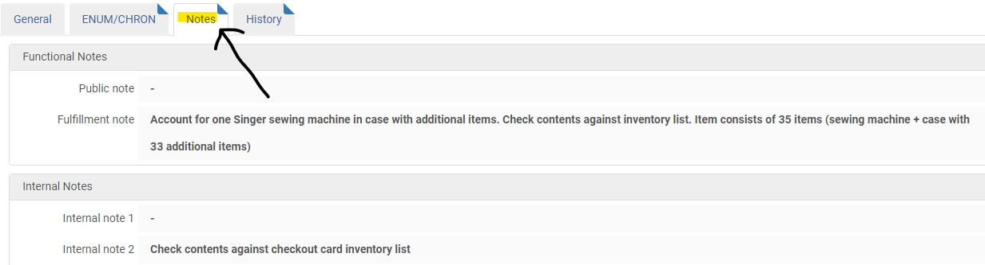
Item Record

Slide 5
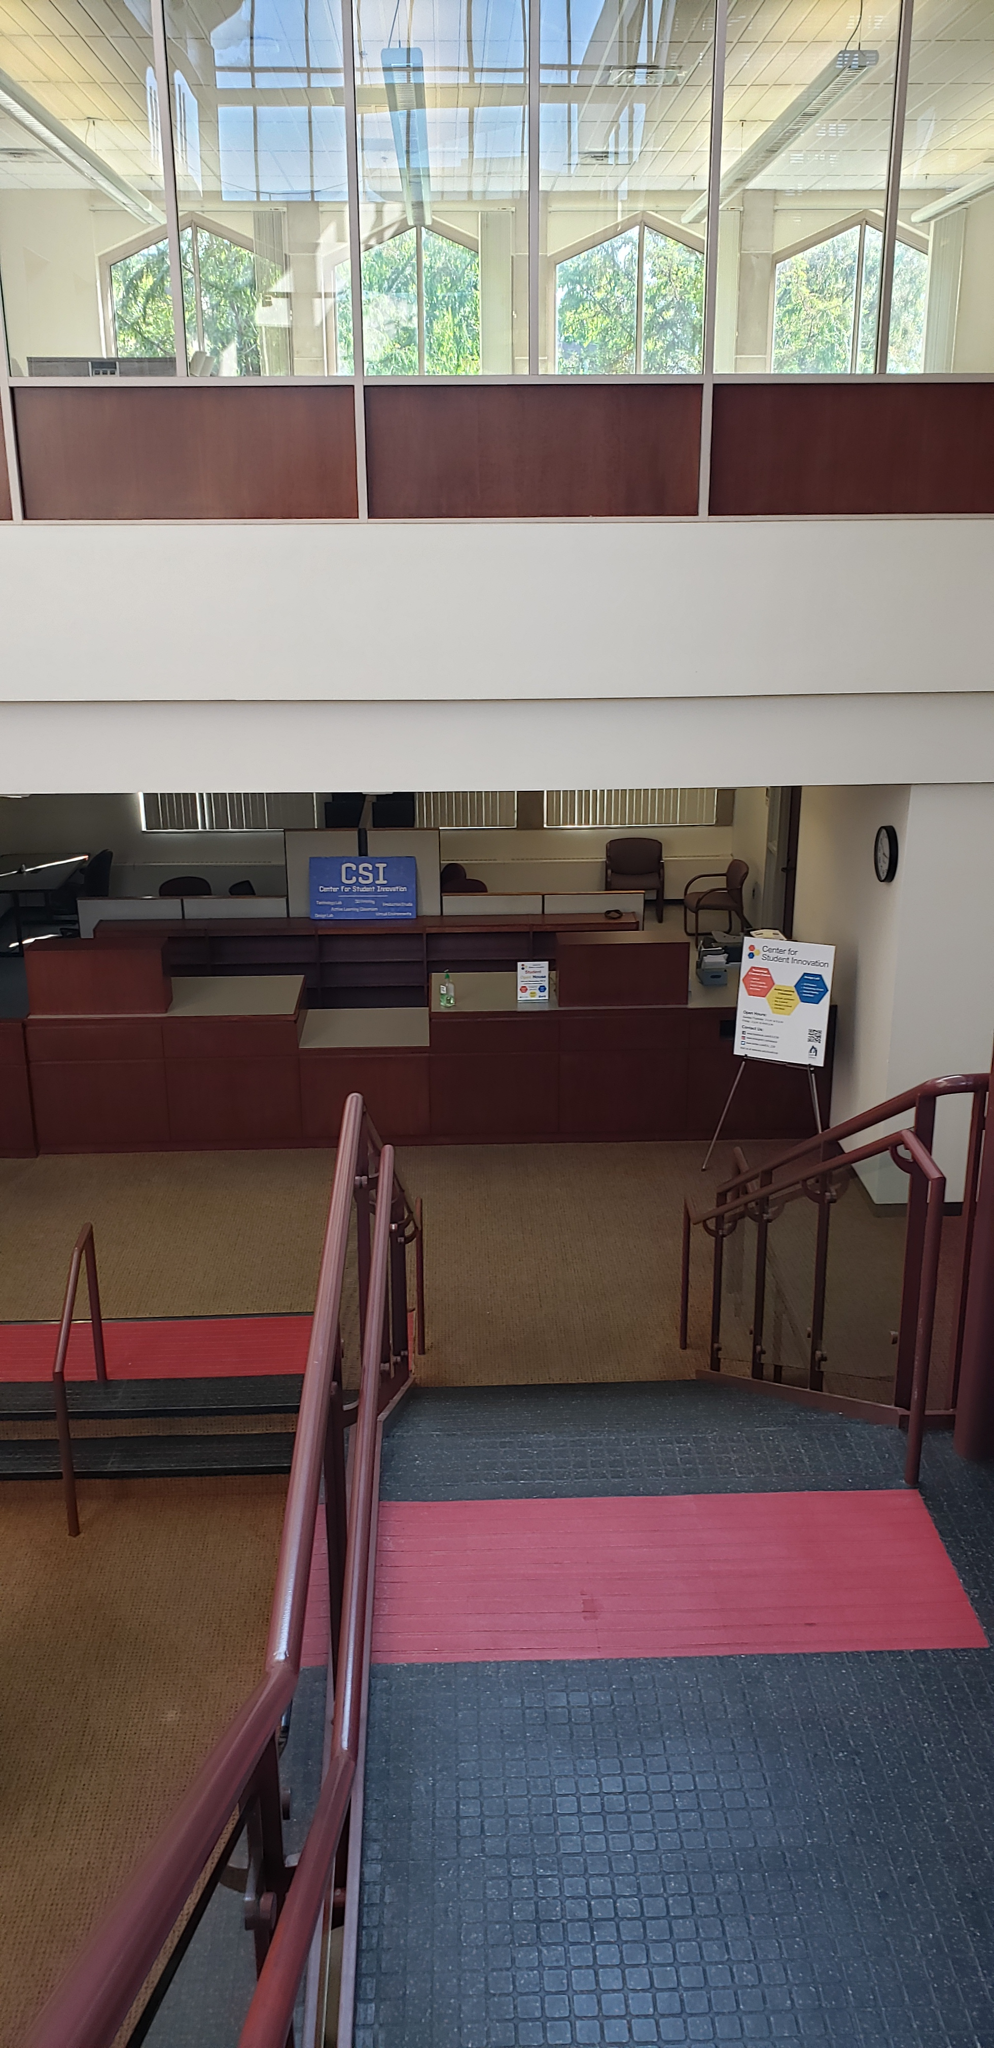
Splitting off the CSI
CSI desk is closed Saturdays
Needed due dates to adjust for closed dates
Separate Circ Desk and Roles

Slide 6
“Building” the New Library
Thank you Debbie!
Tasks –
Create Library
Set Relationships to Institution and Other Library
Set hours
Create Circ Desk
Set User Roles
Create Location
Assign Rules
Moving CSI inventory
Update reports with new location

Slide 7
Sysadmin Rule 1:
If you can’t confidently visualize data flows into and out of the system, do not make changes.

Slide 8
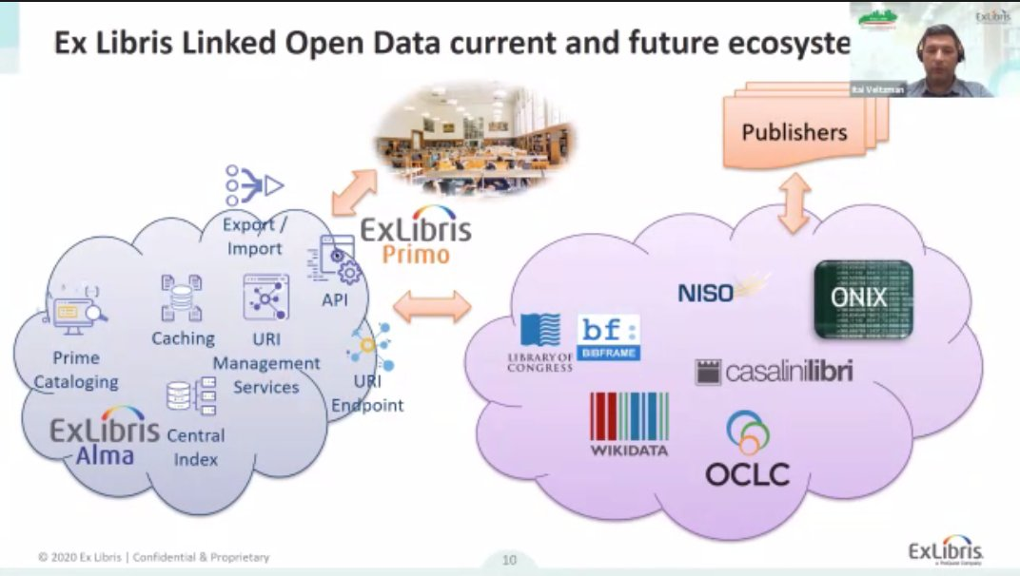

Visualizing Alma, the Wrong Way

Slide 9
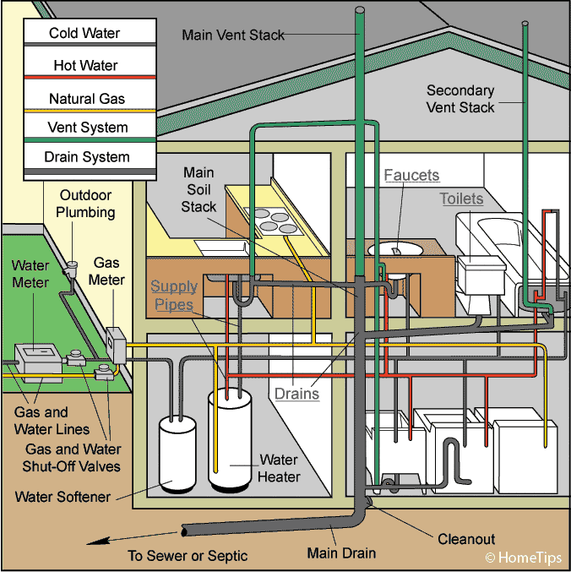
Alma as Plumbing – A Metaphor
Stuff flows in
Stuff is modified
Stuff flows out
So many possible failure points
Functional failure is possible – broke but works

Slide 10
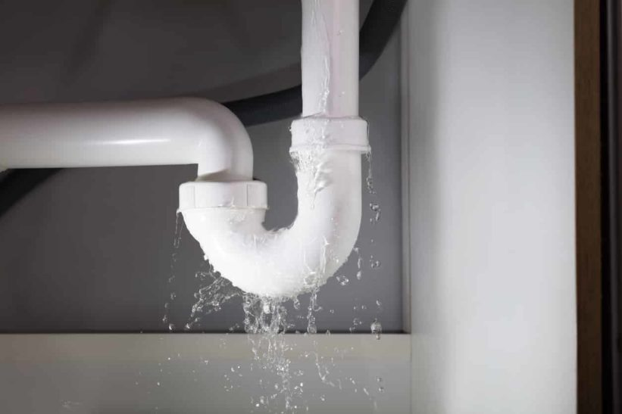
Warning Signs and What Broke
Reports didn’t match Overdue and Lost Job report
Nothing was going overdue
No fines accruing
Overdue and Lost profiles tied to old location. Did not run

Slide 11
Fulfillment Cleanup
Find Lost
Checkout date > 42 days ago
"Due Date"."Due Date" <= TIMESTAMPADD(SQL_TSI_DAY, -42, CURRENT_DATE)
Find Overdue with 2 Day’s Grace
"Return Date"."Return Date" - "Due Date"."Due Date" >2
Run variations of location and/or policy to catch all

Slide 12
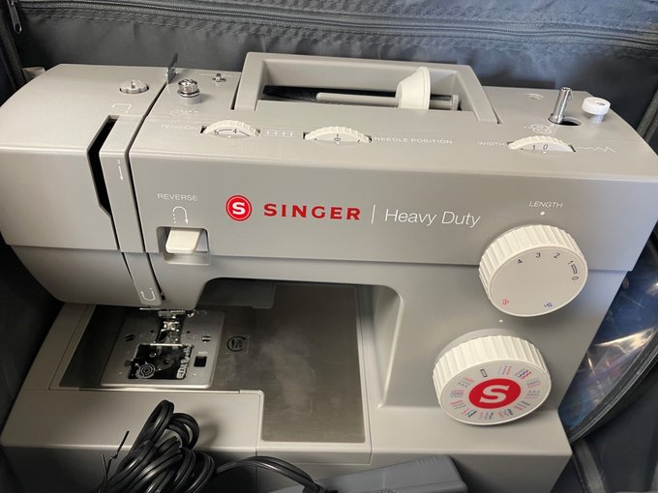
Item Policy and Rules Cleanup
New CSI Equipment
Hello, new sewing machine
Item policy in item record?
Fulfillment rules matter!
Fulfillment Configuration Utility
[Fulfillment>Advanced tools>Loans>
Fulfillment Configuration Utility] … (thanks, Ted!)

Slide 13
How to do it Better
Expect problems
Constant Vigilance!
Have reports ready, check daily
Days overdue
Users with fines
Items with lost status
Item count by location

