Slide 1
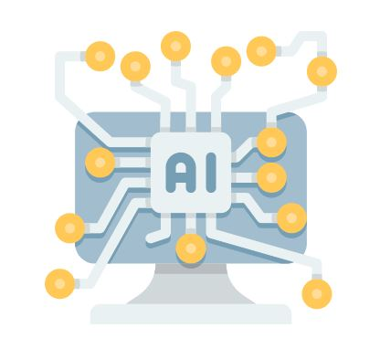
AI Literacy is not Endorsement
Navigating Trust, Pedagogy, and a Polarized Campus in AI Instruction
Robin Harris & Lisa Wallis, NEIU Libraries
CARLI Instruction Showcase / June 4, 2026

Slide 2


Who we are
Robin Harris, MLIS
Information Services Librarian
Lisa Wallis, MSLIS, MSPH
eResources & Systems Librarian / Professor
* Because it’s relevant today
Roles
OER Cmte co-chair
FYE librarian
CTL liaison
* Because it’s relevant today
Member of
NEIU Info Security Cmte
NEIUPI Exec Board
NEIU AI Institute team
Notes:
Each of us gives intro
We are here today to talk about what happens when a routine library instruction initiative accidentally drops you directly into a campus-wide debate.

Slide 3
By the end of this session, you will be able to…
Teach AI literacy without being mistaken for an AI evangelist.
Strategies for framing AI instruction as an extension of core information literacy values, not a technology endorsement.
Get out of the library bubble.
How faculty relationships and cross-disciplinary dialogue can ground and legitimize your AI instruction efforts.
Articulate that critical evaluation and endorsement are not the same thing.
What librarians specifically bring to AI instruction, and why that matters if your motives are questioned.
Notes:
Robin
The Catalyst: How our 2025 workshop sparked unexpected campus reactions.
The Response: The structural tools we built to establish trust and neutrality.
The Takeaways: Replicable strategies for your own institution.

Slide 4
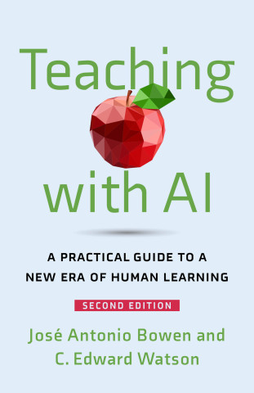
How it started…
Joined CTL's "Teaching with AI" book club in Fall 2024
Faculty from across disciplines with a wide range of views
Some felt that any student use of AI was plagiarism.
Others had already firmly embraced it and redesigned assignments around it.
Many were somewhere in the middle, uncertain and looking for more info.
We provided a neutral source of information and help dispel some misinformation about AI and AI literacy.
Notes:
Our origin story Robin

Slide 5
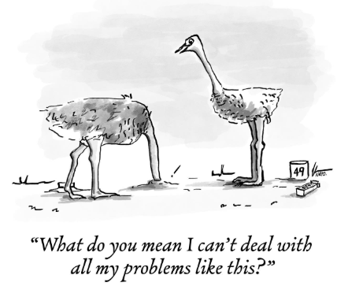
Reading the room and claiming our seat at the table
AI questions increasing at the reference desk and in research consultations.
Students already using AI, but reluctant to say so. Faculty could no longer ignore it.
Librarians talk across disciplines. We began to see patterns.
Campus AI conversations were being led with a focus on efficiency, financial opportunity, quick integration.
Ethics, information integrity, bias, privacy, equity, copyright, etc. were largely absent.
AI literacy is an extension of information literacy. This is our professional expertise. We needed a voice in this conversation.
Notes:
Our origin story Robin

Slide 6
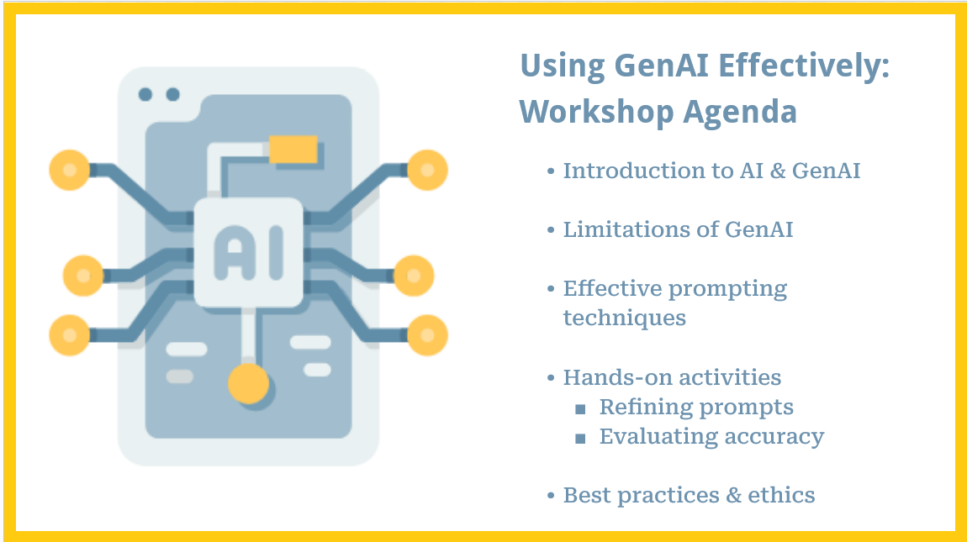
From conversation to action
CTL invited participants to develop a formal action plan for integrating AI into teaching.
We developed a 45-minute workshop: “Using GenAI Effectively: Prompt Generation.”
Tailored advertising for students and for faculty.
Notes:
Our origin story Robin

Slide 7
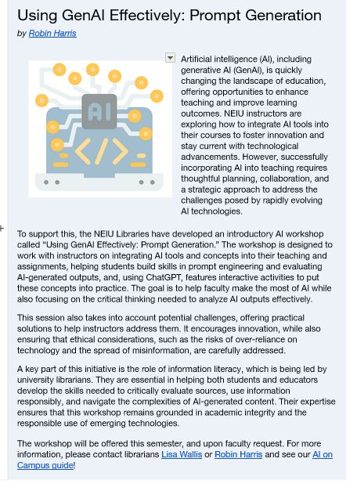
“...incorporating AI into teaching requires thoughtful planning, collaboration, and a strategic approach to address the challenges posed by rapidly evolving AI technologies.”
“... also ensuring that ethical considerations, such as the risks of over-reliance on technology and the spread of misinformation, are carefully addressed.”
…our expertise ensures that this workshop remains grounded in academic integrity and the responsible use of emerging technologies.”
Notes:
Robin
From our perspective, this wasn't a technology endorsement. It was traditional critical thinking applied to a new medium.

Slide 8
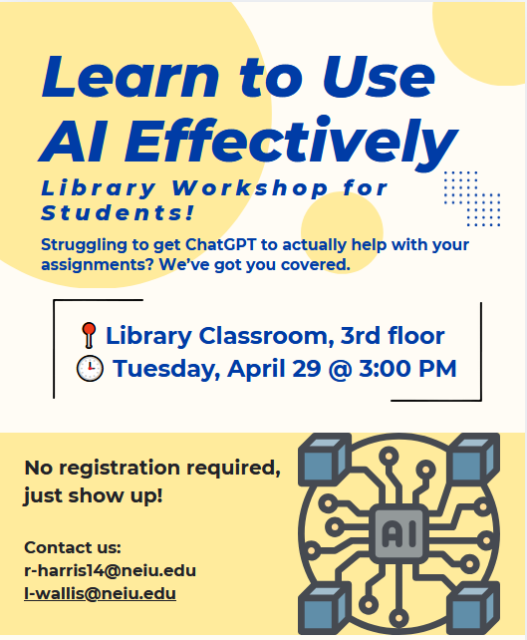
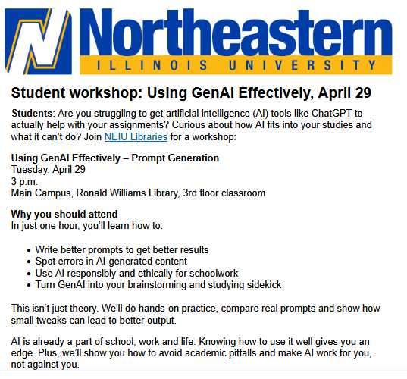
Notes:
Robin
From our perspective, this wasn't a technology endorsement. It was traditional critical thinking applied to a new medium.

Slide 9
Faculty and student assumptions
We did not anticipate that our workshop would be controversial!
“The library wants to teach us how to cheat!”
-> did not attend
–Student to their instructor after seeing our workshop announcement
The underlying tension
Librarian-led AI literacy instruction implicitly legitimizes AI use.
“Would it be OK for me to attend this workshop as well? Faculty in my department would like to hear how students are getting instructed regarding AI. Instead of a bunch of us attending, it would just be me and I would report back.”
-> did not attend
--Faculty Member after seeing our student workshop invitation
Notes:
Robin and Lisa
The reality check: Outside the cozy confines of the book club, the broader campus wasn't on the same page.
Some faculty misread the announcement as the library handing out cheating tutorials. Students assumed they were getting a shortcut tool.
You quickly realized that teaching the technology required navigating the perception of the technology.
Mention how a simple announcement was misread by some faculty as a wholesale endorsement of AI.
Talk about the spectrum of faculty panic you observed—ranging from those who wanted total bans to those who were secretly using it but afraid to admit it.
Zoom Interaction Tip: Ask the audience via chat: "Have your library's AI efforts ever been misconstrued as an endorsement to cheat? Type Yes or No in the chat." (Spend 30 seconds reacting to the chat flood).

Slide 10
In the meantime…
Campus-Wide
Information Security Committee
Campus IT staff would prefer to deactivate and block any AI services due to security concerns.
Labor Negotiations
Campus chapter of UPI
AI is a threat to working conditions for bargaining unit members and must not be imposed by Administration.
Pedagogical Initiatives
AAC&U AI Institute (CTL)
GenAI Position Statement ->
GenAI Grounding Principles
Disciplinary split
Tell us what to do! [about student AI use]
Notes:
Lisa
While you were managing the immediate fallout of your workshop, massive parallel conversations were happening across campus.
Campus IT was looking at infrastructure, privacy, and security.
The Faculty Union was raising labor and academic integrity anxieties.
The CTL was trying to manage pedagogical panic.
The Core Insight: This slide proves your abstract's thesis: AI literacy instruction does not happen in a vacuum. The library was operating in a highly charged, highly contested political ecosystem.
While we were reacting to these individual assumptions, massive parallel conversations were occurring across campus in real time. Our campus IT staff on the Information Security Committee understandably preferred to block AI services entirely due to massive data privacy and security concerns. At the same exact time, our campus faculty union, UPI, was navigating labor negotiations, viewing AI as a direct threat to working conditions and academic integrity that shouldn't be handed down by the administration.
Meanwhile, a team sponsored by the CTL was participating in the AAC&U AI Institute, trying to establish grounding principles amidst a massive disciplinary split. Faculty were shouting, 'Just tell us what to do!' This context reminded us that our library instruction does not happen in a vacuum—we were operating in a highly charged political ecosystem."
-> In the chat, type the name of the department on your campus that you feel is currently the most anxious or skeptical about AI.

Slide 11
“I fundamentally reject that AI is here to stay.”
“Technology will continue to advance with/without the approval of academia.”
Wait, I thought the whole point of GenAI in an academic setting was to make human instructors superfluous! No?
“I have never felt so unseen or unrepresented by a set of grounding principles that are supposed to guide me.”
“AI use should not be condoned at the university.”
As a higher education institution, if we do not grow and progress with AI, competing institutions will do so and offer professional guidance and experiences for their students leaving our students at a disadvantage
Notes:
Lisa

Slide 12
How we responded
Highlighted anti-AI viewpoints
Asked faculty for input in planning instruction
Developed NEIU Libraries position statement
Notes:
Lisa
Recognizing that we were caught in the middle of these competing campus forces, we knew we couldn't just ignore the noise.
First, we made sure to acknowledge and highlight anti-AI viewpoints rather than ignoring them. We did not want to present AI use as inevitable, uncomplicated, or universally beneficial.
Second, we asked faculty for input as we planned instruction. That was important because we wanted to understand where concerns were coming from and to avoid creating the impression that the library was making a unilateral statement about acceptable AI use.
Third, we developed an NEIU Libraries position statement. That helped clarify that our role was not to endorse AI, but to support critical, informed, and ethical engagement with a tool students are already encountering.
Here is what those efforts looked like.

Slide 13
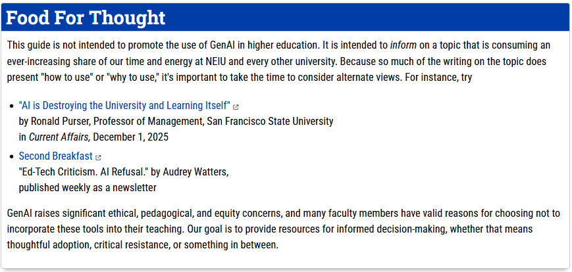
From: https://neiulibraries.libguides.com/ai-campus
Notes:
Lisa
The first prong was our public-facing user guide.
We added a prominent 'Food for Thought' section to explicitly state that our guide is not intended to promote GenAI, but to inform the campus on a topic consuming our time and energy. Crucially, we featured highly critical, anti-AI literature such as Ronald Purser’s essay on how AI is destroying learning, and Audrey Watters’ ed tech-criticism newsletter.
By explicitly giving space to thoughtful opposition and critical resistance, we signaled to skeptical faculty that the library wasn't acting as a cheerleader for Silicon Valley—we were providing balanced resources for informed decision-making.

Slide 14
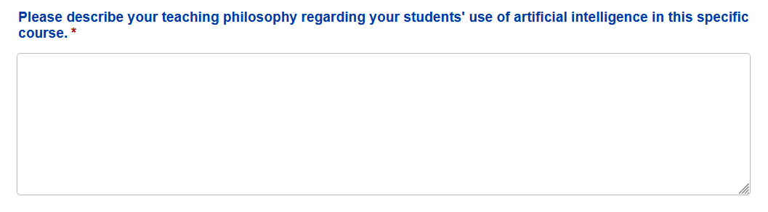
Instruction Request Intake Form
Notes:
Lisa
The second prong of our response happens at the classroom level. We added this mandatory text field to our library instruction request intake form: 'Please describe your teaching philosophy regarding your students' use of artificial intelligence in this specific course.'
As librarians, we constantly tell students to check their syllabi and ask their instructors about AI boundaries—adding this to our form allows us to practice what we preach. It ensures that before a librarian steps foot into a classroom, we are fully aware of and entirely respectful of that specific instructor’s boundaries, ensuring we never accidentally subvert their syllabus.

Slide 15
NEIU Libraries on the Topic of Artificial Intelligence
“The NEIU Libraries' AI literacy resources are a reflection of our professional commitment to information literacy education, not an endorsement or rejection of generative AI (GenAI) technologies. Just as academic librarians taught critical evaluation of Google’s search results in the early 2000s, Wikipedia's page content in the 2010s, and social media's posts throughout the past decade, we now address AI tools because they fundamentally reshape how information is created, accessed, and evaluated….”
From https://neiulibraries.libguides.com/ai-campus
Notes:
Robin

Slide 16
NEIU Libraries on the Topic of Artificial Intelligence
“Our educational stance is pedagogically neutral but informationally rigorous. We teach students and faculty to recognize AI-generated content, critically evaluate outputs, examine bias, use tools effectively when appropriate, and make informed decisions about when and how to engage with these technologies. This approach honors academic integrity while acknowledging that AI tools are already embedded in research databases and writing software our campus community uses daily….”
Notes:
Robin

Slide 17
NEIU Libraries on the Topic of Artificial Intelligence
“This educational mission aligns with ACRL's Framework for Information Literacy in Higher Education, which positions learners as critical evaluators navigating evolving information environments. As it is constantly evolving, we will continuously reassess the capabilities and limitations of AI. Our obligation is to ensure the campus community can make informed, ethical choices about AI tools, grounded in understanding rather than assumption. We are responsible for the professional and ethical use of information; information literacy is a product of human agency.
Approved by the faculty of the NEIU Libraries, February 6, 2026.”
Notes:
Robin

Slide 18
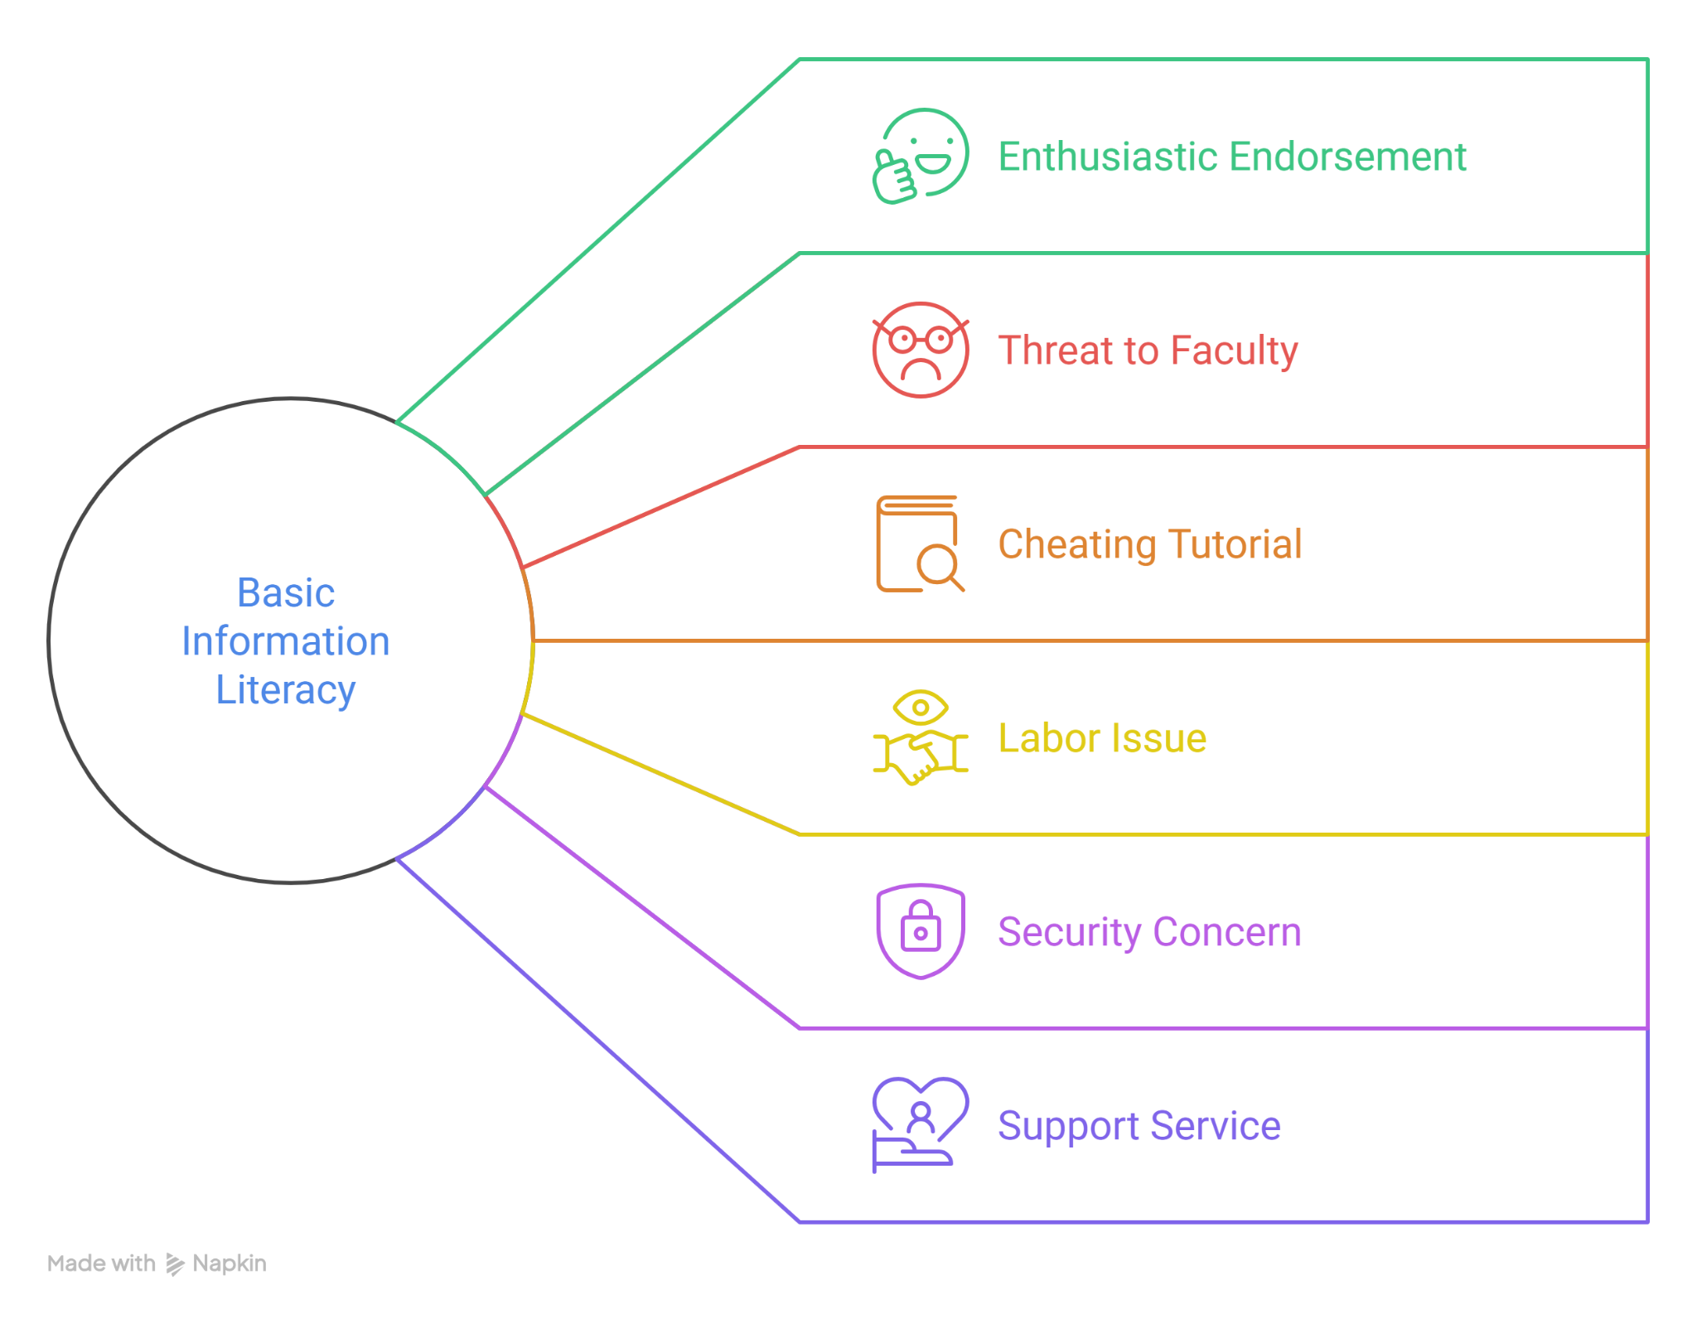
Takeaways
Notes:
Lisa
We developed what we thought was a straightforward student workshop on using GenAI effectively and responsibly.
It was grounded in familiar information literacy practices: asking better questions, evaluating outputs, identifying inaccuracies, and thinking about ethics. But the campus response showed us that AI literacy instruction is not perceived as neutral by everyone.
For some, it looked like permission. For others, it raised concerns about cheating, faculty authority, labor, privacy, and policy.
Our experience taught us that libraries have an important role to play, not because we have all the answers about AI, but because we are already positioned to help students and faculty ask better questions about information, authority, accuracy, and responsible use.

Slide 19
Takeaways
Neutral information may be perceived as advocacy
Faculty are split on the issue, so liaisons may have different experiences
The library can act as a cross-disciplinary listening post
Notes:
Lisa
One of the biggest lessons for us was that neutrality is not always perceived as neutral. Even though our workshop was grounded in information literacy frameworks, some people still read it as advocacy for specific tools.
That mattered because it showed us that the real issue was not just workshop content. The issue was the larger campus environment: uncertainty about academic integrity, uncertainty about faculty expectations, and uncertainty about who should be guiding these conversations.
Our response, then, was as much about relationship-building and communication as it was about instruction. We needed to show that library involvement in AI literacy comes from our existing expertise in evaluating information, teaching critical use, and helping students navigate complex information environments.

Slide 20
Remember
DO name the concerns
(academic integrity, privacy, misinformation, bias, labor, overreliance…)
DO consult campus partners early
DO emphasize evaluation over output
DON’T assume your workshop will be perceived as neutral
DON’T focus on “better prompting” or “how to use…”
DON’T offer universal rules for AI use across courses
Notes:
Robin and Lisa

Slide 21

Resources to share
NEIU Workshop: Using GenAI Effectively: Creating Prompts
NEIU Campus Guide to Artificial Intelligence in Higher Ed
NEIU Student Guide to ChatGPT and Other AI Resources
NEIU AI Literacy Toolkit
Notes:
Lisa

Slide 22

Questions?
What’s the biggest hurdle to AI literacy at your institution?
Notes:
Lisa
Before we take questions, I’d like to end with one for all of you. I’d like you to type your answers in the chat, but don’t hit enter until I say “Send”
Ready?

