Slide 1
Fiscal Period Rollover in Alma
CARLI Office
06/09/2026

Slide 2
Introduction to Fiscal Period Close
Process of closing one year’s activities and beginning another.
Establish a clean break in accounting for orders and invoices.
Involves review of data to find completed and unfinished orders.
  Identify open and closed order lines.
  Identify any pending invoices to resolve.
  Identify any funds being changed.
Involves using “rollover” jobs to review and update Alma data.
  Rollover Ledgers job
  Rollover PO Lines job
Notes:
(Ted)
Fiscal Period Close is a process of closing out the activities for one fiscal period and initiating the activities of another. This parallels the process that your institution’s business office goes through at the end of a fiscal year, where they close the books by ensuring that all payables for the year are tied out to expenses, or any outstanding issues are moved forward. This effort is meant to guarantee that each year’s purchasing activities are clear and distinct from one another.
In general, you might think of Fiscal Period Close as larger process where you work with your acquisitions data to identify what has been resolved and what remains for the future, while Rollover covers the technical aspects of changing data in Alma. Alma provides two jobs to perform these technical aspects. The Rollover Ledgers job creates the fiscal period and copies funds, and the Rollover PO Lines job moves open orders to the new funds and gives you reports that you can use to find issues. We’ll look more closely at these in a few minutes.

Slide 3
Rollover Overview
Rollover Ledgers job
  Creates a new fiscal period (one time task per year).
  Copies selected ledger and funds to the new fiscal period.
Staff adjust ledgers and funds before making them active.
  Active funds may receive allocations and PO lines.
Rollover PO Lines job
  Identifies open PO lines that may move to funds in the new fiscal period.
  Provides reports which PO lines succeed or fail to roll.
Staff review PO lines and clean up issues before rollover.

Slide 4
Roles and Responsibilities
  If you plan to use either rollover job…
  User Roles
    Fiscal Period Manager: enables access to jobs.
    Acquisitions Administrator: enables access to configuration.
    Ledger Manager and Fund Manager: modify and activate ledgers and funds.
  Libraries may request CARLI staff assistance.
Notes:
(Ted)
If you will use either of the rollover jobs at all, even if just for practice or for the reports they generate, someone at your institution will need to have the correct roles. If you are the person at your institution responsible for rollover, you will need the Fiscal Period Manager role to run the rollover jobs. Additionally, to update the fiscal period name after it is created, you would need the Acquisitions Administrator role, or you would need to coordinate work with the person at your institution who holds that role. Staff with the Ledger Manager and Fund Manager roles will be able to modify details in funds and then activate the ledgers when they are ready for use.
You may also request that CARLI staff assist with configuring and running the rollover jobs and letting you know when there are data that should be reviewed. Similarly, if you’re not using acquisitions, you might let CARLI staff know that we should advance the fiscal period at our convenience. CARLI will typically check that all institutions have rolled by October.

Slide 5
Closing the Books
  Review Old Funds
    Current encumbrances
      PO Lines received and waiting for invoices
      PO Lines sent and not received
      PO Lines received and invoices with leftover encumbrances
    Current expenditures
      Invoices awaiting approval
      Credits needing application
  Think about New Funds
    Will the ledger change structure? Adds? Deletes?
Notes:
(Ted)
Historically, closing the books involves reviewing how the year will conclude. For that, you start to the old year’s funds as a way of tracking outstanding issues.
From your current encumbrances, and from the transactions tab, you should be able to identify any outstanding orders that need attention. It could be that there are invoices to enter to close old orders. For orders not yet received, you may want to decide whether to cancel them and re-order with a new vendor, or cancel them pending a decision from the selector, or just let them roll, maybe placing a claim to check the status with the vendor. For continuation PO lines, you’ll want to check if there are encumbrances still in place for items received and invoiced, as it is possible to leave some money encumbered in case of supplemental invoice charges.
Once you’ve reviewed your encumbrances, you’ll have a better idea of how much should roll to the next year.
Expenditures don’t roll from one year to the next, but you do want to review that you have expended funds accurately. The first and main thing to check is whether any invoices are awaiting approval. These could have been skipped by processing or there may be a discrepancy that keeps Alma from automatically closing the invoice. As noted earlier, you want to check if anything has been received but not paid, as it is an accounting best practice to pay for items or services in the year you receive them. If your library has received credits from returns or cancellations, do these need to be entered and applied to other invoices?
Remember, after closing the year, the expenditures will determine the proverbial bottom line for what you purchased. In the context of rollover, if your new allocation is considering the cash balance, then you’ll want this to be accurate for your new fund allocation.
As you’re reviewing the old ledger and funds, you may realize that the ledger you set up isn’t working for you as you’d like. If you’re considering changes to how funds are arranged, or which funds you even need, it’s important to consider how changes will be implemented and the effect that changes might have on existing open orders.

Slide 6
Options for Preparing New Ledgers and Funds
  Create new year’s ledgers and funds by:
    Start over with new funds
    Roll as Draft (activate when ready)
    Roll as Active
  New ledger must be active to accept transactions
    Rollover PO Lines will fail if target ledger/funds in draft
    No ability to modify allocations on draft funds
Notes:
(Ted)
You always have a choice on how to implement your fund rollover. First, you may opt for a fresh start, building a new ledger and fund system based on your needs for the new year. This creates full separation from one year to the next but doing so takes no advantage of Alma’s functionality for rollover. It could also lead to a lot of manual work, not just editing funds but also editing PO lines.
The rollover ledgers job allows you to create a new ledger in a Draft state. While funds are in a draft state, you may modify the core details of the fund, specifically the name, code, and relationship to the ledger and other funds. However, in draft mode, you cannot modify allocations or any other transactions. Still, this gives you the ability to test changes to the ledger without fixing details in place. Using this approach, you can copy your existing funds over to the new fiscal year, then make changes, adding new funds, and deleting any obsolete funds no longer in use.
The rollover ledgers job also allows you to create a new ledger in an Active state. This approach copies the selected ledger as is, and automatically activates all funds right away. It is possible to deactivate a fund later, but you may not have the ability to edit all details later.
I need to reiterate that a ledger must be active to accept any transactions. Transactions include allocations, fund transfers, encumbrances, disencumbrances, and expenditures. Activating the ledger is required before the Rollover PO Lines job may fully rollover orders to the new year.

Slide 8
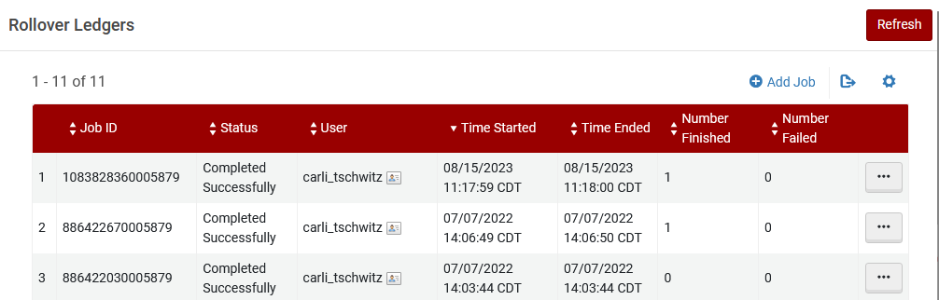
Ledger Rollover
  Acquisitions > Advanced Tools > Rollover Ledgers
  The Rollover Ledgers screen shows the history of past jobs, including dates and times as well as outcomes. The Add Job button above the list starts a new job. The … button for each row includes options to view past job details.
Notes:
(Ted)
Next, we’re ready to look at how to manage the rollover ledgers job.
Start at the main Alma menu, go to Acquisitions > Advanced Tools > Rollover Ledgers. The screen that appears will show a history of past jobs, which we can review to see how previous runs were handled. You may note that there are sometimes multiple runs in a year. These could include runs performed in draft or delete mode, as well as jobs focused on single ledgers or multiple ledgers.
You may also notice from a couple timestamps here that the job may be run frequently. The Rollover Ledgers job is a manual job, meaning it cannot be scheduled to run at a specific time. Though it is considered a good practice to coordinate your timing with other staff using acquisitions.
To kick off this process, click Add Job.

Slide 9
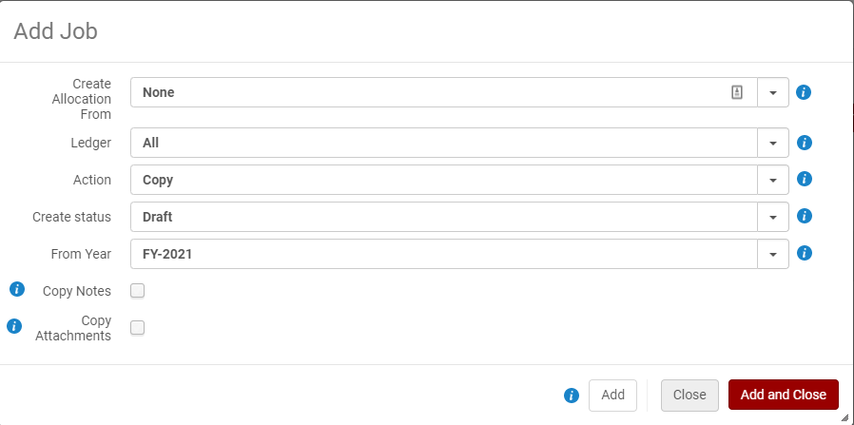
Ledger Rollover Parameters
Add Job
  The Rollover Ledgers Add Job screen offers parameters for selecting allocations, ledgers to roll, actions, create status, and beginning fiscal period. Both Add and Add and Close buttons initiate a job process.
Notes:
(Ted)
We’re looking at a screenshot of the add job screen for ledger rollover. We have a few selections to make to get started.
Create Allocation From: This option lets us create the starting allocation for a fund based on last year’s data. This offers flexibility for rolling different kinds of ledgers.
Allocation Balance - The allocated funds are copied with their allocations to the new ledger for the new fiscal period.
None - No allocations are created for the new fiscal period. This means you can enter the allocations when you find out your budget numbers. Start with a Zero budget.
Cash Balance - The cash balance of the ledger fund populates the allocation balance in the new fiscal period.
Both - The cash balance of the ledger fund and the allocated balance are both added to the allocation balance for the new fiscal period.
Ledger: Select the Ledger you want to Roll. IF you select ALL even draft or inactive ledgers in the fiscal year will be rolled, so you are better off selecting the actual ledger you wish to roll. Additionally, if you have ledgers that have modifications that are different depending on the type of funds managed in them they should be rolled separately, for example:
if your operating budget ledger should start next year with the same allocations, but your gift and endowed funds should only start with whatever money is left from this year, those ledgers should be rolled separately.
Action: Copy or Delete. Generally speaking, you will select COPY here. You would likely only select Delete if you ran an earlier rollover job in draft mode but wanted to delete it at once.
FPC (%) : This field appears only if you select Yes in the Create allocation field and Copy in the Action field. The increase/decrease percentage of the new allocated funds when they are copied from the source ledger. If no percentage is entered, the value defaults to 0%.
Create Status: DRAFT – as noted we need to create this in Draft form so we can edit the Fiscal Period Name, also, Draft is always a good choice when we’re learning new processes
From Year: Select the Current Year to Roll. Alma will populate the list from any eligible and active fiscal period. It is very important to check this value carefully, especially once future fiscal periods are in the system.
Copy Notes: Check these options to copy any notes and attachments during the Rollover.
Copy Attachments:
Regardless of what you select for notes or attachments, any rules regarding encumbrances and grace periods are copied when the ledger is copied.
Finally, note that when you click either button, Add or Add and Close, Alma kicks off the rollover job, so be sure your ready to roll (literally and figuratively) ;)
After the rollover job completes, we can review the outcomes from the Rollover Ledgers page. We’ll see in the results that the job completed, and if a ledger was rolled, we’ll see the number finished. Clicking the … menu button, we can view the detailed report.

Slide 10
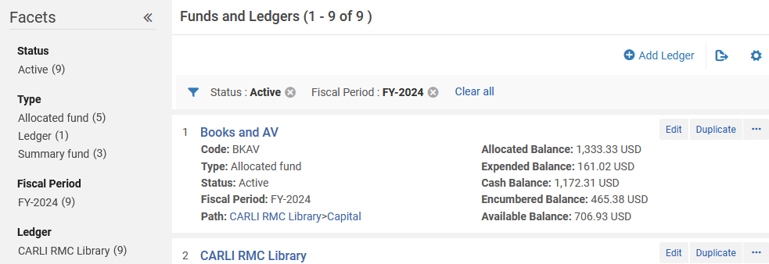
Ledger Rollover Results, Initially
  Acquisitions > Acquisitions Infrastructure > Funds and Ledgers
  Screen defaults to active funds in fiscal period for the date
  Clear the facets to get options for more fiscal years and statuses
  The Funds and Ledgers screen displays available facets on the left, applied facets on the top, and a list of funds. Facets may be cleared using Clear All or clicking the X next to a facet.
Notes:
(Ted)
To view the actual output of the job, we may use the Acquisitions menu, Acquisitions Infrastructure, then Funds and Ledgers. Alma has a default set of filters for the ledgers and funds screen, where it automatically shows active funds that are part of the currently active fiscal period, according to the date of the fiscal period and grace period settings. Usually, that means you’ll reach this screen and see the old fiscal year, and not see anything new.
At the top of list, we see the applied facets of Active and FY-2024. Since we just created a ledger as a draft and a new fiscal period, we won’t see the new data with these facets. Clicking the Clear All option gets us a refreshed screen.

Slide 11
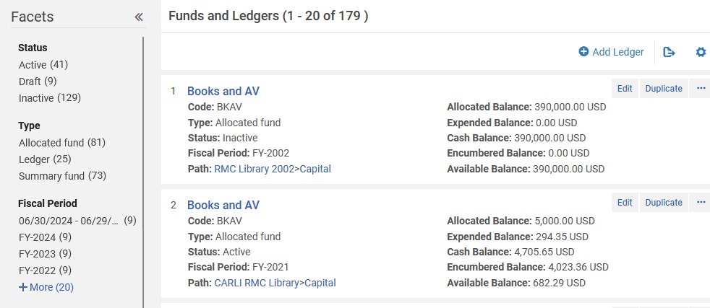
Ledger Rollover Results, Next
  Clear All
  Status facets include Active, Draft, Inactive.
  Fiscal Period facets include other years and “06/30/2024 – 06/29/…”
  The Funds and Ledgers screen displays available facets on the left. New facets may be selected from the facet list on the left.
Notes:
(Ted)
On the refreshed screen, we now see all funds present, including all those from past years that are now inactive. We also see that we can now select funds in a Draft status, which should let us pick our new ledger.
Also, under the Fiscal Period facet, we see the new period at the top, which is labeled “06/30/2024 – 06/29/2025.” This isn’t a terribly memorable name to use as shorthand in orders or analytics. Though you may choose to leave this if you want, we know from helping others that this will make it harder to find these funds. We will change this fiscal period.

Slide 12

Updating the Fiscal Period
  To Rename Fiscal Period:
  Configuration > Acquisitions > General > Fund and Ledger Fiscal Period
  Edit the fiscal period name
  Make sure the fiscal period is Active
  Click Save
  The Fund and Ledger Fiscal Period configuration screen shows all fiscal periods present in Alma. The newest fiscal period may appear on the bottom. The fiscal period name is generated from the dates not the pattern of previous names.
Notes:
(Ted)
To set a more practical and consistent fiscal period name, we go into Alma Configuration, then Acquisitions, General, and Fund and Ledger Fiscal Period. We should find the newest fiscal period at the bottom of the list, though that’s not a guarantee. Instead, you’ll watch for a row with the latest dates *and* a set of dates in the fiscal period name column. Click in the box to enter your preferred fiscal period name.
If you’re used to Alma configuration screens, you might wonder from the screen appearance if it is possible to manually update this table before doing rollover. The screen looks like other tables that can be edited and exported and reimported. However, *only* the rollover ledgers job may add new rows to this configuration screen. In part, this is how Alma keeps a strict constraint on fiscal period lengths as exactly one year.

Slide 13
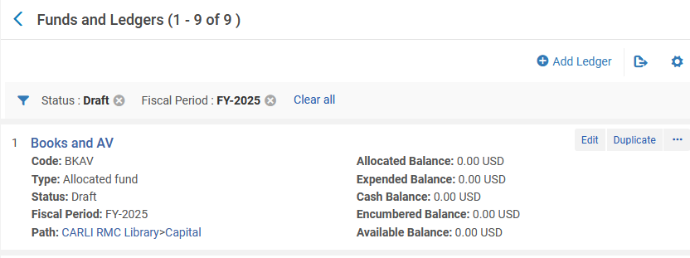
Reviewing Draft Ledgers
  Main menu (“Back” button on menu)
  Acquisitions > Acquisitions Infrastructure > Funds and Ledgers
  Click Clear All on the filter bar
  Select new fiscal period and ledger from facets on left
  Funds and Ledgers matching the new status of Draft and Fiscal Period of FY-2025 will now be listed.
Notes:
(Ted)
With that saved, we go back to the main Alma menu, then back to our funds and ledgers screen. Again, since this screen doesn’t retain selected facets between visits, we need to clear the existing facets first. Then, we may choose the facets that show our newly rolled funds.

Slide 14
Reviewing Ledgers and Funds
  Check new allocations
    New fund Allocated Balance = [Create Allocation From]
    Funds in Draft status cannot have money allocated.
    No transactions for encumbrances until Rollover PO Lines
  Check fund names and codes
    Names and codes with date references may confuse later.
    Did all previously active funds get copied?
    Did previously inactive funds get copied?
  Check fund rules (i.e., grace periods), notes, attachments
Notes:
(Ted)
After copying the ledgers and funds, you’ll have some follow-up to do on the created fund records. First, you’ll review the allocated balance to make sure that it is set according to your selection in the Roll Ledgers job. For example, if you selected to role the previous allocated balance, your new fund’s allocated balance should look like the old one. Similarly, if you selected cash balance, then the new fund should have whatever is left in the old fund right now. Of course, if you selected none, then the new fund allocated balance should be zero dollars.
Note, that while funds are in draft status, you will be able to see the amounts that were copied, but you cannot edit any of the balance amounts. Also, the new funds will have no encumbrance transactions yet, because you haven’t performed the Rollover PO Lines job yet, which you may only do after making the funds Active.
Other details to check on the new funds is the administrative details. Start with the fund names and codes. Do any of these have any date-related details in them that won’t make sense now? If you had a fund code 2024chem, is that useful in 2025?
Check to see that all active funds were copied into the new ledger. This will be important for rolling PO lines, since they need to move from an active fund in the old year to the corresponding active fund in the new year.
The Rollover Ledgers job should also copy any inactive funds as well. If you made them inactive because the fund is going out of use, this may be an opportunity to remove the fund from the ledger.
Finally, check your fund rules, notes and attachments. Fund rules include grace periods which extend your ability to do acquisitions around the fiscal rollover.

Slide 15
Timing for Rollover
  Begin on your schedule.
    Jobs may be run on different days.
    Jobs may be run in draft or "report mode" to preview issues.
  Fiscal Year Settings are not controlled by when you roll.
    The month and day values for start and end dates are fixed.
    The Rollover Ledgers job creates a new period with updated year values.
    Ledgers and funds may be extended forward or backward using grace periods.
Notes:
(Ted)
This is a good opportunity to answer the common question about when is the best time to begin the rollover process. The best answer is whenever you are ready. This is useful, because the two rollover jobs may be used to help you preview how things will move forward. Also, you decide with your actions when the rollover is official. The ledger rollover allows you to create new ledgers and funds in draft, so you could modify details before making the funds active. The PO line rollover job has a report mode that tells you how many lines of what type are open and if there could be any problems rolling them.
Importantly, the date that you start rollover does not alter the effective dates for the new fiscal period. These are fixed in Alma configuration. For example, most institutions have a July 1 start and June 30 end. The rollover ledgers job creates the new fiscal period with new year values. For example, we could do a full rollover today, June 9 for our institution. The ledger and funds could be set to active, and some or many PO lines rolled into the new ledger. However, since it's only June 9, the new ledger won't actually come into effect until July 1. Alma will only let me use funds that are active according to the calendar date. So, from now to June 30, when I place an order or handle an invoice, I'll still use the current fiscal year.
The effective range of a ledger may be extended using grace periods.

Slide 16
Grace Periods
Ledgers and funds may have up to five grace periods.
  Prior to the start date for the fiscal period
    Encumbrances prior to fiscal period
    Expenditures prior to fiscal period
    Transfers prior to fiscal period
  After the end date of the fiscal period
    Fiscal period end encumbrance grace period
    Fiscal period end expenditure grace period
Grace periods are entered in days
  Use a negative value to set an early deadline
Notes:
In Alma, Fiscal Periods cannot be extended beyond the exact dates of your institution’s annual fiscal year (for example, 7/1/2020 – 6/30/2021). If you require more flexibility in ordering, you can add Grace Periods to your Ledger(s) to allow Encumbrances (orders), Expenditures (invoices), or both after the fixed end date of the Fiscal Period.
Ledgers and Funds may have up to 5 grace periods, none are required.
"Prior to the start date for the fiscal period" rules allow you to set the number of days prior to the fiscal period start date you may Encumber (order), Expend (set up Invoices), or Transfer funds.
More commonly used are Grace Periods after the end date of the fiscal period, which allow you to set the number of days after the end of a fiscal year you can use your previous ledger and funds for either Encumbrances (orders) or Expenditures (Invoices). Grace periods are entered in Days, and those entered on the Ledger affect all of the funds for that ledger. If you have a particular fund that needs a different grace period that can be accomplished by overriding the rule and entering a different number of days at the individual Fund level.
You can enter an early deadline (say you would like to stop new orders by June 15) by entering a negative number in the "Fiscal Period end encumbrance grace period" field.

Slide 17
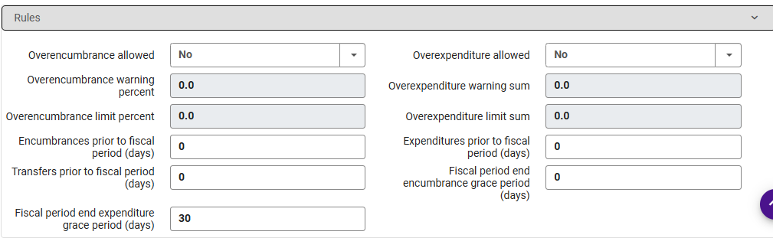
Setting Grace Periods
Setting up Grace Periods for Ledgers and Funds in Alma
Notes:
here I'm sharing a screen shot of a Ledger Rules section and have edited the Fiscal Period End expenditure grace period to be 30 days. I've let the Encumbrance grace period at 0 days. This would allow invoices to be entered after the end of the fiscal year this ledger is part of, but no new orders. This Rule will apply to all funds in this ledger, unless I choose to override the rule at a particular fund.
More information on Grace Periods can be found on the CARLI website at this link.

Slide 18
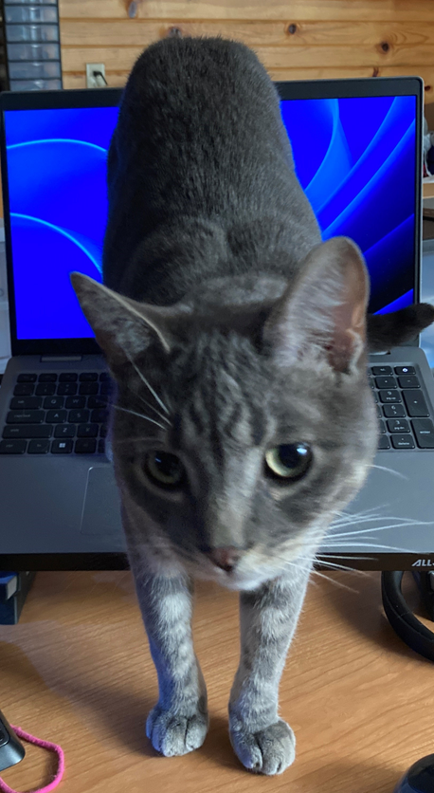
Question Break 1
Notes:
(Ted)
This is a good time to pause to answer questions from chat, or you may raise your hand or unmute.

Slide 19
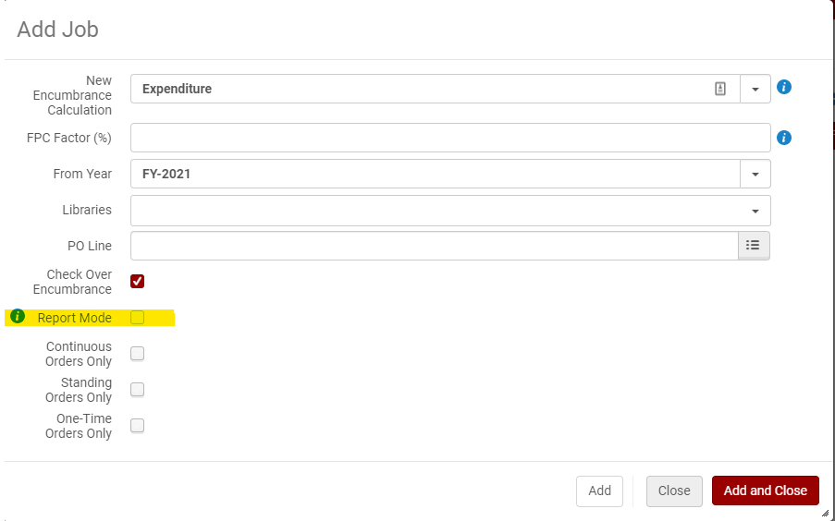
Rollover PO Lines
  To Run PO Line rollover:
  Acquisitions > Advanced Tools > Rollover PO Lines
Notes:
OK, let’s talk a little about rolling PO Lines.
This job can also be found in Acquisitions > Advanced Tools > Rollover PO Lines
Once your Ledger & Funds are set up and Active you can use this in REPORT MODE to check and see WHAT POLs will be rolled – in the same manner you would have used the Open Orders Report in Voyager. There appear to be some shared Analytics reports to find Open Reports as well – For One-Time Orders Alma is looking for lines that are ordered but not yet invoiced. However, the nice thing about the Rollover PO lines job is that you can use it as a “Open Orders Report” AS LONG AS YOU CHECK REPORT MODE! ☺
Let’s take a look at how that would work.
As with the Ledger Rollover Job you are presented with a number of options on the Add Job screen, again, Add and Add and Close will Run the job, not just add the job to a queue.
New encumbrance calculation
The way to calculate the encumbrances in the new fiscal period. When working with continuous PO lines, you can base this calculation on:
Encumbrance – Adds all the encumbrances and moves them to the new fiscal period (plus or minus the FPC factor %). Alma then runs the dis-encumbrance on the entire expenditure.
Expenditure – Calculation is based on the sum of all expenditures related to the fiscal period (plus or minus the FPC factor). The encumbrance is relative for each fund. If this option is selected and the PO line does not have expenditures, calculation is instead based on encumbrance.
Calculation for one-time PO lines is always based on Encumbrance, but the FPC factor % is not calculated.
FPC factor (%) The increase/decrease percentage of the encumbrance when the PO lines are copied to the new fiscal period. If no percentage is entered, the value defaults to 0%. This FPC factor is designed to help with continuation line increase “expectations” – you do not have to use it, but it can help encumberance expectations.
From year The year from which to copy the PO line. Select from the current or previous fiscal period.
Libraries A library or libraries for which the PO line rollover is to take effect. If you do not select a value in this field, rollover is performed for the entire institution.
PO Line You can select a single PO line. If you do not, all PO lines are rolled over. Check over encumbrance Whether to ensure that checking over-encumbrance rules of the fund/ledger are performed. Clear this option if you do not want over-encumbrance rules to be checked, If you chose no allocations for your funds and have not yet allocated funds be sure to uncheck Over encumbrance.
Report mode This option will show any errors and what lines will roll.
Continuous Order Only –
Standing Order Only
One-Time Order Only
If none of these options are selected, or if all of them are selected, then encumbrances for all PO lines types are rolled over. Otherwise, only the selected type/types are rolled over.
I think it is useful to run each type of order separately especially in Report Mode to see what orders are going to roll, particularly for One-Time Orders.
Once you roll each order type you can view download the reports and see what will roll-over and any problems with current POLs.

Slide 20
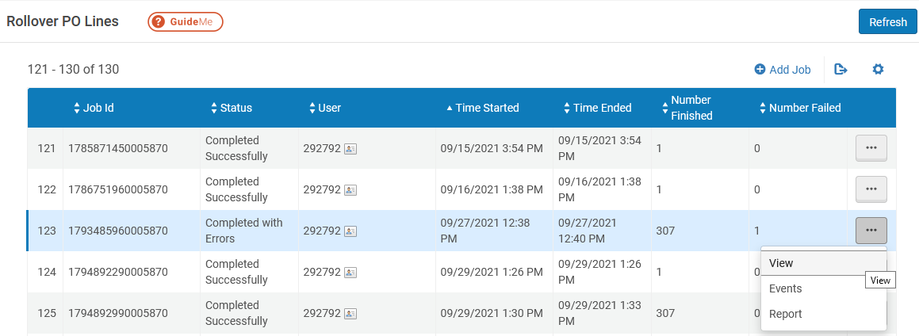
Reports from Rollover PO Lines
Rollover reports appear on the jobs page
Locate the job, click the actions menu, then View.
Notes:
All the reports from previously run Report mode and actual Rollovers appear at the Add Job Screen. Under the “More Actions” menu you can see the options: View, Events & Report.
View: Gives an overview of the results.
Job Events: Counts of successes and Issues. Clicking each one will show a POL list. This is very useful in Report mode as you can download the list to address any issues (POLs you may want to invoice before rollover, etc)
Counters: shows your selections for the rollover job
Report table: counts the number of POL types for the job
Events & Report: Provides a more detailed look at what happened with each POL. When everything goes OK this section is less interesting, but if there are issues it can be useful to download the Excel format and view there.
(yes these do the same thing).

Slide 21
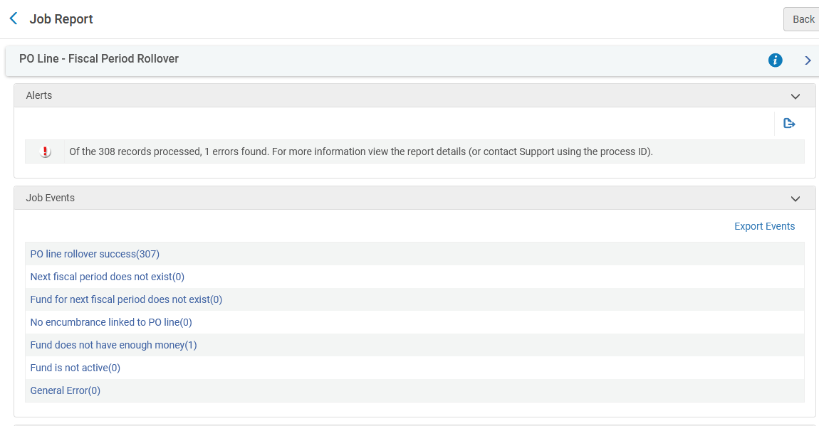
Reports from Rollover PO Lines, Details
The job view is the most interesting option
Alerts: Any issues encountered and the number of them
Job Events: Links to lists of rolled PO lines or POLs with issues
Counters: The parameters for the job and numbers of POLs that would succeed or fail to roll.
Notes:
All the reports from previously run Report mode and actual Rollovers appear at the Add Job Screen. Under the “More Actions” menu you can see the options: View, Events & Report.
View: Gives an overview of the results.
Job Events: Counts of successes and Issues. Clicking each one will show a POL list. This is very useful in Report mode as you can download the list to address any issues (POLs you may want to invoice before rollover, etc)
Counters: shows your selections for the rollover job
Report table: counts the number of POL types for the job
Events & Report: Provides a more detailed look at what happened with each POL. When everything goes OK this section is less interesting, but if there are issues it can be useful to download the Excel format and view there.
(yes these do the same thing).

Slide 22
Evaluating PO Line Rollover
  Are target funds Active yet?
  Use PO Line Rollover in Report mode as needed
    PO lines that should be closed
    PO lines that should be open and rolled, but aren’t rolled
    Check encumbrances to be recalculated correctly
  When fitting, run PO Line Rollover job without Report
    Close to your actual fiscal period cutover
    After you’ve resolved as many inconsistencies as possible
    Within the grace periods for both new and old ledgers

Slide 23
Resources for Fiscal Period Close
Interactive lesson from Ex Libris:
http://exl-edu.com/01_Alma/Extended%20Training/Fiscal_Period_Closure/#/
Fiscal Period Closure Documentation from Ex Libris:
https://knowledge.exlibrisgroup.com/Alma/Product_Documentation/010Alma_Online_Help_(English)/020Acquisitions/100Advanced_Tools/020Fiscal_Period_Closure

Slide 24
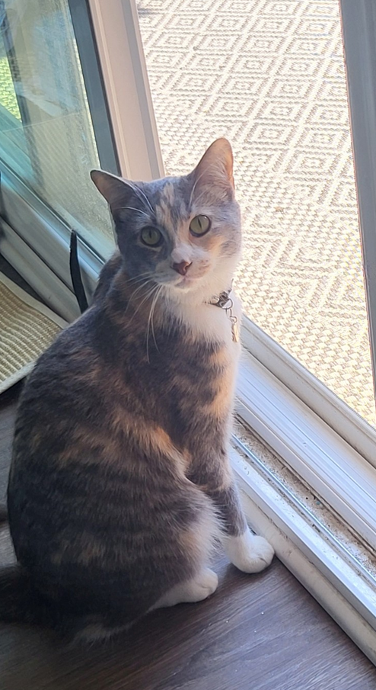
Question Break 2
Notes:
(Ted)
This is a good time to pause to answer questions from chat, or you may raise your hand or unmute.

Slide 25
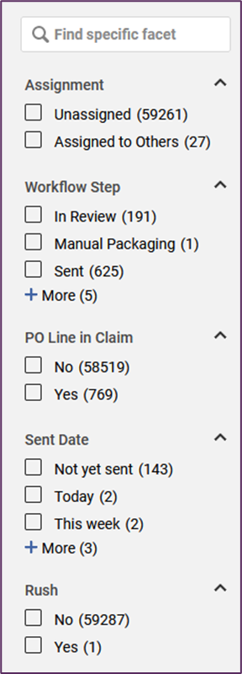
Order Clean-up
  Order Lines: Sent Date after 07/01/2023
  Useful facets for problems
    Workflow Step
    PO Line in Claim
    Rush
    Sent Date
    Order Type
    Material Type
  Analytics > Out of the Box > Out of the Box Analytics: Acquisitions: Claims Dashboard
A list of facets for filtering purchase order lines in Alma. Facet types displayed include Assignment, Workflow Step, PO Line in Claim, Sent Date, and Rush.
Notes:
(Ted)
Ironically, fiscal period close doesn’t actually close any orders. It closes the fiscal year and opens a new one, but the rollover PO lines job will simply leave most POLs in previous years. These orders, if they are still in an open state, can clutter your receiving workbench, your notifications, and your reports for a while if you don’t resolve them. While the revamped order line task list makes it easier to find orders, if we go to Acquisitions > Purchase Order Lines > All PO Lines, we see our full and probably overwhelming ordering history. Even with the facets, it could take a while to manage your way through different problems.
To limit the list to just the current fiscal year, use the Order Lines as the search type, then build an advanced search on Sent Date after the start of your fiscal year.
From there, use one or more facets to pare down the list into smaller, more manageable chunks. You may also save these chunks into sets of their own for you to work through one by one. In some cases, you may be able to resolve some with a job.
I would also mention an out of the box analytics tool, the Ex Libris designed Claims Dashboard. This will show you the list of orders that should have arrived in the last two year. By arrived, that means physically received or electronically activated.

Slide 26
Clean-up Actions
  Options depend on POL Status
    Sent (not received): May cancel or receive*
      Receiving should update status to Waiting for Invoice
    Sent (received/activated): May close or add invoice
    Waiting for Invoice: May close or add invoice
    In Review: May cancel or delete
  Best action may depend on timing
    If you have holdings: receive/activate it
    Current fiscal year: make it complete (order, receive, invoice)
    Past fiscal years: make it close enough
  Change PO Lines Status job
    Cancel, close, or delete a set of POLs
Notes:
(Ted)
Of course, finding the orders is still the easy part. How you resolve them will depend on the POL status. One way or another, you’ll want to get POLs to a closed state.

Slide 27
Renewals
  Continuation PO Lines: subscriptions or standing orders
    Single PO Line per title, series, or package
    Rolled from year to year
    Renewed from year to year
  Renewal types
    Recurring Renewal
      Automatic subscription for one year based on Renewal Date
    Manual Renewal
      User must manually update Renewal Date
    PO Line – Renewal job
      Scheduled job, checks for renewal dates and reminder period
      Automatically renews recurring renewals
      Updates manual renewal POLs to Waiting for Manual Renewal
      Acquisitions > Purchase Order Lines > Renew
Notes:
(Ted)
Something that we realized over the last year that hadn’t occurred before was the relationship between rollover of continuation PO lines and their renewal state. Like a lot of orders, subscriptions and standing orders may be initiated at any time in the year, but continuation vendors typically handle renewals at the same time every year. However, the times when we review and set renewals may not align completely with fiscal period close. We found it is possible for these situations to overlap in a way that needs monitoring.
For those less familiar with Alma’s continuations architecture, here’s a quick overview. In Alma, a continuation, rather a subscription or a standing order, is entered as a single purchase order line. This is done as an efficiency to reuse the same object over and over for future transactions; this can be unfamiliar to those who have used systems that require a new PO line for each year’s purchase. But by using the single line, we’re able to track costs on the title and the same PO line number over time, while not requiring the creation of any new holdings for each order. The POL is rolled from year to year based on whether the title is renewed from year to year.
Alma supports two types of renewal. There is recurring renewal, which automatically renews based on the renewal date initially entered. Then there is manual renewal, which requires user intervention to determine if the order should continue another year. Alma has a POL renewal job that checks for the renewal date as well as a reminder setting. The job will either renew the POL automatically or add the POL to the waiting for renewal list.

Slide 28
Renewals and Rollover
  Eligibility to Roll based on Renewal Date and Status
    Waiting for renewal + Renewal Date after rollover date: Open
    Waiting for renewal + Renewal Date before rollover date: Closed
    Waiting for invoice + any Renewal Date: Open
    Sent + any Renewal Date: Open
  Problems for Unrolled Continuation
    Renewal blocked: “Fund subscription is not active”
    Solution: manually roll POL, then renew
Notes:
(Ted)
It turns out that the renewal status and renewal date factor into whether Alma considers a continuation POL as open. As I mentioned earlier, the rollover PO lines job will scan for any PO lines that are considered open orders. Thanks to couple support tickets this past year, we learned that a continuation would be ineligible to rollover if the renewal date fell prior to the date that the Rollover PO Line job ran and the status was waiting for renewal. Other combinations read as open, which makes sense. If I roll on July 1, and renew on July 31, I haven’t reached the deadline for a decision to renew or not. But if I renewed on May 1, then on July 1, the POL reads as waiting for invoice.
How this revealed itself is interesting. A library found in the fall that they couldn’t get a POL to renew manually. They encountered an error: Fund subscription is not active. On closer examination, we spotted that the fund on the POL was still in the previous fiscal period’s ledger, and that the renewal date was before their rollover date. Alma had seemed very forgiving about some of the data on PO lines before that, so it was a surprising effect.

Slide 29
Is Rollover Necessary?
Yes.
Create new fiscal period with Rollover Ledgers job.
  Fiscal period is used by Acquisitions and by Analytics.
  Fiscal period update must be done within a few months of fiscal period end date.
  Fiscal period cannot be created manually in Alma configuration.
If your institution does not use Acquisitions:
  Fiscal period close is complete.
  Your I-Share Liaison may request that CARLI do your rollover for the new fiscal year.
Notes:
(Ted)
Over the years, we’ve been asked about Fiscal Period Close whether there is a requirement to do anything. The answer is yes, though how much you have to do, and how you go about the work, will depend on how you use acquisitions in Alma.
There is one task that is required for any institution, whether they use acquisitions or not. That task is to create the new fiscal period. The reason for this is that the fiscal period is used both for Acquisitions and for Analytics, where the fiscal period dates are used to create ranges for filters and tracking transactions.
The fiscal period may be created as a function of the Rollover Ledgers job only. It isn’t possible to create the fiscal period manually, and CARLI staff have learned the hard way that there is a window for making sure the new fiscal period is created. CARLI staff consider it a best practice to see that this gets done.
If your institution doesn’t use acquisitions functionality, and that means no PO lines or invoices, no vendors or funds, then you’re done. If you prefer that CARLI takes care of this for you, so that you don’t need to adjust your roles just for this, then send us a support ticket and we will take care of the fiscal period.

Slide 30
Ending work in Acquisitions?
Do a last rollover to close out the old orders and funds.
  Run Rollover Ledgers job to create the new fiscal period and draft ledger.
  Delete the new ledger.
  Find and close any open PO lines.
Notes:
(Ted)
We've heard from some libraries that decided to change course with acquisitions, maybe due to the changes announced for the Rialto service, maybe due to staffing levels, or maybe it just doesn’t work for your workflows. That’s no problem. If your library decided that you're no longer going to create PO lines or track acquisitions in Alma for your new vendor, go ahead and do the rollover once, and delete the ledger that is created. Next year, there will be nothing to roll, and you'll only need to create the new fiscal period.
We also recommend that you go through any open PO lines and make sure they are closed or cancelled. Alma will continue to mark unreceived items as claims and create notifications about subscription renewals. These data may be visible to you or other staff. If your future self decides to try acquisitions again, you’ll want a fresh start without virtual dust bunnies coming out at you.
You don’t need to delete anything, just make sure that POLs are not open, invoices are all paid and settled.

Slide 31

Question Break 3
Notes:
(Ted)
With that, we’ve reached the end of our content for today. We’ll continue to take questions from you.

Slide 32
Questions?

