Slide 1
I-Share Alma Primo VE Release Updates Webinar Will Start Shortly
Welcome!
The webinar will start at 1pm and run until 2pm.
Please mute your microphone.
As time permits, we will respond to questions typed in the chat box, and offline afterwards, as needed.
This session will be recorded and made available on the CARLI website.

Slide 2
August 2026 Alma and Primo Quarterly Release Notes Webinar
July 30, 2026

Slide 3
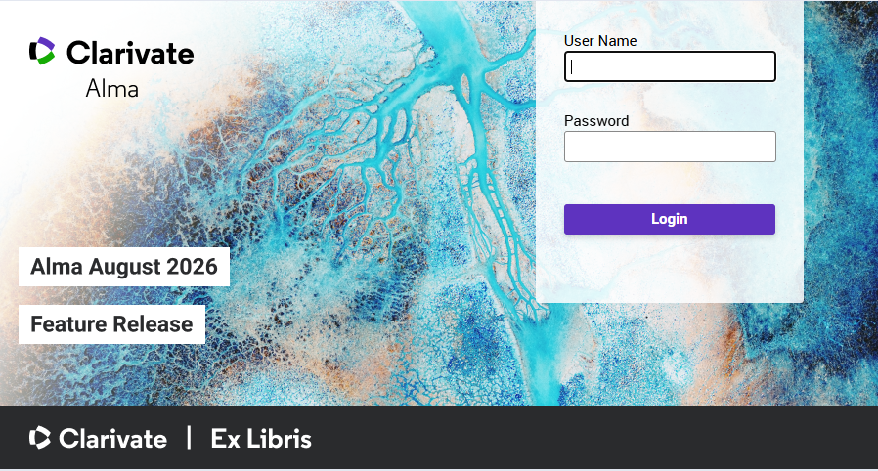
Today’s Agenda
Announcements, Events, and Reminders
August 2026 Quarterly Release Features
  Alma features
  Primo VE features
Q&A
Today’s session is being recorded and will be posted to the CARLI website.
Alma login page
Notes:
(Marisa)
Today’s agenda starts with Announcements, Events, and Reminders
Then August 2026 Quarterly Release Features
Alma features
Primo VE features
And finally, Q&A
Today’s session is being recorded and will be posted to the CARLI website.

Slide 4
Announcements and Events
Welcome our two new I-Share Libraries!
  Field Museum of Natural History (FLD)
  Chicago History Museum (CHM)
Reminder of our two recently closed I-Share Libraries
  Trinity Christian College (TRN)
  Trinity International University (TIU)
Semi-annual Alma Sandbox refresh occurs on Sunday, Aug. 9, 2026.
Upcoming Events – see also the CARLI Calendar
  Sunday, Aug. 2, 2026 – Alma and Primo Quarterly Feature Release
  Wednesday, Aug. 26, 2026 – ERMT: Electronic Resources Management Tea
Notes:
(Marisa)
This slide has some announcements and upcoming events. See the CARLI Calendar for a full list of upcoming events!
Welcome our two newest I-Share libraries: the Field Museum of Natural History Library and the Chicago History Museum, live on Alma and Primo for all activities.
A reminder about the closure of Trinity Christian College and Trinity International University, which closed in May and June respectively. CARLI staff are working on cleaning up loans, fines, and patrons from these institutions. The Alma Transit slip will route any Items returned to your library from Trinity Christian to the Illinois State Library, and any items from Trinity International to the Moody Bible Institute.
The semi-annual Alma Premium Sandbox refresh will occur on Sunday, August 9, 2026. For more details, please see the email sent on July 20 to the I-Share announce and I-Share Liaisons email lists.
Most importantly, the August Feature Release we will be discussing today will be available in production on Sunday, August 2

Slide 5
Reminders
In this webinar, CARLI Staff are sharing the updates we feel are most important to the I-Share environment.
Staff at I-Share libraries can review the full set of release notes available from the Alma and Primo VE Support Pages:
  Alma Release Notes
  Primo VE Release Notes
Slides have been marked with audience tags:
Acquisitions
Analytics/Statistics
Cataloging
Circulation
Configuration
ILL/ Resource Sharing
Everyone
Electronic Resources Management
Primo VE/ Discovery
Reference/ Instruction
Systems
User Management
Notes:
(Marisa)
In today’s presentation, we are highlighting those updates in Alma and Primo VE that are the most important to the I-Share environment. In the interest of time, we’re not covering everything, so we encourage you to review the release notes yourself. You may find something that is practical to your local uses, though you will also encounter some updates that don’t apply to I-Share libraries at all. If you have any questions about updates, please contact us at support@carli.illinois.edu.
Slides have been marked with audience tags to help you get information to the right people at your institution.
These slides are available for download on the CARLI website.

Slide 6
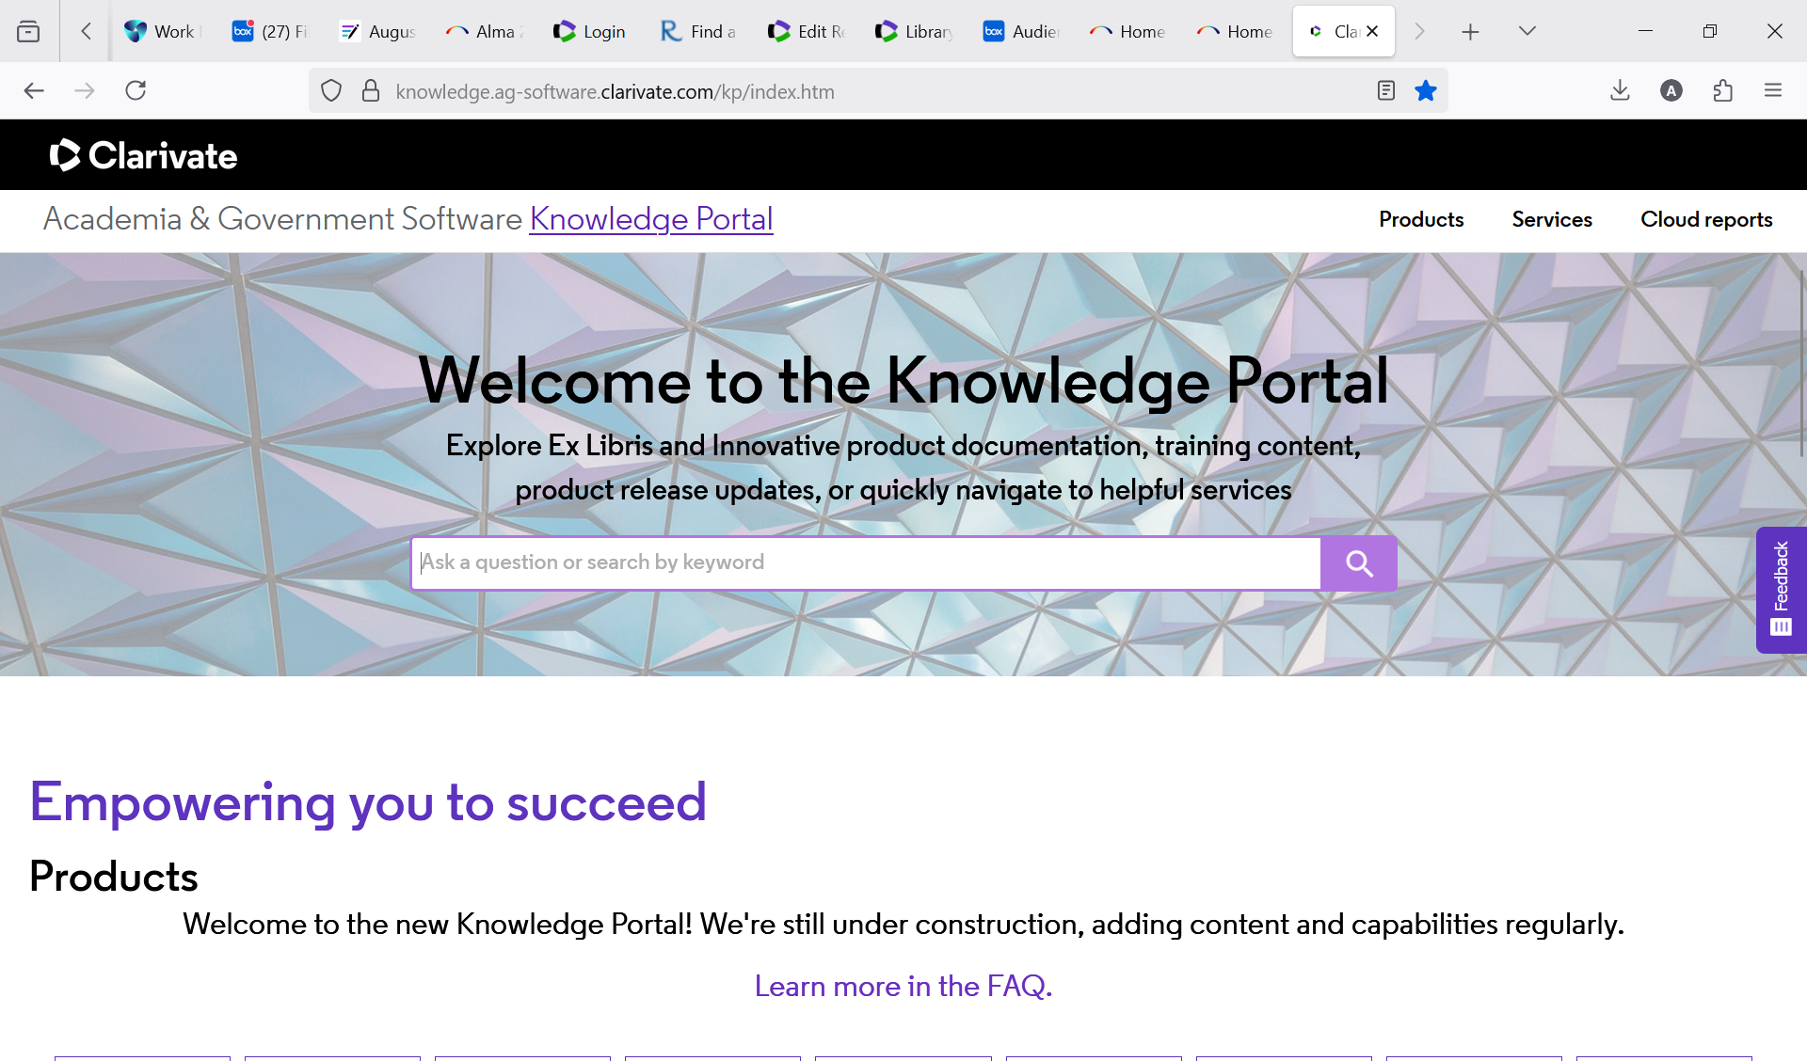
New Knowledge Portal
Starting with the August release, the Alma documentation will be published and maintained in the new Clarivate Knowledge Portal. Primo documentation will move soon.
The current Ex Libris Knowledge Center will continue to be available until November, but pages will not be updated.
The Alma AI Knowledge Assistant will be discontinued in November.
There are no redirects from pages in the old Knowledge Center to new pages in the Knowledge Portal.
New Clarivate Knowledge Portal
Everyone
Notes:
Everyone (Adrienne)
You will have to search for the relevant document in the new Knowledge Center.

Slide 7
New Physical Items UI
New UI in Alma for physical items aims to streamline workflows and offers a new search experience.
To learn more:
Register for the Ex Libris Webinar “The New Physical Items Experience in Alma” on 9/1/26 at 9:00 a.m.
See the Ex Libris documentation “Introduction to the New Physical Item Experience”
Everyone
Acquisitions
Cataloging
Circulation
Notes:
Everyone Acquisitions Cataloging Circulation (Adrienne)
To learn more about the new Physical Items UI, register for the Ex Libris Webinar “The New Physical Items Experience in Alma” or see the documentation.

Slide 8
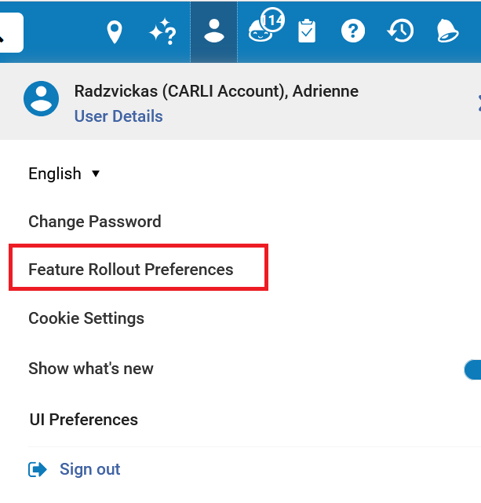
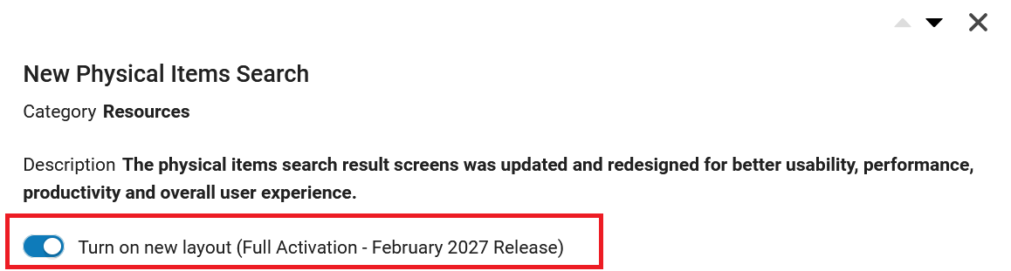
New Physical Items Search: How to Access
To access the new search, toggle it on in Feature Rollout Preferences.
New Physical Items Search feature
Feature Rollout Preferences in the User Details menu
Everyone
Notes:
Everyone (Adrienne)
The new physical items search and lists offer a side-by-side editor, more actions available directly from the search, and enhanced navigation options. It is similar to the layout of the physical titles search. To access the new search, select your user icon > Feature Rollout Preferences and Turn on new layout.

Slide 9
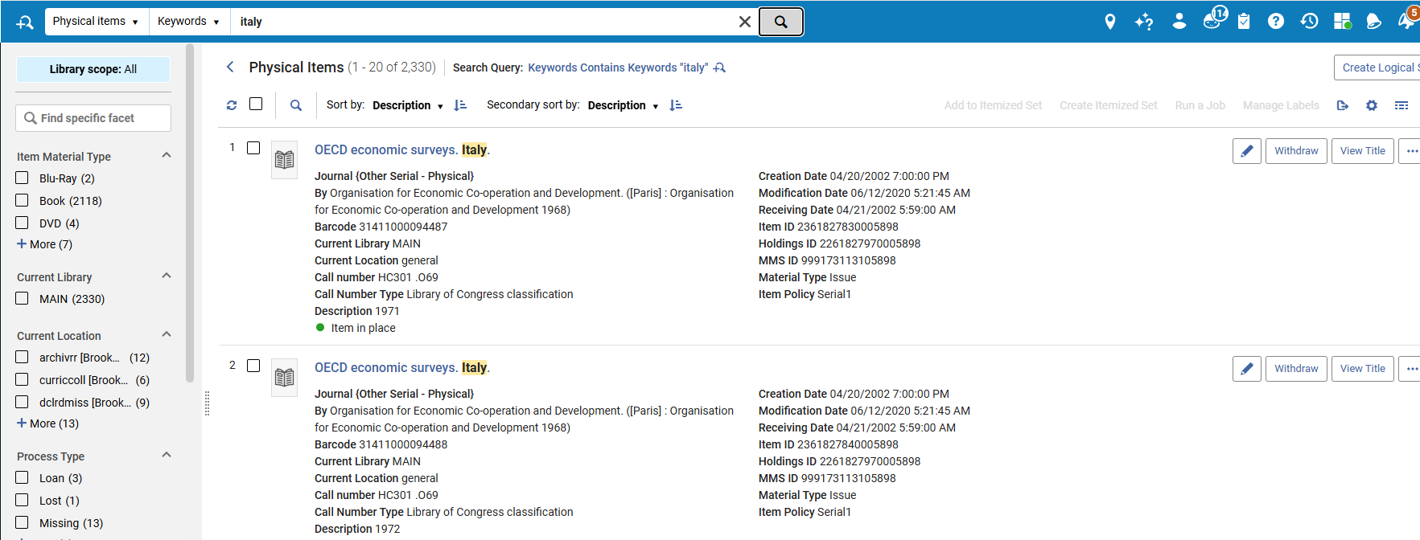
New Physical Items Search: Search Results
Search Results screen of the Physical Items search
Everyone
Notes:
Everyone (Adrienne)
The search results screen is similar to that for Physical Titles and Holdings. The fields displayed by default (Edit, Withdraw, and View Title) have changed. When you select Edit, the record will be displayed on a sliding panel if your monitor’s resolution is large enough.

Slide 10
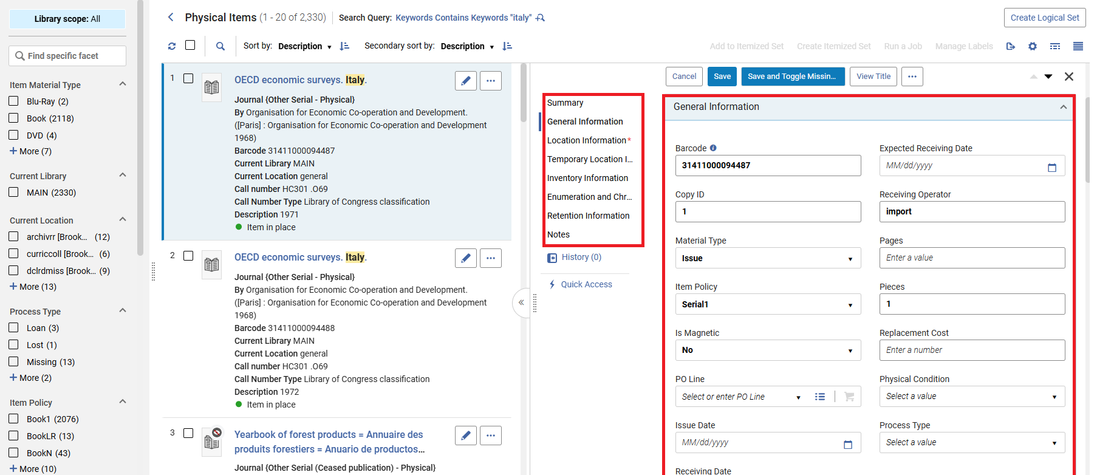
New Physical Items Search: Editing Item
Use the list on the left-hand side to jump to a section of the item record. Edit the fields on the right-hand side.
Edit Item page
Everyone
Notes:
Everyone (Adrienne)
This is the panel in which you can edit the item. Use the list on the left-hand side to jump to a section of the item record. Edit the fields on the right-hand side.

Slide 11
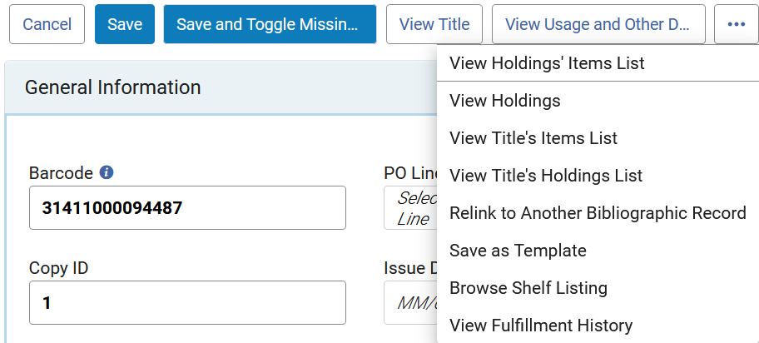
New Physical Items Search: Menu Items
New options in the ellipsis button of the Edit Item screen
Edit Item page menu options
Everyone
Notes:
Everyone (Adrienne)
When you click the ellipsis, there is a new set of menu choices. They also have been made clearer.

Slide 12
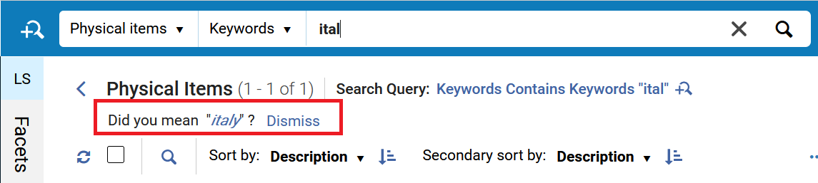
“Did You Mean” Suggestions
"Did you mean" suggestions are supported in simple searches in Alma. When enabled, the interface displays an alternative suggested term when a search returns 0 -15 results. Users can click the suggested term to trigger a new search or dismiss the suggestion.
Search results with a “did you mean” suggestion
Institution-level setting: Configuration > General > General Configuration > Other Settings > did_you_mean_search_suggestion.
Individual User setting: User menu > UI Preferences > Did you mean search suggestion
Everyone
Notes:
Everyone (Adrienne)
"Did you mean" suggestions are supported in simple searches in Alma. When enabled at the institution and user levels, the interface displays an alternative suggested term when a search returns 0 -15 results. Users can click the suggested term to trigger a new search or dismiss the suggestion.
The institution-level setting is at Configuration > General > General Configuration > Other Settings > did_you_mean_search_suggestion. Users can change the setting at User > UI Preferences > Did you mean search suggestion.

Slide 13
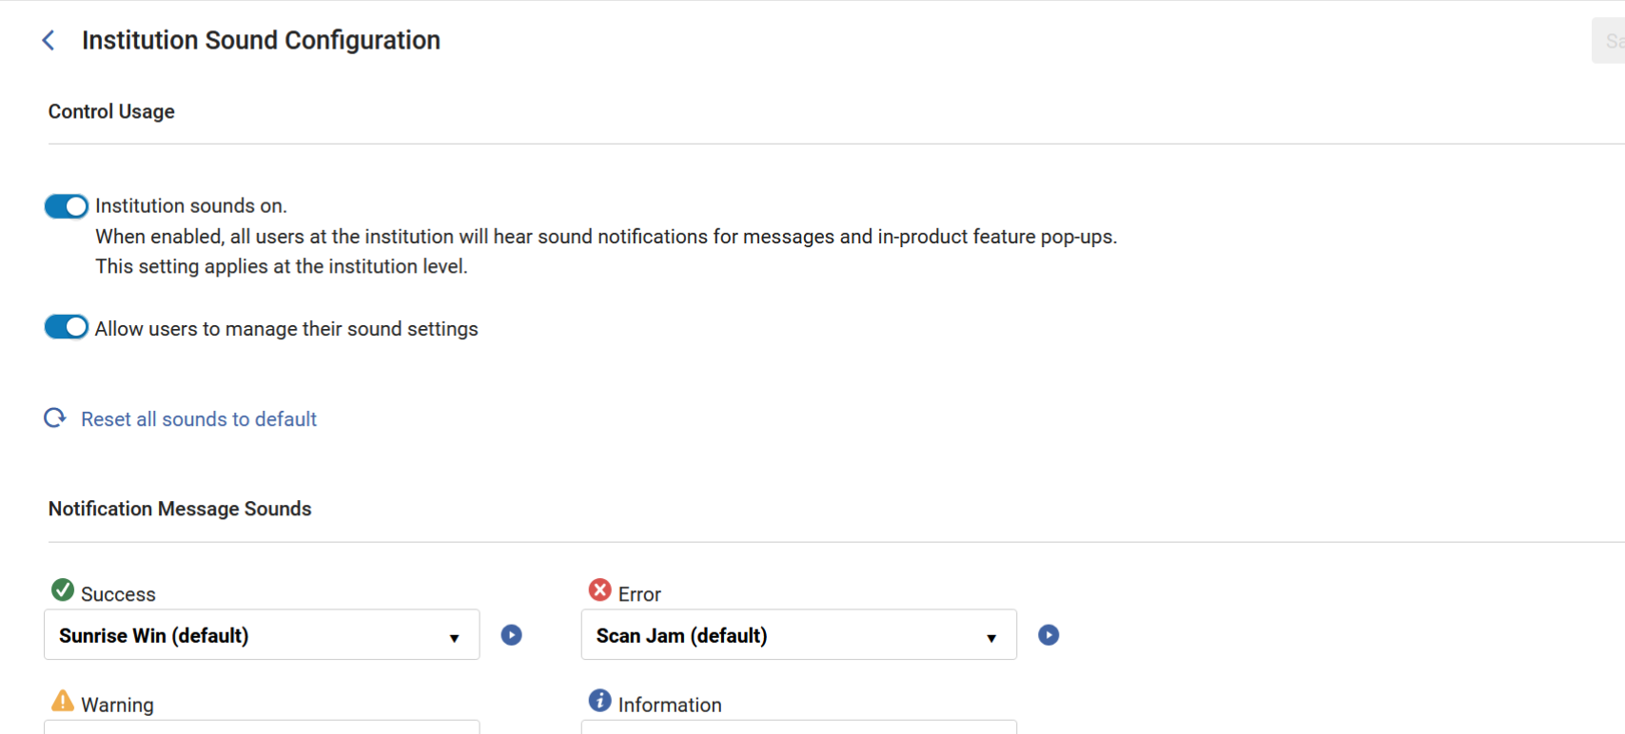
Sound Configuration
At the IZ level, you can set the sound configuration at Configuration > General > User Interface Settings > Sound Configuration.
If you select “Allow users to manage their sound settings”, they can set them at User > UI Preferences > Advanced Sound Settings
NOTE: The sounds are on by default at the IZ level in the August update.
Everyone
Configuration
Institution Sound Configuration screen
Notes:
Everyone (Adrienne)

Slide 14
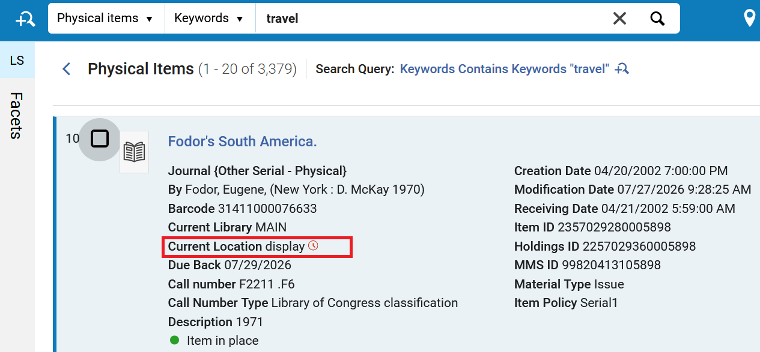
Temporary Location Icon
In the new repository searches, a clock icon indicates when items are in a temporary location. This icon was updated to show more prominently, making it easier to identify temporary locations at a glance.
Physical Items screen with Temporary Location icon
Cataloging
Circulation
Notes:
Cataloging and Circulation (Adrienne)

Slide 15
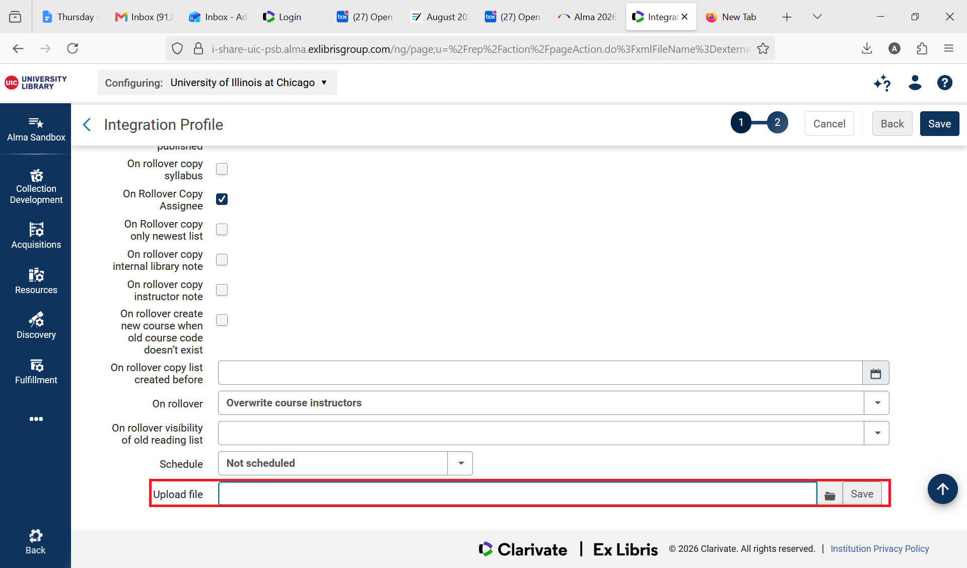
Course Loader Integration Profile Now Uploads Local Files
The Course Loader Integration Profile now enables users to upload a file containing course information directly from their computer.
The Course Loader Integration Profile still supports loading data from an FTP server.
Course Loader Integration Profile screen
Circulation
Notes:
Circulation (Adrienne)

Slide 16
Improved Use of Network Resources in Course Reading Lists
According to the release notes: Institutions can now add resources from the Network Zone directly to locally managed reading lists. When a Network Zone resource is used in a citation, the reading list will display its availability across the consortium, including Held By information for all participating libraries.
This functionality is still being tested by CARLI. We will contact the I-Share Liaisons when the testing is done.
Circulation
Notes:
Circulation (Adrienne)

Slide 17
Update: May Release Notes Settings that Need Re-Testing
CARLI staff met with the Resource Sharing Committee to test four settings from the May release notes, listed below.
Our initial testing was inconclusive, and the settings will need re-testing, with possible Ex Libris support tickets submitted.
CARLI staff will email the I-Share Liaisons and the Resource Sharing Interest Group (ResShar-IG) email lists once a conclusion is reached.
  Please subscribe to the CARLI ResShar-IG email list, if you have not already
Four May settings:
  Sharing Limits Across the Network
  Update of User Data for Fulfillment Network in Real Time
  Automatic Due‑Date Adjustment for Early Patron Expiry
  Prevent Requests for Blocked Loans
Circulation
Configuration
ILL/ Resource Sharing
Notes:
[Debbie]
In the May release notes, I mentioned four settings that the CARLI Office would be testing with the CARLI Resource Sharing Committee. We did meet to review those settings, and, our initial testing was inconclusive.
We will re-test those settings after the August release and will open tickets with Ex Libris support if the results are still inconclusive.
CARLI staff will email I-Share Liaisons and the Resource Sharing Interest Group email list once a conclusion is reached on the May release settings.
Please subscribe to the Resource Sharing Interest Group email list if you’re interested and you have not already.
The email list is open to anyone interested in Resource Sharing who would like to ask questions, to share information or strategies with their CARLI colleagues, and those who would like these email updates when they are sent.

Slide 18
Control Over Canceling Hold Requests in Transit
CARLI staff will test and discuss the setting with the CARLI Resource Sharing Committee; the decision to enable this setting, or not, will be a consortial decision.
This setting is not enabled by default.
Do NOT edit this setting in your library’s configuration.
  “A new circulation policy now allows libraries to determine whether a hold request can be canceled once it has been put in transit. This added control helps prevent unintended cancellations during fulfillment, strengthens workflow reliability, and ensures that items already en route continue through the process as intended.”
Circulation
Configuration
ILL/ Resource Sharing
Notes:
[Debbie]
The August release notes bring a new configuration setting that would make it possible to prevent a patron from canceling a request after the item has been put in transit.
Currently, Alma allows the patron to cancel the request up until the point that it is checked out to the patron’s account.
CARLI staff will test and discuss the setting with the CARLI Resource Sharing Committee.
The decision to enable this setting, or not, will be a consortial decision. Please do not make any edits to this setting at your library.
This setting is not enabled by default.

Slide 19
Consortial Fulfillment Limits
CARLI staff will test and discuss the setting with the CARLI Resource Sharing Committee; the decision to enable this setting, or not, will be a consortial decision.
This setting is not enabled by default.
Do NOT edit this setting in your library’s configuration.
  “Networks can now define fulfillment limits at the network level, enabling consistent policies across all member institutions. For example, a user group can be restricted to a maximum of 10 concurrent loans across the entire network.”
  These limits could be set to apply to the settings in the Patron Limits table in Alma Config, which include the Max Cash, Max Overdues, and Max Overdue Recalled limits.
Circulation
Configuration
ILL/ Resource Sharing
Notes:
[Debbie]
This is another setting that CARLI staff will test and discuss the setting with the CARLI Resource Sharing Committee.
The decision to enable this setting, or not, will be a consortial decision. Please do not make any edits to this setting at your library.
This setting is not enabled by default.
This has a lot of potential; those who have been at an I-Share library since we migrated from Voyager to Alma might remember that there were similarly described settings in Voyager for the overall “UB Limits.”
After testing this setting with the Resource Sharing Committee, and passing any questions along to Ex Libris support as needed, CARLI staff will be sure to keep you all informed of updates.

Slide 20
Three new 'Date Needed By’ options
The new settings are:
  Set 'Date Needed By' to Mandatory on Patron Physical Request
  New 'Date Needed By Period' Policy Type for Request Terms of Use Policies
  Autofill of Not needed after/Pickup Date Field
Alma uses the “Date Needed By” value to decide when to cancel a patron’s request.
  The “Date Needed By” is hidden on the I-Share request form; this is a consortial setting.
  Libraries may choose whether to show the “Date Needed By” field on their local request form, when their local patrons place a request for their library’s items.
  Previously, the “Date Needed By” could not be set as mandatory for staff placing a request for a patron in Alma.
If your institution offers local requests, and you offer the ‘Date Needed By’ field to patrons in the request form, please email CARLI Support to talk through these new options.
Circulation
Configuration
ILL/ Resource Sharing
Notes:
[Debbie]
The August release brings three setting updates for the “Date Needed By” in patron physical requests.
The release of the settings together is related.
Some background- Alma uses the “Date Needed By” value to decide when to cancel a patron’s request.
The Date Needed By field is evaluated independently of the Hold Shelf Period and may cause a request to be cancelled before or shortly after arrival, even if hold shelf time remains.
The “Date Needed By” is hidden on the I-Share request form; this is a consortial setting.
Libraries may choose whether to show the “Date Needed By” field on their local request form, when their local patrons place a request for their library’s items.
Previously, the “Date Needed By” could not be set as mandatory for staff placing a request for a patron in Alma.
If your institution offers local requests, and you’d like to learn more about:
Making the date mandatory for library staff placing local requests
Auto-populating the local request form with a default “date needed by” value (vs the current default of “blank” or no date).
Please email CARLI Support to schedule a meeting to talk through the implications of these settings in relation to your library’s specific configuration and needs, and see examples of how they would function.

Slide 21
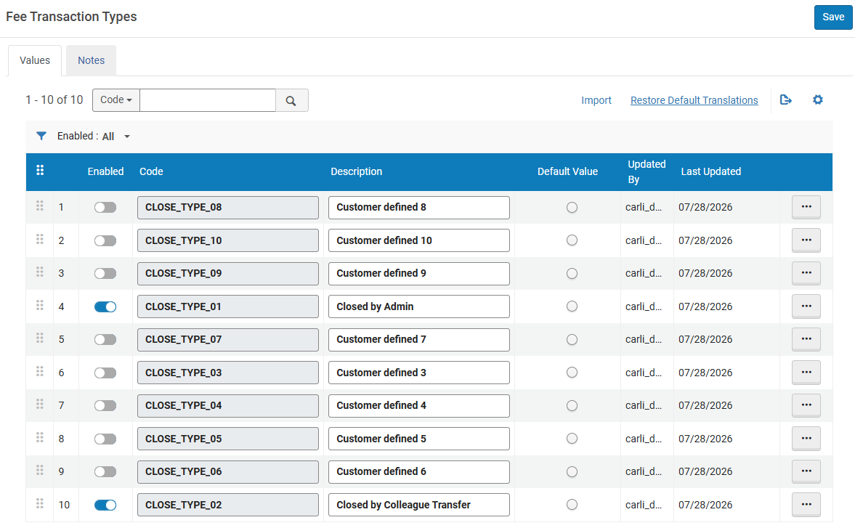
Configurable Closed Fee Statuses
Ex Libris has added 10 customizable “Closed Fee Transaction Types.”
Table located in Alma configuration at the institutional level> User Management> Patron Charges> Transaction Types.
Circulation
Configuration
Fee Transaction Type table in Alma Configuration
Notes:
[Debbie]
Alright, next up, Ex Libris has added what they’re calling “Configurable Closed Fee Statuses.”
Ex Libris says that these settings allow a library to define quote “their own labels for how fines and fees are resolved.”
This new configuration setting in Alma allows a library to add 10 new “closed feel transaction types” as shown on the screen here.
You might notice the default order is a little out-of-numeric-order; you can drag and drop them into code order if preferred.
You can see in this screenshot, I’ve set up two samples in a sandbox to review the functionality of this setting; they’re toggled to enabled with the description customized.
The setting is located in Alma configuration at the institutional level> User Management> Patron Charges> Transaction Types.
Before making any customizations to this table, please talk with your colleagues to make sure you’re in agreement for whether the transaction types are needed, and, how they will be used.

Slide 22
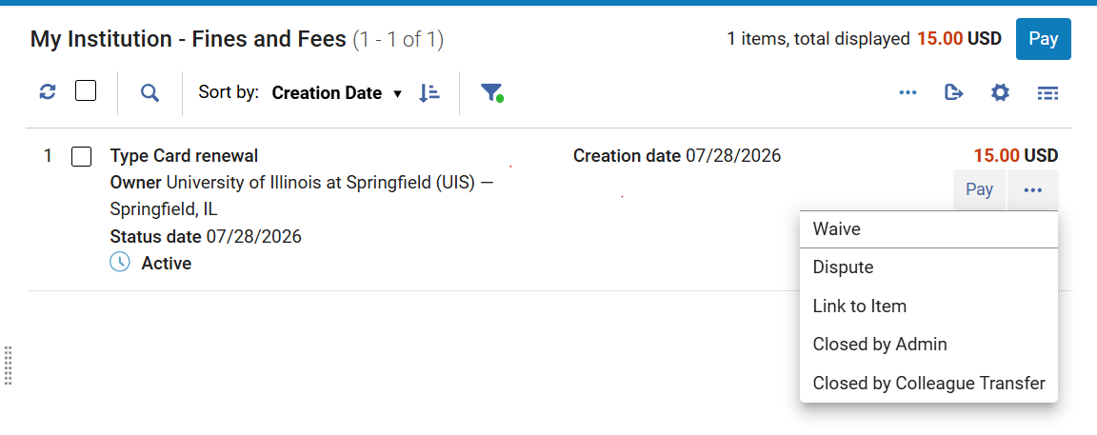
Configurable Closed Fee Statuses, cont’d
New transaction type options still require the fine/fee to be “paid”; this is not a new option to waive a fine, or, close a fine without payment.
Alma Analytics documentation for Fines and Fee
Circulation
Configuration
New statuses showing in the fine/fee options
Notes:
[Debbie]
In this screenshot, you can see a sample user’s fine/fee, where I’ve selected the row action ellipsis button. The two transaction types are now shown in list of actions.
In my testing; these new statuses still require the fine/fee to be PAID. This is not a waive- I still had to select a payment method offered by the circulation desk.
Since this setting is currently only available in the sandboxes until the August release, I was unable to confirm whether the library-defiled fee status would display in the “Fine Fee Transaction Type” field in Analytics; the type does not display in the user’s “closed” fines in Alma.
https://knowledge.ag-software.clarivate.com/alma/en-us/Product_Documentation/Analytics/Fines_and_Fees.html
Ex Libris also mentions that these transaction types can also be applied through the Bursar Import, enabling external systems to set the appropriate transaction type.
If your library uses Bursar transfer, and if this might be of use to you, the release notes provide a link to additional documentation.

Slide 23
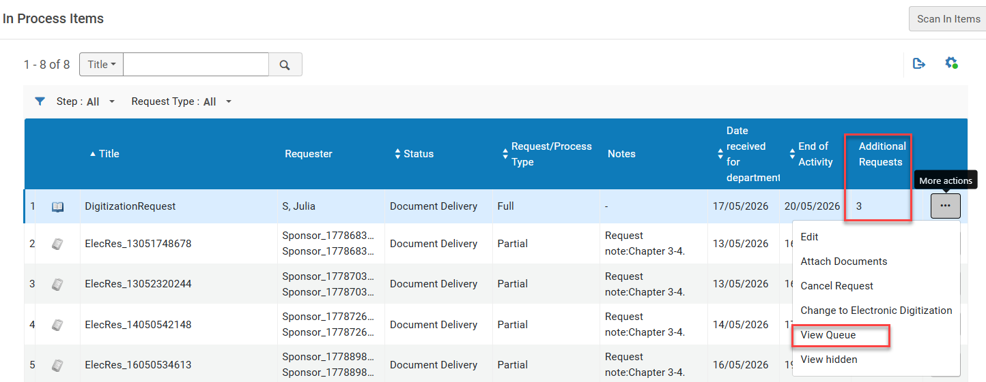
Digitization Request Queue Indicator
New “Additional Requests” column.
New “View Queue” option under the row action ellipsis.
The Manage In Process Items list
Circulation
Notes:
[Debbie]
If your library uses Alma Digitization for document delivery, the August release includes a new column for “Additional requests” that can be added to your table vie to display it.
The new “Additional Requests” column is hidden by default. Select the customization (gear) icon to display it.
When working in the “manage in-process items” list, staff can now also use the new “View Queue” option in the menu for the item to see the additional digitization requests.
Completing the active request automatically activates the next for the same item in the queue.

Slide 24
Cleanly Restore Items
Restoring an item from a temporary location
  Removes “Item is in Temporary Location” check
  Removes Temporary Location value.
To use this:
  Configuration > Fulfillment > General > Other Settings:
  Change the force_empty_temp_location_when_disabled parameter to true.
  Scan it items > Change Item Information: Change type: Restore.
Cataloging
Circulation
Notes:
[Debbie or Ted]
For items that have temporary locations assigned, taking one of these actions to restore the item will clear the Item is in temporary location value AND the temporary location itself. This will remove confusing data from the item record after it has been returned to the permanent location.

Slide 25
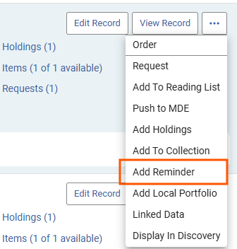
Bibliographic Reminders Tasks
Catalogers may add reminders to bibliographic records.
Reminders appear in the task list (clipboard icon on Alma menu bar)
Add a reminder on the bib record menu.
Bib Record Actions menu
Cataloging
Notes:
[Ted]
Catalogers may place reminders on bibliographic records that may need follow-up. The Add Reminder item appears on the action menu for a title in search results. Reminders that are current or past their due date will appear on the Alma tasks list, which is found using the clipboard icon on the menu bar, or from the Reminders link on the Resources menu.

Slide 26
Related Records Logic Needs Testing
Related records calculated on 773, 774, 800, 810, 811, & 830
New logic for the “Contains” relation on specific data in 773/774
CARLI will test before November indexing.
Please do not edit this setting in your IZ.
New "Contains" relation type logic:
• Only records with 773 with 2nd indicator ≠ 8 or 774 get the "Contains" relation.
• Records include "Contains" indication in the Alma staff search results and remain requestable in the Primo VE GetIt. New "Relation" relation type logic:
• Records with 800, 810, 811, 830 or 773 with 2nd indicator = 8 receive the "Relation" type.
• Records include "Relation" indication in the Alma staff search results and are not requestable in the Primo VE GetIt.
Cataloging
Configuration
Primo VE/ Discovery
Notes:
[Ted]
The new release introduces an optional change in logic for identifying related records with the Contains relationship. Contains frequently comes up with bound-withs and some series.
The existing relationship uses several fields and may result in the related records appearing in the Get It section of a Primo view. The new option will limit Contains to a specific combination of fields. Though other relations can still be displayed as well, the contains relation also affects requesting.
Ex Libris notes that selecting this option requires full indexing, which will next happen in November. CARLI staff will be investigating this before recommending which options to use, as Ex Libris also notes the change as irreversible. In the meantime, please leave this setting unchanged.

Slide 27
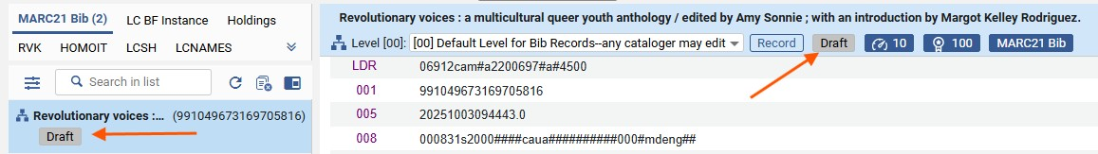
Metadata Editor Improvements
Rename normalization, indication, and merge rules
View “Draft” status of records with unsaved changes. A record in the metadata editor with unsaved changes will display the Draft badge.
Bib record with “Draft” badges
Cataloging
Notes:
[Ted]
In the metadata editor, we get two welcome improvements.
First, it will now be possible to rename normalization, indication, and merge rules. Previously the rule name could only be assigned when the rule was created.
Second, the Draft badge will appear on the records list to identify that a record has unsaved changes. Records that have Draft may be saved to commit changes, or released to discard any pending changes.

Slide 28
Future sessions on new functionality
Improvements to collection development reporting (Rialto)
Improvements to linked open data, BIBFRAME, crosswalks
Cataloging
Acquisitions
Analytics/Statistics
Notes:
[Ted]
In this and the last several releases, Ex Libris has added functionality for collection development and analysis, linked open data, BIBFRAME, and crosswalks among metadata schemas. A lot of these functions are new to many libraries, and most will require consortial cooperation. To go through all of these improvements out of context would be confusing for us, if not you in our audience. We’re planning sessions in the coming months to explore these functions further.

Slide 29
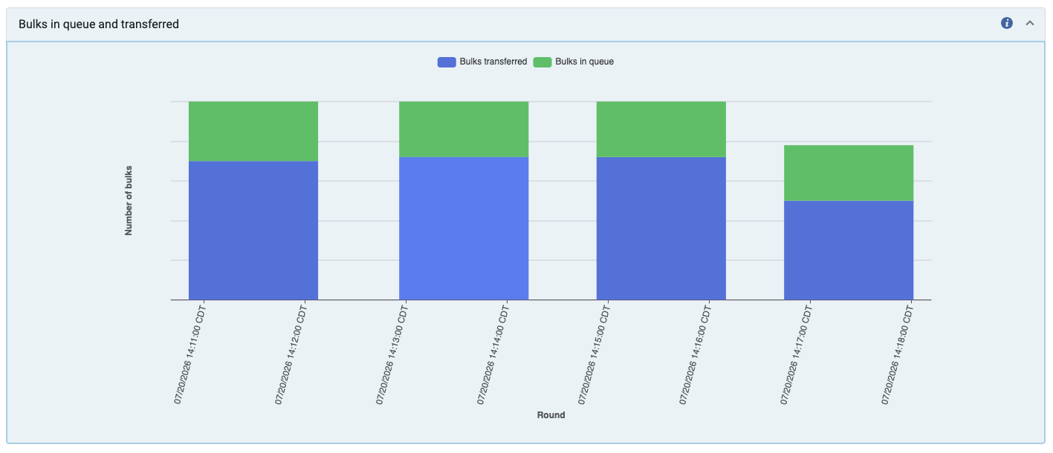
Progress Details for Jobs that use ”Bulks”
View an Ex Libris video recording training (57 mins.)
Bar graph of Bulks in queue and transferred. Bulks transferred are displayed in blue. Bulks in queue are displayed in green.
Everyone
Notes:
Everyone
(Marisa) You can now view progress details for jobs that use “bulks” in the History tab of Monitor Jobs in Alma. A ”bulk” is defined by Ex Libris as a “discrete unit of work from a splitting of the job population.” This means that large batch processes are chunked into smaller batch processes. For the jobs that use the bulks you will now see a View link displayed at the far right of the row for a job. When you click on the link, you will see many visuals about the job’s progress, such as: a line graph of Bulks waiting for processing, a bar chart of bulks in queue and transferred and progress rate distribution, as well as a timeline of submitted to end time. An example of one of these visuals is on the slide above. To learn more about this implementation, visit the video link being shared in the chat to view the training that was provided by Ex Libris about this feature release.

Slide 30
Improved Visibility of Centrally Managed Bibliographic Records
I-Share Electronic Stat 4: Unique Electronic Titles Including NZ
This report provides a title count of electronic titles active in your institution. The count includes bibliographic records in your institution zone (IZ) and shared to your IZ from the network zone (NZ). Records are deduplicated on title and counted only once for a given title. This may result in somewhat lower counts than raw electronic title counts if title information is generic.
Table of Bibliographic Details
More information about I-Share Electronic Stat 4
Analytics/Statistics
Electronic Resources Management
Notes:
Analytics/Statistics, Electronic Resources Management
(Marisa) Previously, I-Share libraries only had access to a small subset of bibliographic fields in alma Analytics. Since, the June release now I-Share libraries have access to a whole swath of bibliographic full details from Network e-resources. With this enhancement, CARLI I-Share libraries can now get the same information on unique titles that is supplied in the Electronic Stat 4 report of Unique Electronic Titles Including NZ. The list of full bibliographic details now available is in a table in the linked Ex Libris document. Further information about the I-Share Electronic Stat 4 report is on the CARLI webpage, “I-Share Annual Statistical Package for Alma Data” and is linked to in the chat.

Slide 31
Support for Wildcards in “Phrase Searches” in Primo VE
“synchronized swim*”
“librar* behavior”
“gr?y matter”
Using Wildcards in Phrase Searches in Primo VE
Note: Wildcard searching in phrases will not retrieve CDI records until August 5.
Primo VE/ Discovery
Notes:
Primo VE/Discovery
(Marisa) Now supported! Wildcard characters asterisk and question mark are supported as phrase searches, meaning you need to enclose your wildcard search in quotation marks. You can conduct these types of searches in Basic and Advanced Search. This is available in Primo VE and NDE, as well as CDI searches. Wildcards can be used as a prefix, suffix, or in the middle of a word. There are examples of the wildcard phrase searches on the slide. A note that this enhancement does not apply to the “starts with” or “contains (exact)” search operators. For more information about this enhancement see the link for Using Wildcards in Phrases Searches in Primo VE.

Slide 32

Important Security Update: Change to Email Action in Primo VE
As of May 27, 2026, Email from Primo VE must be sent through an email client on the device
This change is to enhance security and reduce exposure to phishing-related risks
If the user's device has no default email-client configured, selecting the Email action opens a blank window, and nothing is sent
Bulk emailing of selected records is also no longer supported
  Export All and Export to Excel actions are still supported
If you wish to disable the Email Action, it is configured in the Brief Record Display tab of View Configuration
Primo VE/ Discovery
Configuration
Notes:
Primo VE/ Discovery
(Jessica) On May 27, 2026, Ex Libris made a change to the “Email” action option that can appear in the Brief Display and the “Send to” area of the Full Record display in Primo VE. This change is to prevent abuse, phishing, and spam.
Previously, the Email action would open a small pop-up to allow the user to input an email address to send a record to via email. Now, this function will try to open the native email client on the device to send the email. If the user's device has no default email-client configured, selecting the Email action opens a blank window, and nothing is sent.
Email from Primo can no longer be sent without an email client. Bulk emailing of selected records is no longer supported. The Export All and Export to Excel actions are still supported.
We have heard that some other Alma/Primo customers are choosing to disable the Email Action option due to this change in behavior. Record Actions including the “Email” action are configured in the Brief Record Display tab of View Configuration of Primo VE. If you choose to make an adjustment, be sure to consult and share with other staff at your institution who may need to know about it.

Slide 33
Limitations on the Number of Search Results in Primo (1 of 2)
In the June 2026 release, the search results limits were changed to:
  Guest users can only access the first 250 results in the results list.
  Signed-in users can only access the first 2000 results in the results list.
Upon reaching the limit, the user is prompted to sign in.
  If they sign in, the search results page is displayed with more results.
  If they do not, a message indicating “Sign in to view full results” is displayed.
If a signed-in user attempts to access more than 2000 results, they will see a message “You have reached the maximum number of results to display. To get more relevant results, please refine your search term.”
Primo VE/ Discovery
Notes:
(Jessica) Primo VE/Discovery
In the last quarterly release webinar for May 2026, we told you that Ex Libris had put in place a limit of 500 search results in the April software release in order to protect the system from bot traffic and service disruptions with a better solution coming in June 2026.
In the June 2026 release, the search results limitations were changed to:
Guest users can only access the first 250 results in the results list.
Signed-in users can only access the first 2000 results in the results list.
This is the current behavior today:
Upon reaching the limitations, the user is prompted to sign in. If they sign in, the search results page is displayed with more results. If they do not, a message indicating “Sign in to view full results” is displayed.
If a signed-in user attempts to access more than 2000 results, they will see a message “You have reached the maximum number of results to display. To get more relevant results, please refine your search term.”
This limitation may also be encountered if the user follows a deep link into Primo search results with an offset greater than 250, which is probably an unusual occurrence, but worth mentioning.

Slide 34
Limitations on the Number of Search Results in Primo (2 of 2)
I-Share Libraries are encouraged to test this behavior before the fall semester begins.
Reach out to CARLI Support with any questions about labels or login help links.
In September 2026, there will be further refinement to allow for more search results from Guest users if CAPTCHA verification is enabled in Primo.
  CARLI will share this information with I-Share Liaisons and the CARLI Primo VE Interest Group email list.
Primo VE/ Discovery
Notes:
(Jessica) Primo VE/Discovery
Before the fall semester starts, CARLI encourages all I-Share libraries to test the Primo search limitations as both a Guest and a Signed-in User so that you can see exactly what your users will experience in advance. If you have any questions about which labels are customizable, or how to add login help links to the authentication box in Primo, please reach out to CARLI Support.
In September, Ex Libris will be further refining the behavior of search results to allow for more search results from Guest users if the CAPTCHA verification option is enabled in your Primo, and a “full browsing experience” for signed-in users. CARLI will share that information with the I-Share Liaisons and CARLI Primo Interest Group email lists when it becomes available with additional configuration instructions.

Slide 35
Primo VE NDE Update
“Primo VE NDE UI: Share, Learn, and Ask” session was held on June 17, 2026. It was not recorded but summary notes were posted in the CARLI Primo NDE Implementation Basecamp
  Next session will be Tuesday, Sept. 22, 2026 from 2:00-3:00pm
If you want to join the Basecamp for all CARLI libraries implementing NDE UI, send an email to support@carli.illinois.edu with your name and email address
CARLI’s Primo VE NDE UI for I-Share webpage
  Lists status of major known consortial issues
  Links to documentation and information
Primo VE/ Discovery
Notes:
(Jessica) Primo VE/Discovery
The CARLI Primo VE Discovery Committee held a “Share, learn, and ask” session on June 17 for member libraries to share information and ask questions about NDE. This session was not recorded but notes were posted in our CARLI Primo NDE Implementation Basecamp. The Committee will be hosting another session on Tuesday, Sept. 22, 2026 at 2pm, so watch for an announcement in Basecamp and to our Primo VE interest group email list, PVE-ig.
We already have had representatives from several libraries join the Basecamp, and we hope it will be a good way for libraries to share information as we all transition to Primo VE NDE UI! If you or someone else at your library would like to join, send a message to CARLI Support.
And a friendly reminder about CARLI’s Primo VE NDE UI for I-Share webpage where you will find we have posted the status of known consorital issues with the NDE. Please remember that our list on this page is not comprehensive as there are over one hundred known issues with Primo NDE that I counted in Ex Libris’s own Known Issues Portal planned or scheduled to be fixed. In addition, on CARLI’s webpage, there are also many links to documentation and information.

Slide 36
Specto / Specto Starter / Alma Digital
Alma Digital (Alma-D) is being rebranded as Specto Starter.
Reminder: Alma Digital (now Specto Starter) is not included as a CARLI-provided offering in the current Ex Libris contract for Alma/Primo for I-Share. A separate subscription is required to use the product within Alma.
  Only two I-Share libraries have subscribed (Knox College, and DePaul University).
In the August release, Ex Libris set the Specto menu to appear in Alma unless a configuration is set to opt-out regardless of subscription status.
  CARLI staff have set this to disable access to the Specto menu in all I-Share IZs (except KNX and DPU).
If you have any questions, contact CARLI Support.
Notes:
(Jessica)
And finally, if you have read the August Alma release notes or are subscribed to the Alma-L customer email list, you may have heard about Specto!
The Alma Digital product, also known as Alma-D, is being rebranded as Specto Starter
As a reminder: Alma Digital (now Specto Starter) is not included in the current I-Share contract for Alma. A separate subscription is required to use it, and the only I-Share libraries that are subscribed are Knox College and DePaul University.
Unfortunately, in the August release, Ex Libris has made the decision to set a new Specto menu to appear in Alma for all customers unless a configuration is disabled. To avoid confusion for I-Share libraries, CARLI staff have disabled access to Specto in all I-Share IZs (except KNX and DPU).
If you have any questions, let us know at CARLI Support.

Slide 37
Questions?
support@carli.Illinois.edu

