Slide 1
I-Share Alma Primo VE Release Updates Webinar Will Start Shortly
Welcome!
The webinar will start at 1pm and run until 2pm. Please mute your microphone. As time permits, we will respond to questions typed in the chat box, and offline afterwards, as needed.
This session will be recorded and made available on the CARLI website.

Slide 2
May 2026 Alma and Primo Quarterly Release Notes Webinar
April 30, 2026

Slide 3
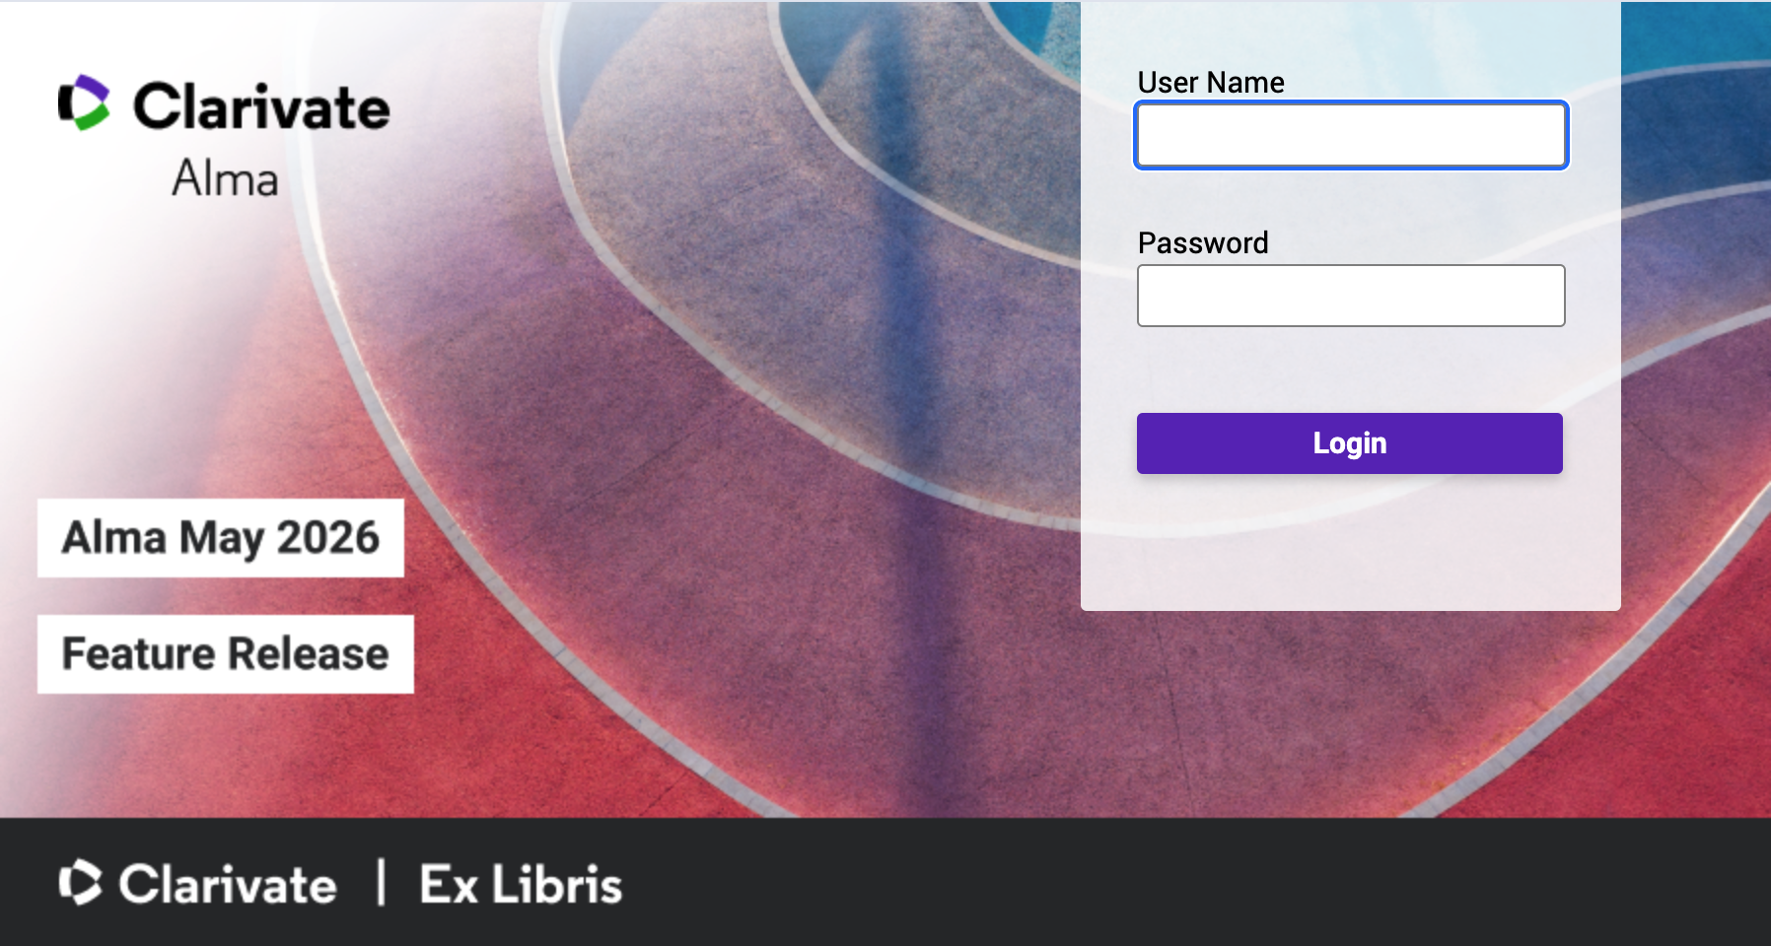
Today’s Agenda
Announcements, Events, and Reminders
May 2026 Quarterly Release Features
Alma features
Primo VE features
Q&A
Today’s session is being recorded and will be posted to the CARLI website.
Alma login page
Notes:
Today’s agenda starts with Announcements, Events, and Reminders
Then May 2026 Quarterly Release Features
Alma features
Primo VE features
And finally, Q&A
Today’s session is being recorded and will be posted to the CARLI website.

Slide 4
Announcements and Events
Sunday, May 3 - The May Alma/Primo VE Feature Release will be available in production
Thursday, May 7, 2:00pm to 3:15pm - Exploring Alma Analytics Together: A CMC Community Chat
Friday, May 8, 1:00pm to 2:00pm - CARLI Resource Sharing Committee Textbook and Course Materials Collections: A Discussion
Tuesday-Wednesday, May 19-20 - CARLI Staff Retreat (There may be a delay in ticket responses; thanks for your patience!)
Monday, May 25 - CARLI Office Closed for Memorial Day
Wednesday, May 27, 9:00 to 9:45am - Electronic Resources Management Team (ERMT)
Notes:
This slide has some announcements and upcoming events. See the CARLI Calendar for a full list!
Most importantly, the May Feature Release we will be discussing today will be available in production on Sunday, May 3rd.

Slide 5
Reminders
The form for CARLI Committee volunteers is open until May 1– tomorrow! Please consider volunteering and share this opportunity with your colleagues.
Managing EBSCO E-Collections in the Institution Zone project deadline May 1.
CARLI Committee Annual Reports due June 1.
Notes:
A few quick reminders!
The volunteer form for CARLI Committees is open through tomorrow, Friday, May 1. CARLI Committees are an integral part of our consortium, and we have had an unusually low number of volunteers this year. Please consider volunteering and share with your colleagues.
The Managing EBSCO E-Collections in the Institution Zone project deadline is also coming up tomorrow, May 1.
And finally, CARLI Committee Annual Reports will be due June 1.

Slide 6
Reminders (2 of 2)
In this webinar, CARLI Staff are sharing the updates we feel are most important to the I-Share environment.
Staff at I-Share libraries can review the full set of release notes available from the Alma and Primo VE Support Pages:
Alma Release Notes
Primo VE Release Notes
Slides have been marked with audience tags:
Acquisitions
Cataloging
Circulation
Configuration
ILL/ Resource Sharing
Everyone
Electronic Resources Management
Primo VE/ Discovery
Notes:
In today’s presentation, we are highlighting those updates in Alma and Primo VE that are the most important to the I-Share environment. In the interest of time, we’re not covering everything, so we encourage you to review the release notes yourself. You may find something that is practical to your local uses, though you will also encounter some updates that don’t apply in I-Share at all. If you have any questions about updates, please contact us at support@carli.illinois.edu.
Slides have been marked with audience tags to help you get information to the right people at your institution.
These slides are available for download on the CARLI website.

Slide 7
Sharing Limits Across the Network
With the Alma “release update” on May 10th, this setting will be released to both the Production and Sandbox environments.
This setting cannot be tested until then.
This setting is not enabled by default.
CARLI staff will test the setting and discuss with the CARLI Resource Sharing Committee.
“Libraries participating in a fulfillment network can now apply their local patron limits, such as maximum loans, requests, cash balance, or overdue thresholds, across the entire consortium. When a patron reaches a defined limit at any institution in the network, a library may choose to block the patron’s activity locally. This supports consistent policy enforcement and improved fairness by helping maintain equitable access to shared resources across the consortium, and it supports stronger network governance.”
Circulation
Configuration
ILL/ Resource Sharing
Notes:
[Circulation][ILL/Resource Sharing][Configuration]
(Debbie)

Slide 8
Update of User Data for Fulfillment Network in Real Time
The May Release Notes say that: “When the source institution of a user changes user details, all of its linked accounts now receive this update in real time. This update will help ensure that linked account information is consistent and accurate across all institutions.”
These automatic user record updates were not seen while testing in the Sandbox, but Sandboxes do not always function “real time” like Production.
CARLI staff will double-check this new functionality is working as anticipated in Production after the May Release.
Circulation
ILL/ Resource Sharing
Notes:
[Circulation][ILL/Resource Sharing]
(Debbie)

Slide 9
Automatic Due‑Date Adjustment for Early Patron Expiry
Reminder: Fulfillment Jobs configuration has consortial requirements and should only be modified by CARLI Office Staff: Alma Configuration Settings That Should Not Be Changed
CARLI staff will do some further testing of the new job and discuss with the CARLI Resource Sharing Committee before enabling.
Ex Libris has added a new job to Alma, “Update Loans for Shortened User Expiry”
Alma can now automatically update a patron's loan due dates when a patron's expiry date is moved to be earlier.
If a loan’s due date extends beyond the new patron expiry date, the system can now adjust it to ensure the loan does not exceed the user record expiration date.
Claim returned and lost status loans are excluded.
The job sends the patron the “Loan Status Notice” letter.
Circulation
Configuration
ILL/ Resource Sharing
Notes:
[Circulation][ILL/Resource Sharing][Configuration]
(Debbie)

Slide 10
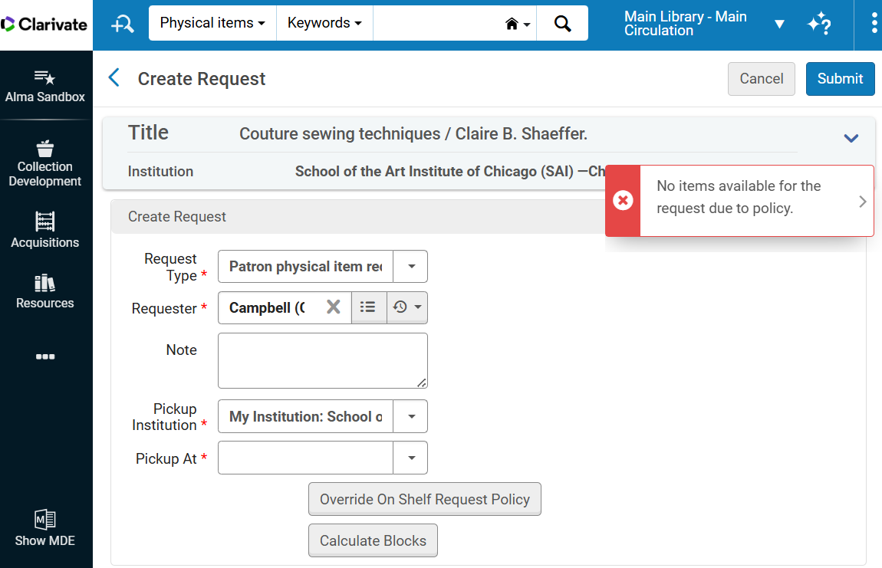
Prevent Requests for Blocked Loans
CARLI Office Staff will do more testing of the new ability to “prevent requests for blocked loans” to determine it is working as anticipated.
This block appears to apply to both local and I-Share requests, both for staff in Alma, and the patron in Primo VE.
“Alma can be configured to block item requests when a patron is not eligible to loan the item, based on its loan terms of use or any existing blocks on the patron.”
Warning message given when request is attempted, and loan prevented due to patron limit. Pressing the “Calculate Blocks” button will provide more details.
Circulation
Configuration
ILL/ Resource Sharing
Notes:
[Circulation][ILL/Resource Sharing][Configuration]
(Debbie)

Slide 11
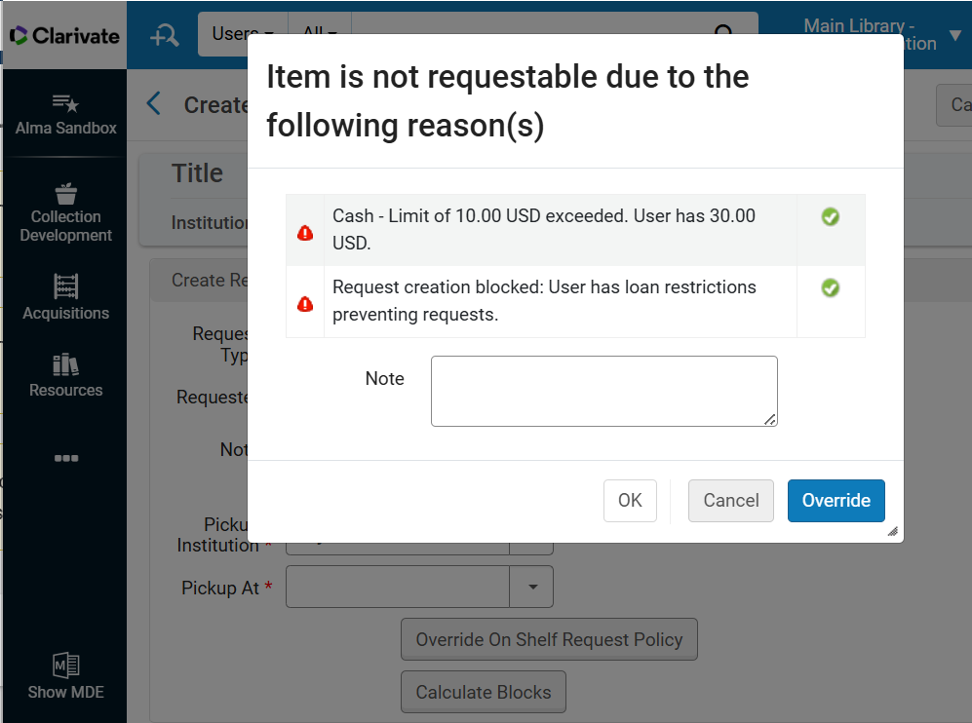
Improved Navigation for Hold Blocks Information
“The display of block information during hold, booking, and digitization request creation has been redesigned to streamline the workflow and reduce interruptions. Previously, block details appeared in a pop‑up after entering the Requester in the request form. Now, this information will only pop up after selecting the Calculate Blocks button in the request form, allowing staff to review block status only when needed.”
After “Calculate Blocks” is selected, Alma will display the pop-up with the reasons that the patron’s request was blocked and provide the option to override that was made available in the February release.
Circulation
Configuration
ILL/ Resource Sharing
Notes:
[Circulation][ILL/Resource Sharing][Configuration]
(Debbie)

Slide 12
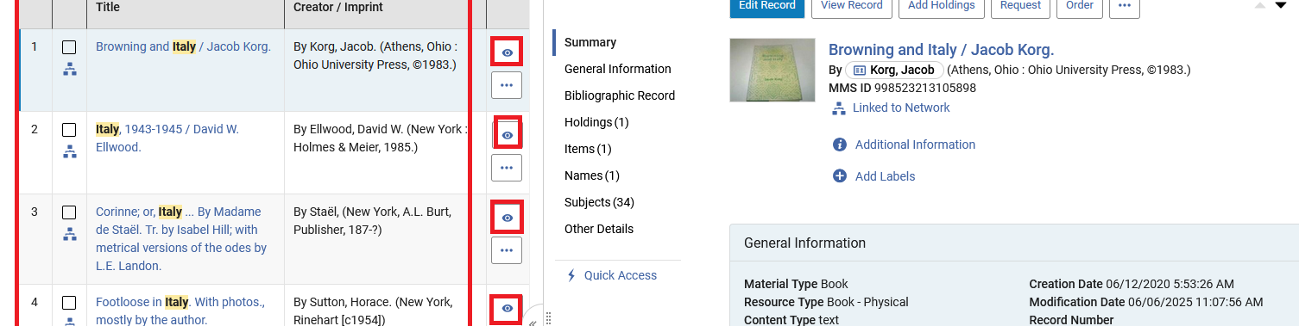
Table View Split Screen
When in table view for a list, such as physical items, you can open the right details pane by clicking the eye icon. In split screen, the first two columns of the table are displayed along with the eye icon for each listing. Clicking the eye icon will change the details page to the one for the listing.
Physical Titles search in table view with a split screen showing the details pane
Everyone
Notes:
[Everyone] (Adrienne)

Slide 13
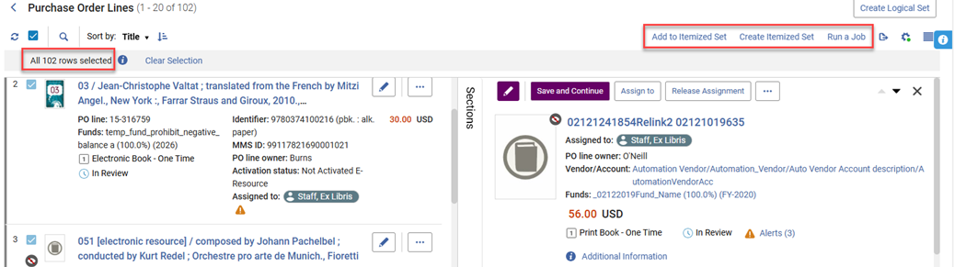
Support for Create Itemized Set and Add to Itemized Set Actions When Using Select All
For the lists that support the Select All option and for users with roles that support creating sets, the Select All functionality was enhanced to support two additional bulk actions: Create Itemized Set and Add to Itemized Set.
Add to Itemized Set, Create Itemized Set, and Run a Job options when Select All is selected
Everyone
Notes:
[Everyone] (Adrienne)

Slide 14
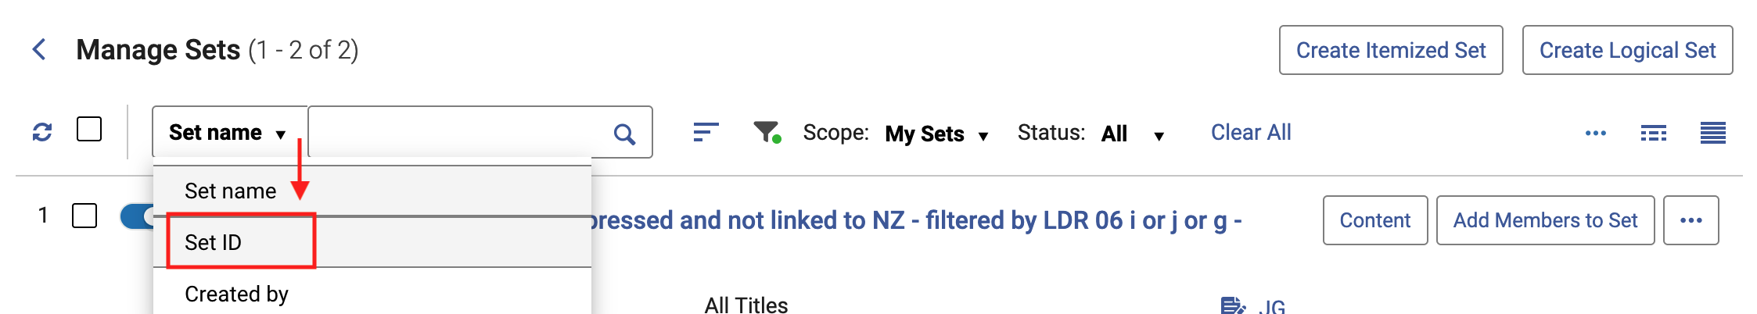
Search by Set ID in Manage Sets
A new “Set ID” search option was added to the Manage Sets screen. The search by ID is an exact match search and requires the full ID number.
Set searching options include Set name, Set ID, and Created by.
Everyone
Notes:
[Everyone] (Adrienne)

Slide 15
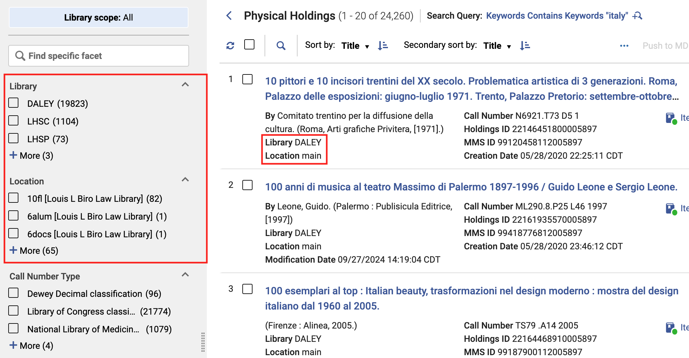
Enhanced Handling of Library and Location in the Physical Holdings Search
Facet by location without first faceting by library — the library name is displayed in brackets after the location name to distinguish between similar locations in different libraries.
See the library and location information according to the Repository search results configuration in the record view, facets and export to Excel.
Physical Holdings search with library and location highlighted
Everyone
Notes:
[Everyone] (Adrienne)

Slide 16
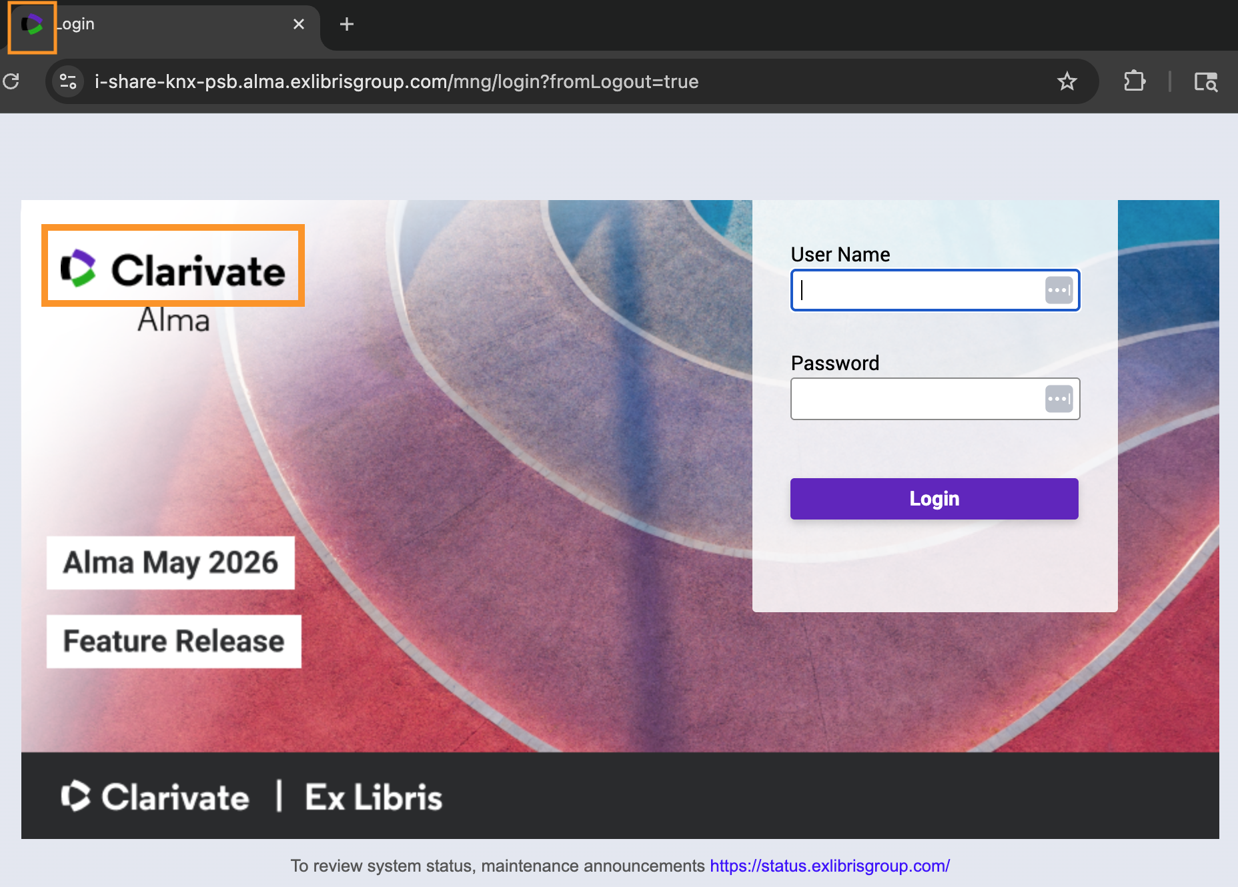

Rebranding of Ex Libris/Clarivate logos
Ex Libris/Clarivate logos were rebranded and now appear in Alma as well as other Ex Libris sites
Your institution’s customized logos will not be changed.
Alma login page with new logos.
Everyone
Notes:
[Everyone] (Adrienne)

Slide 17
Expanded List of Resource Types
Resource types in Alma are based off record Leader, 007, 008 values.
E.g., Book – Physical, Projected Medium – Electronic, etc.
Typically used as facets on titles search results or in Analytics.
New resource types will become available in June after semi-annual indexing.
Audio Musical (serial); Audio Musical (Integrating resource), Game – Physical
Magazine, Updating Database, Blog, Repository, Newsletter, etc.
Cataloging
Notes:
(Adrienne)[Cataloging]
Alma already includes a detailed list of resource types that distinguish records based on values in the MARC record leader, 007, and 008 fields. These resource types may be used to search for bibliographic records in Alma or Analytics, and they appear as facets for Alma titles searches.
In this release, 36 new resource types will be added and 6 existing types will receive updated definitions. All definitions are visible at the resource types list in Alma documentation <https://knowledge.exlibrisgroup.com/Alma/Product_Documentation/010Alma_Online_Help_(English)/010Getting_Started/050Alma_User_Interface_%E2%80%93_General_Information/Searching_in_Alma?mt-draft=true#Rules_Used_to_Create_the_Resource_Type_Field_MARC_21_KORMARC_and_UNIMARC>.
These new resource types will not be fully visible in Alma until after semi-annual indexing is finished in June.

Slide 18
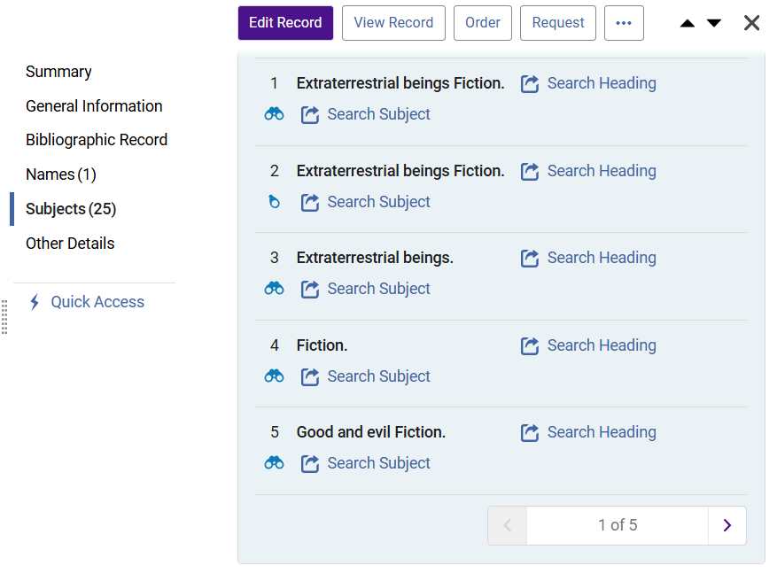
Linked Heading Visibility
Names and Subjects on simple record display show links.
Useful when following titles from the Authority Control Task List.
Looking glass icons show if headings are linked.
Cataloging
Notes:
(Bradley)[Cataloging]
An improvement that will benefit everyone, but mostly appeal to catalogers, is the inclusion of linked heading icons on the simple record display screen. Name headings and subject headings will include the icons next to the term if the heading is fully linked or partially linked. Previously, these icons were only visible in the metadata editor. Catalogers that work with the authority control task list may appreciate seeing these records a step earlier in the process of linking from the list to the record.

Slide 19
Alma AI Assistant for Acquisitions Funds and Ledgers General Availability
FYI about this AI Assistant exiting Beta testing.
The AI Assistant works with Acquisitions - Funds and Ledgers. Staff users with the Fund/Ledger Manager role can ask questions about their institution’s funds and ledgers and receive immediate, natural-language responses.
After the beta testing additional functionality has been added to allow the assistant to transfer and allocate Funds
View a short video about transfer actions from within the AI chat
Administrators can choose to activate the feature in Configuration > Acquisitions > AI Features > Alma AI Assistant (Funds and Ledgers) Toggled to On
Acquisitions
Configuration
Notes:
[Acquisitions][Configuration]
(Bradley)
As mentioned in February’s release update, Alma has an AI Assistant for Acquisitions Funds and Ledgers. This tool is now out of Beta.
The Acquisitions AI Assistant works with Funds and Ledgers for staff users that have the Fund/Ledger Manager role. It allows natural language questions about funds and ledgers that are answered with immediate natural language responses. Functionality added after the beta release includes the ability of the assistant to transfer and allocate funds.
Administrators can choose to activate the feature in Configuration > Acquisitions > AI Features > Toggle Alma Ai Assistant (Funds and Ledgers) to On.

Slide 20
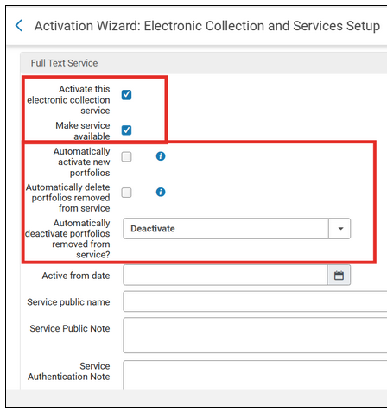
New Settings for Portfolios
“Automatically deactivate portfolios removed from service?” menu options:
Deactivate
Keep all active
Keep perpetual access portfolios active
More information about Activating an Electronic Collection from the Community Zone and the new options.
The new setting, “Automatically deactivate portfolios removed from service?” in the Activation Wizard.
Electronic Resources Management
Notes:
[Electronic Resource Management]
(Marisa created, Yanira present)
(Yanira) There are new settings for portfolios when activating an electronic collection or when an electronic collection is already active, and you want to modify settings for how portfolios being removed from the community are handled.
Pictured above is the activation wizard screen when activating an electronic collection. The screenshot is focusing on the Full Text Service options. There are four boxes to check and now a fifth option available with a drop-down menu. The new option is “automatically deactivate portfolios removed from service question mark” and has the following choices: “deactivate” which is the default where portfolios are unlinked from the CZ and set to Not Available in the institution, there is ”keep all active,” which is portfolios are unlinked from the CZ but remain available in the institution, and there is “keep perpetual access portfolios active,” which is portfolios are unlinked from the CZ and handled based on their access type.
There are two things to note with these new options:
The automatic deactivation option is only relevant when the “Automatically delete portfolios removed from service” box is NOT checked.
When the “keep perpetual access portfolios active” option is for a portfolio with no access type defined, then the collection’s access type will be used.

Slide 21
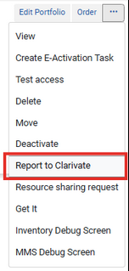
Electronic Resource Incident Reporting
Modifications to Incident Reporting in Alma Portfolios:
“Report to Ex Libris” has been replaced with “Report to Clarivate”.
The ”Additional info:” section of the incident report now includes the following:
Autoholdings indication and if profile is defined
Provider collection ID and name
DBID
Portfolio ID (local/IZ and global/CZ)
The “more actions” menu for a portfolio in Alma.
Electronic Resources Management
Notes:
[Electronic Resource Management]
(Marisa created, Yanira present)
(Yanira) There have been modifications to the incident reporting for electronic resources in Alma. Where it used to say, “Report to Ex Libris” it has now been re-branded to say, “Report to Clarivate.” See the image on the slide for reference. Also, when you select to make a report to Clarivate there are things added to the Additional info section of the report. These are an autoholdings indication to denote when a portfolio is in an autoholdings e-collection and if the autoholdings profile is defined, the provider collection ID and name are included, as well as the DBID, and the portfolio IDs for the IZ and CZ.

Slide 22
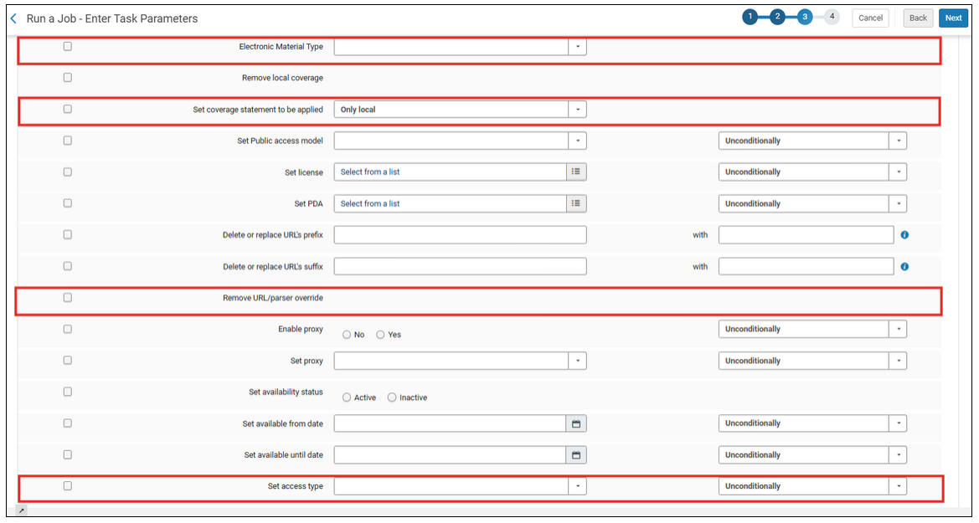
Updates to Change Electronic Portfolio Information Job
New additions:
Electronic Material Type
Set coverage statement to be applied
Remove URL/parser override
Set access type
Four new options that have been added to the ”Change electronic portfolio information job.”
Electronic Resources Management
Notes:
[Electronic Resource Management]
(Marisa created, Yanira present)
(Yanira) The “Change electronic portfolio information job” has four new task parameters added, they are:
Electronic Material Type
Set coverage statement to be applied
Remove URL/parser override
Set access type
The electronic material type now includes an empty value that clears the field. This will overwrite any field in the IZ, when the portfolio is linked to the CZ. The set coverage statement to be applied is a new dropdown with the choices: only local, global and local, or only global and these options when selected will not update standalone portfolios. The remove URL/parser override is a new option that clears all URL or parser override fields in the portfolio linking tab. The set access type that updates the portfolio’s access type field from the following options: current, perpetual, current and perpetual, or empty and you can also apply one of the following conditions: if field empty, if field not empty, or unconditionally.

Slide 23
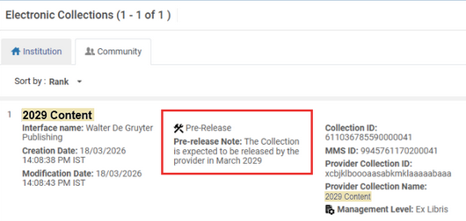
Notice of Upcoming Electronic Collections
Pre-release notes and information about upcoming electronic collections will be featured in the middle of the interface name and collection ID in the CZ.
More information included in the Community Zone about upcoming electronic collections.
Electronic Resources Management
Notes:
[Electronic Resource Management]
(Marisa created, Yanira present)
(Yanira) This feature release is being slowly rolled out starting with content provided by the Adam Matthew company. As seen in the image, upcoming e-collections with no portfolios yet loaded into Alma will have a collection ID and notes about the pre-release that act as a placeholder. In the future, this placeholder and e-collection ID will be useful information for calendar year and fiscal year purchases where there is a new e-collection added every year, but sometimes is not available for a few months. Examples of this are the Sage and Wiley calendar year journal and database collections where the e-collection name is the same, but a few new portfolios are added to the new year e-collection.

Slide 24
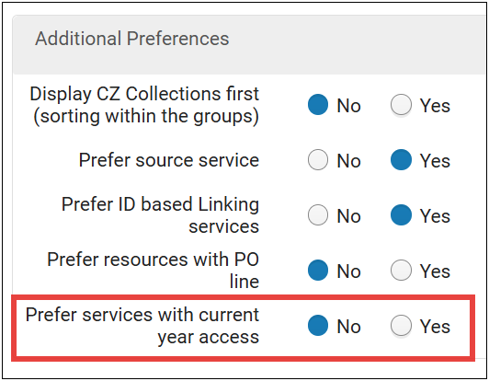
Online Services Order Configuration Improvement
Current year access can now be prioritized – pushed to the top of the list in Primo VE!
Prefer services with current year access option when configuring online services order.
Electronic Resources Management
Primo VE/ Discovery
Notes:
[Electronic Resource Management] and [Primo/Discovery]
Marisa created, Yanira presented
(Yanira) When configuring Online Services Order, you can now select the option to “prefer services with current year access.” This new option is in the Additional Preferences section and prioritizes the Network Zone services and Institution Zone services together with current access. This setting enables institutions to prioritize services with coverage dates that have current calendar year access. This setting is set to “no” by default. When it is set to “yes,” Alma pushes current year access resources to the top of the list taking priority over all other criteria in the Additional Preferences section. Note that this is according to the portfolio’s coverage and takes embargo definitions into account.

Slide 25
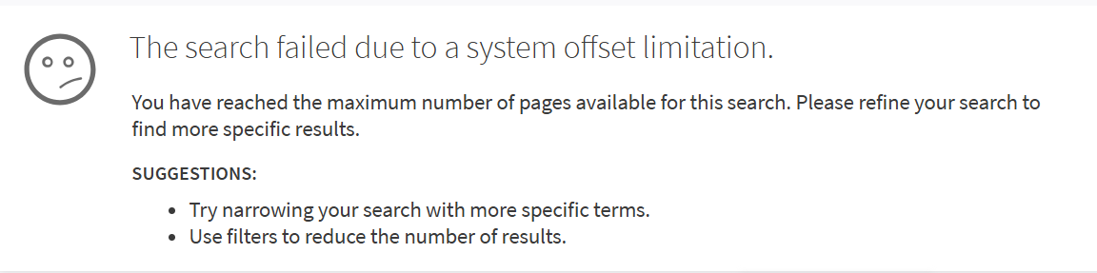
Temporary Search Result Limit of 500
Due to increased automated (bot) traffic causing slowness and potential service disruptions, a temporary limit of 500 results in Primo VE was introduced in April 2026.
Ex Libris plans for a full solution with the June 2026 release, which will require users to authenticate to see more than 500 results.
Message users will see after 500 results in Primo VE
Primo VE/ Discovery
Notes:
(Jessica) [Primo VE/Discovery]
Due to increased automated (bot) traffic causing slowness and potential service disruptions, a temporary limit of 500 results was introduced in the April release and will continue until a full solution is implemented, which is planned for June 2026. This immediate action helps maintain system stability. After reaching the limit, users will see this message: The search failed due to a system offset limitation, with suggestions on how to refine the search for more specific results.

Slide 26
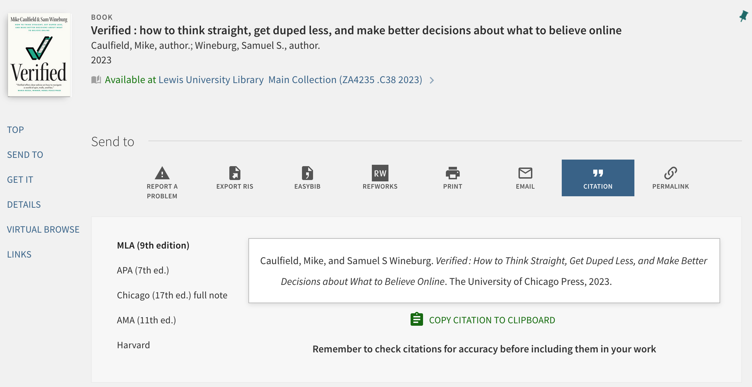
Citation Style Language (CSL) Updates
CSLs in the May release were refreshed as of February 2026
I-Share libraries should plan to test Citations in Primo VE at least quarterly
See Managing Citations Styles for Primo VE
Full record in Primo VE with the Citation Action selected
Primo VE/ Discovery
Notes:
(Jessica) [Primo VE/Discovery]
As we first mentioned in the February webinar, starting in 2026, Ex Libris has moved to a regular update schedule for Citation Style Languages or CSLs to reduce the gap in time between new editions being available and customers being able to use them in Primo VE. The Citations featured in Primo VE use the open-source GitHub CSL Style Repository for their formatting. Some citations are available out of the box, and libraries can add or update the citations.
In the upcoming May release, styles have been refreshed from a snapshot taken in February 2026. CARLI recommends that I-Share libraries check the Citation sections in Primo VE quarterly to see that they are working properly as you may need to update the configurations.
For more information, see Ex Libris’s documentation ”Managing Citation Styles for Primo VE” or reach out to CARLI Support and we can help you update them, if needed.

Slide 27
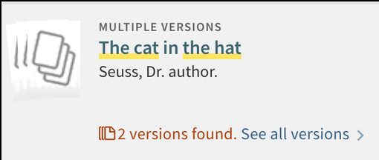
Expanded Options for Preferred FRBR Record
Additional options for preferred FRBR record display
CARLI’s Primo VE Dedup and FRBR page
Ex Libris documentation on Configuring FRBR/Dedup Options
A search result in Primo VE of a FRBR Group with 2 versions found.
Primo VE/ Discovery
Notes:
(Jessica) [Primo VE/Discovery]
There are now additional levels of criteria that libraries can choose for Primo VE to select a preferred record in a FRBR Group to display in the search results.
By default, unless you’ve disabled in your View, Primo VE automatically performs record deduplication and record FRBR-ization when displaying search results. FRBR stands for the Functional Requirements for Bibliographic Records published by the International Federation of Library Associations and Institutions, or IFLA.
For more information you can see CARLI’s website (https://www.carli.illinois.edu/products-services/i-share/discovery-interface/dedup_frbr) or the Ex Libris documentation page (https://knowledge.exlibrisgroup.com/Primo/Product_Documentation/020Primo_VE/Primo_VE_(English)/050Display_Configuration/010Configuring_Discovery_Views_for_Primo_VE#Configuring_FRBR.2FDedup_Display_Optionsr)

Slide 28
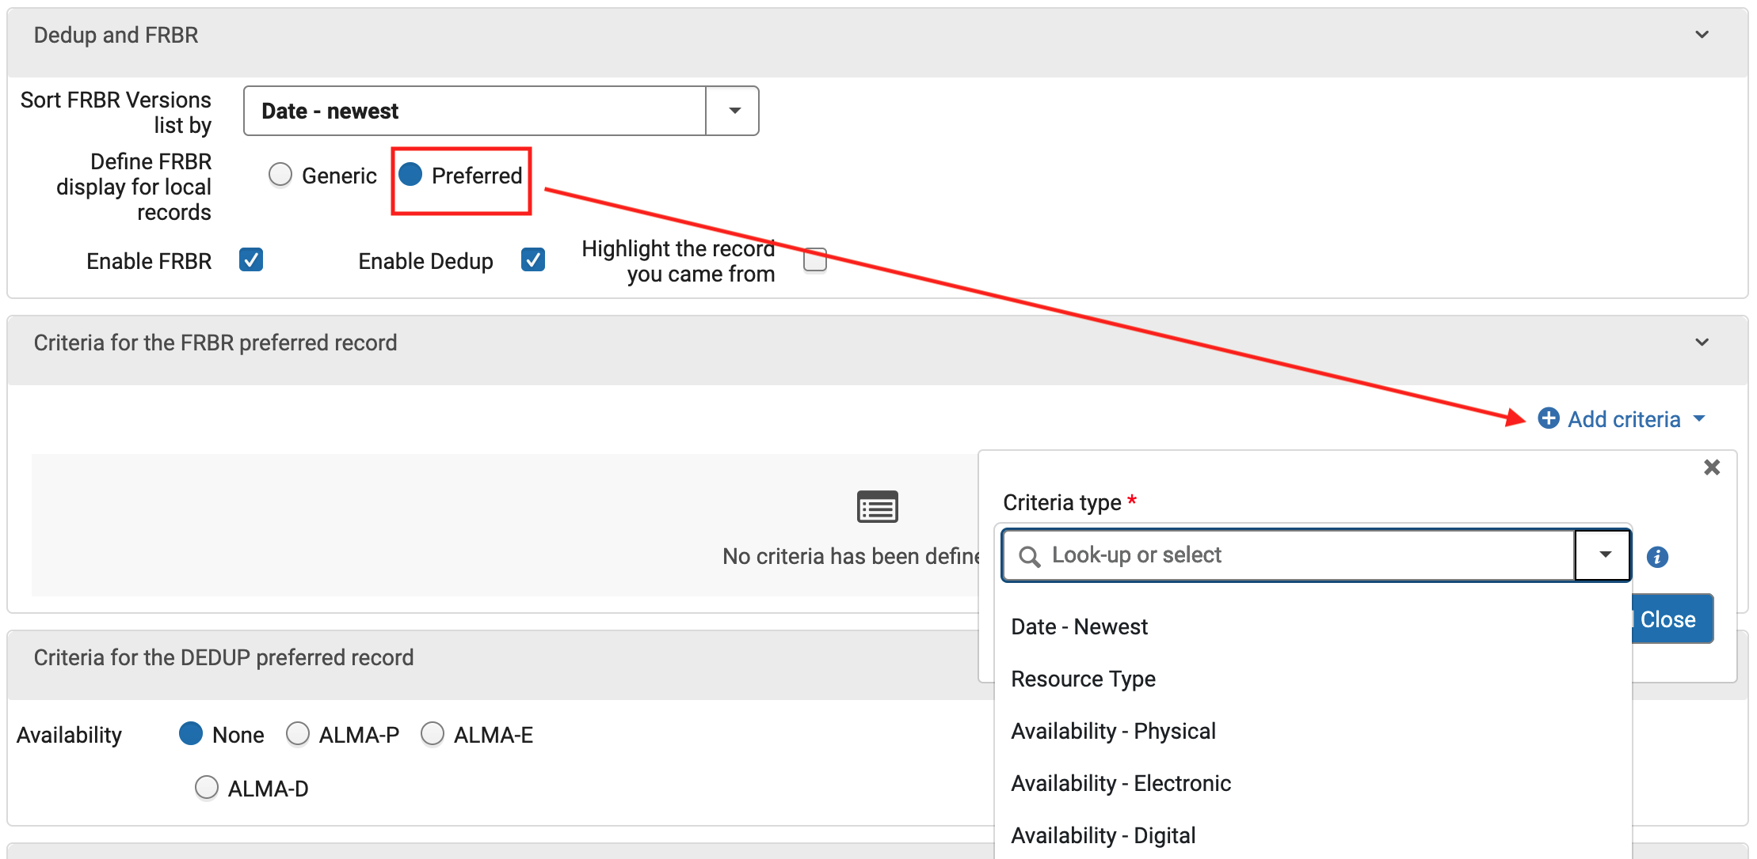
Expanded Options for Preferred FRBR Record Configuration
Alma Configuration > Discovery > Display Configuration > Configure Views > Edit > Brief Results tab
Primo VE View Configuration for Dedup and FRBR
Primo VE/ Discovery
Notes:
(Jessica) [Primo VE/Discovery]
These settings in the Primo VE View Configuration allow libraries to select if they would like Primo VE to prefer certain kinds of records to use as the representative record when a FRBR Group is being displayed in the search results. You can choose from Date – Newest, Resource Type, or Availability of Physical or Electronic inventory.

Slide 29
Primo VE NDE Update
Primo VE NDE UI: What’s Next? session held on April 15, 2026. Recording and slides available
Highlights:
Frequently Asked Questions and Answers
All I-Share libraries should make plans to migrate to Primo VE NDE UI before January 2028.
CARLI’s Primo VE NDE UI for I-Share webpage
New community Basecamp for all CARLI libraries implementing NDE UI. To join, send email to support@carli.illinois.edu with name and email address.
CARLI I-Share Libraries Primo VE NDE UI Survey – Sent to I-Share Liaisons. Due June 6.
Primo VE/ Discovery
Notes:
(Jessica) [Primo VE/Discovery]
A couple of weeks ago, CARLI and the Discovery Primo VE Committee hosted a webinar about Primo VE NDE UI, or the next Primo discovery interface. If you missed that session, I encourage you to review the 30-minute recording and slides. It contains an overview of the NDE project, some frequently asked question and answers, timelines, announcement of a new CARLI community Basecamp you or others at your library can sign up to join, and a heads up about a survey CARLI has put out to ask I-Share libraries about their NDE plans.
We already have had several folks join the Basecamp, and we hope it will be a good way for libraries to share information as we all transition to Primo VE NDE UI! The Committee is also planning on hosting future webinars to give libraries the opportunity to talk with each other.

Slide 30
Questions?

