Slide 1
Configuring Local fields in Primo VE for I-Share July 21, 2025
Local Fields in Primo VE for I-Share
Notes:
Welcome to today’s webinar on “Configuring Local Fields in Primo VE for I-Share”, brought to you by the CARLI Discovery Primo VE Committee!

Slide 2
Today’s Agenda
Brief overview of default Primo VE configurations for Display, Facets, and Search
What are Local Fields for Primo VE?
Which Local Fields have been set up for I-Share by CARLI?
How to configure consortial Local Fields for Full Record display, Brief Record display, Advanced Search, and Facets
Q&A
Presenters
Jessica Gibson - Associate Director of System Services, CARLI
Matt Short – Associate Professor, Head of Technical Services, Northern Illinois University
Margaret Heller – Head of Digital Services, DePaul University
Notes:
My name is Jessica Gibson from the CARLI Office, and our agenda today will cover the following:
First, a brief overview of default Primo VE configurations for Display, Facets, and Search
Next we’ll define what are Local Fields in Primo VE
Then, we’ll go over which Local Fields have been set up consortially for I-Share libraries
And finally, we will demonstrate how to configure these Local Fields in the full record display, brief record display, Advanced search, and Facets,
At the end there will be time for Questions
For this program, I’ll be joined today by Matt Short from Northern Illinois University and Margaret Heller from DePaul University.

Slide 3
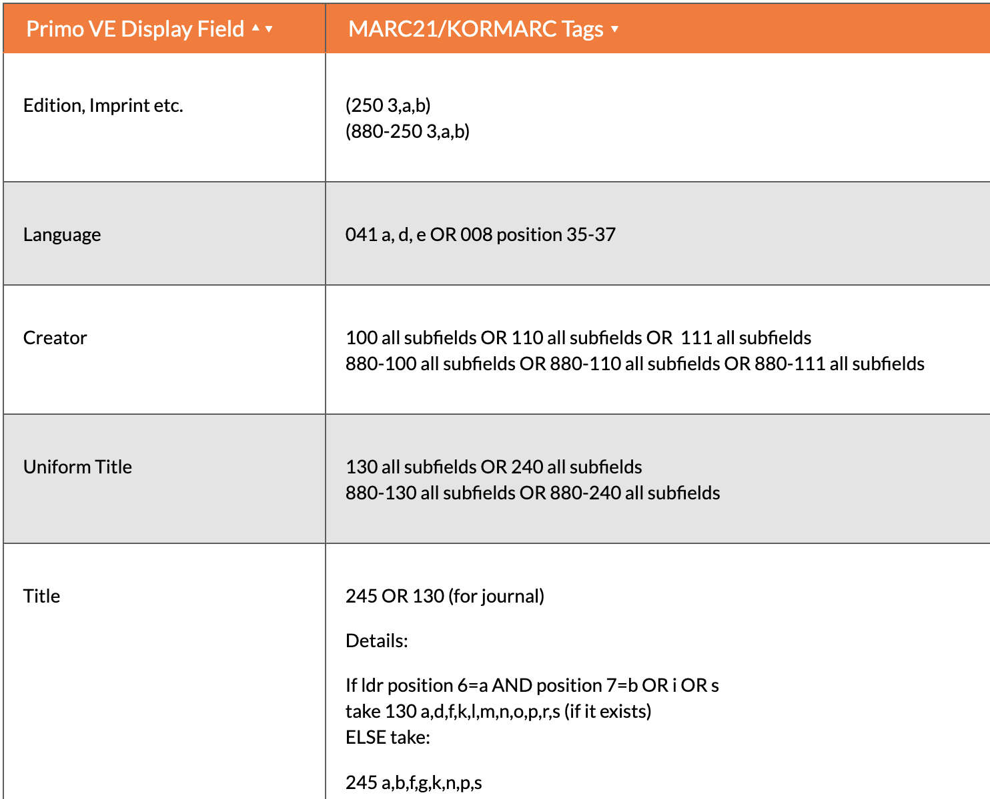
Default Primo VE Configurations for DiSplay, Facet, and Search
Ex Libris documentation: Mapping to the Display, Facets, and Search Sections in the Primo VE Record
Lists the default fields and MARC definitions mapped for display, facet, and search.
However, not all default fields are configured for display, facet, and search out of the box.
A portion of the Primo VE mapping table for display.
Notes:
To begin, I want to direct your attention to Ex Libris’s documentation called “Mapping to the Display, Facets, and Search Sections in the Primo VE Record” This covers all of the MARC21 definitions of fields that are available out of the box for display, facet, and searching in Primo VE. Most but not all of the fields are pre-configured for you. Some of the facets are preconfigured for you. What this means is that there may be some fields defined already but that are not in use by your library because you didn’t know they were there.
For example, one common field that is defined but not configured for use out-of-the-box is the Identifier field, which contains the LC, ISBN, ISSN, ISMN, OCLC, PUBNUM, and GOVDOC data. Several I-Share libraries have added this to their Primo VE full record displays to show these numbers.
Your library may add any fields for display/facet/search that are pre-mapped but not pre-configured using the exact same methods we will show later in the presentation for adding Local Fields. These configuration can be made by anyone with the Discovery Admin role in Alma.

Slide 4
What are Local Fields?
Local Fields for Primo VE are additional MARC fields that can be configured to display and be used for searching and faceting beyond the default fields.
I-Share institutions can set up Local Fields for Primo VE in their Alma IZs, but in our shared consortial environment, Local Fields have effects beyond just your local Primo VE instance.
Notes:
So those were the out-of-the-box fields that came with Alma and Primo VE. Today’s webinar is about the new Local Fields that have been defined for I-Share libraries. Local Fields for Primo VE are additional MARC fields that can be configured to display and be used for searching and faceting beyond those default, out-of-the-box fields. They can be created for MARC fields that are not in the default list and for fields that are in the default list but are not exactly how you want them to be. Any MARC fields can technically be a Local Field, but there are some caveats in our shared bibliographic environment that we will discuss further.
All I-Share institutions can set up Local Fields for Primo VE, but in our shared consortial environment where we share bibliographic records between many libraries, Local Fields can have effects beyond just your local Primo VE instance, so it is important to be mindful when using them.
Let me add here that Ex Libris’ naming conventions for things can be a bit confusing, and there are several things within Alma and Primo VE that are called LOCAL SOMETHING and they are easy to confuse! So, next, let’s quickly discuss Local Extensions, which are NOT Local Fields, but are related and do come into play when you’re thinking of using Local Fields.

Slide 5
Local Fields are not Local Extensions
Background: Shared bib records are stored in the Alma Network Zone (NZ), while local details are stored in the institution zone (IZ). Local details include a library's inventory records--holdings, items, portfolios--and local bibliographic details such as notes and local headings that are relevant to the library's users.
A Local Extension is a MARC bibliographic tag that may be added to a shared NZ bib record via the Alma Metadata Editor, but the data in it is stored and visible only in the IZ copy of the bib record.
Local Extensions may be applied only for the following MARC fields:
090-099, 590-599, 690-699, 770-779, 780-789, 900-999
Notes:
As background, in our network environment, shared bib record are stored in the NZ, and local details are stored in the IZ.
Local details include physical holdings and electronic portfolios and Local Extensions.
Local Extensions are MARC fields in bib records that contain local data and are stored in the IZ and can only be seen in Alma and Primo VE by the I-Share library that applies them to the bib record.
However, only certain MARC fields can be Local Extensions, so it is important to keep these in mind when you are thinking about creating and using Local FIELDS, because if you put local data into a field that cannot be a Local EXTENSION, those data are not protected and may be removed from the shared network bib in the future.

Slide 6
More Information about Local Extensions
CARLI’s consortial documentation on Local Extensions:
How-To: Using Local Extensions for Copy-Specific Bibliographic Data
I-Share Common Definitions for Local Extensions
Ex Libris documentation about Local Extensions:
Adding Local Extensions to Bibliographic Records in the Network Zone
Notes:
For more information, CARLI has two web documents about Local Extensions and how to use them in our shared network environment.
And of course, Ex Libris also has general information on Local Extensions in their documentation.

Slide 7
Local Fields for I-share
Every I-Share library can use Local Fields numbered 1-50 in their IZ.
Some may have already been set up in your IZ by Ex Libris staff upon migration to Alma.
Consortial Local Fields are numbered 51-100.
These are configured centrally in the NZ and distributed to all IZs.
I-Share libraries can choose to use them or not. How to set them up to use them will be covered later in this session.
I-Share libraries may adjust the field names and definitions, if desired.
The CARLI Discovery Primo VE Committee chose fields that we thought would help most libraries and that had been used in our previous VuFind system.
If you have a suggestion for another consortial field, contact CARLI Support.
Local Fields in Primo VE for I-Share documents the consortial Local Fields.
Notes:
Now that we’ve covered the difference and relationship between Local Fields and Local Extensions, let’s get back to Local Fields.
There can be up to 100 Local Fields, but hopefully you will not need that many! Fields numbered 1-50 are for IZ use only. Fields numbered 51-100 are consortial local fields that we configure in the NZ and distribute to all the I-Share library IZs. Establishing Local Fields at the consortial level saves individual I-Share libraries time and effort.
The consortial fields have been distributed, but I-Share libraries can choose to use them or not, they are not mandatory. They exist to be helpful if you’d like to configure them for display, search, or facet.
The consortial Local Fields that the CARLI Discovery Primo VE Committee has set up and distributed thus far are listed on the CARLI website. Let’s go take a look at them… Go to https://www.carli.illinois.edu/products-services/i-share/discovery-interface/local_fields_recommendations
The table on this page lists the fields that have been configured and distributed along with the MARC definitions for the Local Field. All fields can be set up for display. Those fields that can be set up for Search and/or Facet are noted in the fourth column.
Now that we’ve covered the basics of what Local Fields are, I will turn this presentation over to Matt Short from Northern Illinois University to discuss how to configure Local Fields for use!

Slide 8
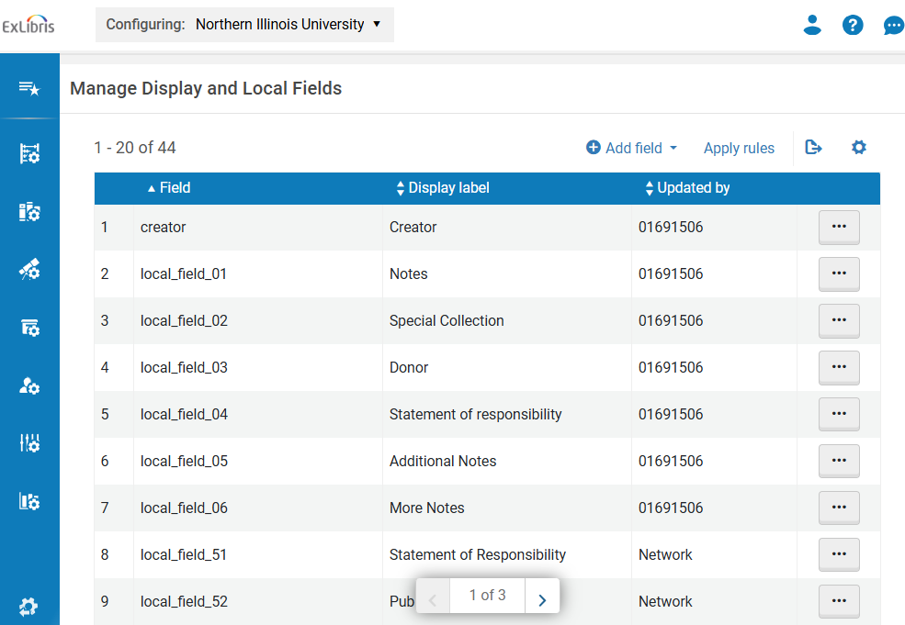
Review local fields
Open Alma Configuration (Ctrl + Alt + C)
Local Fields can be found under Discovery > Display Configuration > Manage display and local fields
Review fields 1-50 (IZ) and 51-100 (NZ)
Notes:
Before you start configuring new fields for brief record display, full record display, advanced search, and facets, it’s a good idea to first review all of your existing local fields.
Open Alma Configuration and navigate to Discovery > Display Configuration > Manage display and local fields.
Start by reviewing fields 1-50, which are the local fields reserved for your IZ. If you haven’t configured any local fields yet, you may see nothing here.
Note that you can also configure display fields here, which allows you to change how all 24 of Primo’s pre-configured fields are displayed, although we’re not discussing those today.

Slide 9
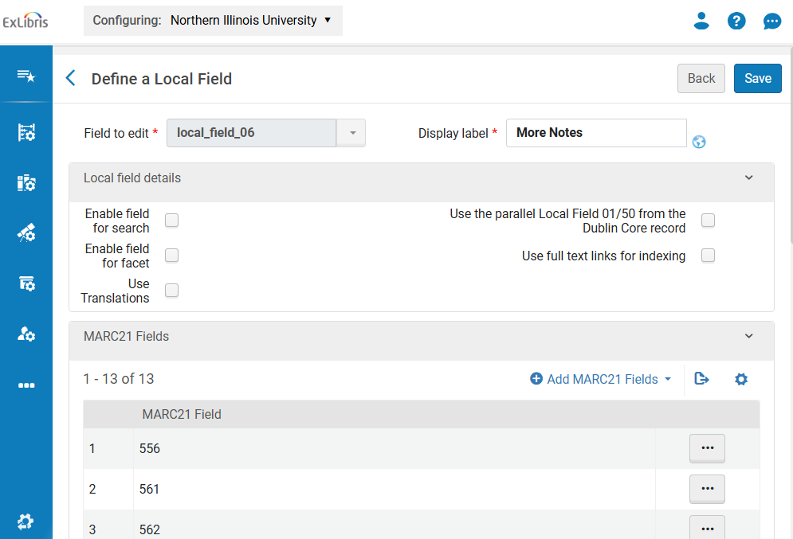
MARC Method fields
Limited to 09X, 5XX, 69X, and 9XX ($a only)
Already indexed by Ex Libris
Each can accommodate up to 20 MARC fields
Note which fields have been configured in your IZ to avoid duplication when configuring for search/display
If desired, edit the display label here
Notes:
Primo uses two methods for creating local fields: the MARC method and the Normalization Rule method. One you can be freely edited and modified and is already indexed, the other requires re-indexing and should not be modified without first checking with CARLI.
Each of these fields can accommodate up to 20 MARC fields, which are limited to notes and some local extensions. These are all configured to display subfield A only.
Before configuring the new fields distributed by CARLI, first review any local fields you’ve already created. For example, I currently have all 5XX notes in three separate local fields: Notes, Additional Notes, and More Notes. The NZ fields may use more specific fields for notes, like “Bibliography” for 504. I’ll want to be aware of this duplication to avoid adding both fields later when configuring my View. If you opt to use CARLI’s fields instead, you may want to rename or delete your old IZ fields to avoid confusion or to free up that field for later re-use.
We recommend leaving Display Labels alone on any consortial fields, so patron experience across catalogs and in the consortial view is more seamless, but if you really hate the label, you’re welcome to edit it here. After saving your changes, remember to click “Apply Rules” from the Manage Display and Local Fields page.
MARC method can be enabled for search and facet in the IZ, if they aren’t already, but there are some additional steps that need to be taken after checking the boxes here, which we won’t cover today.

Slide 10
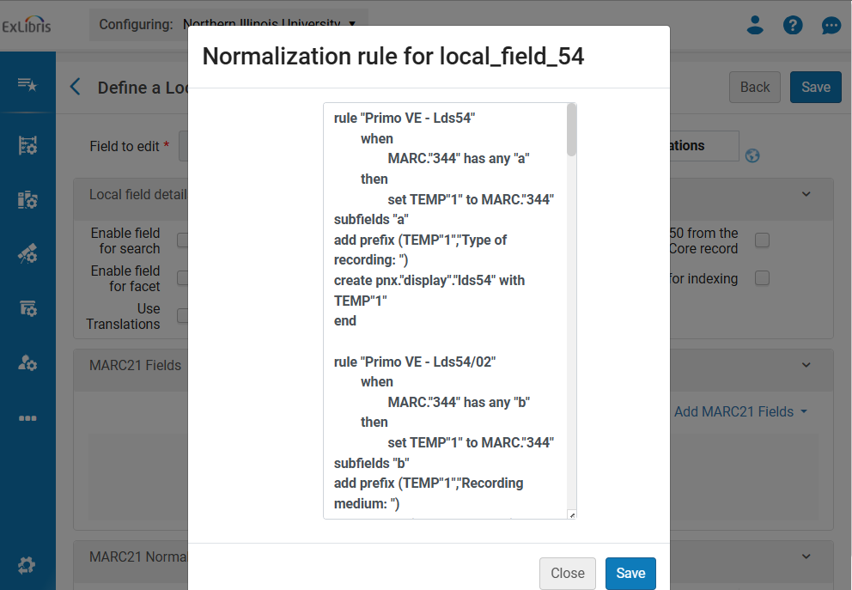
Normalization Rule Method fields
Normalization Rule fields consist of custom Norm Rules (HT Orbis Cascade)
Not indexed automatically
Norm Rules should not be edited in the IZ
If there’s a problem with an existing rule, please report to CARLI
Notes:
The other method for creating local fields is via Normalization Rule. You can distinguish these from MARC fields because the MARC21 Fields area will be empty. Note that the MARC method fields will also have their own normalization rules, too.
Most of the Normalization Rules that have been distributed, with a few modifications, were cribbed from Orbis Cascade Alliance, but have been tested against CARLI member library data.
Unlike MARC Method fields, Norm Rule fields are not indexed automatically, which means any change to the normalization rule will not go into effect until your records have been reindexed.
That said, Ex Libris advises against individual IZs creating or editing Normalization Rules, which could result in data displaying different across member libraries. Any problems or suggested changes to existing Normalization Rules should instead be communicated to CARLI for review, editing, and re-distribution via the NZ.

Slide 11
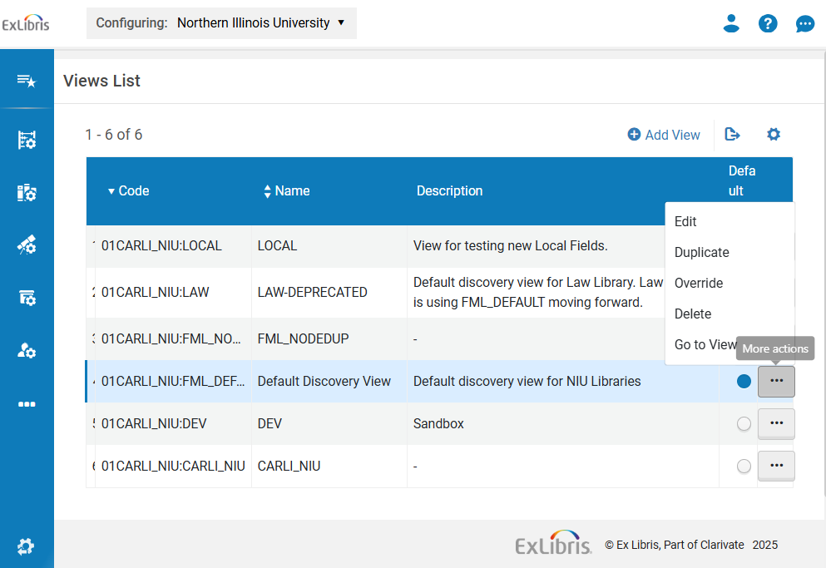
Duplicate default view
Open Alma Configuration (Ctrl + Alt + C) again
Views can be found under Discovery > Display Configuration > Configure Views
Duplicate your default View for testing
Notes:
After you’ve reviewed the local fields, it’s time to deploy them in Primo.
We recommend that you test these fields before adding them to your default View, so you can test before using them in production. To do so, go to “Configure Views” under Display Configuration, click the ellipses on your default view, and “Duplicate.” I have a duplicate View here called LOCAL that I’m using for testing.
Click the ellipses on your new View and hit Edit to start configuring.

Slide 12
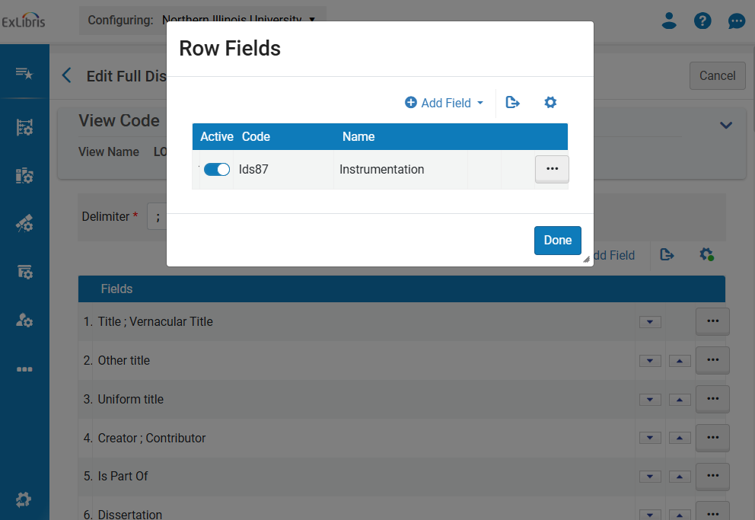
Add a local field to full display
Full Record Services > Details > Configure > Add Field
Add fields, then click done. Multiple fields can be added to each row.
Confirm field code and name to avoid duplication
Should be immediately available in your test view
Notes:
There are three places in your View you’re most likely to use local fields: the full record display, advanced search, and facets.
To edit the full display, go to the “Full Record Services” tab and Configure on “details.” This will allow you to add, remove, and rearrange local fields.
When adding a field to a row, you first need to add the field and then click “Done.” Again, be aware of possible duplication between IZ and NZ fields by confirming the field code and name, if necessary.
Note that it’s possible to add more than one field to a row, if you want those fields displayed in a single line.
Any changes you make here should appear right away in your test View. From Configure Views, hit the ellipses again and select “Go to View” to open Primo in a new browser tab to confirm.

Slide 13
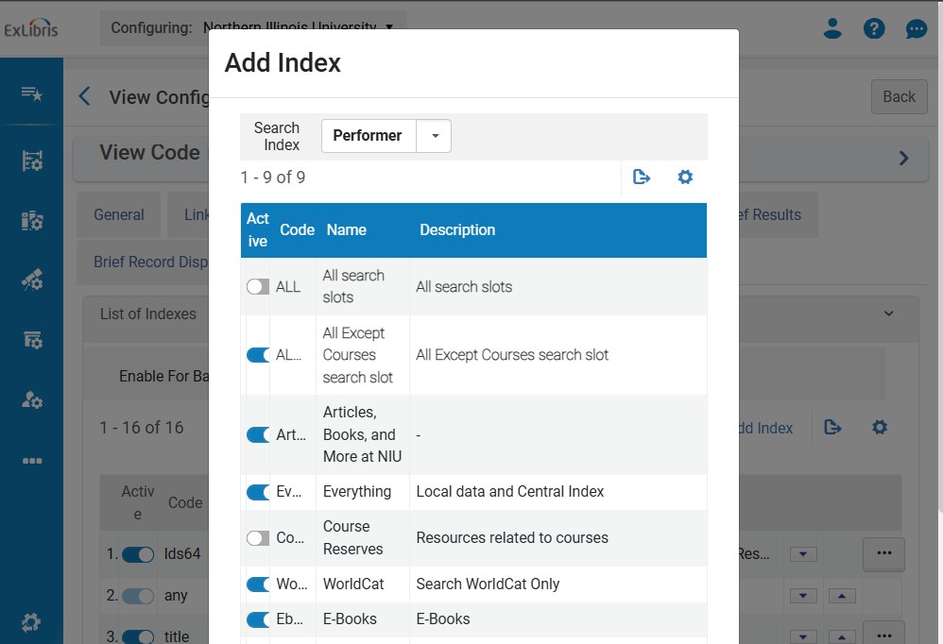
Add a local field to advanced search
Advanced Search Configuration > List of Indexes > Add Index
Only fields configured for advanced search are available here.
New indexes may not be immediately available, so wait before testing
Notes:
If you want to add a local field to Advanced Search, go back to your duplicate view and click on the “Advanced Search Configuration” tab.
Only those fields that have been configured already for search will be available here.
To add one of these fields for search, click “Add index” and select the field from the “Search Index” drop down. Here you can also define which search slot the field will be available in. Scroll down to “Add Index” to finish adding the new index, then use the arrows to re-order the field within Advanced Search. By default, new fields are inserted first.
New search indexes may not be immediately available for testing in Primo, so give any changes a few minutes or hours before testing.
If you have “Enable for Basic Search” checked, these fields will also now be available for filtering, if Basic Search has been configured for your view. These fields can also be boosted in your Ranking Configuration, just like any other field. See CARLI’s previous webinar about ranking configuration for more information.

Slide 14
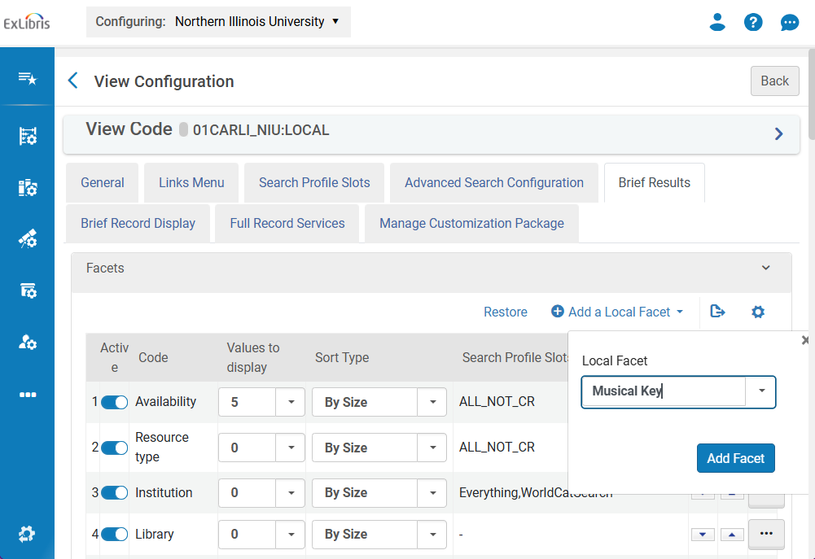
Add a local field to local facet
Brief Results > Facets > Add a Local Facet
Only fields configured for facets will be available here
Automatically enabled and in alphanumeric order
Wait to test
Notes:
Finally, to add Local Fields as facets, you can go back to your duplicate view again and click on the “Brief Results” tab. To add a new facet, click “Add a Local Facet” and then select the field. These facets will be automatically enabled in alphanumeric order. Again, you can use the arrows to reposition.
As with Advanced Search, only those fields that have been configured as facets will be available here.
Any changes you make to facets may not be immediately available in Primo, so wait and try again if the facets don’t immediately appear.
There are many other places in Primo where local fields can be deployed, including Brief Record Display and Sort, but those use cases are narrower. If you’re already making use of local fields there, or would like to, you might want to review those settings as well.

Slide 15
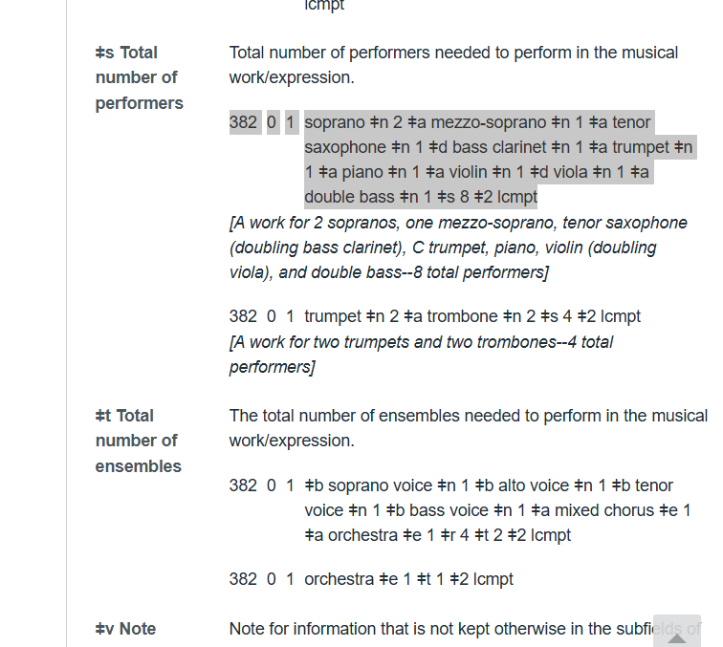
Testing local fields
Three ways to test:
With known records
With dummy records
With Indication Rules
If a local field is not displaying correctly, and the problem is not with the data, report to CARLI
382 in OCLC Bib Formats
Notes:
Some of the new local fields may solve particular use cases you already have. In that case, search your catalog for records with the corresponding fields to review.
If, like me, you plan to just deploy every local field and want to make sure that you’ve configured the View correctly, you can create a single record or two that contains each field. The easiest way to do this is by finding an existing record, copying it, and then copy/pasting relevant fields from OCLC Bib Formats. Refer to the Local Fields for I-Share chart on CARLI’s website for a list of fields to include. Just don’t forget to delete these records when you’re finished testing.
Not surprisingly, we found that not every field displayed correctly in every record, because not all records were uniform and used these fields the same way. This is especially true of music fields, like 382, 383, and 384. For more comprehensive testing, you could instead use Indication Rules to find all matching records with these fields and add them to sets. This is a good approach to take if you want to use the opportunity to do some data cleanup.
If you find local fields that don’t display correctly, and you suspect the problem is with the Normalization Rule and not with the data, please let CARLI know, so we can review and make adjustments. Again, don’t edit the Normalization Rules directly, which could have unintended consequences elsewhere in the Network.

Slide 16
Live Demonstration:
How to configure consortial Local Fields for Full Record display, Advanced Search, and Facets
Notes:
Once you’ve tested your new local fields in the duplicate View and everything checks out, you’re ready to do it all over again in your default View!
Margaret is now going to do a brief demo of creating a duplicate View and then deploying some of the NZ fields in Full Record display, Advanced Search, and Facets.

Slide 17
Ex Libris Documentation:
How to Add a Field to a Display Line in the Brief Record – This procedure allows you to add the local field to a display line in the record's brief record section.
How to Configure the Details Service to add the field to the Full Record – This procedure allows you to display the local field in the Details section on the full record display page.
How to Add a Search Index – This procedure allows you to add the local search field on the Advanced Search page. "Enable field for search" must be checked first in the field definition.
How to Add a Local Facet – This procedure allows you to add the local facet on the Brief Results page. "Enable field for facet" must be checked first in the field definition.
Notes:
These Ex Libris documents walk through how to Add a Field to a Display Line in the Brief Records, how to Configure the Details Service to ad a field to the Full Record display in Primo VE, how to Add a Search Index to the Advanced Search, and how to Add a Local Facet on the Results page.

