Slide 1
A Second Look at Primo VE Research Assistant CARLI Discovery Primo VE Committee June 10, 2025
Slides: https://www.carli.illinois.edu/second-look-primo-ve-research-assistant

Slide 2
Optional, Anonymous Poll
Please complete the optional, anonymous Zoom poll about your library’s plans for the Primo VE Research Assistant!
Anonymous results will be shared during this webinar.

Slide 3
Optional, Anonymous Poll Results
Notes:
Title: Your library and the Primo VE Research Assistant
Question: Is your library planning to use the Primo VE Research Assistant?
Yes, we’ve already activated the Research Assistant, and it is live in our Primo VE instance. (2/53) 4%
We are planning on activating the Research Assistant in our Primo VE in the near future. (1/53) 2%
We are unsure if we will be activating the Research Assistant. (36/53) 68%
We will not be activating the Research Assistant in the foreseeable future. (3/53) 6%
I don’t know. (11/53) 21%

Slide 4
Today’s Agenda
Brief Overview/Demo of how to configure Research Assistant
Review of What’s New since Initial Release
Review of October 2024 “First Impressions” Webinar Takeaways
Open Discussion

Slide 5
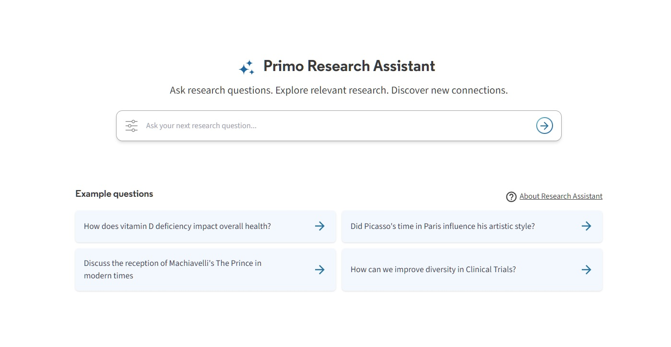
Introduction to Primo Research Assistant
Andrew Belongea Metadata and Systems Librarian Columbia College Chicago abelongea@colum.edu

Slide 6
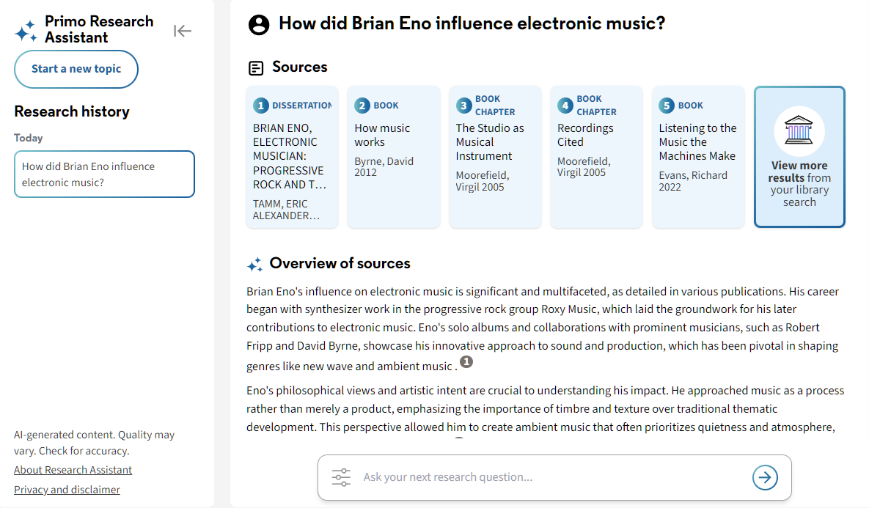
What is it?
ExLibris’s generative AI and retrieval-augmented generation (RAG) search
It prompts patrons to ask a research question using natural language. The tool then converts this language into a Boolean query and searches the CDI for results.
It returns five relevant sources, a summary overview with text generated from the sources’ abstracts, and suggested research questions.

Slide 7
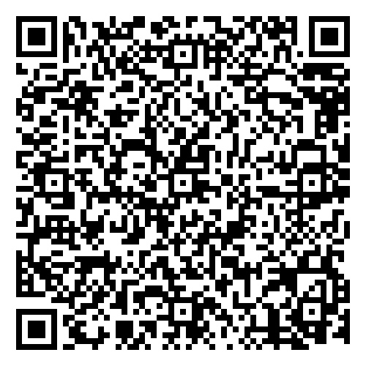
How does it work? (via ExLibris Knowledge Center)
https://knowledge.exlibrisgroup.com/Primo/Product_Documentation/020Primo_VE/Primo_VE_(English)/015_Getting_Started_with_Primo_Research_Assistant

Slide 8
Where does it get content?
Content scope:
CDI records only, using CDI metadata and abstracts
Exceptions:
News content (Newspaper articles, Newsletters, Text resources)
Collections (except for IHP, Rambi and Moshe Dayan center) that are not marked as “free for search” in the CDI collection list (subscription A&I databases)
Sources with insufficient metadata and abstracts that are needed to run the tool effectively
Documents marked as withdrawn or retracted; retraction notes
Any collections from the following content providers: APA, DataCite, Elsevier, JSTOR, and Condé Nast
Any content published by the providers above coming via aggregator collections

Slide 9
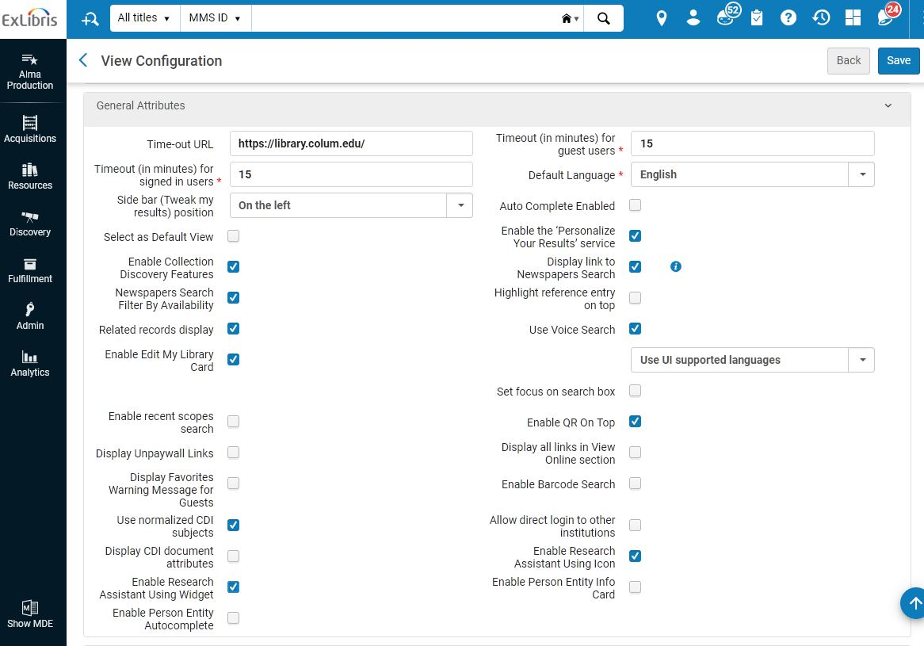
Activating the Research Assistant
Configuration -> Discovery -> Display Configuration -> Configure Views -> [Edit view] -> General Attributes -> Enable Research Assistant Using Widget/Icon

Slide 10
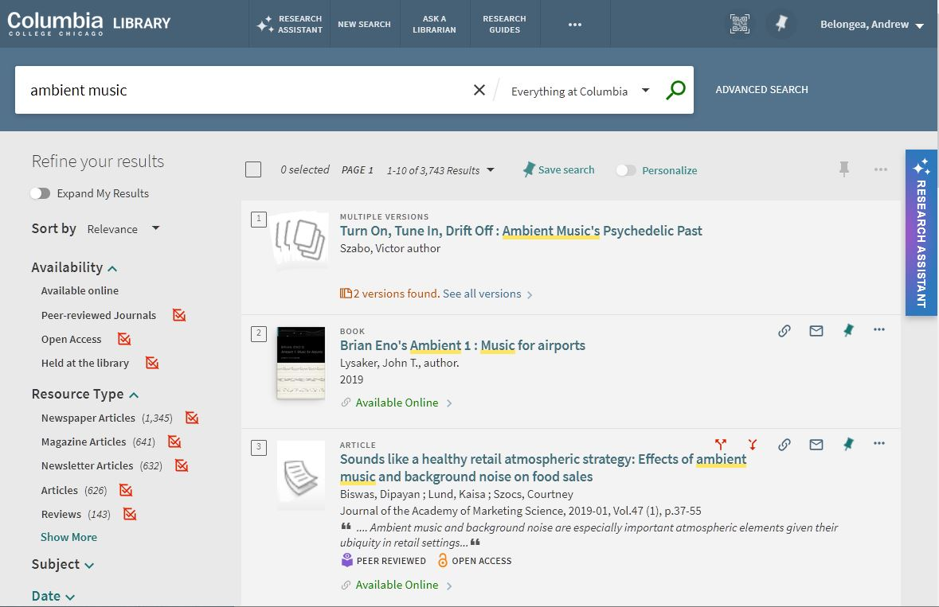
Activating the Research Assistant
Configuration -> Discovery -> Display Configuration -> Configure Views -> [Edit view] -> General Attributes -> Enable Research Assistant Using Icon/Widget
Icon
Widget

Slide 11
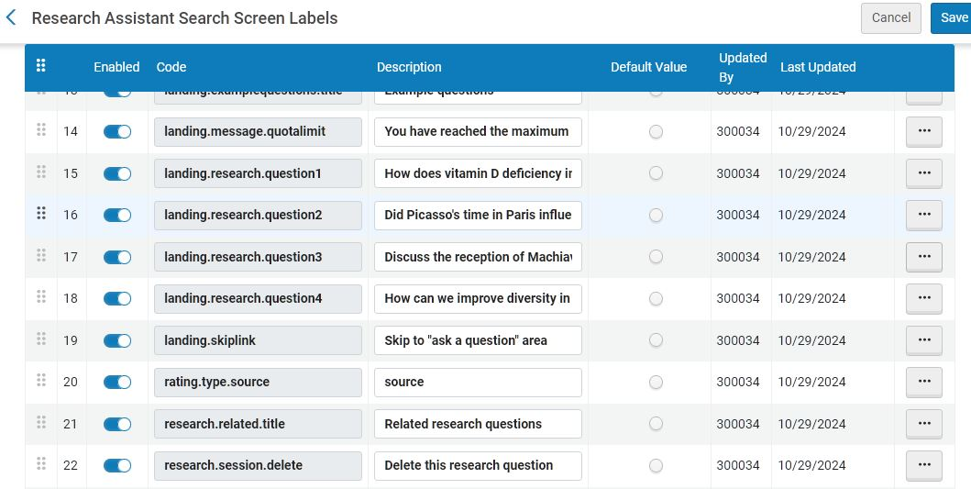
Changing the display labels
Configuration -> Discovery -> Display Configuration -> Labels -> Research Assistant Labels
Configuration -> Discovery -> Display Configuration -> Labels -> Research Assistant Search Screen Labels

Slide 12
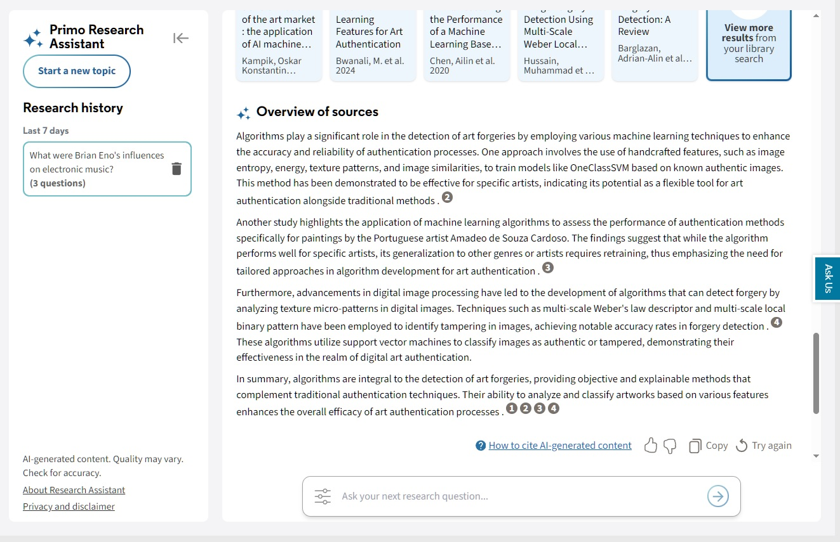
Changing the custom link

Slide 13
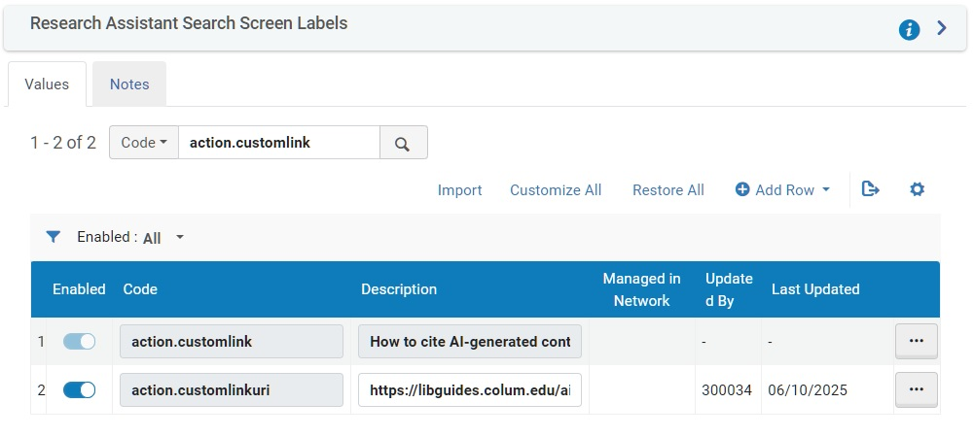
Changing the custom link
Customize the text:
Configuration -> Discovery -> Display Configuration -> Labels -> Research Assistant Search Screen Labels -> action.customlink
Customize the link URL:
Configuration -> Discovery -> Display Configuration -> Labels -> Research Assistant Search Screen Labels -> action.customlinkuri

Slide 14
Primo VE Research Assistant: New Developments & Takeaways Revisited
Lindsey Skaggs, Illinois State University
CARLI Discovery Primo VE Committee
June 10, 2025

Slide 15
What’s New Since its Initial Release?
Accessibility improvements for screen readers
See all at https://knowledge.exlibrisgroup.com/Primo/Release_Notes/002Primo_VE/2025/010Primo_VE_2025_Release_Notes?mon=All
Reorder link placement in Menu bar
“How to Cite” link
Option to enable users to save history
Pre-search filters
Sources moved above overview on results page
Notes:
Reordering links allows libraries to keep in in the sidelines or prominently share. Features in blue have screenshots
Release Notes: https://knowledge.exlibrisgroup.com/Primo/Release_Notes/002Primo_VE/2025/010Primo_VE_2025_Release_Notes?mon=All

Slide 16
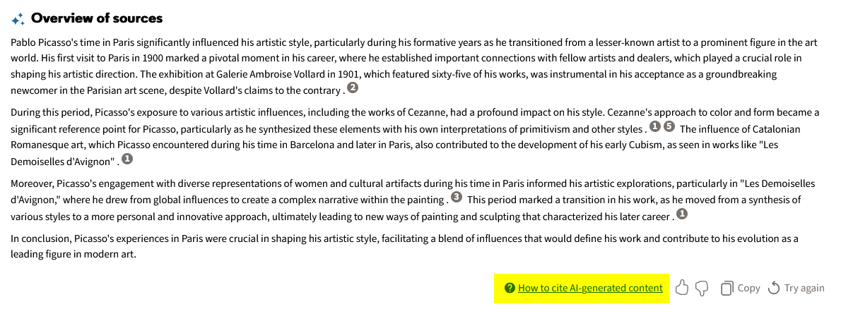
“How to Cite” Link
Enable by entering a website in Labels configuration (code: action.customlinkuri)
Link text may also be changed in Labels (code: action.customlink)

Slide 17
Save History
Libraries can determine whether users can save their history
Function enabled by default
Can be disabled in Configuration > Discovery > Other > Customer Settings by setting save_users_RA_search_history to false
If enabled by library, users can toggle feature on/off in My Account

Slide 18
Pre-Search Filters
Filtering by Resource Type, Dates, and “Available Online” available but users must select the toggle
Users can also add parameters into search (e.g., “Return sources from 2020-2022”)

Slide 19
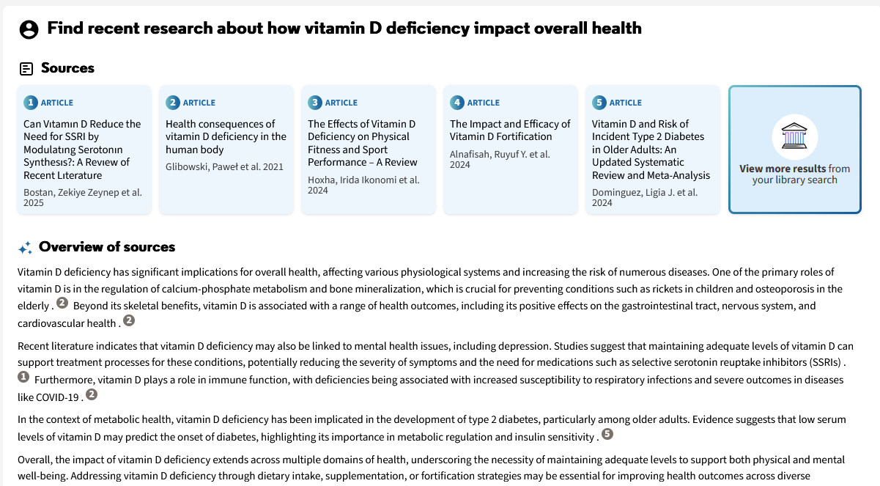
Sources/Overview Reordered
Overview originally displayed first; now sources are prioritized

Slide 20
October 2024 Takeaways
CARLI DPVE Committee hosted Primo VE Research Assistant: First Impressions webinar on October 31, 2024
Takeaways from the discussion shared at https://www.carli.illinois.edu/primo-ve-research-assistant-first-impressions
Have any of these impressions/takeaways changed?

Slide 21
Research Assistant uses CDI metadata and abstracts, not full text, to suggest resources. It does not return local collections. Libraries should keep an eye on Ex Libris's documentation, since the content scope is liable to change. Currently, there are several exclusions, including news content and collections from certain providers (JSTOR, Elsevier, etc.). Content from providers who do not participate in the CDI (e.g., EBSCO) is also excluded unless there are overlapping records from participating providers.
No change – scope is limited to certain CDI collections

Slide 22
Content scope limitations are not clear to users.
No change – out of the box, scope limitations are not clear to users.
Libraries could mitigate this by updating the help text in “About Research Assistant” or by co-opting the “How to Cite” link
Configuration > Discovery > Display Configuration > Labels > Research Assistant Search Screen Labels

Slide 23
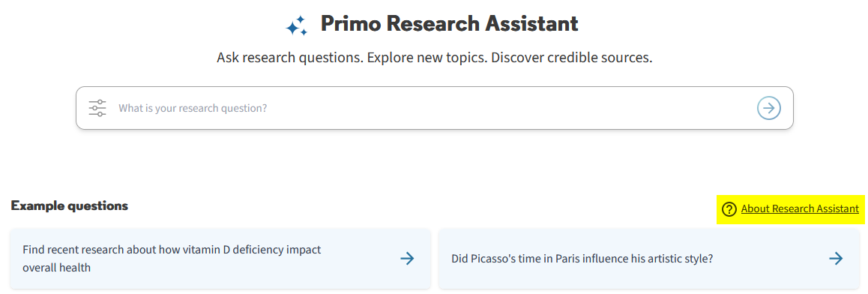

Slide 24
Searches conducted using Research Assistant are automatically set to “expand beyond my library” and this cannot currently be customized. As a result, sources may be returned for which a user does not have access. Conversely, due to the scope limitations, results often don’t include resources users do have access to.
No change – libraries cannot set the scope to search only materials owned or licensed by their library.
New feature lets users pre-filter their query to “Available online.”

Slide 25
Default labels may be misleading for users (e.g., "the 5 most relevant sources"). Labels can be configured in Configuration > Discovery > Display Configuration > Labels > Research Assistant Labels.
No change

Slide 26
Research Assistant may be useful for novice searchers and to illustrate how searches are created. Selecting “View More Results” will display the search terms being used, which can help explain keyword selection and Boolean searching. This set of results will include the providers whose abstracts were not included in the first set of AI results such as JSTOR. The constructed searches, however, are limited to extended OR keyword phrase searches.
Still accurate
New pre-filtering options can also be used to help students learn how to engineer their prompts

Slide 27
Research Assistant is a search aid and does not attempt to do all the work for users, which may make it more suitable for students than other generative AI tools.
Still accurate
Update to move search results above generated text highlights the tool’s purpose

Slide 28
The tool may or may not fit within an institution’s AI policies. Libraries should investigate before enabling Research Assistant.
Still accurate

Slide 29
Ex Libris’s release of this feature gives them a competitive advantage by promoting that they have an AI-powered assistant. Libraries do not have to accept a tool that does not suit their needs and can continue asking for updates until they are ready to implement it.
Still accurate
Libraries can enable Research Assistant when they want and do not have to pay extra

Slide 30
Other Thoughts from the CARLI DPVEC
Unlike other generative AI products, Research Assistant returns real sources, not “hallucinations”
Provides opportunity for instruction about prompt engineering vs traditional search construction
Can query RA in other languages
Can include some parameters in RA prompt
Open University’s Research Assistant usability study provides useful insights
Notes:
https://oro.open.ac.uk/103099/1/Primo%20Research%20Assistant%20Report.pdf

Slide 31
Discussion

Slide 32
Discussion Prompts
For libraries who have enabled Research Assistant, what has been your experience with it?
For libraries who have not enabled Research Assistant, why not?
How have perceptions of AI changed since September 2024 (Research Assistant’s initial release) that influence how we approach these tools?
Has your library or institution enabled other AI-based tools?
What role is your library taking in campus AI initiatives?
Notes:
What have you heard from your patrons about it? [Any experiences in instruction?] If you’ve enabled it, have you changed labels or done any customization? Enabled the “How to cite” link?

Slide 33
Padlet Summary
At the end of the June 10, 2025 session, presenters shared an online Padlet with the following question: Reflecting on today’s discussion, are you more or less likely to activate Primo VE Research Assistant? Why?
11 of 55 participants responded:
All respondents indicated that they are less likely to activate the Research Assistant.
2 participants stated that they intend to activate it in a test view to observe students’ use of the tool in a controlled environment.
Several participants mentioned the limited scope as the primary reason for why they would not implement the feature.
One participant noted the Boolean searches are poorly constructed and not ideal for teaching or searching.
2 participants noted the environmental impact of AI as a deterrent, though not the sole deterrent.
Several participants expressed disappointment that only limited changes were made between its initial release in September 2024 and May 2025.

