Slide 1

The Webinar will start shortly
Welcome!
This webinar will start at 10am and run until 11am. Please mute your microphone to start to avoid excess background noise.
This session will be recorded and posted to the CARLI website for later viewing.

Slide 2
Making Primo VE More Resourceful: New Audio and Visual Resource Types for I-Share Libraries Dec. 10, 2024
Notes:
Hello, everyone, welcome to another CARLI webinar. Today’s webinar, entitled “Making Primo VE More Resourceful: New Audio and Visual Resource Types for I-Share Libraries” is hosted by the CARLI Discovery Primo VE Committee. My name is Jessica Gibson from the CARLI Office, and I will get things started today.

Slide 3
Today’s Agenda
What are Resource Types?
CARLI Recommendations for Local Resource Types and the I-Share Environment
Details on the New Local Resource Types established by the CARLI Discovery Primo VE Committee
How to Find and Correct Miscoded Bib Records
Notes:
In today’s webinar, we’ll first discuss briefly “What are Resource Types?” followed by CARLI’s Recommendations for Local Resource Types in our network environment. Next, we will present the details of the new Local Resource Types established by the CARLI Discovery Primo VE Committee. And finally, we will talk about how to find and correct miscoded bib records for audio and video items that might cause the wrong Resource Type to be displayed.

Slide 4
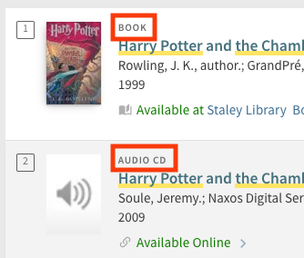
What is the Resource Type in Primo VE?
It is derived from a bibliographic record and displays in small, gray text at the top of the Brief Record display.
An image highlighting the Resource Type indicators in the Brief Record display.
Notes:
So, to make sure we are all on the same page as we dive in, What is the Resource Type in Primo VE?
A Resource Type in Primo VE is the small, gray text at the top of a record in the Brief Record display, highlighted in the image here in a red box. These Resource Types are derived from data found in the bibliographic record.

Slide 5
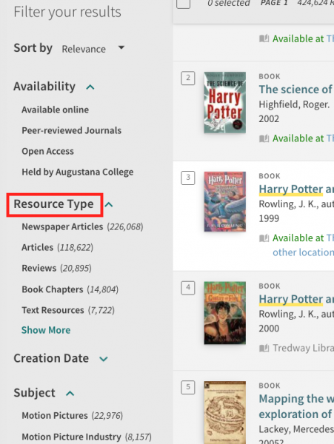
Resource Types are also one of the default facets in Primo VE
An image of the Facets in Primo VE highlighting the Resource Type option.
Notes:
And as you are probably aware, “Resource Type” is also one of the standard, out-of-the-box default facets available to users in Primo VE.

Slide 6
Facts about Resource Types
Resource Types are assigned based on bibliographic fields such as the Leader, 007, and 008 for MARC records, or the discovery:resourceType, dcterms:type, and dc:type fields for Dublin Core records.
Primo VE Resource Types are different from Alma Resource Types.
CDI Records have their own list of Resource Types that display in Primo VE.
Local Resource Types can be created to display in Primo VE, but in a network environment like I-Share, the types must be defined in both the Network Zone (NZ) and the Institution Zones (IZ).
Notes:
Here are some important facts to understand about Resource Types:
They are assigned by the system based on fields in the bibliographic record such as the Leader, 007, and 008 in MARC records, or the discovery:resourceType, dcterms:type, and dc:type fields in Dublin Core records.
Another important fact, there are different Resource Types!
Primo VE Resource Types that display in the Primo VE discovery interface are different from Resource Types that you see assigned in Alma as a staff user.
And to complicate things a bit more, there is also an independent list of Resource Types for that display in Primo VE on bib records that come from the Ex Libris Central Discovery Index, or CDI.
Rounding out the varieties of Resource Types are the Local Resource Types that we are going to discuss further today. These can be configured to display in Primo VE, but in a network environment like I-Share, the Local Resource Types should be defined the same way in both the Network Zone and the Institution Zones.

Slide 7
Local Resource Types in I-Share
CARLI strongly recommends that I-Share libraries consult with CARLI Support before creating any Local Resource Types
Sometimes a Local Resource Type in the IZ will be possible/preferrable
Definition at the network level better when bib records are linked to NZ
CARLI Recommendations on Local Resource Types in Primo VE for I-Share Libraries
Notes:
Because Local Resource Types need to be defined identically in the NZ and the IZs for best results when records are linked to the NZ, CARLI recommends that libraries consult with CARLI Support before creating any Local Resource Types.
Sometimes it will make sense to create a local type only in your IZ for records that are local to your IZ, but in many cases, it will be better to define it at the network level.
The CARLI webpage on Local Resource types describes this background and rationale and lists the consortial Local Resource Types we are working on.

Slide 8
New Local Resource Types in I-Share
The CARLI Discovery Primo VE Committee has established several new Local Resource Types for I-Share:
Models
Implemented in NZ on 8/16/2024. Implemented in IZs on 9/5/2024.
Audio CD, Audio LP, Audio cassette, Audiotape reel, DVD, Blu-ray, Videocassette, Film reel, and LaserDisc
Implemented in the NZ on Dec. 9, 2024
Will be implemented in all IZs by CARLI staff in the coming weeks
I-Share libraries do not need to do anything, but you may find bib records that need to be corrected.
Notes:
And we are working on several new Local Resource Types for I-Share that the CARLI Discovery Primo VE Committee has recently established!
The first new Resource Type was for Models. There were around 1000 bib records for models in the network, so this was kind of like our test case that we completed back in August and September.
Now we are implementing new Local Resource Types for more granular descriptions of audio and visual materials, including: Audio CD, Audio LP, Audio cassette, Audiotape reel, DVD, Blu-ray, Videocassette, Film reel, and LaserDisc. These have been implemented in the NZ, and CARLI will be rolling this out to each IZ in the coming weeks.
In good news, I-Share libraries do not need to do anything to take advantage of these new Local Resource Types; they appear in Primo VE automatically! However, you and your colleagues may find bib records that are miscoded and displaying the wrong Resource Type. Such bibliographic records will need to be corrected because, as the saying goes: Bad Data In, Bad Data Out!
For more details on this, I will turn this presentation over to Andrew Belongea, a member of the CARLI Discovery Primo VE Committee, and an INTEGRAL part of getting these new Resource Types in place for I-Share! Andrew is the Metadata and Systems Librarian at Columbia College Chicago Library. He has worked in Chicago libraries over the past 17 years, including at The University of Chicago, UIC, and The Newberry Library.

Slide 9
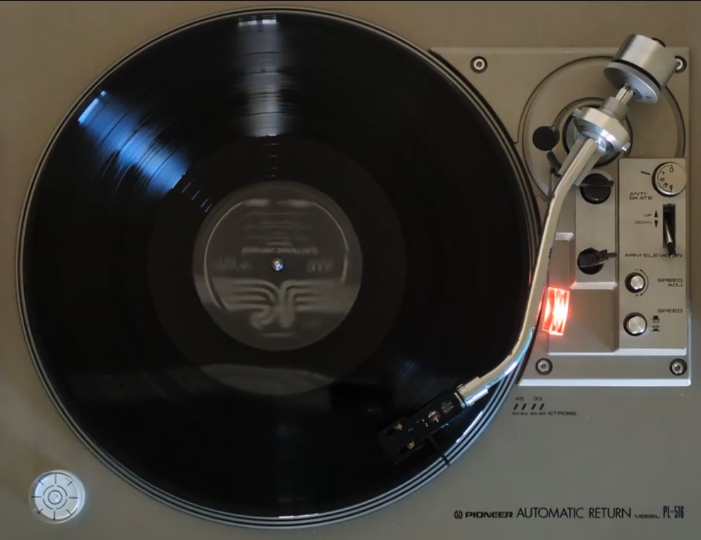
Making Primo VE More Resourceful:
New Audio and Visual Resource Types for I-Share Libraries
Andrew Belongea Metadata and Systems Librarian Columbia College Chicago abelongea@colum.edu

Slide 10
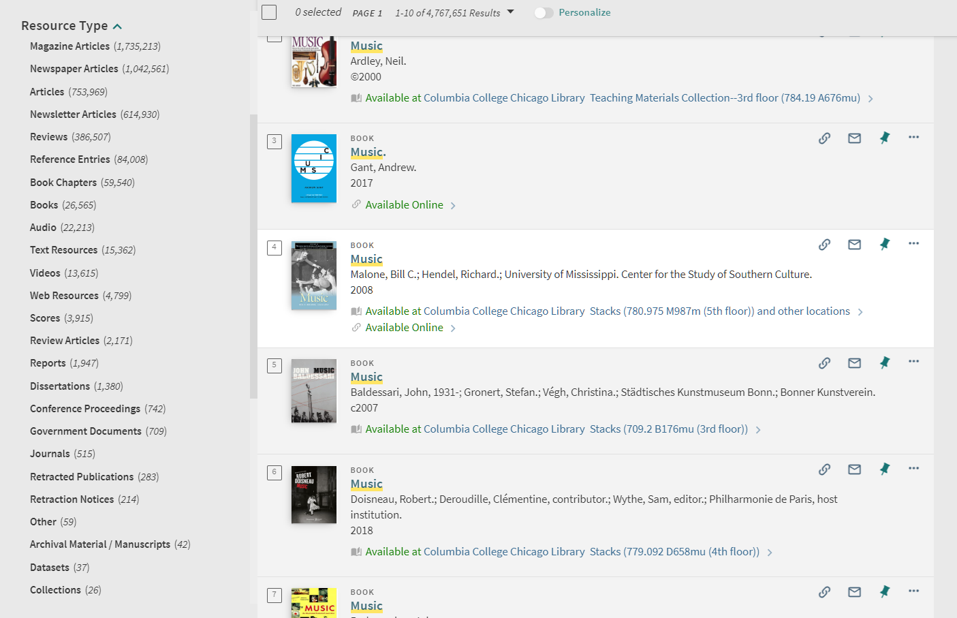
Only two, broad resource types for “Audio” and “Videos”

Slide 11
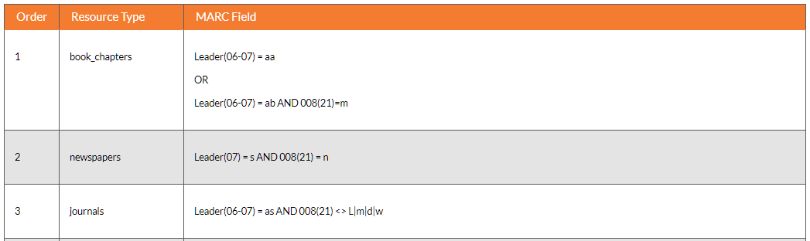
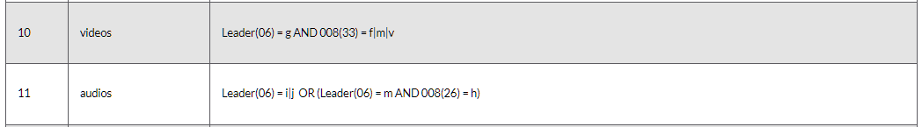
Resource types in Primo VE are determined by the fields in a bibliographic record

Slide 12

ExLibris – “Mapping to the Display, Facets, and Search Sections in the Primo VE Record”
https://knowledge.exlibrisgroup.com/Primo/Product_Documentation/020Primo_VE/Primo_VE_(English)/120Other_Configurations/Mapping_to_the_Display%2C_Facets%2C_and_Search_Sections_in_the_Primo_VE_Record

Slide 13
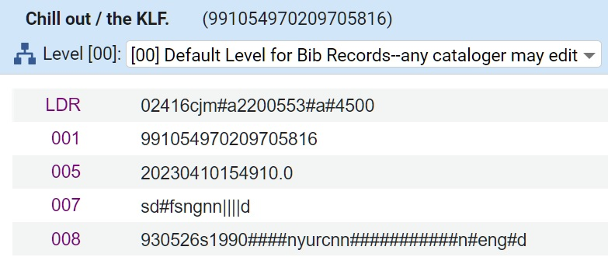
Resource types in Primo VE are determined by the fields in a bibliographic record
Audio example:
LDR(06) = j, therefore resource type “Audio” is assigned

Slide 14
Resource types in Primo VE are determined by the fields in a bibliographic record
Audio example:
We have other fields available to define physical resource types!

Slide 15

Counting positions in fixed and control fields
007
s
d
#
f
s
n
g
n
n
m
m
n
e
d
0
1
2
3
4
5
6
7
8
9
10
11
12
13
ǂa
ǂb
ǂd
ǂe
ǂf
ǂg
ǂh
ǂi
ǂj
ǂk
ǂl
ǂm
ǂn

Slide 16
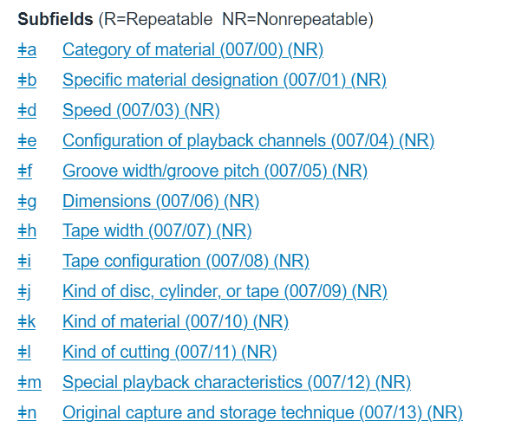
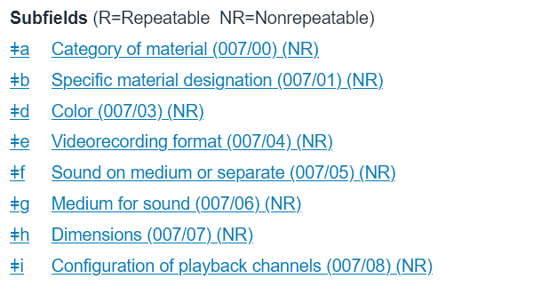
007 Physical Description Fixed Fields
Sound recording
Videorecording

Slide 17



OCLC – “007 General information”
https://www.oclc.org/bibformats/en/0xx/007.html
OCLC – “Physical Description Fixed Field (Sound Recording) (R)”
https://www.oclc.org/bibformats/en/0xx/007sound.html
OCLC – “Physical Description Fixed Field (Videorecording) (R)”
https://www.oclc.org/bibformats/en/0xx/007video.html

Slide 18
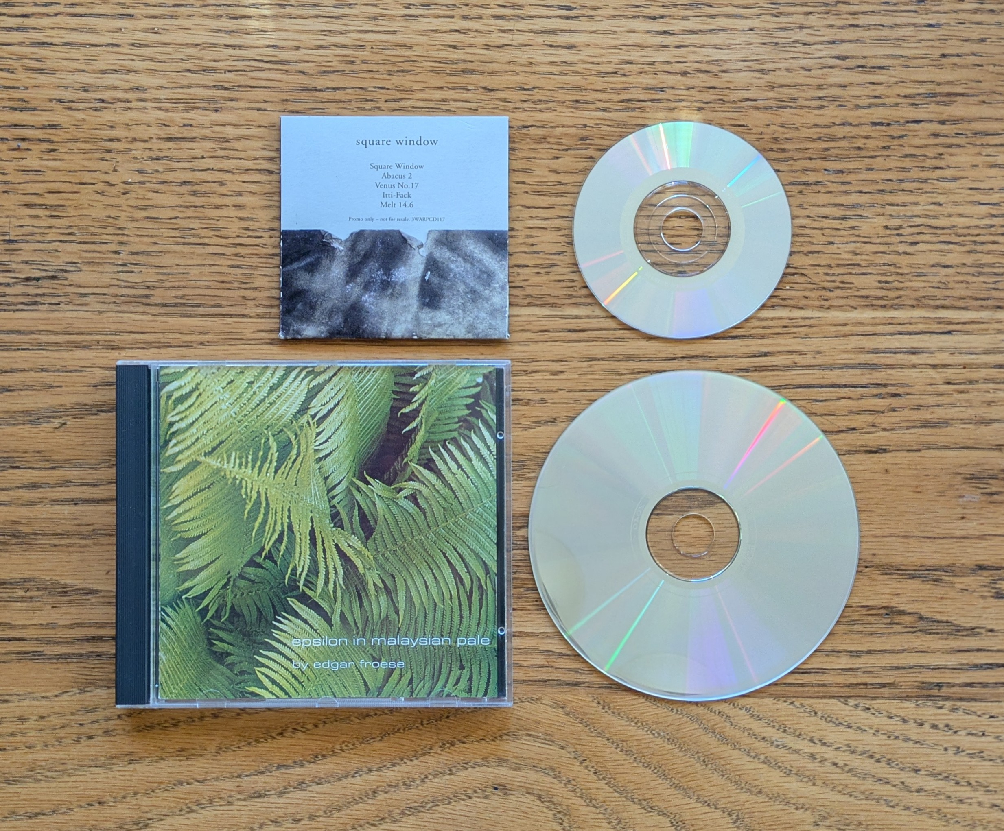
Audio CD Resource Type
LDR(06) = i|j
AND
007(ǂa/0)= s
007(ǂb/1)= d
AND
007(ǂd/3)= f
OR
007(ǂg/6)= a|g
CDs are sound (s) discs (d) and spin at 1.4 m per sec (f) or are either 3 in. (a) or 4 3/4 in. (g) in diameter.

Slide 19
Audio CD Resource Type
Three examples of a CD 007:
s ǂb d ǂd f ǂe s ǂf n ǂg a ǂh n ǂi n ǂk m ǂm e ǂn e
sd#fsnannmee
s ǂb d ǂd f ǂe s ǂf n ǂg g ǂh n ǂi n ǂk m ǂm e ǂn e
sd#fsngnnmee
s ǂb d ǂd u ǂe s ǂf n ǂg g ǂh n ǂi n ǂk m ǂm e ǂn d
sd#usngnnmed
CDs are sound (s) discs (d) and spin at 1.4 m per sec (f) or are either 3 in. (a) or 4 3/4 in. (g) in diameter.

Slide 20
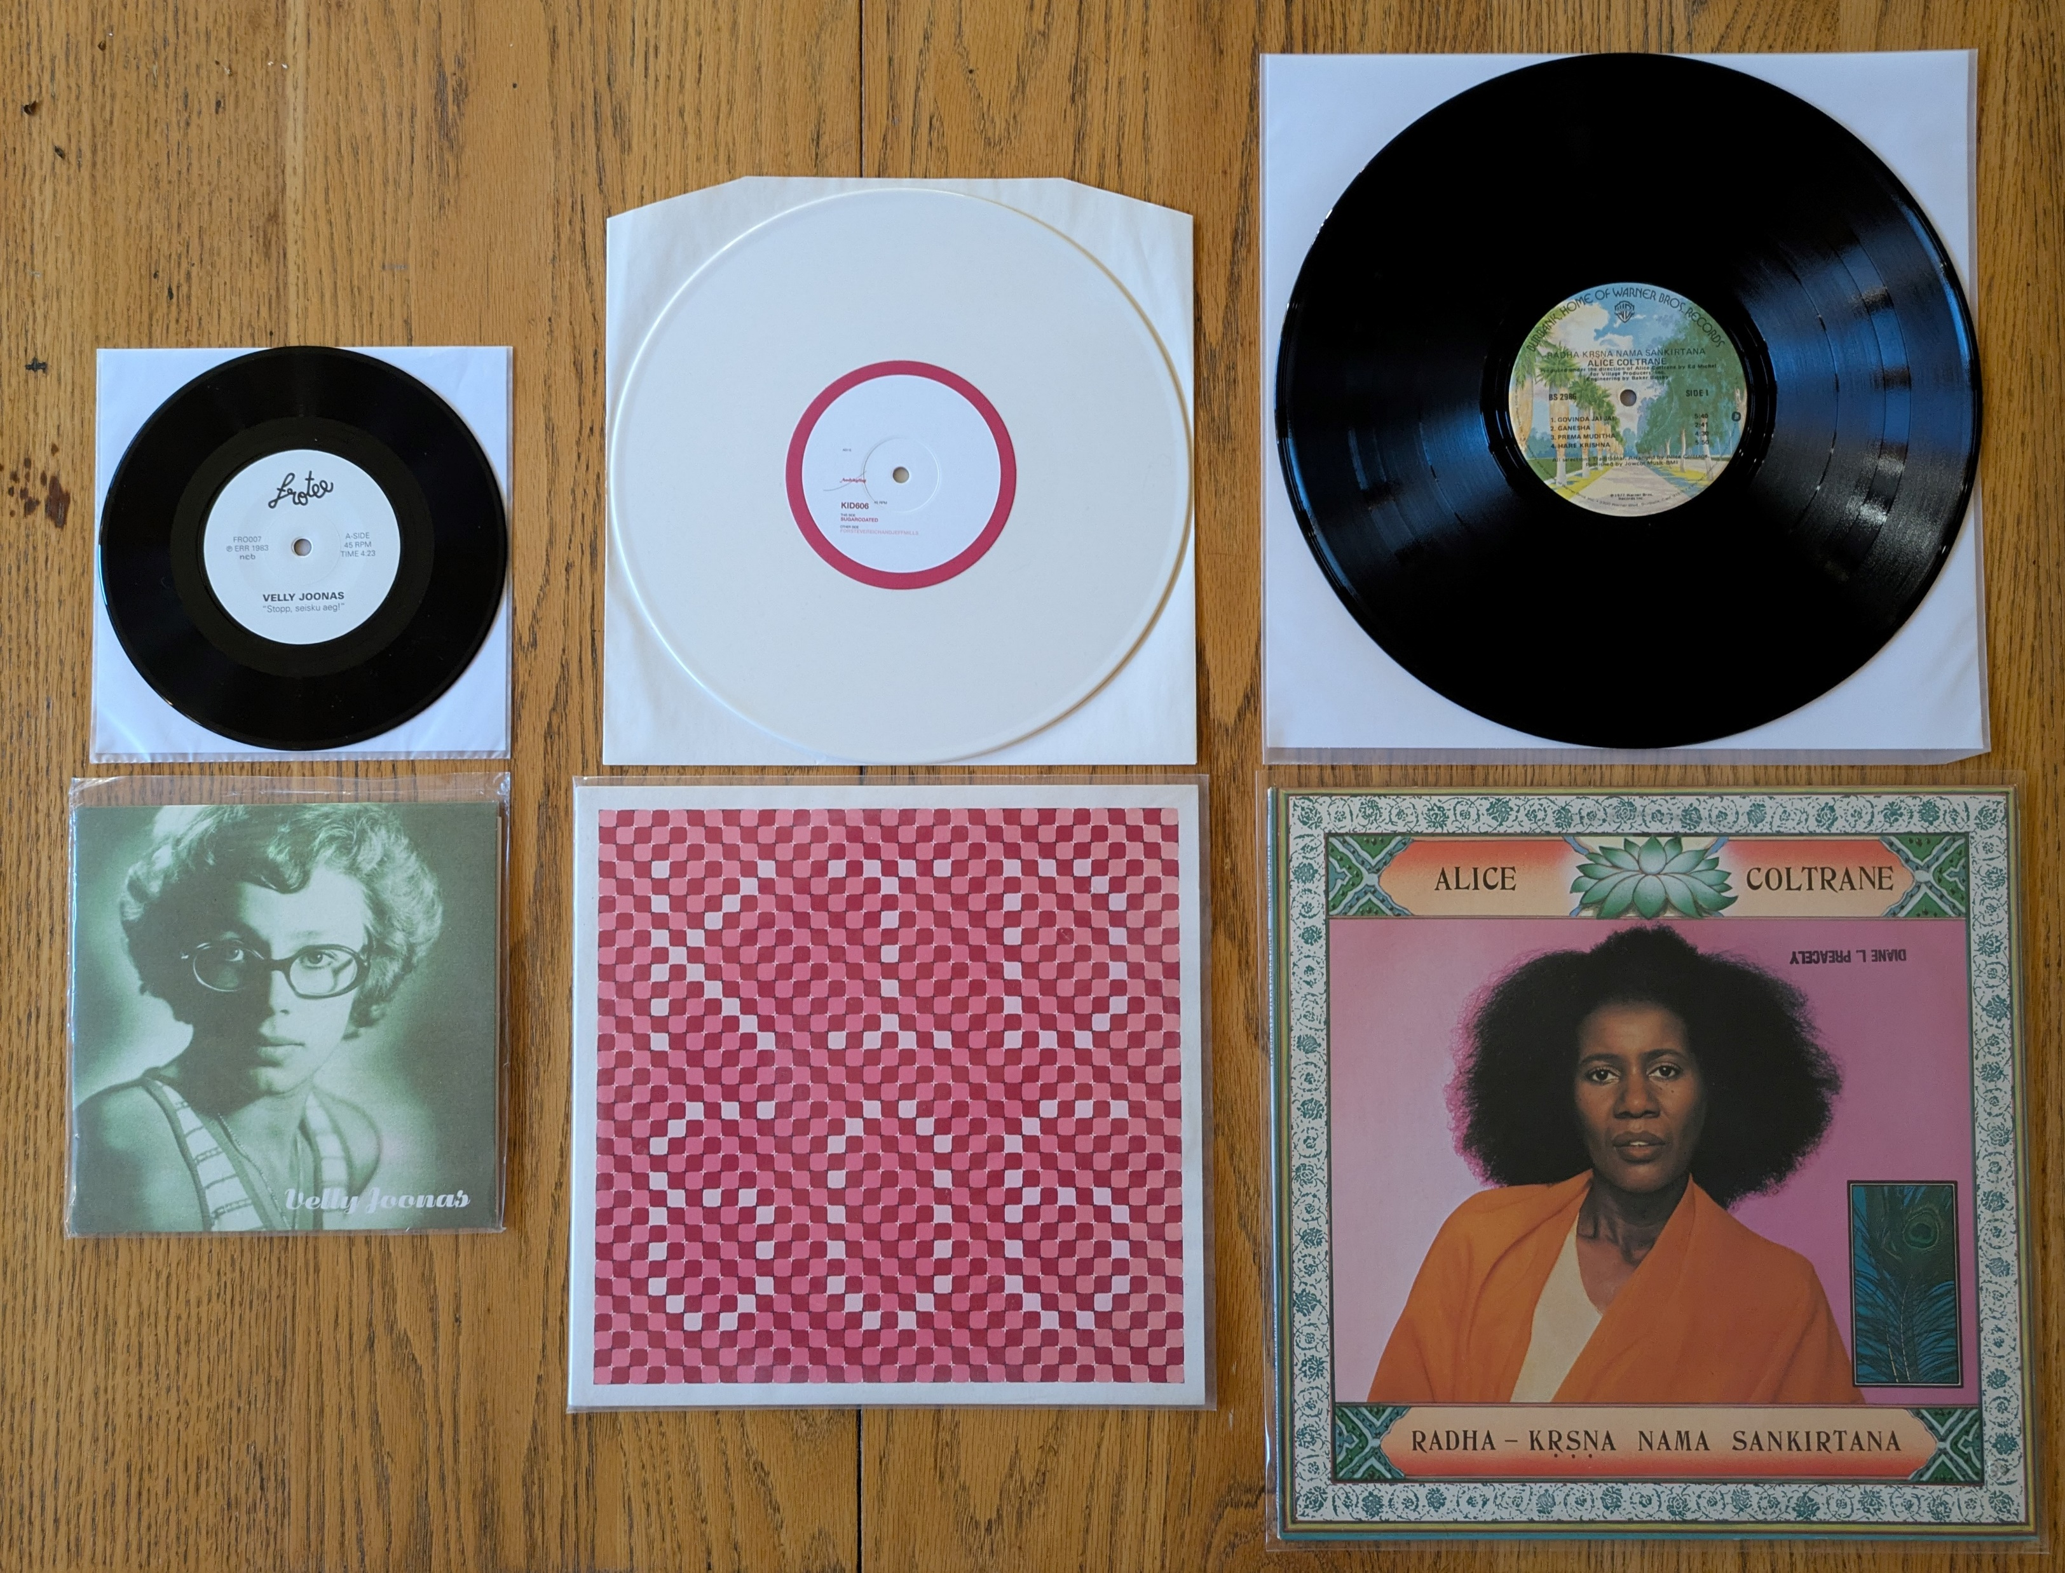
Audio LP Resource Type
LDR(06) = i|j
AND
007(ǂa/0)= s
007(ǂb/1)= d
AND
007(ǂd/3)= a-e
OR
007(ǂg/6)= b-f
LPs* are sound (s) discs (d) and spin at 16 rpm (a), 33 1/3 rpm (b), 45 rpm (c), 78 rpm (d), or 8 rpm (e) or are 5 in. (b), 7 in. (c), 10 in. (d), 12 in. (e), or 16 in. (f) in diameter.

Slide 21
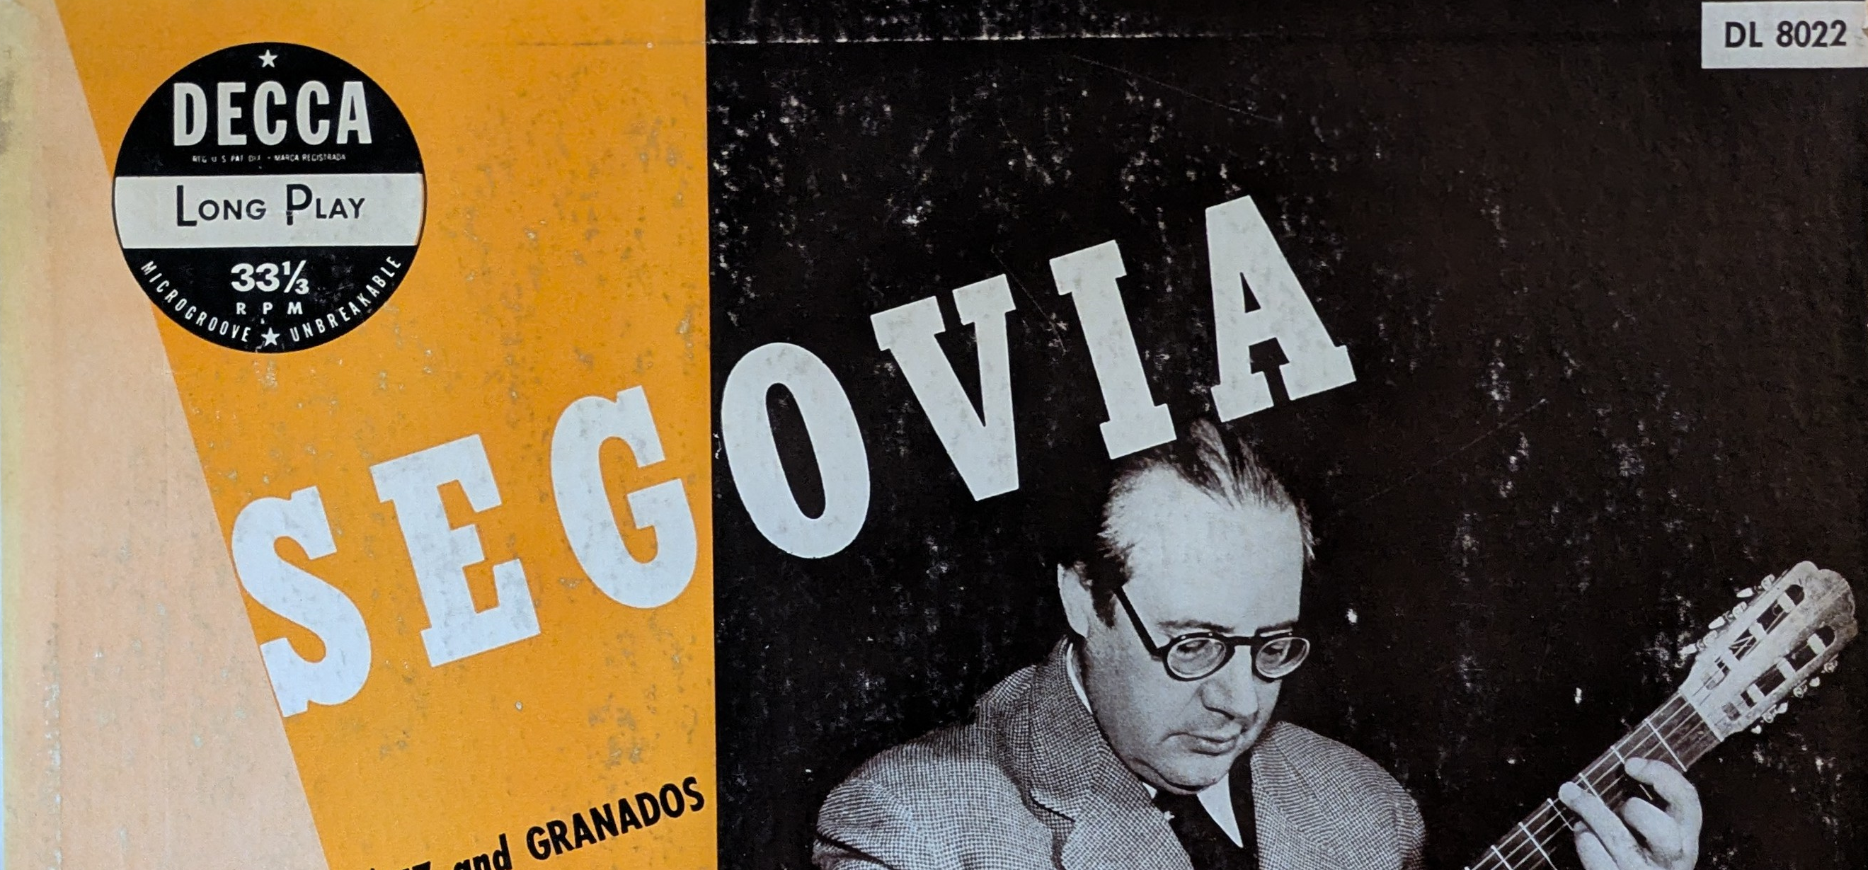
*LP stands for “Long Play,” and technically refers to full-length albums that are played at 33 1/3 rpm. We have selected this term due to the common usage of LP to refer to phonograph discs in general.

Slide 22
Audio LP Resource Type
Three examples of an LP 007:
s ǂb d ǂd c ǂe s ǂf m ǂg c ǂh n ǂi n ǂj m ǂk p ǂl l ǂn e
sd#csmcnnmple
s ǂb d ǂd b ǂe m ǂf m ǂg d ǂh n ǂi n ǂj m ǂk p ǂl l ǂn b
sd#bmmdnnmplb
s ǂb d ǂd u ǂe s ǂf m ǂg e ǂh n ǂi n ǂk m ǂm e ǂn e
sd#usmennmee
LPs are sound (s) discs (d) and spin at 16 rpm (a), 33 1/3 rpm (b), 45 rpm (c), 78 rpm (d), or 8 rpm (e) or are 5 in. (b), 7 in. (c), 10 in. (d), 12 in. (e), or 16 in. (f) in diameter.

Slide 23
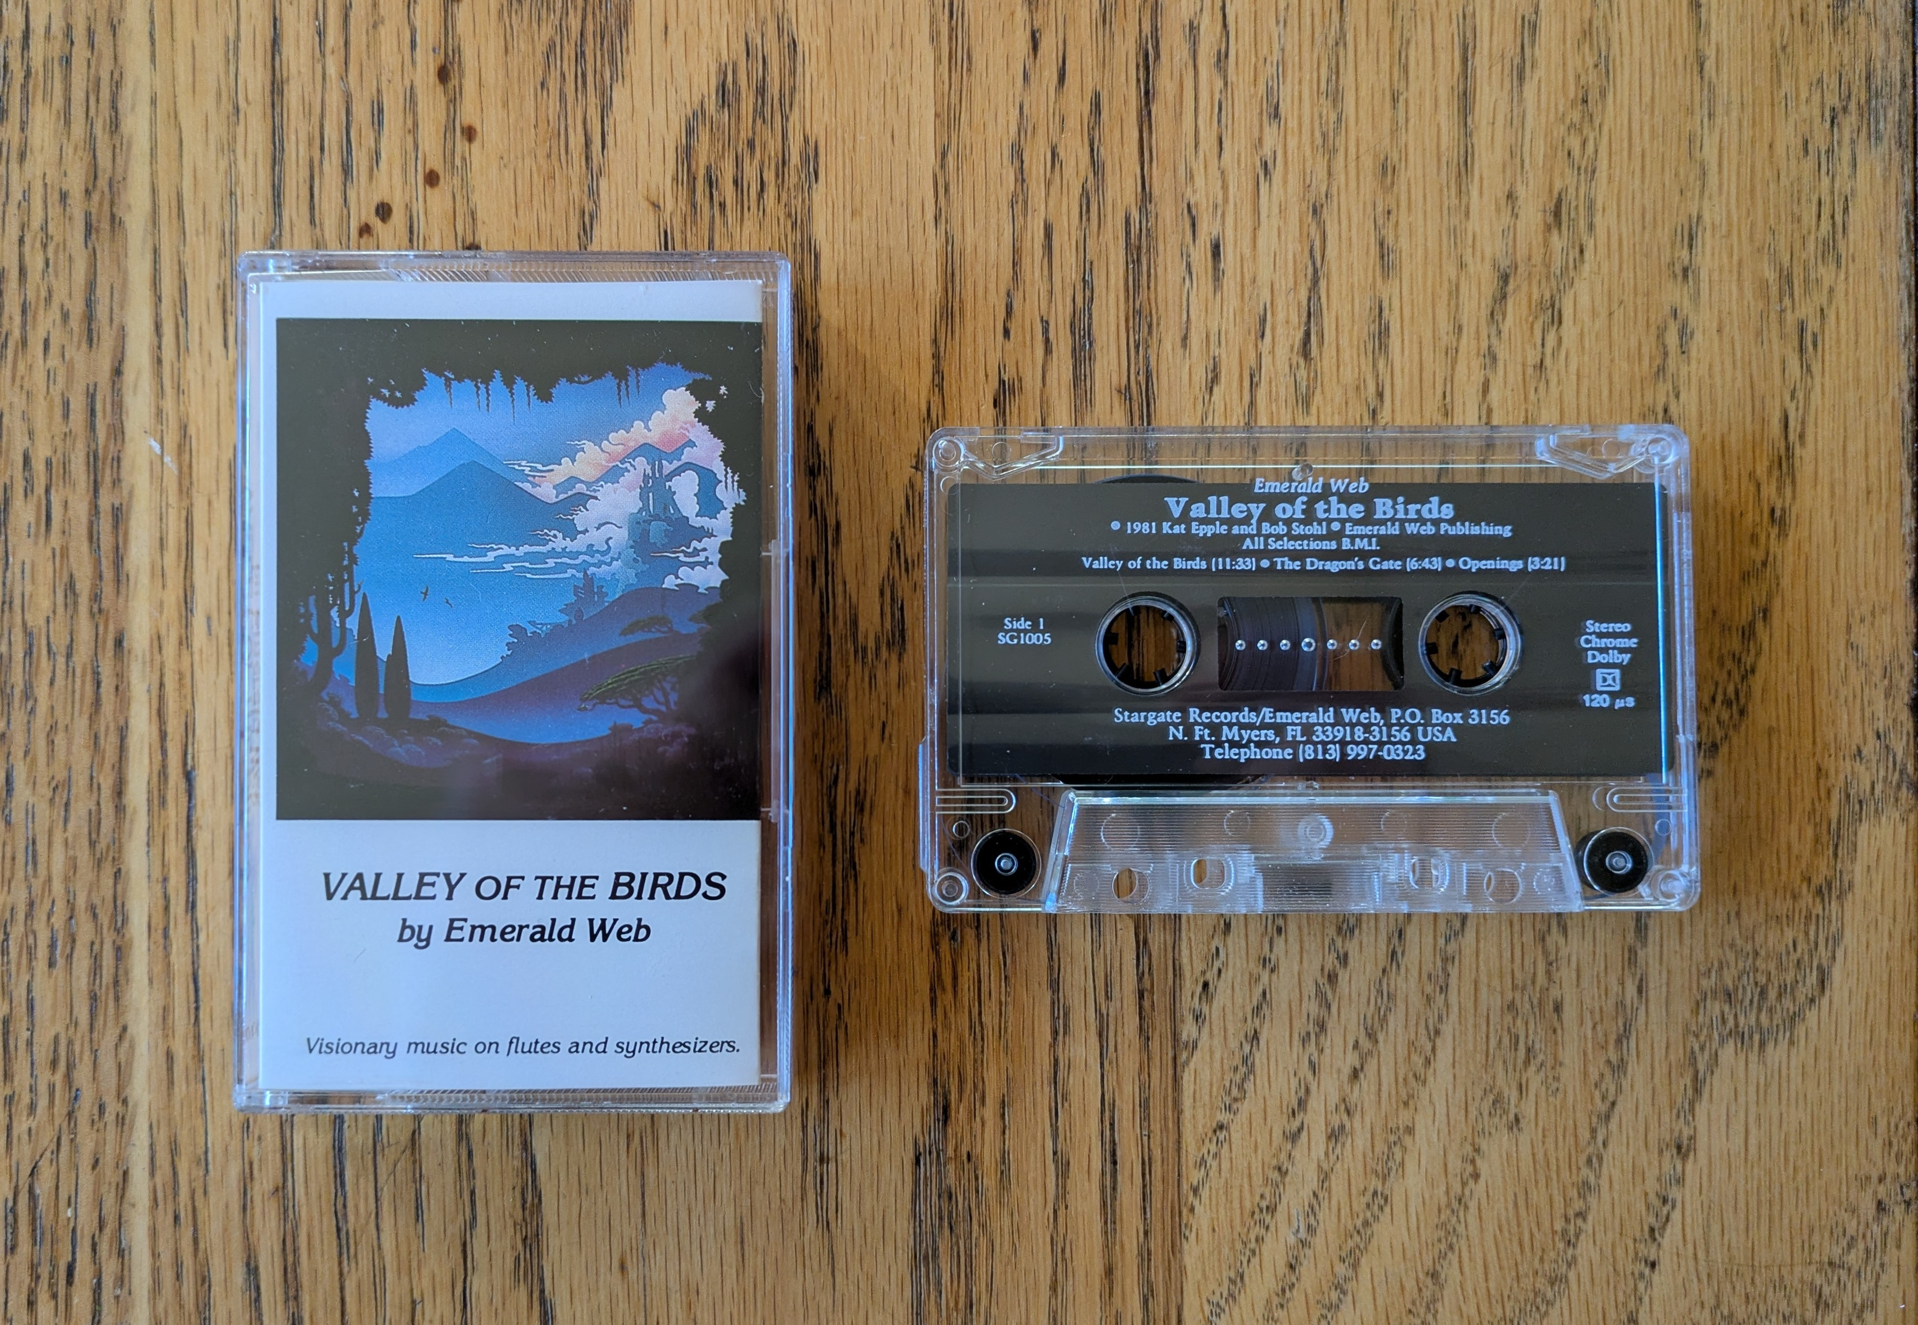
Audio Cassette Resource Type
LDR(06) = i|j
AND
007(ǂa/0)= s
007(ǂb/1)= s
Audio cassettes are a container holding a narrow, usually 1/8 inch, sound tape on two reels (s).

Slide 24
Audio Cassette Resource Type
Example of an audio cassette 007:
s ǂb s ǂd l ǂe s ǂf n ǂg j ǂh l ǂi c ǂk p ǂm c ǂn e
ss#lsnjlcpce
Audio cassettes are a container holding a narrow, usually 1/8 inch, sound tape on two reels (s).

Slide 25
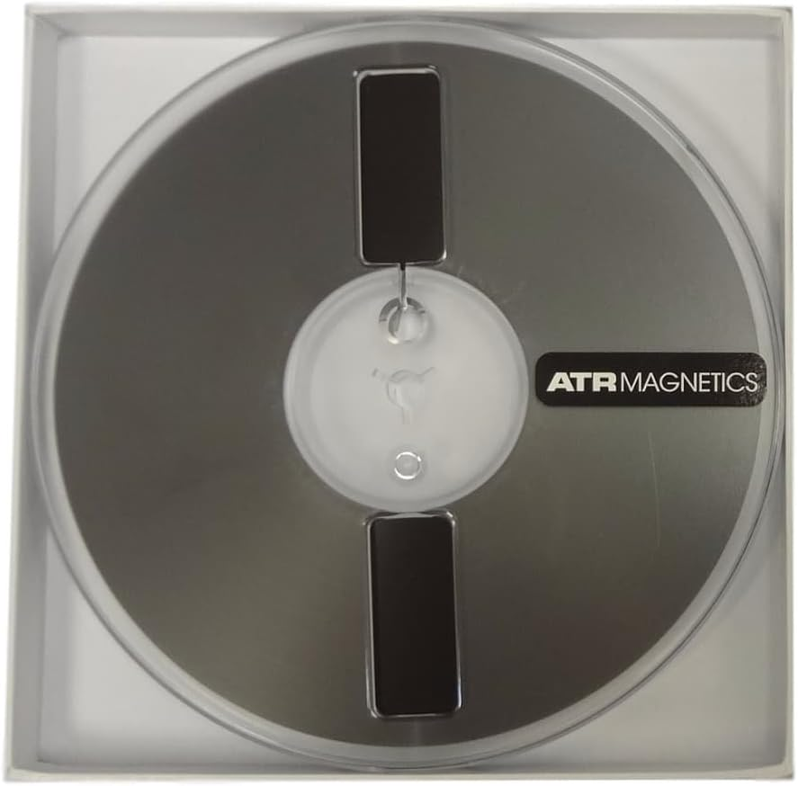
Audiotape Reel Resource Type
LDR(06) = i|j
AND
007(ǂa/0)= s
007(ǂb/1)= t
Audiotape reels are an audiotape-transport system with separate supply (feed) and take-up reels (t).

Slide 26
Audiotape Reel Resource Type
Example of an audiotape reel 007:
s ǂb t ǂd o ǂe u ǂf n ǂg c ǂh m ǂi u ǂk c ǂn e
st#ouncmuce
Audiotape reels are an audiotape-transport system with separate supply (feed) and take-up reels (t).

Slide 27
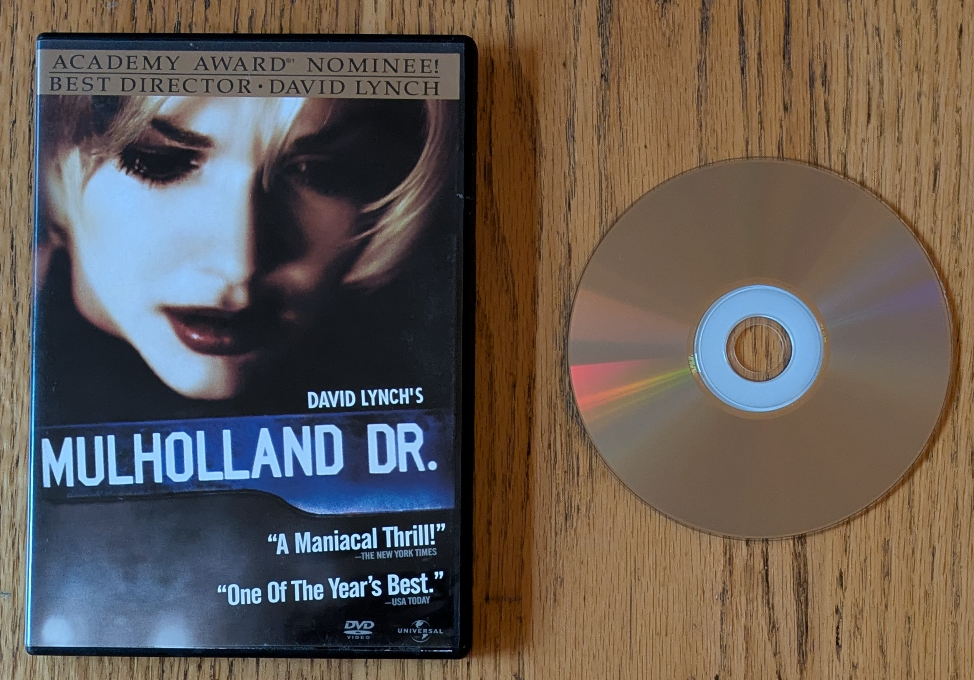
DVD Resource Type
LDR(06) = g
AND
007(ǂa/0)= v
007(ǂb/1)= d
007(ǂe/4)= v
DVDs are a laser optical (reflective) videorecording system that uses a digital technique called PCM (Pulse Code Modulation) to represent video information on a grooveless, smooth, round plastic disc (v).

Slide 28
DVD Resource Type
Example of a DVD 007:
v ǂb d ǂd c ǂe v ǂf a ǂg i ǂh z ǂi q
vd#cvaizq
DVDs are a laser optical (reflective) videorecording system that uses a digital technique called PCM (Pulse Code Modulation) to represent video information on a grooveless, smooth, round plastic disc (v).

Slide 29
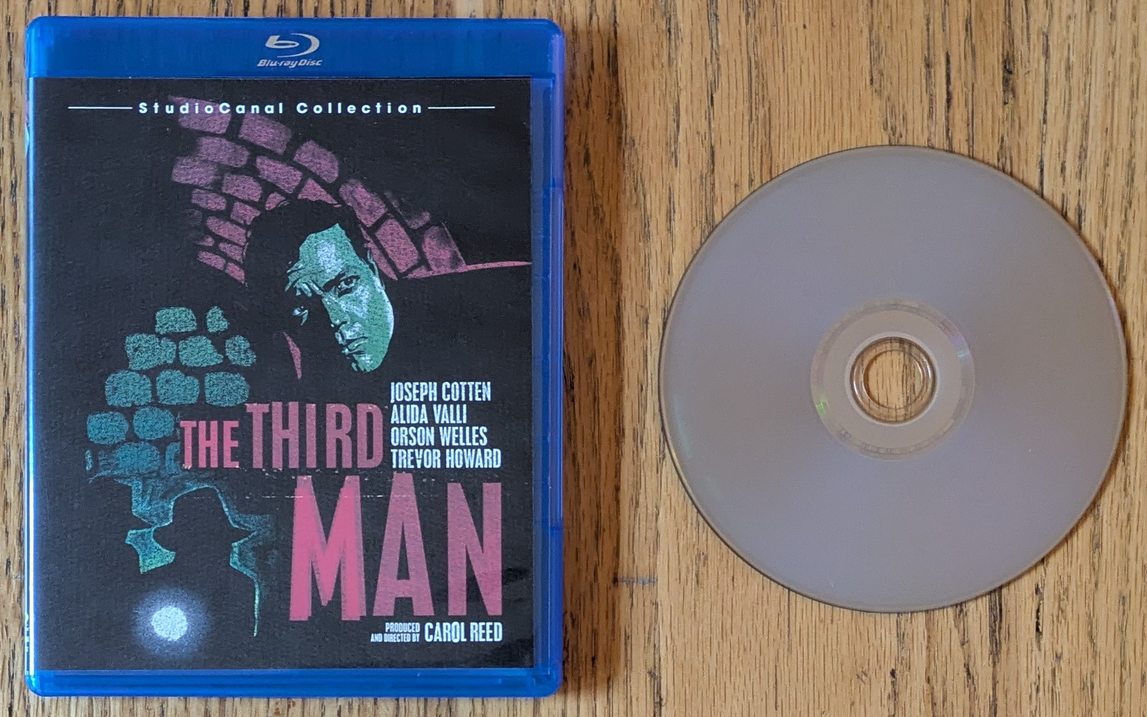
Blu-ray Resource Type
LDR(06) = g
AND
007(ǂa/0)= v
007(ǂb/1)= d
007(ǂe/4)= s
Blu-rays are an optical disc format designed for high-definition video and data storage developed by Sony/Phillips. Blu-ray uses a blue-violet laser with a shorter wave length to allow for greater data storage in a smaller space (s).

Slide 30
Blu-ray Resource Type
Example of a Blu-ray 007:
v ǂb d ǂd b ǂe s ǂf a ǂg i ǂh z ǂi u
vd#bsaizu
Blu-rays are an optical disc format designed for high-definition video and data storage developed by Sony/Phillips. Blu-ray uses a blue-violet laser with a shorter wave length to allow for greater data storage in a smaller space (s).

Slide 31
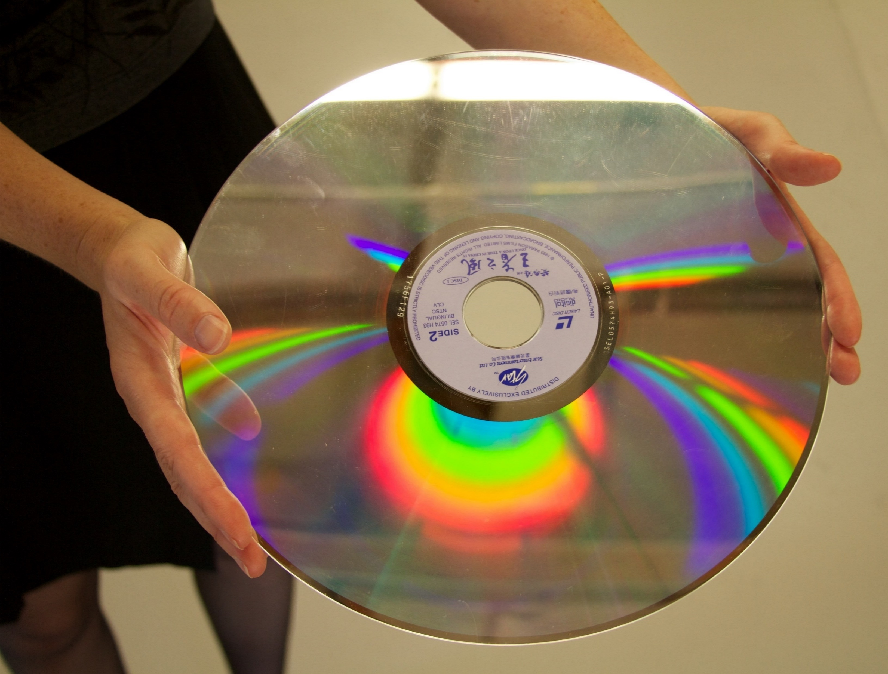
LaserDisc Resource Type
LDR(06) = g
AND
007(ǂa/0)= v
007(ǂb/1)= d
007(ǂe/4)= g
LaserDisc is a laser optical (reflective) videorecording (v) system that uses an analog technique called PWM (Pulse Width Modulation) to represent video information on a grooveless, smooth, round plastic disc (d). The disc is read (played back) by a weak laser beam that registers data appearing on the disc as tiny pits or depressions of varying lengths. Laserdiscs exist in three standard commercially produced sizes: 12, 8, and 4 3/4 inch diameters (g).

Slide 32
LaserDisc Resource Type
Example of a LaserDisc 007:
v ǂb d ǂd c ǂe g ǂf a ǂg i ǂh z ǂi s
vd#cgaizs
LaserDisc is a laser optical (reflective) videorecording (v) system that uses an analog technique called PWM (Pulse Width Modulation) to represent video information on a grooveless, smooth, round plastic disc (d). The disc is read (played back) by a weak laser beam that registers data appearing on the disc as tiny pits or depressions of varying lengths. Laserdiscs exist in three standard commercially produced sizes: 12, 8, and 4 3/4 inch diameters (g).

Slide 33
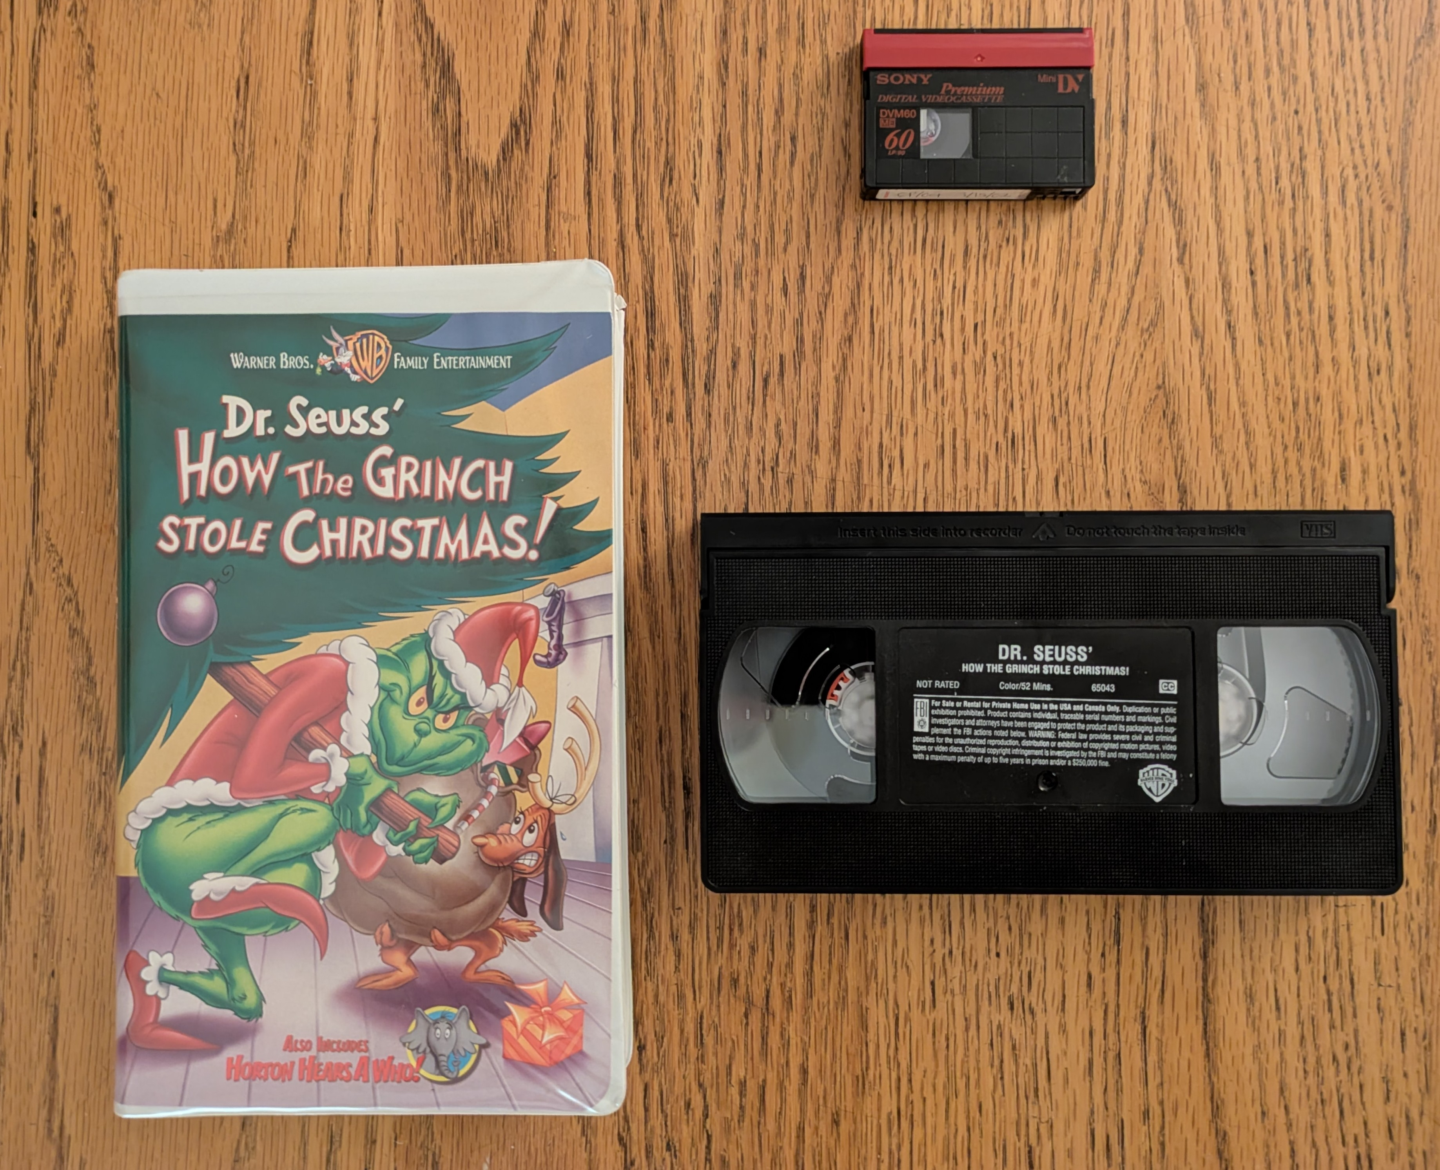
Videocassette Resource Type
LDR(06) = g
AND
007(ǂa/0)= v
007(ǂb/1)= f
Videocassettes are a videorecording (v) on tape encased in a cassette that runs reel-to-reel (f).

Slide 34
Videocassette Resource Type
Examples of a videocassettes 007:
v ǂb f ǂd c ǂe b ǂf a ǂg h ǂh o ǂi s
vf#cbahos
v ǂb f ǂd c ǂe z ǂf a ǂg h ǂh m ǂi s
vf#czahms
Videocassettes are a videorecording (v) on tape encased in a cassette that runs reel-to-reel (f).

Slide 35
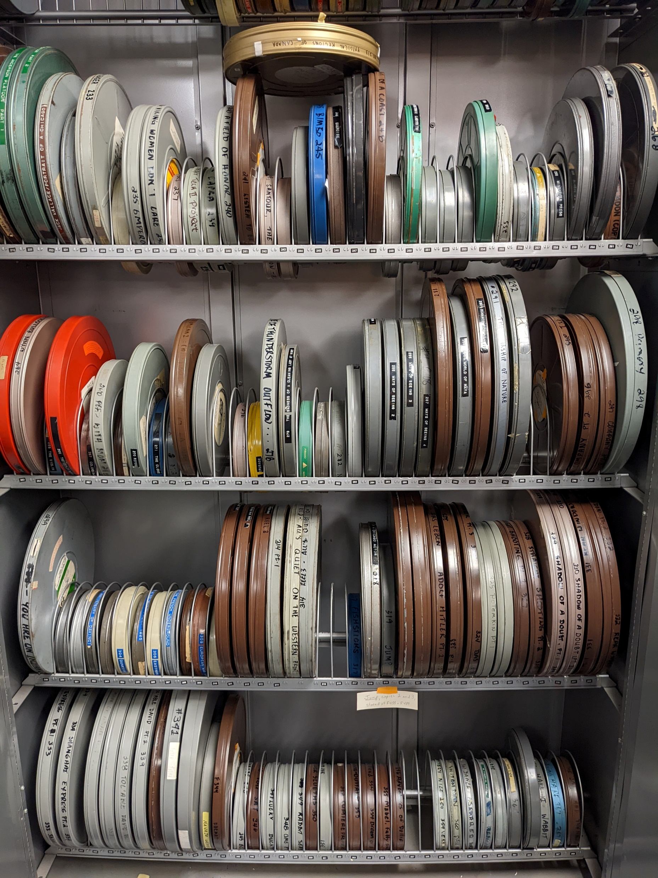
Film Reel Resource Type
LDR(06) = g
AND
007(ǂa/0)= m
007(ǂb/1)= r
Film reels are an open reel of motion picture film (m) designed for use with a projector having its own take-up reel. Includes sound track film intended to accompany visual images actually not present (r).

Slide 36
Film Reel Resource Type
Example of a film reel 007:
m ǂb r ǂd c ǂe a ǂf a ǂg a ǂh d ǂi s
mr#caaads
Film reels are an open reel of motion picture film (m) designed for use with a projector having its own take-up reel. Includes sound track film intended to accompany visual images actually not present (r).

Slide 37

OCLC – “007 Physical Description Fixed Field (Motion Picture)”
https://www.oclc.org/bibformats/en/0xx/007motio.html

Slide 38
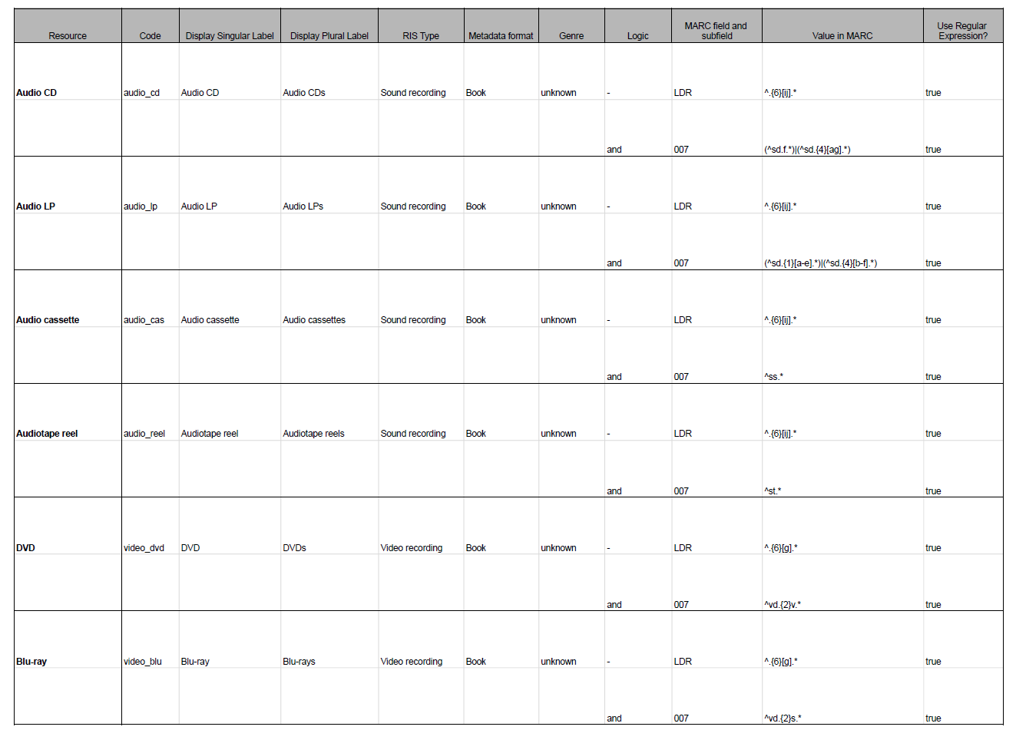
Alma Configuration

Slide 39

Spreadsheet with resource definitions, secondary resource type configurations, and indication rules to find incorrectly coded records:
https://docs.google.com/spreadsheets/d/1v0ktZ1P-suObjytdT5MqrM97Txb4JJSrxRjll20ZbYM/edit?usp=sharing

Slide 40
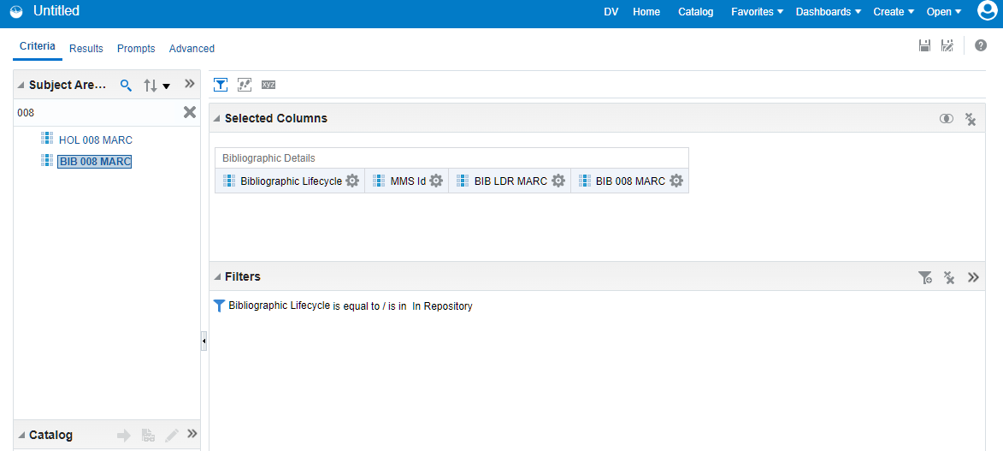
Finding Miscoded Records: Finding Sets to Filter

Slide 41
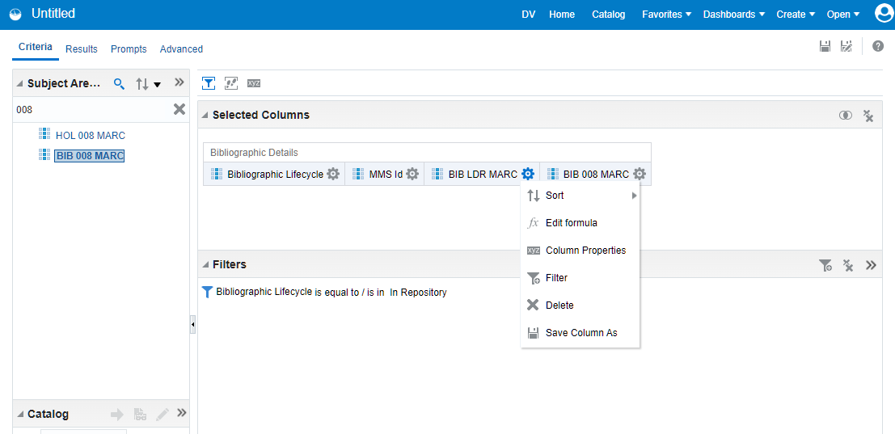
Finding Miscoded Records: Finding Sets to Filter

Slide 42
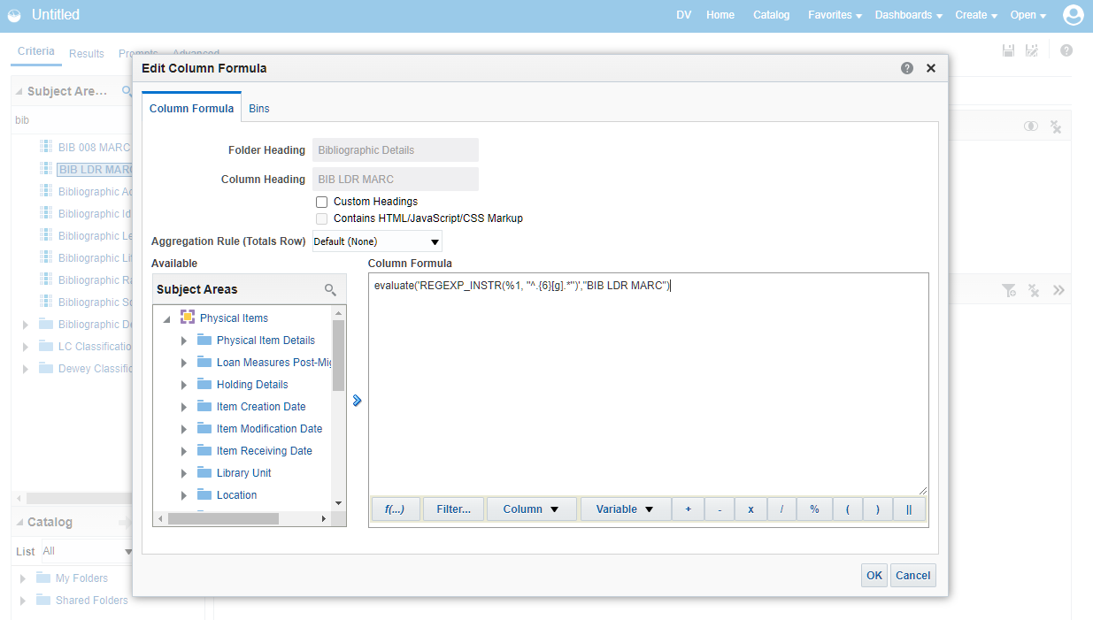
Finding Miscoded Records: Finding Sets to Filter
For audio = evaluate('REGEXP_INSTR(%1, ''^.{6}[ij].*'')',"BIB LDR MARC")
For video = evaluate('REGEXP_INSTR(%1, ''^.{6}[g].*'')',"BIB LDR MARC")

Slide 43
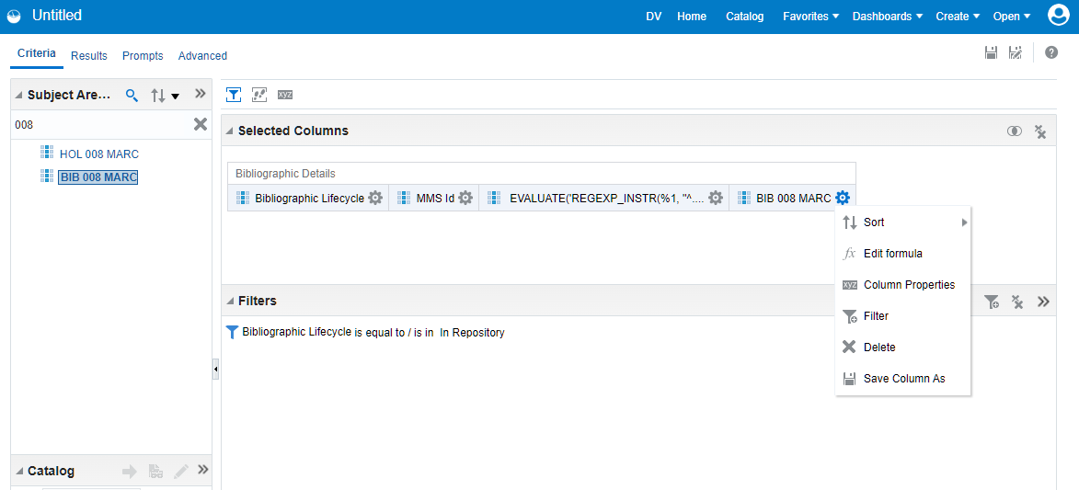
Finding Miscoded Records: Finding Sets to Filter

Slide 44
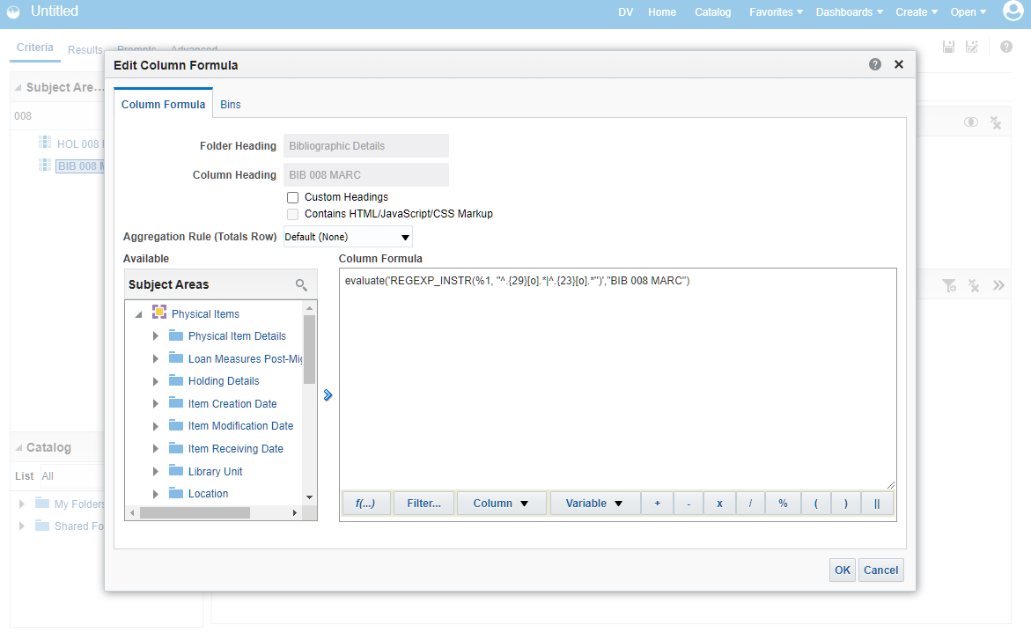
Finding Miscoded Records: Finding Sets to Filter
evaluate('REGEXP_INSTR(%1, ''^.{29}[o].*|^.{23}[o].*'')',"BIB 008 MARC")

Slide 45
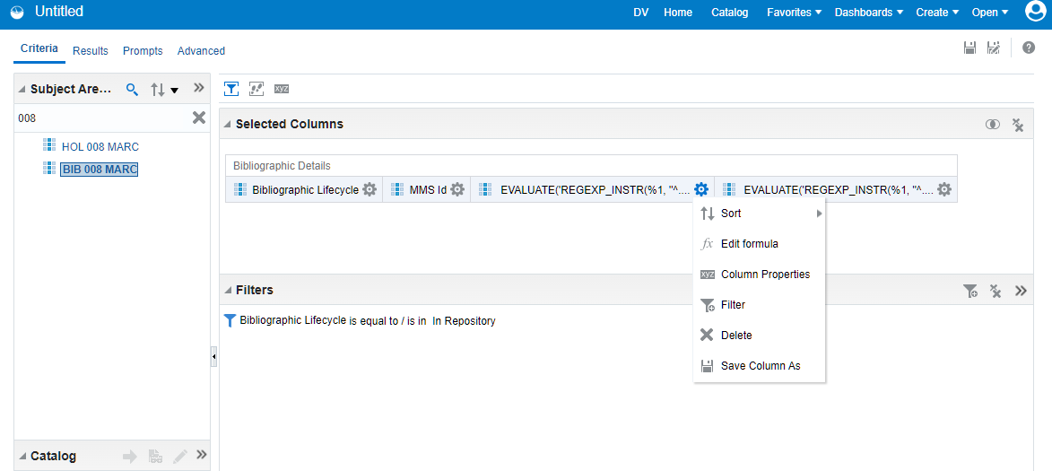
Finding Miscoded Records: Finding Sets to Filter

Slide 46
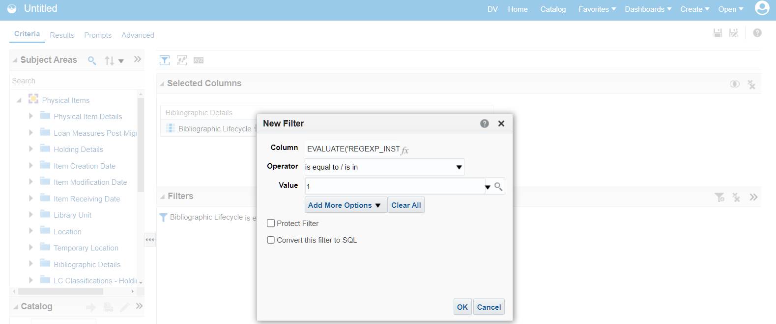
Finding Miscoded Records: Finding Sets to Filter

Slide 47
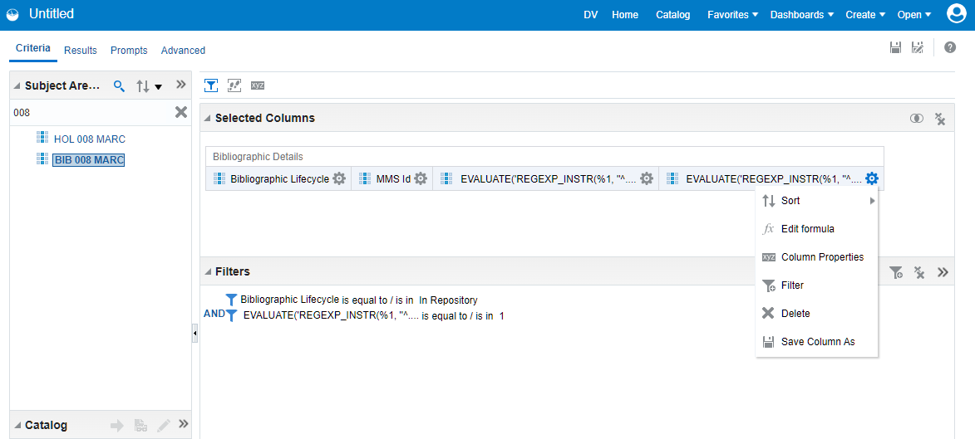
Finding Miscoded Records: Finding Sets to Filter

Slide 48
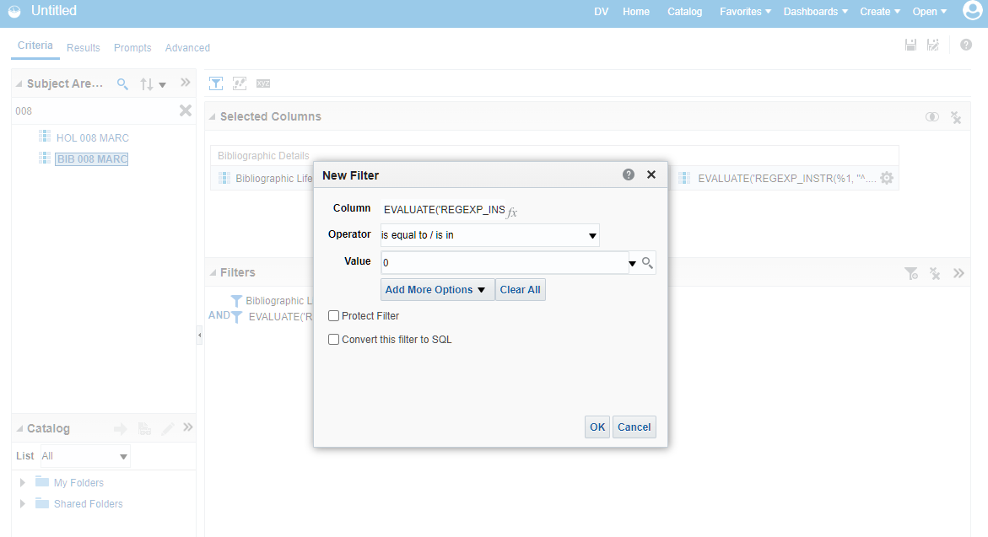
Finding Miscoded Records: Finding Sets to Filter

Slide 49
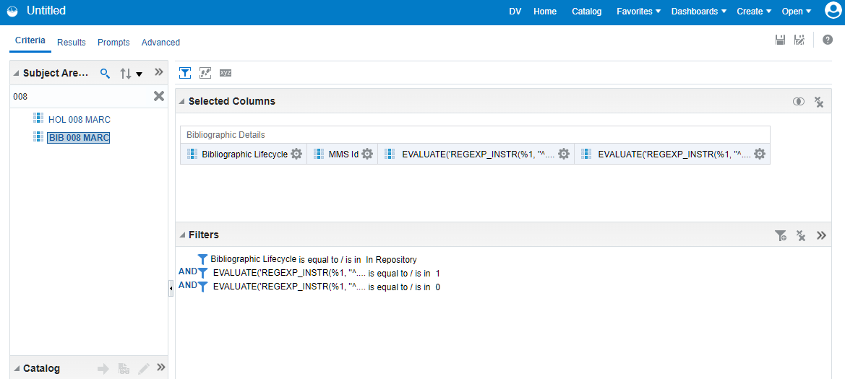
Finding Miscoded Records: Finding Sets to Filter

Slide 50
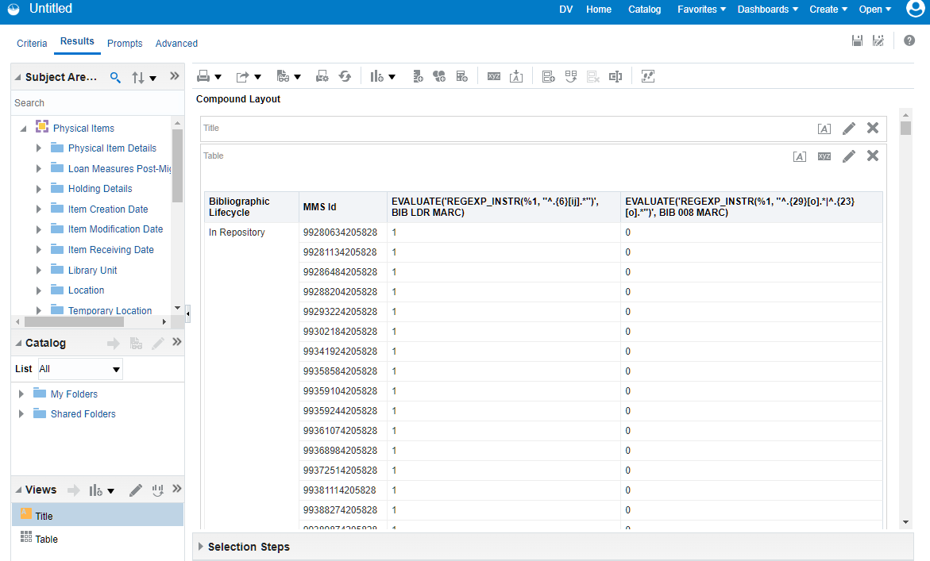
Finding Miscoded Records: Finding Sets to Filter
Create set with MMS Id results

Slide 51
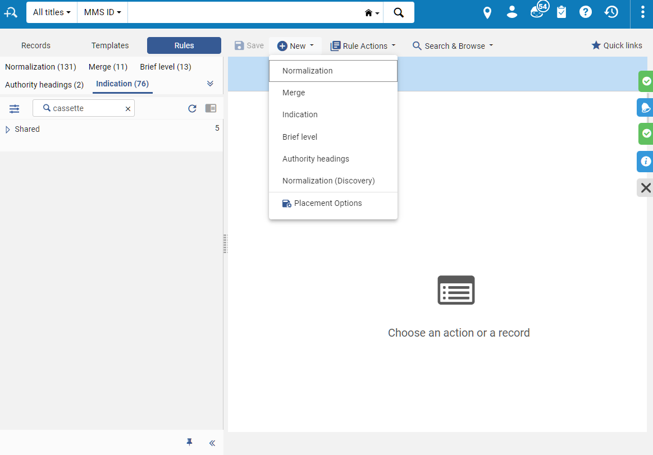
Finding Miscoded Records: Create Indication Rules
In the Metadata Editor

Slide 52
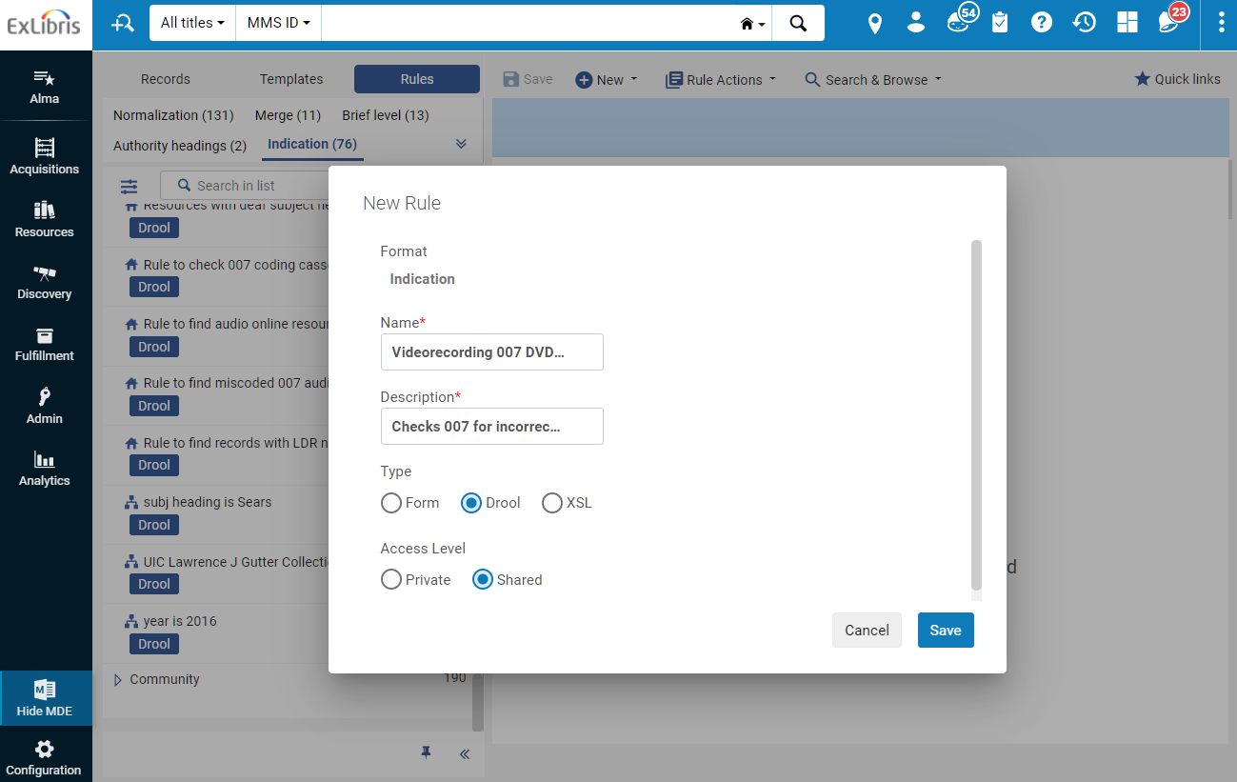
Finding Miscoded Records: Create Indication Rules

Slide 53
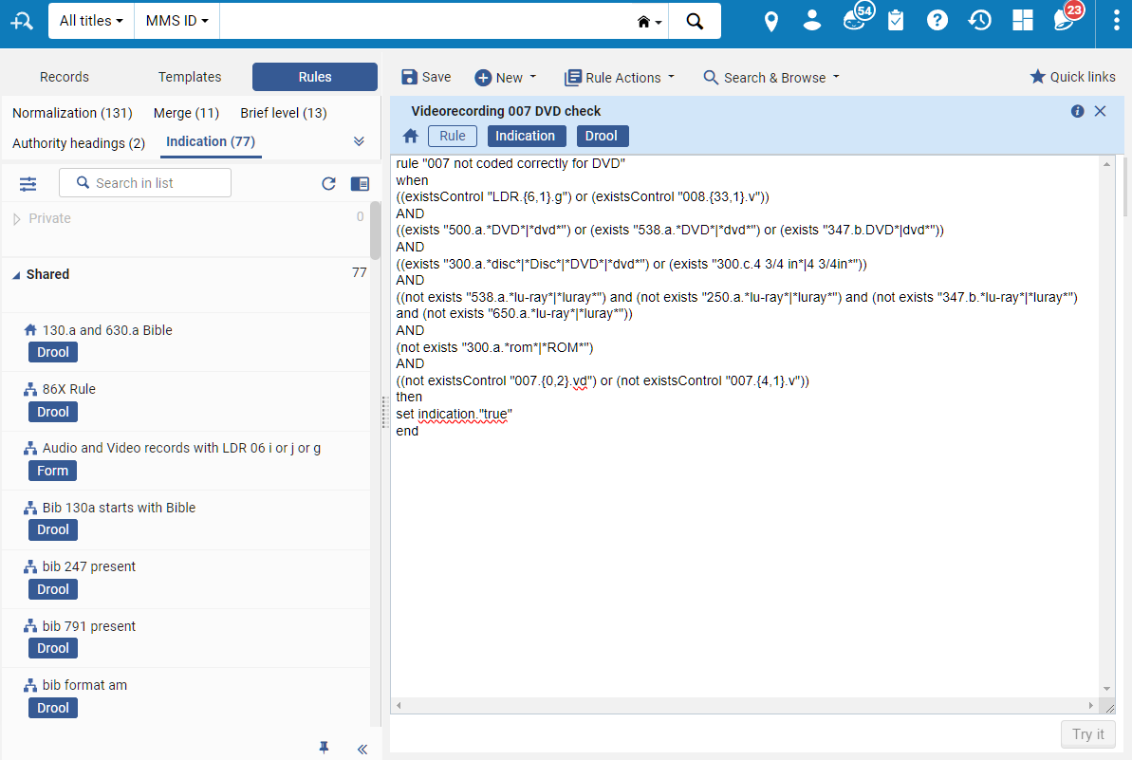
Finding Miscoded Records: Create Indication Rules
Indication rule text files linked in spreadsheet here:
https://docs.google.com/spreadsheets/d/1v0ktZ1P-suObjytdT5MqrM97Txb4JJSrxRjll20ZbYM/edit?usp=sharing

Slide 54
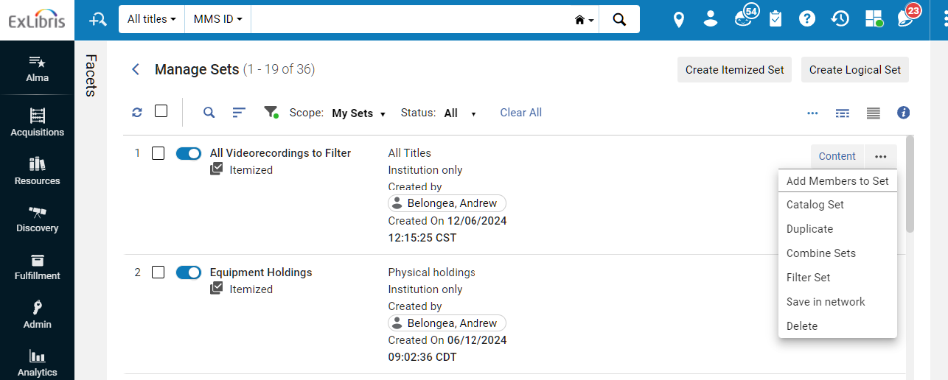
Finding Miscoded Records: Filter Set

Slide 55
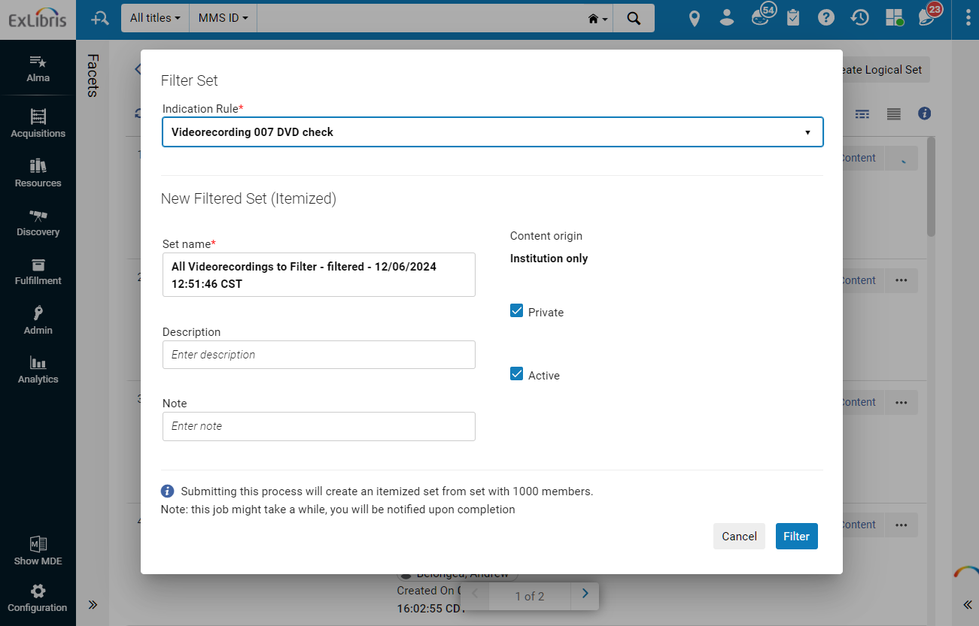
Finding Miscoded Records: Filter Set

Slide 56
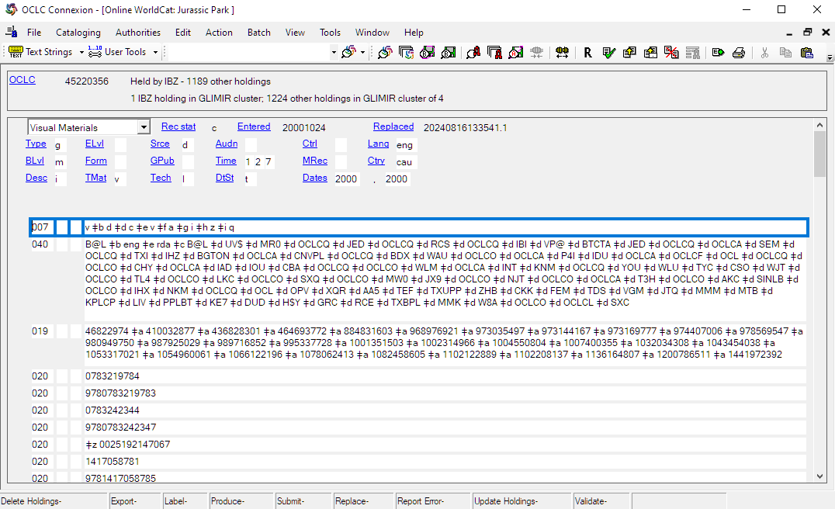
Correcting Miscoded Records
Correct records in OCLC and then export.
Run “Recalculate Local Resource Types” Job (Admin > Manage Jobs and Sets > Run a Job) on updated records.

Slide 57
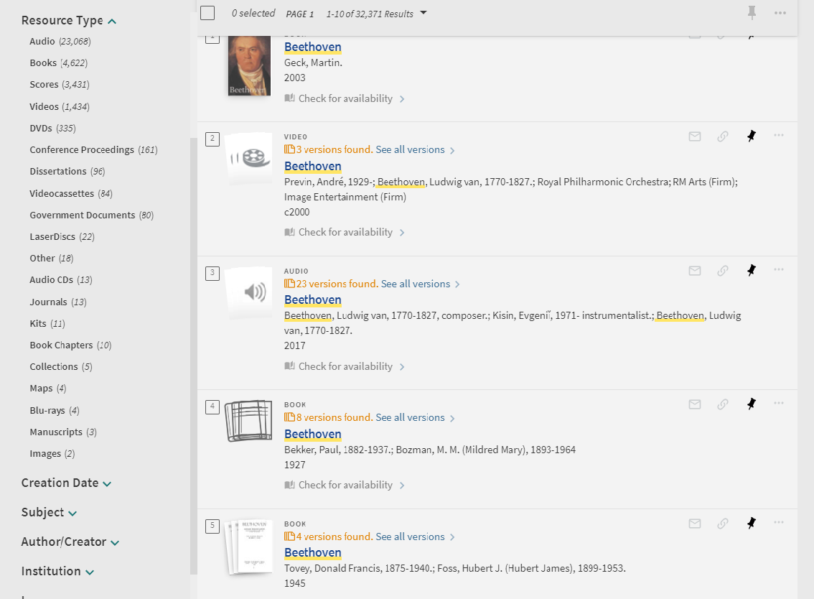
New Resource Types in Primo

Slide 58
Secondary Resource Types in Primo

Slide 59
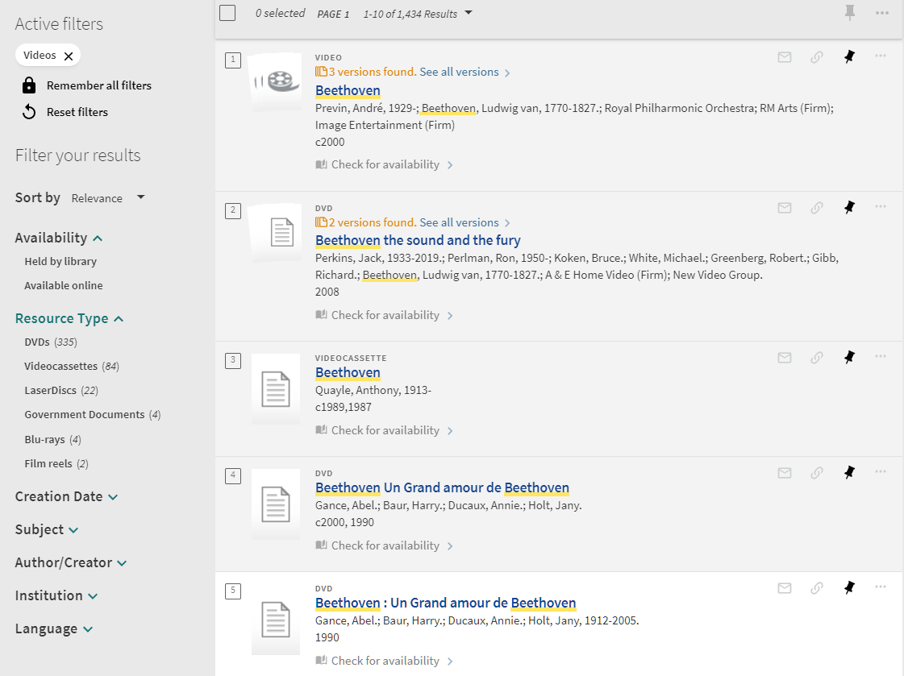
Secondary Resource Types in Primo

Slide 60
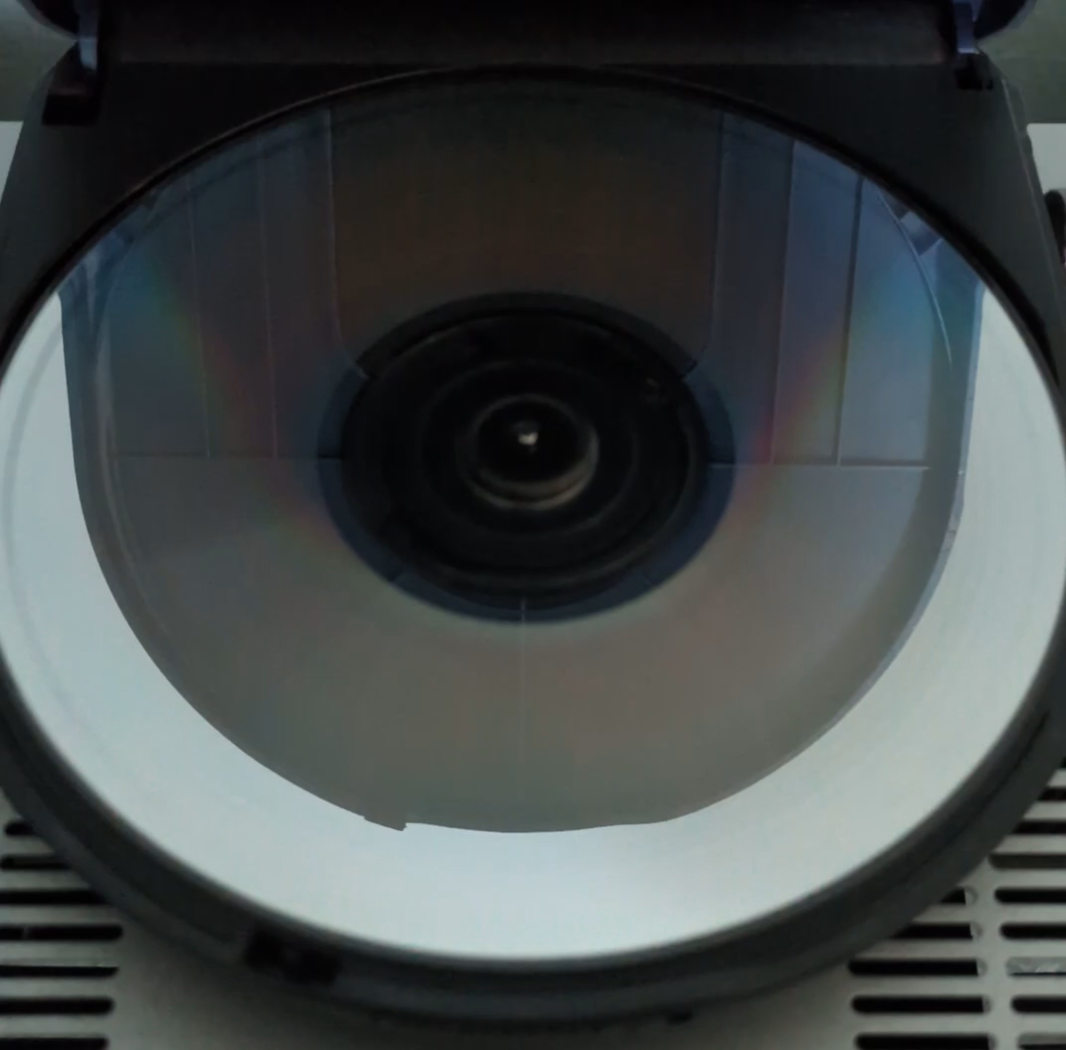
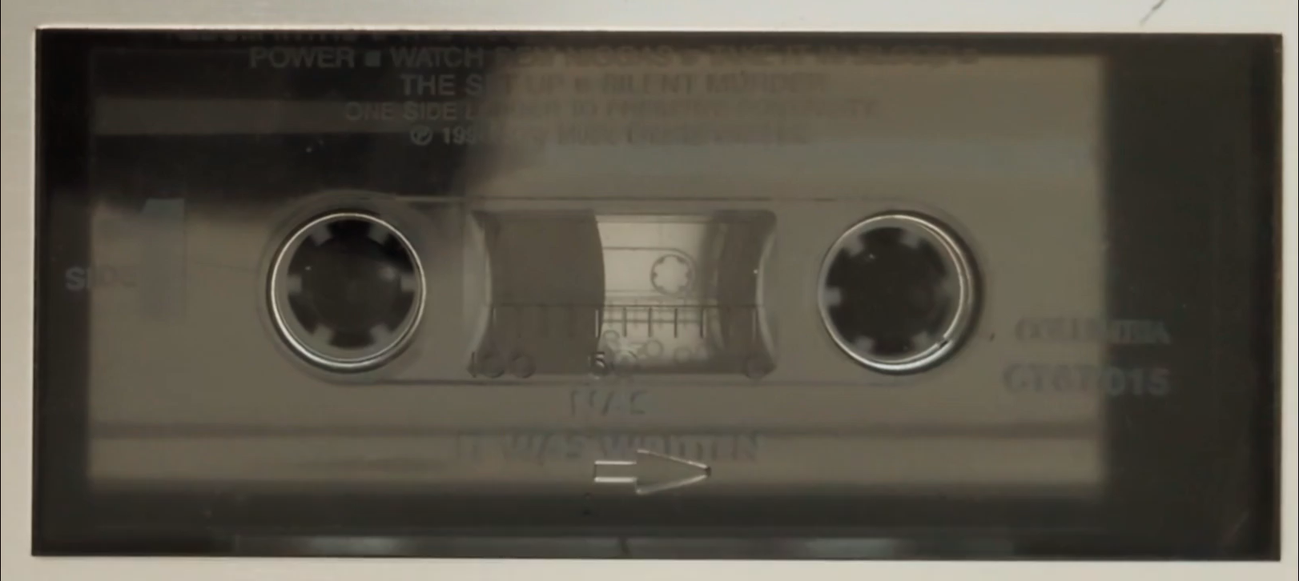
Thank you for your time and attention!
Questions?
Andrew Belongea Metadata and Systems Librarian Columbia College Chicago abelongea@colum.edu

