Slide 1
I-Share Alma Primo VE Office hours will start shortly
Welcome!
Office Hours will start at 2pm and run until 3pm. Please mute your microphone. As time permits, we will respond to questions typed in the chat box, and offline afterwards, as needed.
This session will be recorded and made available on the CARLI website both as PDF slides and as a recording, with live links to all referenced resources.

Slide 2
Alma Primo VE Open Office Hours SEPTEMBER 8, 2022 PRIMO VE POTPOURRI

Slide 3
AGENDA
Agenda – 9/8/2022
Announcements and Reminders
Primo VE: Potpourri of Customizations
Disclaimers and Reminders
Feedback Tool
Alphabetic Sort of Subjects in Full Record Display Details
CDI Search Results Options
Indexing of Holdings Metadata
Quicklinks
Location Order in Full Record Display’s Get It Section
Journal Coverage Dates in Brief Results
Disable Edit Option in Personal Details of My Library Card
Broaden “Not Available” status in Brief Results
Display License Terms Information for E-Resources

Slide 4
REMINDERS
I-Share Liaisons Webinar
Wednesday, September 14 from 3:00-4:00pm
Review the roles and responsibilities of I-Share Liaisons. Attendance of I-Share Liaisons is encouraged but not required.
Register on CARLI website at:
https://www.carli.illinois.edu/role-i-share-liaisons-webinar-0
Session will be recorded.
Notes:
https://www.carli.illinois.edu/role-i-share-liaisons-webinar-0

Slide 5
REMINDERS
Upcoming Office Hours
Held on the 2nd Thursday of each month from 2:00-3:00pm
Next session: October 13, 2022
Let’s Talk About Fulfillment
Held on some Fridays of each month from 2:00-3:30pm
Next session on September 16
Technical Services Q&A
Next session: Wednesday, September 21, from 2:00-3:00pm
https://go.illinois.edu/CARLItsqa for past sessions
All event are on the CARLI Calendar!
Notes:
https://www.carli.illinois.edu/calendar

Slide 6
REMINDERS
Alma Electronic Resources
Be sure to update your electronic collections in your Alma IZ
Activate any new collections and subscriptions for patrons to get access
Deactivate and delete collections if you no longer subscribe
Update any authentication changes you have made

Slide 7
Primo VE Potpourri
Configurations, Settings, and Customizations You Might Not Be Aware Of

Slide 8
Friendly Disclaimers
When making changes to configurations, settings, or customizations…
Do not make changes without consulting with all stakeholders at your library.
Keep a change log or record of what you change and the rationale behind it.
When possible, test changes in one of the CARLI Sandboxes or in a TEST View of Primo VE first before making changes in production.*
Save a copy of your old configuration package zip file! Alma contains only the current version.
You’ll need the Discovery Admin role to make most of these changes except where noted.
Notes:
Always consult with all stakeholders at your library before making changes that will affect the behavior of your Primo VE interface. For most it’s the beginning of a new year, and your reference and instruction colleagues will thank you for not changing things out from under them!
It’s always a good idea to keep a change log. Future You or Future Someone Else will thank Present You for keeping track of the changes made!
In many cases, Sandboxes and Test Views allow you to preview changes before committing to changing them in production.
If you are updating or changing your Primo VE configuration package, remember to save a copy of your old customization package before you upload a new one. Alma contains only the most recently-uploaded version, so you may need the old version if there are any issues with the changes you made.
Most of these changes can be made by someone with the Discovery Admin role except where noted

Slide 9
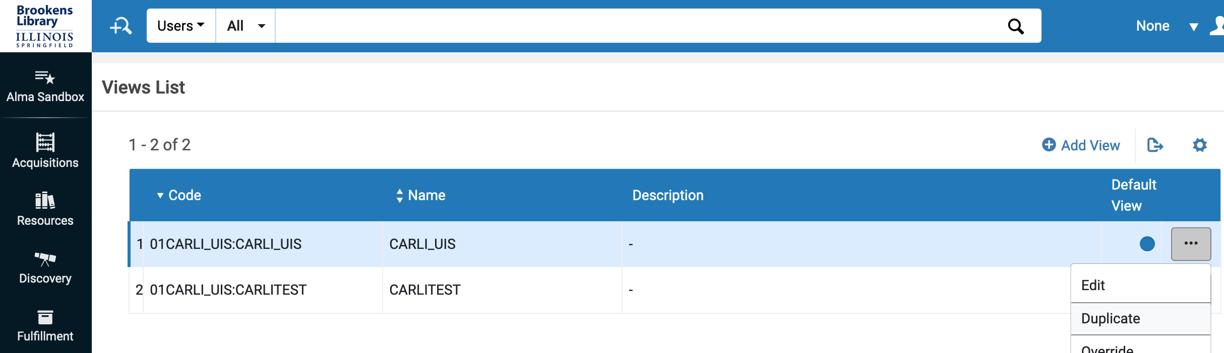
Sandboxes and Test Views
Information on the Alma and Primo VE Sandboxes can be found at: https://www.carli.illinois.edu/products-services/i-share/alma/sandbox
From the Primo VE Views list in Alma, you can Duplicate an existing View to make a new Test View:
*Future Slides will recommend where to test a feature in this footer.
Notes:
Information on how to connect to the Sandboxes is posted here on the CARLI website. https://www.carli.illinois.edu/products-services/i-share/alma/sandbox
It is easy to create Test Views in Primo VE by Duplicating an existing View; that way, you’ll have all of the current customizations of that View and be able to make incremental changes for testing.
Throughout the rest of this presentation, watch for a Testing Recommendation location in the slide footer.

Slide 10
Angular 1.8 in November 2022 release
Primo VE is moving to Angular 1.8 with the November 6, 2022 software release
Upgrade may impact your JavaScript customizations in Primo VE and may require you to adjust the customizations prior to the upgrade to ensure a smooth migration to Angular 1.8.
Ex Libris’ Preparing for the Upgrade to Angular 1.8 website: https://knowledge.exlibrisgroup.com/Primo/Product_Materials/Announcements/Preparing_for_the_Upgrade_to_Angular_1.8_in_Primo%2F%2FPrimo_VE
Details on the changes, including webinar recordings
How to test your Primo VE NOW to identify any issues
How to adjust customizations, if needed
Frequently Asked Questions
CARLI will test our posted customizations and send an announcement about any changes needed.
Follow instructions in link above to test in production with special URL parameter.
Notes:
In the November 6, 2022 software release, Primo VE is moving to Angular 1.8. The upgrade may affect local JavaScript customizations.
This Ex Libris website contains details on the changes, includes information on how to test your Primo VE NOW to look for any issues, how to adjust your customizations, if needed, and other Frequently Asked Questions.
https://knowledge.exlibrisgroup.com/Primo/Product_Materials/Announcements/Preparing_for_the_Upgrade_to_Angular_1.8_in_Primo%2F%2FPrimo_VE
CARLI will be testing the customizations posted on the CARLI website and issue an announcement about any changes needed. https://www.carli.illinois.edu/products-services/i-share/discovery-interface/custom_package

Slide 11
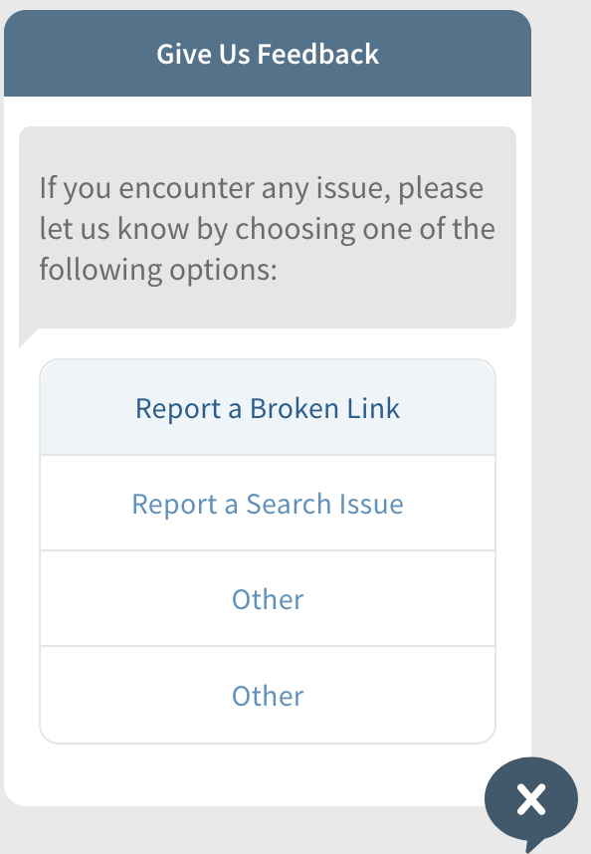
“Give Us FeedbacK” Tool
New built-in widget allows libraries to receive feedback from users.
Up to four categories to offer
Appears in the lower right-hand corner of all pages.
Configurable by Primo VE View.
Sends email (Alma Letter) to one or more addresses.
Need Letter Admin or General Sys Admin role for Letters
See it in action in the KNX Sandbox CARLITEST View
https://knowledge.exlibrisgroup.com/Primo/Product_Documentation/020Primo_VE/Primo_VE_(English)/120Other_Configurations/Configuring_the_Feedback_Tool_for_Primo_VE
Testing Recommendation: Sandbox – configured in KNX Sandbox CARLITEST View
Notes:
This built-in functionality allows you to solicit feedback from your users without having to install custom CSS/JavaScript code or General Electronic Services.
You can have up to four categories, and the tool is configurable per Primo VE View.
The tool sends email to one or more addresses, and the email is configurable with the Alma “Report a Problem Letter”
First available in May 2022, Ex Libris is working on more enhancements for this feature in the November feature release! All labels can be changed, of course.
I’ve configured it to be on in the KNX Sandbox if you’d like to take a look!
https://knowledge.exlibrisgroup.com/Primo/Product_Documentation/020Primo_VE/Primo_VE_(English)/120Other_Configurations/Configuring_the_Feedback_Tool_for_Primo_VE

Slide 12
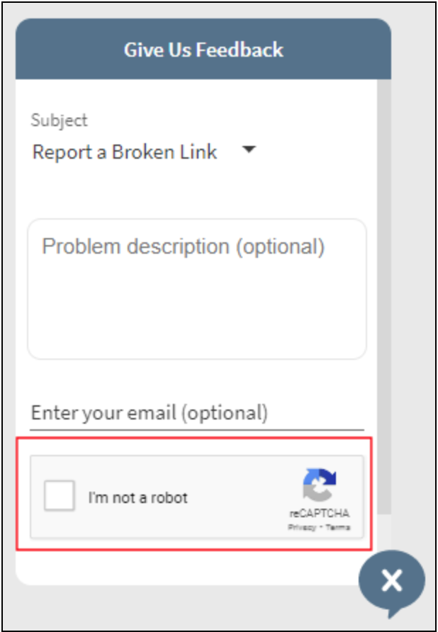
Adding reCAPTCHA security to email sent from Primo VE
Can add reCAPTCHA security to Email Action email and Feedback tool.
Must register your institution (if you haven’t already) and get keys from Google to input into Alma in the Captcha Keys mapping table (Alma Configuration > Discovery > Other > Captcha configuration)
Labels are configurable
https://knowledge.exlibrisgroup.com/Primo/Product_Documentation/020Primo_VE/Primo_VE_(English)/120Other_Configurations/Getting_reCaptcha_Site_and_Secret_Keys
Testing Recommendation: Sandbox
Notes:
You can now add reCAPTCHA security to the Email action on the Full Record Page and the Give Us Feedback Tool.
This configuration will apply to both, you can’t selectively apply the reCAPTCHA feature.
For more information, see the Ex Libris documentation on how to get reCAPTCHA keys and configure them in Alma:
https://knowledge.exlibrisgroup.com/Primo/Product_Documentation/020Primo_VE/Primo_VE_(English)/120Other_Configurations/Getting_reCaptcha_Site_and_Secret_Keys

Slide 13
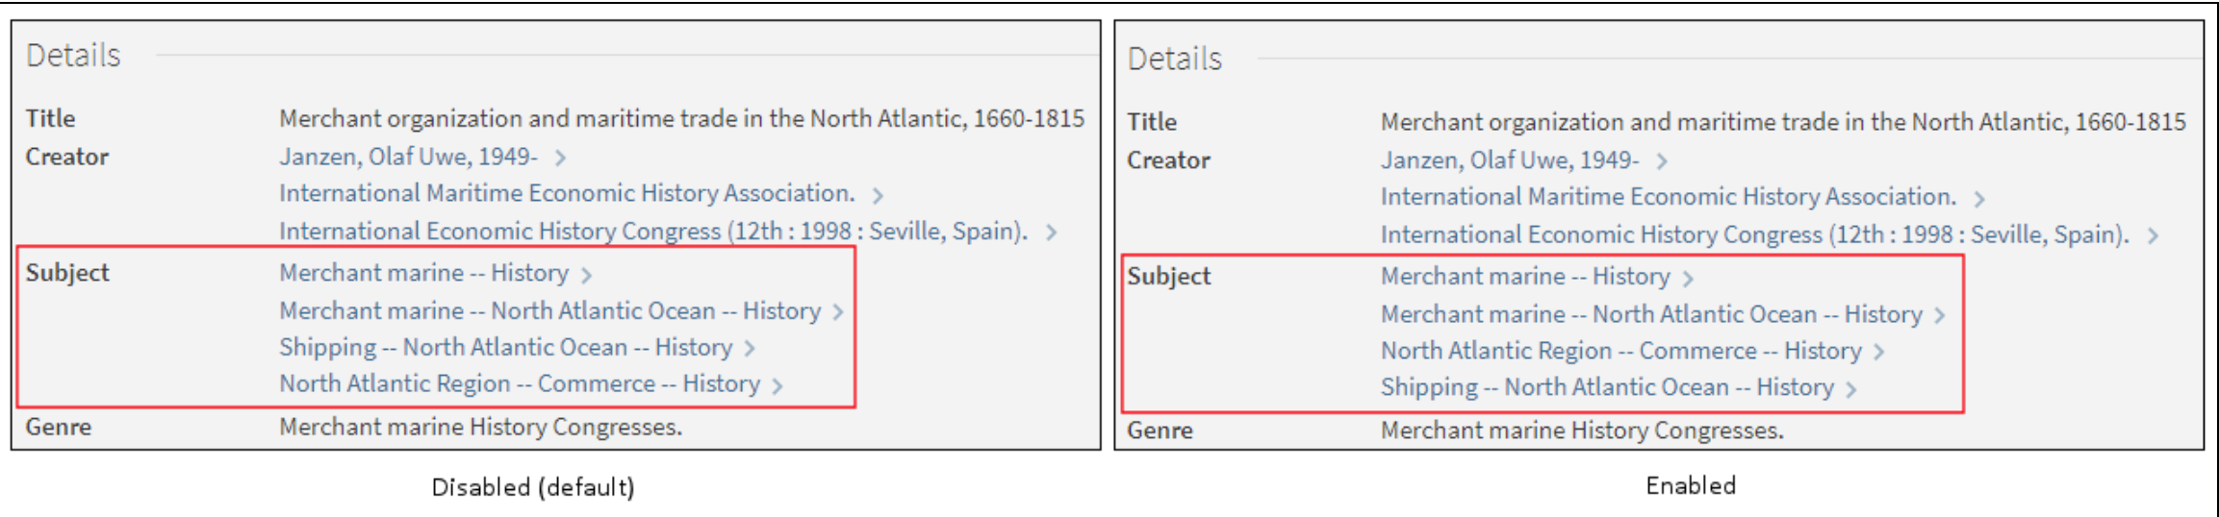
Alphabetic Sort of Subjects in Full Record Display Details Section
Subjects display in the order they occur in the MARC record by default.
This feature will alphabetize their display instead.
Alma Configuration Menu > Discovery > Other > Customer Settings > subjects_alphabetical_sort_fullDisplay parameter to true
Enabled in UIS Sandbox
Testing Recommendation: Sandbox
Notes:
By default, bibliographic Subjects display in the Full Record Details section in the order that they occur in the MARC record. With this feature, you can cause the Subjects to be displayed in Primo VE alphabetically instead.
Note that you cannot select which kinds of subjects to apply this sort to; it will apply to all fields under the Subject label that are present in the bib.
This functionality is disabled by default. To enable it, set the subjects_alphabetical_sort_full parameter to true in Configuration Menu > Discovery > Other > Customer Settings

Slide 14
Options in Search Profiles that Include CDI
Search Profiles define groups of records to be searched in Primo VE.
In a Primo VE Search Profile for the Central Index (CDI), or a Blended Search Profile that includes the Central Index (CDI) as one of the scopes, here are three options you may configure to affect search results:
Filter by Availability
Exclude CDI eBooks
Search in FT
Alma Configuration > Discovery > Search Configuration > Search Profiles
All three are Enabled/Configured in UIS Sandbox “Articles” search scope.
Testing Recommendation: Sandbox; or create Test Search Profile and Test View
Notes:
Next we’ll go through a few of the options for Search Profiles that include the Central Discovery Index, or CDI.
Search Profiles enable your library to define groups of records that meet specific conditions for your users to search in Primo VE. The groups may contain records that belong to the Central Index (CDI), to a specific library, to the I-Share Network, to a specific location or set of locations, etc.
In Search Profiles with CDI, there are options to
Filter by Availability
Exclude CDI eBooks
And Search in Full Text
Important Note about Search Profiles: They are global and used in all Primo VE Views. In order to test them without affecting your current production Search Profiles, you would need to add a new Testing Search Profile to duplicate the one currently in use and change the setting(s), then activate that Testing Search Profile in a TEST View.

Slide 15

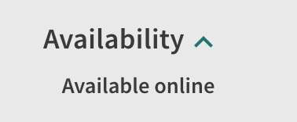
Filter By Availability in CDI Searches
Filter by Availability
Check the “Filter by Availability” box if you want to display results of CDI records only if they have full text available.
After performing a search, users may select the “Expand My Results” option from the facets to display other records for which your library does not have full text.
Uncheck the “Filter by Availability” box if you want to display all CDI records by default, including those without full text.
After performing a search, users may select the “Available Online” facet to display only CDI records with full text.
Testing Recommendation: Sandbox; or create Test Search Profile and Test View
Notes:
The “Filter by Availability” option can be checked or not.
Check it if you want Primo VE to display results from CDI only if they have full text options available for your users. When this is “on”, users can always choose to “Expand My Results” from the Primo VE facets to show results without full text.
You’d leave this option unchecked if you wanted Primo VE to display all CDI records by default, even those without full text access. Users can refine these results to only those with full text by applying the “Available online” facet.

Slide 16
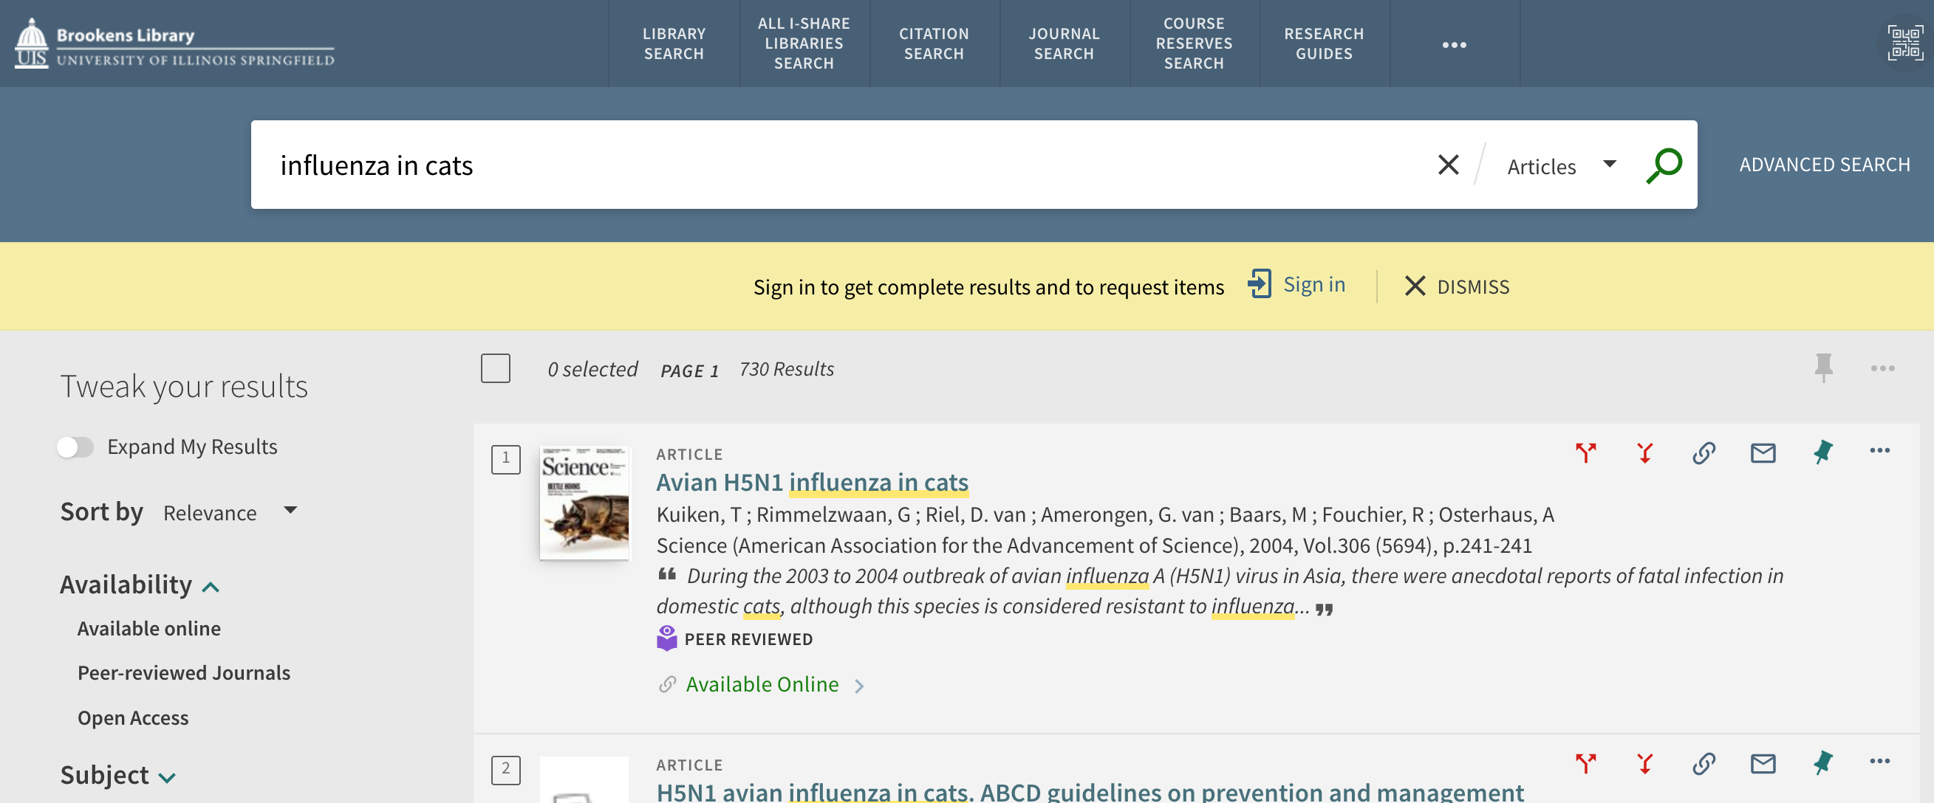
Filter By Availability in CDI Searches
Notes:
Here is a screenshot from the UIS Sandbox showing the location of the “Expand My Results” toggle and the “Available online” facet.

Slide 17
Exclude ebooks from CDI search Results
Exclude CDI eBooks
Phase 1 introduced in November 2021
When checked, excluded ALL eBooks from CDI search results.
Many libraries found this unsatisfactory and did not enable it.
Phase 2 introduced in August 2022
Now when checked, will exclude CDI eBook records only when there are active portfolios in active e-collections in Alma, thereby reducing duplicate results
Books from database collections continue to appear in results.
May not be appropriate if your library is using Rapido; check with Ex Libris Rapido Support before enabling.
Testing Recommendation: Sandbox; or create Test Search Profile and Test View
Notes:
In November 2021, Ex Libris introduced Phase 1 of this configuration option to exclude eBooks from CDI search results. This option was meant to help reduce duplicate results for the same title from your Alma and CDI when a library preferred to use their own eBook cataloging records instead of the records from CDI, but turning on this option during Phase 1 filtered ALL eBook records from the CDI results. So, if you hadn’t locally cataloged all of your ebooks in Alma, it was removing all access to certain things when records for them were only available from the CDI results.
With the second phase of this enhancement in August 2022, this configuration option now excludes CDI eBook records only for collections that have portfolios in Alma instead of filtering out all eBook records from the CDI results. Books from database collections will continue to appear in the CDI search results.
So for example, if you enable this setting and have active portfolios in e-collections for Wiley and JSTOR ebooks, these ebooks will not be returned by searches of CDI, but the ebooks from HathiTrust or other e-collections without active portfolios in Alma will be returned.
For more details regarding these options, see https://knowledge.exlibrisgroup.com/Primo/Product_Documentation/020Primo_VE/Primo_VE_(English)/040Search_Configurations/010Configuring_Search_Profiles_for_Primo_VE#Adding_a_Search_Profile and scroll down to the chart titled “Valid Scope Types”; see the section on “Central Index”.

Slide 18
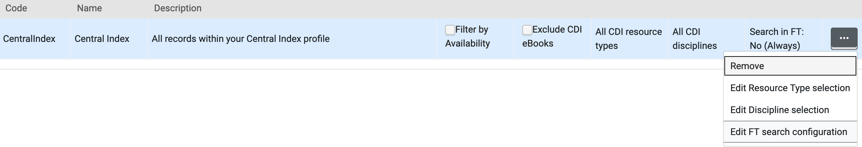
Give Users Ability to include/Exclude Full Text MatchES in CDI Searches
Search in FT
“Search in FT” option is edited by clicking the ellipsis button and choosing “Edit FT search configuration”.
By default, set to “No, Always”
This setting will configure whether searches check indexed full text for matches on search terms, and whether or not users can override the setting themselves in Primo VE.
Testing Recommendation: Sandbox; or create Test Search Profile and Test View
Notes:
This setting will configure whether searches check indexed full text for matches on search terms, and whether or not users can override the setting themselves in Primo VE.
By default, this is set to “No, Always” which means that full text is never checked for matches to the search query and users cannot change this.
For more details regarding these options, see https://knowledge.exlibrisgroup.com/Primo/Product_Documentation/020Primo_VE/Primo_VE_(English)/040Search_Configurations/010Configuring_Search_Profiles_for_Primo_VE#Adding_a_Search_Profile and scroll down to the chart titled “Valid Scope Types”; see the section on “Central Index”.

Slide 19
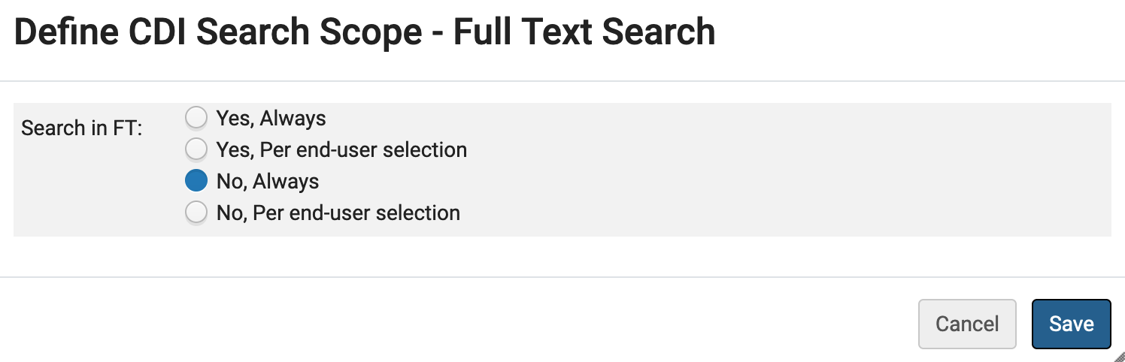
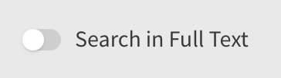
Give Users Ability to include/Exclude Full Text MatchES in CDI Searches
Yes means results will include items if the search terms are not in the citation metadata but are in the full text of the document (and it is indexed).
No means results will only include terms in the metadata.
Always means no end-user option to enable/disable this choice.
Per end-user selection will create a slider option in Primo VE for the user to toggle the Yes/No option themselves.
Notes:
Clicking “Edit FT search configuration” from the ellipsis shown on the last slide will open the screen to enable the following choices for including/excluding full text matches in CDI records:
Yes, Always
Yes, Per end-user selection
No, Always
No, Per end-user selection
If it is set to one of the Yes options, then search results will include items even if the search terms are not in the citation metadata so long as those terms are in the full text of the document (and so long as the full text is indexed). Setting it to No will find the terms only in the metadata.
The option with “Per end-user selection” will create a slider option in the sidebar of Primo VE results list pages so that users can toggle the option on/off themselves.

Slide 20
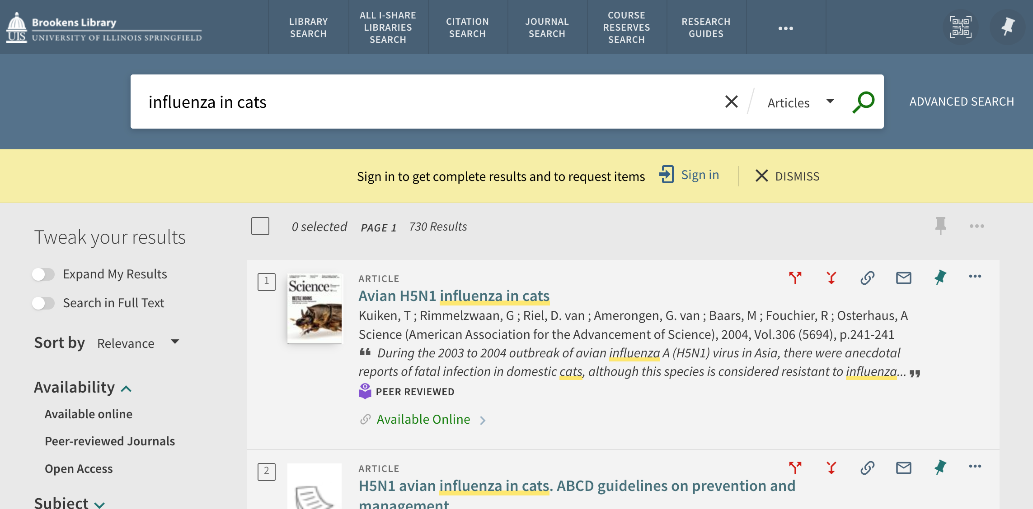
Give Users Ability to include/Exclude Full Text MatchES in CDI Searches
Here is an example with No, Per end-user selection chosen:
Notes:
Here is an example in the Sandbox when “No, Per end-user selection” is chosen. After performing the search and getting results, the users could toggle this ON to rerun the search for matches within full text.

Slide 21
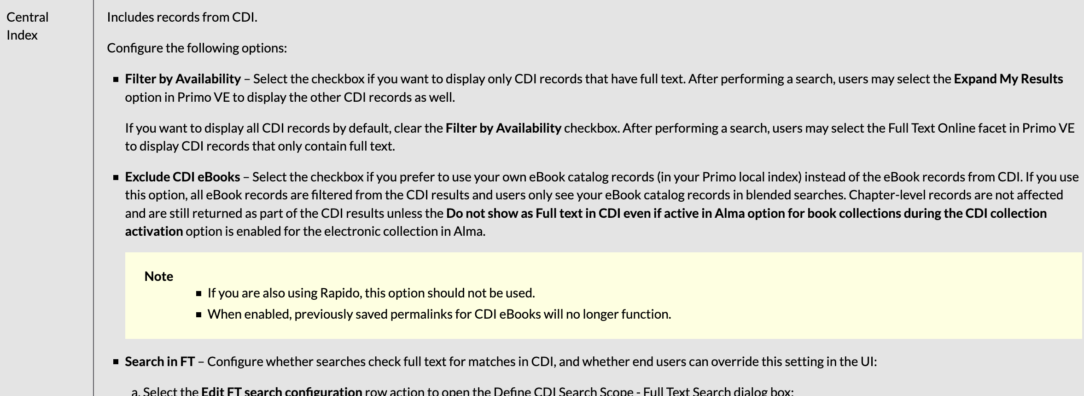
Ex Libris Documentation on CDI Search Scope options
For more details on these three options go to:
https://knowledge.exlibrisgroup.com/Primo/Product_Documentation/020Primo_VE/Primo_VE_(English)/040Search_Configurations/010Configuring_Search_Profiles_for_Primo_VE#Adding_a_Search_Profile
Scroll down to the chart titled “Valid Scope Types” and see the section on “Central Index”:
Notes:
For more details on these three options, see https://knowledge.exlibrisgroup.com/Primo/Product_Documentation/020Primo_VE/Primo_VE_(English)/040Search_Configurations/010Configuring_Search_Profiles_for_Primo_VE#Adding_a_Search_Profile and scroll down to the chart titled “Valid Scope Types”; see the section on “Central Index”.

Slide 22
Primo VE Supports Indexing of Holdings Metadata
In addition to metadata in the bibliographic record, Primo VE now supports the indexing of holdings metadata so that users can search for holdings information in Primo VE.
Configure the holdings record fields in Alma.
Make sure your holdings records have the appropriate metadata in them.
Reindex the holdings records with the metadata (this is also accomplished by the semi-annual Primo VE reindex).
https://knowledge.exlibrisgroup.com/Primo/Product_Documentation/020Primo_VE/Primo_VE_(English)/080Configuring_Delivery_Services_for_Primo_VE/Configuring_Holdings_Search_for_Primo_VE
Testing Recommendation: Sandbox
Notes:
In addition to metadata provided in the bibliographic record, Primo VE now supports the indexing of holdings information so that users can search for information that is included in the holdings record.
After this feature is configured in Alma,
and your holdings record have the appropriate data,
and these holdings records have been re-indexed,
then users in Primo VE can perform basic and advanced searches to find records based on holdings information.
For more information, see
https://knowledge.exlibrisgroup.com/Primo/Product_Documentation/020Primo_VE/Primo_VE_(English)/080Configuring_Delivery_Services_for_Primo_VE/Configuring_Holdings_Search_for_Primo_VE
I know that the Newberry Library is already using this feature to expose unique Holdings metadata for search in Primo VE!

Slide 23
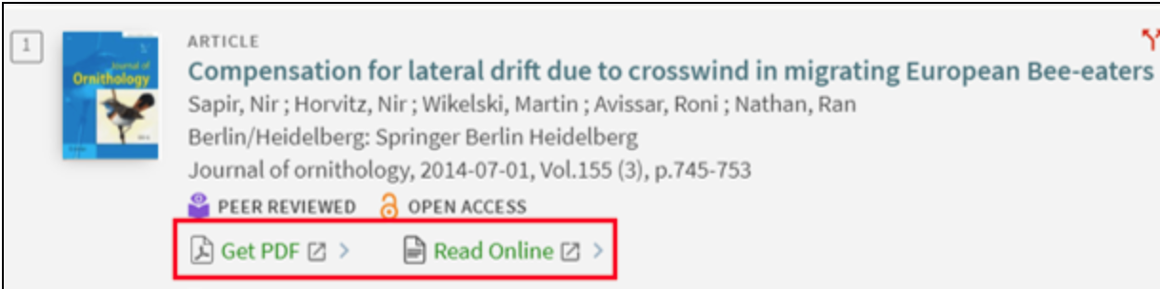

Quicklinks
CDI Quicklinks feature embeds links to PDF and HTML full text directly into the Brief Displays in Primo VE.
Available for 19 content providers: Quicklinks Provider List
Alma Configuration > Discovery > Display Configuration > Configure Views > Edit View > General tab > check the box for Display Quick Links
https://knowledge.exlibrisgroup.com/Primo/Product_Documentation/020Primo_VE/Primo_VE_(English)/030Primo_VE_User_Interface/Quicklinks_in_Primo_and_Primo_VE
Testing Recommendation: Sandbox
Notes:
The CDI Quicklinks feature embeds links to the PDF and HTML full text directly into the brief display in Primo VE. This provides a convenient and quick way for users to access full text from CDI with a single click.
Libraries often have access to several platforms for the same item. However, with Quicklinks, we only show one link of each type (PDF and HTML). Users who are familiar with the different platforms and prefer to select a link themselves can click into the record and continue to select from all options provided in the View Online section of the Full Record.
Quicklinks is currently available for a selected list of 19 content providers. Ex Libris is continuing to work with new providers so that the list of providers will grow over time. For a list of providers who currently support Quicklinks, see Quicklinks Provider List.
https://knowledge.exlibrisgroup.com/Primo/Product_Documentation/020Primo_VE/Primo_VE_(English)/030Primo_VE_User_Interface/Quicklinks_in_Primo_and_Primo_VE

Slide 24
Custom Order of Locations in Full Record Display Get It Section
Get It section of the Full Record page displays the physical locations that hold an item. If there are multiple locations, the Get It section lists the Locations in alphabetical order by default, without regard to which Library a location is in.
New option for Custom Libraries Order per Primo VE View.
The Brief Display availability statement will also display the preferred Library’s locations first.
For each prioritized Library, Alma further sorts the locations alphabetically and then by the number of available items, or by Location priority, if established.
https://knowledge.exlibrisgroup.com/Primo/Product_Documentation/020Primo_VE/Primo_VE_(English)/050Display_Configuration/010Configuring_Discovery_Views_for_Primo_VE#Configuring_the_Get_It_Service
Testing Recommendation: Test View
Notes:
The Get It section of the Full Record display page is where users will see the physical holdings at your library. Previously, the locations in Get It were sorted either by alphabetic order or by best location.
With this enhancement, called Custom Libraries Order, you can now create a default sort order by Library for all views and override it with custom ordering per view.
This may be useful for institution who have customized Views for different Alma Libraries. Let’s say you have a separate Primo VE View for your Archives which has its own Library in Alma, and users of that View will likely care most about holdings at the Archives over holdings in another of your Libraries. With this feature, for that Archives View only, you can configure it so that the Archives Library location holdings will display first in the Get It section before other libraries at your institution. This configuration also displays the preferred holdings in the Brief Results availability statements in search results.
Let’s look at an example…
https://knowledge.exlibrisgroup.com/Primo/Product_Documentation/020Primo_VE/Primo_VE_(English)/050Display_Configuration/010Configuring_Discovery_Views_for_Primo_VE#Configuring_the_Get_It_Service

Slide 25
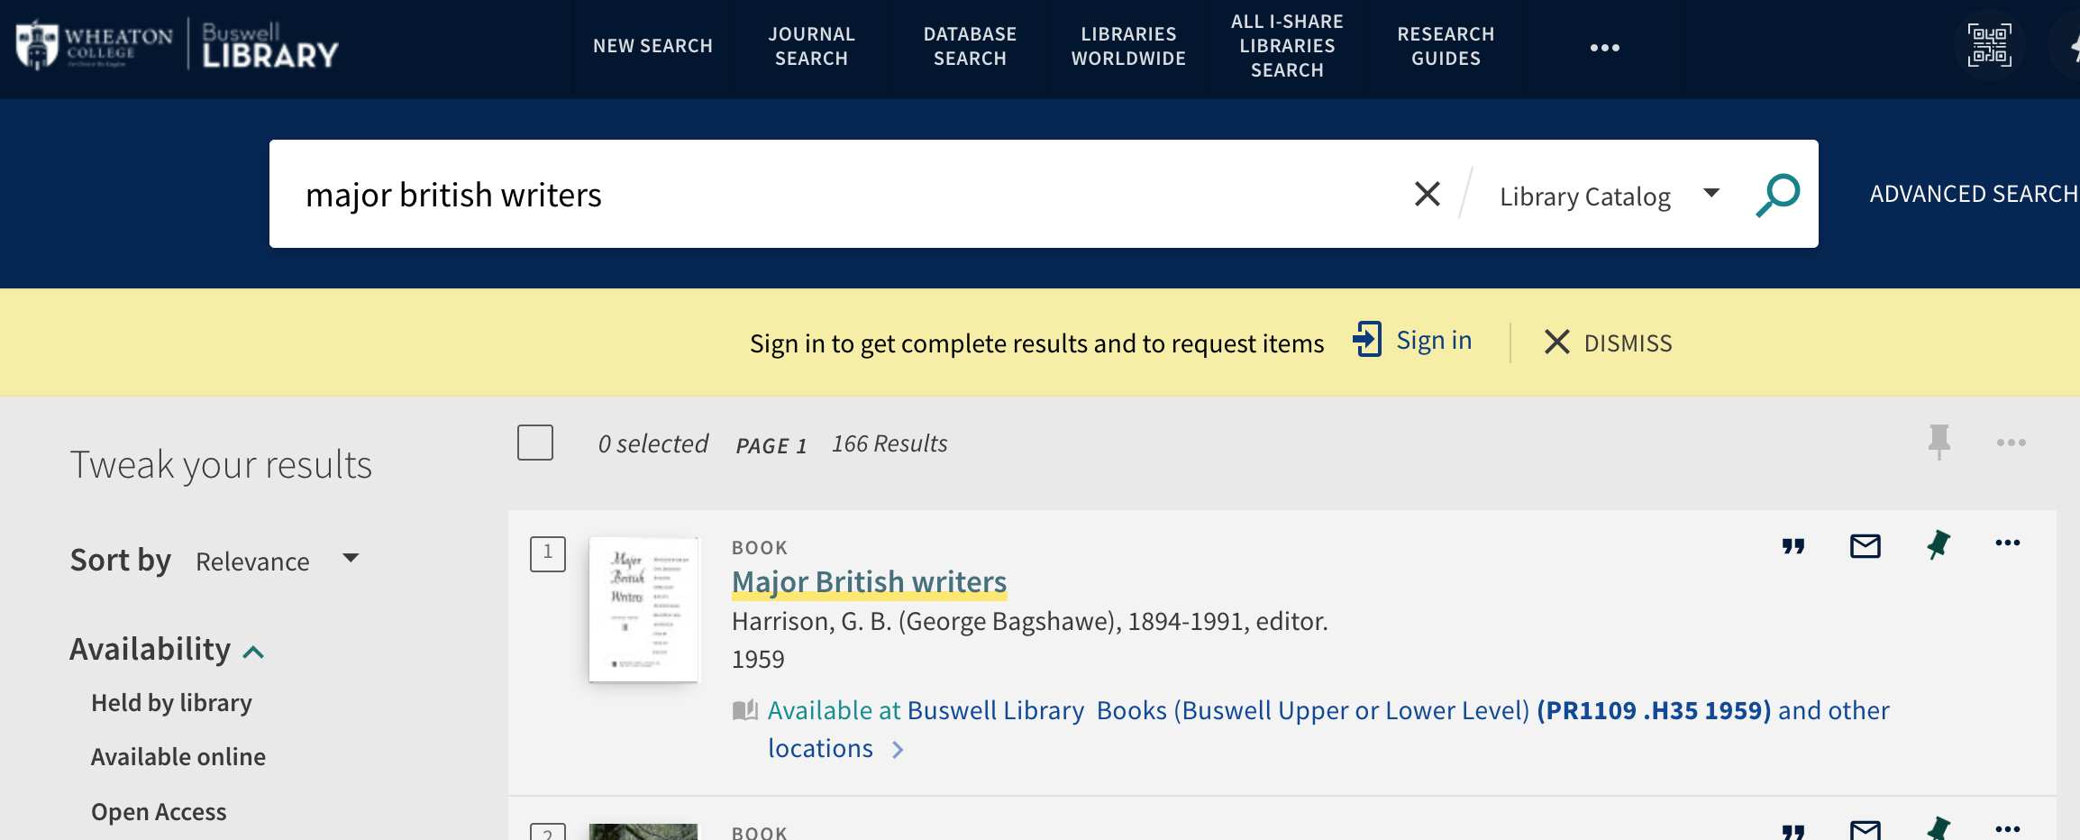
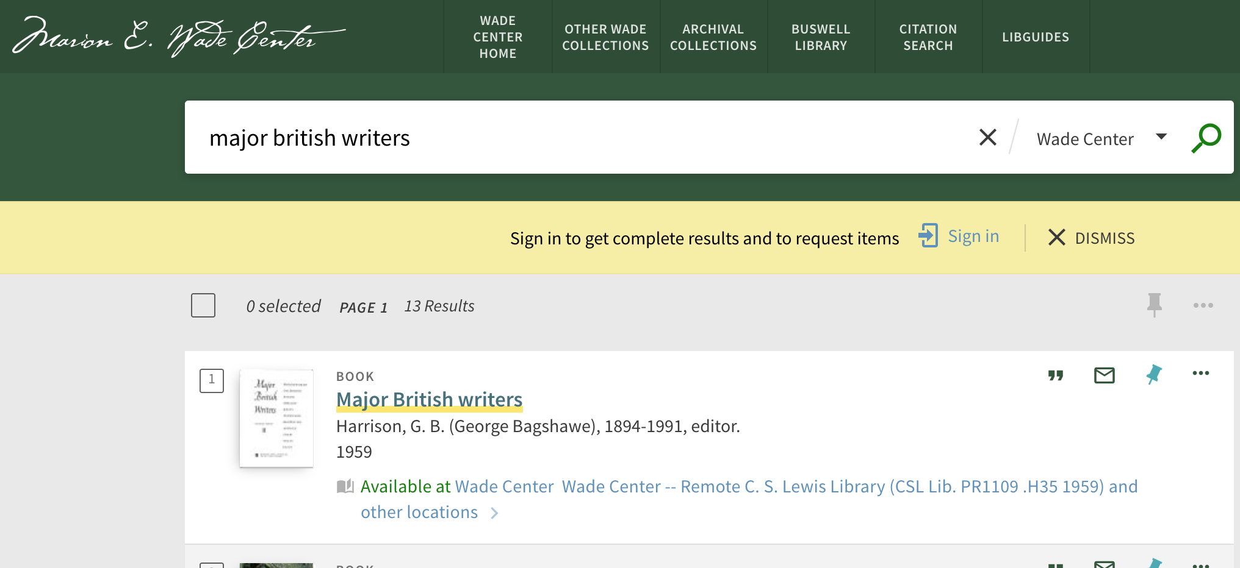
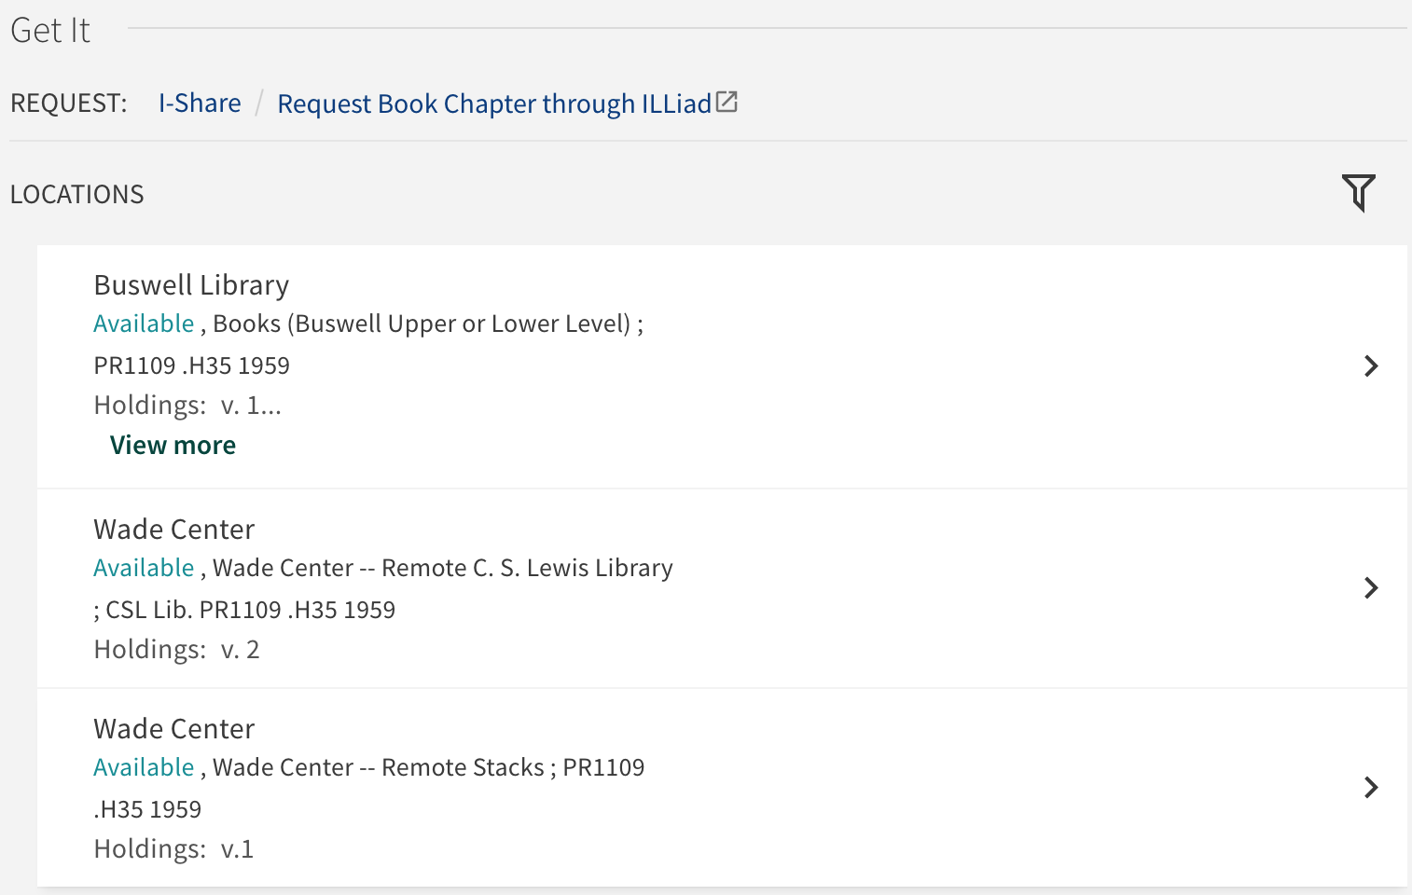
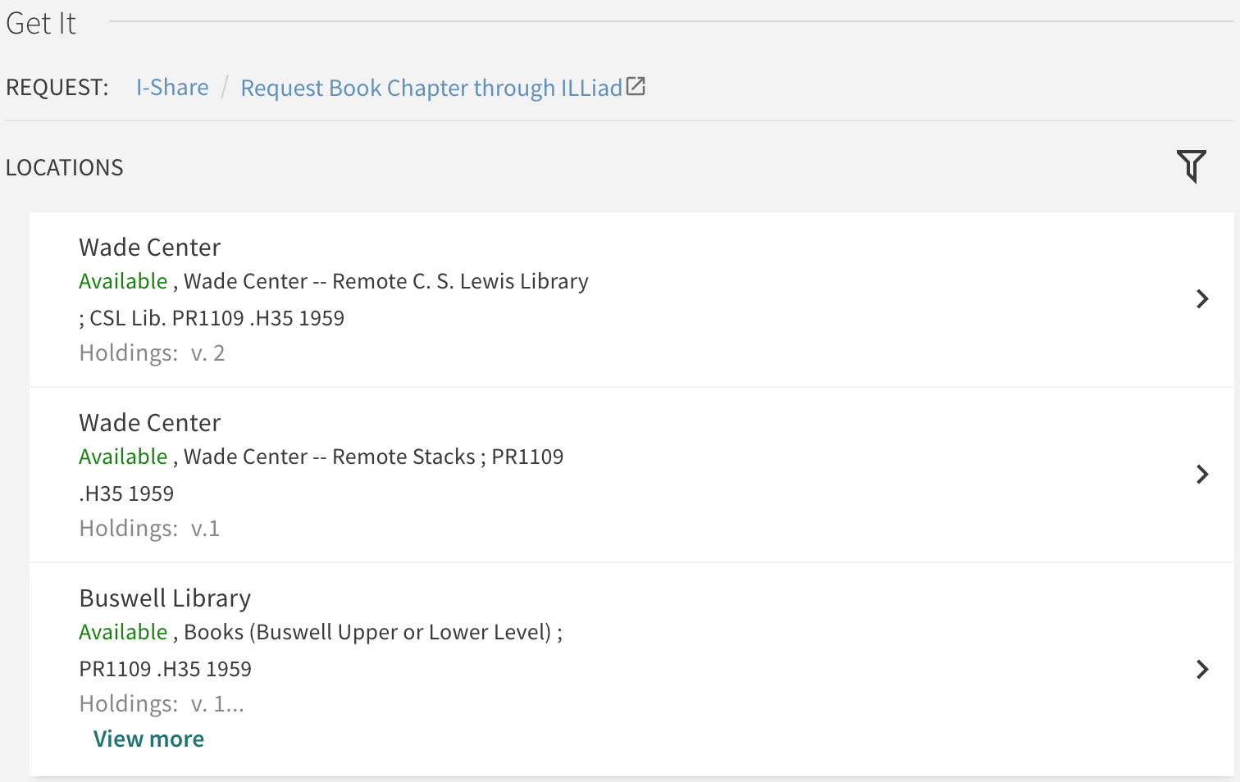
Example: Custom Order of Locations used by Wheaton College
WHE Buswell Library View
WHE Wade Center View
Notes:
Here is an example of this feature in action after being configured at Wheaton College. Their main Primo VE View is on the left in blue and the holdings in Get It below it for a Full Record. They have a separate library in Alma for their Wade Center, and a separate Primo VE View for it seen here in green with the Get It section below it. They were able to use this feature to have the Wade Center holdings appear first in both the Brief Results and the Get It section on the Full Record page in the Wade Center View.

Slide 26
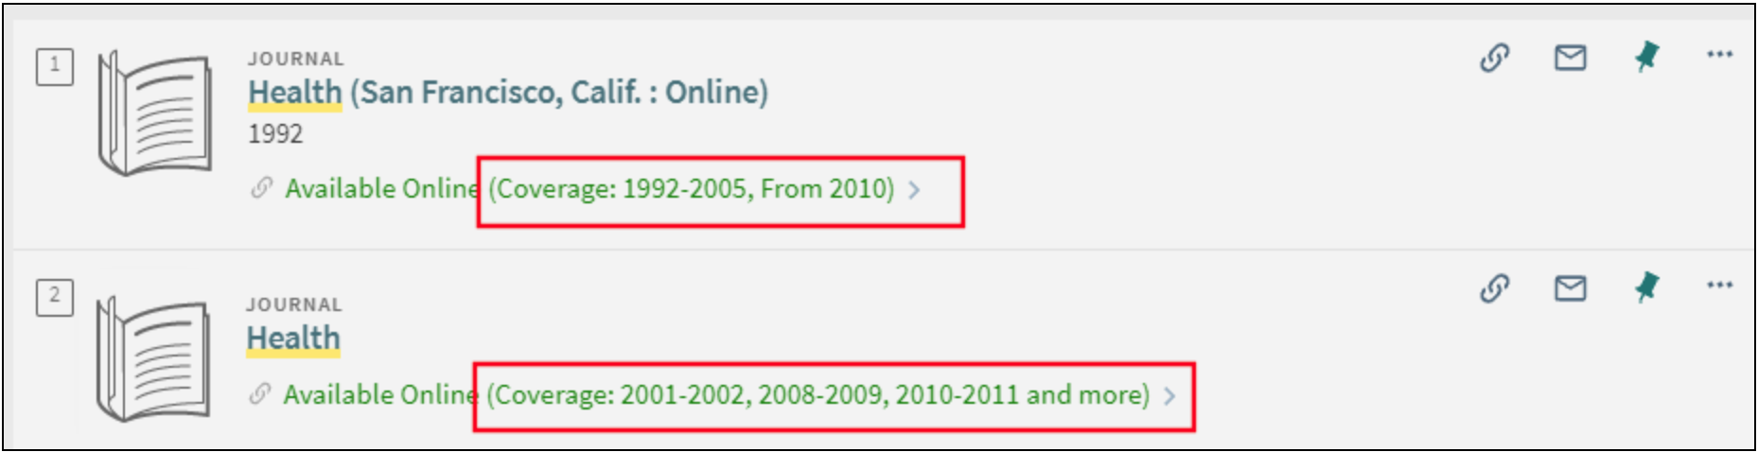
Show Journal Coverage Dates in Brief Results and Journal Search
For electronic journals managed in Alma, Primo VE can display a coverage summary by year which is taken from the portfolio in the Brief Results availability statement area.
Can include up to three date ranges; if more there will be an “and more” label. Can include one embargo.
Coverage is calculated in real-time, so may not display immediately.
Alma Configuration > Discovery > Other > Customer Settings > set the parameter brief_results_journal_coverage to true
Testing Recommendation: Sandbox
Notes:
For electronic journals managed in Alma, there is an option to display a coverage summary by year in its availability statement in the results on the Library Search and Journal Search pages, reducing the need to view the journal's full display to get coverage information. The coverage summary will include a maximum of three date ranges. If there are more than three, the summary will include the more label. The date ranges come from the portfolio in Alma.
Because the coverage information is calculated in real time, it will not appear instantly in the results.
If a journal is available with no limitations and its portfolios do not contain any date ranges, overage information will not display in the availability statement.
Coverage information may include a single embargo, and if multiple embargoes exist, only one of them will appear in the coverage. If there a more than three date ranges in the coverage, the embargo will be excluded from the coverage if it exists.
To configure, go to Configuration Menu > Discovery > Other > Customer Settings and set the parameter brief_results_journal_coverage to true.
There are no refinements to this configuration option, it is either true (on) or false (off). The default is false (off).

Slide 27
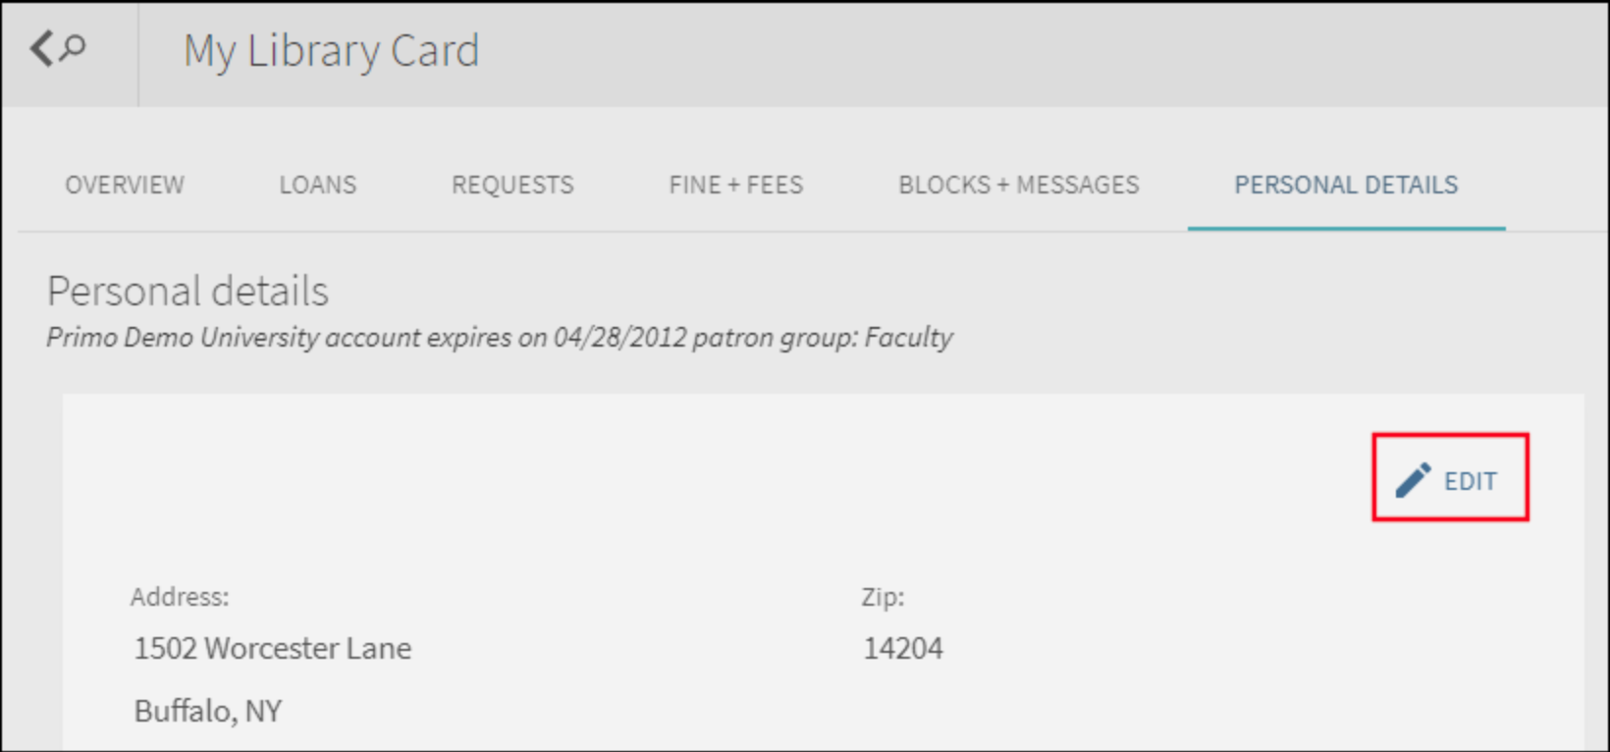

Disable Edit Option in Personal Details of My Library Card
In Primo VE My Library Card, there is an option to allow users to EDIT their personal information.
Often these data come from campus/student information systems and cannot be modified by Primo VE.
This option hides the EDIT button in My Library Card.
Alma Configuration > Discovery > Display Configuration > Configure Views > Edit the View > General tab > clear the checkbox for “Enable Edit My Library Card”
Testing Recommendation: Sandbox or Test View
Notes:
In many cases, borrower information comes directly from campus information systems and cannot be modified from within Primo VE. With this option, the Edit option can be hidden on the Personal Details tab in My Library Card since changes made by users in Primo VE would have no effect in the campus system.
Go to Alma Configuration > Discovery > Display Configuration > Configure Views > Edit View > General tab > clear the checkbox for “Enable Edit My Library Card”

Slide 28
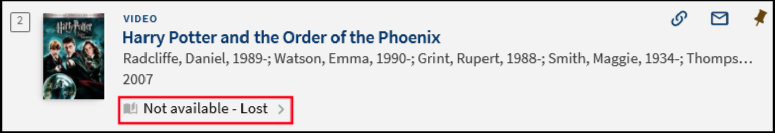
Broaden “Not Available” status in Brief Results
For any item that is not available, the item’s default Primo VE display label is only “Not Available”.
For single-item records, setting can be enabled to broaden the “Not Available” statuses to provide more details such as Hold Shelf, Loan, Lost, In Process Missing, etc.
Labels are customizable.
Alma Configuration > Discovery > Other > Customer Settings > set the broaden_availability_status parameter to true
Result example: “Not available” becomes “Not available – Lost”
Configured in UIS Sandbox and KNX Sandbox
Testing Recommendation: Sandbox
Notes:
By default, the “Not Available” status in Primo VE will appear for any item that is not available; however, there is a configuration setting you can enable that will provide more details on why the item is Not Available in
Configuration Menu > Discovery > Other > Customer Settings > and set the broaden_availability_status parameter to true.
When set to true, single-item records that are Not Available will now display with additional information (and yes, the labels are customizable!)
Not available - Acquisition
Not available - Claimed Returned
Not available - Hold Shelf
Not available - Loan
Not available - Lost
Not available - In Process
Not available - Missing
Not available - Resource Sharing Request
Not available - Technical - Migration
Not available - Transit
Not available - Requested

Slide 29
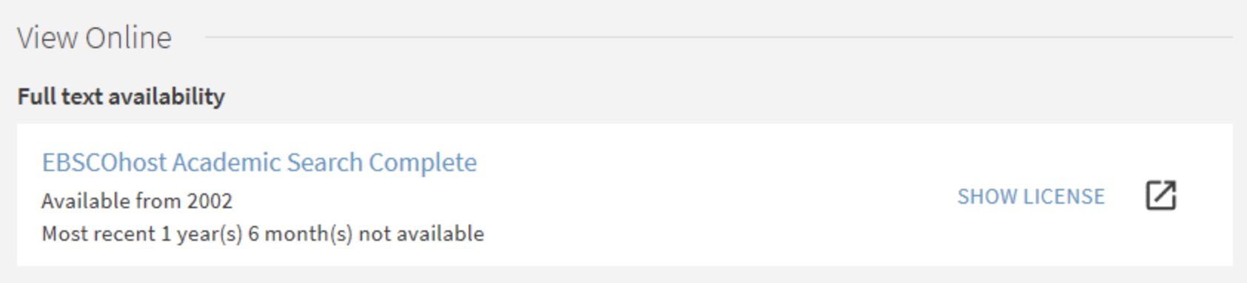
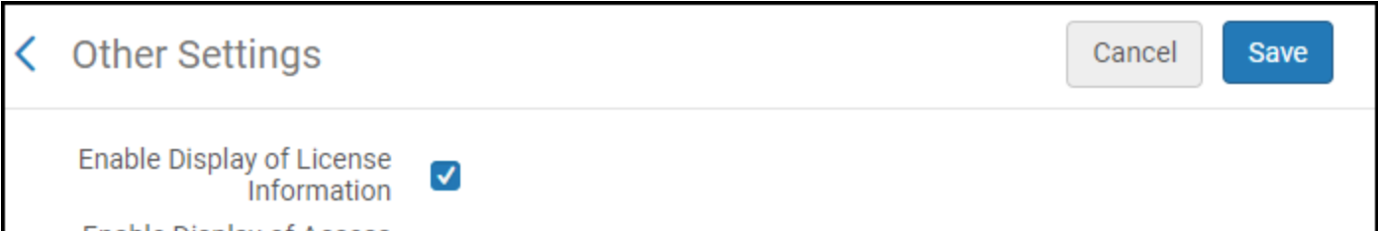
Display License Terms Information for E-Resources
If you have License Terms in your electronic resources in Alma, you can configure them to display in Primo VE in the View Online section.
Alma Configuration > Fulfillment* > Discovery Interface Display Logic > Other Settings > check box for Enable Display of License Information
https://knowledge.exlibrisgroup.com/Primo/Product_Documentation/020Primo_VE/Primo_VE_(English)/080Configuring_Delivery_Services_for_Primo_VE/Configuring_Discovery_Interface_Display_Logic_for_Primo_VE#Configuring_Miscellaneous_Display_Options
* Requires General System Admin or Fulfillment Admin role
Testing Recommendation: Sandbox
Notes:
Our final potpourri item is that you can configure License Terms Information from electronic resources to display in Primo VE in the View It section of the Full Record.
Note that this option requires the General System Administrator role or the Fulfillment Admin role to set.
https://knowledge.exlibrisgroup.com/Primo/Product_Documentation/020Primo_VE/Primo_VE_(English)/080Configuring_Delivery_Services_for_Primo_VE/Configuring_Discovery_Interface_Display_Logic_for_Primo_VE#Configuring_Miscellaneous_Display_Options

Slide 30

Your Questions
Notes:
Please type any questions in the chat, or feel free to unmute to ask questions.

Slide 31

I-Share Alma Primo VE Office hours
Join us October 13 at 2pm for another
Office Hour session.
Contact CARLI at
support@carli.illinois.edu
POS1009070396, Missouri ironweed; Plants of SIUE (Southern Illinois University Edwardsville) https://collections.carli.illinois.edu/digital/collection/sie_plants/id/223/rec/70

