Slide 1
I-Share Alma Primo VE Office hours will start shortly
Welcome!
Office Hours will start at 2pm and run until 3pm. Please mute your microphone. As time permits, we will respond to questions typed in the chat box, and offline afterwards, as needed.
This session will be recorded and made available on the CARLI website both as PDF slides and as a recording, with live links to all referenced resources.

Slide 2
Alma Primo VE Open Office Hours July 14, 2022 User Management: Creating & Updating User Data

Slide 3
Agenda Office Hours
Agenda – 7/14/2022
Announcements and Reminders
User Management: Creating & Updating User Data
User Record Requirements
SIS Sync Practices
Survey Results
Update frequency
Expiry and Purge Dates
Common Desirable Practices

Slide 4
Reminders
I-Share Annual Statistics Package
https://go.illinois.edu/annstats
FY2021-2022 Annual Statistics Package reports are being run and posted to your libraries’ secure FTP folder.
Collection stats were generated on July 1
Circulation and AFN Stats 1-3 generated on July 2
Request stats and unique titles stats will be generated July 15
If you’re not familiar with CARLI’s secure FTP server, see
https://go.illinois.edu/CARLIsftp
Files on secure FTP server are deleted after 60 days to conserve space

Slide 5
Announcements
Announcements/Reminders
Upcoming Office Hours
2022 Office Hours have been scheduled – 2nd Thursday of each month, 2pm-3pm.
Next session: August 11, 2022
Let’s Talk About Fulfillment
Off for July
New schedule for 2022-2023 coming soon
Technical Services Q&A
Off for July
https://go.illinois.edu/CARLItsqa for past sessions
Next session: August 11, 2022

Slide 6
Announcements
Announcements/Reminders
Alma Electronic Resources
Be sure to update your electronic collections in your Alma IZ for the current fiscal year subscriptions
Activate any new collections and subscriptions for patrons to get access
Deactivate and delete collections if you no longer subscribe
Alma Acquisitions: Fiscal Period Rollover
CARLI staff are available to consult on rollover tasks
CARLI will create new fiscal years for non-Acq institutions
EBSCO/CARLI OpenAthens Health Checks and Q&A
Wednesday, July 20, 10-11am
Tuesday, July 26, 10-11am
EBSCO Support is holding “Health Checks” for CARLI libraries using OpenAthens to help with optimizing and using the product to address your library’s ever-changing needs. Register via the CARLI Calendar!

Slide 7
Reminders
Shared Document Depository
https://www.carli.illinois.edu/products-services/i-share/i-share-documentation/shared-documentation
The depository contains documentation submitted by CARLI member libraries for the benefit of the broader community.
Workflow topics include: Acquisitions, Analytics, Cataloging, eResources, Fulfillment, Primo VE, SIS, Users and more.
Note: The documentation is not peer-reviewed; it is up to those using the documentation to determine whether the information is still valid, accurate, and of use for their purpose.
Notes:
Why reinvent the wheel? Projects are easier to begin with some inspiration! Start your next local project by reviewing other libraries’ documentation first.
Over 50 shared documents from I-Share libraries!
And if you have local documentation to share, please do! It’s easy to submit via the link on the page.

Slide 8
User Management: Creating & Updating User Data

Slide 9
User Record Requirements

Slide 10
User Record Requirements
Required data for all records:
Primary Identifier
Last name
Email address (must also be checked as Preferred)
User Group
Expiry Date
Purge Date
Address (must also be checked as Preferred)
Address line 1
Address state/province
Address postal code
City

Slide 11
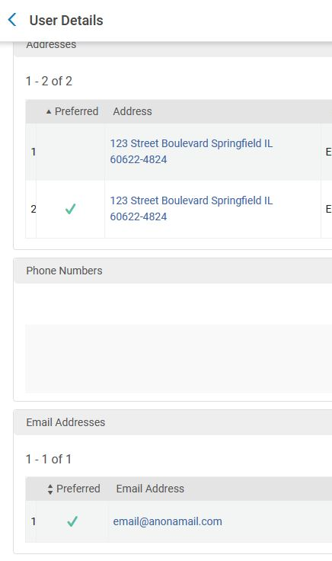
Having Preferred Contact Details is Required
Preferred contacts support…
AFN functionality
Accurate letter creation
AFN reporting
Primo VE user detail display
Always select a preferred address, even if only one is present.

Slide 12
User Record Requirements: Primary and Other Identifiers
User records support multiple identifiers for:
Login/username
If using single sign-on (e.g., OpenAthens, Microsoft Azure, etc.), user record must contain a matching identifier
Matching to student information system for updates
Find user for fulfillment (e.g., check-out, request)
Possible identifiers
Institution ID (e.g., student ID number, employee ID, “Banner ID number”)
Barcode
Username or “Net ID” (must be provisioned by Ex Libris)
Email (if provisioned; separate from the email address)
Choice of Primary Identifier
Should be a value that will not change over time
Commonly used as the SIS match point

Slide 13
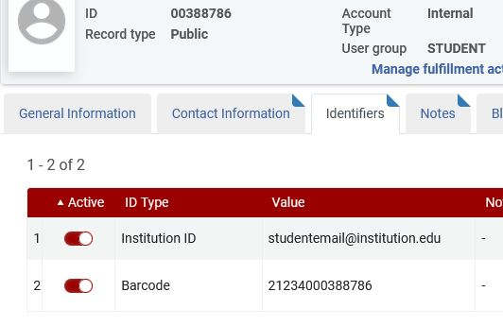
Identifiers
Identifiers must be unique
Across the institution
Ideally, across I-Share

Slide 14
Student Information System Synchronization practices

Slide 15
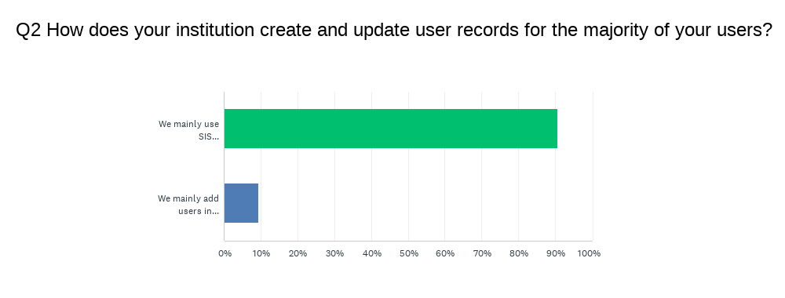
Student Information System Sync Practices
CARLI ran the “Alma Institutional Student Information System (SIS) Practices” survey in June and July 2021
55 responses representing 50 institutions
4 incomplete surveys
Most libraries responding use SIS sync (48 of 53)
3 institutions identifying manual entry only
1 institution identified a SIS process that included extra steps

Slide 16
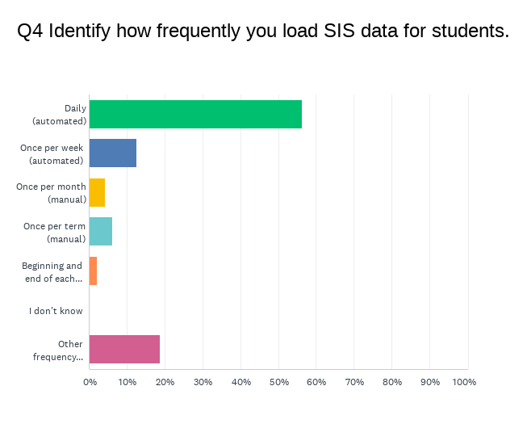
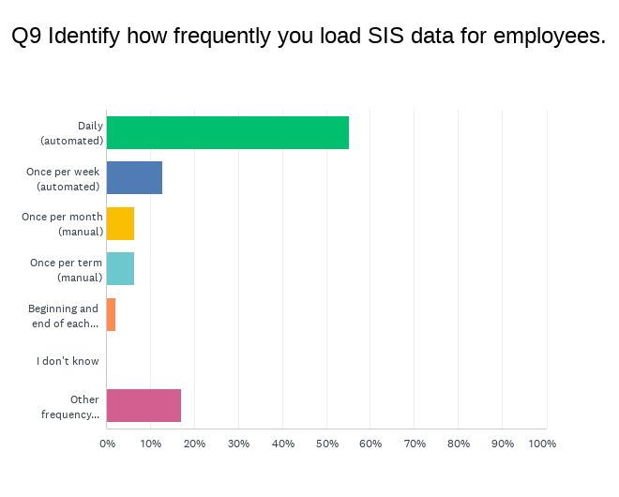
SIS Practices: Frequency of Updates
Over half of institutions run daily SIS updates.
Both students and employees covered here
Two institutions are daily except for weekends
Six institutions run once per week
Seven institutions run monthly on semester basis

Slide 17
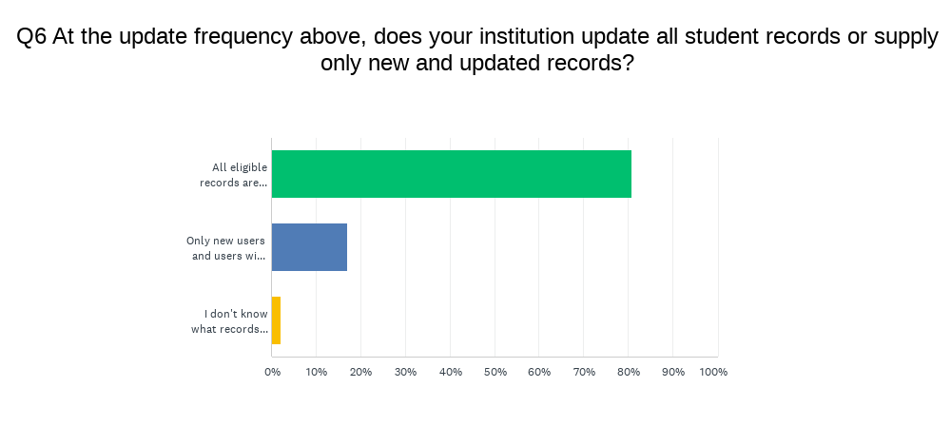
SIS Practices: Contents of Updates
Most institutions perform comprehensive loads
Sending all available records
Two institutions are daily except for weekends
Fewer institutions running regular incremental loads
8 load new students at frequency (5 for employees)
1 institution supplements with monthly comprehensive loads

Slide 18
Expiry and Purge Dates
Who wants a patron record to live forever?
Expiry Date
Used to authorize a user against a calendar.
Provide access to active patrons
Expired user cannot login
Cannot borrow or renew loans past expiry date
Purge Date
Used to manage access to user data
Retain long enough to provide accountability
Set short enough to protect patron privacy

Slide 19
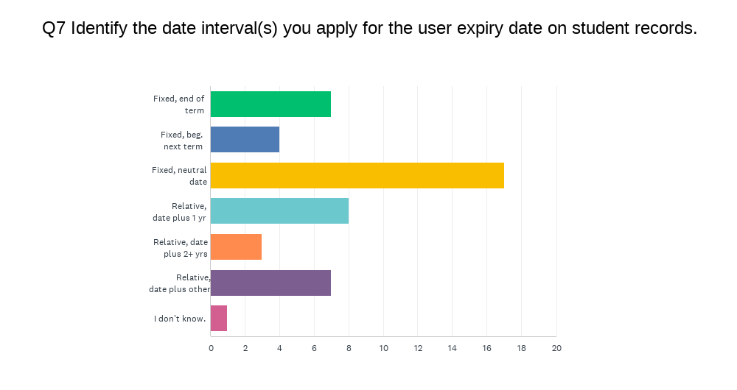
Expiry Date Choices
Broad distribution of practices (n = 45)
28 institutions choose a fixed date on the calendar
17 choose a neutral date, e.g., 6/30 or 12/31
11 choose a date on the academic calendar
18 institutions set a date relative to the update
3 set expiry multiple years in the future
8 set expiry as the update day + 365 days

Slide 20
Expiry Date Choices: Interesting variations
60 days from update
6 months from update
9 months from update
End of term + 3 weeks
End of term + 3 months grace period
Update date + Longest Loan Period + 1 day
End of the month following the end of the term
Expected graduation date OR end of term date
Employees’ records more commonly a fixed future date
5/31/2025
1/1/2030
7/31/2031

Slide 21
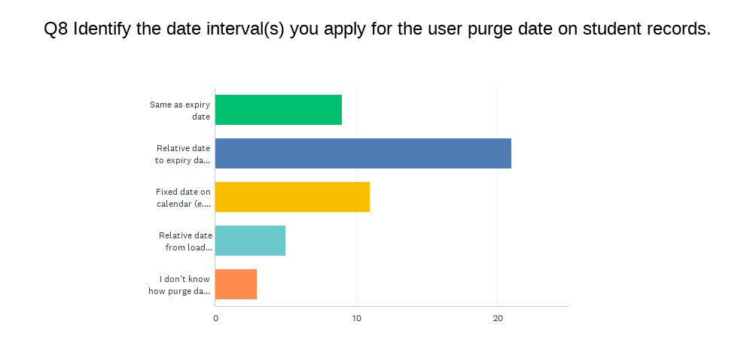
Purge Date Choices
Practices tied often to expiry and load choices (n = 48)
26 institutions choose a date related to another date
21 choose date relative to the expiry date (e.g., Expiry + 1 year)
6 choose date relative to the update
11 institutions choose a fixed calendar date
9 institutions use the same expiry and purge date

Slide 22
Purge Date Choices: Interesting variations
Most common: expiry date + one year
6 months from update
12 months from update
9/15 of the year after expiry
Expiry + 2 years
Graduating students get 3 months past graduation date; other students get 12 months past expiry (end of term)
Employees’ records more commonly a fixed future date
1/1/2030
Frequently, institutions using same criteria as students

Slide 23
Common Desirable Practices for User Management

Slide 24
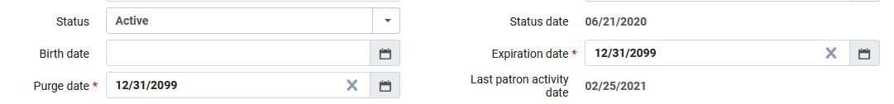
Common Desirable Practices
Most institutions use SIS loads; All create users manually
Collect only as much data as needed for operations
Retain only for as long as needed for operations
Consider record retention policies at your institution
Select reasonable dates
Frequency of updates
Services offered (e.g., loan periods, authentication)
Notes:
Setting expiry and purge dates is a complex balancing act among access for the user to your services, the frequency at which you update user data, and the values of providing patron privacy and system security.

Slide 25

Your Questions
Notes:
Please type any questions in the chat, or feel free to unmute to ask questions.

Slide 26
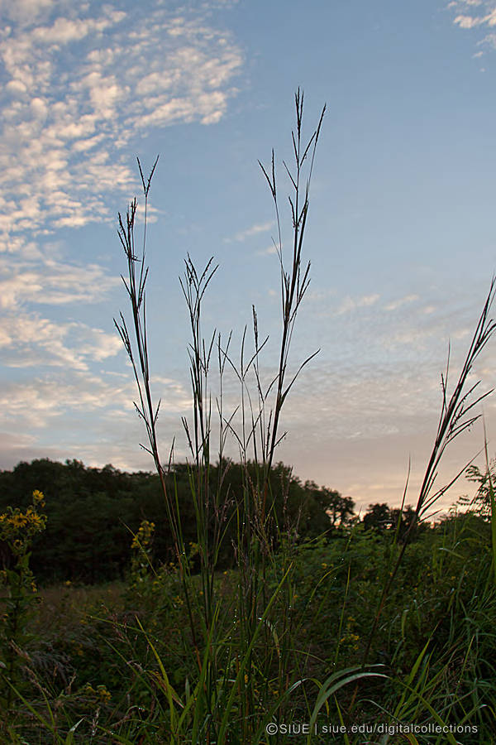
I-Share Alma Primo VE Office hours
Join us August 11 at 2pm for another
Office Hour session.
Contact CARLI at
support@carli.illinois.edu
POS1008170080, Big bluestem; Plants of SIUE (Southern Illinois University Edwardsville) https://collections.carli.illinois.edu/digital/collection/sie_plants/id/73/rec/11

