Slide 1
I-Share Alma Primo VE Office hours will start shortly
Welcome!
Office Hours will start at 2pm and run until 3pm.
Please mute your microphone.
As time permits, we will respond to questions typed in the chat box, and offline afterwards, as needed.
This session will be recorded and made available on the CARLI website both as PDF slides and as a recording, with live links to all referenced resources.

Slide 2
Alma Primo VE Open Office Hours
June 9, 2022
User Management: Timely Tidy Tasks
Notes:
(Debbie)

Slide 3
Agenda Office Hours
Agenda – 6/9/2022
Announcements and Reminders
User Management: Timely Tidy Tasks
  Patron Purge aka Purging User Records
    Overview
    Local User Records
    Linked User Records
  Anonymization
    Overview
    Consortial Plans
  Future Office Hours
    User Management: Starting Steps
Notes:
(Debbie)

Slide 4
Announcements
Announcements/Reminders
  Upcoming Office Hours
  2022 Office Hours have been scheduled –
  2nd Thursday of each month, 2pm-3pm.
  Next session: July 14, 2022
  Topic: User Management: Starting Steps
The CARLI Office will be closed on Friday, June 17th in observance of Juneteenth.
Notes:
(Debbie)

Slide 5
Announcements
Announcements/Reminders
  Technical Services Q&A Sessions
  Scheduled for once a month from 10:30am-12:00pm
  Upcoming Dates: Summer pause; watch for future announcement
  Registration will be open and available on the CARLI Calendar
Let’s Talk about Fulfillment (I mean Alma, not life’s purpose)
  Current sessions scheduled for every other week, alternating Tuesdays at 10:30am and Fridays at 2pm.
  New timeline for late summer/fall 2022; will be announced soon.
  Registration open and available on the CARLI Calendar
  June 10: Calendar Maintenance and Open Q & A
  June 21: Ghosted Resource Sharing Transactions and Open Q & A
Notes:
(Debbie)

Slide 6
Reminders
Shared Document Depository
https://www.carli.illinois.edu/products-services/i-share/i-share-documentation/shared-documentation
The depository contains documentation submitted by CARLI member libraries for the benefit of the broader community.
  Workflow topics include: Acquisitions, Analytics, Cataloging, eResources, Fulfillment, Primo VE, SIS, Users and more.
  Note: The documentation is not peer-reviewed; it is up to those using the documentation to determine whether the information is still valid, accurate, and of use for their purpose.
Notes:
(Debbie)
Why reinvent the wheel? Projects are easier to begin with some inspiration! Start your next local project by reviewing other libraries’ documentation first.
Over 50 shared documents from I-Share libraries!
And if you have local documentation to share, please do! It’s easy to submit via the link on the webpage.
https://www.carli.illinois.edu/products-services/i-share/i-share-documentation/shared-documentation

Slide 7
Agenda
User Management: Timely Tidy Tasks
  Patron Purge, aka Purging User Records
    Overview
    Local User Records- your steps
    Linked User Records- CARLI plans
  Anonymization
    Overview
    Consortial Plans
Notes:
(Debbie)
Our agenda for today’s topic of user management, the alliterative “Timely Tidy Tasks”.
For the first portion, we’ll be talking about purging user records, and then we’ll switch to a brief discussion on transactional anonymization in Alma.
These are both topics that we CARLI staff have talked about a little bit here or there, but haven’t yet done any formal presentations on since we went live with Alma ALMOST 2 YEARS AGO. Where did that time go? It’s time for these topics to be addressed.

Slide 8

Purging User Records: Overview
🥁
Notes:
(Debbie)
Alright! Let’s start with an overview of purging user records in Alma, and then move into workflows and upcoming conversations.
And, I thought we needed a cat pun today, so, here are Purring user records, or User records purrs

Slide 9
Purging User Records: Overview
Purging User Records: Overview
What is Patron Purge?
  In Alma, called “Purging User Records”
  Process of deleting user records in bulk
    Local User Records
    Linked User Records
  Different Alma Analytics results than deleting a single user record from within Alma
Notes:
(Debbie)
Patron Purge, aka Purging User Records, is the process of identifying user records that no longer need to be retained in Alma by your institution and going through the workflows needed to delete those records in bulk, aka in a batch.
If you were with us on Voyager and can remember back that far now (I can barely remember Voyager these days), this was a process that we also used in that system.
To do a local patron purge in Voyager, you would submit what we called the Work Request Online or WRO form, filling out the parameters you wanted to use for the local patron record deletion, and the CARLI Office would run the job in Voyager on your library’s behalf.
For I-Share patrons in Voyager, there was a built-in circulation job that ran overnight, each night, and automatically deleted what we used to call “stub” records (what we now call linked user records) that were no longer being used for any transaction.
Local User Records, in Alma
In Alma, staff at each I-Share institution with appropriate roles can do the purge user record workflow, for your local records, on your own without CARLI office staff intervention.
My colleague Ted will be going over the workflows and documentation for your local home records here shortly.
Now, while your institution can do the workflow on your own, remember that staff at the CARLI Office are available to assist!
Depending on your level of comfort, we can:
1) purge user records on your behalf using your criteria,
2) set up a zoom meeting to watch while you work through the process,
3) Review and assist with questions.
Linked User Records, In Alma
Later in the presentation today, I’ll talk about the CARLI Office’s plans for purging the Linked User Records that are in Alma.
Now, notice the last point on this slide- that Purging User Records is different in Analytics than Deleting a single user record from within Alma.
Keep this point in mind for a few slides- I’ll come back to it soon for the explanation- but wanted to include it here at the beginning of the presentation for emphasis.

Slide 10
Purging User Records: Overview
Purging User Records: Overview
What is Patron Purge?
  In Alma, called “Purging User Records”
  Process of deleting user records in bulk
    Local User Records
    Linked User Records
  Different Alma Analytics results than deleting a single user record from within Alma
Why is Purging User Records important?
  CARLI Privacy Policy
Notes:
(Debbie)
But first, why is purging user records important? Why should we do this work?
Libraries should and do take the collection and storage of patron’s identifiable information very seriously.
As stated in the CARLI Privacy Policy, “It is our policy to store personal information in our systems for the shortest amount of time necessary to complete transactions or provide service.”
It’s the second half of that statement “time necessary to provide service” that comes into play here.
Once a home library patron, a user, is no longer affiliated with your institution and has no obligations to your institution (or to other I-Share libraries), they can reasonably expect that your library will no longer retain their personally identifiable information.
If they should return, someday, as an alumni, or, as a community patron, you can re-add their record anew, with their most current contact information.
Should they re-enroll, or be re-employed someday, you can re-add their record anew, with their most current information.
When patrons have no further association to your institution, and no further obligations, we should responsibly purge their user records.

Slide 11
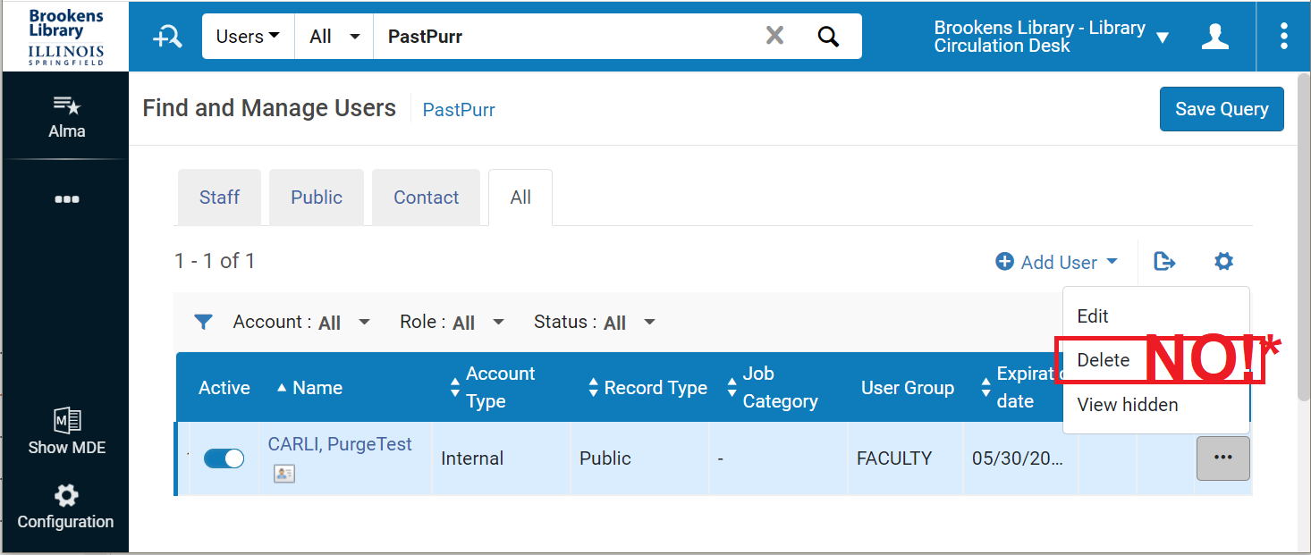
Purging User Records: Overview
Purging User Records: Overview
Different Alma Analytics results than deleting a single user record from within Alma
Notes:
(Debbie)
Okay- now back to the point “that Purging User Records is different in Analytics than Deleting a single user record from within Alma.”
In the screenshot on this slide, I’m looking at an example user record in Alma, from the User Management> Find and Manage Users screen.
For the example user, I’ve selected the row ellipsis, and have highlighted that there is a “Delete” option available, which I’ve also annotated with a large “NO!” followed by a small asterisk.
If you delete a record using this option, Alma will have no history that the record ever existed; all statistics associated with this user record will be erased.
If you delete a record with this workflow, their associated statistical data will up and vanish, as if the user record never existed. This is bad for your library’s usage statistics.
When you no longer need to maintain a user record in your IZ, you will use the user record purge workflows, NOT this delete user option.
So what do you do if you realize that your library has inadvertently created two records for the exact same person? Instead of using this delete option on screen, you can use the “Merge user” functionality to combine the records together, to allow Alma to keep the stats.
Regarding that asterisk after the No- There may be a rare occasion where you want to delete the record without keeping any statistics. For example, if you are the one who accidentally JUST created that second record for the same user, and you realize it before the patron had any activity on the account.

Slide 12
Purging User Records: Overview
Purging User Records: Overview
Patron Purge vs. Anonymization
Data maintained with Patron Purge
  Configuring User Deletion: https://knowledge.exlibrisgroup.com/Alma/Product_Documentation/010Alma_Online_Help_(English)/050Administration/040Configuring_User_Management/100Configuring_Delete_User_Policy_Settings
  CARLI required setting:
  Keep statistics and remove primary ID (recommended) – The user's statistical data is retained: that is, all non-identifying statistical data, (such as the user group and job category) are retained, as well as data on the Statistics tab. The primary ID is removed and an internal unique Alma ID is moved into the last name. All other data is deleted.
Notes:
(Debbie)
Patron purge vs. Anonymization:
When your library “purges” a user record with the workflow that Ted will describe, the patron record is deleted from your Alma IZ.
Most of the patron’s identifying information is removed from Alma Analytics, but, in the transaction history and in Alma Analytics, Alma still knows that at one time, there was a user records that existed, and, that user record performed transactions.
In a way, a patron purge is a form of anonymization. The level of data that is retained when a patron record is purged is determined by a setting in Alma Configuration called the “Delete User Policy.”
In keeping with the CARLI Privacy Policy, the setting required is: Keep statistics and remove primary ID (recommended)
The user's statistical data is retained: that is, all non-identifying statistical data, (such as the user group and job category) are retained, as well as data on the Statistics tab.
The primary ID is removed and an internal unique Alma ID is moved into the last name.
All other patron identifiable data is deleted.
-------------------------
Alma Anonymization itself is a separate process in Alma which will be discussed again towards the end of this presentation today.
When anonymization is enabled, the process removes personal patron information from fulfillment transactions, while the user record itself is maintained in your IZ.
When anonymization is enabled, the user record dosen’t have to be purged for the transaction to have anonymity one the transaction is complete.

Slide 13
Purging User Records: Overview
Purging User Records: Overview
How does Purging User Records work in Alma?
  Admin job
    Admin > User Management > Purge User Records
    Role needed:
      User Administrator
  Input parameters:
    Number of Days After Purge Date
    User Type
    User Group
    Waive Threshold
Notes:
(Debbie)
So- a quick overview of how the user record purge works in Alma; the actual step-by-step workflows will be discussed in the next section.
User Record Purge in Alma is an “Admin Job” which library staff, with the User Administrator role can run on a “Set” of hopefully pre-selected user records.
You begin with the step of reviewing and preparing the user records to be deleted based on user group. (Ted will describe the process); Once your review is complete and your records prepared, you’re ready to run the Admin job.
The input parameters for the job are the:
Number of days after Purge Date:
This is a grace period to apply to a user's purge date. For example, if this job is run on June 20, 2021 and this field is set to 10, the job purges every user whose purge date is before June 10, 2021. The default is 0, which means every user whose purge date is today or earlier, but Ex Libris does NOT recommend using zero.
User Type: There are a few options here; depending on your users, you will most often select Public, but perhaps sometimes select Staff.
User Group: Limit the job to specific user groups- the purge job is run one user group at a time.
Waive threshold: Alma will purge users that owe fines and fees that are below the Waive Threshold, FYI.
User records with no purge date in the record will not be eligible for purge, that is, unless you update their record to contain a purge date.

Slide 14
Purging User Records: Overview
Purging User Records: Overview
User record purge availability:
  Balance due on their local account is below “waive threshold”
  No outstanding local loans.
  No assigned PO lines, POs, or invoices.
  No locked bibliographic records.
  No assigned import profiles.
  Not working in the MD Editor.
  Not currently locked by a running job.
  No associated assets or grants (If Esploro is enabled for your institution)
  NOTE: DOES NOT CHECK AFN ACTIVITY.
Notes:
(Debbie)
Here’s a quick summary of what transactional activity will prevent the deletion of a local user record.
Read through slide. Note bottom one. Flip to next slide for known issue.

Slide 15
Purging User Records: Overview
Purging User Records: Overview
NOTE: DOES NOT CHECK AFN.
Known Issue: Alma's User Purge job is not AFN aware (posted 3/15/2021)
https://www.carli.illinois.edu/products-services/i-share/alma-primo-ve-known-issues
Idea Exchange:
https://ideas.exlibrisgroup.com/forums/308173-alma/suggestions/44761048-user-purge-should-be-made-afn-aware-and-not-allow
Notes:
(Debbie)
Known Issue: Alma's User Purge job is not AFN aware (posted 3/15/2021)
https://www.carli.illinois.edu/products-services/i-share/alma-primo-ve-known-issues
In the local workflow section, we have some steps in place to help you work with this limitation.
The Alma User Purge job is not AFN-aware; it will allow the deletion of a user record from the user's home institution's IZ even when the user has active transactions at another AFN institution.
These "orphaned" linked user records are confusing for both users and library staff. Examples of the confusion we've encountered thus far:
If the user's home institution performs a purge and then re-loads records, the orphaned linked user records in the other AFN member institutions do not re-connect to the new version of the user's home record. The user is then confused why they cannot see their AFN-charged material on their account.
If the item's home institution contacts the user, the user will often contact their home institution for assistance. The user's home institution cannot see the user's record in their own IZ anymore, so they are confused.
If the item's home institution is unable to contact the user, they often contact the user's home institution for assistance. The user's home institution cannot see the user's record in their own IZ anymore, so they are confused.
Please vote for and comment on the Idea Exchange:
https://ideas.exlibrisgroup.com/forums/308173-alma/suggestions/44761048-user-purge-should-be-made-afn-aware-and-not-allow

Slide 16
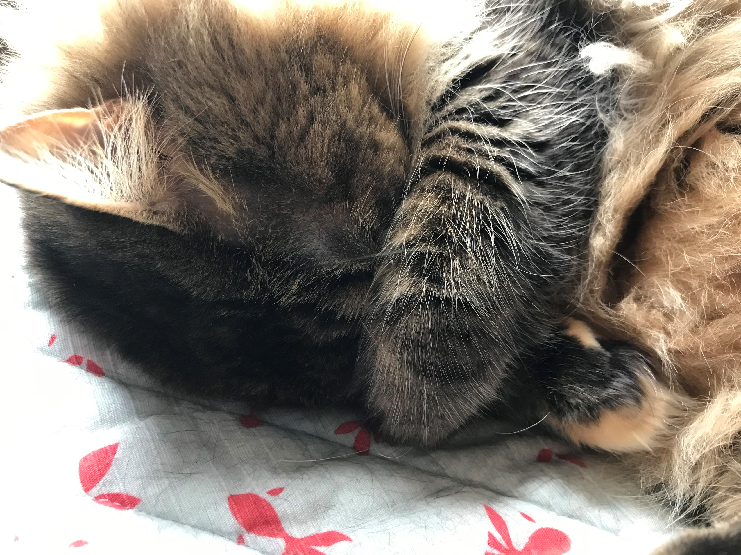
Purging User Records: Overview
Purging User Records: Overview
What’s the worst that can happen?
Notes:
(Debbie)
What is the worst case if you purge a record that you didn't mean to purge?
Alma won't purge users with active loans or fines & fees (above the waive threshold) in your IZ.- all of those settings two slides back.
If they have AFN activity, they will have orphaned linked user records; After the home record is re-added, CARLI staff can work with libraries to merge the orphaned linked user records back into a fresh copy of the new home record’s fresh linked user record.
If you purge an active user who is still at your institution:
If they’re included in your regular SIS loads, then the new record will be added with the next load their record is included in.
And they're not included in regular SIS loads (or SIS loads are infrequent), then...

Slide 17
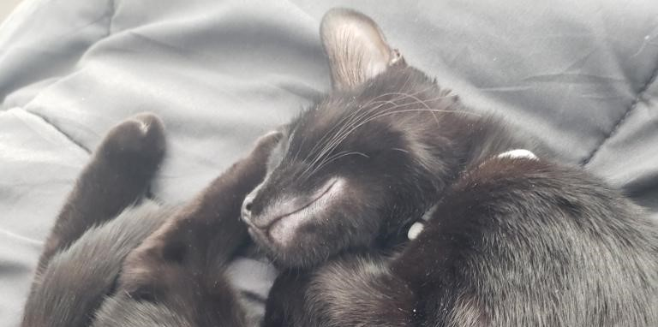
Purging User Records: Overview
Purging User Records: Overview
Workflows: Local vs. Linked User Records
Notes:
(Debbie)
Alright! Here’s where we transfer to our subsections on workflows for your local home patrons, and what CARLI staff have in the works for linked user records.
Over to Ted for the local workflows!

Slide 18
Purging User Records: Local User Records
Notes:
(Ted)
Thanks Debbie. We’re going to go over a best practice that other Alma institutions have identified for purge, because despite the lengthy list of Alma activities that Debbie presented earlier, Alma user purge is still a blunt instrument.

Slide 19
Purging User Records: Local User Records
Purging User Records: Local User Records
https://go.illinois.edu/UserPurge
User purge is a blunt instrument
  Key requirement: User record purge date is in the past
  Exceptions: User has active transactions (loans, fines, fees)
Best practices for purge
  Review reports to select users that should be purged
    Rather, exclude records that you know that you shouldn’t purge
    Look at different user groups, outlier data on specific users
  Create a user set, exclude records with I-Share activity
  Update set of users to have a clear “OK to Purge” user group
  Run purge on the approved set of users
Notes:
(Ted)
To reiterate, the key eligibility requirement for a record is for the purge date to be in the past. Alma’s purge job doesn’t consider the expiry date, whether user records are manually created or loaded via SIS synchronization, or when they were created. It will simply try to purge the records that fit your specifications and that have purge dates in the past.
Now, if you assigned purge dates with purpose, thinking about the right amount of time to keep a record active after a user is no longer associated with your institution, then letting purge do its thing will work for you. However, if you look at purge dates across your user records and see a hodgepodge of dates for different patrons in the same groups, you might reasonably wonder which records might be purged that you didn’t want to purge. That’s why we’re recommending a practice that is common among other Alma libraries, one which starts by reviewing reports of users, then making conscious choices about which records may be included in the purge.

Slide 20
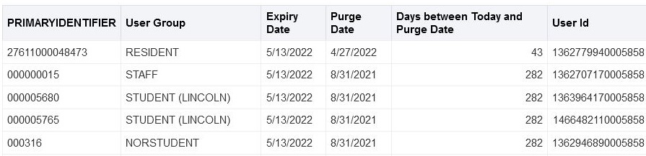
Purging User Records: Local User Records
Start with Reports
Users with Purge Dates of Current Date or Earlier
  In CARLI’s shared folder: User Management Reports
  Identifies users eligible for purge with no conditions
  Days between Today and Purge Date
    Calculated based on current date and purge date
    Use this to guide your criteria on the purge job
Notes:
(Ted)
CARLI staff have created and shared a report called Users with Purge Dates of Current Date or Earlier that will be a useful guide for you. This report identifies all of your local users—that is, I-Share users are excluded—that have a purge date of today or earlier. This report also excludes any user records that have already been deleted, which is important, as Analytics does retain some traces of user data after purge. We’ll come back to that in discussing anonymization later. Getting back to the report, it presents you with the primary identifier, user group, expiry date, purge date, user names, and a calculated field called Days between Today and Purge Date. This particular field will be very useful in helping you select the right criteria for the purge job.
When you are planning a purge, we recommend that you start by running and exporting this report to your computer. You may then work on the report in Excel to do things like filter on different user groups, look for users who appear eligible for purge but shouldn’t be. For an obvious example, check if your college president’s user record is on the list and hasn’t been updated in a while. You can remove rows, copy users to another sheet, etc. Just remember to save each worksheet that is “approved” as its own file.
You’re also welcome to create your own local versions of this report in your analytics folder. Be sure to copy the shared report into your institution’s shared reports folder before making any changes to the criteria.

Slide 21
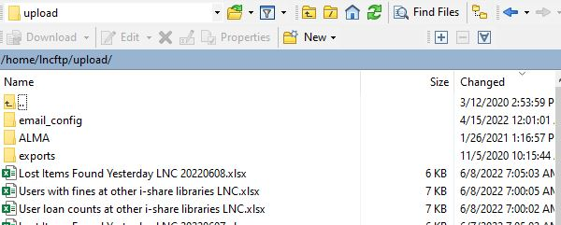
Purging User Records: Local User Records
Start with Reports
User loan counts at other I-Share libraries xxx.xlsx
Users with fines at other I-Share libraries xxx.xlsx
  Identify users that have activity in other I-Share libraries
  Exclude these users from purges
PIDs for users with loans or fines at other i-share libraries XXX.xlsx
  Contains primary identifiers only
Notes:
(Ted)
The next reports you’ll need to review are some daily reports generated by CARLI and shared via the secure ftp server. These reports are named User Loan Counts at Other I-Share Libraries and Users with fines at other I-Share Libraries. These two reports should be familiar to you, as we’ve emailed news of them recently. The report on loan counts has existed for about a year, and it was first created to help circ staff identify when any patrons had outstanding loans at the end of a semester. The fine report is newer but serves the same purpose of helping you know when your patrons have I-Share activity that you might need to follow-up.
These reports are important to consider in terms of purge because of a detail that Debbie mentioned earlier. Alma’s user purge job is not network-aware, so it doesn’t take into consideration whether any of your local user records have any linked network user records in other institutions. If the local record is eligible for purge, then the purge job will remove it and thus orphan any remote data, breaking the links for the linked user.
We want you to avoid creating orphaned users in other I-Share libraries. To that end, we have created a third report, 'PIDs for users with loans or fines at other i-share libraries XXX.xlsx’, that combines the primary identifiers from both reports into a list that you may use to filter your other user reports. You might choose to review the list and remove those rows from Excel, or you can follow the process that we’re about to use in creating Alma user sets.

Slide 22
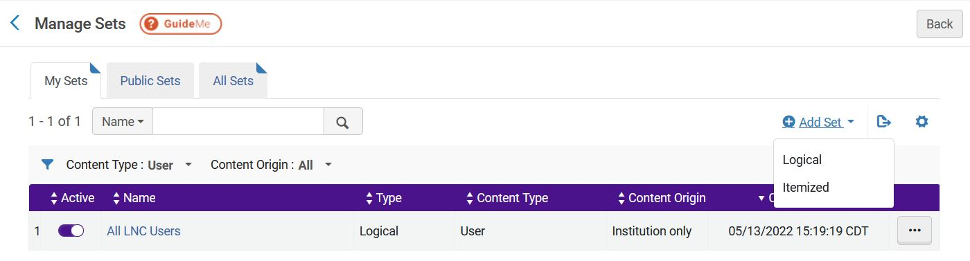
Purging User Records: Local User Records
Create User Sets
Admin > Manage Jobs and Sets > Manage Sets
  Create a set for the users with purge dates in the past
  Create a set for the users with I-Share activity
Notes:
(Ted)
Now that you have reports in hand, and you have also reviewed these reports, you’ll create user sets for each report. In both cases, we will create itemized sets, and we will import the report data into those sets. If you’ve created sets before, this will be familiar to you. If you haven’t, then follow the steps listed on the user purge practices page.
Creating itemized sets requires a job to run to match your report to actual data. Alma will email you when the job has finished, and then you’ll find your sets listed on the manage sets page.

Slide 23
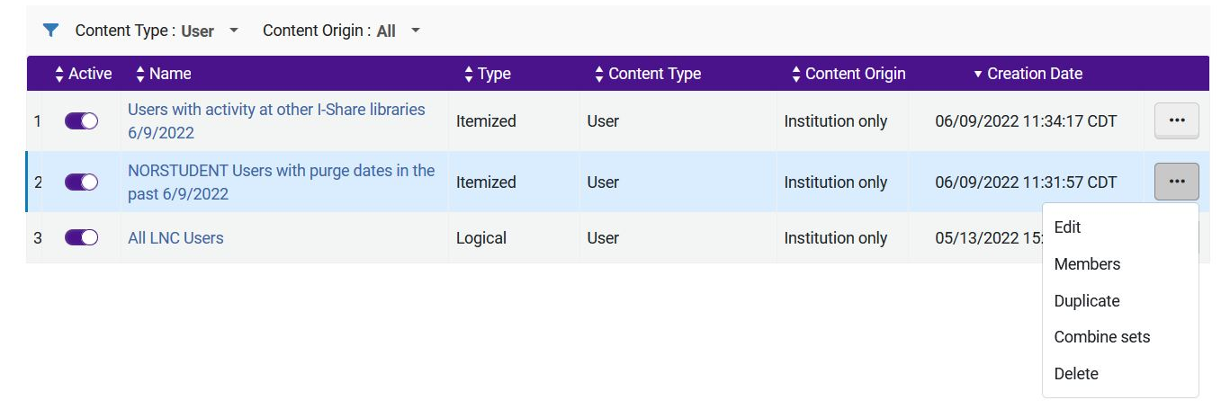
Purging User Records: Local User Records
Filter the First User Set
Admin > Manage Jobs and Sets > Manage Sets
  Select the set of users with purge dates in the past
  Actions menu button > Combine Sets
  Update your set name
  Select NOT as the combine operator
  Select set for users with I-Share activity
Notes:
(Ted)
Now that you have reports in hand, and you have also reviewed these reports, you’ll create user sets for each report. In both cases, we will create itemized sets, and we will import the report data into those sets. If you’ve created sets before, this will be familiar to you. If you haven’t, then follow the steps listed on the user purge practices page.
Creating itemized sets requires a job to run to match your report to actual data. Alma will email you when the job has finished, and then you’ll find your sets listed on the manage sets page. Locate your primary set of users that you find eligible to purge, click the actions menu button, then select Combine sets.

Slide 24
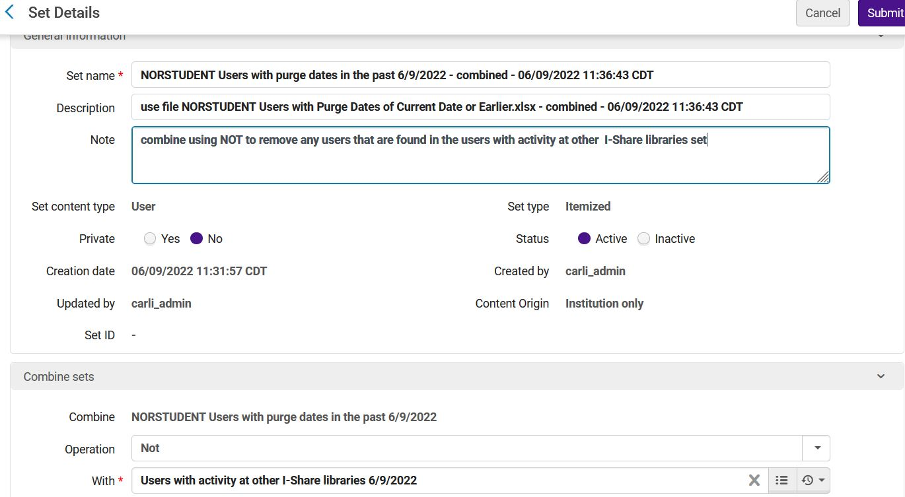
Purging User Records: Local User Records
Notes:
(Ted)
The set name will be almost the same as your original set, so you may want to rename it for clarity, for example, Eligible Students to purge 6/9/22. In this visual, I’m including a lot more detail than I otherwise might for illustration purposes. At the bottom of the set screen, we see the options for combining two sets. We need to select the NOT operator, then select the set that contains the PIDs for users with activity at other libraries. Once we’ve done those two things, we click Submit, then Confirm when prompted. As usual, Alma will kick off a job, then email us when the set is ready. The job report will tell us if any records were filtered out, and if so, how many users remain in the final set.

Slide 25
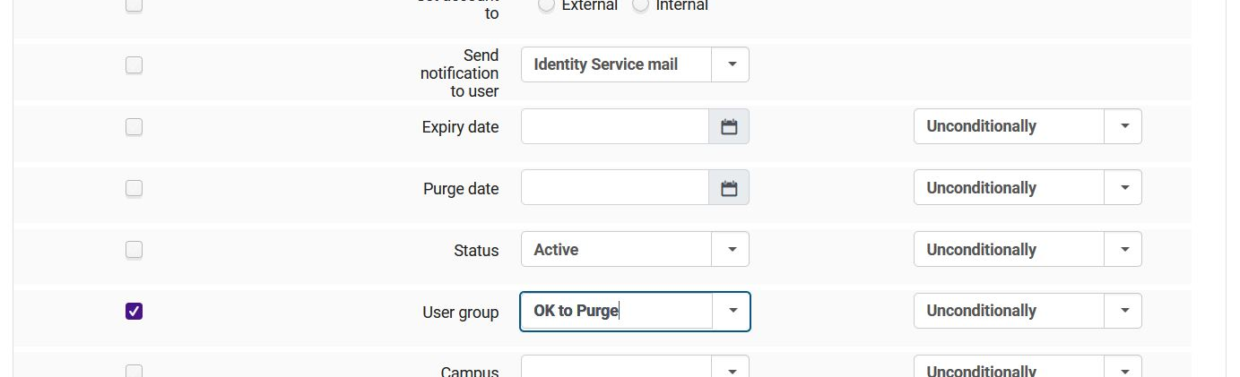
Purging User Records: Local User Records
Modify Users to be “OK to Purge”
Admin > Manage Jobs and Sets > Run a Job
  Select the Update/Notify Users job
  Select the combined user set
  Select the user group field, “OK to Purge” as new group
  Run the job
Notes:
(Ted)
There’s one more action to take on these sets, and that’s to modify the existing user records so that it’s clear to us and Alma that they are eligible to purge. For that, we will use the Update/Notify Users job on the combined set that we just created. On the third page for this job, there are several user record fields available for update. We will select the User Group field, making sure to tick the box on the left so the job knows to update this field, we choose the OK to Purge user group from the drop-down list of groups, and we make the change unconditionally. From there, we move ahead to run the job.

Slide 26
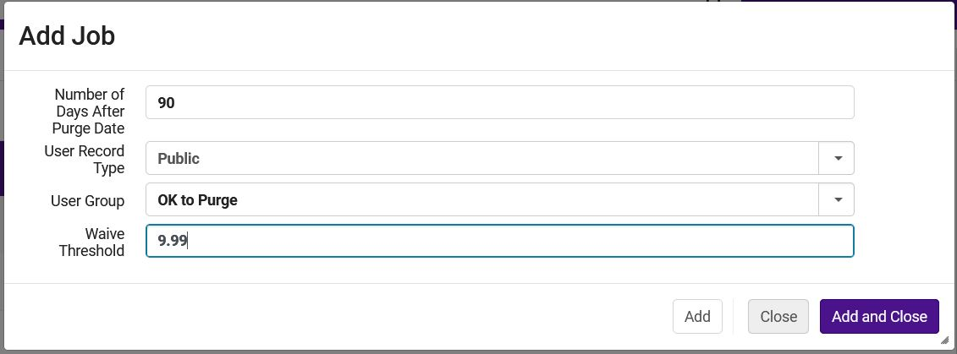
Purging User Records: Local User Records
Run the User Purge Job
Admin > User Management > Purge User Records
  Add a job
  Select Public; Select OK to Purge as user group
  Set the Number of days after the purge date
  Set the Waive threshold
  Add and Close to run the job
Notes:
(Ted)
So now that we’ve identified these records as being truly eligible to purge, we can safely run the purge job on only this set of users. Go to the Admin menu, select purge user records under the User Management heading. Select Public as the record type, select OK to purge as the user group. Then set an appropriate number of days after the purge date based on the data you found in the report. Also set a waive threshold if you would forgive local fines below a certain amount. You may choose to leave both of these blank, but other Alma sites recommend at least 1 for each. Click Add and Close to run the job. As you might expect, Alma will email you when the job concludes, and the job report will tell you more about any records that were not purged and why they were retained.
Now I should point out that we have intentionally drawn out these steps a little more in order to demonstrate how to work the process safely, because it’s usually more difficult to know when a user has left the institution than when they have arrived. It’s certainly possible to streamline this process as you get used to it. It should also be possible to streamline the process to just using the purge by itself once you have purge dates that are aligned with how frequently user data are updated—both by SIS loads and manually. We’ll be talking more about this later this summer at another office hours session.
Next, I’m going to hand it back to Debbie, who will explain how CARLI plans to keep linked users cleaned up.

Slide 27
Purging User Records: Linked User Records
( aka: I-Share Patrons, AFN)
Notes:
(Debbie)

Slide 28
Purging User Records: Linked User Records
Purging User Records: Linked User Records
Linked User Records:
  Are copies of patron home records copied to other IZs for transactions.
  Have I-Share user group.
CARLI Office staff will:
  Manage the purging of the I-Share user group records.
  Finalize steps to routinely purge linked user records that are no longer needed for transactions.
  Send an announcement once steps are in place.
Notes:
(Debbie)
Linked user records are the copies of a patron’s home record that are copied to, and saved to, another I-Share Library’s IZ typically as the result of a request or loan transaction.
In Voyager, the equivalent called “stubs” were automatically deleted when no longer in use by a circulation server job.
In Alma, there is not yet a way to automatically delete linked user records when no longer needed.
The CARLI Office staff will handle the purging of the I-Share user group linked use records.
We’re investigating options for automating this process as much as possible and will send an announcement with more information once steps are in place.
This will reduce two issues for us consortially:
1) Patron Identifiable Information is being maintained in the Alma IZs outside the patron's home institution for longer than is needed for transactions.
2) Even though Primo VE now contains an "activity" indicator to show a patron that they have a transaction with another institution, the overall list of institutions where the patron's record is maintained can be too long to be manageable. Patrons are often confused as to why a library would still be listed on their account, when they have no current activity at that other institution.
Now I’ll pass this back over to Ted to discuss Anonymization in Alma.

Slide 29
Alma Anonymization
Notes:
(Ted)

Slide 30
Alma Anonymization
Alma Anonymization
Alma provides multiple layers of anonymization
  Transactional: Alma will remove PII from loans/requests when complete
    CARLI staff will implement anonymization settings in each institution
    Waiting on Ex Libris to ensure that AFN-related data are retained
    Will likely be implemented *after* July 1. Watch for details.
  User: Alma will remove PII from user records when purged
    CARLI staff will implement anonymization settings in each institution
    Institutions planning purges sooner should request assistance
    Possible good practice: Check these settings before running purges
Notes:
(Ted)
Alma provides multiple layers of anonymization to help us keep our users personally-identifiable information secure. In essence, that’s the chief goal behind today’s presentation. Libraries need certain amounts of data to offer services to patrons, but we shouldn’t retain any more of their data than we need, and we shouldn’t retain any details after services are no longer available to those users.
The first type of anonymization is on the transactional level. When a user completes a transaction—that is, loans are returned, fines are paid, requests have been filled or unfilled and cancelled, Alma will run jobs to remove the personal data from those transactions. Alma doesn’t remove *all* of the data; Alma retains details such as user group and statistical categories if they were in place when the transaction occurred. We’re also working with Ex Libris to make sure that details about I-Share transactions are retained, such as which institution was involved in a request or loan.
The second type of anonymization applies to the user records themselves. As we’ve mentioned earlier and in previous office hours, Alma Analytics retains details on your records even after they are no longer active in Alma. This includes user data. Alma provides us tools to control how much user data are removed and retained when performing a user purge. Using the principle of retaining enough to offer services, we plan to set the anonymization level such that all of a user’s personally identifiable information are removed, but details such as user group and statistical category are retained. Those details should allow CARLI and libraries the ability to run reports in the future without having to retain personal data.
Note that I’m using the future tense here, that CARLI will implement these settings. We’re planning to do this to establish consistent settings for all I-Share institutions, which should make reporting strategies consistent as well. If your institution will be running purges in the near future, please contact CARLI support and we will verify these settings are correct for you.

Slide 31

Your Questions
?
Notes:
Please type any questions in the chat, or feel free to unmute to ask questions.

Slide 32
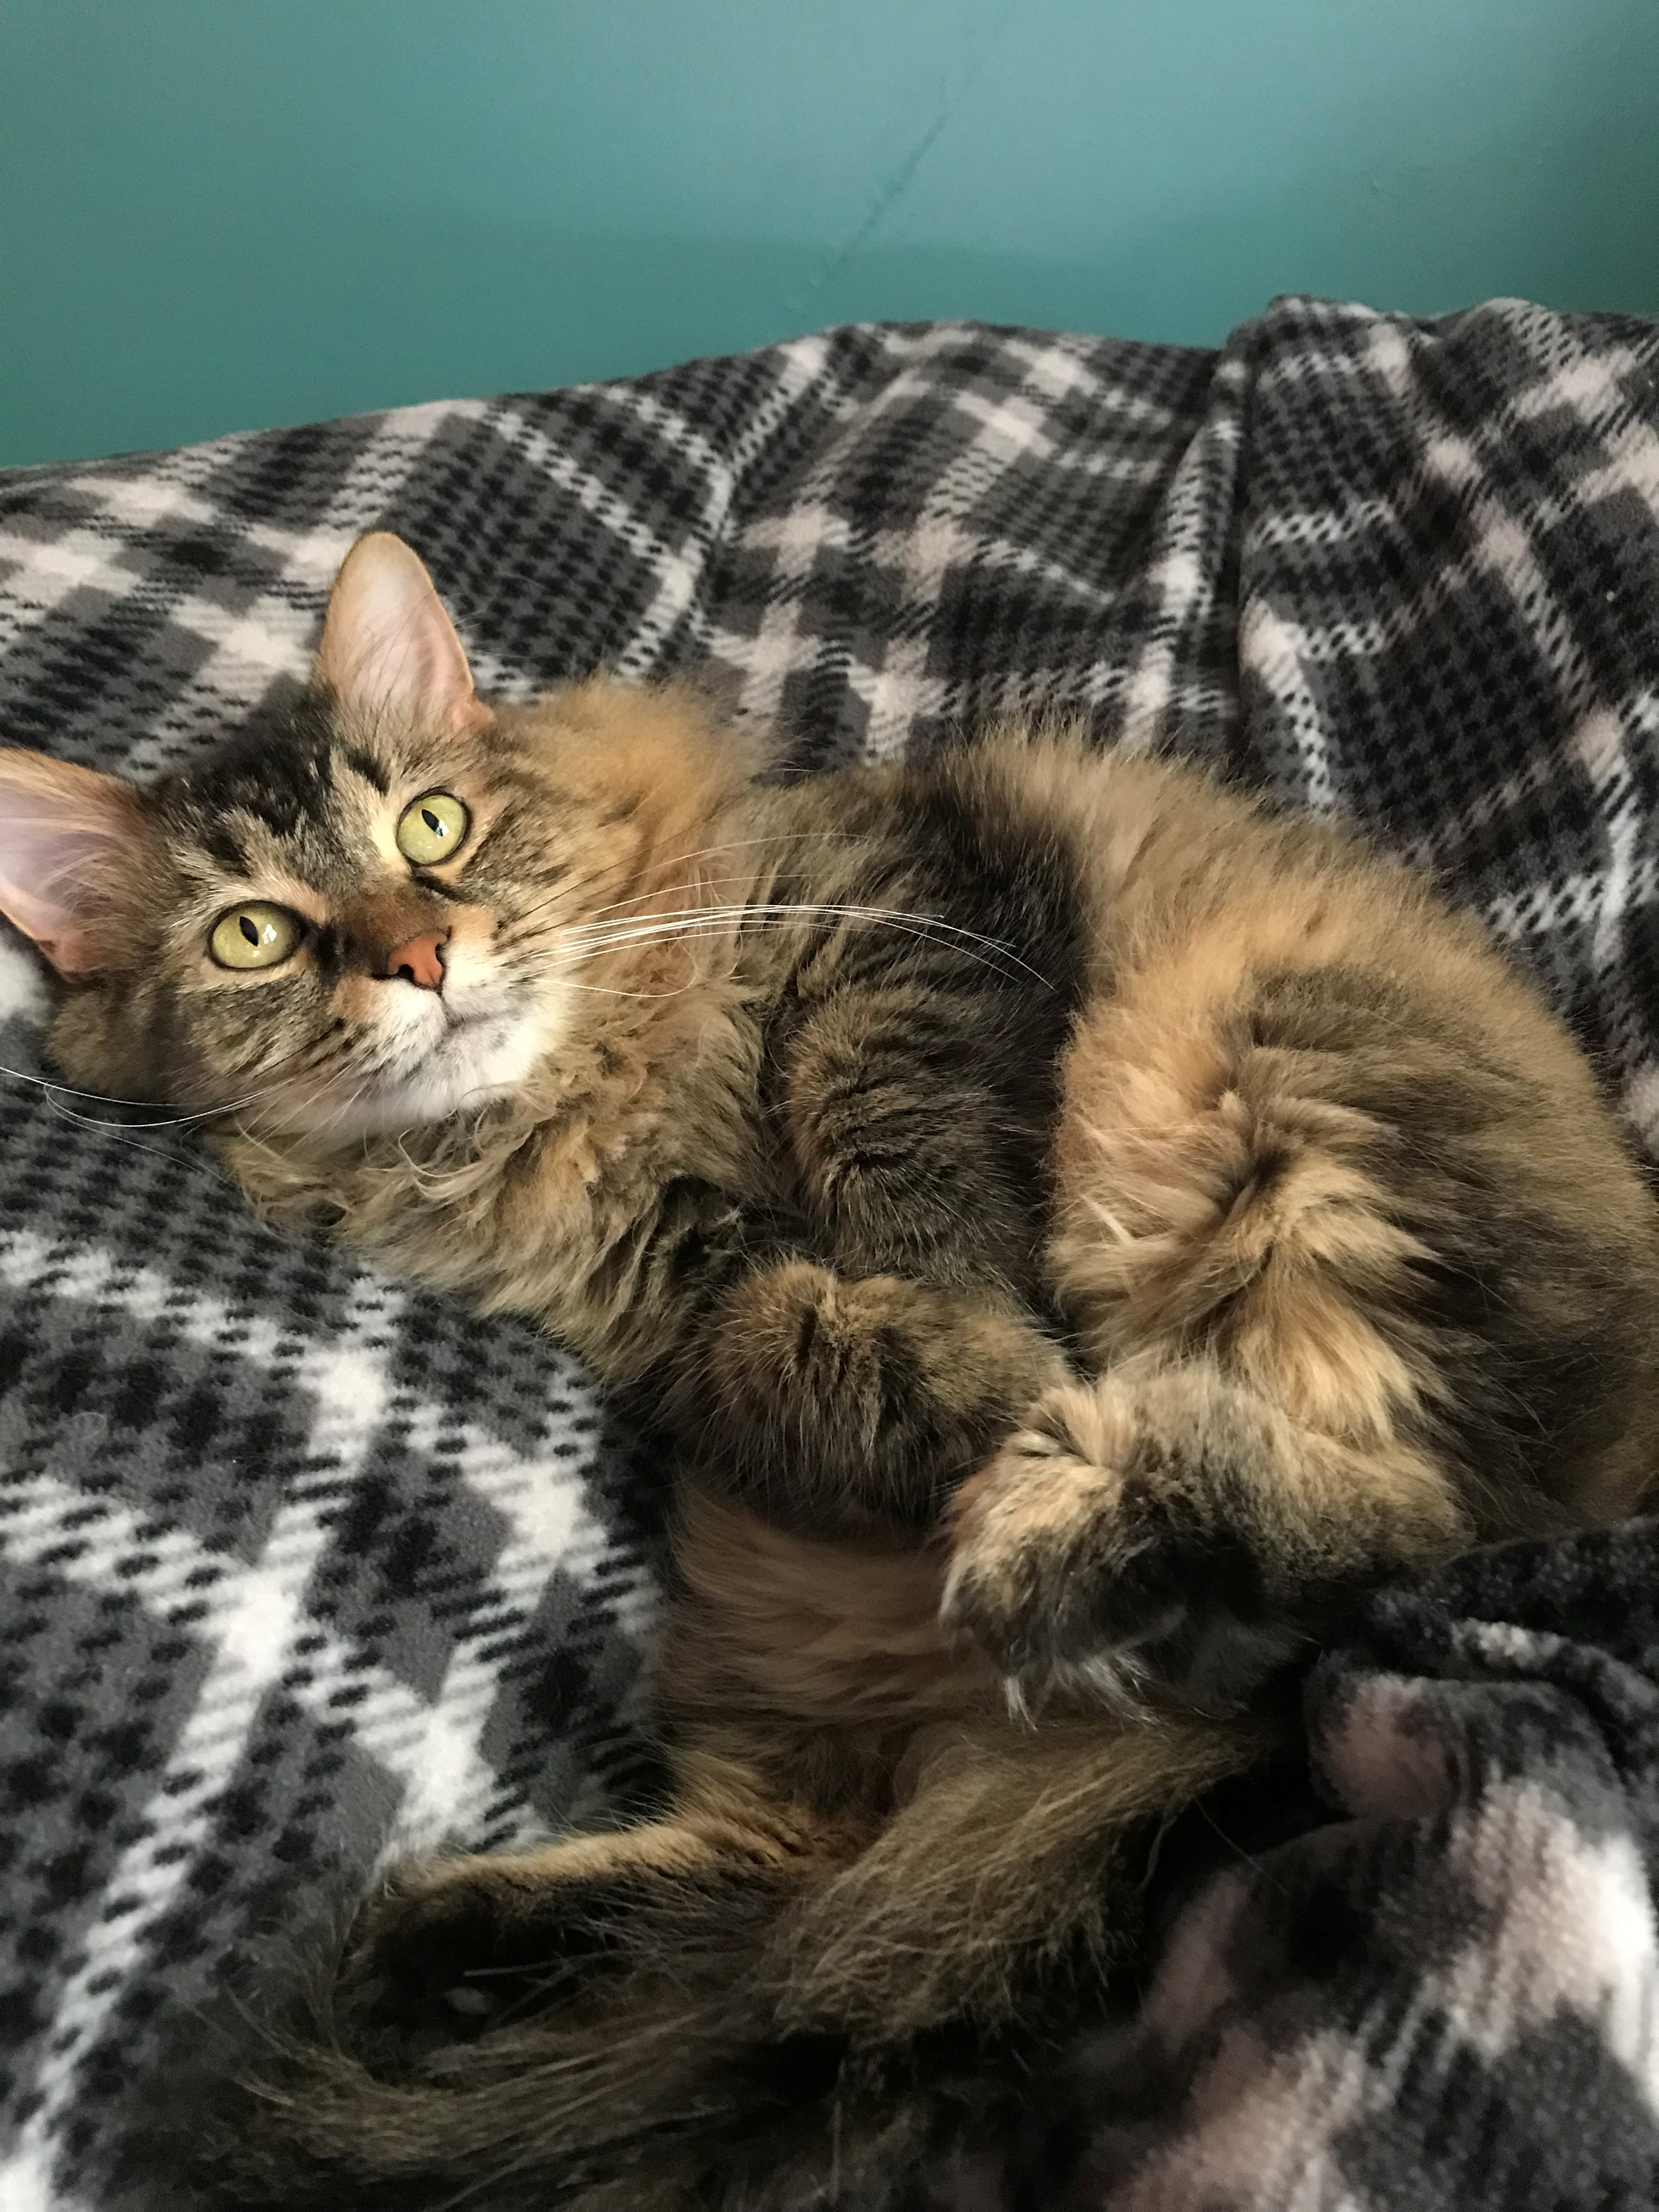
I-Share Alma Primo VE Office hours
Join us July 14
at 2pm for another
Office Hour session.
Contact CARLI at
support@carli.illinois.edu

