Slide 1
RESOURCE RECOMMENDER
Lori Thompson
Senior Library Specialist
Southern Illinois University
School of Medicine Library
lthompson@siumed.edu

Slide 2
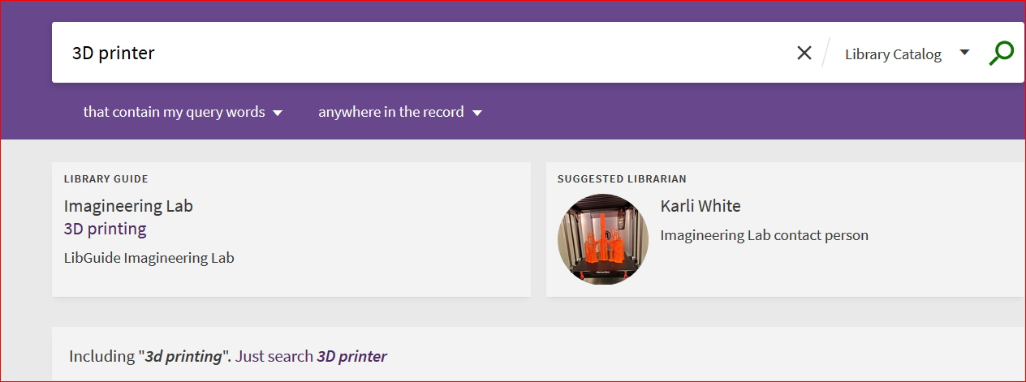
The Resource Recommender service allows you to recommend the following resources based on searchable tags that you configure in Alma. Some options are database, website, person, library information, and library guide. You will need the Discovery Administrator Role.
ALMA menu > Discovery > Other > Resource Recommender Configuration

Slide 3
ALMA menu > Discovery > Other > Resource Recommender Configuration
I found it helps if you gather this information or make your decisions before you begin configuring.
Especially the tags. However, you can always add more tags. Choose Views All, to see in Test View.
Notes for Library information Resource Recommender Graphic Medicine
Key: GraphicMed
Name: Graphic Medicine Collection
Description: Quick Link to our Graphic Medicine Collection
Tags: graphic medicine;cartoon;comic books;graphic novels; Tip: Subject headings might provide good ideas
Link: https://i-share-sim.primo.exlibrisgroup.com/discovery/collectionDiscovery?vid=01CARLI_SIM:CARLI_SIM&collectionId=8117196000005891
Link Text: Can leave blank or add a note here
Note: This does not display to user. Optional descriptive text to explain more about this resource to staff members
Views: All
Go to Library Information click Edit at ellipsis
Resource Configuration: Library information page click to Add Resource
Add Resource box or form will appear. Fill in mandatory and desired fields. Then Add and Close
Go to Primo VE enter one of your tags in the search bar. Library information box with clickable url should display.

Slide 4
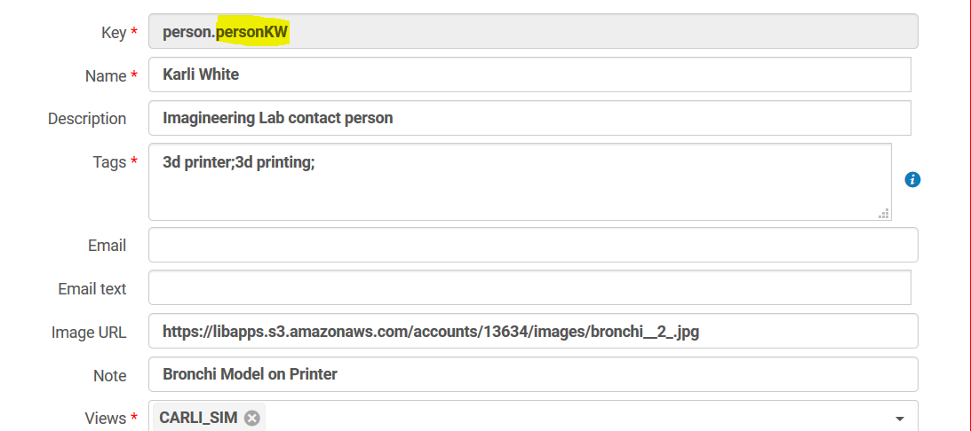
Resource Configuration: Suggested librarian
What goes in Key field? PersonSomething. It saves to person.personKW {example}
Since the Key is used as an internal ID, it cannot be modified later. Names can.
If you want to specify multiple tags for a recommendation, separate them with a semicolon.

Slide 5
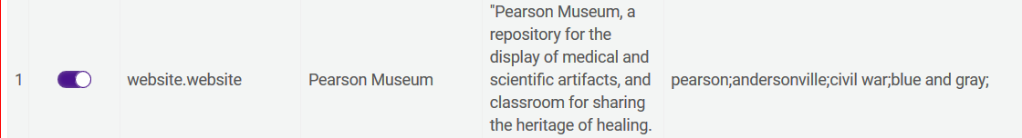
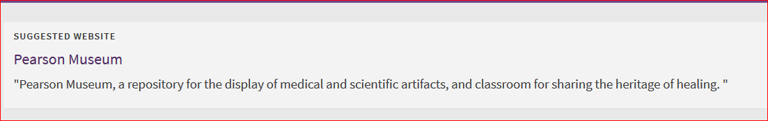
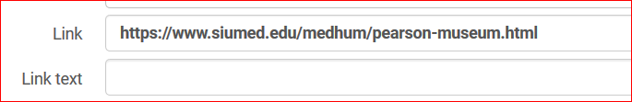
Resource Configuration: Suggested Website
What goes in Key field? WebsiteSomething. It saves to website.website {example}
Suggested Website. We created this to showcase a Civil War Medicine Collection and a current display from the Pearson Museum featured in our Medical Library.
Pearson Museum displays as clickable link here in Primo VE.
We found that adding Link Text such as Pearson Museum here duplicated the Name and displayed oddly. Thus, we left the Link Text field blank on purpose.

Slide 6
RESOURCE RECOMMENDER HELP
EXLIBRIS Resource Recommender for Primo VE
https://knowledge.exlibrisgroup.com/Primo/Product_Documentation/020Primo_VE/Primo_VE_(English)/120Other_Configurations/010Resource_Recommender_for_Primo_VE
Related Webinars
Primo VE - Become an Expert Series: Search Interfaces
If you would like to contact me:
Lori Thompson
lthompson@siumed.edu

